Slide 1
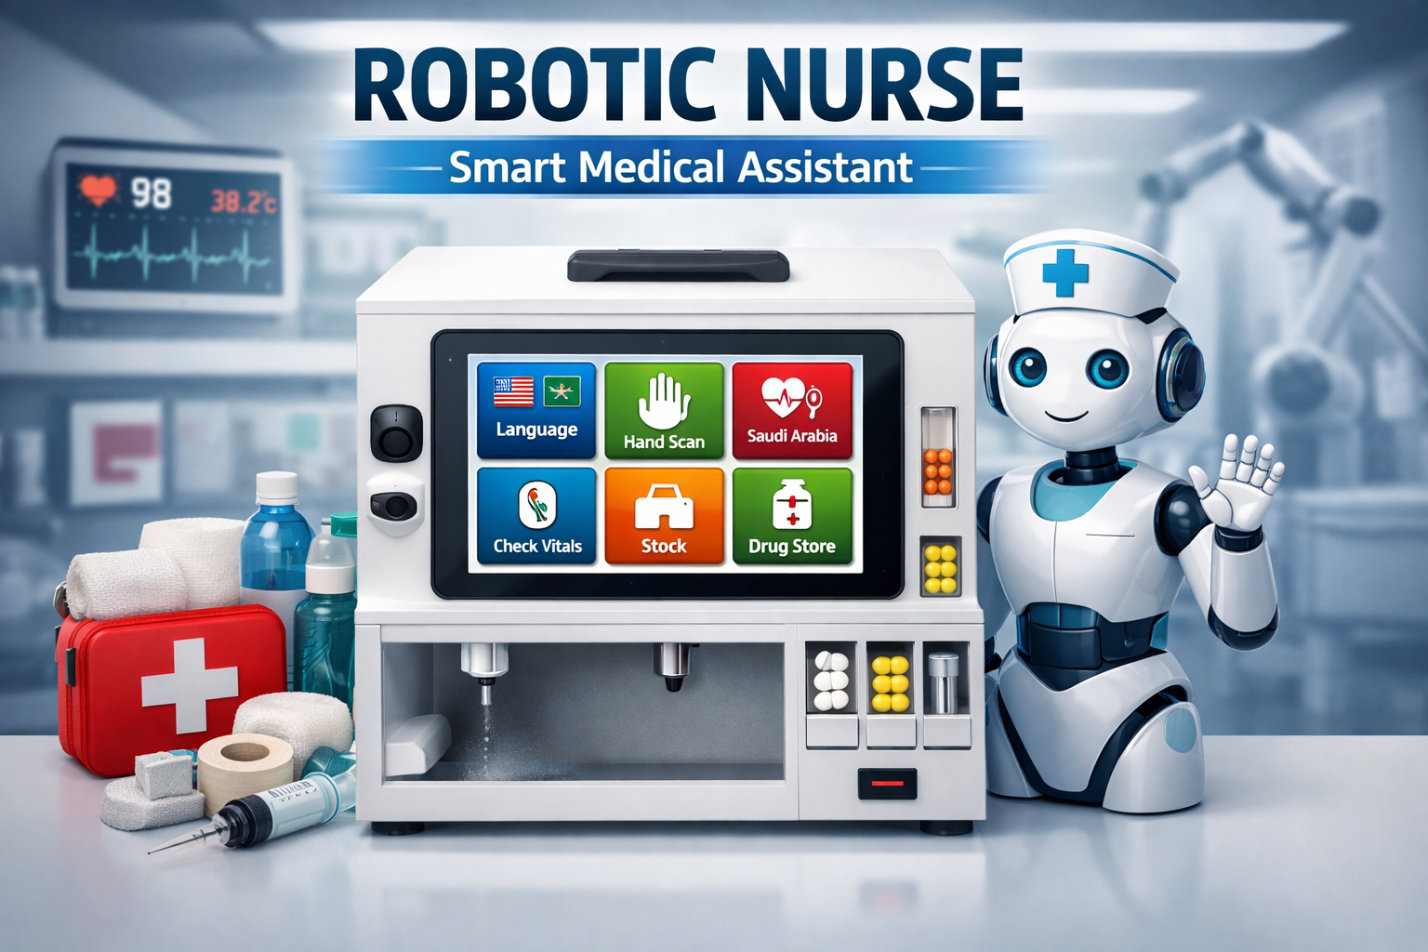

Slide 2

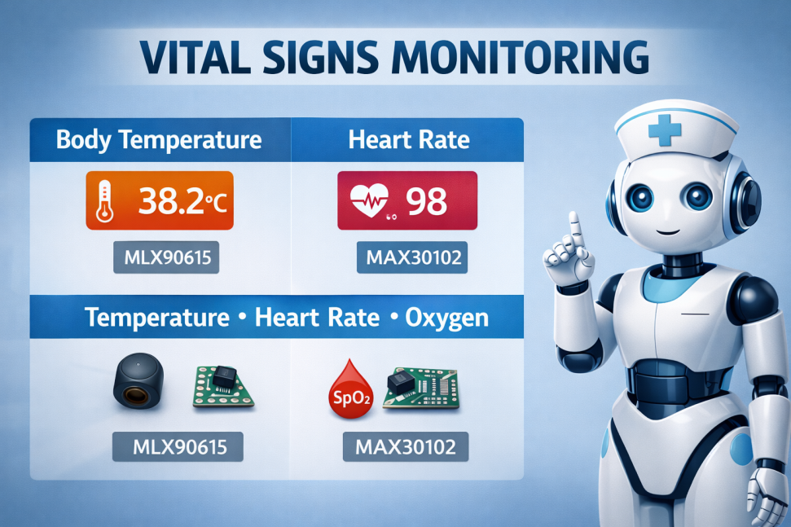
OUR PROJECT
Smart First Aid
Vital Signs Monitoring
Automatic Medicine Dispensing

Slide 3
FLOW CHART
START
FLU
WOUND AND BURN DETECT
IS IT BURN OR WOUND
WOUND
BURN
WATER
ALCOHOL
PLASTER
WATER
OINTMENT
GAUZE
WHAT IS YOUR TEMP?
HIGH(37.5-40)
NORMAL (<37.5)
EXTRA HIGH (>40)
PULSE RATE AND OXY
PILSE RATE AND OXY
PULSE RATE AND OXY
DRUG2
BACK TO START
DRUG1

Slide 4
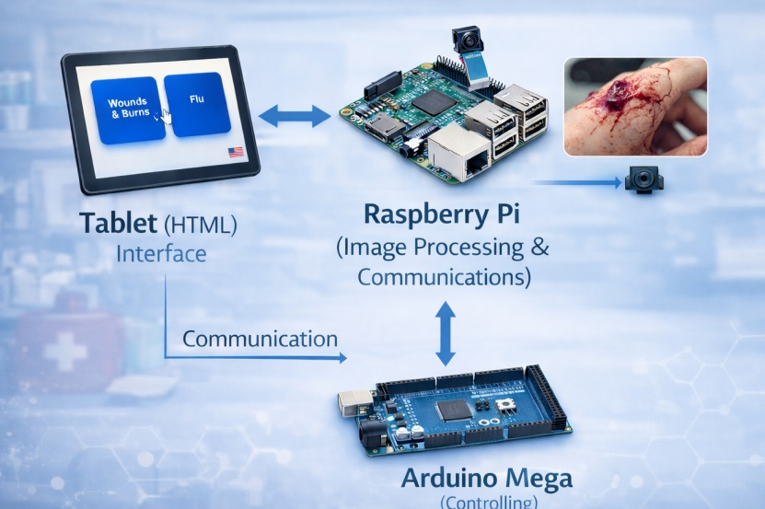
SYSTEM ARCHITECTURE
Tablet
Raspeberry PI 4
Arduino Mega

Slide 5
COMPONENTS
Arduino mega
Raspberry pi 4
Ultrasonic sensors
IR sensors
Pulse oxygen sensor
Temperature sensor
Water pumps
DC motors
Stepper motor nema 17
Servo motor
LEDS
Relay
Wood
Plastic 3d printing
Tablet
Camera

Slide 6
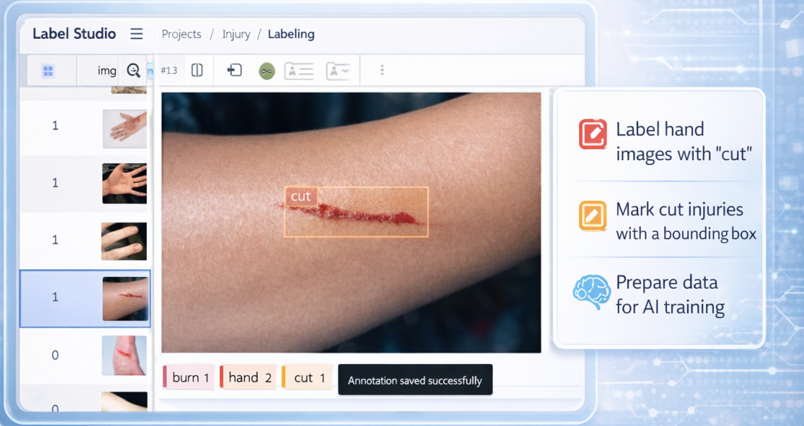
IMAGE PROCESSING
Collect hand images
Label the images
Train detection model

Slide 7
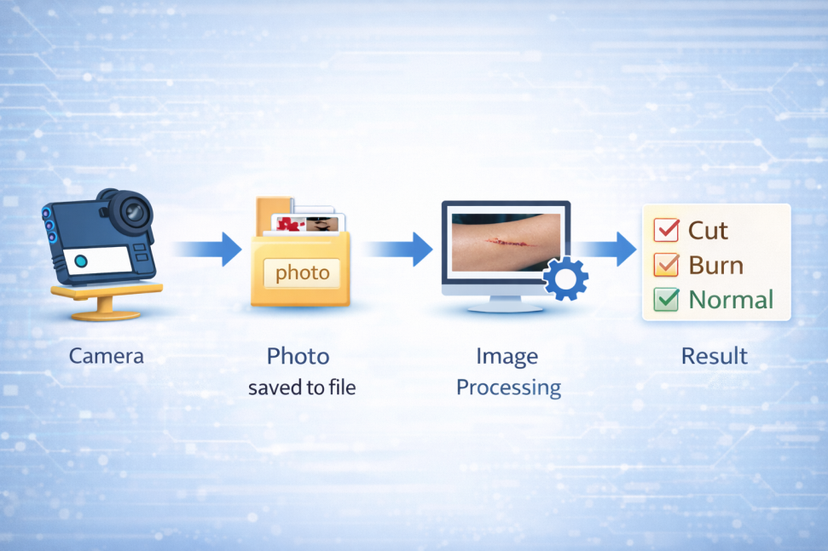
IMAGE PROCESSING

Slide 8
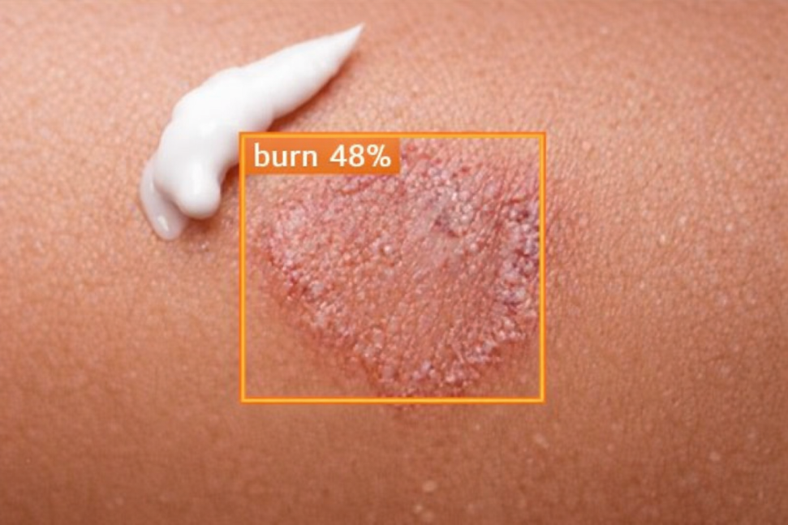
IMAGE PROCESSING

Slide 9
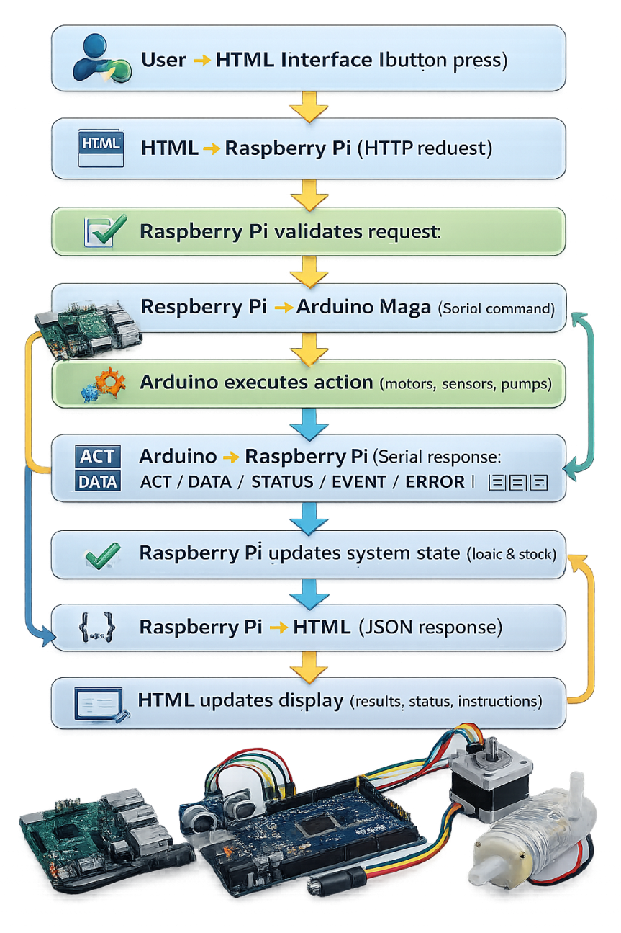
COMMUNICATION
User action
HTML sends request
Raspberry Pi controls logic
Arduino controls hardware
Arduino sends feedback
Raspberry Pi confirms
HTML shows result

Slide 10
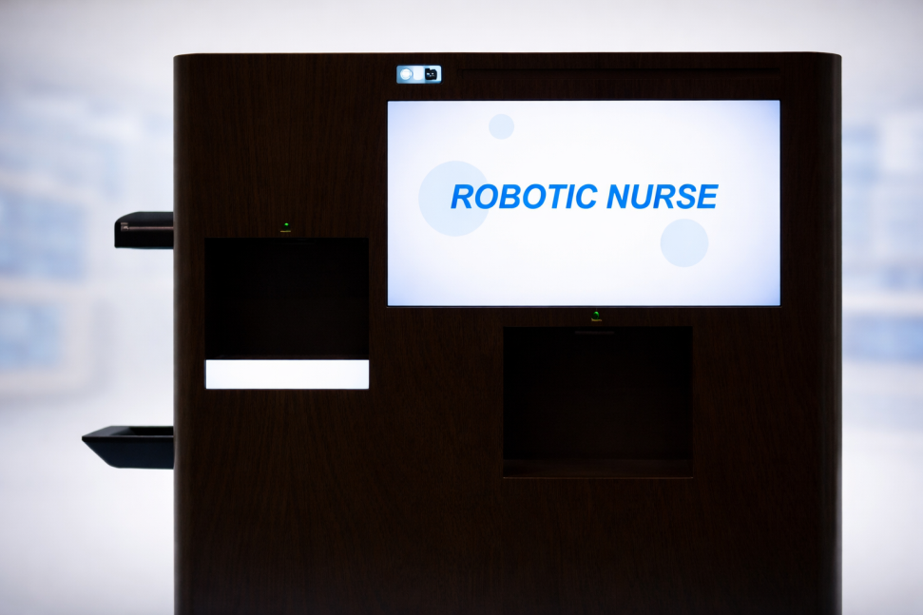
HTML USER INTERFACE
Simple and user-friendly design
Sends commands to Raspberry Pi
Displays results and instructions

Slide 11
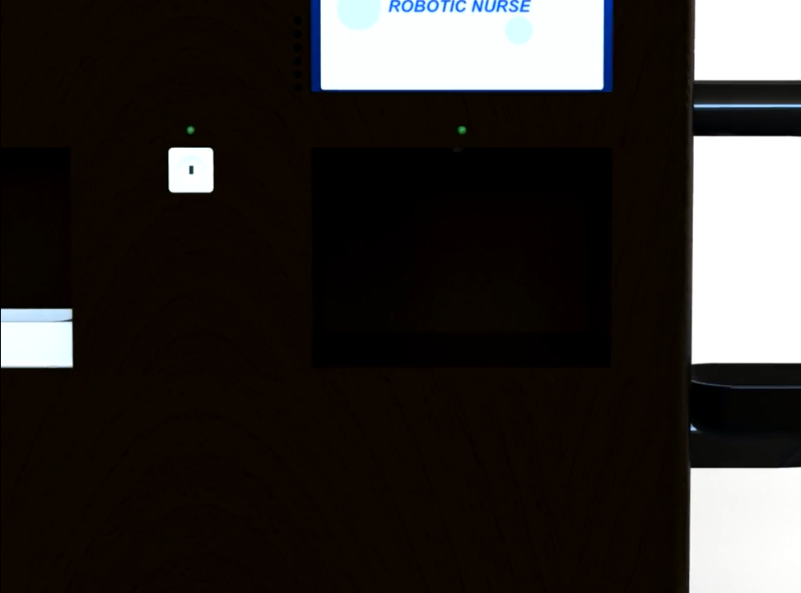
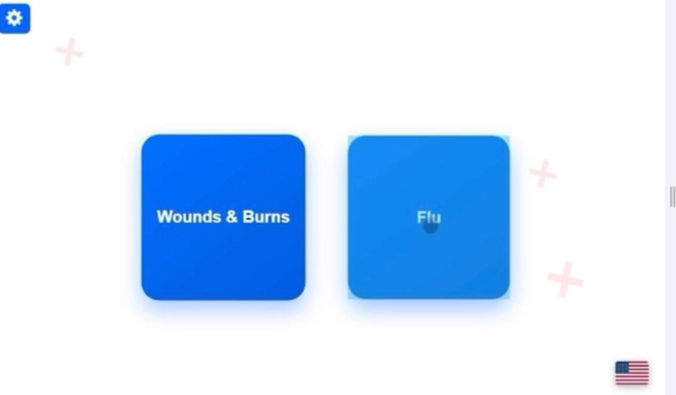
HTML USER INTERFACE
Voice guidance
Language switching (Arabic / English)
Instructional videos

Slide 12
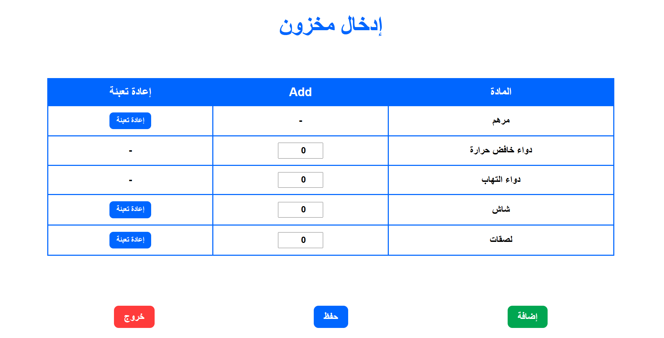
STOCK

Slide 13
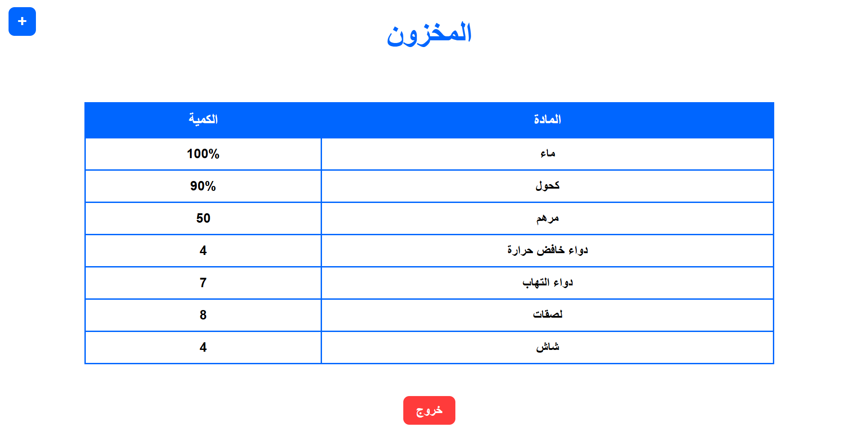
STOCK

Slide 14
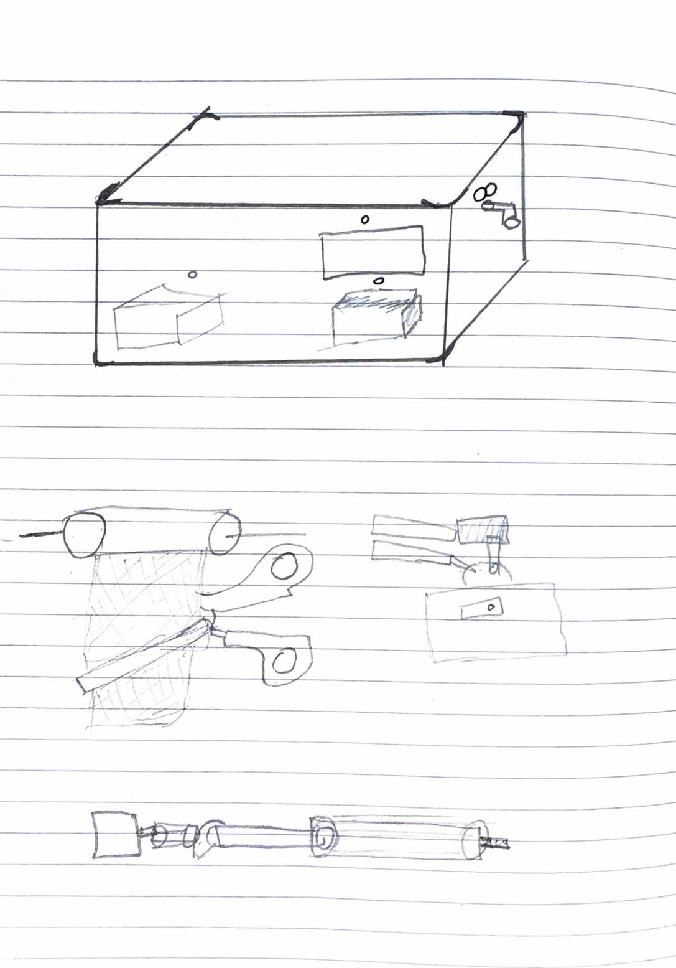
DESIGNING
Inexpensive
Modern
Suitable for its purpose

Slide 15
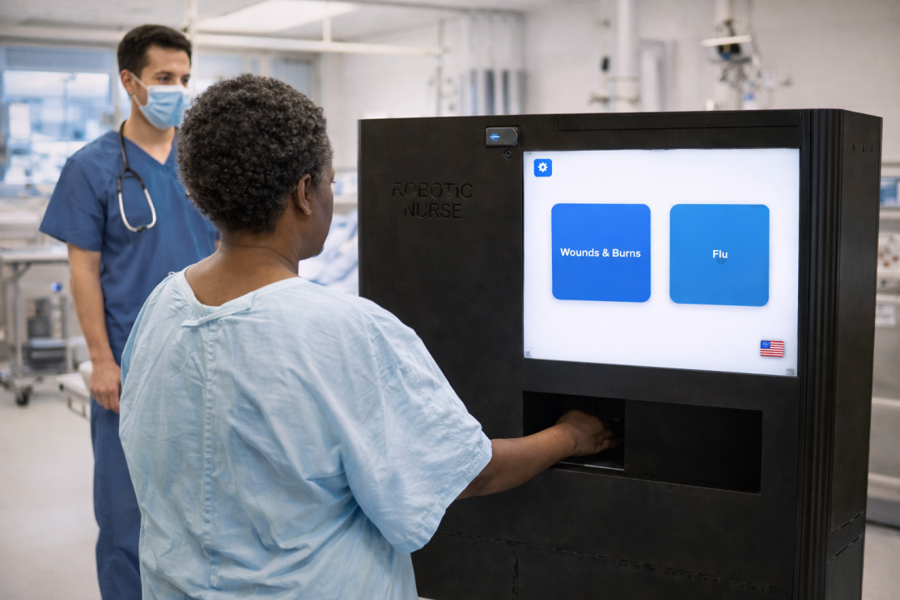
CONCLUSION
Smart healthcare solution
Low-cost and practical
Reduces medical workload
Easy and safe to use
Integrates hardware and software

Slide 16


