Slide 1


Design of a wastewater collection network of Madama Village
By
Hayat Al-fares (11715536)
Ro'a Ataya (11716272)
Under Supervision of: Dr. Mohammad N. Almasri

Slide 2
OUTLINE
01
02
03
04
Introduction
Cost of the Network
Design of a wastewater collection network
Recommendations

Slide 3

INTRODUCTION
1. Background
2. Objectives
3. Methodology
01

Slide 4






Background

Slide 5

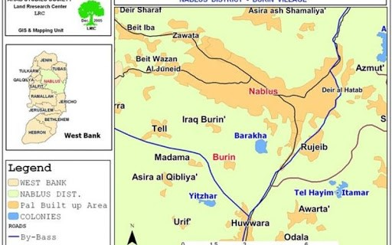

About Madama
Madama is a Palestinian Village located in the West Bank. It is located about 5 Km south of Nablus. have an elevation of 498 meters above sea level and Its area is approximately 3,400 dunums.
According to the Municibility data, the total population in Madama Village about 2,239 capita in 2021.
Location of Madama Village

Slide 6
Objectives
Design of a wastewater collection network of Madama Village using SewerCAD
Estimate the cost of the network
Suggest a suitable wastewater treatment plant location.

Slide 7








Methodology
Selection of the project idea
Selection of the study area
Data collection
Data analysis and assessment using Excel
Recommendations
Cost estimation
Design of the WWCN hydraulically
Construction of WWCN using sewerCAD

Slide 8
Design of a Wastewater Collection Network
02

Slide 9

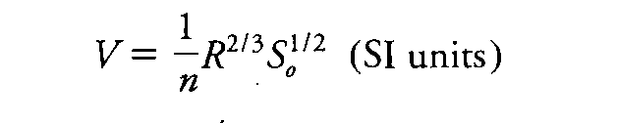
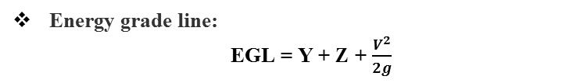
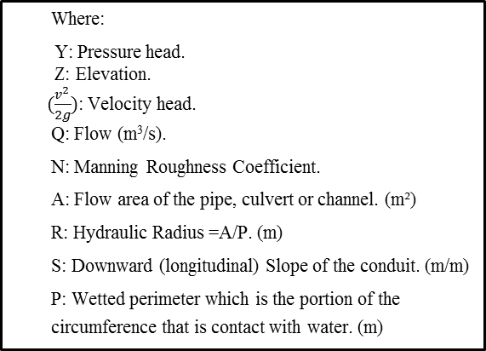
Equations Used in SewerCAD
Hydraulic grade line:
HGL = Y + Z
Where:
Y: Pressure head.
Z: Elevation.
$(\frac{v^{2}}{2g})$: Velocity head.
Q: Flow (m³/s).
N: Manning Roughness Coefficient.
A: Flow area of the pipe, culvert or channel. (m²)
R: Hydraulic Radius =A/P. (m)
S: Downward (longitudinal) Slope of the conduit. (m/m)
P: Wetted perimeter which is the portion of the circumference that is contact with water. (m)
Energy grade line:
EGL = Y + Z + $\frac{V^{2}}{2g}$
Manning's equations:
The most commonly used equation in open channel and sewage.

Slide 10
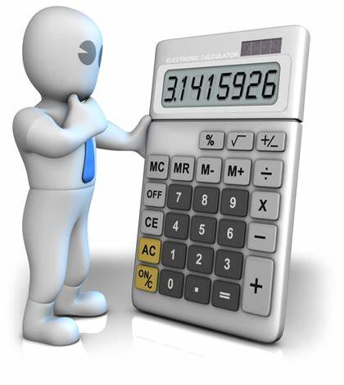
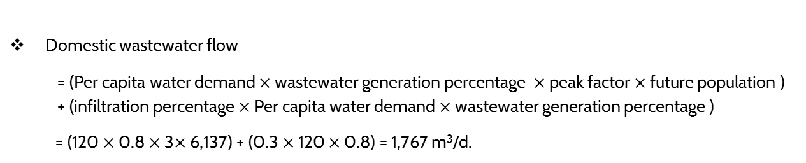
wastewater load calculation
Future population for Madama:
year | 1997 | 2007 | 2017 | 2021 | 2051
population | 1,239 | 1,735 | 2,092 | 2,239 | 6,137
Domestic wastewater flow
= (Per capita water demand $×$ wastewater generation percentage $×$ peak factor $×$ future population ) + (infiltration percentage $×$ Per capita water demand $×$ wastewater generation percentage )
= (120 $×$ 0.8 $×$ 3$×$ 6,137) + (0.3 $×$ 120 $×$ 0.8) = 1,767 m³/d.

Slide 11

Design Constrains
Cover depth (1-5 m).
Velocity (0.6-3 m/s).
Slope (1 % -12 %).
Conduit partially full system (75 %).
Minimum sewer diameters (not less than 8 inch).

Slide 12
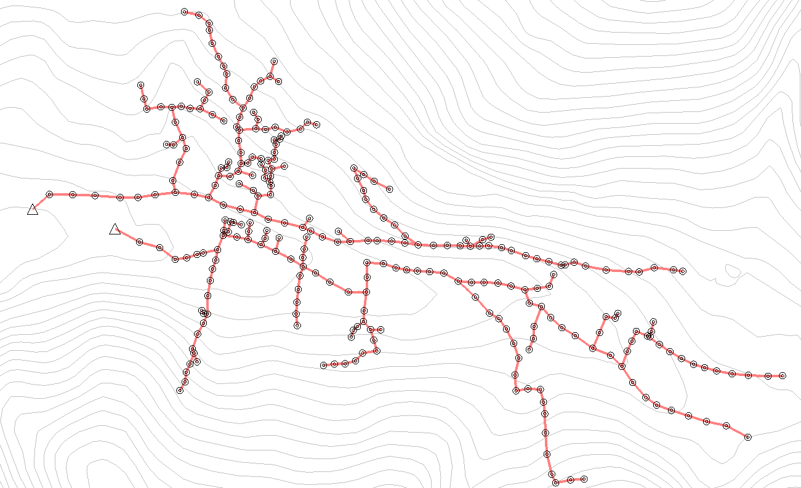
Manholes distribution and wastewater collection network layout
The load was equally distributed over all manholes.
Manholes were distributed every 30 meters and at intersections, taking into account the lack of conflict between the manholes and the obstacles on the ground.
Manholes and sewers are distributed to make the flow into the network by gravity.
Conduit
Manholes
Outfall

Slide 13
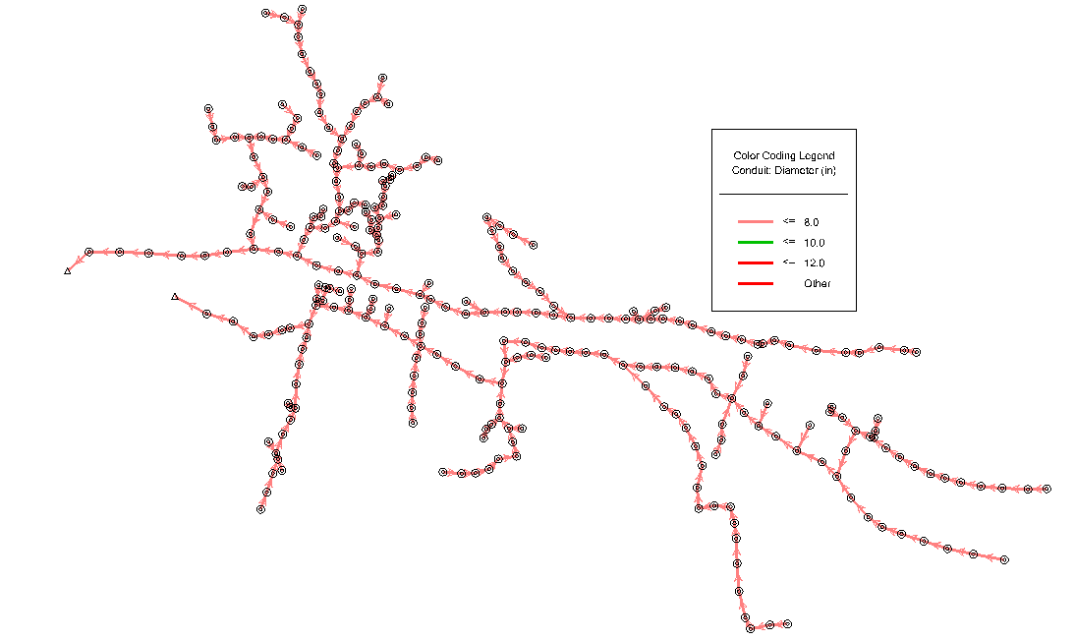
Results
Diameters:
All diameter equal 8 in, as the color-coding in sewerCAD
Conduit
Manhole
Outfall

Slide 14
Velocity:
all values is within the acceptable range (0.6 m/s - 3 m/s).

Slide 15
Slope:
all values is within the acceptable range (1% - 12%).

Slide 16
Cover (start) :
all values is within the acceptable range (1m – 5m).

Slide 17
Cover (stop) :
all values is within the acceptable range (1m – 5m).

Slide 18
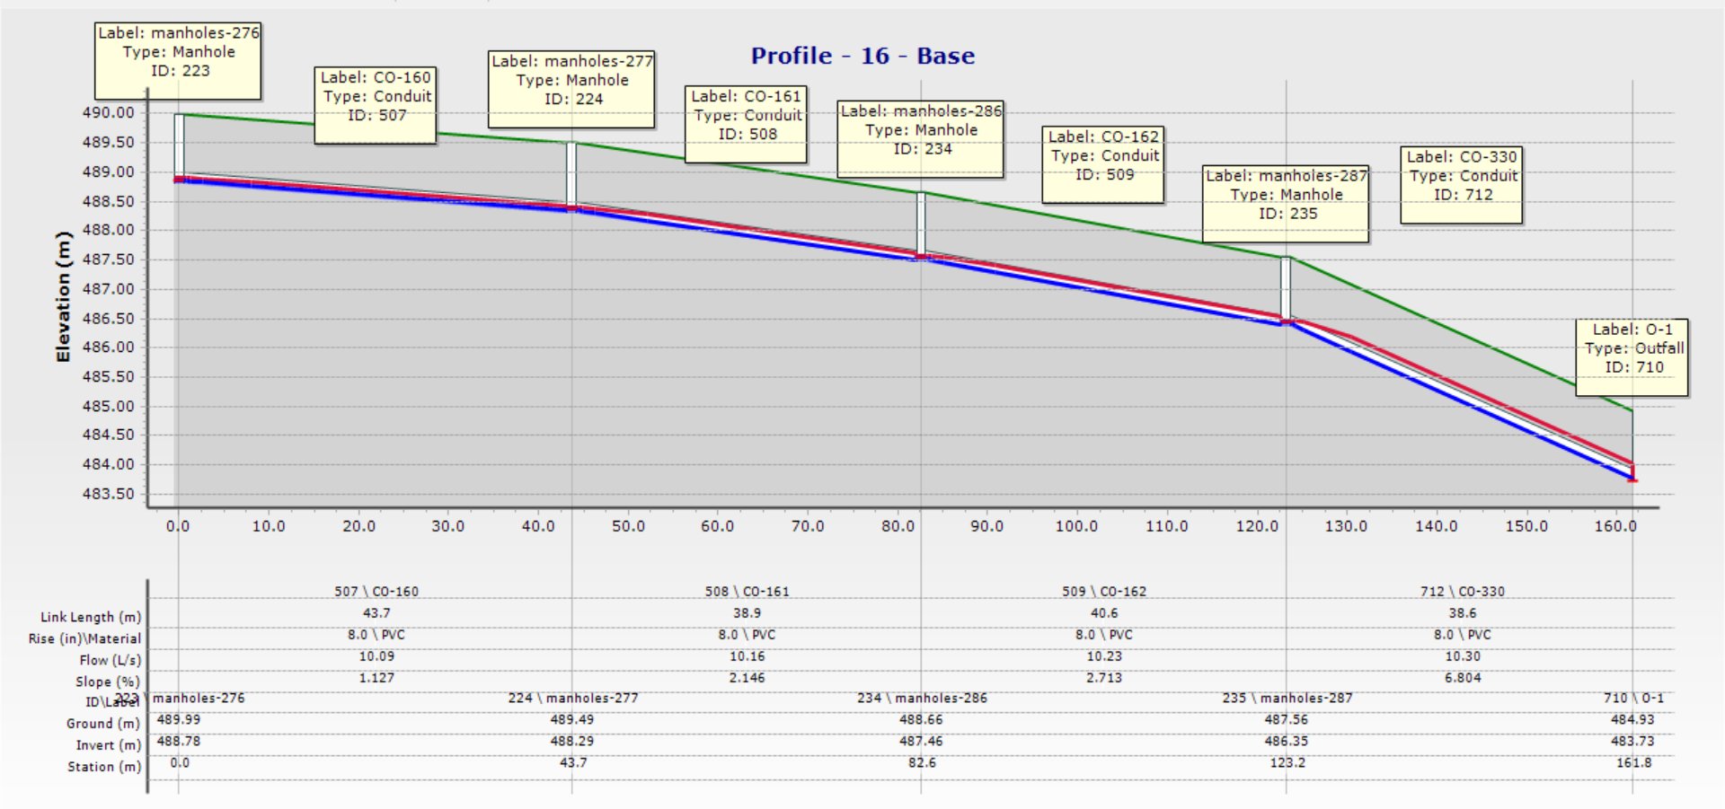
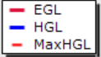
Profiles :

Slide 19
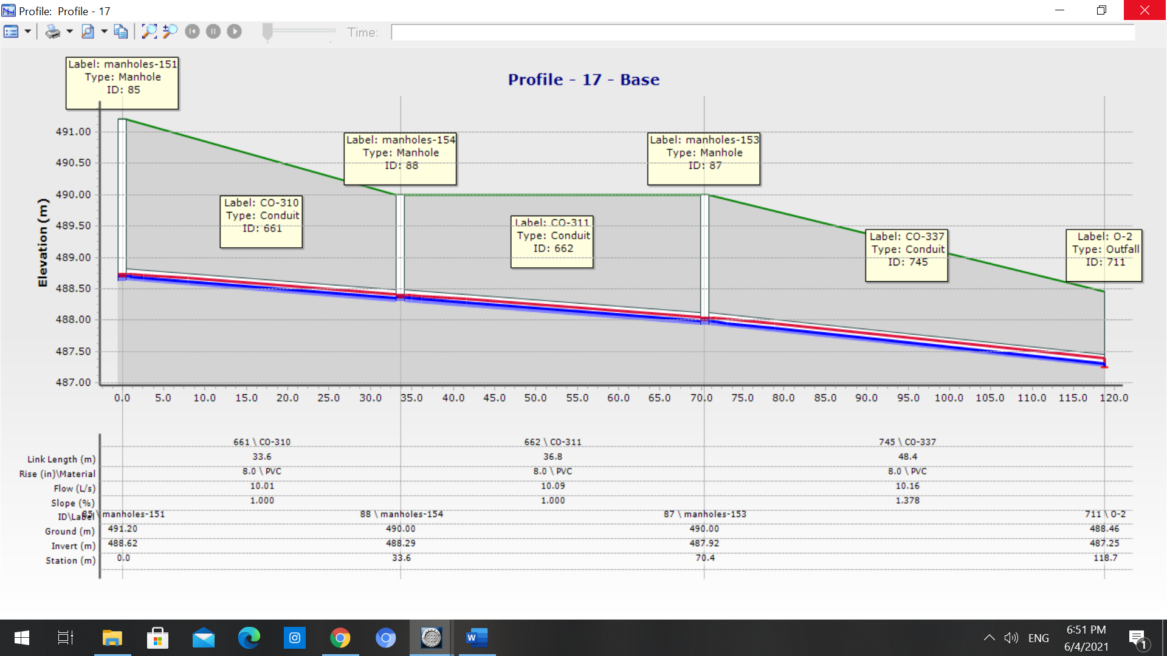

Slide 20
Cost of the Network
03

Slide 21


Cost of the Network
Conduits cost
=50,336 $.
Manholes cost
=101,175 $.
Excavation Cost
=138,096 $.
Re - paving cost
=88,490 $
Backfilling cost
=77,463$.
Total cost of the Sewer collection network = 455,560 $
Cost per kilometer (${Km}^{2}$) = 133,988 $\$/{Km}^{2}$

Slide 22
Recommendations
04

Slide 23
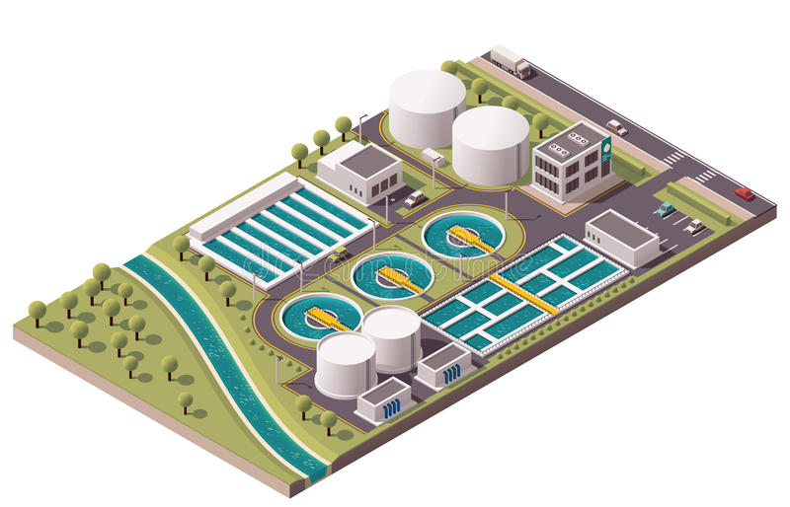
Know we solve the problem of accumulate wastewater in cesspit. So, the next step is to think how we can treat this waste water and get the best utilization from it. therefor, we suggest a location in the end of the network to build a waste water treatment plant (WWTP).
This WWTP can achieve some environmental benefit:
Reduce the usage of potable water and replacing it with treated wastewater in manufacture or any other uses, to save water resources and expand agricultural areas, to produce various agricultural crops at lower financial value.
The WWTP could provide electricity in Advanced stages.
reducing the environmental pollution by disposing of the produced wastewater.
The produced sludge is a much cheaper and better replacement for the chemical fertilizers.

Slide 24
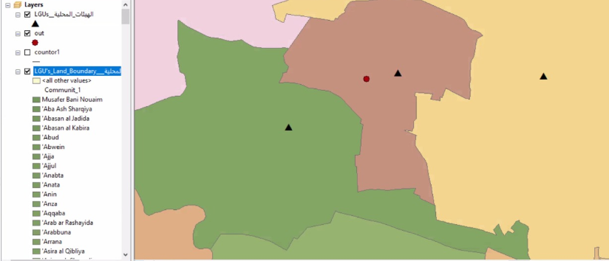
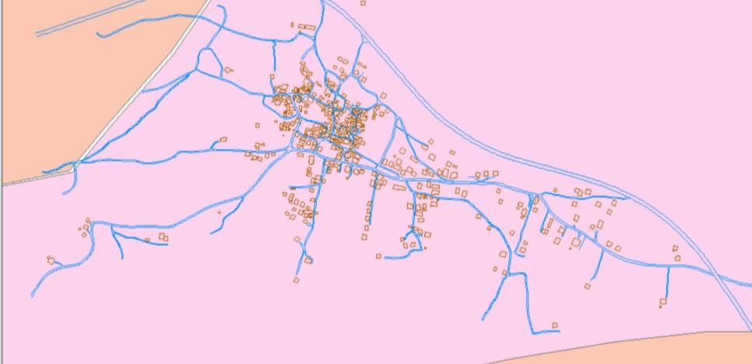

The suggested location to built up is justify with
N
LGU boundary map
Manhole
Conduit
N
N
Outfall
WWTP
political land map
contour map

Slide 25
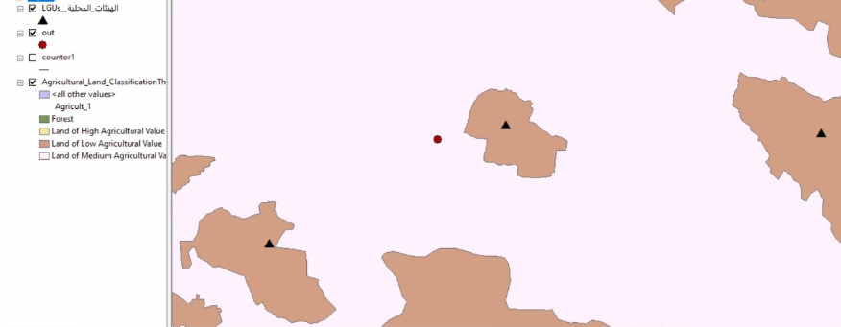
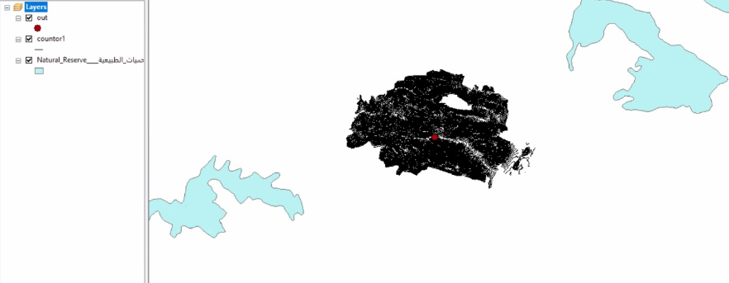
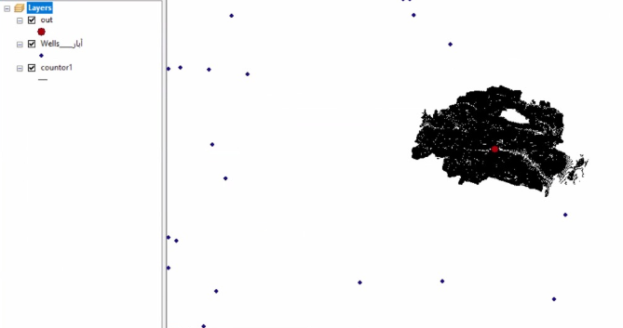
N
agricultural areas map
N
N
nature reserves map
wells distribution map

Slide 26
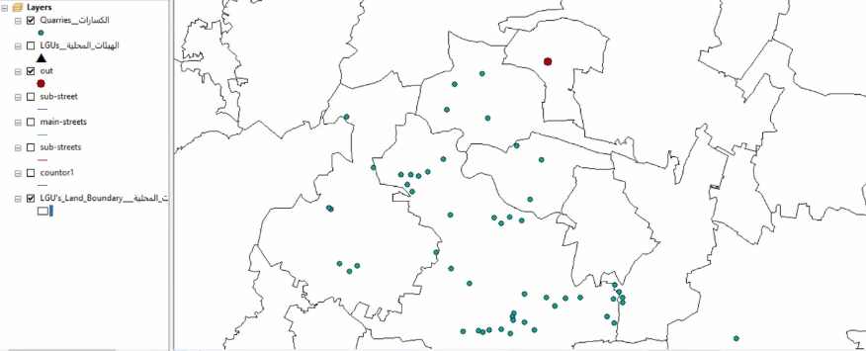
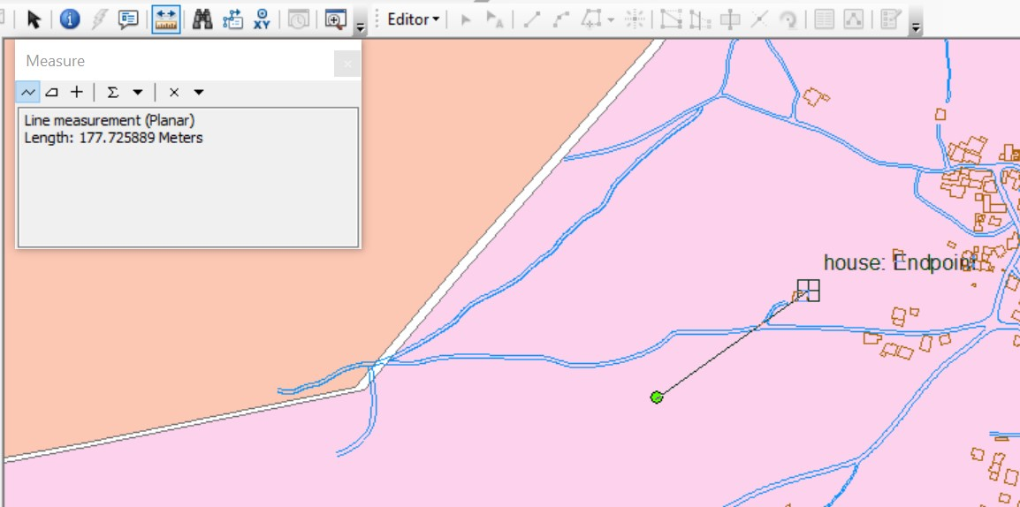
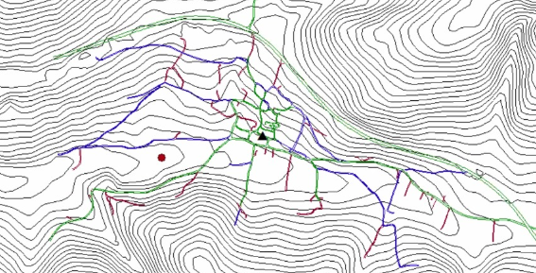
N
quarries distribution map
N
N
distance between house and WWTP
transportation network map

Slide 27


