Slide 1
Municipality Building
Prepared By :
Thaer abu haniya
Nidal Nazzal
Supervisor: Mohannnad al-haj Hussain

Slide 2
Content:
Architectural Aspects and passive analysis
Site analysis
Passive Analysis
Acoustical analysis
Structural Aspects
Electro mechanical system analysis
HVAC system
mechanical system
Electrical system

Slide 3
Architectural Aspects
&
Site analysis

Slide 4
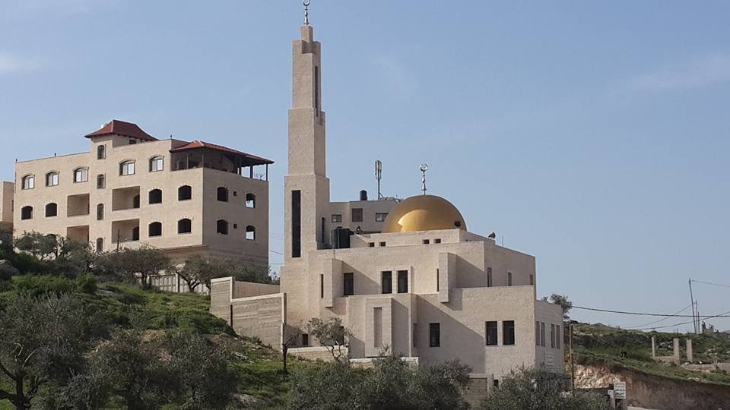
Site Analysis
The site is located in (Bit wazan), in Nablus , about 496 m above sea level and, the Site has a total area of 554 m2.

Slide 5
Architectural Aspects

Slide 6
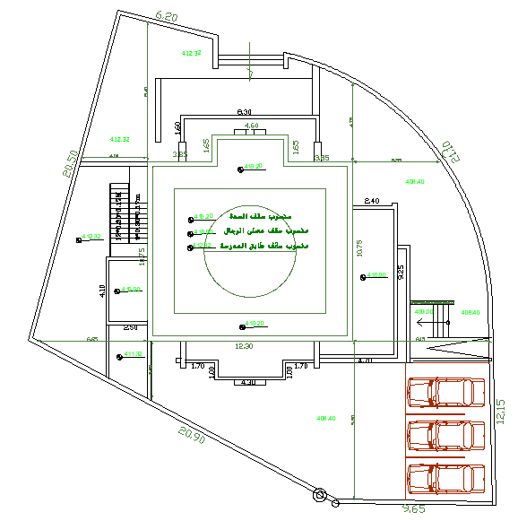
Site Plan

Slide 7
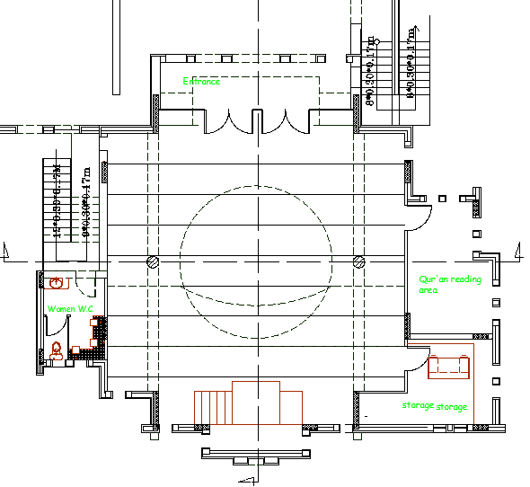
Ground floor (Pray Hall)

Slide 8
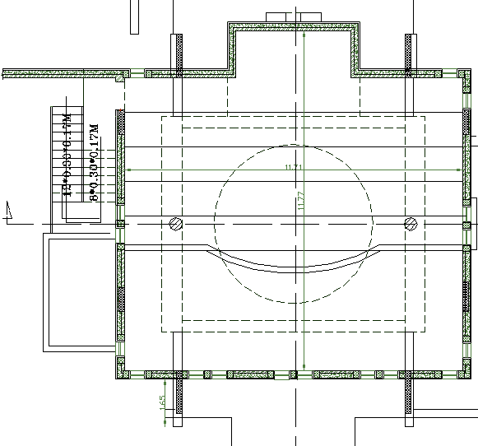
First Floor

Slide 9
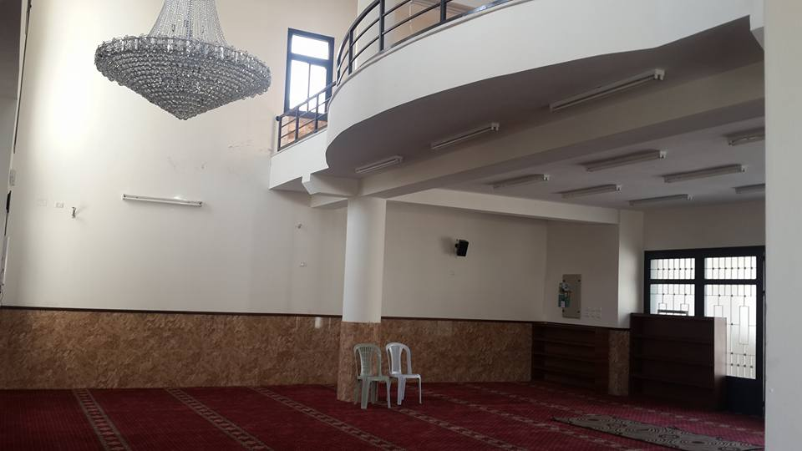
Internal View

Slide 10
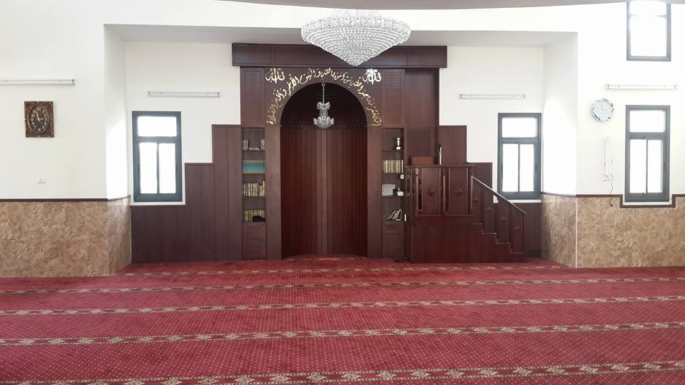
Internal View

Slide 11
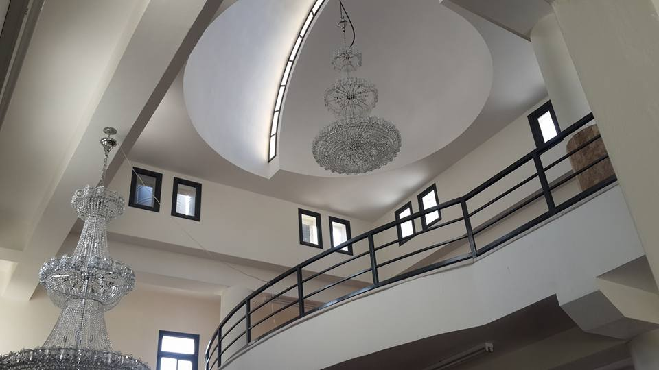
Internal View

Slide 12
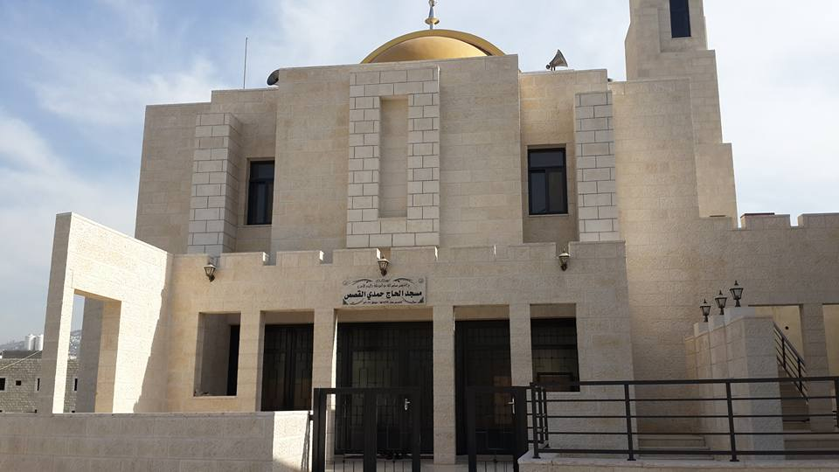
External View

Slide 13
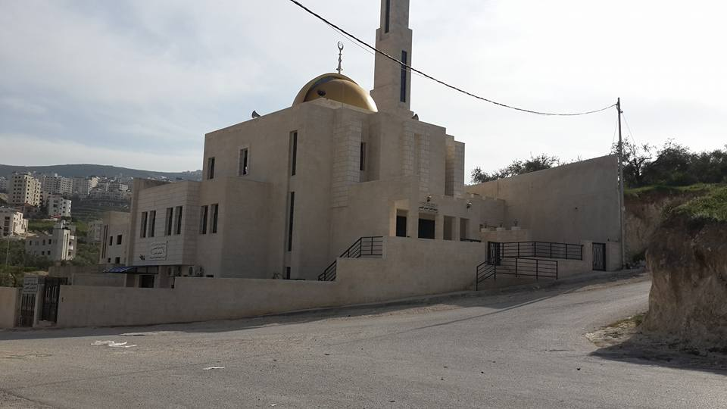
External View

Slide 14
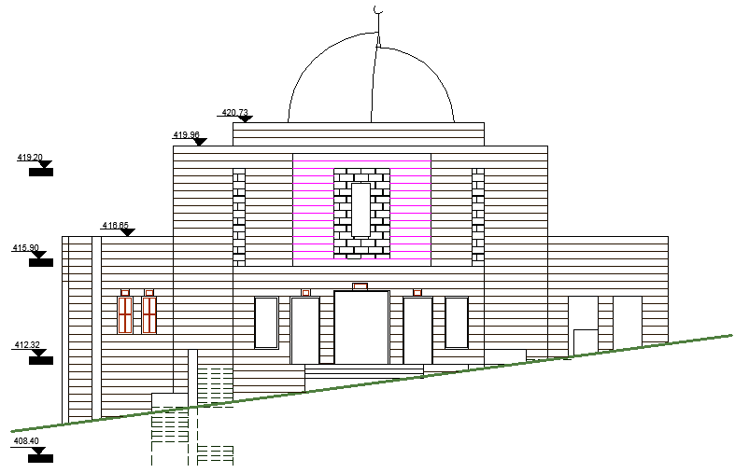
Elevation’s: North wall

Slide 15
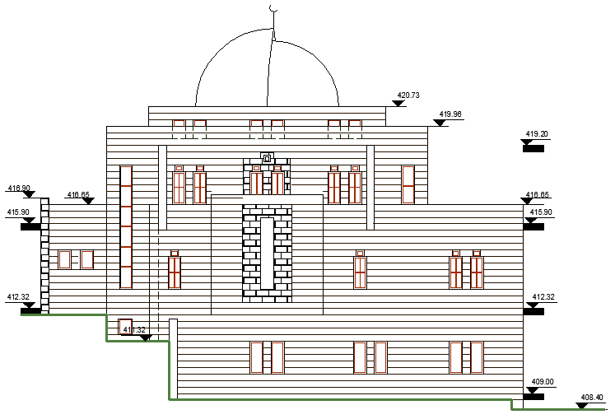
Elevation’s: South wall

Slide 16
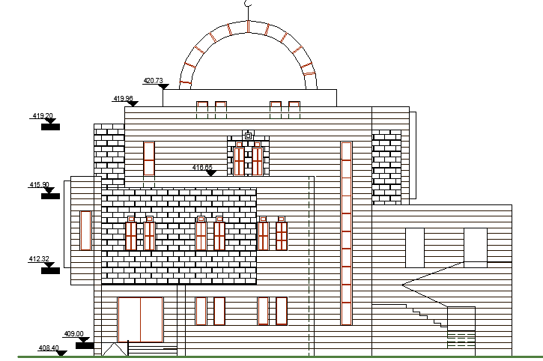
Elevation’s: East wall

Slide 17
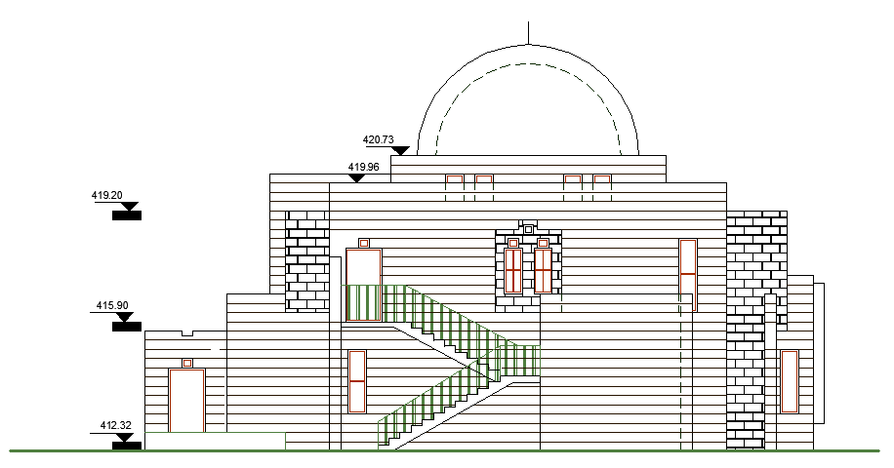
Elevation’s: West wall

Slide 18
No minaret in the design.
In this project the minaret is not designed as we see in the elevation but on the ground there is a minaret as seen in the picture
This makes us wonder what basis has been established.

Slide 19
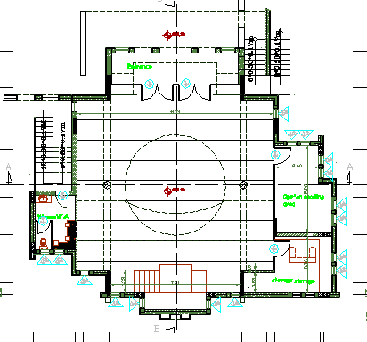
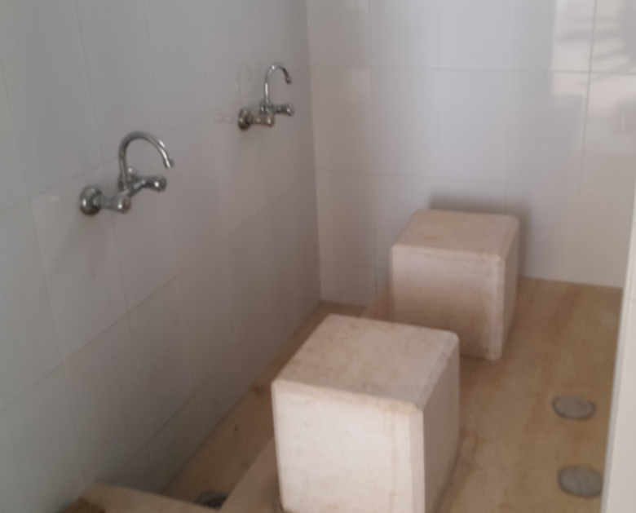
The ablution.
The standard determine that is one ablution unit for everyx25 m2 of the praying area.
But as we can see in Figure that the number of ablution unit is not enough .
The appropriate number of ablution unit in this project must be 180/25 = 8 units.
180 is the area of prayer hall in the mosque.

Slide 20
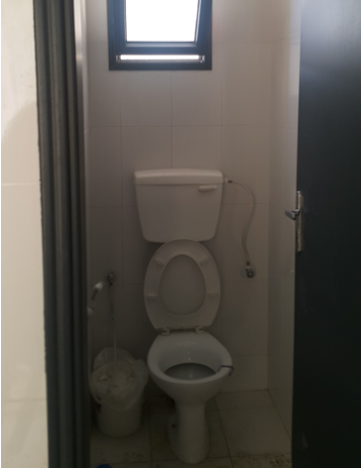
The Toilet facilities.
Number of WCs in ground floor is 1, and the required number of WC’s is at least 8 .

Slide 21
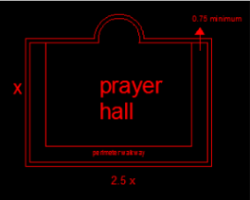
Prayer Hall.
The prayer hall does not applicable with standards , Because the ratio between the length of the room and its width is not equal 1:2.5

Slide 22
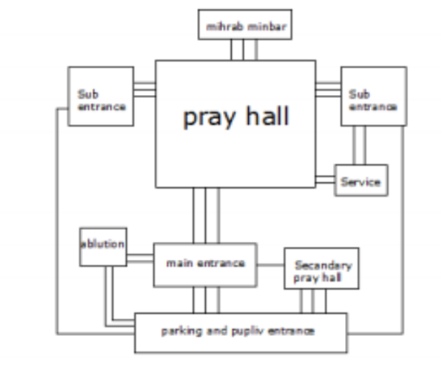
Relationship and zoning diagram for a Mosque

Slide 23
  Passive Analysis

Slide 24
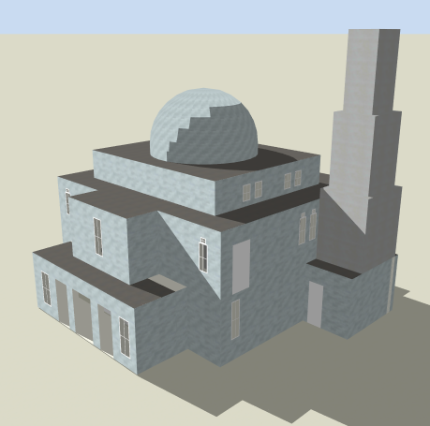
  Passive Analysis
Shading analysis
Thermal analysis
Daylight

Slide 25
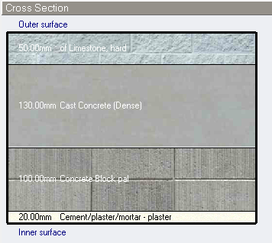
    Envelope construction details for the building
External Wall layers
U-value =2.435 w/m 2 –k

Slide 26
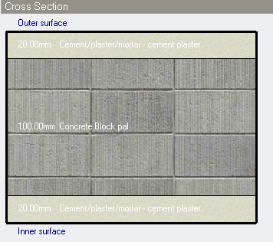
Internal Wall
U-value =2.653 w/m 2 –k

Slide 27
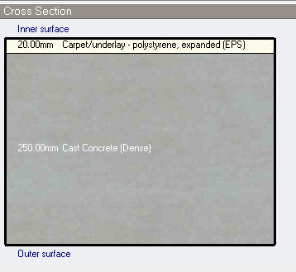
Floor layers
U-value =1.042w/m²-k

Slide 28
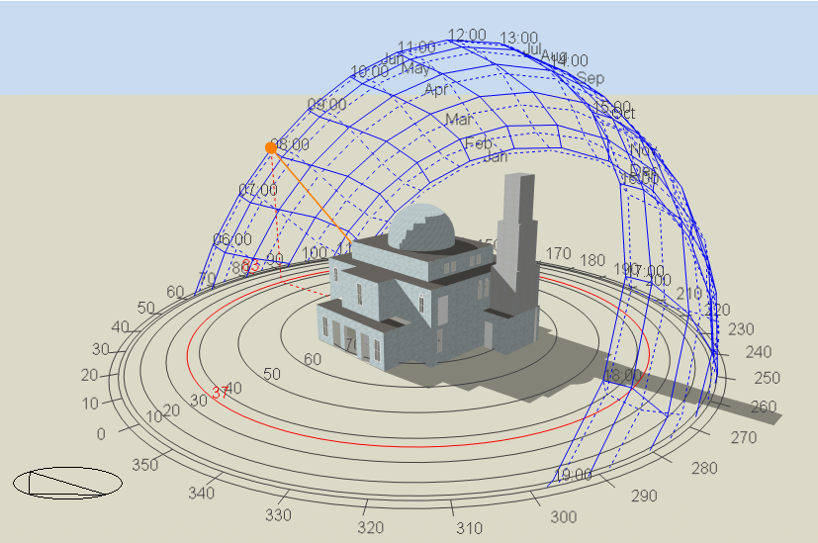
Solar analysis
Annual and daily Sun path was obtained from design builder as shown in Figures :

Slide 29

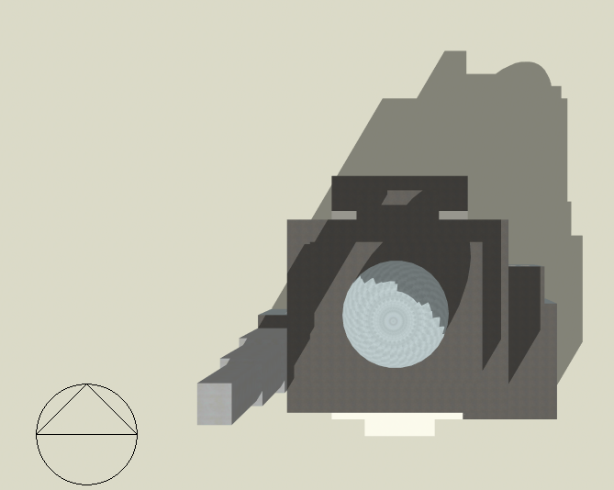
Shadow Analysis
Winter day:
21/1 at 8:00am
21/1 at 2:00 pm

Slide 30
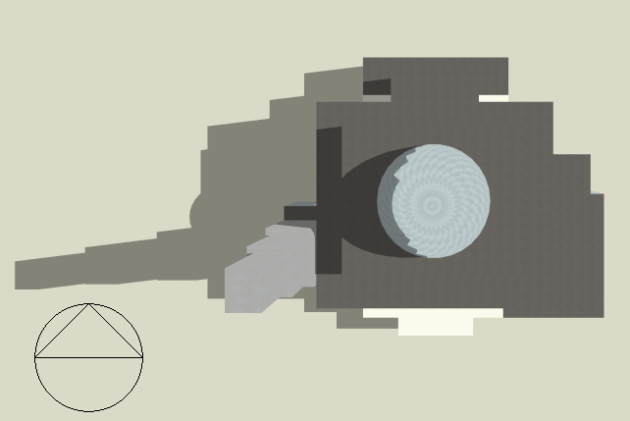
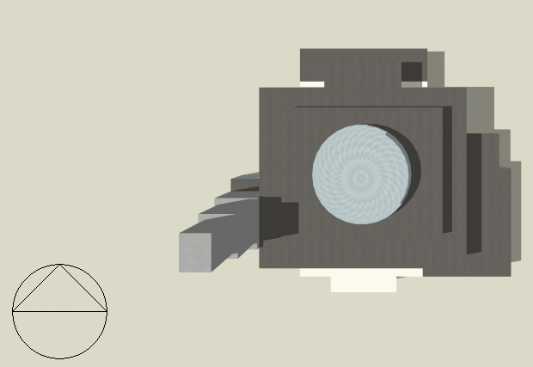
Shadow Analysis
Summer Days:
21/6 at 8:00 am
21/6 at 2:00 pm

Slide 31
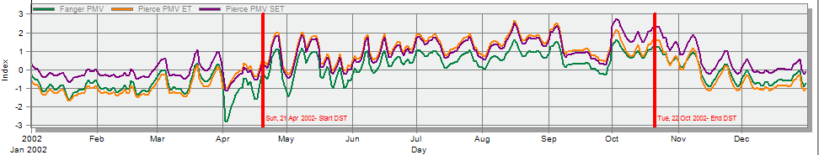
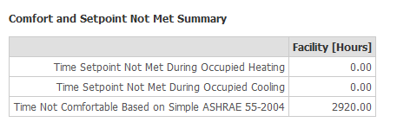
Thermal analysis
Comfort graph (Pierce and Fanger PMV) (natural ventilation)

Slide 32
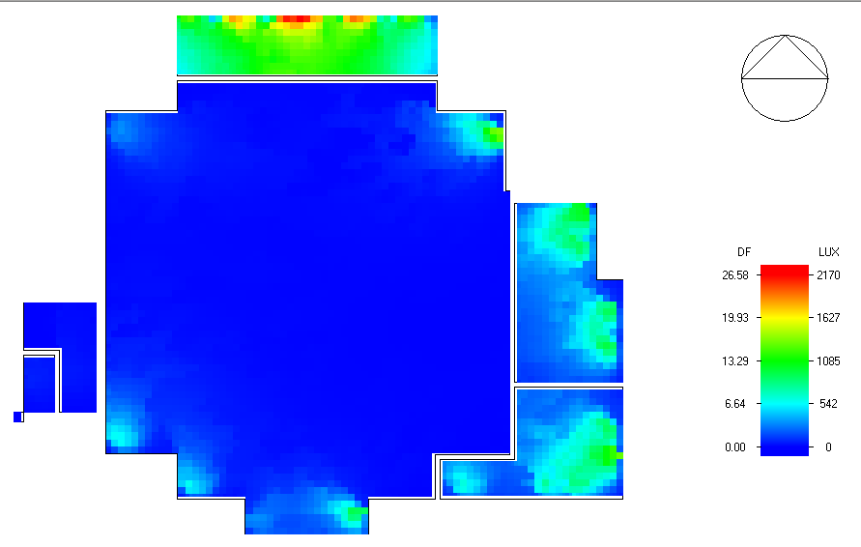
      Daylight:

Slide 33
    Acoustical analysis

Slide 34
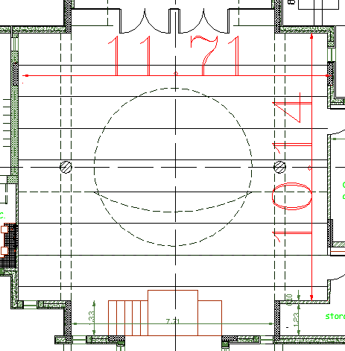
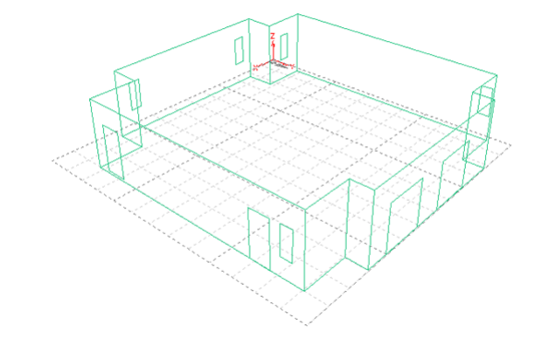
Reverberation time (RT60)
Pray hall room

Slide 35
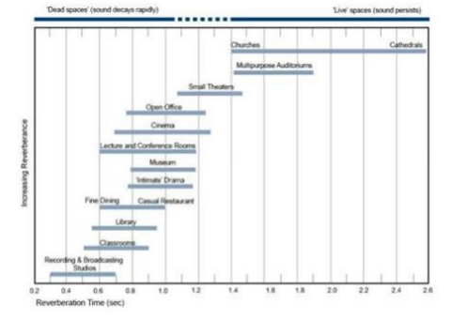
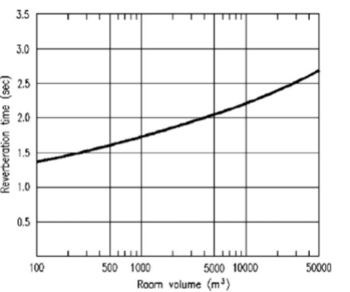
Recommended values of RT60 in Mosque
The recommended reverberation time (RT60) shall be from 1.2 to 2 seconds.

Slide 36
Reverberation time (RT₆₀)
Empty occupancy
FREQ. | RT₆₀
63Hz: | 0.82
125Hz: | 0.95
250Hz: | 0.85
500Hz: | 0.61
1kHz: | 0.54
2kHz: | 0.48
4kHz: | 0.45
8kHz: | 0.41
16kHz: | 0.37
At 50 % occupancy
FREQ. | RT₆₀
63Hz: | 0.98
125Hz: | 1.27
250Hz: | 1.13
500Hz: | 0.93
1kHz: | 0.82
2kHz: | 0.70
4kHz: | 0.70
8kHz: | 0.59
16kHz: | 0.56
At Full occupancy
FREQ. | RT₆₀
63Hz: | .89
125Hz: | 1.14
250Hz: | 0.85
500Hz: | 0.74
1kHz: | 0.69
2kHz: | 0.59
4kHz: | 0.64
8kHz: | 0.57
16kHz: | 0.54
Pray hall

Slide 37
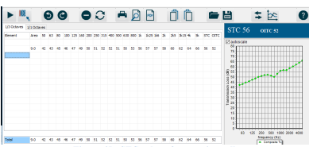
Sound Transmission Loss (STC):
Space Adjacency | Recommended STC
Pray hall | 53
According to Figure So STC value is 56 dB bigger than 53 dB
which is not accepted.

Slide 38
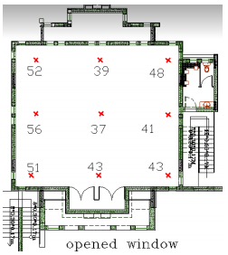
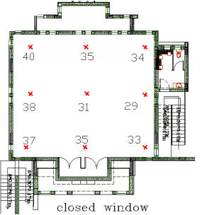
Noise Criteria
Space Adjacency | Recommended NS
Mosque | 30 - 35
Background Noise

Slide 39
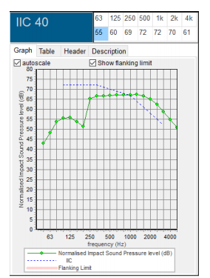
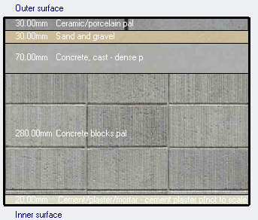
IIC for ceiling:
Composite Transmission loss Calculation
Since IIC = 40 dB it’s not acceptable .

Slide 40
Structural Aspects

Slide 41
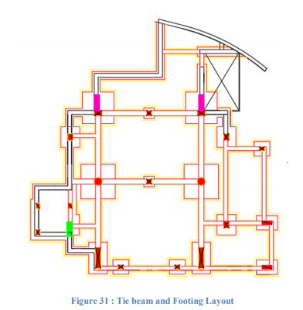
Structural systems:
Foundations System:
The structural system used isolated footings under square, rectangular and circular columns, as shown:

Slide 42
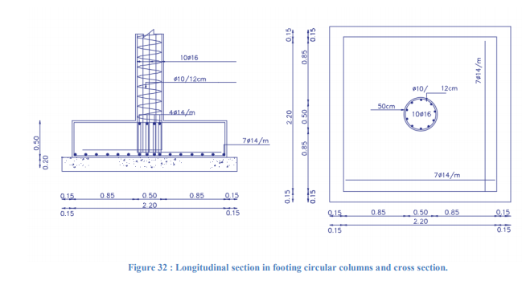
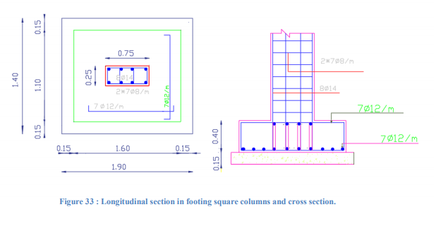

Slide 43
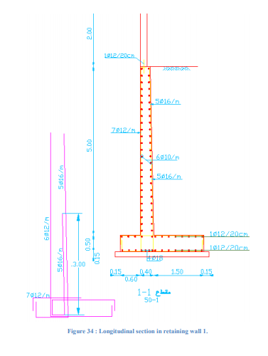
Retaining Walls :
This used to supported the soil lodes

Slide 44
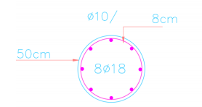
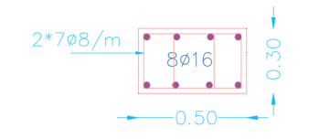
Columns:
Circular Column
Rectangular Column

Slide 45
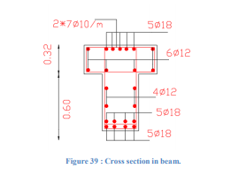
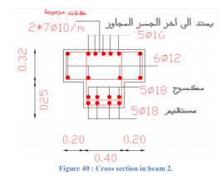
Concrete Beam System :
Drop beams system used in the building

Slide 46
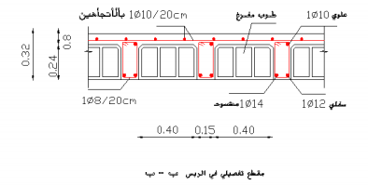
Concrete Slab System:
One way ribbed slabs system was used
Preliminary Check thickness of slab for deflection:
One end continuous is critical, the minimum thickness = 5.84/18.5= 315mm. So, t=32 cm

Slide 47
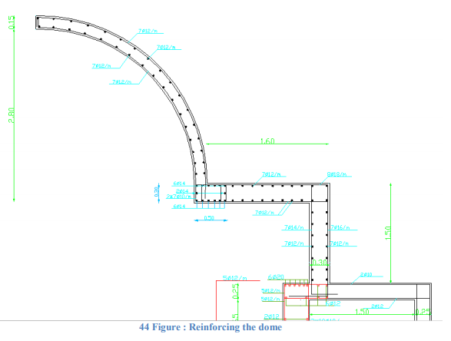
Designing and reinforcing the dome :
The domes of the solutions are used in mosques, theatres or halls to cover the large sea.

Slide 48
Electro mechanical system
analysis

Slide 49
    HVAC system :
There is no HVAC system in the mosque !

Slide 50
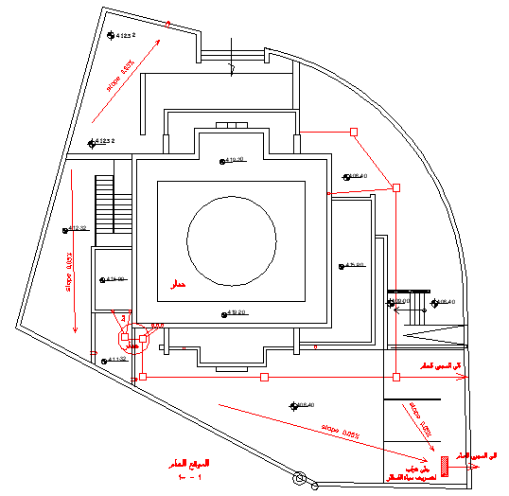
    Water drainage system :

Slide 51
    Water drainage system :
pipe | Actual diameters | Required diameters
Vertical pipe | 4 in | 4 in
Horizontal pipe | 4 in | 4 in
Branch | 2 in | 2 in

Slide 52
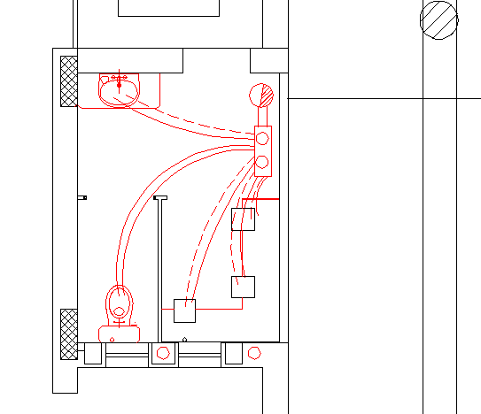
    Water supply system :
pipe | Required Diameters | Actual diameters
Vertical pipe | 2.5 in | 2.5 in
Horizontal pipe | 1.25 in | 1.25 in
Branch pipe | 1 in | 1 in

Slide 53

Water storage :
The required daily usage is 8-10liter/day per Prayer.
Number of tanks Are used is 8 tanks.
Required number of tanks Are needed is 4 tanks , 3 for cold water and 1 for hot water.

Slide 54
Electrical system

Slide 55

Artificial Lighting :

Slide 56

Ceiling plan for ground floor :

Slide 57

3D – rendering Internal view:
Ground Floor Pray Hall

Slide 58

3D – rendering Internal view:
First Floor Pray Hall

Slide 59

Luminaires used:

Slide 60

Luminaires used:

Slide 61

3D rendering view for selected rooms:
Ground Floor Pray Hall

Slide 62

3D rendering view for selected rooms:
First Floor Pray Hall

Slide 63

Lux-meter measured values :
Daylight only Ground Floor

Slide 64

Lux-meter measured values :
Daylight and Artificial Light Ground Floor

Slide 65

Lux-meter measured values :
Daylight only First Floor

Slide 66

Lux-meter measured values :
Daylight and Artificial Light First Floor

Slide 67



Lighting Results:

Slide 68

Single phase system:
Total power of lighting branch = 10.6 KW/h
Total power of power branch = 12.4 KW/h

Slide 69
Lighting Consumption:
Total daily power for first floor pray area = 1955 * 7 = 13685 watt/day
Total power for the mosque assume the second floor have the same lighting fixtures and
luminaries = 2* 13685 watt / day =27370 watt / day
The total consumption of power building in month = 1430 kW
Cost of consumption = 1430 * 0.72 = 1030 Nis / month.

Slide 70
Thank You ..

