Slide 1

An-Najah National University
Engineering Faculty
Building Engineering Department
Integrated Design of a Digital Media Center in Nablus
Prepared by: Ahmad Atif
Loorene Murad
Sondus Yaseen
Supervised by: Dr. Muhannad Haj Hussien

Slide 2

Contents
Introduction
Brief Insight
Architectural Design
Environmental Analysis
Structural Design
Electro-Mechanical Design
Quantity Surveying

Slide 3
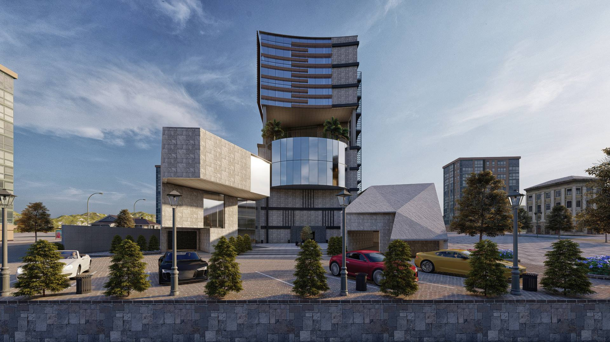
Introduction
“The Digital Media Center is a multimedia lab space as well as an equipment, printing and knowledge resource for people interested in exploring creative uses of emerging media and technology to communicate their ideas.”

Slide 4
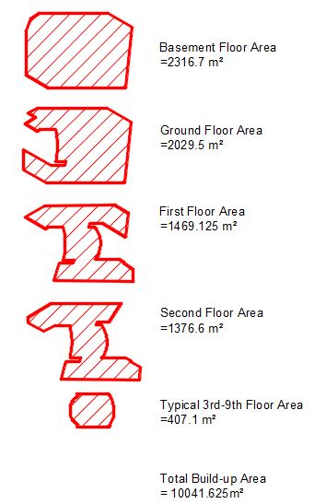
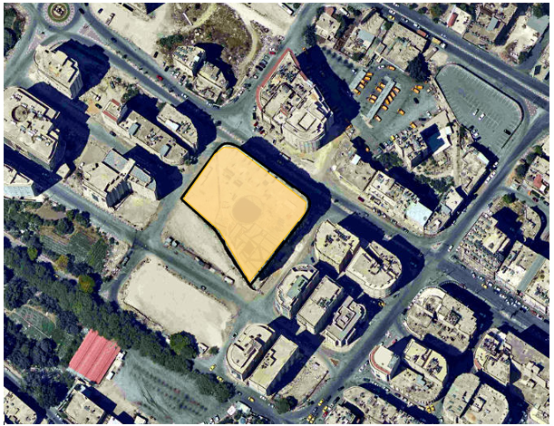
Brief insight

Slide 5
Architectural design

Slide 6
Architectural Plans before and after modification

Slide 7
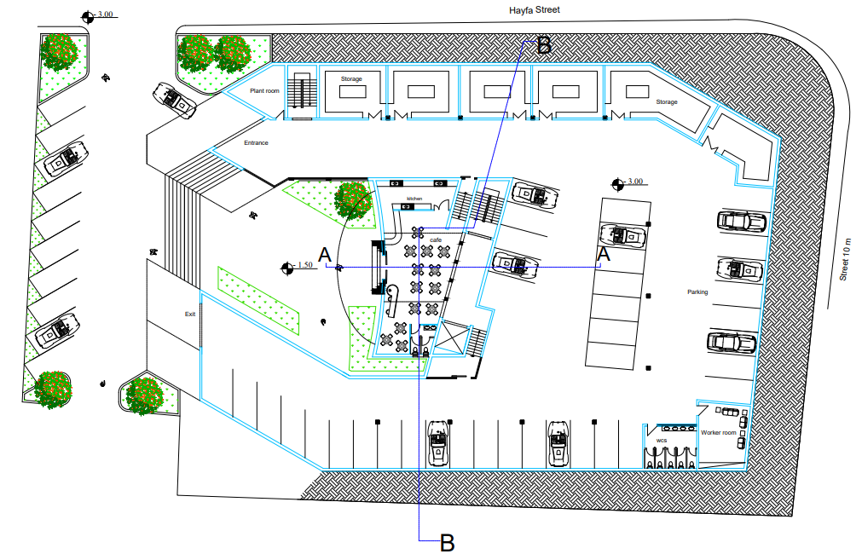
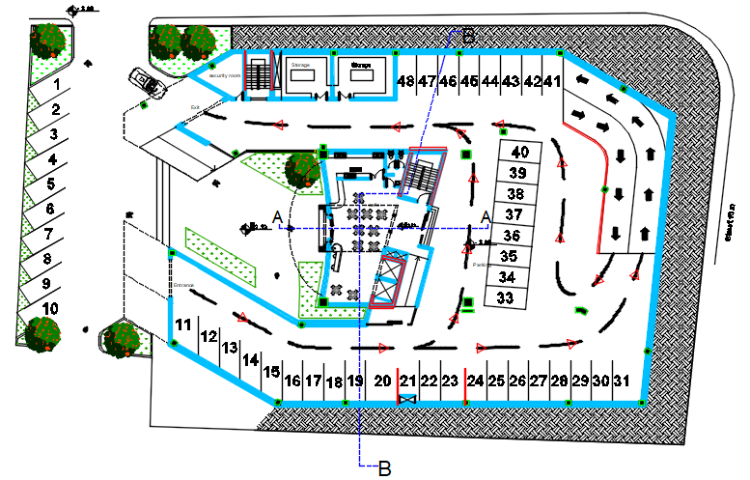
Basement floor
Before
After

Slide 8
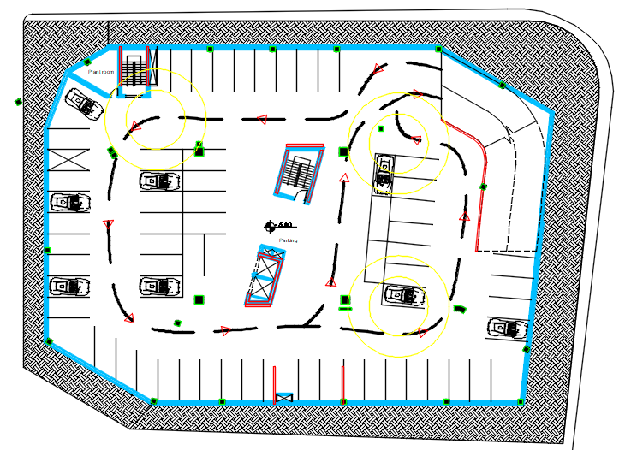
Additional basement plan

Slide 9
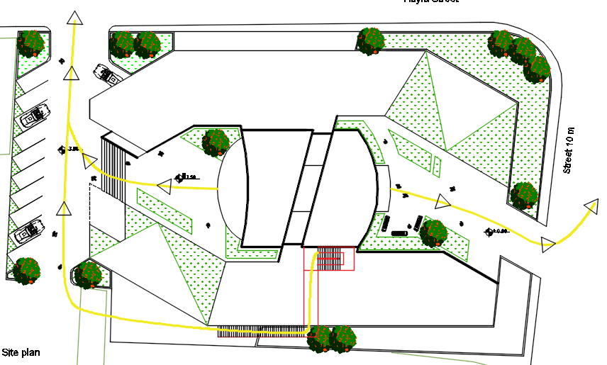
Emergency evacuation plan

Slide 10
Elevations before and after modification

Slide 11
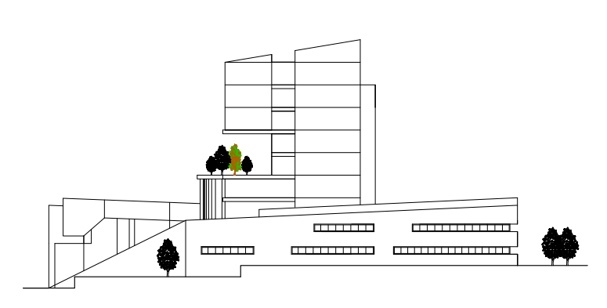
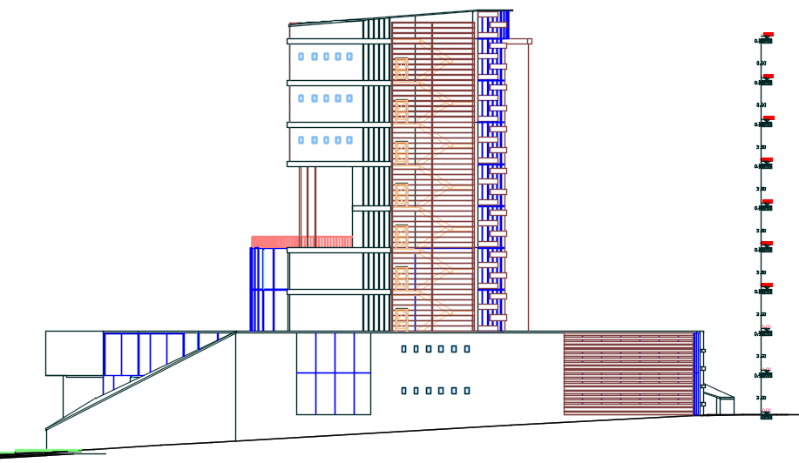
South elevation
Before
South elevation
After

Slide 12
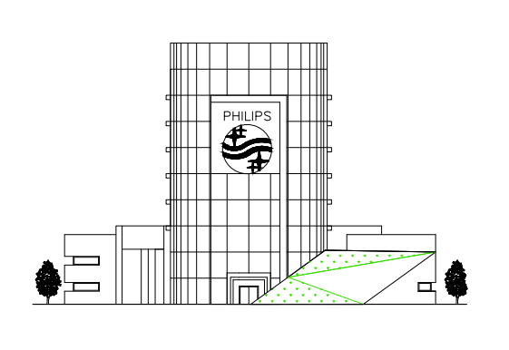
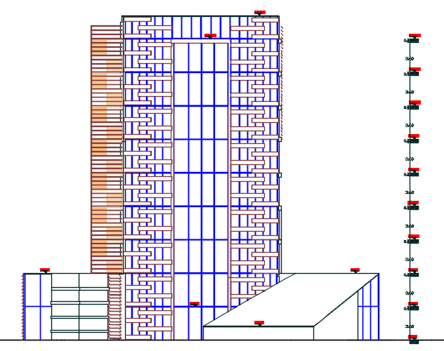
West elevation
Before
West elevation
After

Slide 13
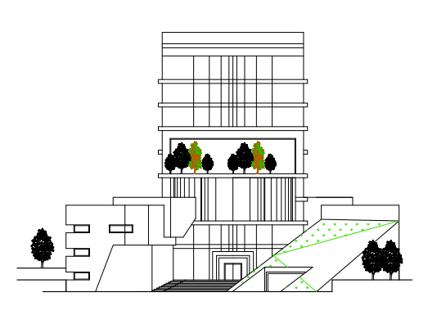
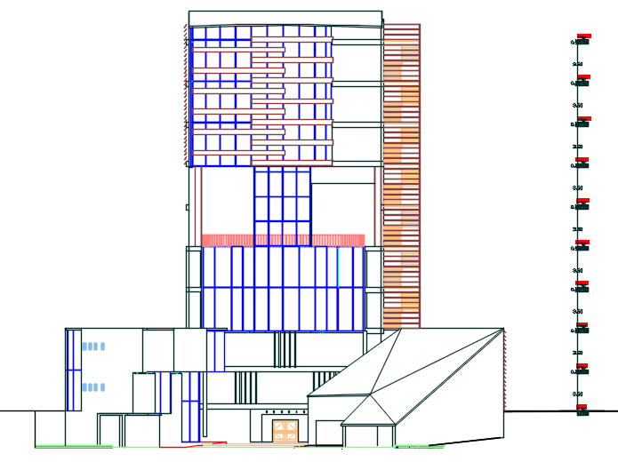
East elevation
Before
East elevation
After

Slide 14
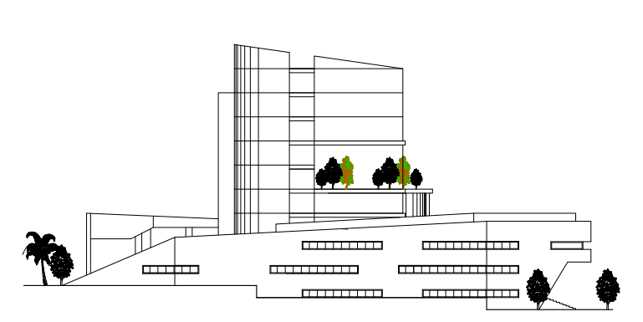
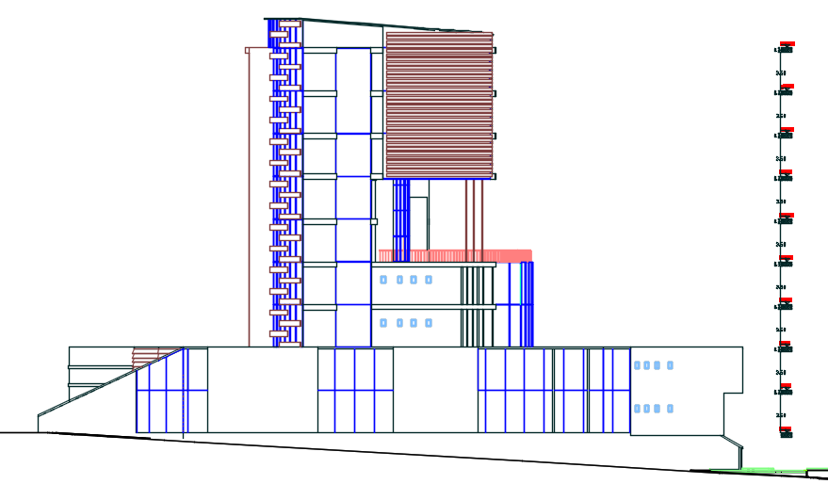
North elevation
Before
North elevation
After

Slide 15
sections before and after modification

Slide 16
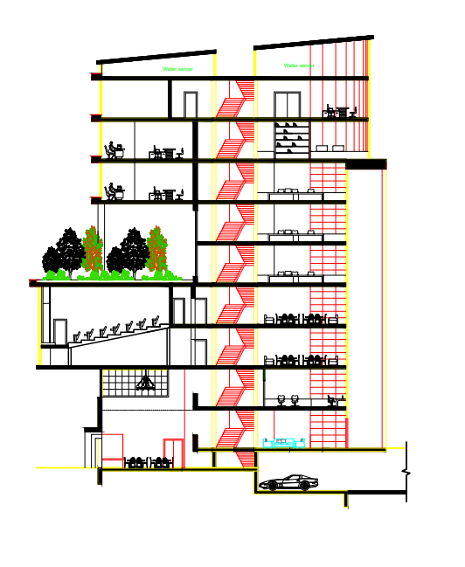
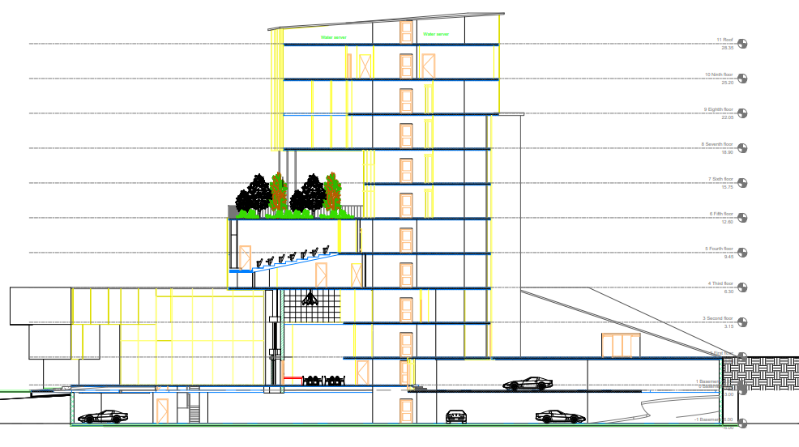
Section A-A
Before
Section A-A
After

Slide 17
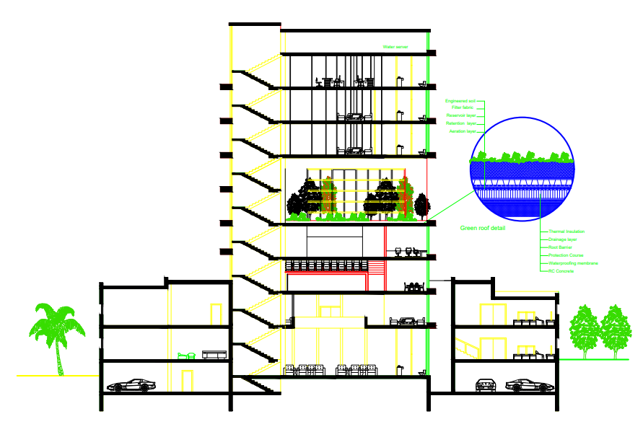
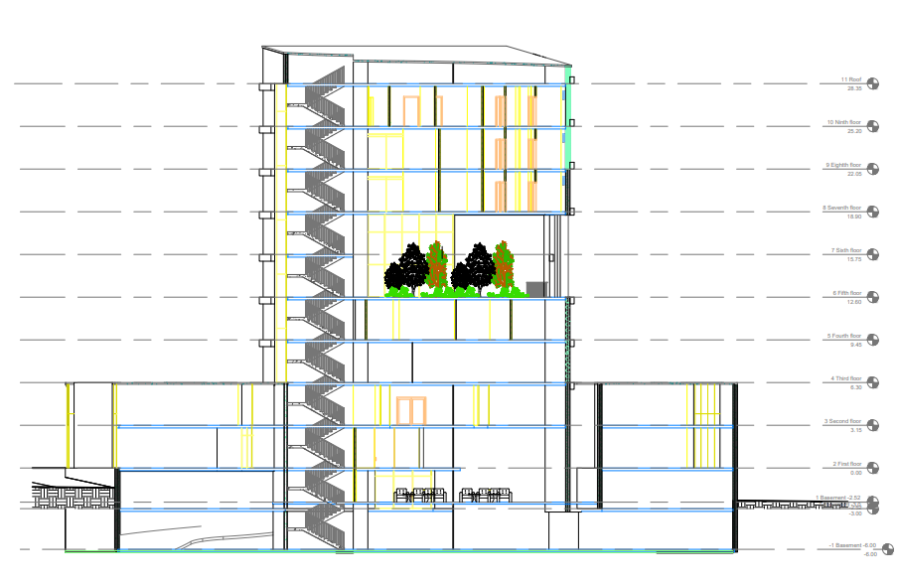
Section B-B
Before
Section B-B
After

Slide 18
environmental analysis

Slide 19
Environmental analysis
1
Shading Analysis
2
Daylight Factor
3
Solar irradiation
4
Thermal Analysis

Slide 20
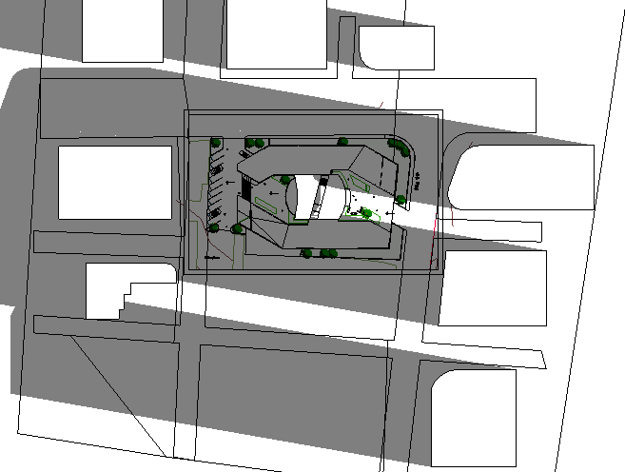
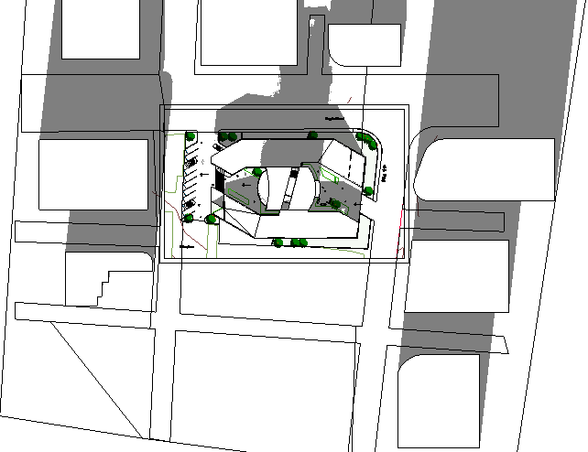
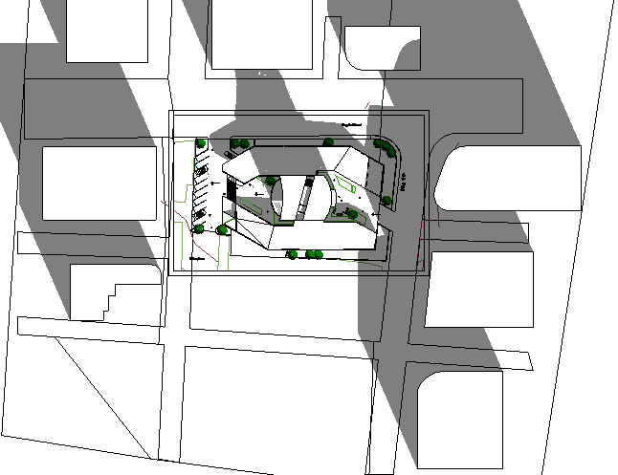
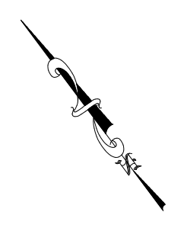
Shading and over shadowing
In Winter:
At 8:00 AM
At 12:00 PM
At 2:00 PM

Slide 21
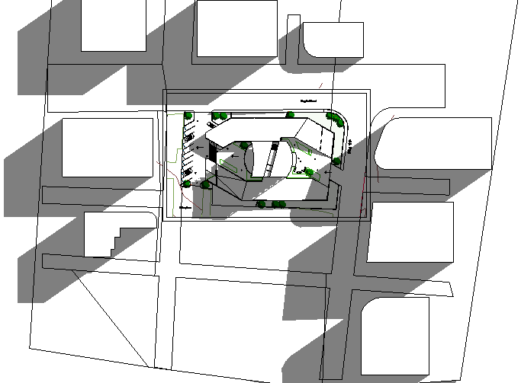
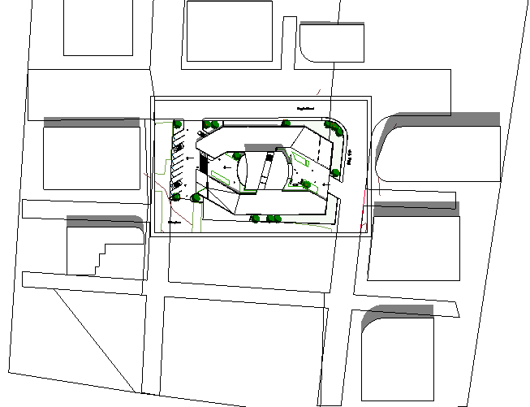
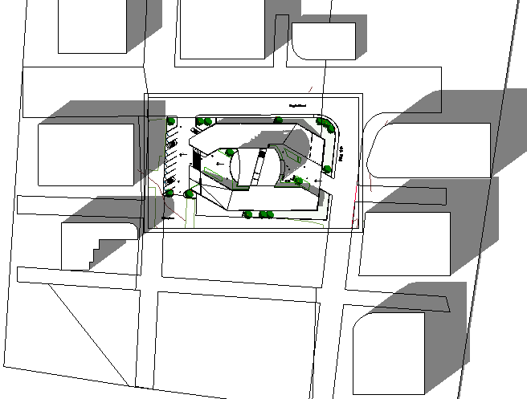
Shading and over shadowing
In Summer:
At 8:00 AM
At 12:00 PM
At 2:00 PM

Slide 22
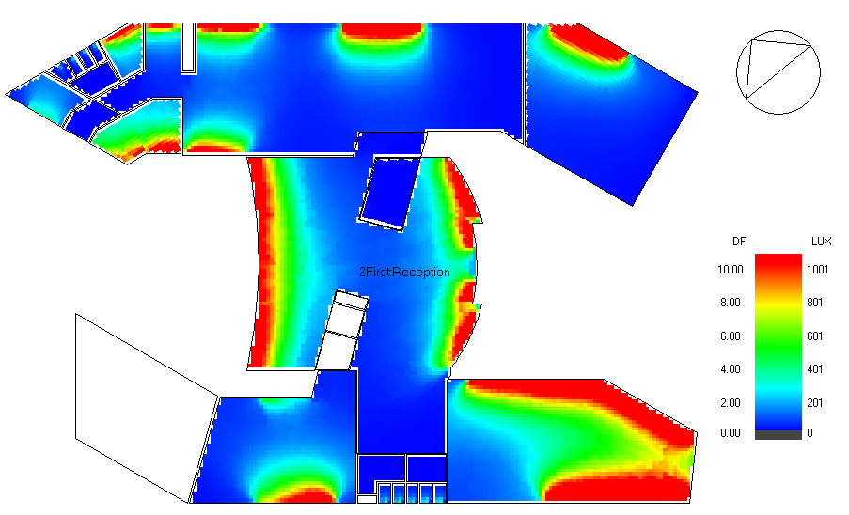
Daylight factor
Before treatments

Slide 23
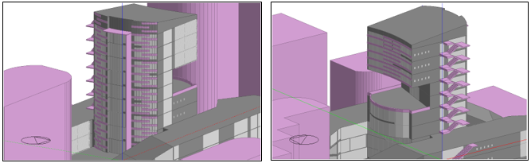
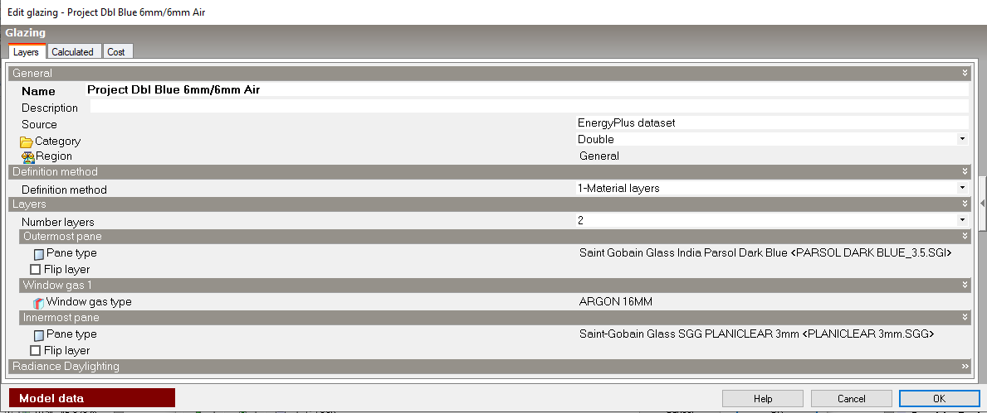
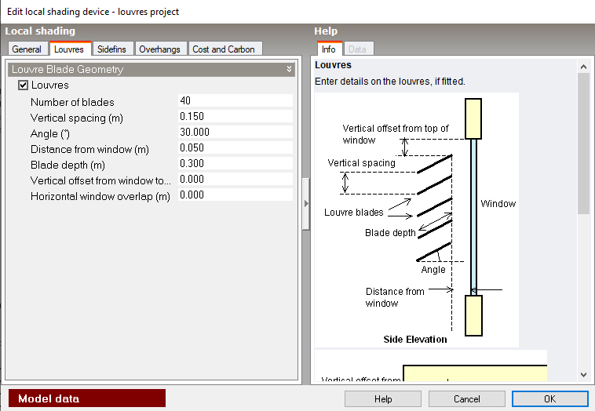
Treatments used

Slide 24
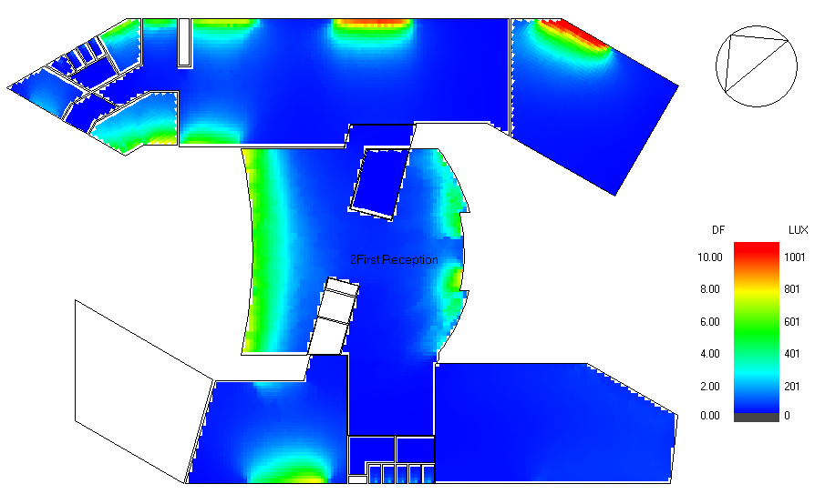
Daylight factor
after treatments

Slide 25
Solar irradiation
Annual solar irradiation
Surface elevation | Solar irradiation before (W/m²) | Solar irradiation after (W/m²)
Roof | 299 | 236
Floors | 17 | 13
South | 206 | 156
East | 79 | 64
North | 69 | 53
West | 70 | 49

Slide 26
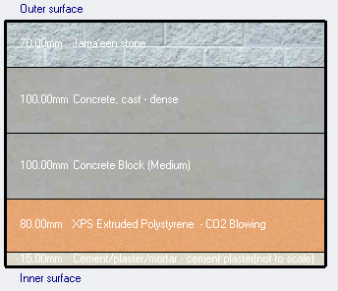
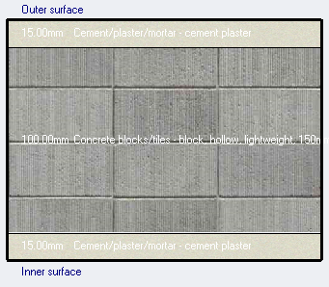
Construction layers and U-value
For External wall
For internal wall
U-value = 0.353 W/m².K
U-value = 1.961 W/m².K

Slide 27
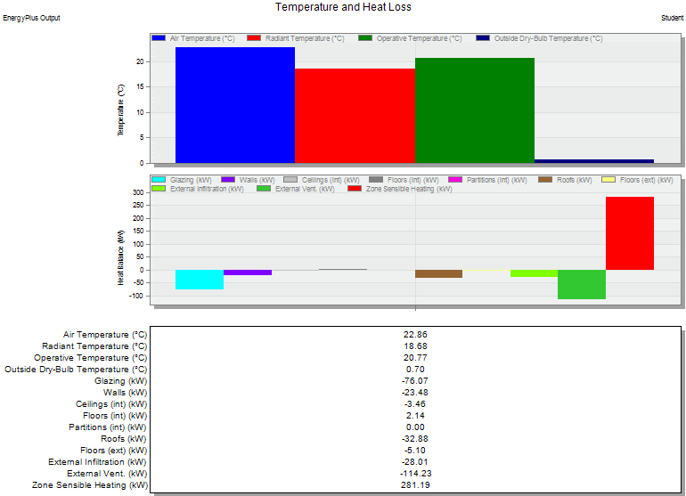
Heating load
Total design heating capacity = 245.23 KW

Slide 28
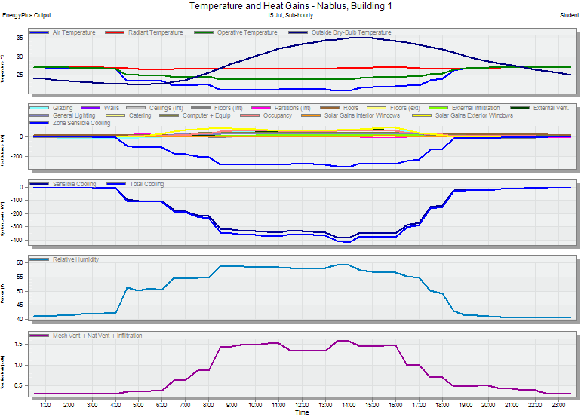
cooling load
Total design cooling capacity = 416.6 KW

Slide 29
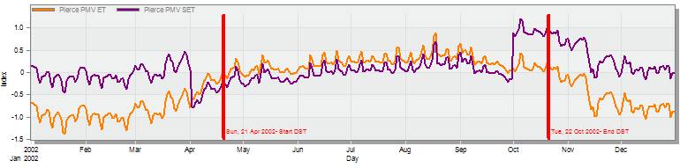
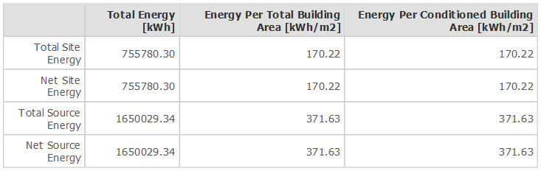
Simulation output
PMV – Set
energy portfolio manager standard for mixed use property is 248.2 KWh/m²

Slide 30
Structural analysis and design

Slide 31
Structural analysis and design
Codes
Material Properties
Validation Checks
Seismic Checks
Design and Detailing

Slide 32
ANALYSIS AND DATA COLLECTION
Codes
ACI 318M-14
UBC 1997
ASCE-16
Material Properties
Reinforced Concrete
24 MPa
28 MPa (used for slabs and beams)
32 MPa (used for columns, shear walls and foundation)
Reinforcing Steel with yielding strength = 420 MPa

Slide 33
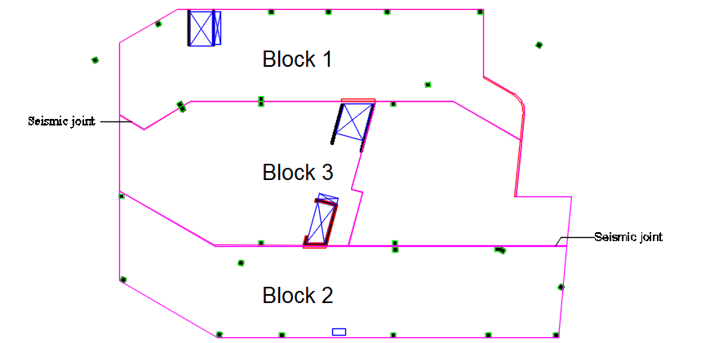
Structural building blocks

Slide 34
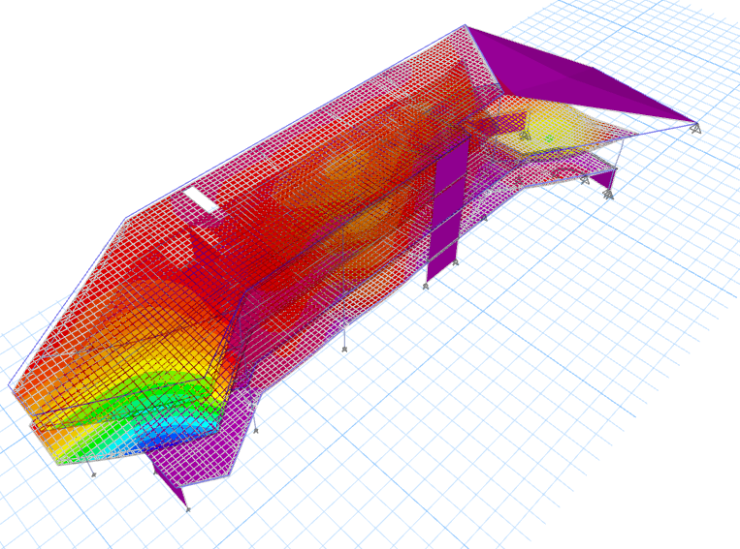
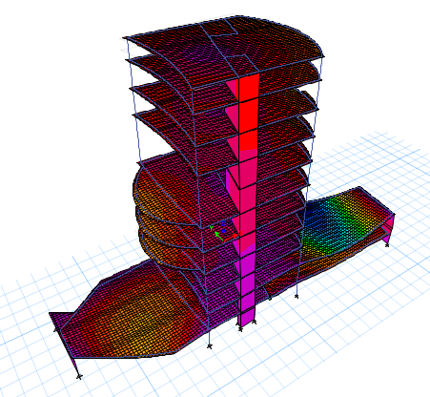
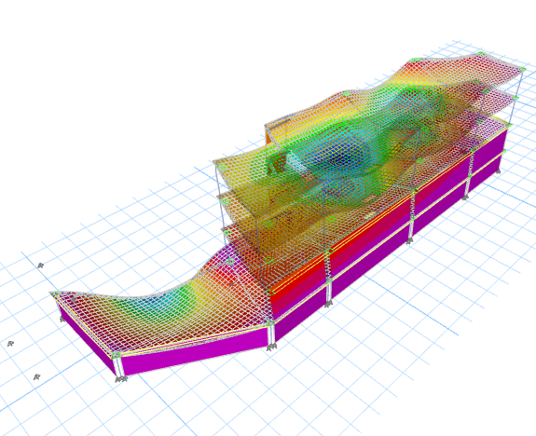
Validation checks
Compatibility Check
Deflection Check
Equilibrium Check
Stress – Strain Check
Block 1
Block 3
Block 2

Slide 35
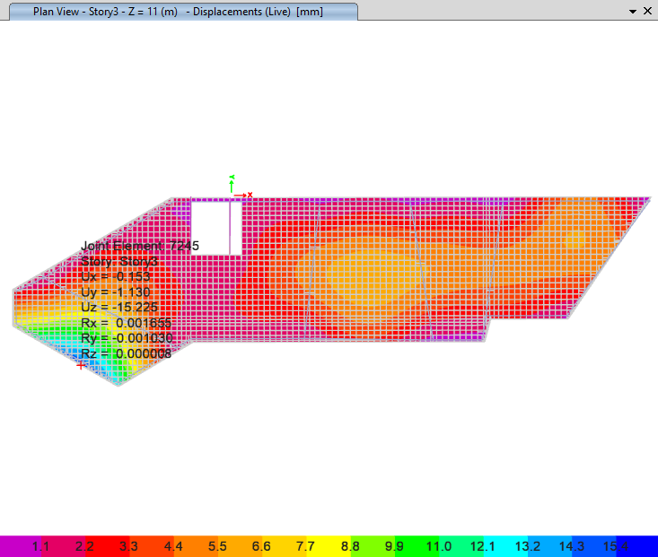
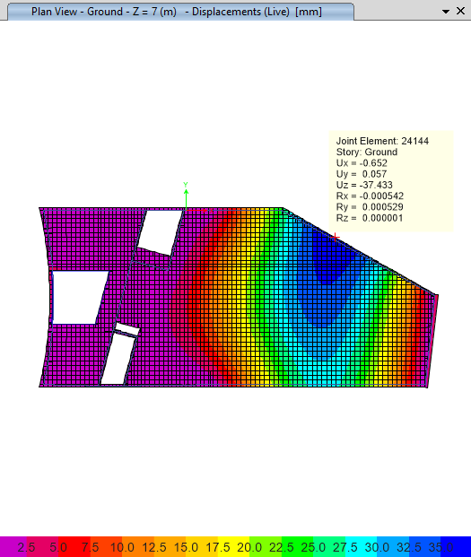
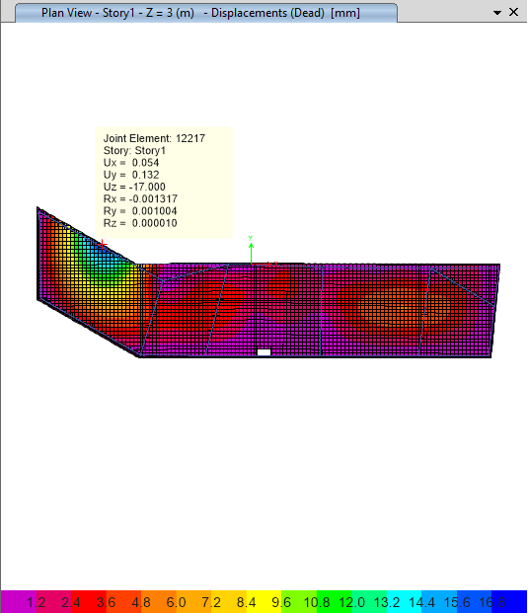

Validation checks
Compatibility Check
Deflection Check
Equilibrium Check
Stress – Strain Check
Block 1
the permissible deflection = $\frac{l}{240}$
Block 3
Block 2

Slide 36
Validation checks
Compatibility Check
Deflection Check
Equilibrium Check
Stress – Strain Check
Block 1 | Dead Load | SID Load | Live Load
Manual | 26349.38 | 9925.338 | 9905.7312
ETABS | 25802.729 | 9955.039 | 9620.6454
%Error | 2.11 | 0.29 | 2.96
Block 1 | Dead Load | SID Load | Live Load
Manual | 21008.234 | 11199.642 | 11050.7376
ETABS | 20081.783 | 11081.726 | 10795.6464
%Error | 4.61 | 1.064 | 2.36
%Error should be less than 5%
Block 1 | Dead Load | SID Load | Live Load
Manual | 46823.34 | 24655.24 | 19029.04
ETABS | 47288.36 | 24655.24 | 19029.20
%Error | 1.14 | 0 | 0

Slide 37
Validation checks
Compatibility Check
Deflection Check
Equilibrium Check
Stress – Strain Check
%ERROR | For column | For beams
Block 1 | 1.1 | 2.05
Block 2 | 8.2 | 6.4
Block 3 | 5.5 | 7.4
%Error should be less than 10%

Slide 38
Seismic inputs
Seismic Zone → Z = 0.2
Soil Profile → S_{E}
Occupancy Category → I = 1.25
Structural System → R = 5.5 (building frame system with shear walls)
Seismic Coefficient → C_{a} = 0.34
C_{v} = 0.64

Slide 39
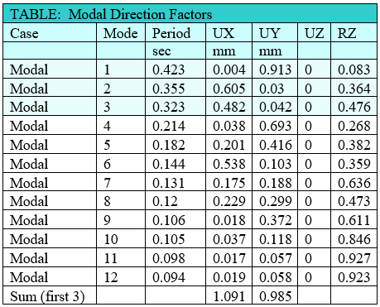
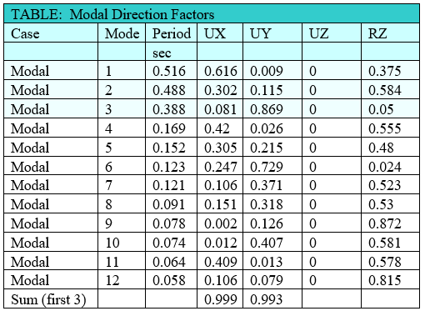
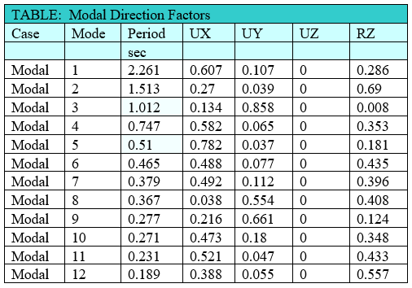
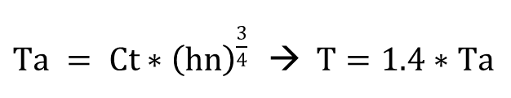
Seismic checks
Period and modal participation ratio check
$Ta = Ct∗{\left(hn\right)}^{\frac{3}{4}}$ $→ T=1.4∗Ta$
Block 1
Block 2
Block 3

Slide 40


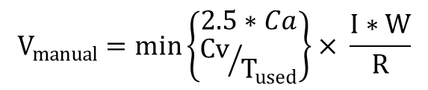
Seismic checks
Base – Shear check
$$V_{manual}=min\left\{\begin{aligned}2.5∗Ca \\ {Cv}/{T_{used}}\end{aligned}\right\}× \frac{I∗W}{R}$$
Block 1
Block 2
Block 3

Slide 41
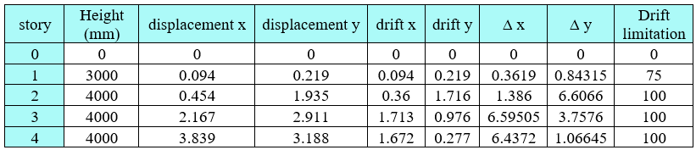



Seismic checks
Drift check
Block 1
$$If \left\{\begin{aligned}&T<0.7→ \frac{Lstory}{40} \\ &T≥0.7→ \frac{Lstory}{50}\end{aligned}\right.$$
Block 2
Block 3

Slide 42



Slabs system
Block 1
Voided slab H=40 cm with hidden beams
Block 3
Block 2
Voided slab H=60 cm with hidden beams
Voided slab H=40 cm with hidden beams

Slide 43



Slabs detailing
Section in slab H=40 cm for block 1 & 2
Section in slab H=40 cm for block 3
Section in slab H=20 cm for SOG

Slide 44

Beams design
Beam #. | B×H(m) | Longitudinal reinforcement |  |  |  | Transverse reinforcement
 |  | position | Ln | #ØD | L(m) | stirrups at support |  | stirrups at middle
 |  |  |  |  |  | s1 | # | s2 | #
3 | 0.7*0.4 | AI | 12.15 | 10Ø20 | 3.45 | 2legs Ø10/80mm | 68 | 4legs Ø10/170mm | 36
 |  | AM | 12.15 | 2Ø20 | 6.98
 |  | AJ | 12.15 | 7Ø20 | 8.10
 |  | AB | 12.15 | 8Ø20 | 13.29
11 | 0.6*0.4 | AI | 8.43 | 9Ø20 | 2.52 | 2legs Ø10/80mm | 47 | 4legs Ø10/170mm | 25
 |  | AM | 8.43 | 2Ø20 | 5.43
 |  | AJ | 8.43 | 5Ø20 | 5.62
 |  | AB | 8.43 | 5Ø20 | 9.57
14 | 0.6*0.4 | AI | 6.81 | 12Ø20 | 2.11 | 2legs Ø10/80mm | 38 | 4legs Ø10/170mm | 20
 |  | AM | 6.81 | 3Ø20 | 4.76
 |  | AJ | 6.81 | 4Ø20 | 4.54
 |  | AB | 6.81 | 6Ø20 | 7.95

Slide 45

Beams design
Beam #. | B×H(m) | Longitudinal reinforcement |  |  |  | Transverse reinforcement
 |  | position | Ln | #ØD | L(m) | stirrups at support |  | stirrups at middle
 |  |  |  |  |  | s1 | # | s2 | #
4 | 0.6*0.4 | AI | 8.11 | 16Ø20 | 5.41 | 4legs Ø10/80mm | 51 | 4legs Ø10/170mm | 24
 |  | AM | 8.11 | 4Ø20 | 5.30
 |  | AJ | 8.11 | 6Ø20 | 5.41
 |  | AB | 8.11 | 14Ø20 | 9.25
9 | 0.6*0.4 | AI | 13.95 | 7Ø20 | 9.30 | 4legs Ø10/80mm | 87 | 4legs Ø10/170mm | 41
 |  | AM | 13.95 | 2Ø20 | 7.73
 |  | AJ | 13.95 | 10Ø20 | 9.30
 |  | AB | 13.95 | 8Ø20 | 15.09
10 | 0.6*0.4 | AI | 11.86 | 11Ø20 | 7.91 | 4legs Ø10/80mm | 74 | 4legs Ø10/170mm | 35
 |  | AM | 11.86 | 4Ø20 | 6.86
 |  | AJ | 11.86 | 10Ø20 | 7.91
 |  | AB | 11.86 | 7Ø20 | 13.00

Slide 46

Beams design
Beam #. | B×H(m) | Longitudinal reinforcement |  |  |  | Transverse reinforcement
 |  | position | Ln | #ØD | L(m) | stirrups at support |  | stirrups at middle
 |  |  |  |  |  | s1 | # | s2 | #
1 | 0.6*0.4 | AI | 5.90 | 5Ø20 | 1.89 | 4legs Ø10/80mm | 37 | 4legs Ø10/170mm | 17
 |  | AM | 5.90 | 3Ø20 | 4.05
 |  | AJ | 5.90 | 5Ø20 | 1.89
 |  | AB | 5.90 | 5Ø20 | 6.72
2 | 0.6*0.4 | AI | 8.42 | 6Ø20 | 2.52 | 4legs Ø10/80mm | 53 | 4legs Ø10/170mm | 25
 |  | AM | 8.42 | 2Ø20 | 4.84
 |  | AJ | 8.42 | 5Ø20 | 2.99
 |  | AB | 8.42 | 5Ø20 | 9.24
15 | 0.6*0.4 | AI | 11.50 | 3Ø20 | 3.29 | 4legs Ø10/80mm | 72 | 4legs Ø10/170mm | 34
 |  | AM | 11.50 | 3Ø20 | 7.15 |  |  |  | 44
 |  | AJ | 11.50 | 10Ø20 | 2.99 |  |  |  | 44
 |  | AB | 11.50 | 7Ø20 | 12.32 |  |  |  | 44
12 | 0.7*0.4 | AI | 10.80 | 6Ø20 | 3.11 | 4legs Ø10/80mm | 68 | 4legs Ø10/170mm | 32
 |  | AM | 10.80 | 1Ø20 | 6.63 |  |  |  | 42
 |  | AJ | 10.80 | 6Ø20 | 2.99 |  |  |  | 42
 |  | AB | 10.80 | 6Ø20 | 11.62 |  |  |  | 42

Slide 47



Columns design

Slide 48



Columns design

Slide 49


Shear walls design

Slide 50


Mat foundation design
GENERAL INFORMATION
Soil capacity 180 KN/m²
Thickness of 1500 mm.
Top cover for the foundation=70 mm
Bottom cover for the foundation= 70 mm
CHECKS
Deflection check
Punching shear check

Slide 51

Stair section

Slide 52
Electro-Mechanical Design

Slide 53




Mechanical systems
Water System
Drainage System
HVAC System
Fire System

Slide 54



Water System

Slide 55

Design of solar flat plate system
      Design data
Plate pitch angle = 30° south facing
Design for January 21st.
Total water volume = 5 m³.
Average water temperature in winter = 8 C°
Required temperature = 22 C°
  → 17 Collectors are needed

Slide 56


Drainage System

Slide 57


Drainage System
Gray Water riser
Black Water riser

Slide 58



HVAC System
Outdoor unit
Indoor unit
Fan coil unit from Trane Company
Outdoor unit from Carreir Company
#of outdoor unit is 26 unit

Slide 59


HVAC System
Diffuser unit
Diffuser unit from Air Master Emirates Company
Square diffuser
Slot linear diffuser

Slide 60


Diffuser and duct distribution

Slide 61


Fire System

Slide 62



Electrical systems
Sockets distribution
Artificial lighting design
Acoustical design

Slide 63



Sockets distribution

Slide 64


Distribution board

Slide 65

Artificial lighting design
Design of Digital game lounge
Luminaires used

Slide 66



Artificial lighting design
Illuminance and glare results

Slide 67


Artificial lighting design
Render results

Slide 68


Artificial lighting design
Lights and switches distribution

Slide 69


Acoustical design
Cinema design
Face | Material
Walls | Plaster
Walls behind cinema | Plywood
Stage floor | Wood floor
Floor under seats | Carpet
Seating area | MTSEAT FABRIC
Floor | Tiles
Ceiling | Gypsum
Doors | Wooden Solid doors

Slide 70




Acoustical design
Cinema design
AL Contour map
SPL Contour map
STI Contour map

Slide 71





Acoustical design
STC & IIC

Slide 72
Quantity surveying and cost analysis

Slide 73
Quantity Surveying and cost analysis
The budgeted cost of the project is 23400114.3 ILS.
The unit cost of the project is 2412.4 ILS.
The budgeted cost of structural system is 9765649.5 ILS.
The budgeted cost of mechanical system is 590886.1 ILS.
The budgeted cost of electrical system is 980000.0 ILS.

Slide 74

3D LUMION model

Slide 75


Slide 76


Slide 77


Slide 78


Slide 79


Slide 80


