Slide 1

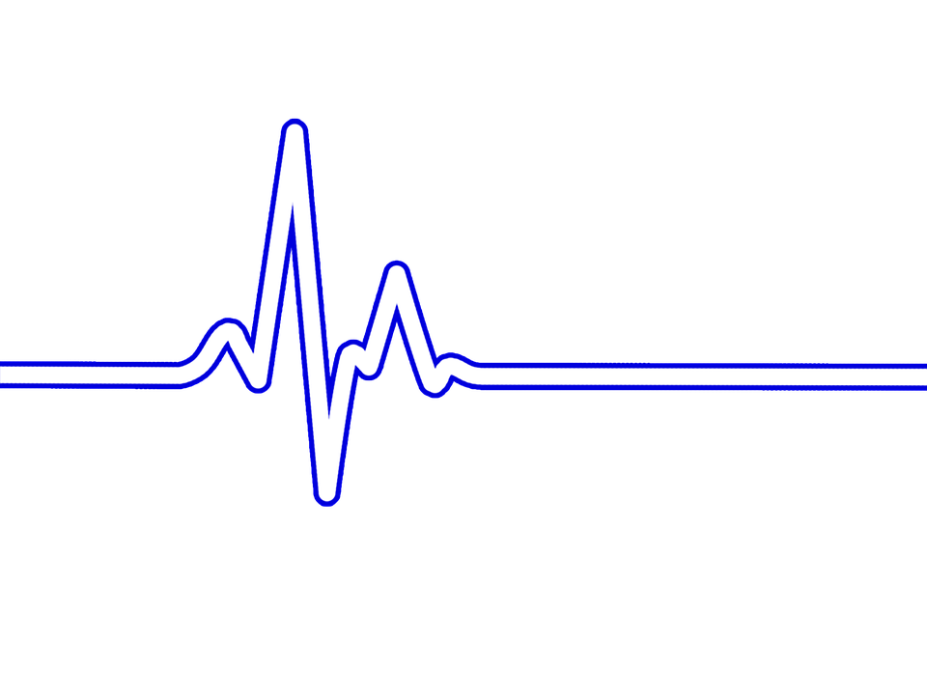
An-Najah National University
Telecommunications Engineering Department
ECG analysis system
Prepared by:
Malak Aqraa
Tasbeeh Masri
Supervisor:
Dr. Saed Tarapiah
Dec- 2018

Slide 2
Outline
Introduction.
Objectives.
Project Description.
Result and Discussion.
Recommendations And Conclusion.

Slide 3
Introduction
The Survey
30.3%
69.7%

Slide 4
Introduction
What is ECG(Electrocardiography) ?
is the process of recording the electrical activity of the heart, as the heart produces small electrical impulses that spread through the heart muscle and cause constriction. These impulses can be detected by the ECG. The doctor uses the electroplating test to help him know the cause Some symptoms, such as palpitations or chest pain, are sometimes performed as part of routine tests, for example, before surgery.

Slide 5
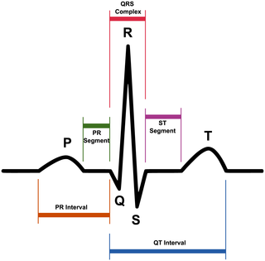

Slide 6
Introduction
what is different between waves on the ECG signal?
1-The P wave is a record of the electrical activity through the upper heart chambers (atria).
2- The QRS Complex is a combination of the Q wave, R wave and S wave and it is a record of the movement of electrical impulses through the lower heart chambers (ventricles) and It also contains the peak value of the signal.
3- The ST segment is the portion of the ECG from the end of the QRS complex to the beginning of the T wave.
4- The T wave occurs after the QRS complex and is a result of ventricular repolarization.

Slide 7
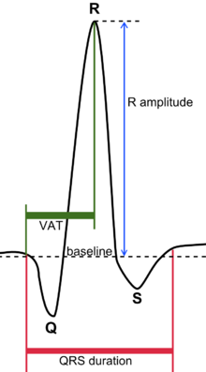
Introduction
In our project, we will focus on analyzing the QRS wave to identify diseases caused by abnormal changes, whether in amplitude, time interval or peak to peak (R-R) interval.and we will calculate the heart rate to detect
QRS normal values:
The QRS duration must be[0.07-.12s].
The peak-peak ( R-R) interval must be in the range [.6-1.2] s.
Heart rate:
The normal heart rate between 60 and 100 BPM /min.

Slide 8
Introduction
QRS changes
wide QRS complex (QRS Duration >.12s):We can diagnose many diseases from wide QRS complex such as Left bundle branch block,Right bundle branch block, Nonspecific intraventricular conduction disturbance. Hyperkalemia. Class I antiarrhythmic drugs. Tricyclic antidepressants. Ventricular rhythms and ventricular extrasystoles (premature complexes). Artificial pacemaker which stimulates in the ventricle. Aberrant conduction (abberancy). Pre-excitation (Wolff-Parkinson-White syndrome).
Short QRS duration(<0.07s):no clinical relevance.

Slide 9
Introduction
QRS changes
High voltage: Hypertrophy ,Left bundle branch block . Right bundle branch block . Normal variant in younger, well-trained and slender individuals.
Low voltage: Normal variant. Misplaced leads. Cardiomyopathy. Chronic obstructive pulmonary disease. Perimyocarditis. Hypothyreosis (typically accompanied by bradycardia). Pneumothorax. Extensive myocardial infarction. Obesity. Pericardial effusion. Pleural effusion. Amyloidosis .

Slide 10
Objectives
Develop ECG data analysis system in real time.
Detect of the QRS complex on the ECG signal.
Calculate the time interval and peak to peak (R-R) interval of the QRS complex in order to detect the abnormal changes of these values.

Slide 11
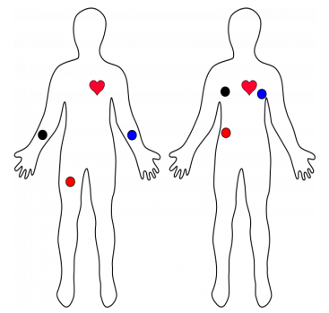
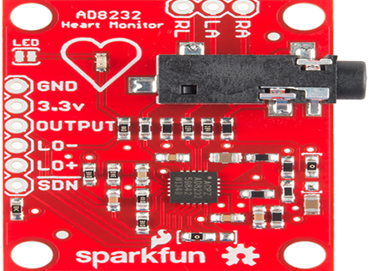
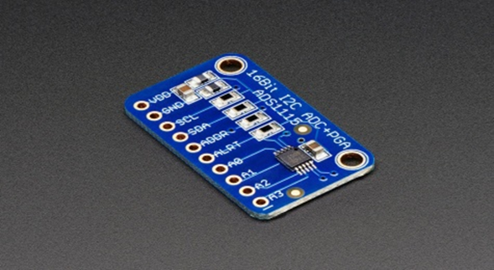
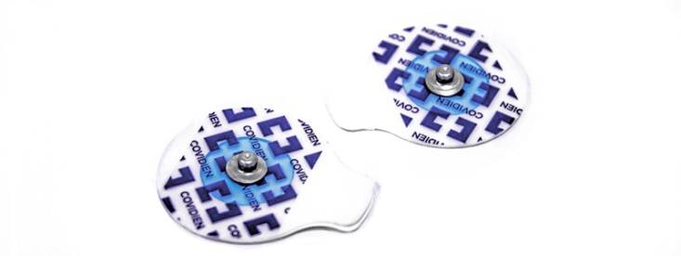

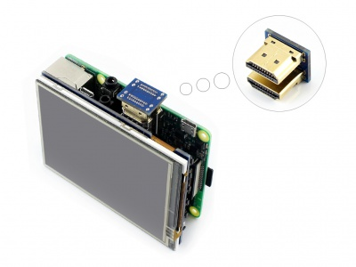
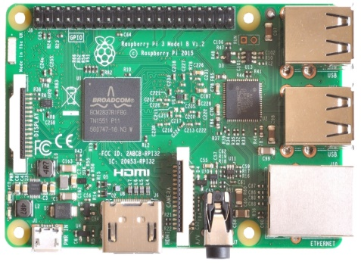
Project Description
Sensor cable.
WIRE
ECG Electrodes Placements.
ECG Sensor
ADC
WIRE
HDMI Touch LCD
To show results
Raspberry Pi3
With simulink model.

Slide 12
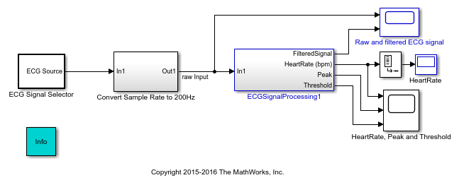
Project Description
QRS detection Simulink model

Slide 13
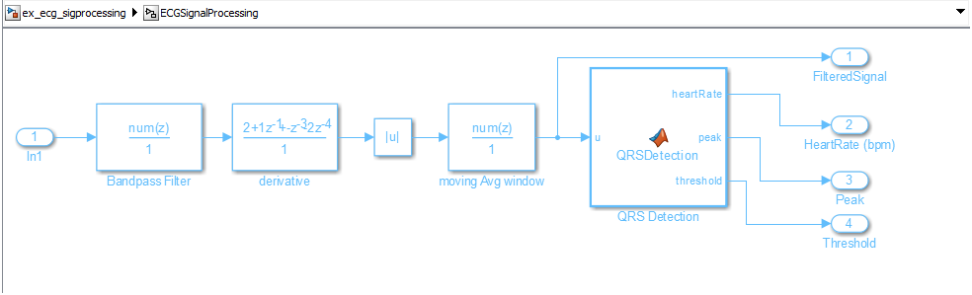
Project Description
The over all QRS detection simulink model

Slide 14
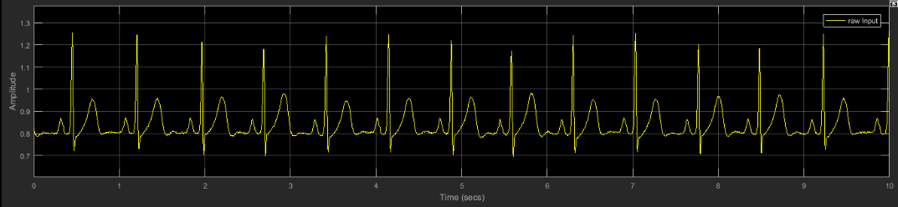
Result and Discussion.
In order to experience the simulink model we applied different heart rates ECG signals from ECG source.
First: we set the heart rate in ECG source block to 82 BPM (which is normal value) .we have the following outputs:
Raw ECG signal with 82 BPM

Slide 15
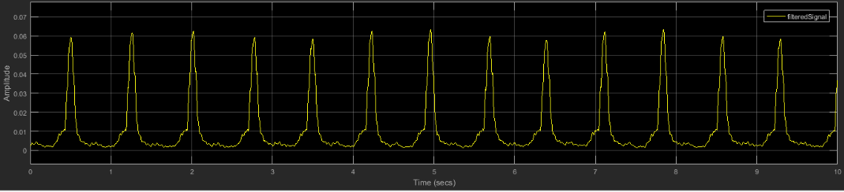
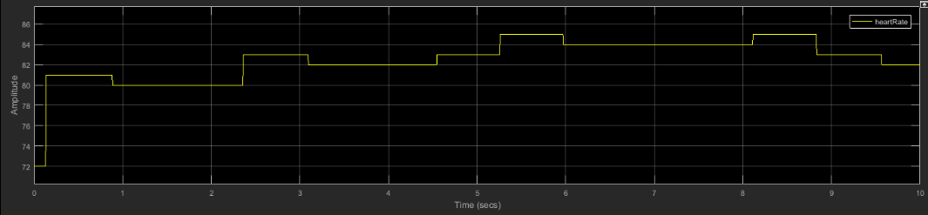
Filtered signal (QRS) with 82 BPM.
Heart rate (82 BPM).

Slide 16
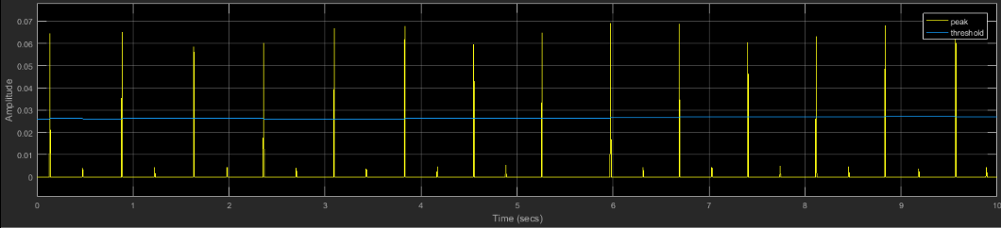
Peak &Threshold (with 82 BPM heart rate).
After calculated the time interval of the QRS The result =.107 s .
Since The normal values of QRS duration mut be[0.07-.12s] so,the QRS duration of the patient lies within the normal range.
We also calculated the peak-peak( R-R) interval of ECG signal with 82 BPM heart rate and the result was=0.735 S .
Since The normal values of peak-peak ( R-R) interval must be in the range [.6-1.2] S so, The peak-peak ( R-R)interval of the patient lies within the normal range.

Slide 17
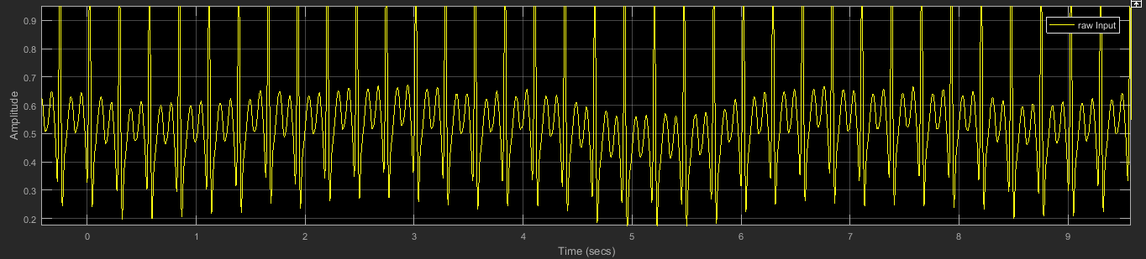
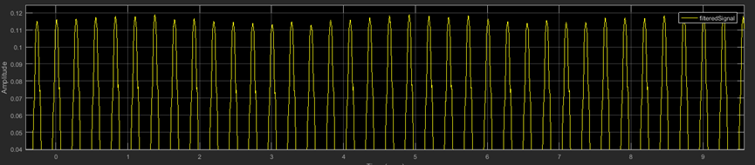
Second : we set the heart rate in ECG source block to 220 BPM (Which is abnormal value ​​where it exceeds the normal limit of the heart rate) .we have the following outputs:
Raw ECG signal with (220 BPM heart rate).
Filtered signal (QRS) with (220 BPM heart rate).

Slide 18
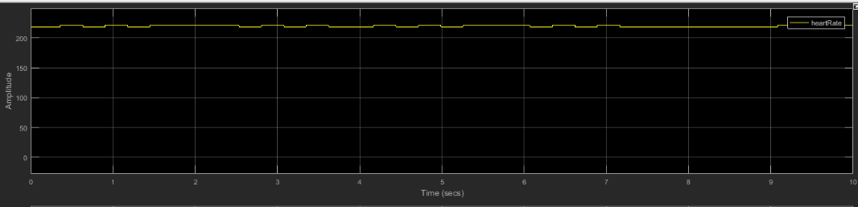
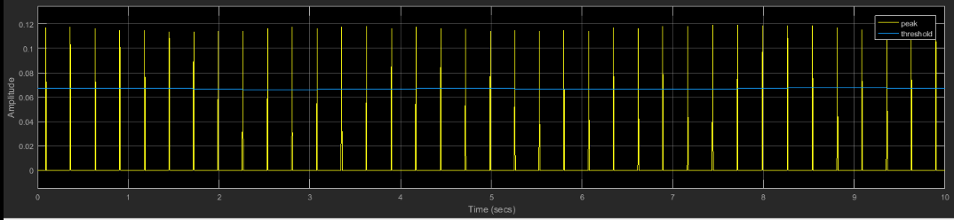
Heart rate (220 BPM).
Peak &Threshold (with 220 BPM heart rate).

Slide 19
After calculated the time interval of the QRS wave,The result was = 0.246 S.
Since The normal values of QRS duration mut be[0.07-.12s] so,the QRS duration of the patient's ECG exceeds the upper limit of normal QRS duration .
We also calculated the peak-peak( R-R) interval of ECG signal with 220 BPM heart rate and the result was=0.274 S.
Since The normal values of peak-peak ( R-R) interval must be in the range [.6-1.2] S so, The peak-peak ( R-R)interval of the patient's ECG lies under the lower limit of the normal ( R-R) interval .

Slide 20
Recommendations And Conclusion.
Based on the principle that a person's heart is the main driver of his life We had the idea of working on this project. Our goals are to design to a system that relieve people of the trouble of going to hospitals and paying large sums of money to check on the health of their hearts. We hope that people will benefit from this project as much as possible

Slide 21

Thank you

