Slide 1
Graduation Project Report II
{Re-Designing of Foundation System for Palestine Capital Market Authority building}
By
Islam Aqel Motaz Buzyyah
Samah Hussein Taima Al-kelani
Yazan Alawneh
Under supervision of: Dr. Mohammad Samanneh

Slide 2

Overview of the Graduation Project I
Project Description

Slide 3
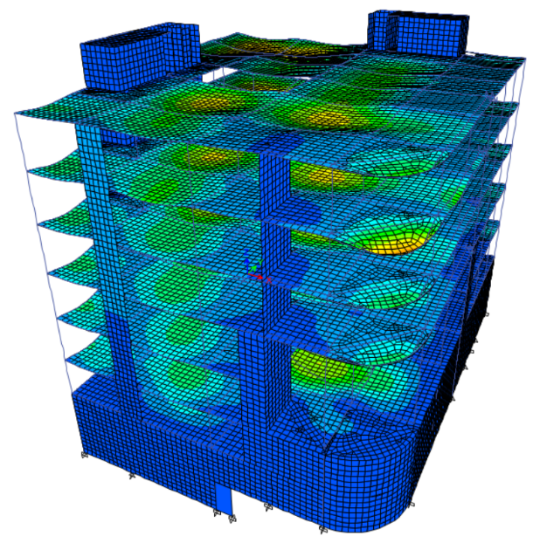
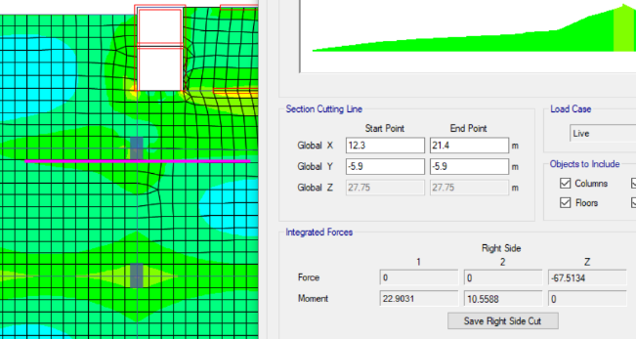
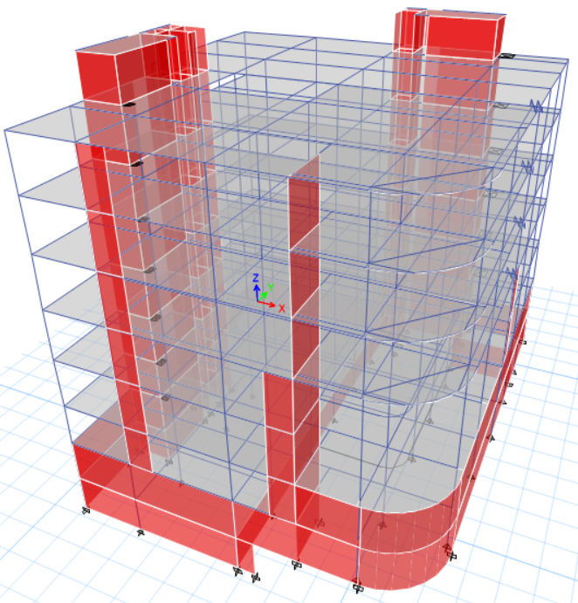
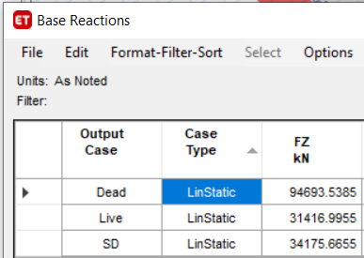
Overview of the Graduation Project I

Slide 4
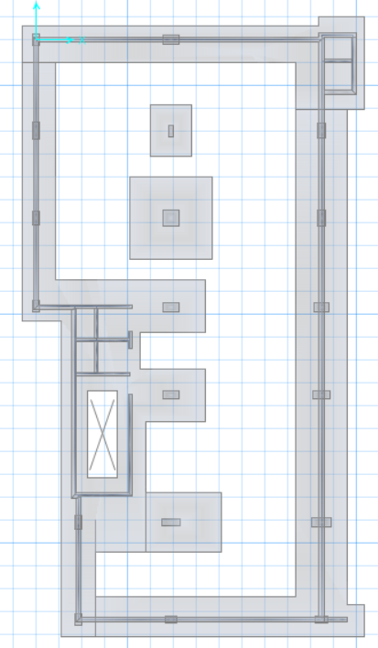
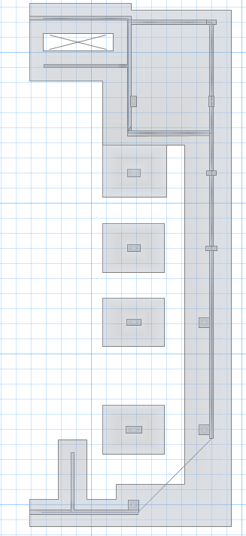
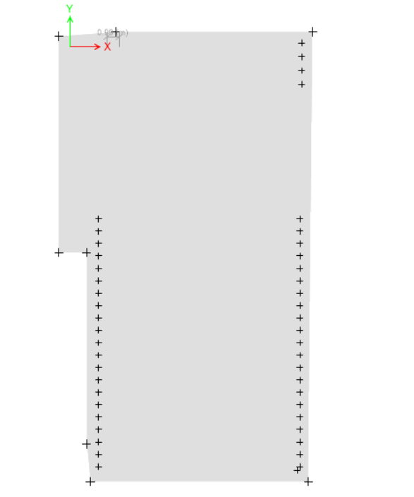
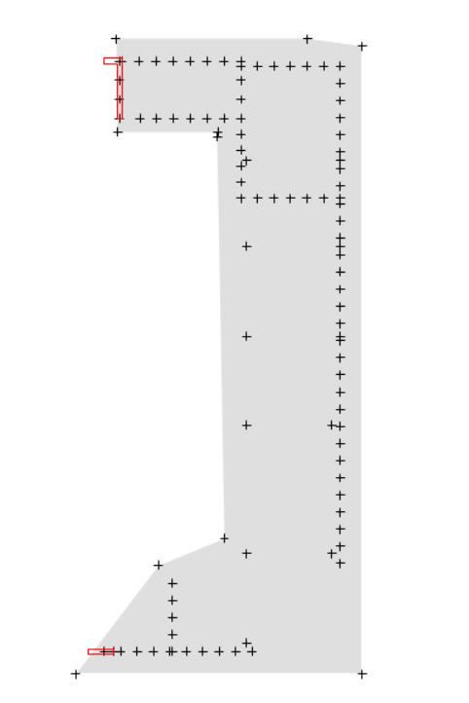
introduction
Single Footings ( 350KN/m² )
Mat Foundation ( 150KN/m² )

Slide 5
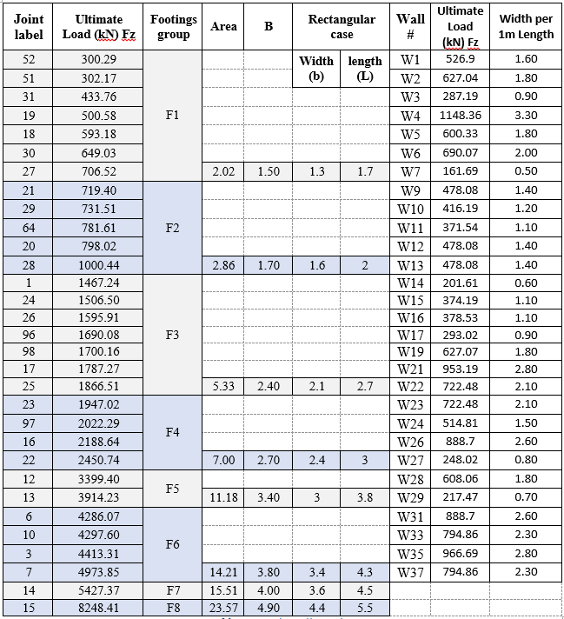

Design of Single Footings
Initial footings dimensions
In the case of bearing capacity for soil 350kN/m2
Area= $\frac{load }{bearing capacity}$

Slide 6
Design of Single Footings
Initial thickness of Single footings:
Suppose the initial thickness = 10% * number of floors
Initial thickness= 10% *8 stories = 800 mm.
Structural modeling of single footings:
To model the footings, SAFE 2016 program will be used. The first step its export all reactions on the supports from all combinations and cases of loads from ETABS to SAFE, then the next step draw all single footings on SAFE as initial dimensions and make changes in the dimensions if needed. Figure shows the layout of footings.

Slide 7
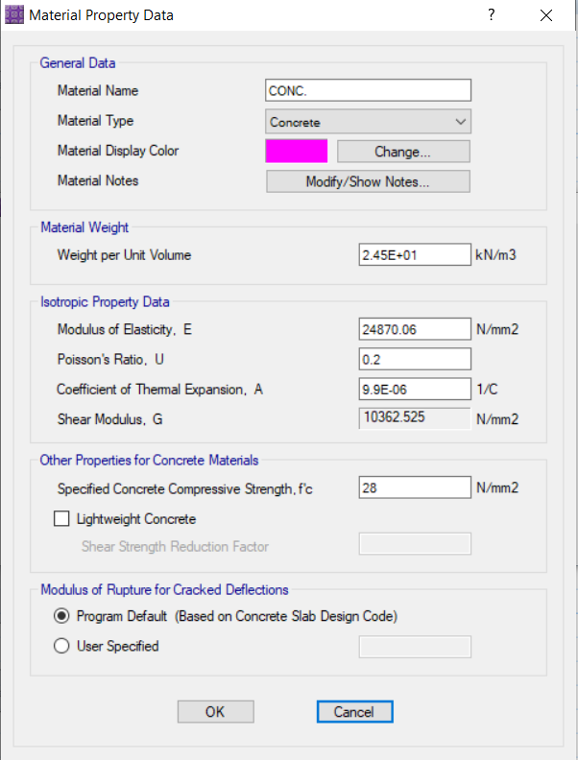
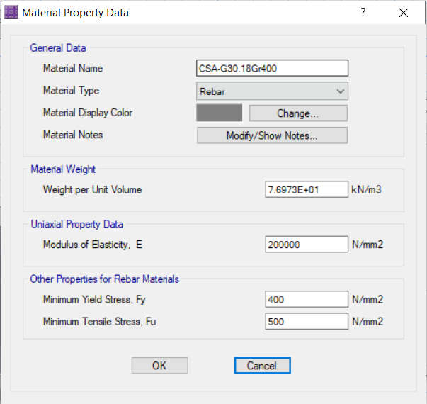
Design of Single Footings
Materials and Footings depths
Concrete properties
Steel properties

Slide 8
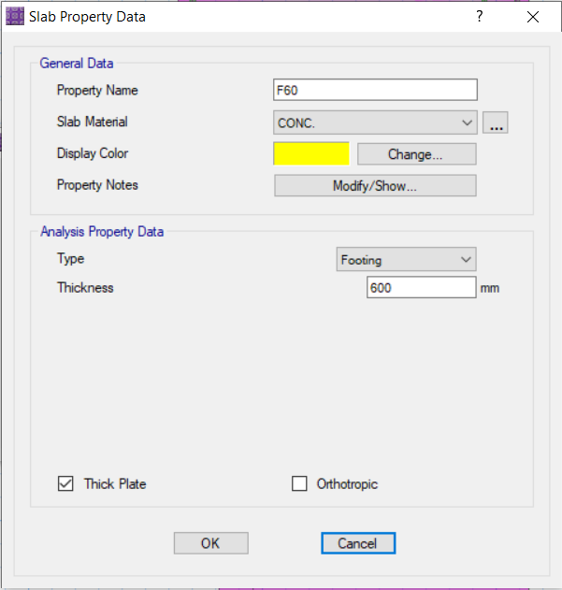
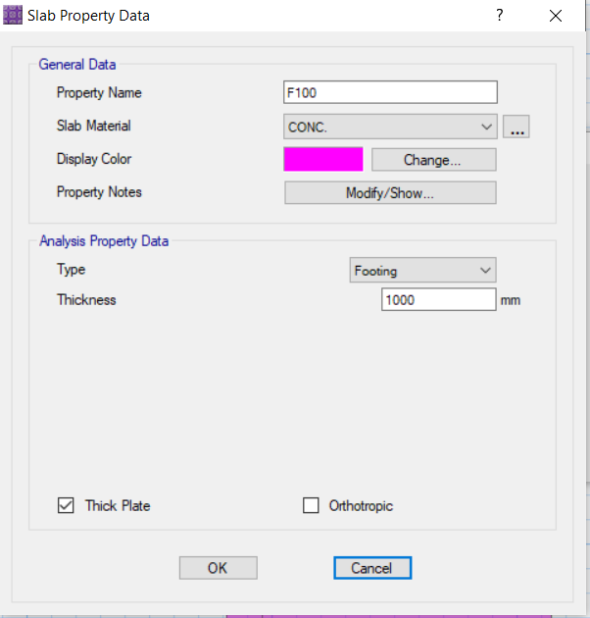
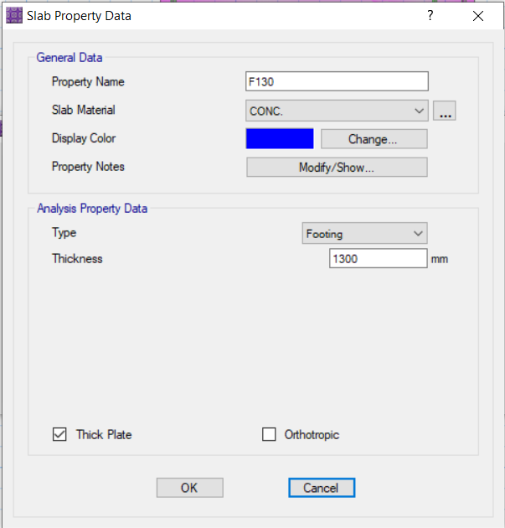
Design of Single Footings
Footings depths:
The load obtained on the bases varied between high and low, so the thickness of the bases varied, to enable each base to carry the next load on it, it was given a suitable thickness for the load.

Slide 9
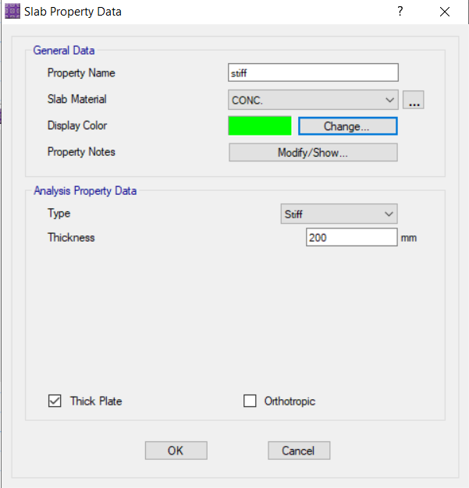
Design of Single Footings
Stiff
The ability of a building or structural element to resist deformation or movement under applied loads. Stiffness is an important characteristic in the design of buildings as it affects their overall stability, strength, and ability to withstand external forces such as wind, earthquakes, or live loads.

Slide 10
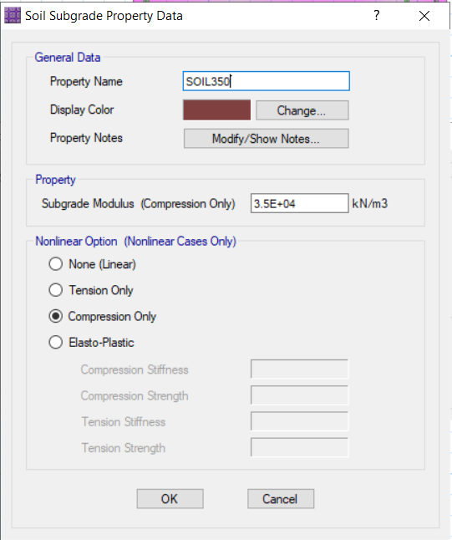
Design of Single Footings
Springs (soil subgrade)
Is often used to describe the behavior of soil subgrade or foundation materials. A spring refers to the soil's ability to deform and exhibit elastic behavior under applied loads, similar to a mechanical spring.
The soil beneath a building foundation or any load-bearing structure can behave like a spring due to its compressibility and ability to undergo elastic deformation. When a load is applied to the soil, it compresses, and the resulting deformation is known as settlement. The soil then exerts an upward reaction force, similar to a spring pushing back against the load.
Subgrade modulus = 100* Bearing capacity = 100*350 = 35000 kN/m²

Slide 11
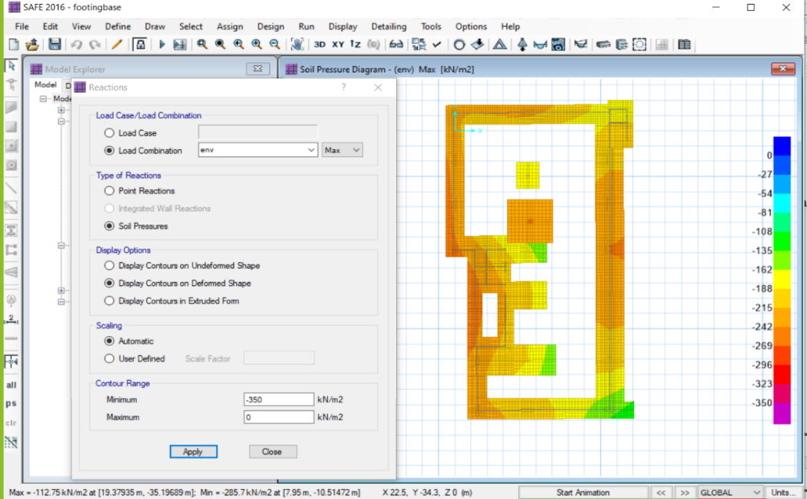
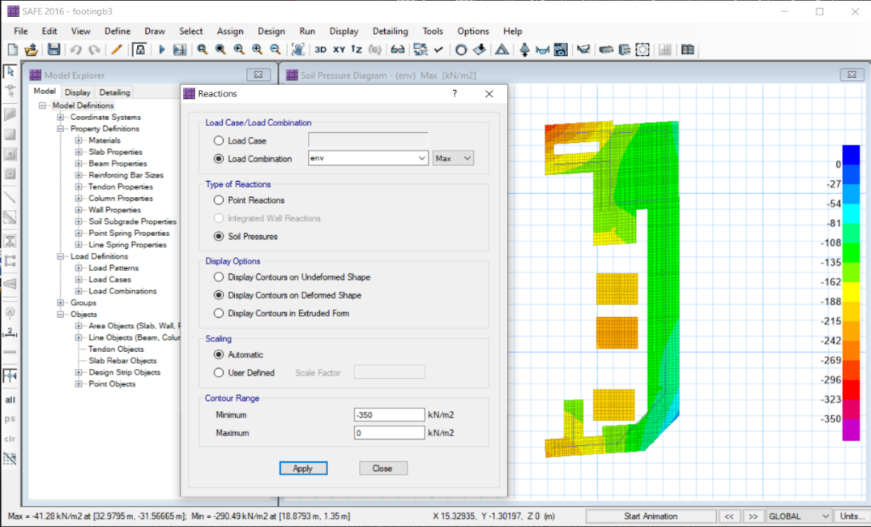
Design of Single Footings
Model checks:
1-Area check
The purpose of this section is check whether the area of the footings is capable of transferring loads to the soil based on the bearing capacity of the soil.
The bearing of capacity values is 350 kN /m2 (upward)
So the allowable range of the pressure on the soil is( -350 to 0)
Maximum pressure= -290kN/m²
Minimum pressure= -41N/m^{2 .}
(-290 & -41 ) inside the range , so This indicates that it does not happen any failure or uplift in footings.

Slide 12
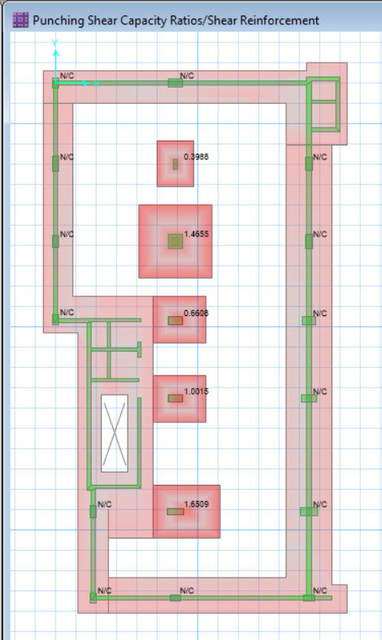
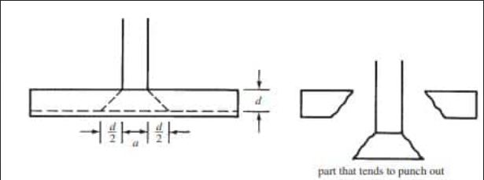
Design of Single Footings
Model checks:
2- Check punching shear
    In SAFE software, the punching shear results are typically displayed as a ratio of the maximum calculated shear force to the punching shear capacity.
Utilization ratio =$\frac{\text{Maximum} \text{calculated} \text{shear} \text{force}}{ \text{Punching} \text{shear} \text{capacity}}$
Utilization ratio must be less than 1 to avoid punching shear

Slide 13
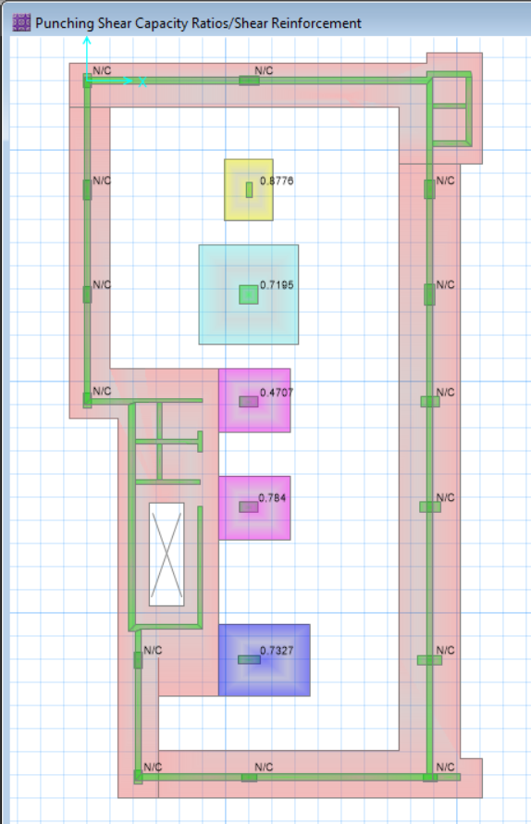
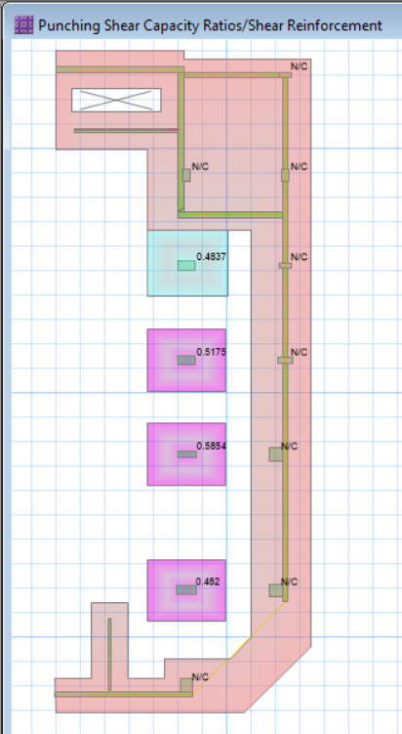
Design of Single Footings
Model checks:
2- Check punching shear
As shown in the figure all values less than one

Slide 14
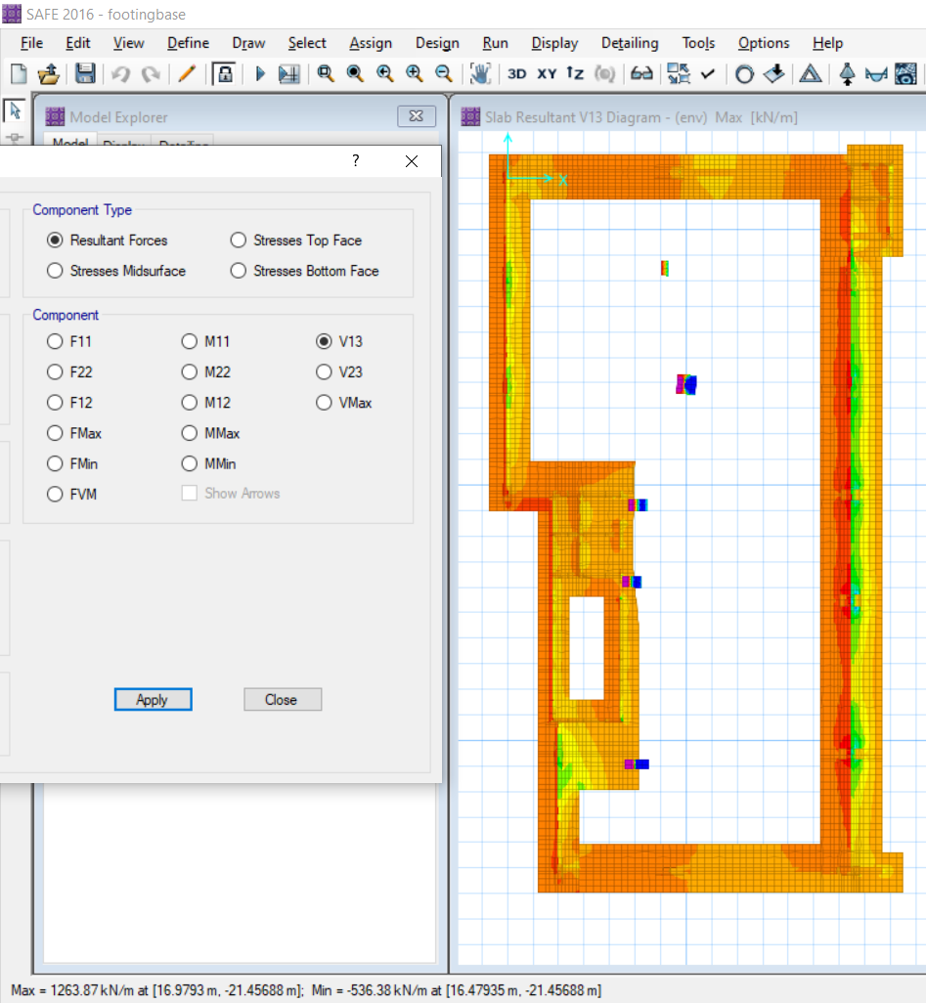
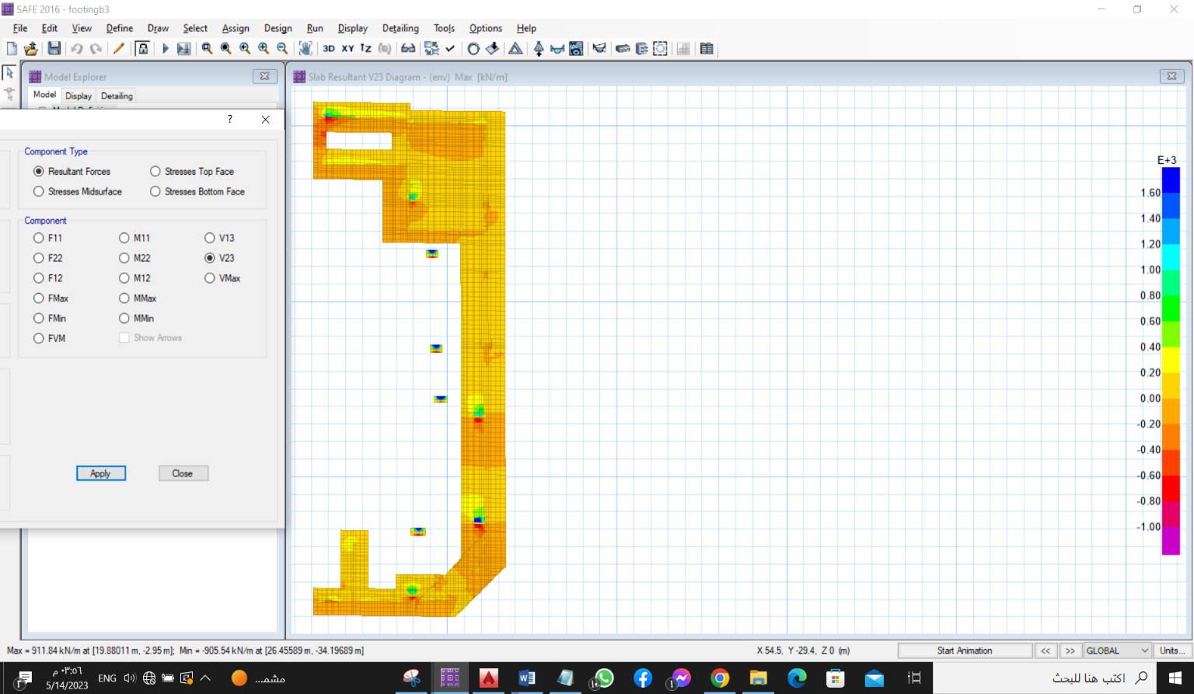


Design of Single Footings
Model checks:
3- Check Wide Beam Shear

Slide 15
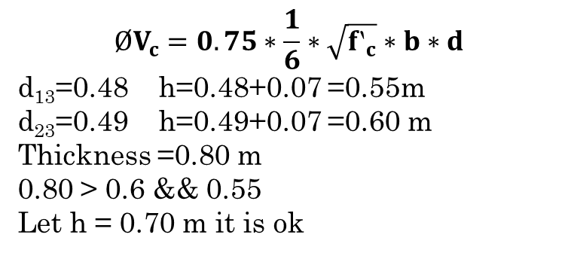
Design of Single Footings
Model checks:
3- Check Wide Beam Shear
$$ØV_{c}=0.75∗\frac{1}{6}∗\sqrt{{f‵}_{c}}∗b∗d$$
d₁₃=0.48 h=0.48+0.07 =0.55m
d₂₃=0.49 h=0.49+0.07 =0.60 m
Thickness =0.80 m
0.80 > 0.6 && 0.55
Let h = 0.70 m it is ok

Slide 16
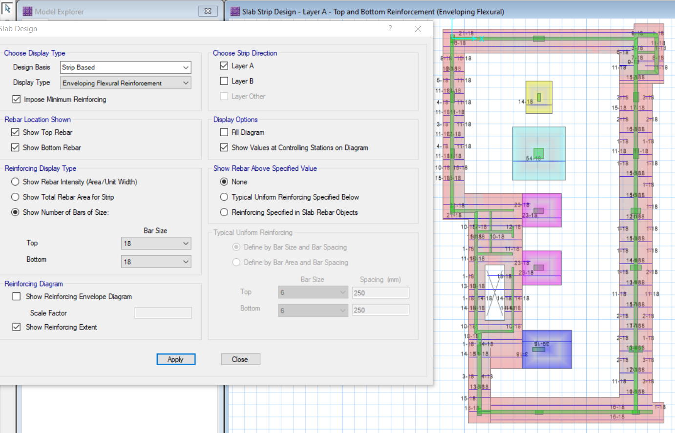
Design of Single Footings
Steel Reinforcement for the single footing
x-reinforcement steel (base)

Slide 17
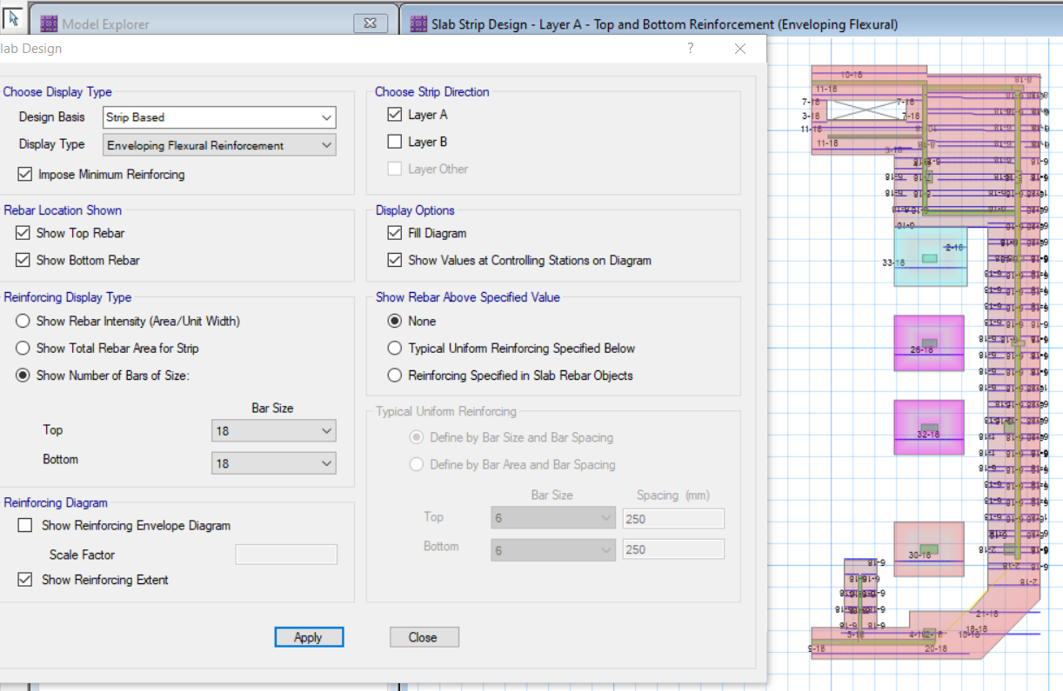
Design of Single Footings
Steel Reinforcement for the single footing
x-reinforcement steel (base)

Slide 18
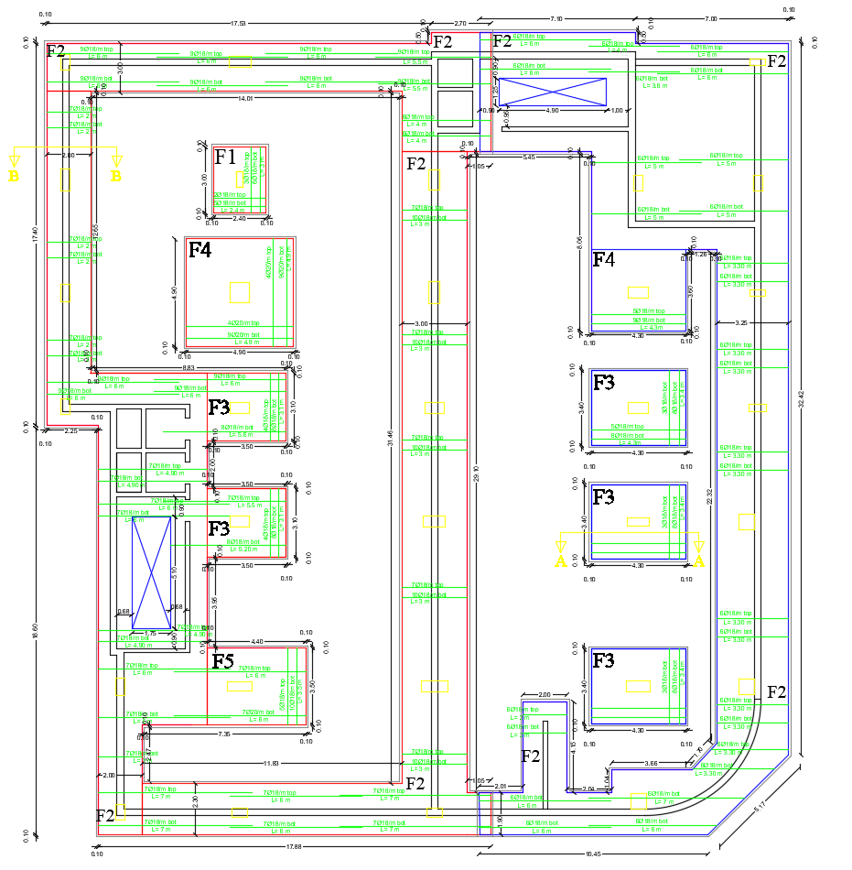
Design of Single Footings
Steel Reinforcement for the single footing
AutoCAD x-reinforcement steel plan

Slide 19
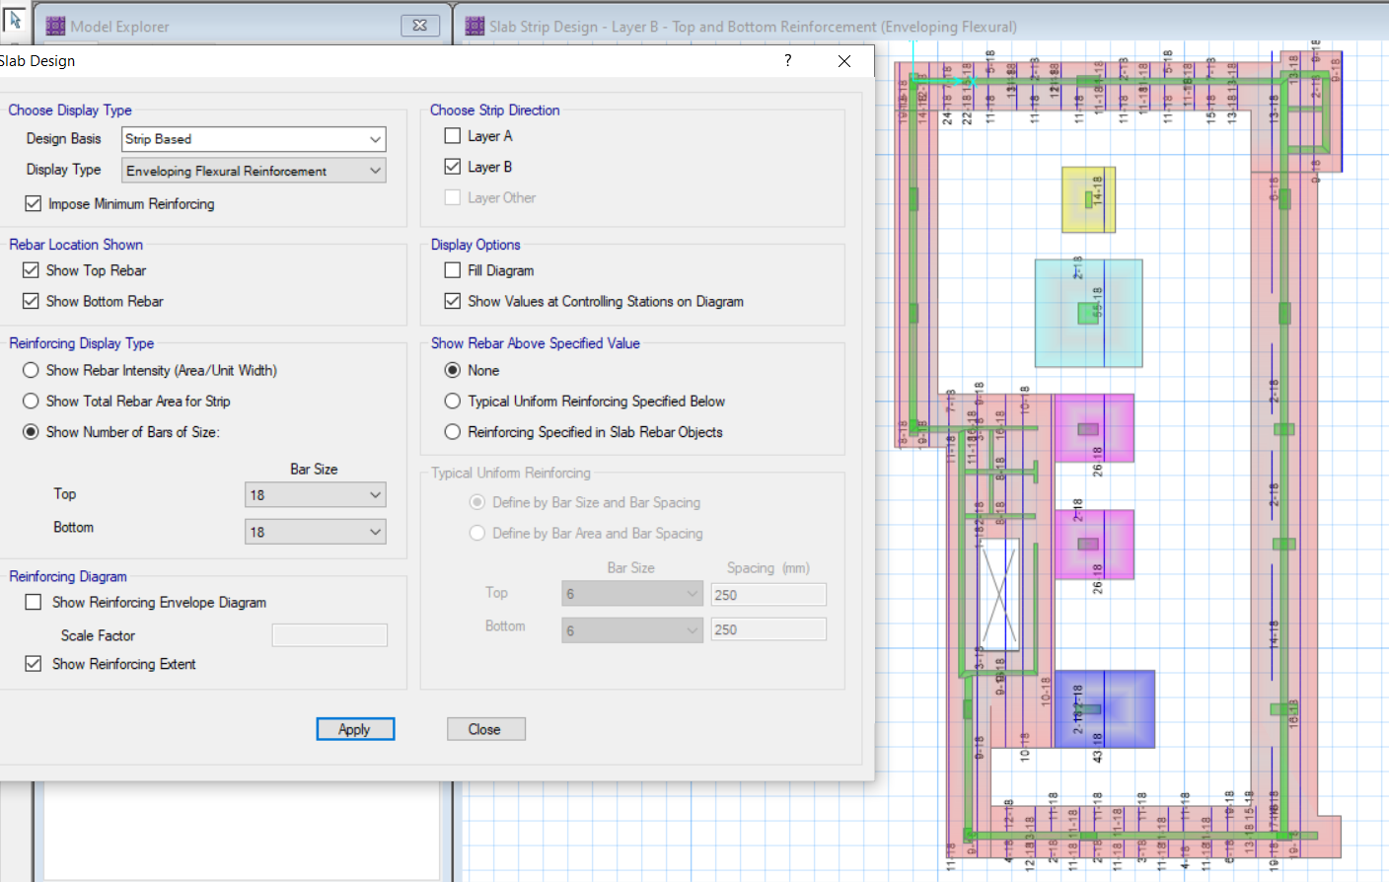
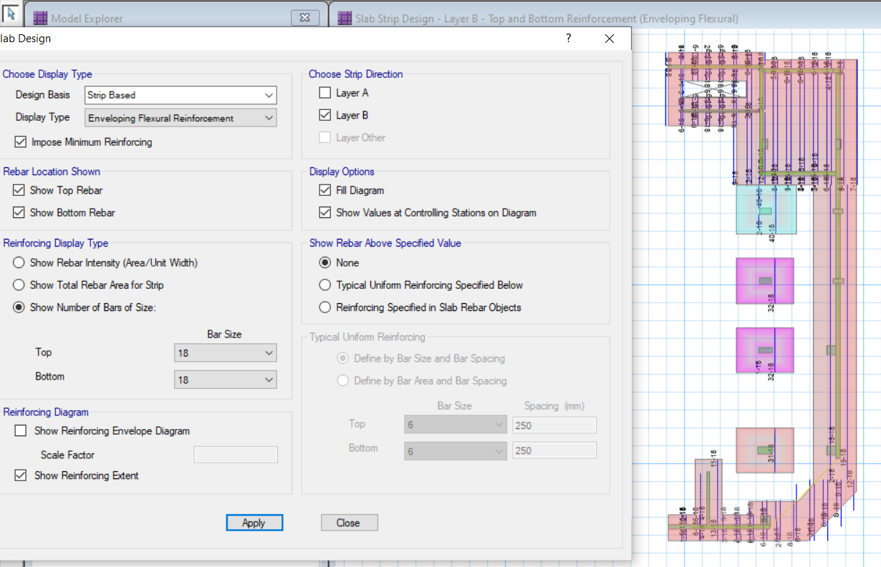
Design of Single Footings
Steel Reinforcement for the single footing
y-reinforcement steel

Slide 20
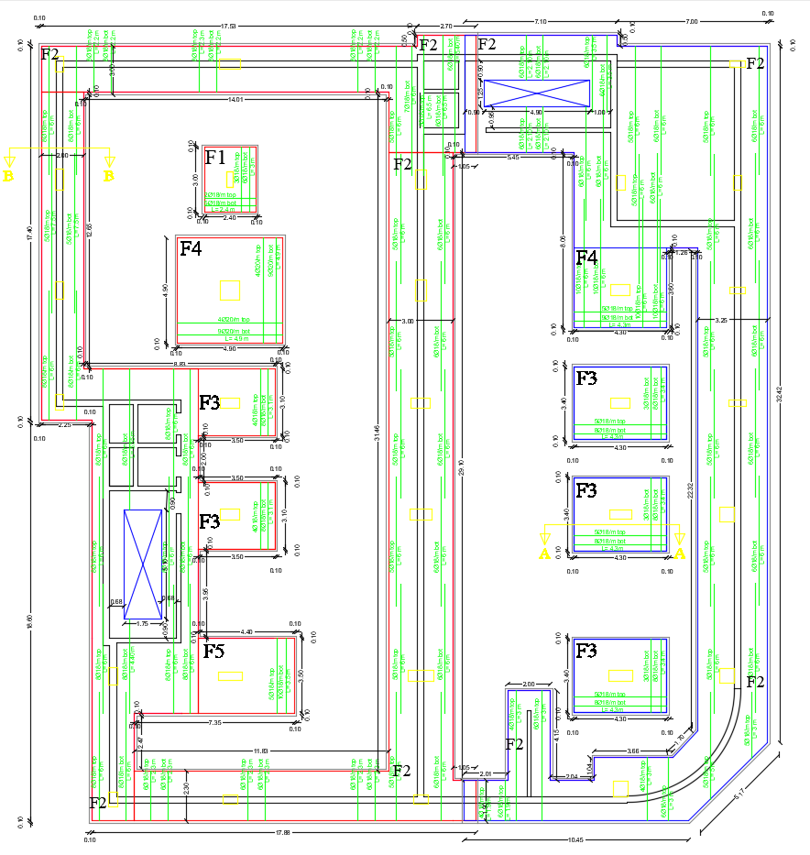
Design of Single Footings
Steel Reinforcement for the single footing
AutoCAD y-reinforcement steel plan

Slide 21
Design of Mat Foundation
The building for which Mat was designed consists of 7 floors on two levels.
The bearing capacity of the soil on which it was designed is 150KN/m2
Design on the program Etabe 18
concrete strength 28Mpa
Modulus of elasticity, E = 4700*√𝑓′𝑐 = 24870.06 Mpa Weight per unit volume
𝛾 = 24.5 kN/m2

Slide 22
loads and dimensions on Mats foundation
LL=3KN/m^2 Because it's a car park
For Mat 1
Area=380m2
Depth 1200mm=1.2m
For Mat 2 We added LL=12KN/m^2
And Sd=4KN/m^2, Because it's an archive.
For Mat2 Area=694m2
Depth =1200mm=1.2m

Slide 23
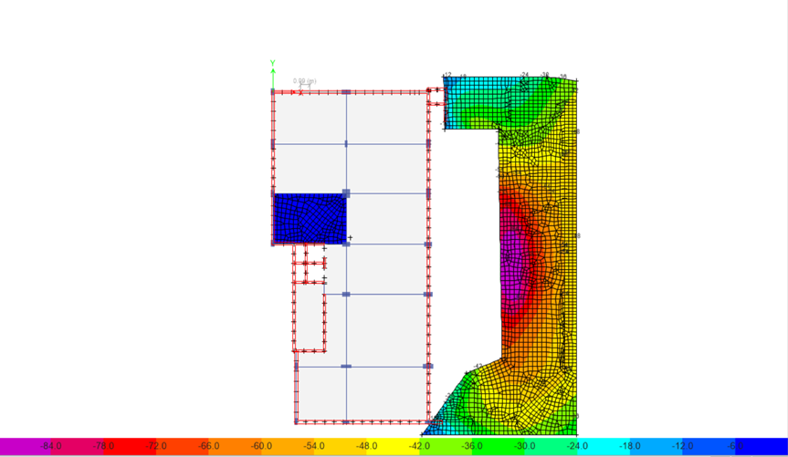
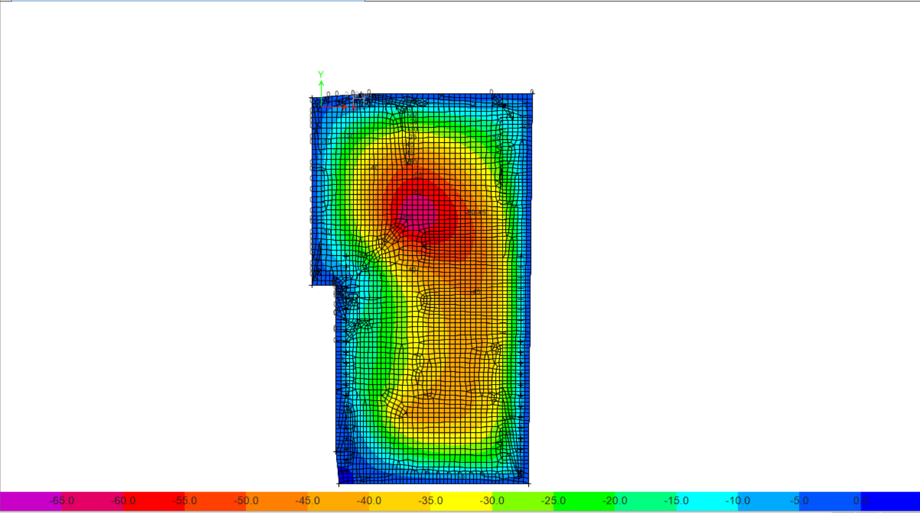
Checks on Mat Foundation
Bearing Capacity Check (Soil pressure)
The allowable range of the pressure on the soil is( -150 to 0)
For Mat 1: The maximum value of pressure is -88 kN/m2
The Minimum value of pressure is -6 kN/m2
For Mat 2:The maximum value of pressure is -65 kN/m2
The Minimum value of pressure is 0 kN/m2

Slide 24
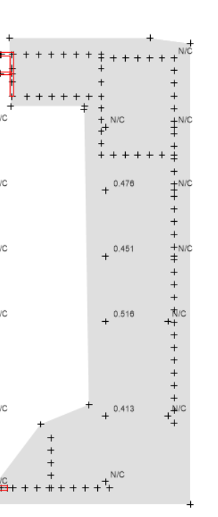
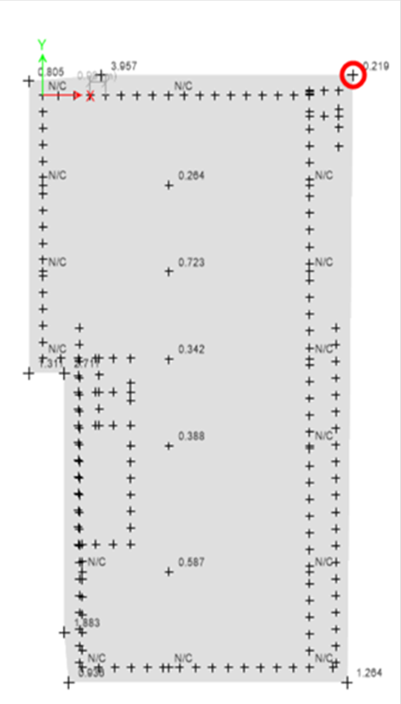
punching shear check
All values must be less than one

Slide 25
check of the shear
Where the shear strength of concrete ΦVc = 1/6* 0.75 * √𝑓𝑐 * b * d
where d = h – 40 mm ΦVc for mat with thickness of 1200 cm
= 1/6* 0.75 * √28 * 1000 * (1200-40) /1000=767.26 kN / m

Slide 26
Steel Reinforcement of the Mat Foundation
Asmin per in code ACI-2014 is Asmin = 0.0018 b h
Asmin = 0.0018 * 1000 * 1200 = 2160 mm2
For Mat 1:
reinforcement in the top rebar for x direction:
Φ25/100mm
reinforcement in the bottom rebar for x direction
Φ25/100mm
reinforcement in the top rebar for y direction
Φ26/100mm
reinforcement in the bottom rebar for y direction
Φ26/100mm
For Mat 2:
reinforcement in the top rebar for x direction:
Φ25/100mm
reinforcement in the bottom rebar for x direction
Φ32/100mm
reinforcement in the top rebar for y direction
Φ26/100mm
reinforcement in the bottom rebar for y direction
Φ32/100mm

Slide 27
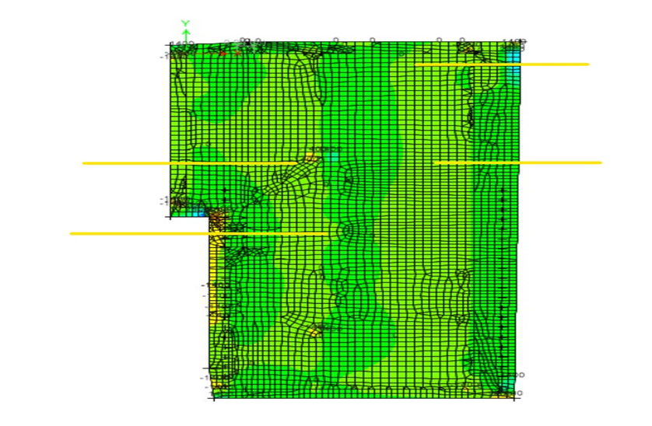
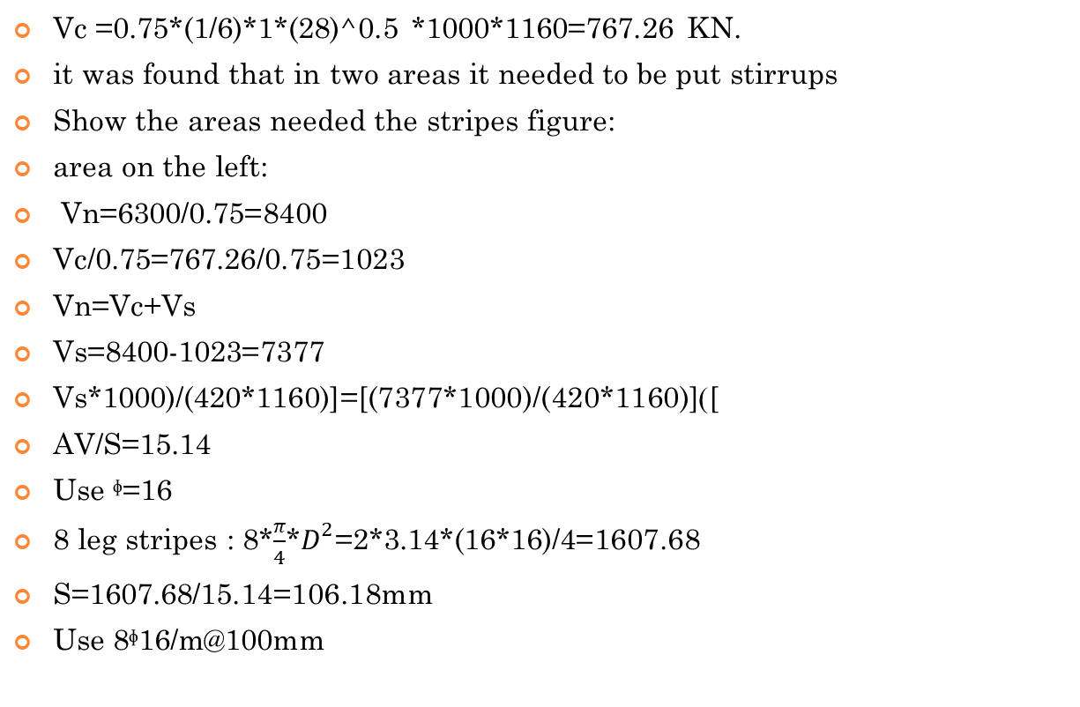
shear reinforcement
Vc =0.75*(1/6)*1*(28)^0.5 *1000*1160=767.26 KN.
it was found that in two areas it needed to be put stirrups
Show the areas needed the stripes figure:
area on the left:
Vn=6300/0.75=8400
Vc/0.75=767.26/0.75=1023
Vn=Vc+Vs
Vs=8400-1023=7377
Vs*1000)/(420*1160)]=[(7377*1000)/(420*1160)])[
AV/S=15.14
Use ᶲ=16
8 leg stripes : 8*$\frac{π}{4}$*$D^{2}$=2*3.14*(16*16)/4=1607.68
S=1607.68/15.14=106.18mm
Use 8ᶲ16/m@100mm

Slide 28

Vu=4000
Vn=4000/0.75=5333
Vs=Vn-Vc=5333-1023=4310
{(Vs*1000)/(420*1160)]=[(4310*1000)/(420*1160)]=8.8
Use ᶲ=16
8 leg strips : :8*$\frac{π}{4}$*$D^{2}$=2*3.14*(32*32)/4=1607.68
S=1607.68/8.8=182.6
Use 8ᶲ16/m@180mm
Check Vs =2/3*(fc)^0.5*b*d=2/3*(28) ^0.5*1000*1160=4092
For two cases Vs>4092 …Ok.

