Slide 1



Radio Network
Planning
Prepared by :
Malak Anabosi SalamAbdo
Supervised by :
Dr. Falah Mohamad

Slide 2
Nominal sites distribution

Slide 3
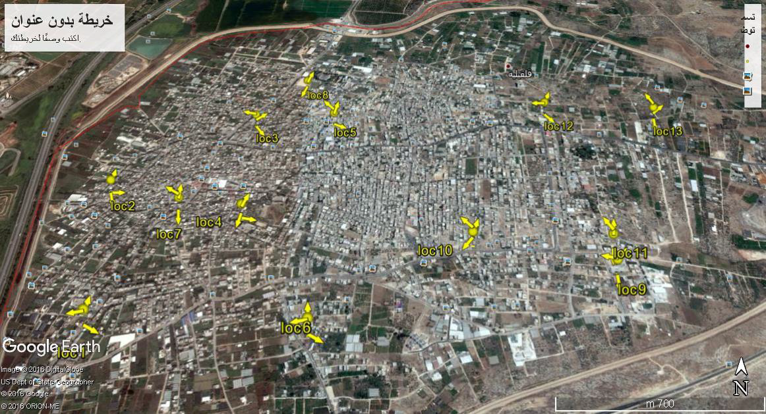

Slide 4
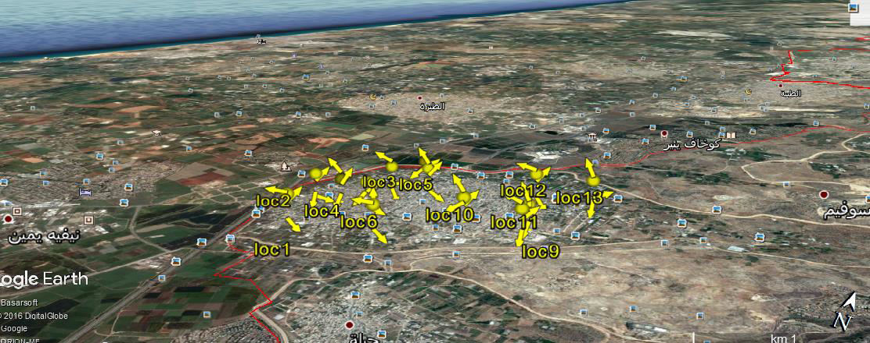

Slide 5
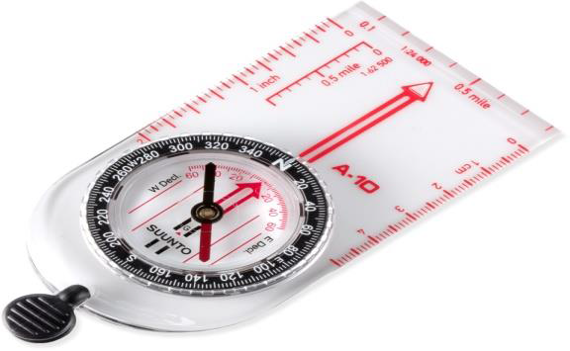
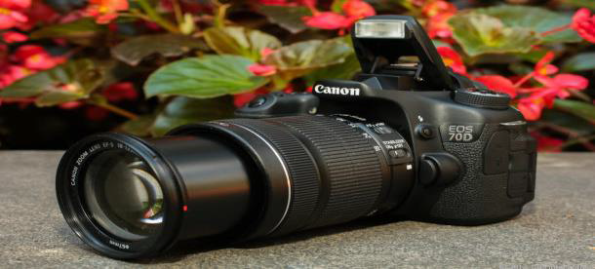
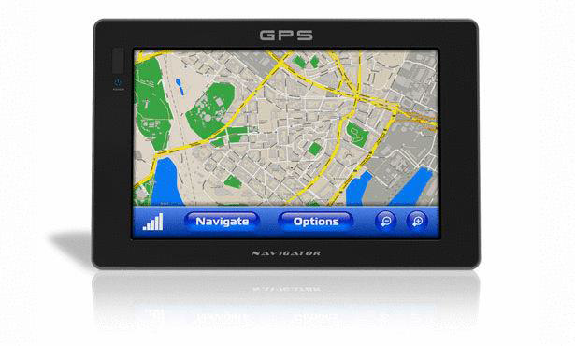
Required equipments for sites survey:

Slide 6
Required procedures:
1. recording longitude and latitude.
2. panoramic view catching (One picture every 30 deg).
3. selecting the monopole and site room location.
4. deciding the actual height of the antennas.
5. having one pictures for each sector's coverage area.
6. discussing the final agreed on data base.
7. write the proposal about the visit containing required changes. to be up dated to data base and on the planning tool.

Slide 7
Practical survey tuning activity

Slide 8
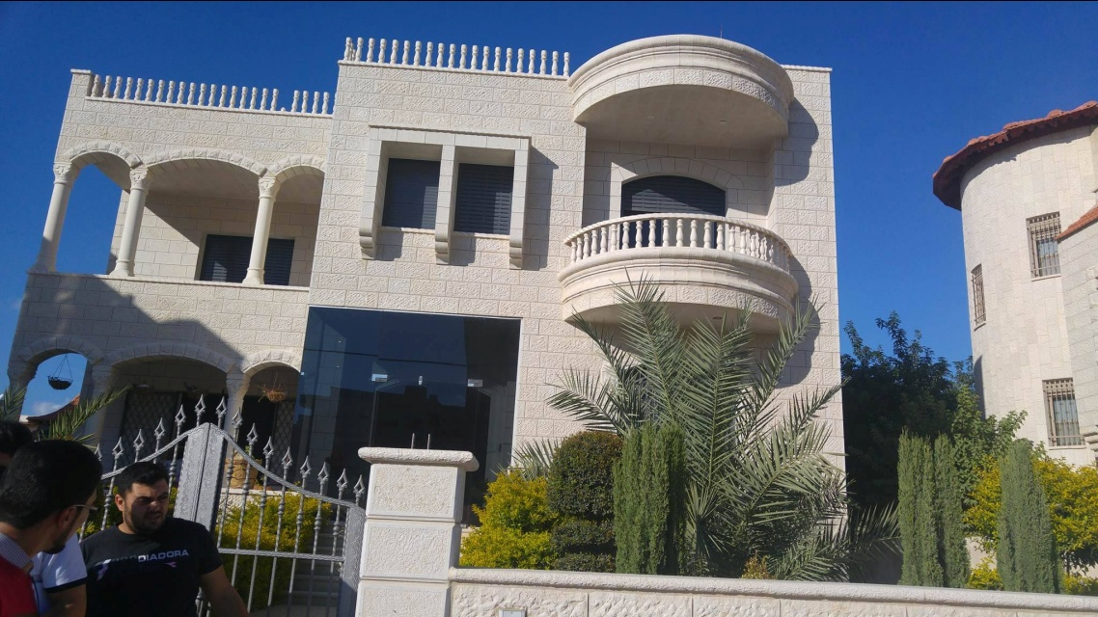
center of location11

Slide 9
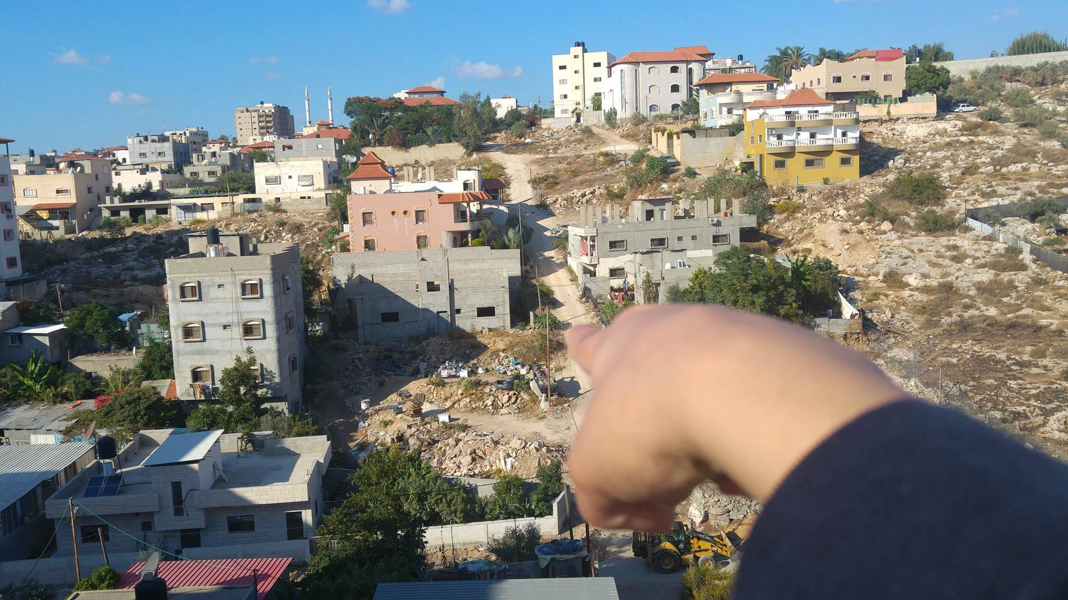
loc11 A

Slide 10
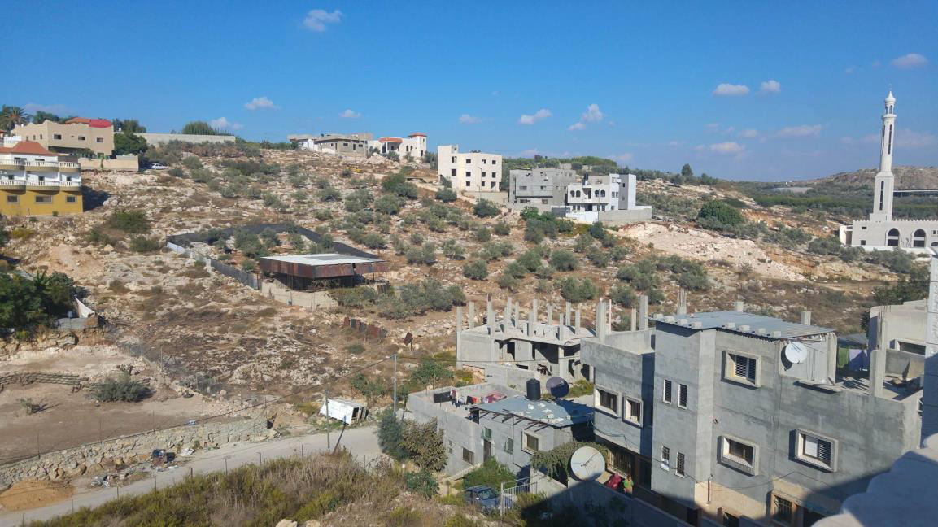

Slide 11
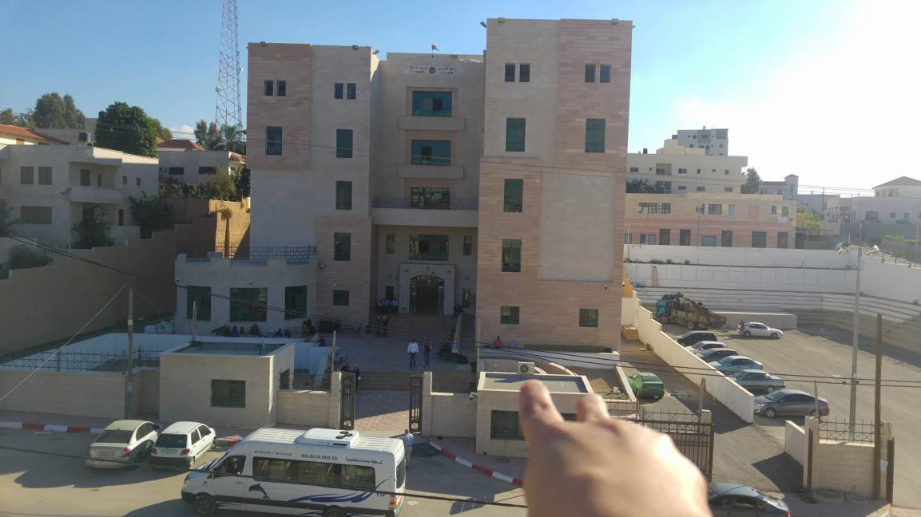
loc11 B

Slide 12
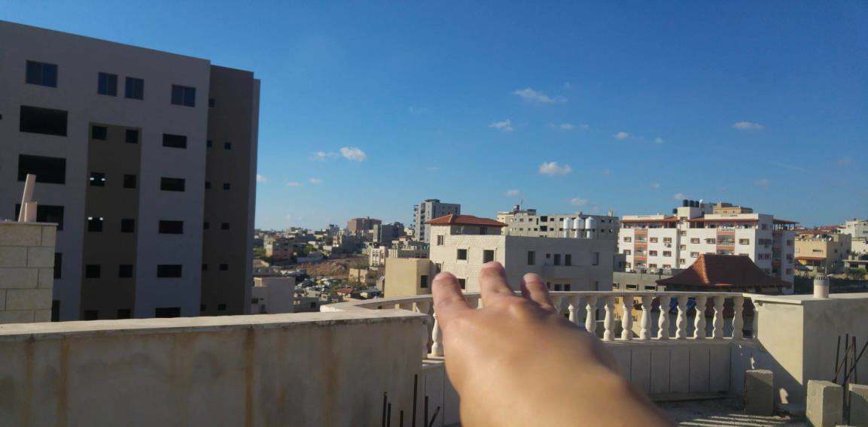
loc11 C

Slide 13
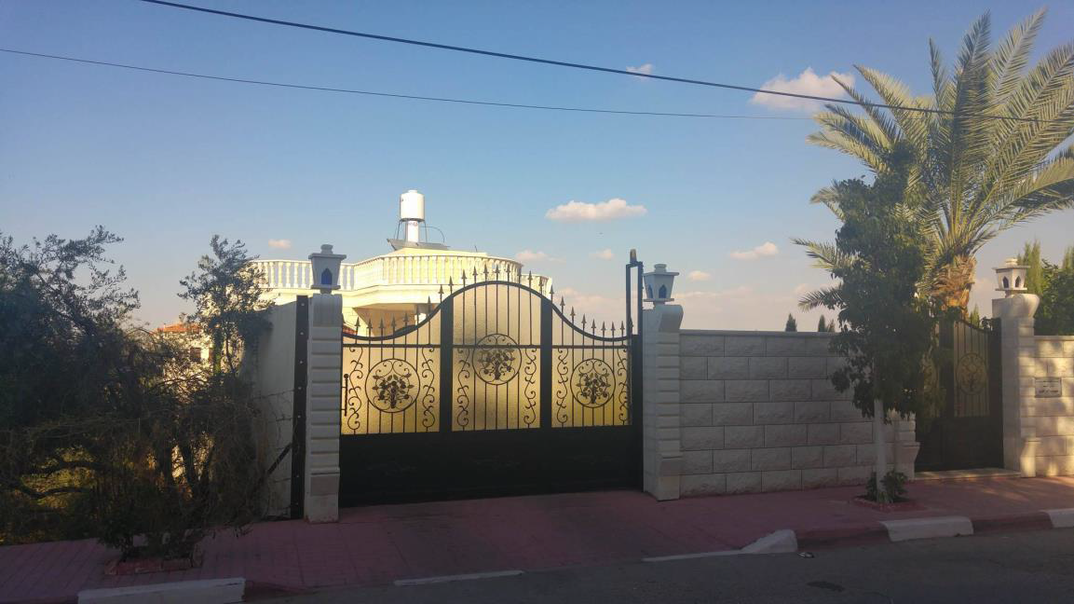
center of location 12

Slide 14
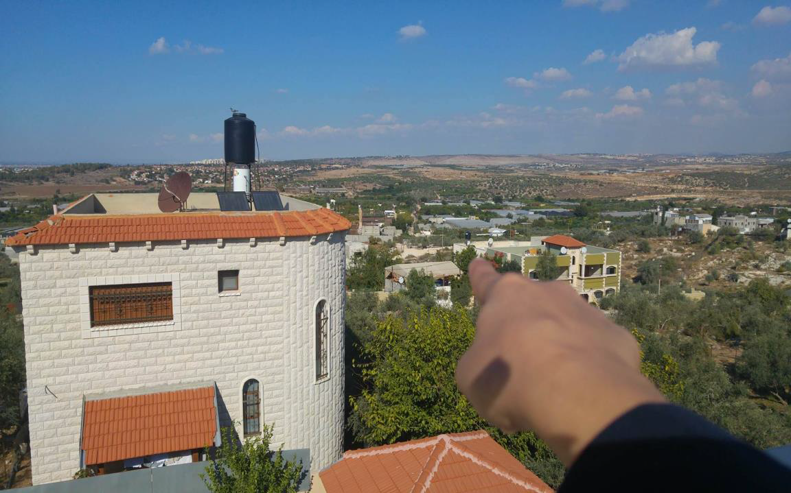
loc12 A

Slide 15
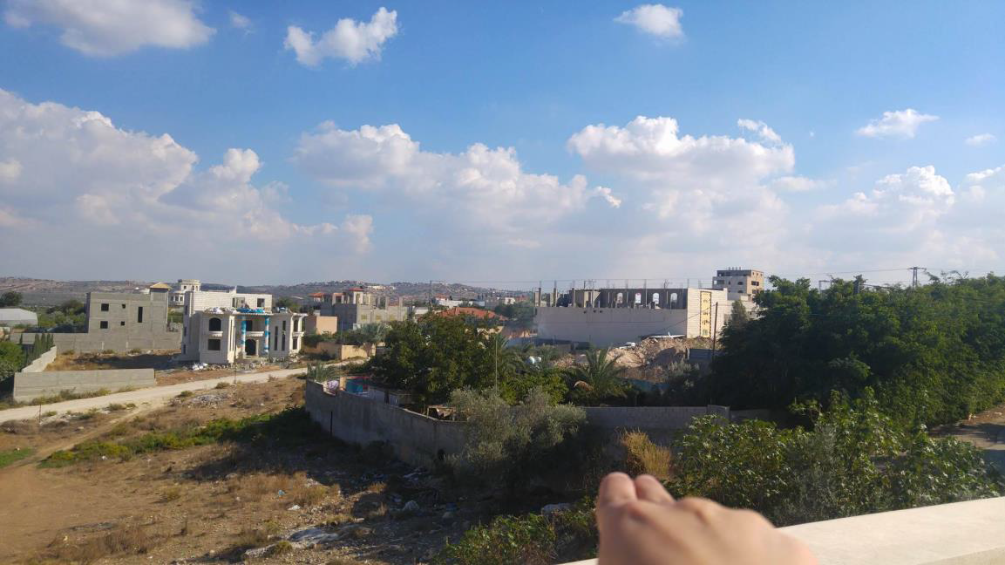
loc12 B

Slide 16
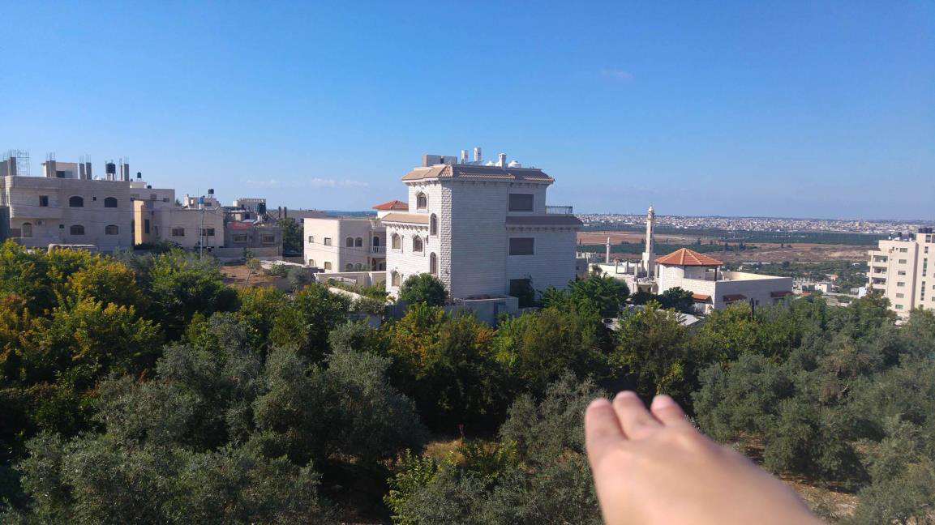
loc12 C

Slide 17
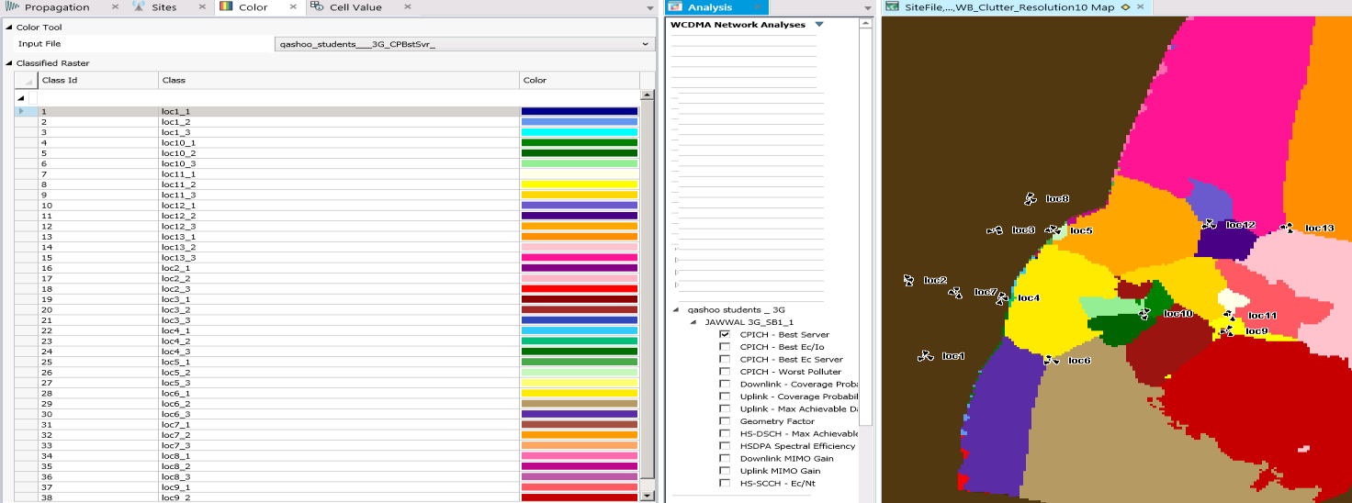
Software simulation covering area of site by software

Slide 18
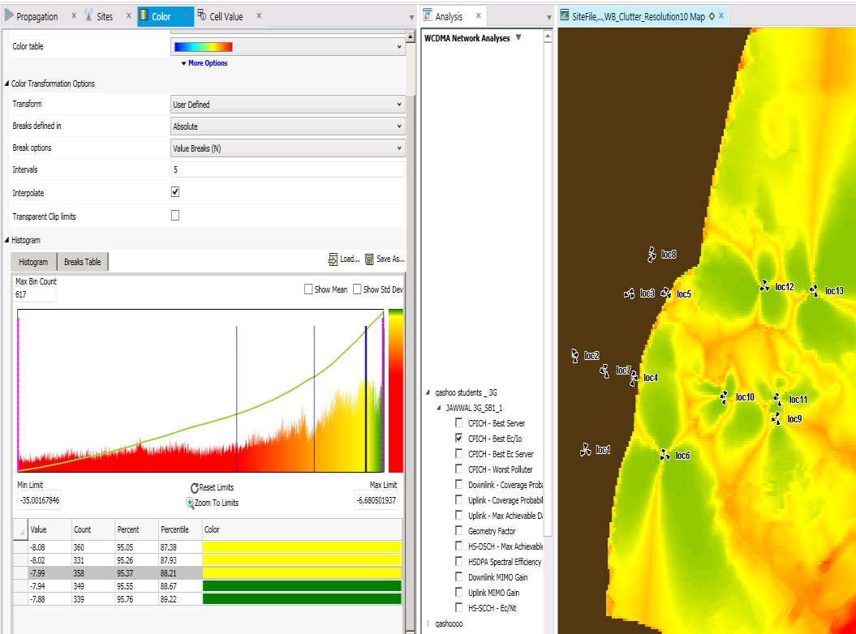
ratio of the total received power density

Slide 19
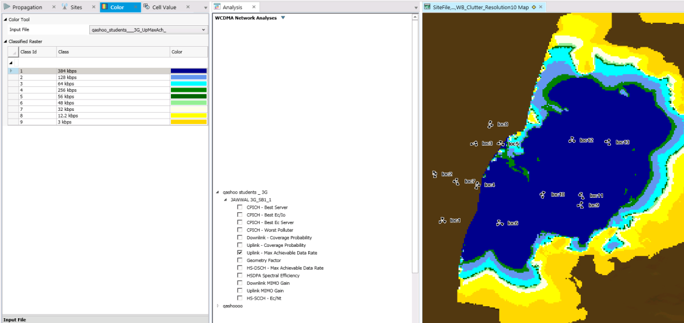
max available data rate

Slide 20
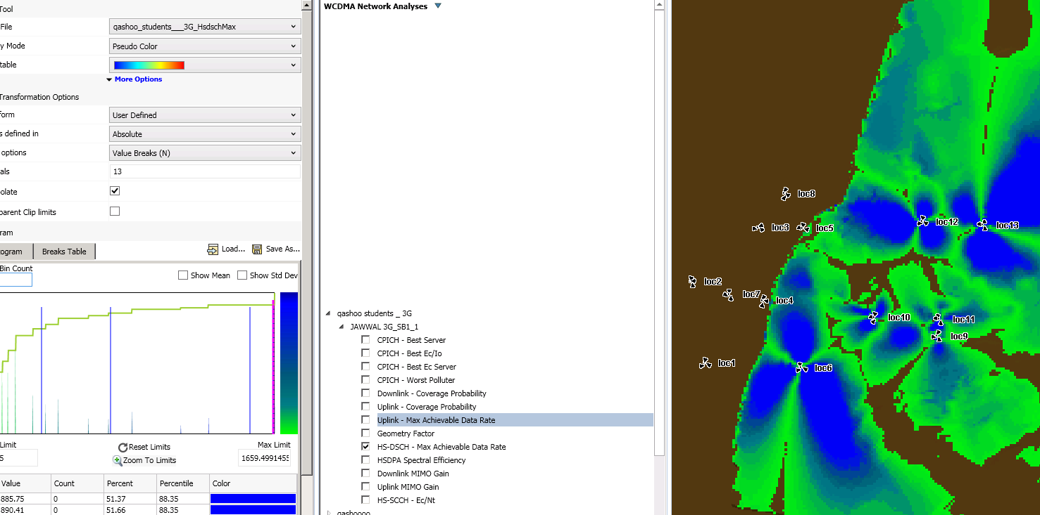
acheivable data rate

Slide 21
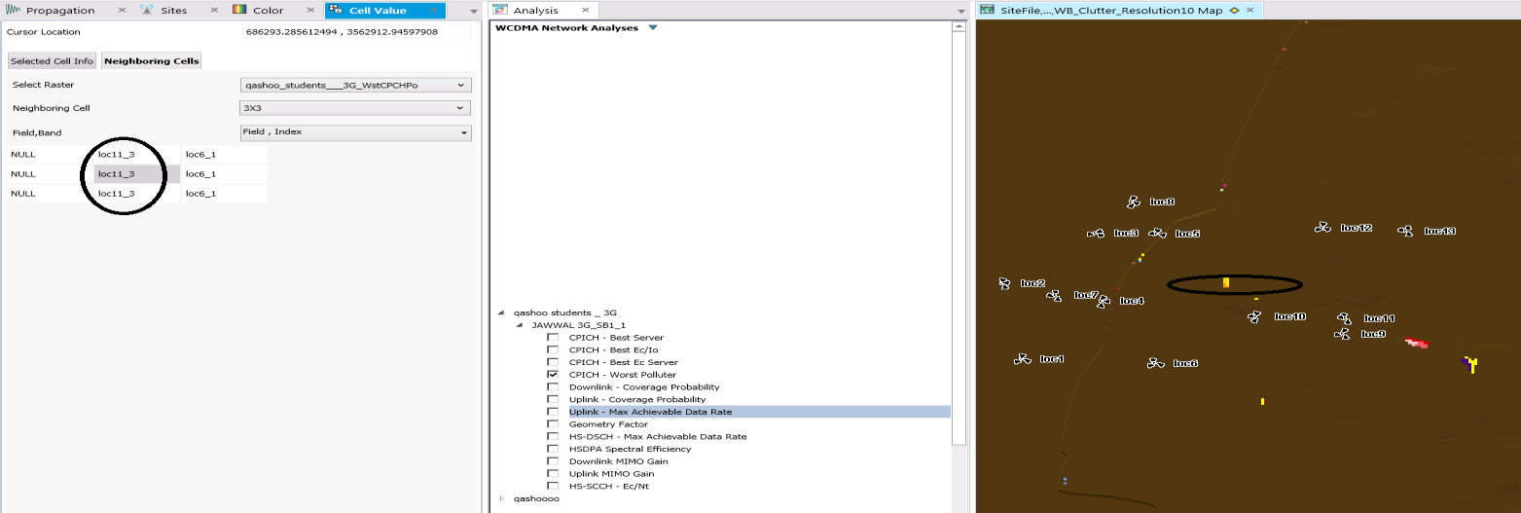
pollution (loc11C and loc6 A)

Slide 22
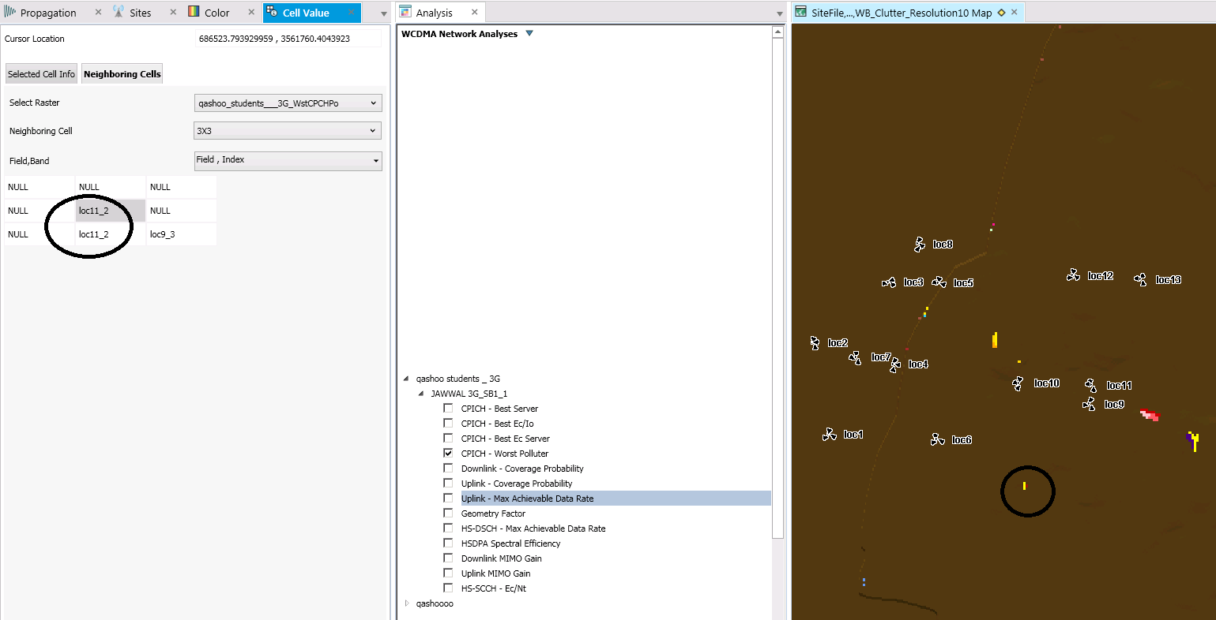
pollution ( loc11 B and loc9 C)

Slide 23
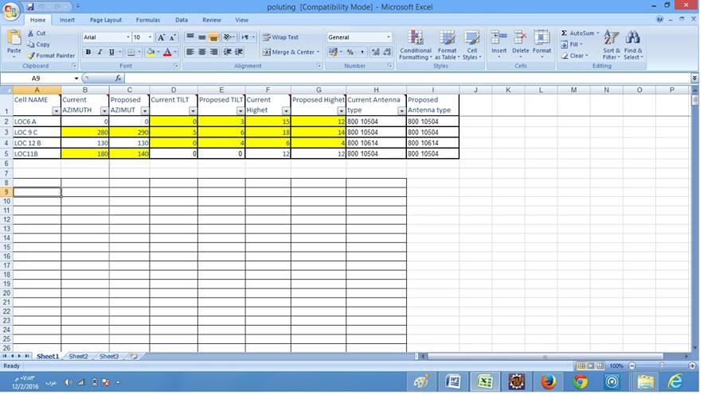
modified data base to solve poluting

Slide 24
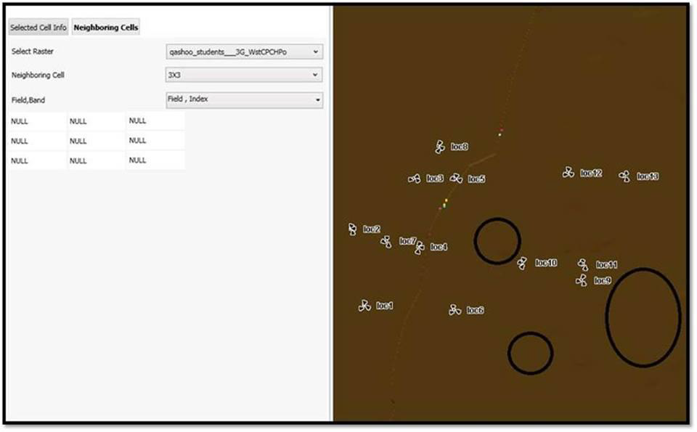
the result after solving polluting

Slide 25


