Slide 1
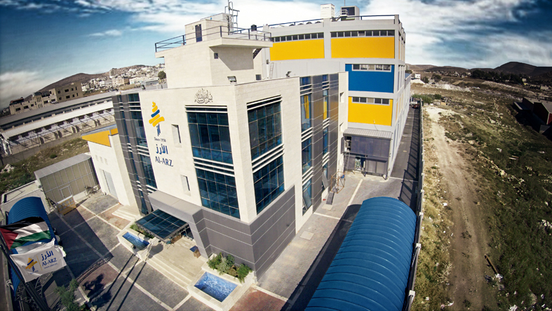
Structural Analysis and Design
of AL-ARZ Building
Prepared By : Somoud Yaseen
Israa Nassasrah
Under Supervision of: Dr. Ryiad Abdel-karim

Slide 2
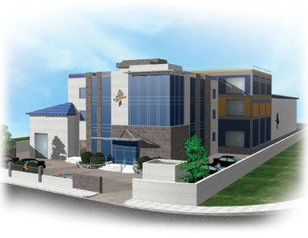
Outline
1 Project description.
2 The Codes Used in Project .
Materials
3
4 Gravity Loads
Preliminary Design
5
Etabs Model
6
7.
Etabs model checks
8
Design Of Slab, Beam And Column
9.
Design of footing, Basement wall and stair

Slide 3
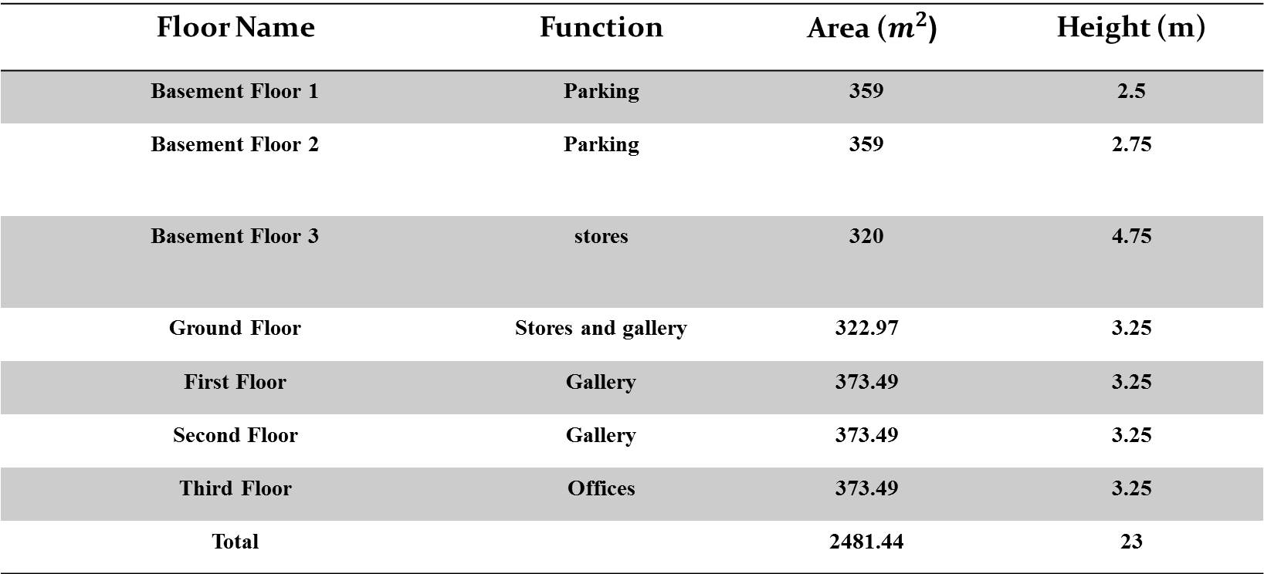
Project Description
Height (m) | ( Area ($m^{2}$ | Function | Floor Name
2.5 | 359 | Parking | Basement Floor 1
2.75 | 359 | Parking | Basement Floor 2
4.75 | 320 | stores | Basement Floor 3
3.25 | 322.97 | Stores and gallery | Ground Floor
3.25 | 373.49 | Gallery | First Floor
3.25 | 373.49 | Gallery | Second Floor
3.25 | 373.49 | Offices | Third Floor
23 | 2481.44 |  | Total

Slide 4
Codes:
ACI 318-14 (American Concrete Institute )
UBC -97 (Uniform Building Code )
ASCE-7(2010)

Slide 5
SOFTWARE
SAP2000
ETABS 16

Slide 6
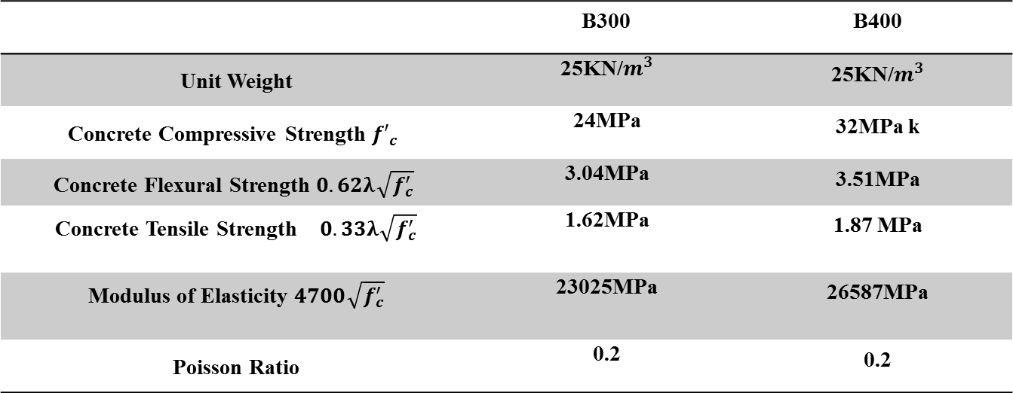
Materials:
1. Concrete
B400 | B300
25KN/$m^{3}$ | 25KN/$m^{3}$ | Unit Weight
32MPa k | 24MPa | Concrete Compressive Strength ${f′}_{c}$
3.51MPa | 3.04MPa | Concrete Flexural Strength $0.62λ\sqrt{f_{c}^{′}}$
1.87 MPa | 1.62MPa | Concrete Tensile Strength $0.33λ\sqrt{f_{c}^{′}}$
26587MPa | 23025MPa | Modulus of Elasticity $4700\sqrt{f_{c}^{′}}$
0.2 | 0.2 | Poisson Ratio

Slide 7
Materials:
2. Steel `
A955 G60 | Steel
420MPa | Yielding strength , fy
620MPa | Tensile strength , fu
200 GPa | Modulus of Elasticity , E

Slide 8
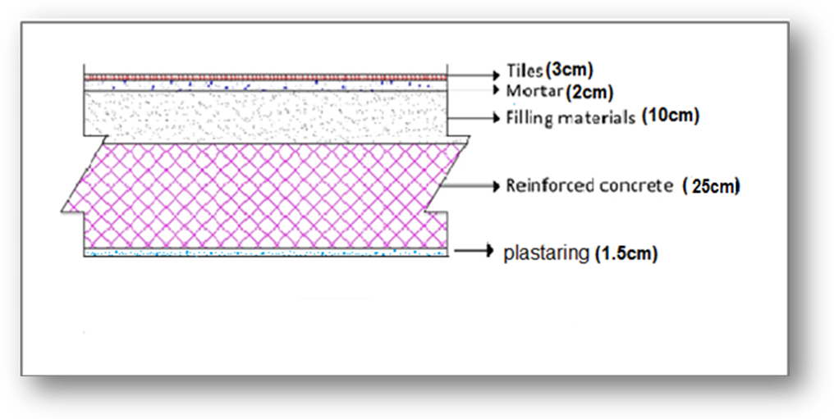
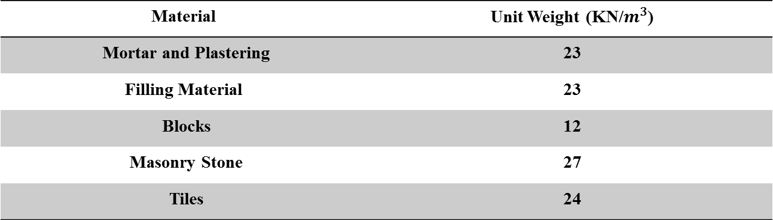
Materials :
(Unit Weight (KN/$m^{3}$ | Material
23 | Mortar and Plastering
23 | Filling Material
12 | Blocks
27 | Masonry Stone
24 | Tiles

Slide 9

Gravity Loads:
Dead Load =Own Weight of structure
Super Imposed Dead Load = 5 KN/$m^{2}$
Live Load for Garages =4.79 KN/$m^{2}$
Live Load for Offices =2.5 KN/$m^{2}$

Slide 10
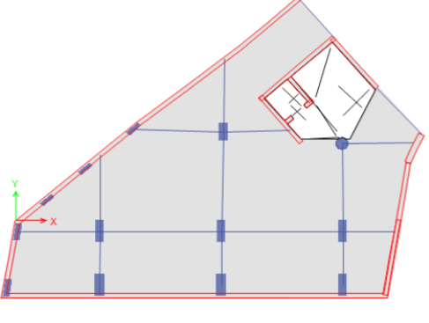
Preliminary Design :
Slabs Structural Systems
Slabs Structural Systems:
Two –Way solid slab
.

Slide 11

Preliminary Design
Preliminary Slabs Thickness :
$$h=\frac{l_{n}\left(0.8+\frac{f_{y}}{1400}\right)}{36+9β}≥90 mm$$
h =25cm

Slide 12
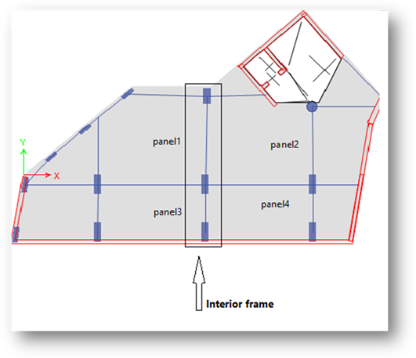
Preliminary Design :
Design Of Interior Frame:

Slide 13
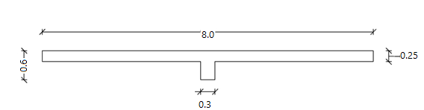

Preliminary Design :
$$Frame width=\frac{8}{2}+\frac{8}{2}=8 m$$
The frame section dimensions :

Slide 14

Preliminary Design :
frame loads:
$Frame own weight=52.625\frac{kN}{m}$
$Super imposed dead load=40kN/m$
$Dead load=52.625+40=92.625 kN/m$
Live load for floors =2.5×8=20 KN/m

Slide 15
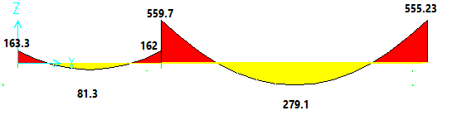
Preliminary Design :
Bending Moment Diagram for the Frame :

Slide 16
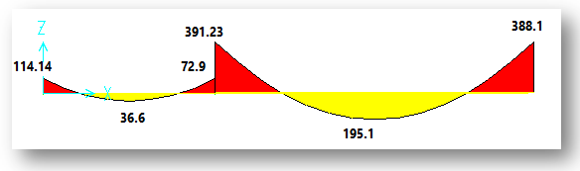
Preliminary Design :
Bending moment diagram for the column strip.

Slide 17
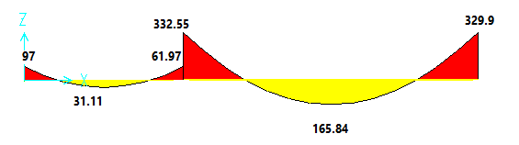
Preliminary Design :
Beam moments:
The beam in each span should resist 85% of column strip moments.

Slide 18
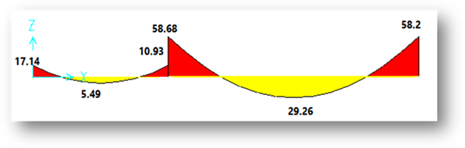
Preliminary Design :
The slab in the column strip takes the difference between the column strip moments and the beam moments

Slide 19
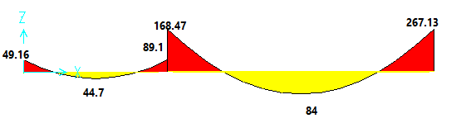
Preliminary Design :
Moments for slab in middle strip:
The slab in the middle strip should resist the difference between the frame moment and the column strip moments.

Slide 20
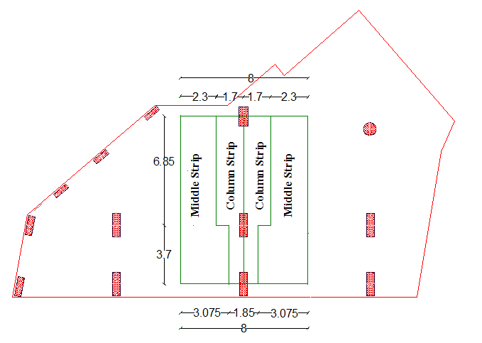
Preliminary Design :
Dimensions of column strip, middle strips, and beams:

Slide 21
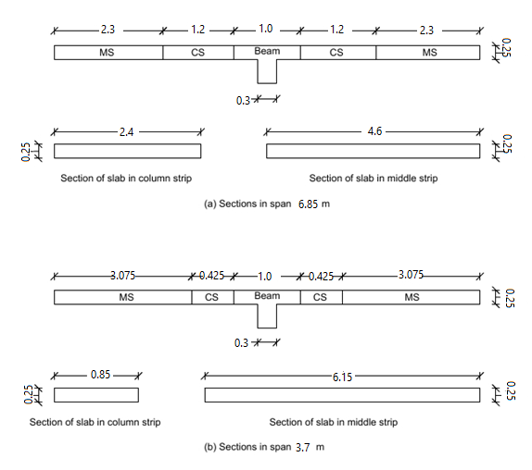
Preliminary Design :
Sections of slabs in column and middle strips in each span

Slide 22

Preliminary Design :
Check Wide Beam Shear in slab:
$V_{u}=17.5\left(\frac{6.85}{2}−\frac{0.30}{2}−0.21\right)=53.63 kN/m$
$∅V_{c}=\frac{0.75×\frac{1}{6}×1×\sqrt{24}×1000×210}{1000}=128.6 kN/m$
$V_{u}=53.63 kN/m<∅V_{c}=128.6 kN/m$
Thickness is adequate.

Slide 23

Preliminary Design :
Design of slab in column strip for flexure:
Maximum positive moment, $M_{u}^{+}=29.26kN.m$
$ρ=0.000736$
$A_{s}=0.000736×2400×210=370.9{mm}^{2}$
$A_{s,min}=0.0018×2400×250=1080{mm}^{2}$
$A_{s}=370.9{mm}^{2}<A_{s,min}=1080{mm}^{2}$
Use $A_{s,min}=1080{mm}^{2}$

Slide 24

Preliminary Design :
Design of slab in column strip for flexure:
Maximum negative moment, $M_{u}^{−}=58.68kN.m$
$ρ=0.001487$
$A_{s}=0.001487×2400×210=749.5{mm}^{2}$
$A_{s,min}=1080{mm}^{2}$
$A_{s}=749.5{mm}^{2}<A_{s,min}=1080$
Use $A_{s,min}=1080{mm}^{2}$

Slide 25

Preliminary Design :
Design of slab in middle strip for flexure:
Maximum positive moment, $M_{u}^{+}=84kN.m$
$ρ=0.001106$
$A_{s}=0.001106×4600×210=1068.4{mm}^{2}$
$A_{s,min}=0.0018×4600×250=2070{mm}^{2}$
$A_{s}=1068.4{mm}^{2}<A_{s,min}=2070{mm}^{2}$
Use $A_{s,min}=2070{mm}^{2}$

Slide 26

Preliminary Design
Design of slab in middle strip for flexure:
Maximum negative moment, $M_{u}^{−}=267.13kN.m$
$ρ=0.003612$
$A_{s}=0.003612×4600×210=3489.2{mm}^{2}$
$A_{s,min}=2070{mm}^{2}$
${ A}_{s}=3489.2{mm}^{2}>A_{s,min}=2070{mm}^{2}→OK$
Use $A_{s}=3489.2{mm}^{2}$

Slide 27
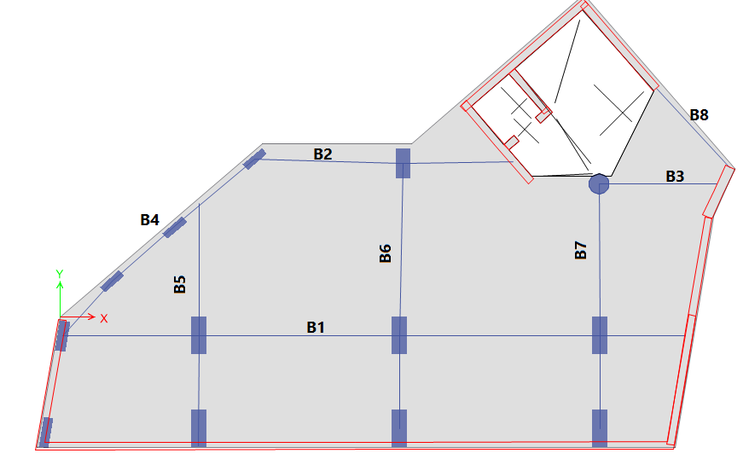
Preliminary Design :
Preliminary Design of Beam :
Structural member | Thickness(mm) | Width(mm)
Main beams for garages | 600 | 300
Main beams for floors | 600 | 300

Slide 28
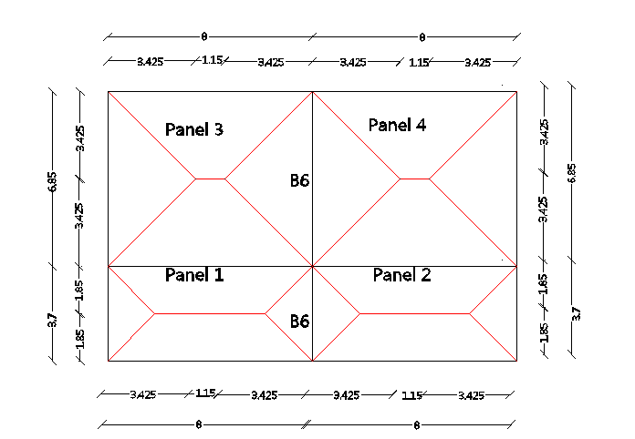
Preliminary Design
Design of beam B6 for shear and flexure:
Design for shear:
transmission of loads into beam B6.

Slide 29
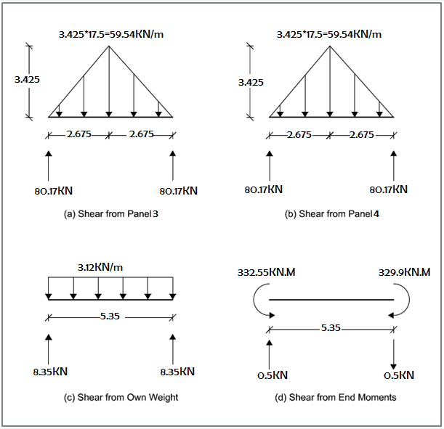

Preliminary Design
Design For Shear :
$V_{n}=\frac{169.19 }{0.75}=225.6 kN$
${ V}_{c}=\frac{\frac{1}{6}×1×\sqrt{24}×300×540}{1000}=132.27 kN$
$V_{n}=225.6 kN>V_{c}=132.27 kN$
Shear reinforcement is required.
$V_{s}=225.6−132.27=93.33 kN$
$Use 1∅12/250 mm$

Slide 30

Preliminary Design
Design For flexure:
maximum positive moment, $M_{u}^{+}=165.84 kN.m$
$ρ=0.001526$
$A_{s}=0.001526×1000×540=824.047$
maximum negative moment, $M_{u}^{−}=332.55 kN.m$
$ρ=0.01137$
$A_{s}=0.01137×300×540=1841.94{mm}^{2}$

Slide 31
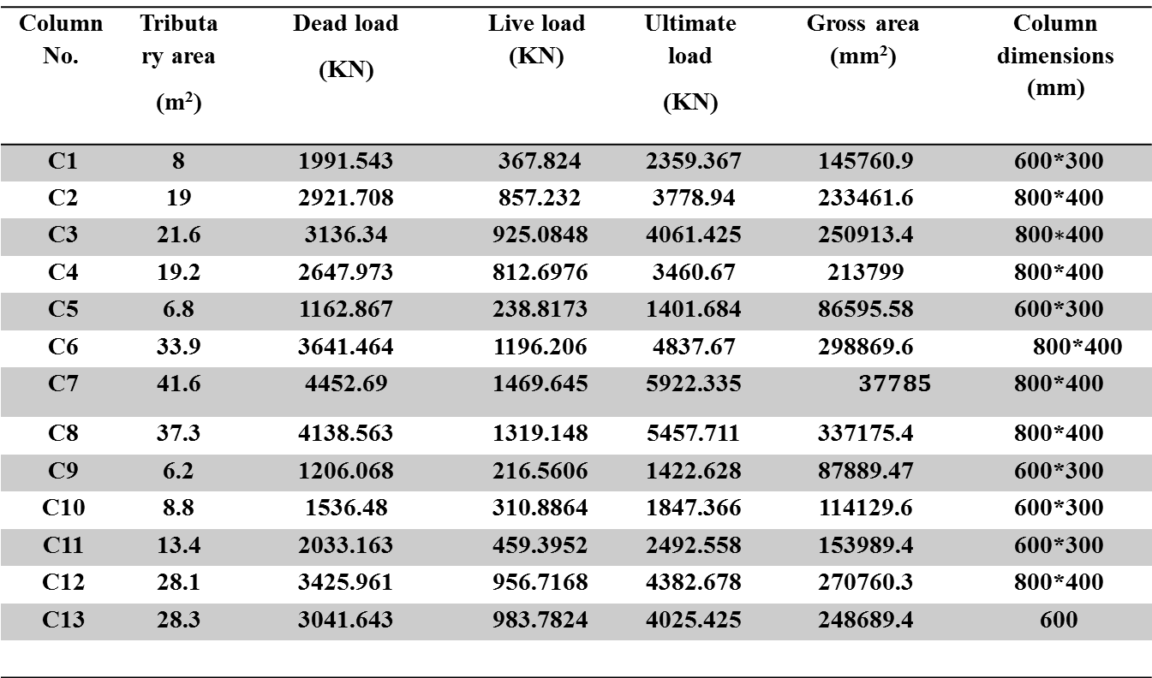
Preliminary Design
Preliminary Design of Column
Column No. | Tributary area (m²) | Dead load (KN) | Live load (KN) | Ultimate load (KN) | Gross area (mm²) | Column dimensions (mm)
C1 | 8 | 1991.543 | 367.824 | 2359.367 | 145760.9 | 600*300
C2 | 19 | 2921.708 | 857.232 | 3778.94 | 233461.6 | 800*400
C3 | 21.6 | 3136.34 | 925.0848 | 4061.425 | 250913.4 | 800$∗$400
C4 | 19.2 | 2647.973 | 812.6976 | 3460.67 | 213799 | 800*400
C5 | 6.8 | 1162.867 | 238.8173 | 1401.684 | 86595.58 | 600*300
C6 | 33.9 | 3641.464 | 1196.206 | 4837.67 | 298869.6 | 800*400
C7 | 41.6 | 4452.69 | 1469.645 | 5922.335 | $$37785$$ | 800*400
C8 | 37.3 | 4138.563 | 1319.148 | 5457.711 | 337175.4 | 800*400
C9 | 6.2 | 1206.068 | 216.5606 | 1422.628 | 87889.47 | 600*300
C10 | 8.8 | 1536.48 | 310.8864 | 1847.366 | 114129.6 | 600*300
C11 | 13.4 | 2033.163 | 459.3952 | 2492.558 | 153989.4 | 600*300
C12 | 28.1 | 3425.961 | 956.7168 | 4382.678 | 270760.3 | 800*400
C13 | 28.3 | 3041.643 | 983.7824 | 4025.425 | 248689.4 | 600

Slide 32
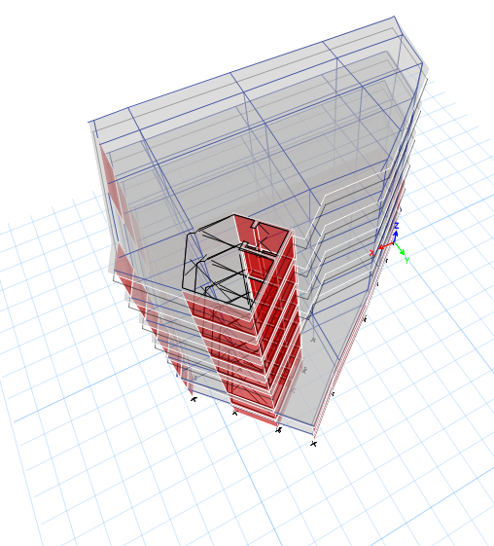
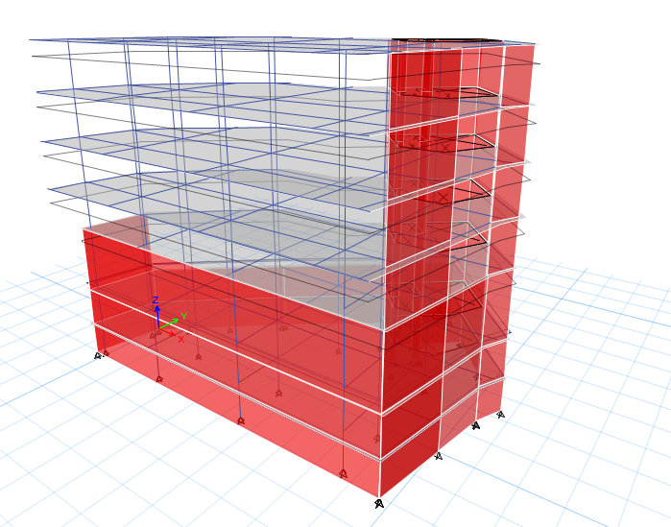
ETABS Model

Slide 33
ETABS Model Checks
Compatibility
Equilibrium
Stress - Strain
Checks

Slide 34
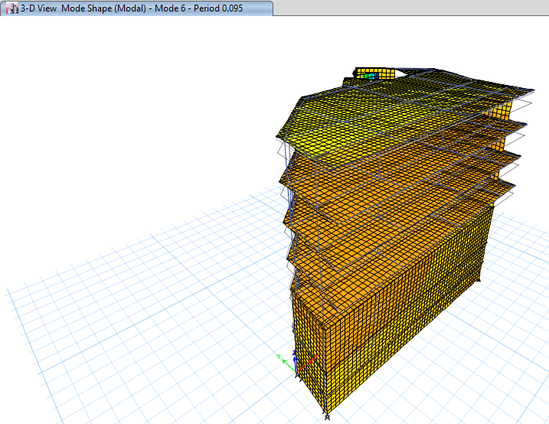
ETABS Model Checks
Compatibility Check

Slide 35
ETABS Model Checks
Equilibrium Check:
%Difference | Manually KN | Fz (Etabs) KN | Load case
2.8% | 32564 | 3166.32 | Dead
1.6% | 7237.3 | 7351.3 | Live
2% | 11394 | 11665.1 | SID

Slide 36
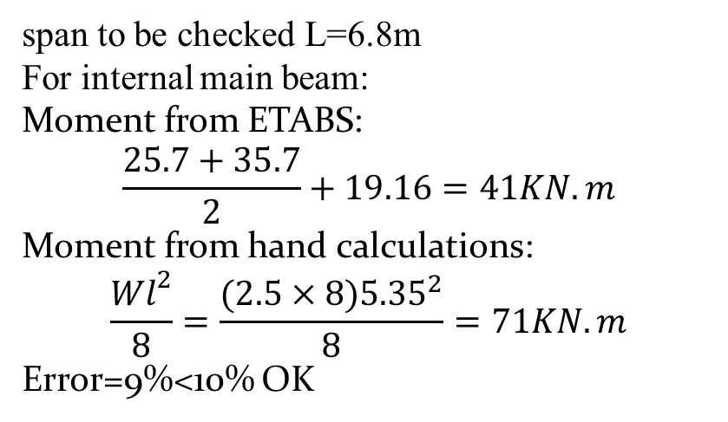
ETABS Model Checks
Stress – Strain Check (For Beam)
span to be checked L=6.8m
For internal main beam:
Moment from ETABS:
$$\frac{25.7+35.7}{2}+19.16=41KN.m$$
Moment from hand calculations:
$$\frac{Wl^{2}}{8}=\frac{(2.5×8){5.35}^{2}}{8}=71KN.m$$
Error=9%<10% OK

Slide 37
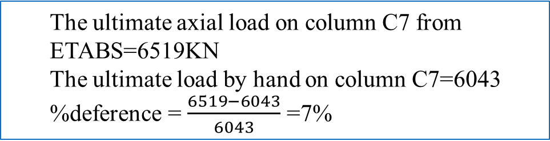
ETABS Model Checks
Stress – Strain Check (For Column)
Make check on column (C7)
The ultimate axial load on column C7 from ETABS=6519KN
The ultimate load by hand on column C7=6043
%deference = $\frac{6519−6043}{6043}$ =7%

Slide 38
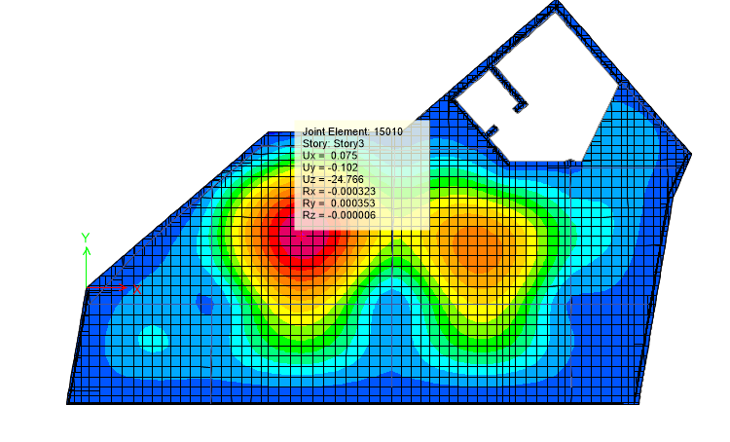

ETABS Model Checks
Deflection Check:
According to ACI 318-14:
${ ∆}_{LT}=∆_{L}+λ_{∞}∆_{D}+λ_{t}∆_{LS}$
$∆_{LT,allowable}=\frac{l}{240}$
From Figure : $∆_{LT,max}=24.766mm$
$∆_{LT,allowable}=\frac{8}{240}×1000=33.33mm$
$∆_{LT,max}=24.766mm<∆_{LT,allowable}=33.33mm→OK$

Slide 39
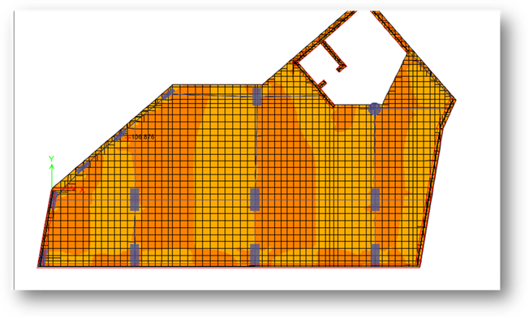

Design Of Slab, Beam And Column
Design of slab:
check of slab for wide beam shear
the maximum shear in X-direction :
$V_{u,X}=106.87 kN/m$
$∅V_{c}=128.6 kN/m$
$V_{u,X}=106kN/m<∅V_{c}=128.6 kN/m$
No need for shear reinforcement.

Slide 40
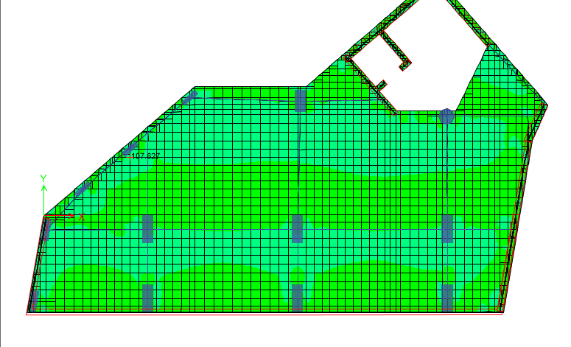

Design Of Slab, Beam And Column
Design of slab:
check of slab for wide beam shear
the maximum shear in Y-direction :
$V_{u,Y}=107.6kN/m$
$∅V_{c}=128.6 kN/m$
$V_{u,Y}=107.6 kN/m<∅V_{c}=128.6kN/m$
Thickness is adequate.

Slide 41
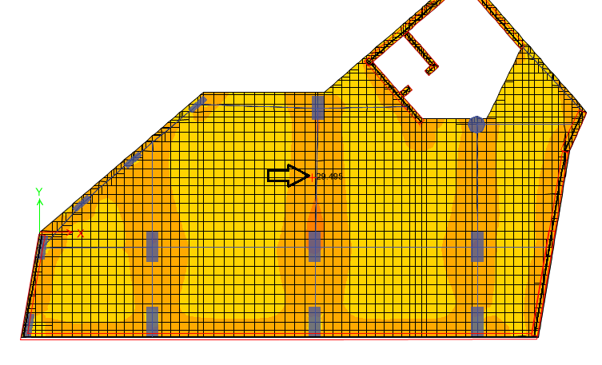

Design Of Slab, Beam And Column
Design the slab for flexure:
For negative moment:
The maximum negative moment from M11=29.49KN.m/m
$ρ=0.00179$
$ρ_{min}=0.0018$
${ρ<ρ}_{min}=0.0018$
$A_{s}=Asmin =ρb_{w}h$=.0018×1000×250=$450{mm}^{2}$
Use As=450→4Ø12

Slide 42
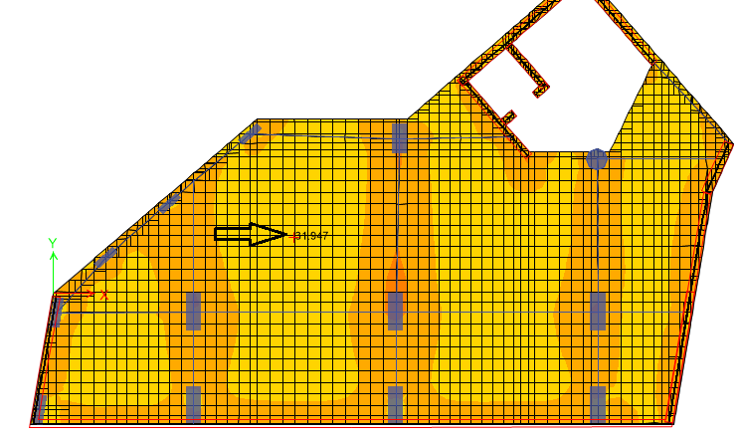

Design Of Slab, Beam And Column
Design the slab for flexure :
For positive moment:
maximum positive moment from M11=31.95KN.m/m
$ρ=0.00195$
As=0.00195*1000*210=409.5${mm}^{2}$
USE As=409.5 →4Ø12

Slide 43
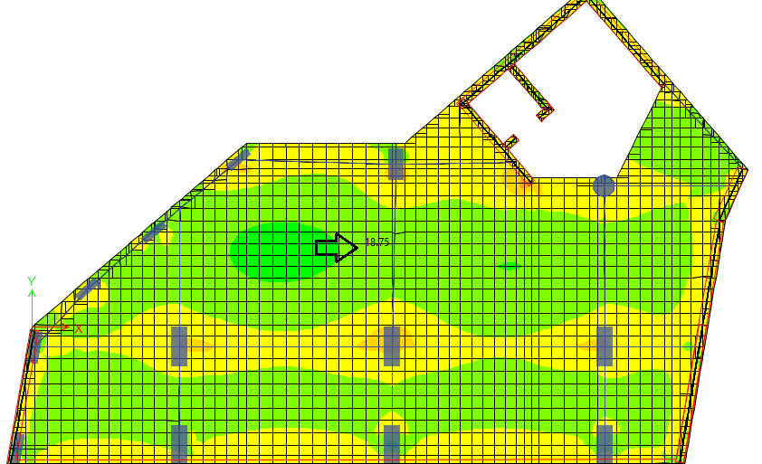
Design Of Slab, Beam And Column
Design the slab for flexure :
For negative moment:
Maximum negative moment from M22=18.75KN.m/m
ρ = 0.001136
As=As min=0.0018×1000×250=450 mm2
Use As=450→4Ø12

Slide 44
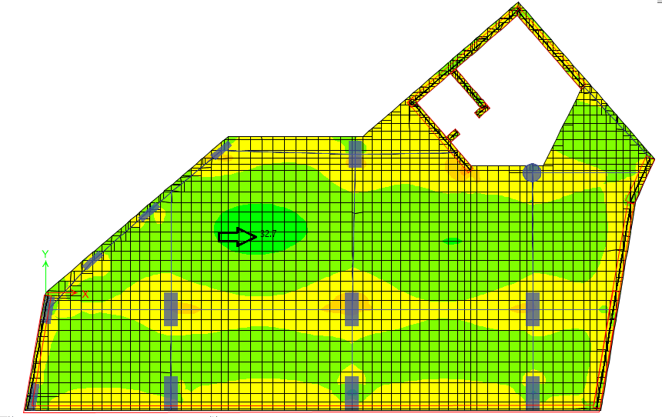
Design Of Slab, Beam And Column
Design the slab for flexure :
For positive moment:
Maximum positive moment frome M22=32.7 KN.m/m
ρ= 0.002
As =0.002×1000×210= 420 mm²
Use As=450→4Ø12

Slide 45
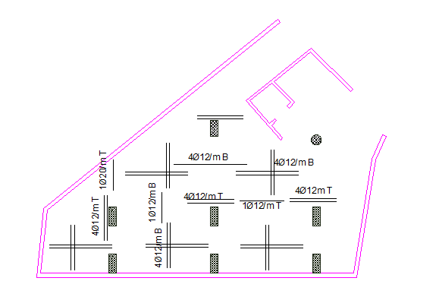
Design Of Slab, Beam And Column

Slide 46
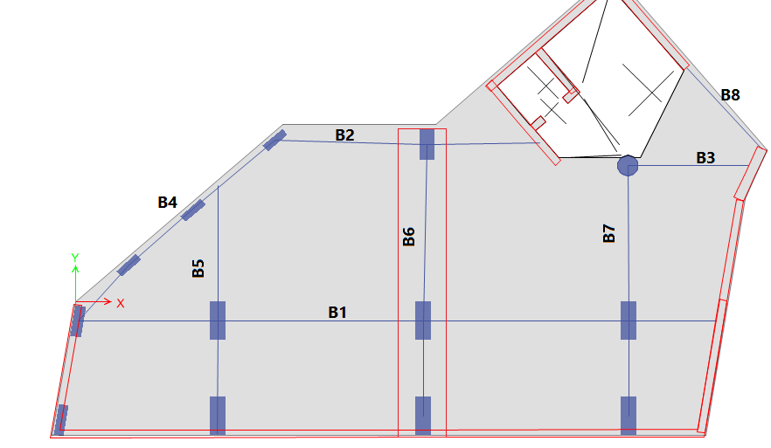
Design Of Slab, Beam And Column
Design of Beams:
For a sample of calculation B6 is taken:
Beam dimension: 300×600 mm

Slide 47
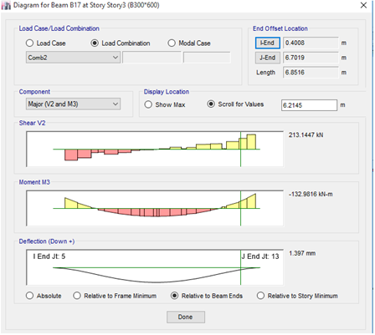

Design Of Slab, Beam And Column
Design of Beams:
Design of B6 for Shear:
Vn = 284 KN
Vc = 132.3 KN
Vs = Vn - Vc = 151.7 KN
$\frac{Av}{s}$=$\frac{Vs}{Fy∗ d }$ = $\frac{151.7∗1000}{420∗560}$ =0.67 mm²/mm
Assume stirrups diameter (10 mm )
Av = 157 mm
Use S = 200 mm→1 φ 10 /20cm

Slide 48


Design Of Slab, Beam And Column
Design of Beam:
Design B6 for flexure :
For maximum negative moment:
$ρ$ =0.008
As = $ρ$*b*d =0.008*300*540 =1296 mm²
Use 8Ø16

Slide 49


Design Of Slab, Beam And Column
Design of Beam:
Design B6 for flexure :
For maximum negative moment
$ρ$= 0.004138
As = $ρ$*b*d =0.004138*300*540 =670.36 mm²
Use 4Ø16

Slide 50

Design Of Slab, Beam And Column
Design of Beam:
Longitudinal reinforcement to resist moment:

Slide 51

Design Of Slab, Beam And Column
Stirrups for shear reinforcement :

Slide 52
Design Of Slab, Beam And Column
Design of column :
The column are divide into 5 groups these groups have the same dimensions
NO. of group | Size(mm) | Bars | Ties
 |  |  | A | B | C
C1 | 1500*600 | 26Ø22 | 1Ø10/125mm | 1Ø10/125mm | 1Ø10/125mm
C2 | 1200*400 | 20Ø18 | 1Ø10/100mm | 1Ø10/100mm | 1Ø10/100mm
C3 | 1000*300 | 16Ø16 | 1Ø10/100mm | 1Ø10/100mm | 1Ø10/100mm
C4 | 1200*600 | 24Ø20 | 1Ø10/100mm | 1Ø10/100mm | 1Ø10/100mm
C5 | 800 | 10Ø25 | 1Ø10/100mm | 1Ø10/100mm | 1Ø10/100mm

Slide 53

Design Of Slab, Beam And Column
Design of Column:

Slide 54

Design of footing and Basement wall
Design of footing:
Suitable footing system:
the allowable bearing capacity for the soil is 250kN/$m^{2}$.
Mat footing has used in our project because total area of footings >50% × area of building
AF = $\frac{ ∑Pservice}{q_{all.}}$=$\frac{57567.9}{250}=230.3m^{2}$
50%*Area of building=203$m^{2}$
The thickness of mat footing=0.9m

Slide 55


Slide 56

Design of footing and Basement wall
Checks of mat foundation:
Compatibility:
By making start animation for the deformed shape of SAFE model, it was noticed that the structural elements are compatible and all of them are moving together,

Slide 57

Design of footing and Basement wall
Allowable displacement in the mat foundation is10mm.
The maximum displacement of the footings is shown in figure
and it is lees than 10mm → ok

Slide 58

Design of footing and Basement wall
Check soil pressure:
Maximum allowable 𝑠𝑡𝑟𝑒𝑠𝑠𝑖𝑠 250 𝑘𝑁/𝑚2
Maximum stress on the footing from SAFE =225 is KN/m2 < 250 KN/m2 → OK
Show figure

Slide 59


Design of footing and Basement wall
Check for Punching shear
Punching shear check is done by SAFE.
Punching shear is the actual load over the ultimate load, so if the values of punching shear design less than 1, so it’s OK
By Hand:
Check for Punching.
Pu=7567KN.
ΦVcp=0.75*$(\frac{1}{3})$*$√24$*(2×1450+2×2350)*850*10⁻³.
=7911.85 KN >Pu............. So it's ok

Slide 60


Design of footing and Basement wall
Design the footing:
Design for shear:
Vu=480KN
ØVc=0.75×1/6×$\sqrt{24}$×1000×850/1000= 520.5 KN
Vu<ØVc
Design of flexure:
We divide the slab into column strip and middle strip as shown in the figure below

Slide 61


Slide 62


Slide 63

Design of footing and Basement wall
Design and Calculation of Basement Wall:
Design Loads:
_Bulk density ($γ$) =18KN/m3
_Angle of internal friction (Ø) =30˚
_Active coefficient in cohesion less s soil (Ka) =0.333
_Load from building =19.5 KN/m
_Soil load:
q1= 0 KN/m2 →at Z=0
q2= 60 KN/m2 →at Z=10
_use sap 2000 to design basement wall

Slide 64


Design of footing and Basement wall
Design for Shear:
$ØVc$ =0.17*0.75*${\sqrt{f}}^{′}c∗b∗d$
=0.17*0.75*$\sqrt{24}∗1000∗250∗{10}^{−3}=$156.15KN
$ØVc=156.15KN>Vu=118.76KN$
Thickness is ok.

Slide 65


Design of footing and Basement wall
Design for flexure:
$Mu=60.9KN.m$
$ρ=0.00264$
$A_{s}=ρbd =0.00264∗1000∗250=660mm2$
Use As min.
Use1 $∅16$/200mm c/c
Exterior face of wall:
${ ρ}_{minimum} \left(vertical\right)=0.0015$
$ρ_{minimum} \left(horezantal\right)=0.0025→for fy=240 and bars≤16mm$
$A_{s \left(vertical\right)}=ρbt$=0.0015*1000*300= 450mm2
Use1 $∅16$/350mm c/c
$A_{s }\left(horezantal\right)=ρbt$=0.0025*1000*300= 750mm2
Front face =$\frac{2}{3}∗750=500mm2$
Rare face =$\frac{1}{3}∗750=250mm2$
Use $5∅12$ for front face
Use1 $∅12$/350mm c/c for rare face

Slide 66

Design of footing and Basement wall

Slide 67

Design of stairs
Dimension of stairs:
The thickness of stair slab is assumed = 18 cm
The figure below shows the plan of stairs

Slide 68
Design of stairs
Loads on stairs:
The total loads on stairs are:
The own weight of stairs = 0.18∗25𝑚 =4.5𝑘𝑁/𝑚2
The live load is assumed =4.5 KN/m2.
The SD =3 KN/m2

Slide 69

Design of stairs
Check for defection based on the long term deflection:
Max. immediate deflection due to service load from SAP( ∆ )=0.52 mm
Deflection limitation:-
∆ 𝐿,𝑎𝑙𝑙𝑎𝑤𝑎𝑏𝑙𝑒( 𝐿𝑜𝑛𝑔𝑡𝑒𝑟𝑚) ≤ 𝑙/240 = 2400/240 = 10𝑚𝑚
0.52<10 → OK

Slide 70

Design of stairs
Check for shear:
Vu=20.12KN/m from figure
𝑑 = 180-30 = 150 𝑚𝑚
∅𝑉𝑐 = 0.75× ×√𝑓𝑐` 𝑏 ×𝑑 =
=0.75× × ×1000
Since ∅𝑉𝑐 =99𝑘𝑁>𝑉𝑢 = 20.12 ,
there is no need for shear reinforcement.

Slide 71

Design of stairs
Design for longitudinal steel with stairs using (M22):
- In flight:
For the middle M22 (positive) =8.5KN.m
Bottom steel
𝜌= 0.001
𝜌<𝜌min=0.0033
So the 𝐴𝑠 = 0.0033 ×150×1000 = 495𝑚𝑚2
𝑢𝑠𝑒𝐴𝑠 (4 ∅124/ 1m)
Use (4 ∅14/1m) for all longitudinal steel ( main steel )
- In landing:
M22 in the Landing= 1kN.m and it is positive moment (bottom steel)
𝜌 = 0.0001
𝜌<𝜌min
Use As min.=0.0033*1000*150=495 mm2 (4 ∅14)

Slide 72

Design of stairs
Design for Transverse steel with stairs using (M11):
the transverse moment =3KN.m
𝜌=0.000353
𝜌<𝜌min.
Use As min
𝐴𝑠 𝑠ℎ𝑟𝑖𝑛𝑘𝑎𝑔𝑒 = 𝐴𝑠 𝑚𝑖𝑛 = 0.002×180×1000 = 360 𝑚𝑚2
in both face (Use 5 ∅10 /1m for each layer)

Slide 73

Design of stairs

