Slide 1


Slide 2
Graduation Project II
Water Resources Management for The Western Pressure Zone in Nablus city
Asem Basheer
Bara’ Shalhoub
Qusai Abu-Aisheh
Under supervision of: Eng. Hamees S. Tubeileh
Submitted in partial fulfillment of the requirements for Bachelor degree in Civil Engineering

Slide 3
Contents
Introduction.
Objectives.
Study Area.
Evaluation of existing situation.
Evaluation of water gap.
Water network modifications.
Proposals.
Discussion and recommendation.

Slide 4
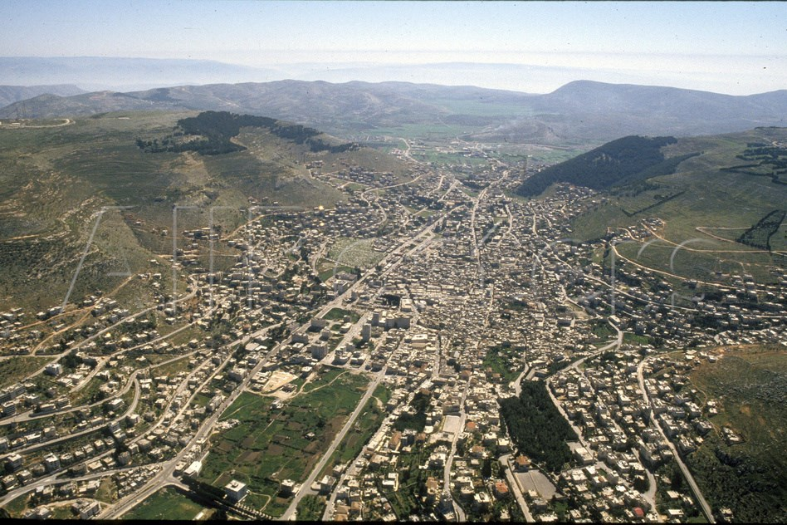

Slide 5
Objectives
The main aim of this project is to enhance the water system in the western pressure zone of the city for the upcoming fifteen years and to solve the existing problems in the system.

Slide 6
Pressure zones
Northeast pressure zone (NE)
Northwest pressure zone (NW).
Southern pressure zone (S).
Central pressure zone (C).
Eastern pressure zone (E).
Western pressure zone (W).

Slide 7
The Western Pressure Zone (WPZ)
Al-Mrayj (W0).
Rafedya (W1).
Rafedya main St. (W2).
Al-Makhfeya (W3).
Al-Amreya and Tel St. (W4).
Dier Sharaf (W-1).
Ein camp.

Slide 8
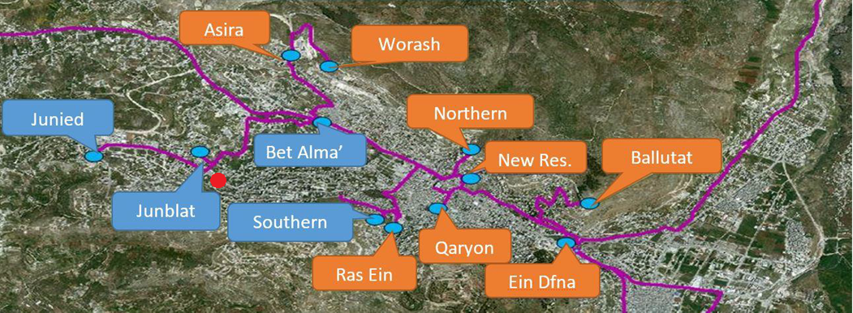
Water Resources in Nablus city

Slide 9
Evaluation of water gap
Estimation of population
P_{future}= P₀ (1+i)^{n}
Where,
P = population
i = growth rate
n = number of years
Area | Growth rate |  |  | population
 | 2016-2020 | 2020-2025 | 2025-2030 | 2016 | 2020 | 2025 | 2030
W2A | 2.985 | 3.034 | 3.095 | 17566 | 19759 | 22944 | 26722
W3 | 2.785 | 2.843 | 2.890 | 17062 | 19044 | 21909 | 25262

Slide 10
Water consumption
Average water consumption is assumed to be constant along the design period at 120 L/c/d.
Where:
UFW: Unaccounted-for Water.
Notes:
UFW: Unaccounted-for Water, is the difference between the quantity of water supplied to an area network and the metered quantity of water used by the customers.

Slide 11
Water demand
Area | demand (LPCD) |  |  | demand *10^4 m3/year
 | 2020 | 2025 | 2030 | 2020 | 2025 | 2030
W2a | 167 | 167 | 167 | 120.2 | 139.6 | 162.6
W3 | 167 | 167 | 167 | 115.9 | 133.3 | 153.7

Slide 12
  Water deficit
Area | Deficit (m³/year)
 | 2020 | 2025 | 2030
W2a | 509,015.4 | 702,767.9 | 932,549.8
W3 | 640,150.9 | 814,439.5 | 1,018,449
 |  | Sum | 1,950,999

Slide 13
Water network modifications
Assumptions :
Population density is assumed to be constant over the area at the end of the design period.
water will be pumped once each 4 days.
The loss is assumed to be 20% in the new WDN
The WaterCAD model is considering a continuous flow design.
Velocity limitations is (0.3 – 3) m/s.
Pressure limitations is (20 – 100) m H2O.

Slide 14
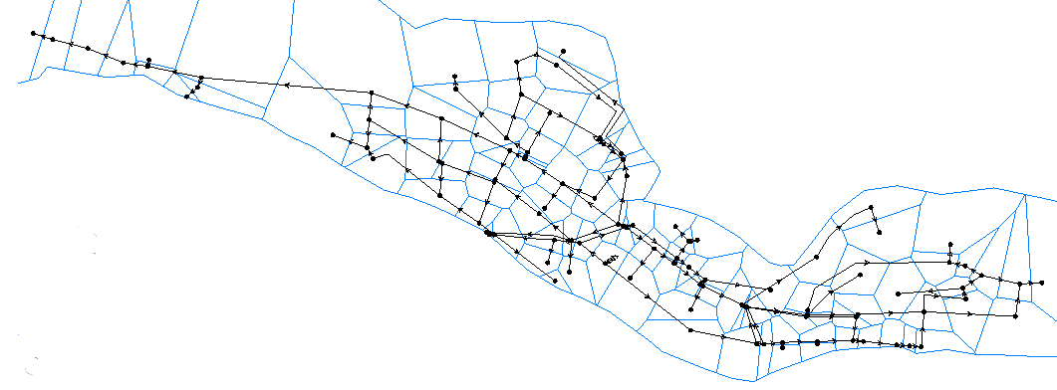
WaterCAD
Thiessen polygon

Slide 15
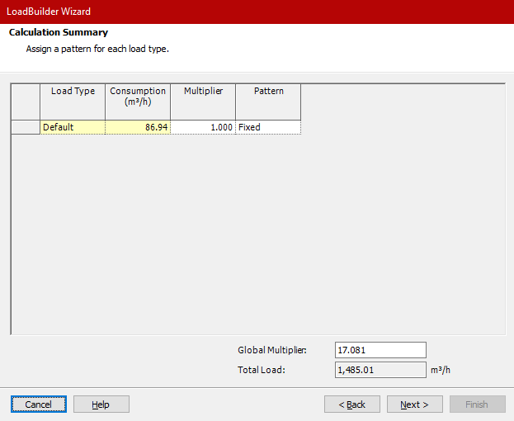
WaterCAD
Load builder

Slide 16
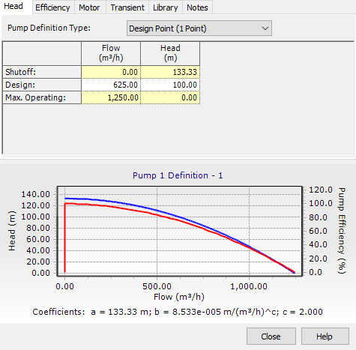
WaterCAD
Pump characteristic

Slide 17
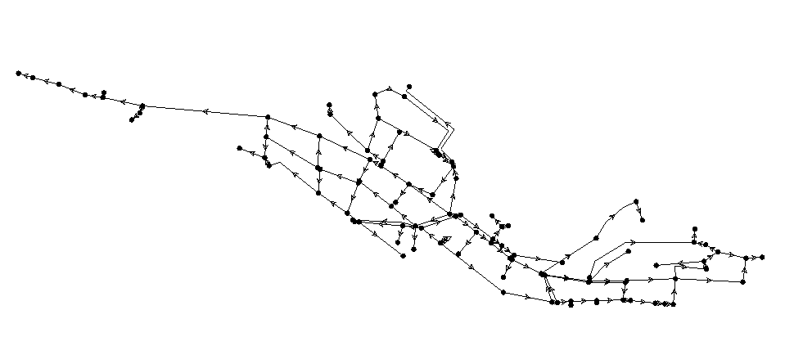
Model W2a modification
Design demand = 1485 m3/h

Slide 18
Model W2a modification
New design current situation

Slide 19
Model W2a modification
New design current situation

Slide 20
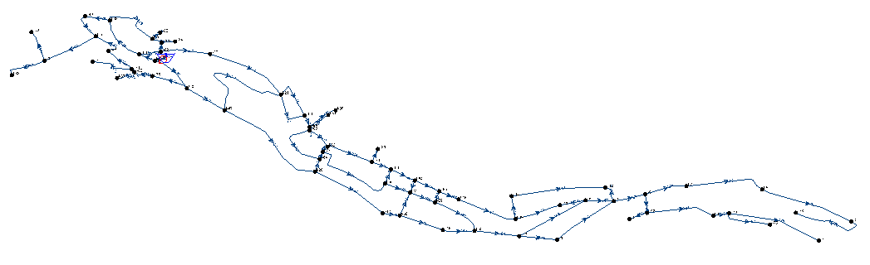
Model W3 modification
Design demand = 1052 m3/h

Slide 21
Model W3 modification

Slide 22
Model W3 modification

Slide 23
Proposals
Wells
  Sabastia 2: with an average productivity rate of 2.1 Mm3 /year.
  Sabastia 3: with an average productivity rate of 2.1 Mm3 /year.
  Dier Sharaf 2: with an expected productivity rate of 2.5 Mm3 /year.

Slide 24
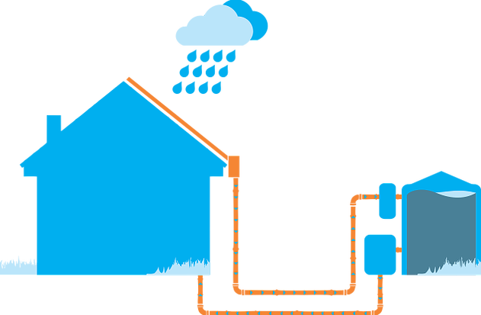
Rainfall Harvesting

Slide 25
Rainfall Harvesting
Volume of collected rainfall = F*A*D
Where:
F: Reduction factor = 0.9 .
A: Area of building roofs in the study area.
D: Depth of average annual precipitation= 664 mm for the last 30 years.

Slide 26
Rainfall Harvesting
Area of building roofs = NB * Aavg
Where:
NB: Number of buildings.
Aavg : Average area of building roof =400 m2 as obtained from Nablus Municipality.

Slide 27
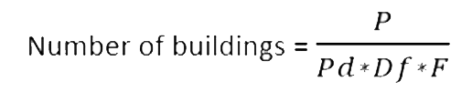
Rainfall Harvesting
Where:
P: Population in the study area.
Pd: Average number of persons in each department = 5.25 as obtained from Nablus Municipality.
Df : Average number of departments at each floor=2 as obtained from Nablus Municipality.
F : Average number of floors at each building=5 as obtained from Nablus Municipality.

Slide 28
Rainfall Harvesting
Volume of collected rainfall = 236,650 m³/year

Slide 29
Discussion and recommendations
Intermittent water supply.
Water consumption is assumed to be 120 l/c/d while according to WHO it is equal to 150 l/c/d.
Decreasing water losses in the WDN.
Distributing water by gravity.
Nablus western wastewater treatment plant.
Notes:
6kw/m3 0.7nis

Slide 30
Thank you

