Slide 1
Design of Three Critical Intersection and Two Links in Jenin City
Preperd by :
Ibrahim Taffal
Abed AL-Razzaq Hajeer
Abdullah Ghannam
Murad Marei
Supervision of : Dr. Amjad Issa

Slide 2
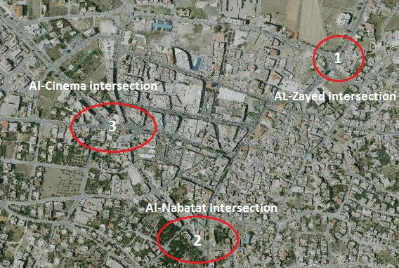
Part 1: definition of the three intersections

Slide 3
Part 1: definition of the three intersections
After the data was collected for each intersection such as accounting of traffic volume and inventory study, This data has been analyzed by synchro software to obtained the LOS.
Furthermore, The 8 warrants was checked for each intersection.

Slide 4
Part 1: Data analysis results
LOS for the three intersections:
# | Intersection name | LOS
1 | Al-Nabatat | D
2 | Al-Zayed | F
3 | Al-Cinema | F

Slide 5
Part 1: Data analysis results
2. Results summary for the eight warrants met:
 | Al-Nabatat | Al-Zayed | Al-Cinema
Warrant 1 | Met | Not Met | Met
Warrant 2 | Met | Met | Met
Warrant 3 | Met | Met | Met
Warrant 4 | Not Met | Met | Met
Warrant 6 | Met | Met | Met

Slide 6
Part1: Design of Traffic Lights Signals
After checking warrants for the intersections, traffic Light signals are designed and making the necessary calculations to develop the LOS for the intersections.
Webster method Adopted at the calculations of the cycle length.

Slide 7
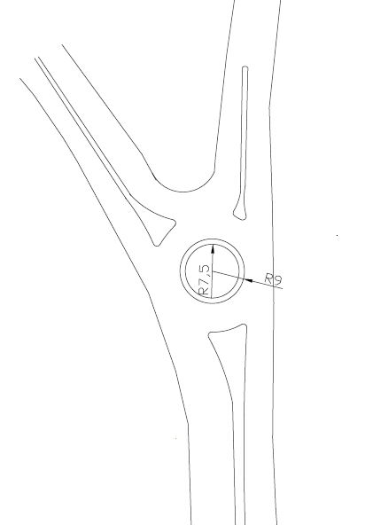
Part1: Design of Traffic Lights Signals for Al-Nabatat intersection
Geometric design:

Slide 8
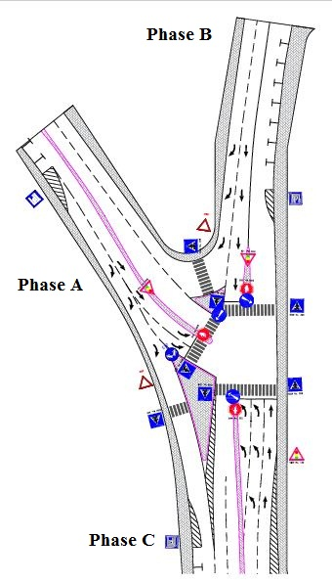
Part1: Design of Traffic Lights Signals for Al-Nabatat intersection

Slide 9
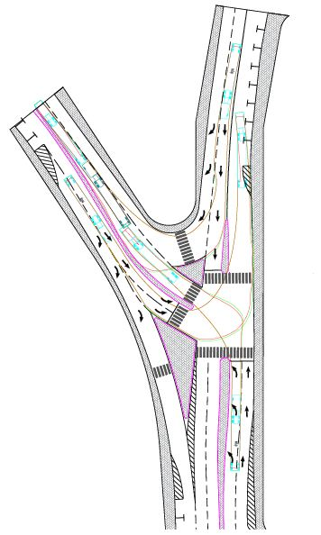
Part1: Design of Traffic Lights Signals for Al-Nabatat intersection
Vehicle tracking:

Slide 10
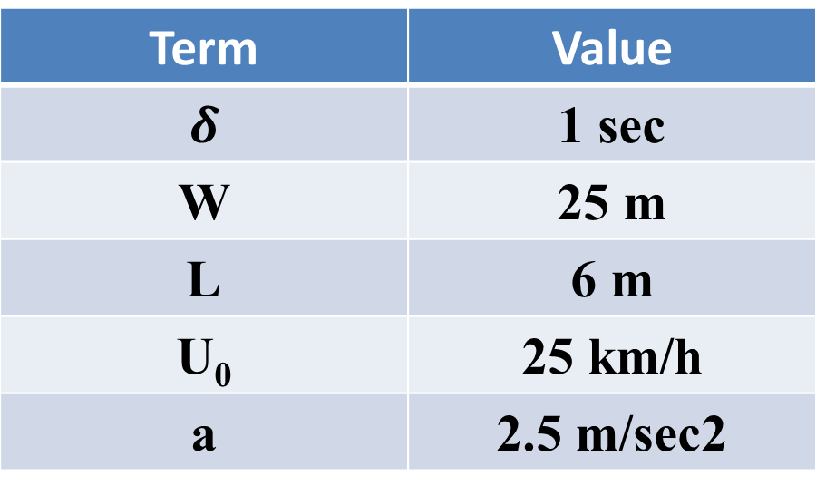
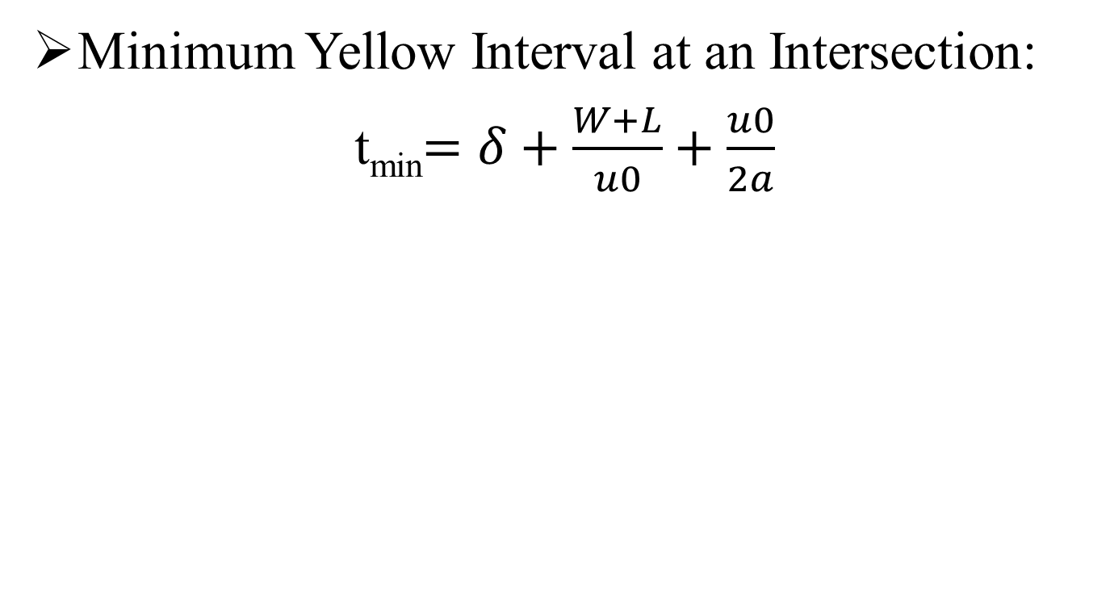
Part1: Design of Traffic Lights Signals for Al-Nabatat intersection
Minimum Yellow Interval at an Intersection:
t_{min}$=δ+\frac{W+L}{u0}+\frac{u0}{2a}$
Term | Value
$$δ$$ | 1 sec
W | 25 m
L | 6 m
U₀ | 25 km/h
a | 2.5 m/sec2

Slide 11
Part1: Design of Traffic Lights Signals for Al-Nabatat intersection
Minimum Yellow Interval = 7 sec
Phase | A | B | C
Yellow | 4 | 4 | 4
All red | 3 | 3 | 3
Total | 7 | 7 | 7

Slide 12
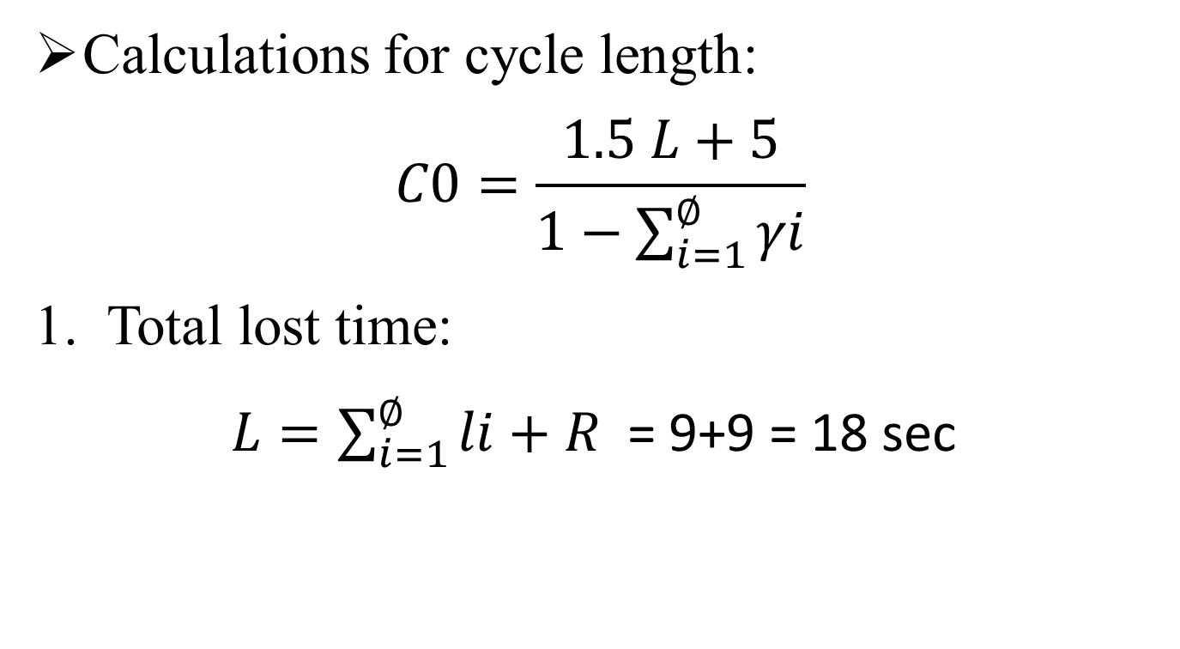
Part1: Design of Traffic Lights Signals for Al-Nabatat intersection
Calculations for cycle length:
$$C0=\frac{1.5 L+5}{1−\sum_{i=1}^{∅}{γi}}$$
Total lost time:
$L=\sum_{i=1}^{∅}{li+R }$= 9+9 = 18 sec

Slide 13
Part1: Design of Traffic Lights Signals for Al-Nabatat intersection
2. Maximum value of the ratios of approach flows to saturation flows for each phases(γ) :
The following figure show the values of DHV for each movements by using PHF= 0.9

Slide 14
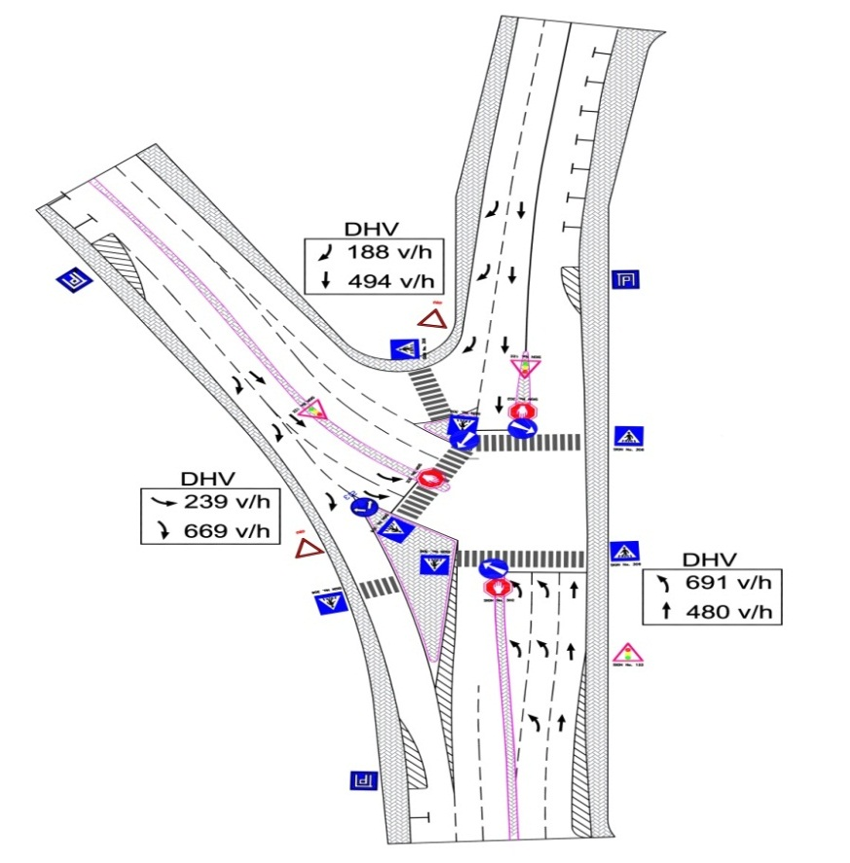
Part1: Design of Traffic Lights Signals for Al-Nabatat intersection

Slide 15
Part1: Design of Traffic Lights Signals for Al-Nabatat intersection

Slide 16
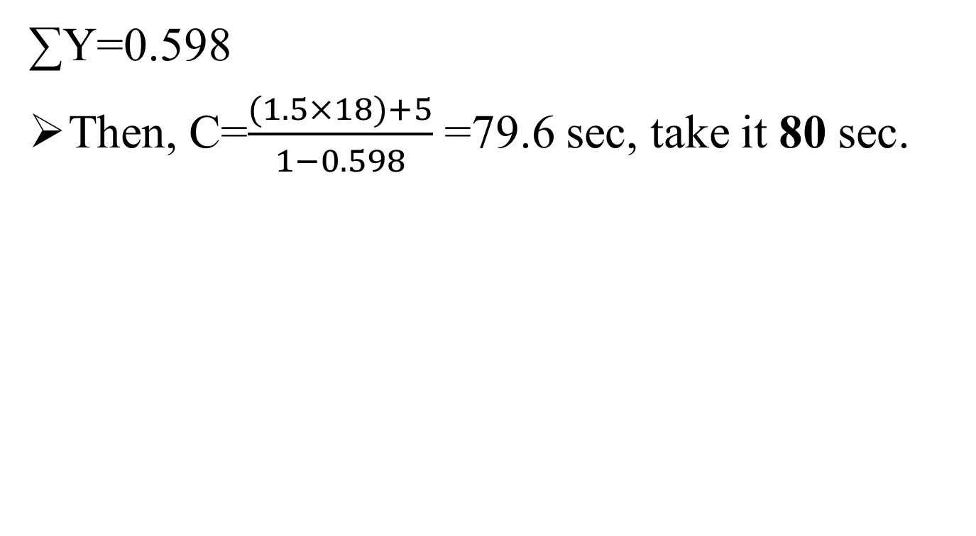
Part1: Design of Traffic Lights Signals for Al-Nabatat intersection
∑Y=0.598
Then, C=$\frac{(1.5×18)+5}{1−0.598}$ =79.6 sec, take it 80 sec.

Slide 17
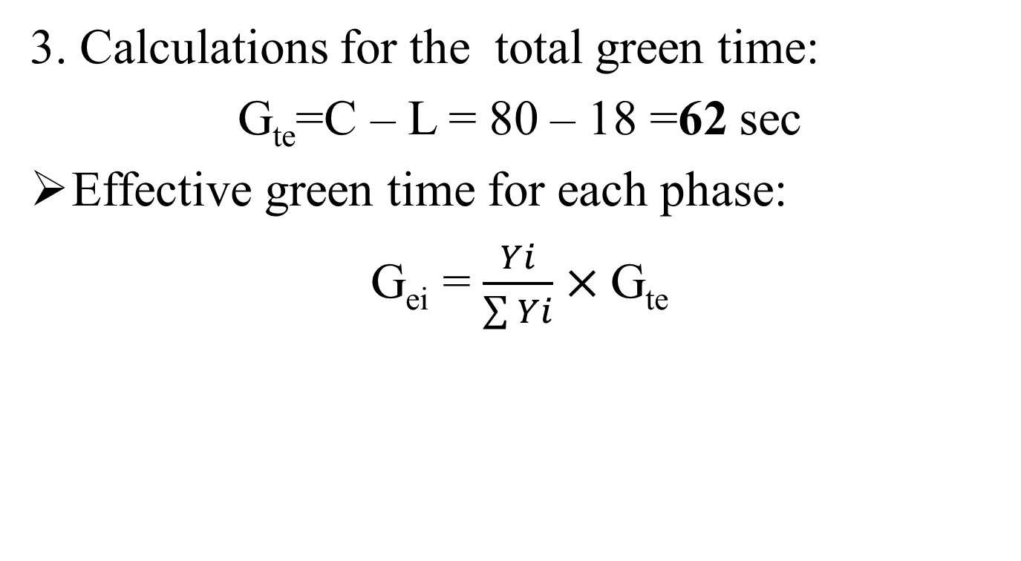
Part1: Design of Traffic Lights Signals for Al-Nabatat intersection
3. Calculations for the total green time:
G_{te}=C – L = 80 – 18 =62 sec
Effective green time for each phase:
G_{ei} = $\frac{Yi}{\sum{Yi}}×$G_{te}

Slide 18
Part1: Design of Traffic Lights Signals for Al-Nabatat intersection
The following table summarized the values of effective green time for each phase:
Phase | Y_{i} | G_{ei}(sec)
A | 0.08 | 8.3
B | 0.295 | 30.6
C | 0.223 | 23.1

Slide 19
Part1: Design of Traffic Lights Signals for Al-Nabatat intersection
actual green time for each phase:
G_{a}= G_{e} – yellow + l_{i}
Phase | G_{ei} | Yellow | L | G_{a}(sec)
A | 8.3 | 4 | 3 | 10
B | 30.6 | 4 | 3 | 30
C | 23.1 | 4 | 3 | 22

Slide 20
Part1: Design of Traffic Lights Signals for Al-Nabatat intersection
The following table summerized the timing for the light signal on Al-Nabatat intersection:

Slide 21
Part1: Design of Traffic Lights Signals for Al-Nabatat intersection
LOS:
By compensating the results in the last table into the HCS software using (operation) option, the LOS is C, so it has been developed the LOS from D to C.

Slide 22
Part1: Design of Traffic Lights Signals for Al-Nabatat intersection
BOQ: Bill Of Quantity

Slide 23
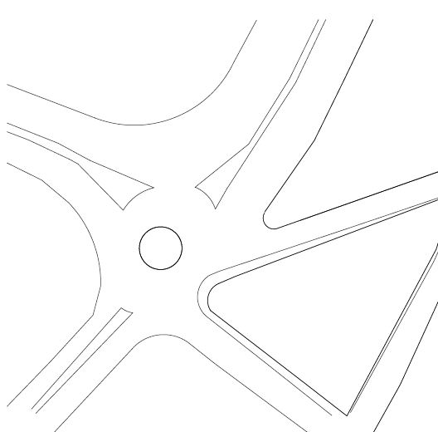
Part1: Design of Traffic Lights Signals for Al-Zayed intersection
Geometric design:

Slide 24
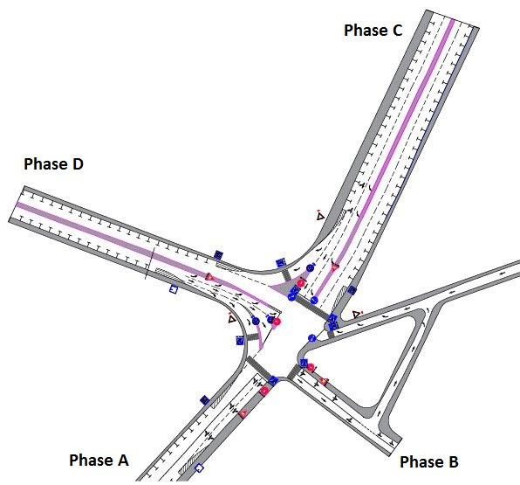
Part1: Design of Traffic Lights Signals for Al-Zayed intersection

Slide 25
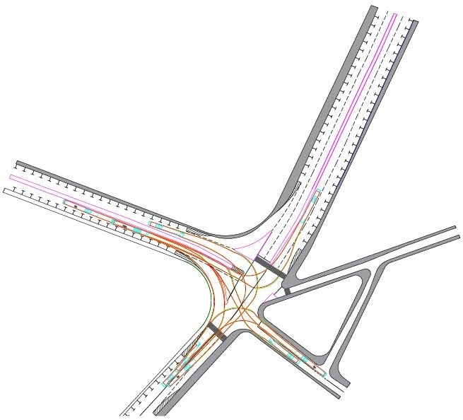
Part1: Design of Traffic Lights Signals for Al-Zayed intersection
vehicle tracking:

Slide 26
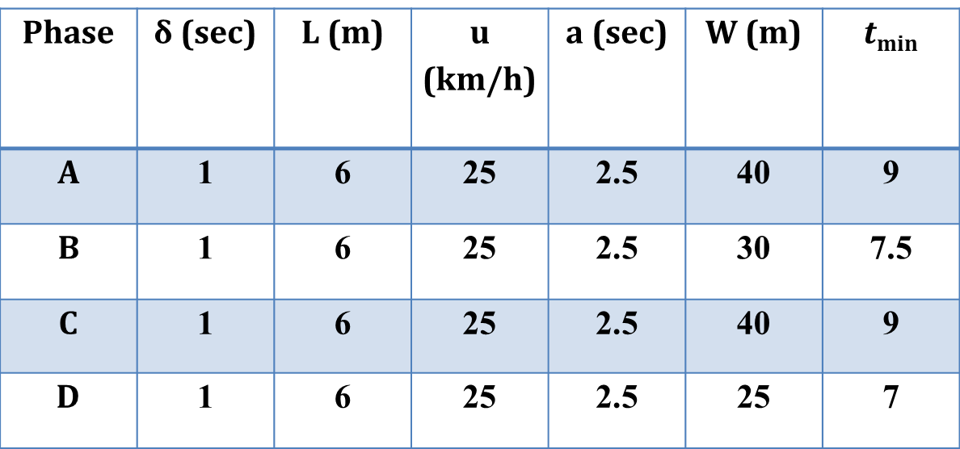
Part1: Design of Traffic Lights Signals for Al-Zayed intersection
Minimum Yellow Interval at an Intersection:
Phase | δ (sec) | L (m) | u (km/h) | a (sec) | W (m) | $t$_{min}
A | 1 | 6 | 25 | 2.5 | 40 | 9
B | 1 | 6 | 25 | 2.5 | 30 | 7.5
C | 1 | 6 | 25 | 2.5 | 40 | 9
D | 1 | 6 | 25 | 2.5 | 25 | 7

Slide 27
Part1: Design of Traffic Lights Signals for Al-Zayed intersection
Minimum Yellow Interval at an Intersection:
The following table summarized timing for All red and yellow interval:
Phase | A | B | C | D
Yellow | 5 | 5 | 5 | 5
All red | 4 | 2.5 | 4 | 2
Total | 9 | 7.5 | 9 | 7

Slide 28
Part1: Design of Traffic Lights Signals for Al-Zayed intersection
Calculations for cycle length:
Total lost time:
L = (4×3) + (4+2.5+4+2) = 24.5 sec.

Slide 29
Part1: Design of Traffic Lights Signals for Al-Zayed intersection
Maximum ratio (q/s)

Slide 30
Part1: Design of Traffic Lights Signals for Al-Zayed intersection
∑Y=0.816
Cycle length = 230 sec
D | C | B | A | Phase
41 | 59 | 56.5 | 41 | Green
5 | 5 | 5 | 5 | Yellow
2 | 4 | 2.5 | 4 | All Red
182 | 162 | 166 | 180 | Red

Slide 31
Part1: Design of Traffic Lights Signals for Al-Zayed intersection
By compensating the results in the last table into the HCS software using choice (operation), , the LOS is F, by the way the LOS achieved by HCM method was F. Thus not been developed the LOS. Furthermore, it the length of cycle is very large and not acceptable

Slide 32
Part1: Design of Traffic Lights Signals for Al-Zayed intersection
The following two conditions were assumed to solve the problem of the cycle length:
Splitting the cycle length into two sessions.
Changes in Traffic directions.

Slide 33
Part1: Design of Traffic Lights Signals for Al-Zayed intersection
Splitting the cycle length into two sessions:
Cycle length will be equal 130 sec, which it acceptable.
D | C | B | A | Phase
21 | 30 | 29.5 | 21 | Green
4 | 4 | 4 | 4 | Yellow
2 | 4 | 2.5 | 4 | All Red
103 | 92 | 94 | 101 | Red

Slide 34
Part1: Design of Traffic Lights Signals for Al-Zayed intersection
By compensating the results in the last table into the HCS software using operation choice, the LOS is D, so the LOS is improved from F to D.

Slide 35
Part1: Design of Traffic Lights Signals for Al-Zayed intersection
2.Changes in Traffic directions:

Slide 36
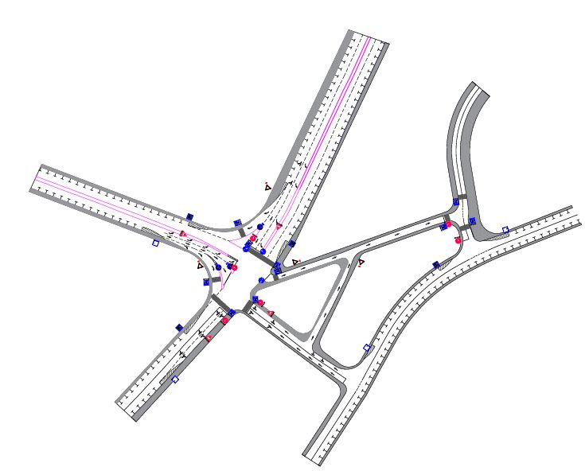
Part1: Design of Traffic Lights Signals for Al-Zayed intersection

Slide 37
Part1: Design of Traffic Lights Signals for Al-Zayed intersection

Slide 38
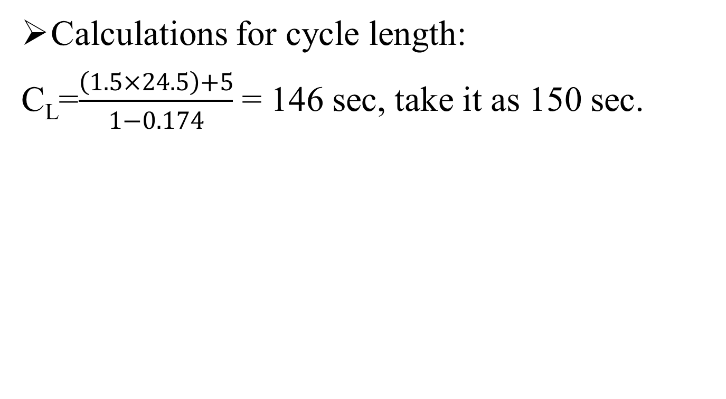
Part1: Design of Traffic Lights Signals for Al-Zayed intersection
Calculations for cycle length:
C_{L}=$\frac{\left(1.5×24.5\right)+5}{1−0.174}$= 146 sec, take it as 150 sec.
D | C | B | A | Phase
28 | 40.5 | 21 | 28 | Green
5 | 5 | 5 | 5 | Yellow
2 | 4 | 2.5 | 4 | All Red
115 | 100.5 | 121.5 | 113 | Red

Slide 39
Part1: Design of Traffic Lights Signals for Al-Zayed intersection
By compensating the results in the last table into the HCS software using choice (operation), the LOS is D, so it is developed the LOS from F to D.

Slide 40
Part1: Design of Traffic Lights Signals for Al-Zayed intersection
BOQ: Bill Of Quantity

Slide 41
Al-Cinema intersection
Al-Cinema intersection located in the heart of CBD area, which the LOS was F estimated by synchro softwar and it suffers of traffic congestion.

Slide 42
Al-Cinema intersection
Light signal:
To find a solution for the problem of traffic congestion on the intersection were tried to using light signals, but there was a problem is that the cycle length was very large(300-350sec) .

Slide 43
Al-Cinema intersection
Traffic system management:
To solve the problem of this intersection the suggest was to setting up traffic system management for the region around it,
From one street 22% of the percentage of vehicles entering the intersection were reduced (760 vehicles out of 3451 vehicles).

Slide 44
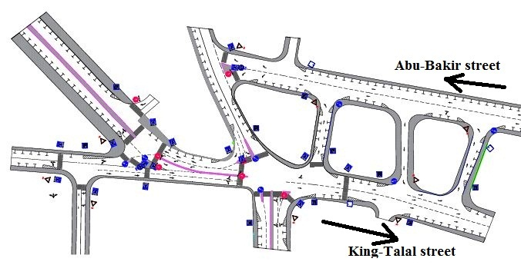
Al-Cinema intersection

Slide 45
Al-Cinema intersection
Traffic system management :
Moreover, the new traffic management for the region around the intersection does not cause a congestion on other streets such as those that have been changed.

Slide 46
BOQ
BOQ: Bill Of Quantity

Slide 47
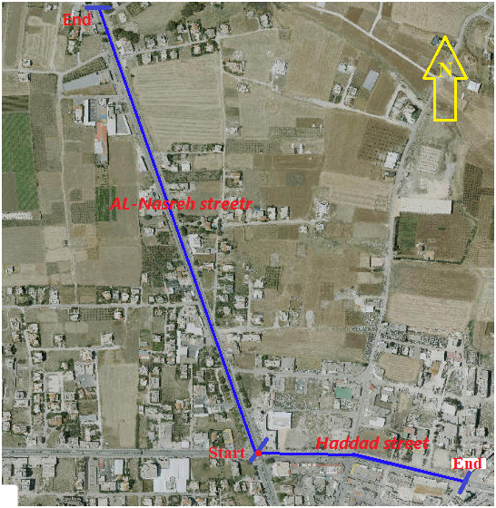
Part(2): Design of Two Links

Slide 48
Part2:Data collection:
1- Inventory study:
Name Link | Length Studies (M) |  | No. of Lane | Lane Width(M) | Side Walk Width(M) | Parking Lane Width(M)
 | PCI | Design
AL-Nasreh Street | 1700 | 1900 | 4 | 3.25 | 1 | 2
Haddad Street | 400 | 1200 | 2 | 3.2 | No side walk | 2

Slide 49
2- Traffic count :
 | AL-Nasreh street |  | Haddad street
Classification | Right | left | Right | left
passenger | 526 | 670 | 322 | 289
Taxi | 85 | 80 | 64 | 60
Truck | 5 | 7 | 9 | 8
Bus | 2 | 3 | 2 | 1
Total | 618 | 760 | 397 | 358

Slide 50
3- Types and areas of defects:
Section No | Alligator cracking | Block cracking | Longitudinal cracking | Transverse cracking | Pothole | Raveling | Rutting
1 | 120 | 6.1 | 0.02 | 0.09 | 1.1 | 35 | 25
2 | 24 | 15.1 | 0.015 | 0.06 | 0 | 56 | 27
3 | 91.2 | 3.4 | 0.01 | 0 | 0.56 | 70 | 15
4 | 15.1 | 16 | 0.4 | 0.05 | 0.21 | 47 | 20

Slide 51
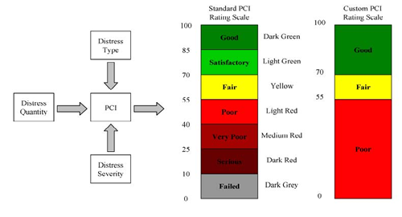
Part2: Data analysis:
1- PCI Analysis and treatment :
a) Pavement Condition Index (PCI): is a numerical indicator that rates the surface condition of the pavement with rang (0_100), where (0) the bad possible condition and (100) the best possible condition.
PCI = 100 – CDV

Slide 52

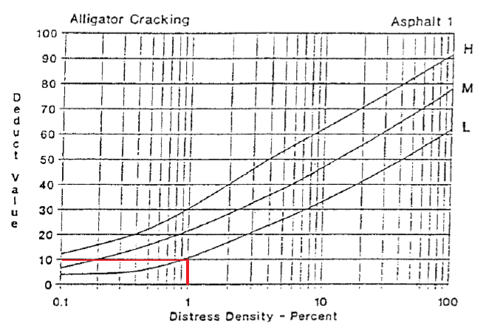
Estimation density of each defect
Density =
Estimation deducts value of each defect

Slide 53
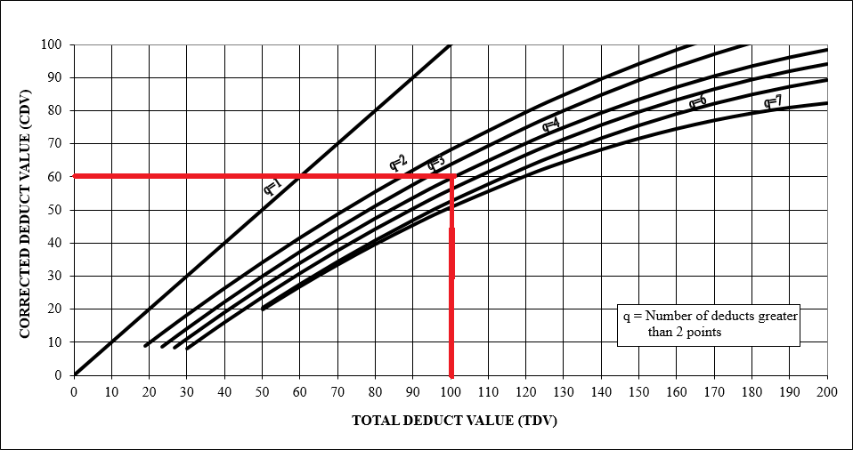
Estimation corrective deduct value (CDV):

Slide 54
Estimation of PCI for each section
PCI = 100 – CDV
PCI value of Haddad right direction
Section number | PCI
1 | 10
2 | 46
3 | 25
4 | 50
PCI value of Haddad left direction
Section number | PCI
1 | 21
2 | 40
3 | 24
4 | 54

Slide 55
b) Treatment of pavement :
condition category | Pavement condition index |  | General treatments strategy | Treatment unit coast/m2
 | Lower limit | Upper limit
Excellent | 90 | 100 | Do nothing | 0
Excellent | 80 | 90 | hot sand and roll | 3.5
Very good | 70 | 80 | Hot seal/seal coat | 2
Good | 60 | 70 | Crack sealing | 0.5
Good | 50 | 60 | Surface patching | 2
Fair | 40 | 50 | Deep patching | 25
Fair | 30 | 40 | Slurry seal | 3.5
Poor | 20 | 30 | Milling and repave | 17.5
Very poor | 10 | 20 | Base repair and repave | 30
Failed | 0 | 10 | Structural overlay | 40

Slide 56
Section number | PCI | Suitable treatment | Unit coast/m2 | Treatment cost$
1 | 10 | Base repair and repave | 30 | 19500
2 | 46 | Deep patching | 25 | 16250
3 | 25 | Milling and repave | 17.5 | 11375
4 | 50 | Surface patching | 2 | 1300
Total cost for Haddad street =88,725 $
Total cost for AL-Nasreh street = 556,225 $
Total cost for two street = 644.950 $

Slide 57
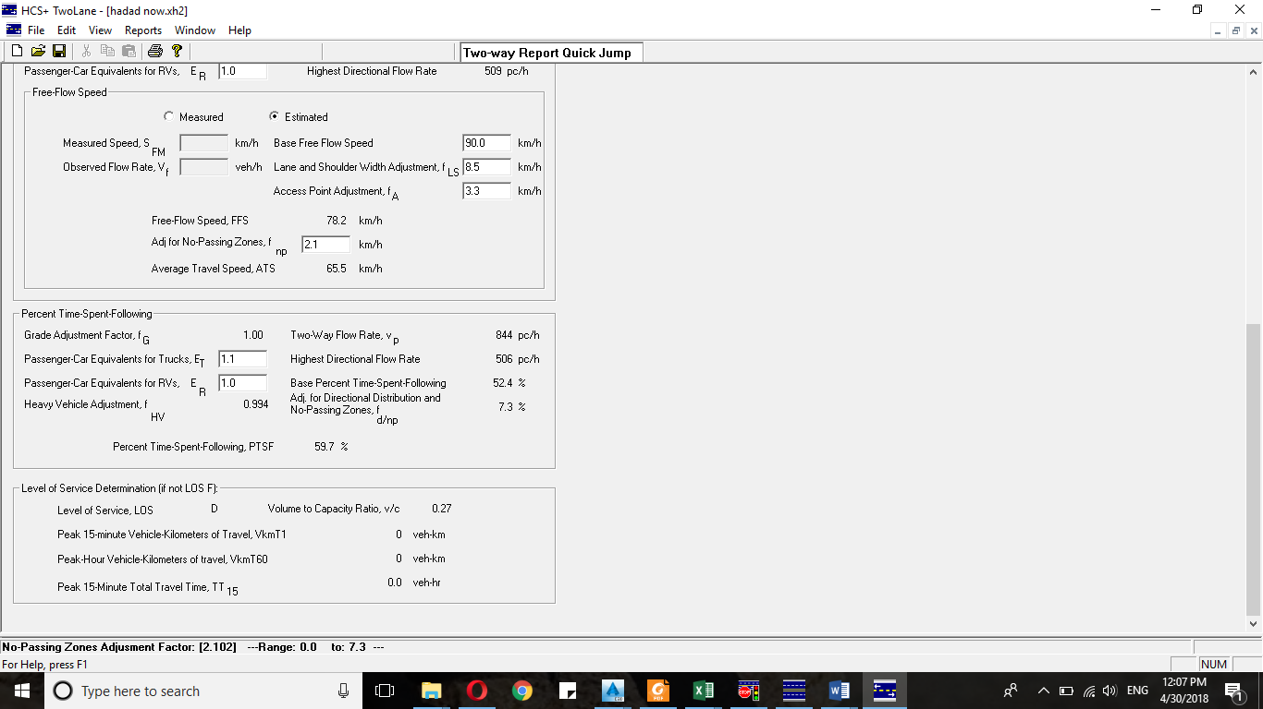
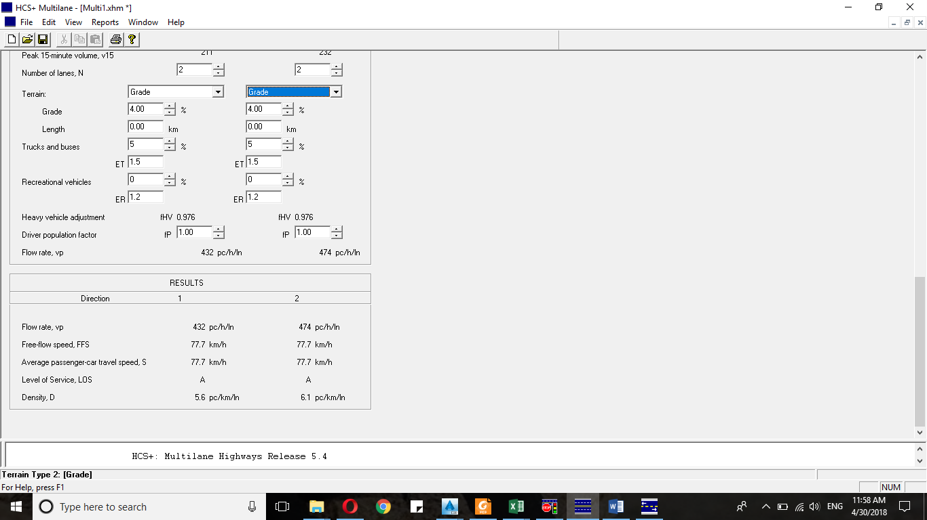
2- Traffic Volume Analysis
Using Highway Capacity Software (HCS2000) to find the current level of service (LOS) for two links:
Link Name | (LOS)
Haddad | D
AL-Nasreh | A

Slide 58
Part2: Design of Two Links
1-Design control Cratiria
a. Design Speed :
Superelevation (e) = 4%
Calculate:
-Side friction factor from next figure.
-Minimum Radius for Two Links by next equation.
Link Name | Design Speed
Haddad | 60 Km/hr
AL-Nasreh | 80 Km/hr

Slide 59
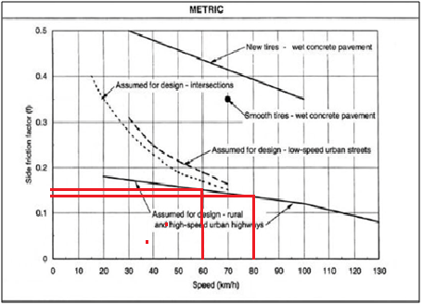


= 135 m
Link Name | Design Speed(Km/hr) | Side Friction Factor (f%) | Minimum Radius (m) | Superelevation (e%)
Haddad | 60 | 17 | 135 | 4
AL-Nasreh | 80 | 14 | 280 | 4

Slide 60
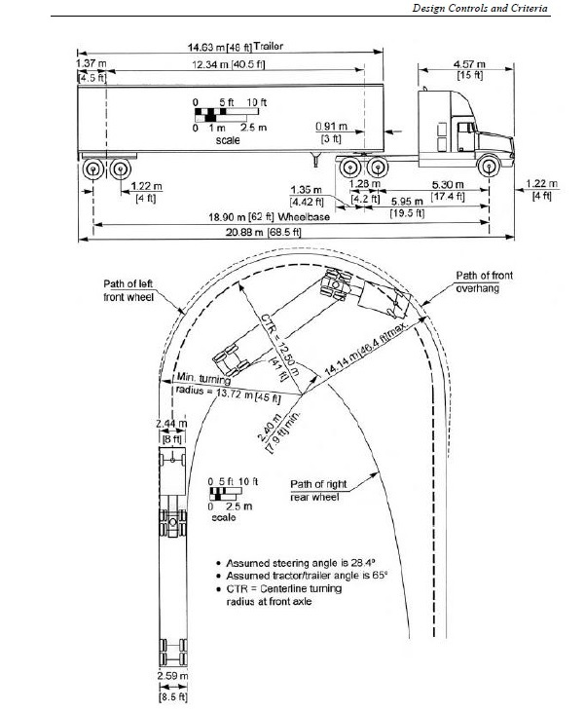
b. Design Vehicle (WB-20) …AASHTO(2011)
Dimension calcification: | Unit (meter)
Height | 4.1
Width | 2.6
Length | 22.4
Minimum turning radius | 13.7
Minimum inside radius | 1.3

Slide 61
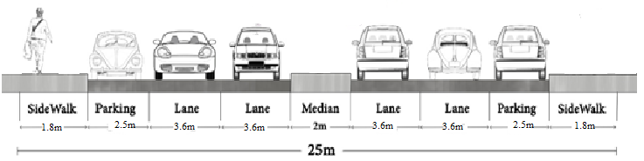
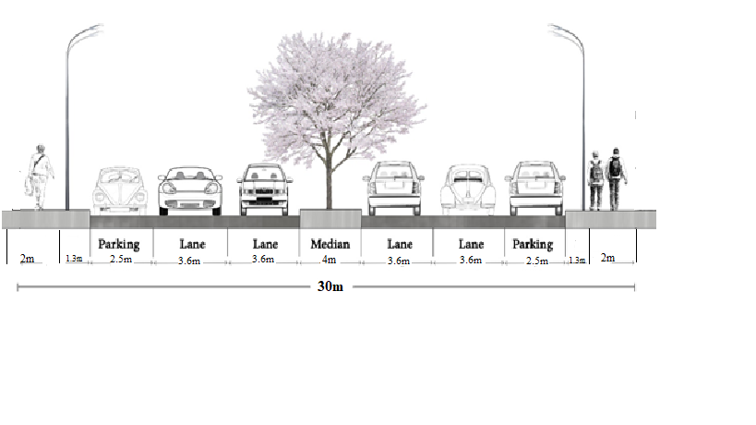
c. Typical Cross Section Elements
Link Name | No. Lane | Total Section Width (m) | Travel Lane Width (m) | Medians Width (m) | Sidewalks (m)
Haddad | 4 | 25 | 3.6 | 2 | 2
AL-Nasreh | 4 | 30 | 3.6 | 4 | 1.3+2 (3.3)
Haddad
AL-Nasreh

Slide 62
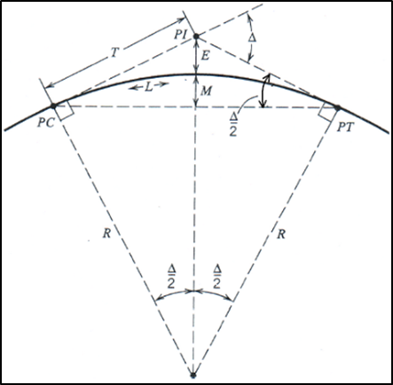
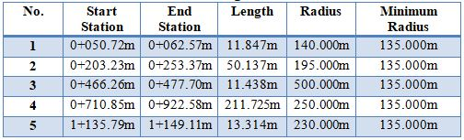
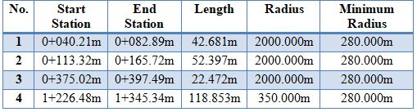
2- Design Horizontal Alignment
Use CIVIL3D software
Type the horizontal curve is simple curve along two links.
Haddad Street
AL-Nasreh Street

Slide 63
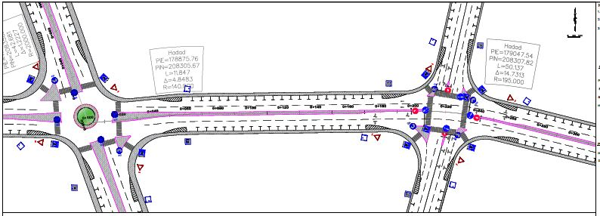
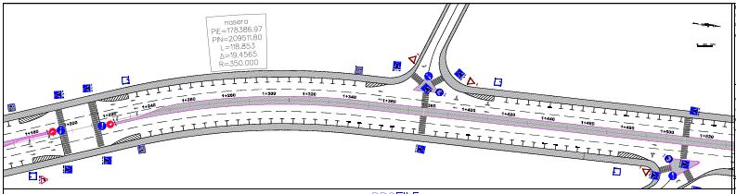
Section (0 – 300) Hadda Street
Section (1200 – 1500) AL-Nzsreh Street

Slide 64
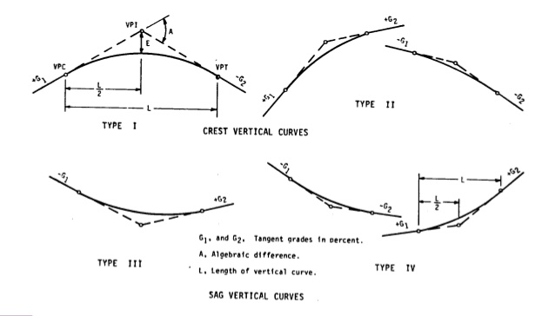
2- Design Vertical Alignment
Crest curve : minimum K for
Stopping Sight Distance(SSD)
Sag curve : minimum K for
Headlight Sight Distance(HSD)

Slide 65
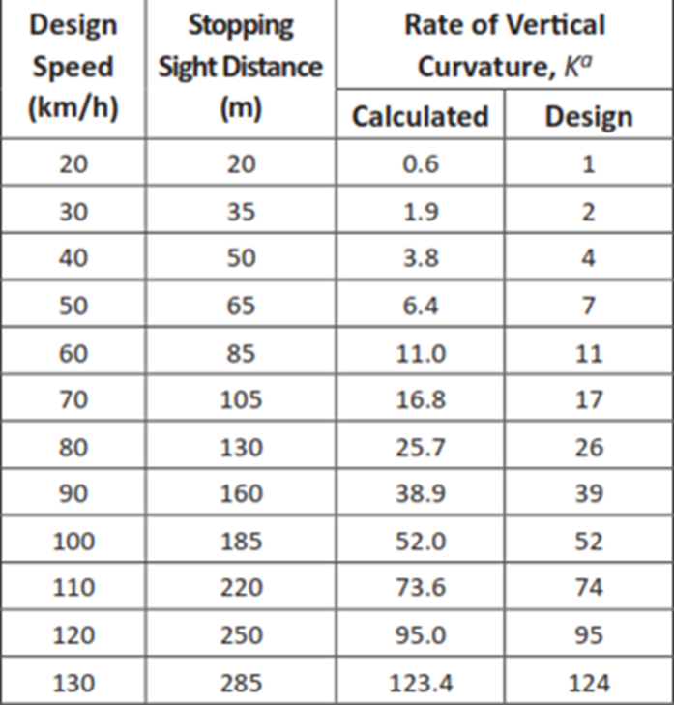
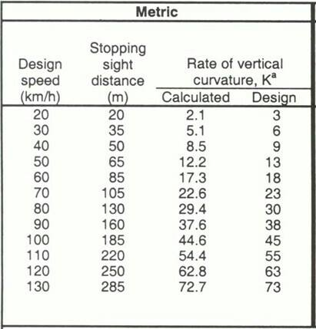
Crest curve
Sag curve

Slide 66
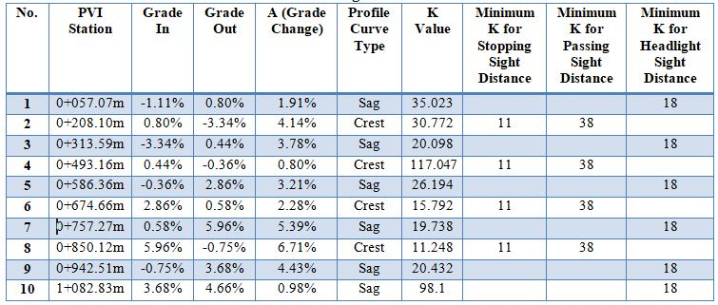
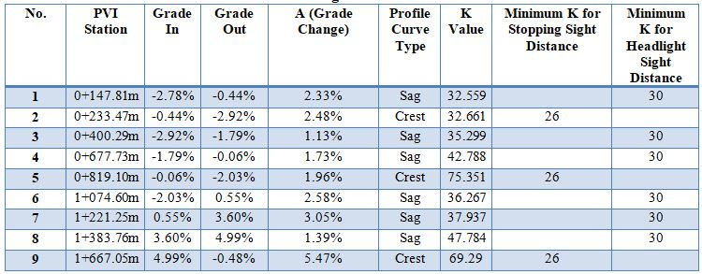
Haddad Street
AL-Nasreh Street

Slide 67
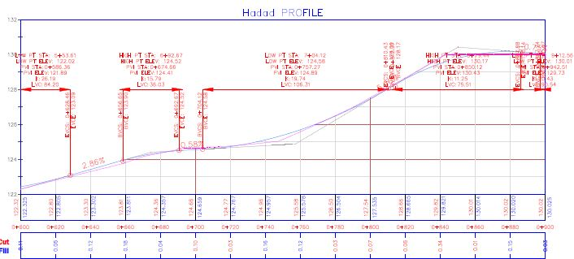
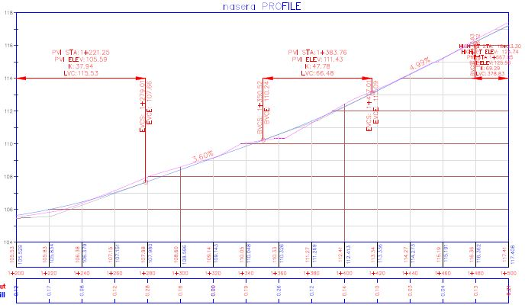

Slide 68
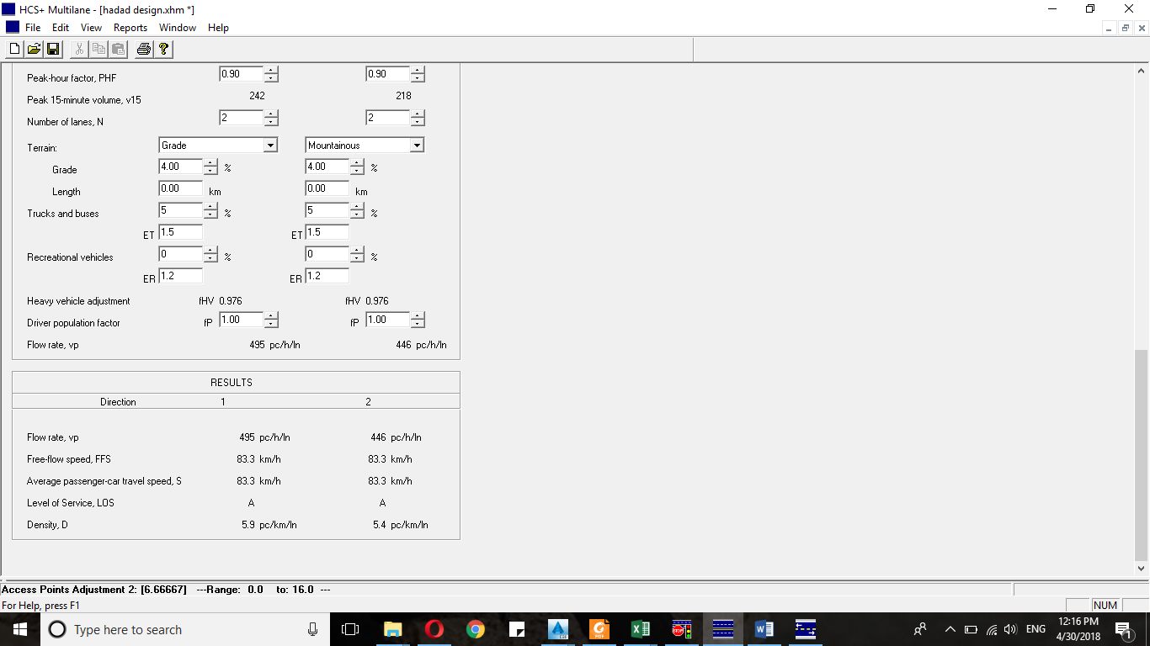
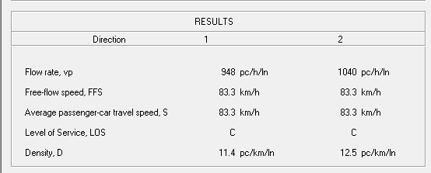
The (LOS) after 20 years consider growth rate 4%
P=
Link Name | (LOS)
Haddad | A
AL-Nasreh | C

Slide 69
4- Design pavement:
 | PHV | ESAL | Levels of reliability | Standard deviation
AL-Nasreh | 760 | 0.104*10⁶ | 95% | 0.45
Haddad | 397 | 0.097*10⁶ | 95% | 0.45
Layer | Al-nassrh |  | Haddad
 | CBR | Mr(Ib/in2) | CBR | Mr(Ib/in2)
sub-grade | 5.6 | 8400 | 11.3 | 16950
sub base | 40 | 27083 | 40 | 27083
base course | 100 | 48700 | 100 | 48700

Slide 70
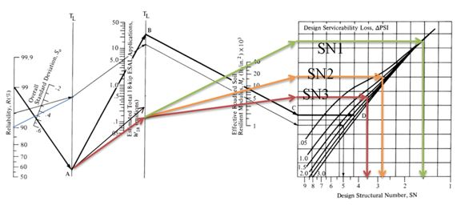
Estimation of structural number:

Slide 71
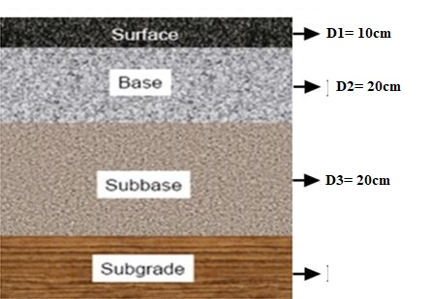
SN1=1.76 , SN2=2.66 , SN3=3.36
SN1=a1*D1 →where a1=0.44
SN2=SN1+(a2*D2*m2) →where a2= 0.14, m2=0.8
SN3=SN2+(a3*D3*m3) →where a3= 0.1, m3=0.8
D1 = 10cm , D2 = 20cm , D3 = 20cm

Slide 72
BOQ : Bill Of Quantity
Description items | Unit | Quantity | Cost/Unit | Total
cutting and wages | M³ | 52,985 | 3$ | 158,955
fill | M³ | 3,440 | 4$ | 13,760
Base course thickness 20 cm | M² | 91,350 | 3$ | 274,050.
Sub base thickness 20 cm | M² | 91,350 | 2$ | 182,700.
(5cm) Asphalt layer (in two layers) | M² | 252,588 | 10$ | 2,525,880
longitudinal pavement marks | L.M | 10,000 | 3$ | 30,000
Marking of pavement including the crosswalk, island and arrows. | M² | 2,645 | 15$ | 39,675
traffic signs | UNIT | 175 | 150$ | 26,250
(10*20 cm) sidewalks pavers. | M² | 32,956 | 30$ | 988,680
Curb stone | M | 12,400 | 15$ | 186,000
Cuties | UNIT | 1140 | 5$ | 5,700
 | Total Project Cost |  | 4,431,650 $

Slide 73
Conclusion
The first part of the graduation project
The bad current condition in term of traffic congestion and level of service uses improved through redesigning the three intersection using traffic signals for Al-Zayed and Al-Nabatat intersections, and channelization for Al-Cinema intersection.

Slide 74
Conclusion
The second part of the graduation project
The general rating for existing pavement condition for AL-Nasreh and Haddad Street is fair to very poor.
Moreover, The proper treatment and cost for each section was identified. Moreover, a new pavement design was proposed for both Streets (Al-nasreh &Hadad).

Slide 75
Recommendation
Prevent the track from enter intersections at the day and find alternative routes.
We recommended for a new system traffic management for the whole city.
It is important to apply the proper maintenance strategy for two street (Hadad & alnasreh).

Slide 76


