Slide 1
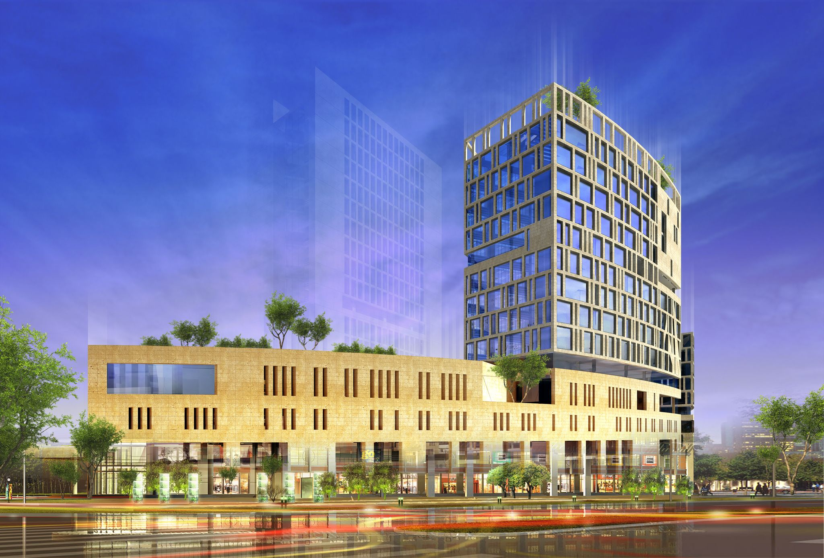

Analysis of Ammar Tower on Ramallah city
By:
Karsou Othman (11819320)
Osaid Abu Shanab (11821753)
Mahmoud Najjar (11821751)
Under supervision of:
Dr. Munther Diab

Slide 2
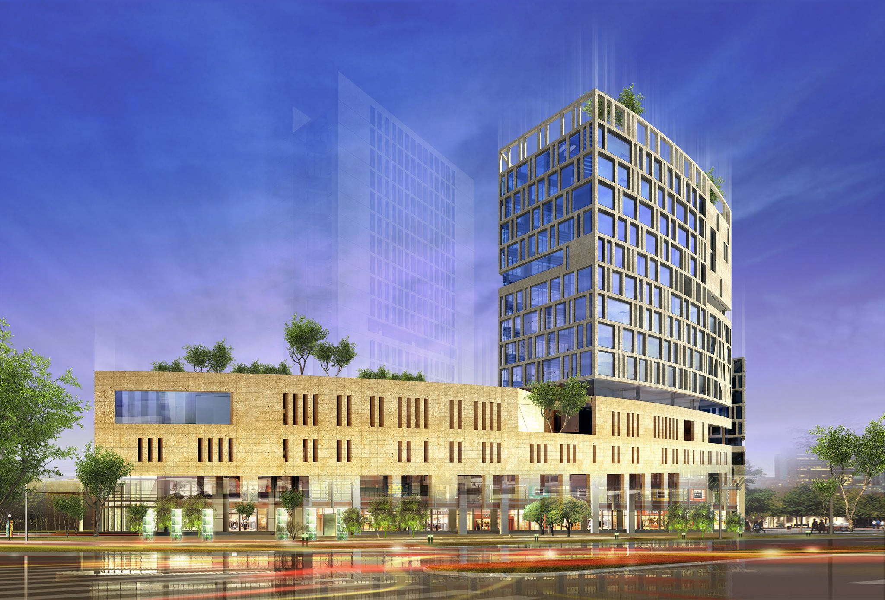
outline
1
Introduction
2
Preliminary Dimensions
3
Seismic analysis

Slide 3
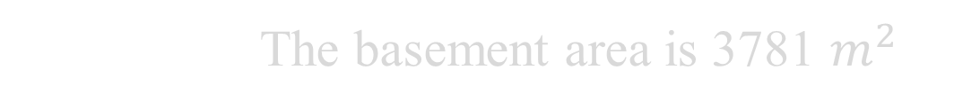
Project description
1
The project name is ammar tower
Introduction
2
Located at It's located at Al-ersal center in Al-biereh
3
Consist of 19 floors
4
The basement area is 3781 $m^{2}$

Slide 4
Project description
5
Ground floor to the 4th floor has an area equal to 2140 $m^{2}$
Introduction
6
5th floor up to the roof have an area equal to 1036 $m^{2}$
7
In this project the structure was analyzed 25 floors
8
Consist to 3 basements and 22 floors

Slide 5
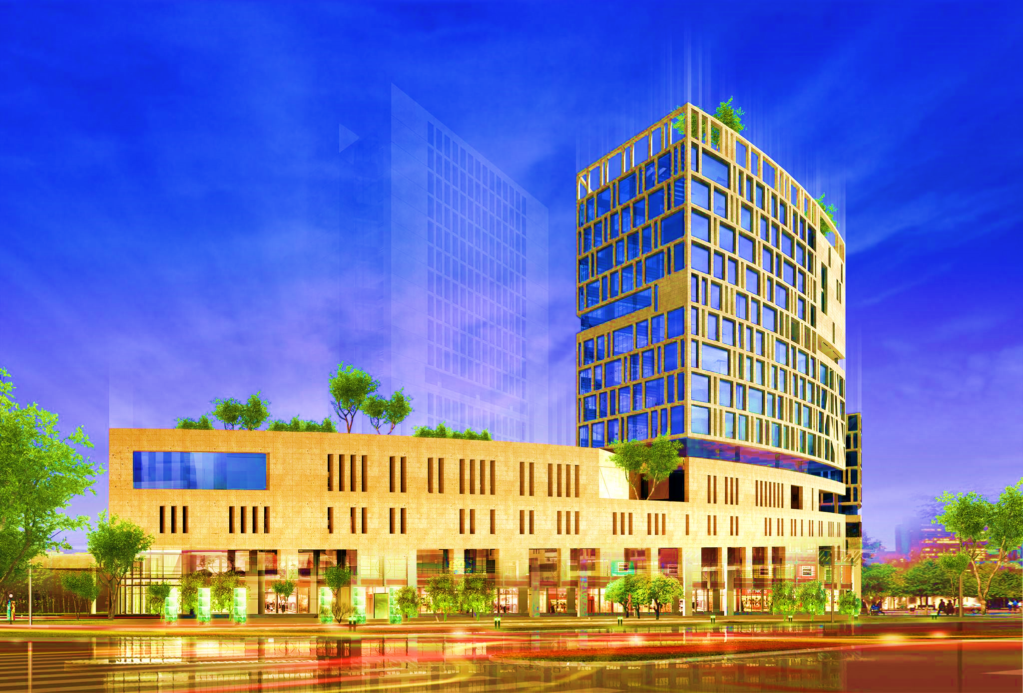
A photograph of Ammar Tower in Ramallah

Slide 6
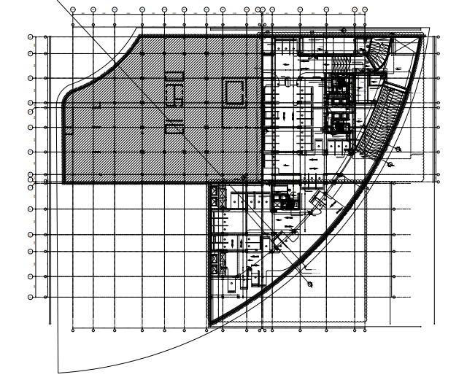
Left part It was not implemented in reality.

Slide 7
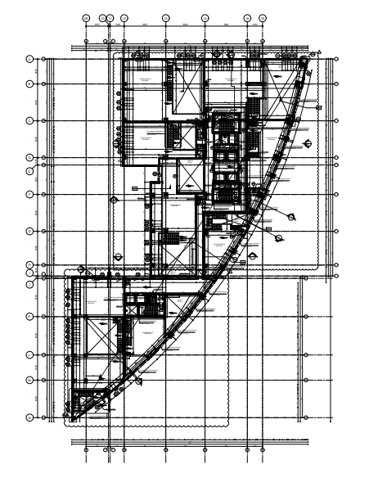
Ground floor , first floor , second floor , third floor and fourth floor have the same plan view.

Slide 8
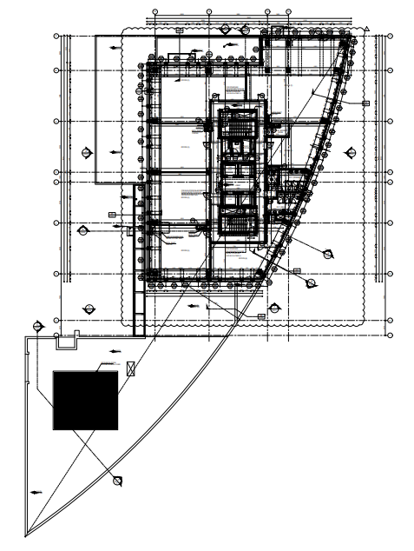
fifth floor up to the roof have the same plan view.

Slide 9
Hight | Floor | Hight | Floor
4 | f10 | 3.5 | Basement 3
4 | f11 | 3.5 | Basement 2
4 | f12 | 5.1 | Basement 1
4 | f13 | 4 | Ground floor
4 | f14 | 4 | f1
4 | f15 | 4 | f2
4 | f16 | 4.5 | f3
4 | f17 | 4 | f4
4 | f18 | 4 | f5
4 | f19 | 4 | f6
4 | f20 | 4 | f7
4 | f21 | 4 | f8
 |  | 4 | f9
Introduction

Slide 10
Materials
Concrete.
value | Property
30 | Compressive strength, fc ( MPA )
25.7 | Modulus of elasticity, Ec (GPa)
25 | Unit wight (kN./m3)
Introduction
Steel.
Value | Property
420 | Yielding strength, fy (Mpa)
200 | Modulus of elasticity, Es (GPa)

Slide 11
Materials
Other materials.
Ɣ in kN/m³ | Material
12 | Blocks
18 | Filling Materials
26 | Tiles
23 | Plaster
13 | Aggregate
23 | Concrete Mortar
30 | Masonry Stone
Introduction

Slide 12
Load type
The load was calculated according to ASCE 17-16 code.
As the following:
Introduction
Value | Type
5 kN./m2 | Live load
5 kN./m2 | Super dead load
Program calculated | Dead load

Slide 13
Types of structural systems.
1
Wall-frame system (dual system)
Preliminary Dimensions
2
Shear wall system
3
Frame system
The system used in this project is wall-frame system (dual system)

Slide 14
The dimension were calculated according to ASCI 318-19 code.
Preliminary Dimensions
Thickness | Type
300 mm | Flat slab
400 mm | Voided slab
400 mm | Waffle slab
250 mm | solid slab
350 mm | Ribbed slab

Slide 15
width | Depth | Frame section
700 mm | 700 mm | Column
500 mm | 800 mm | Beam
Preliminary Dimensions
thickness | Type of wall
300 mm | Shear wall
250 mm | Retaining wall

Slide 16
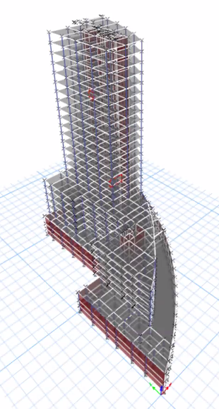
3D- Modeling by ETAPS software.

Slide 17
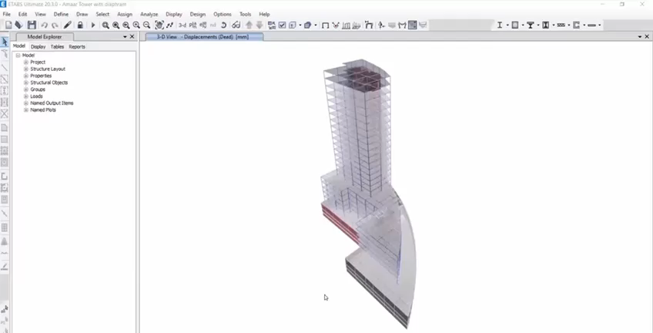
Verification of Structural Analysis.
Compatibility Check.
Preliminary Dimensions

Slide 18
Verification of Structural Analysis.
Equilibrium Check.
Preliminary Dimensions
Value | Check load
10000 kN | ETAPS result
10000 kN | Hand calculation
0% | Percentage of error

Slide 19
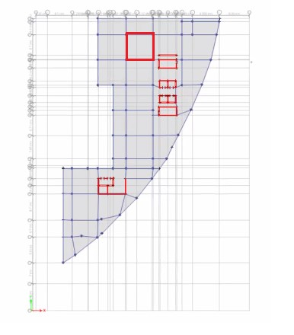
Verification of Structural Analysis.
Internal force check.
On slab:
Preliminary Dimensions
Percentage of error | Hand calculation | ETAPS RESULT | Type
8.72% | 289.97 kN.m | 269.67 kN.m | Moment

Slide 20
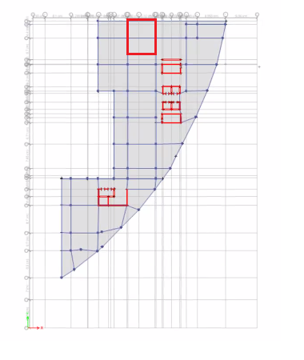
Verification of Structural Analysis.
Internal force check.
On beam:
Preliminary Dimensions
Percentage of error | Hand calculation | ETAPS RESULT | Type
7.01% | 207.33 kN.m | 192.8 kN.m | Moment

Slide 21
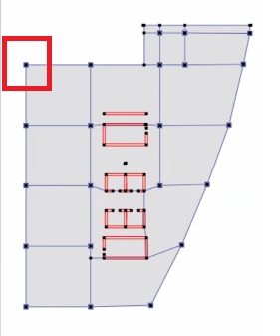
Verification of Structural Analysis.
Internal force check.
On column:
Preliminary Dimensions
Percentage of error | Hand calculation | ETAPS RESULT | Type
6.12% | 371.57 kN | 348.8 kN | Axial force

Slide 22
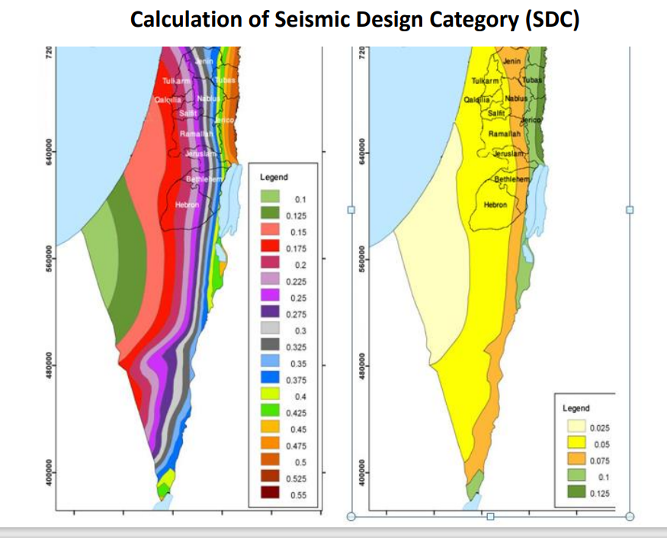
Equivalent static.
seismic analysis
value | Factor
0.275 | S1
0.075 | Ss

Slide 23
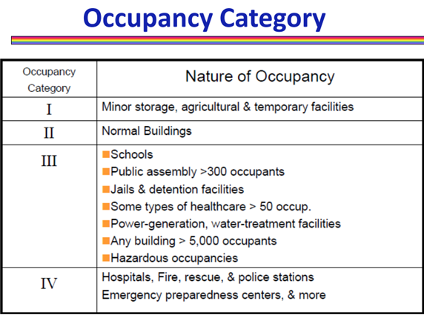
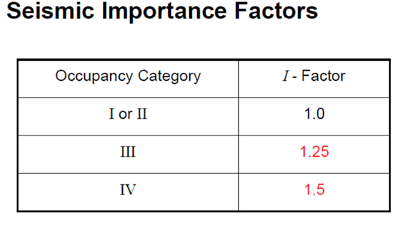
Importance factor.
seismic analysis

Slide 24
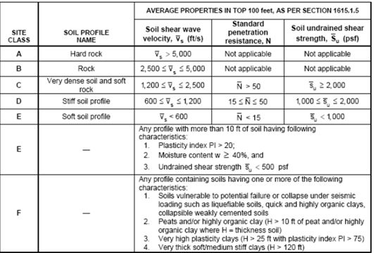
Site class.
seismic analysis
Site classification is B

Slide 25
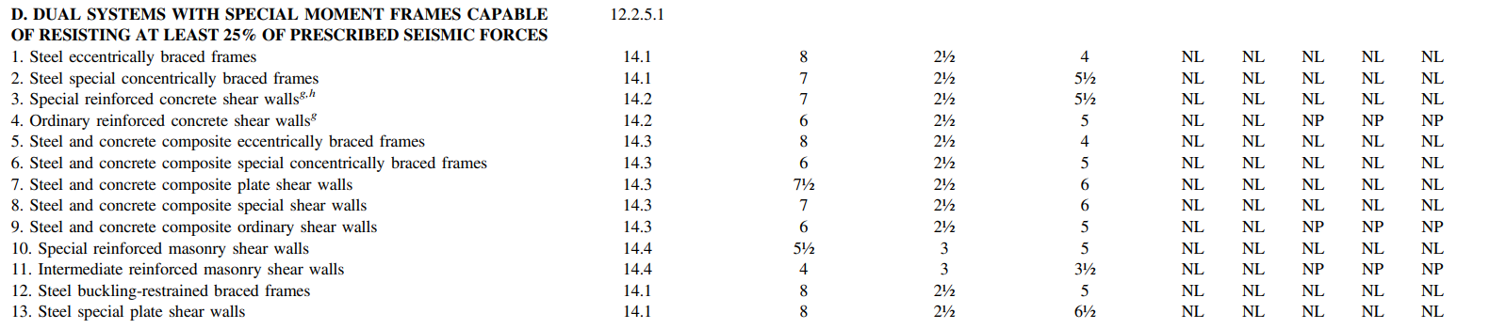
Response Modification factor.
seismic analysis

Slide 26
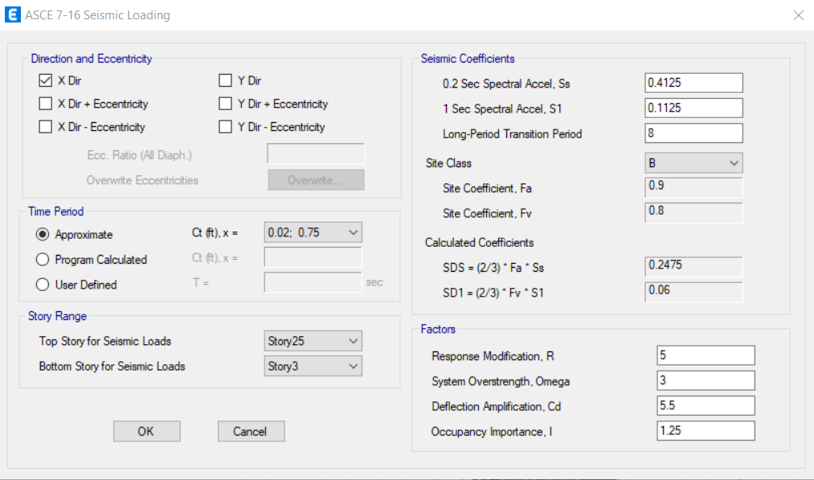
All the factors were entered to the ETABS To calculate the forces.
seismic analysis

Slide 27
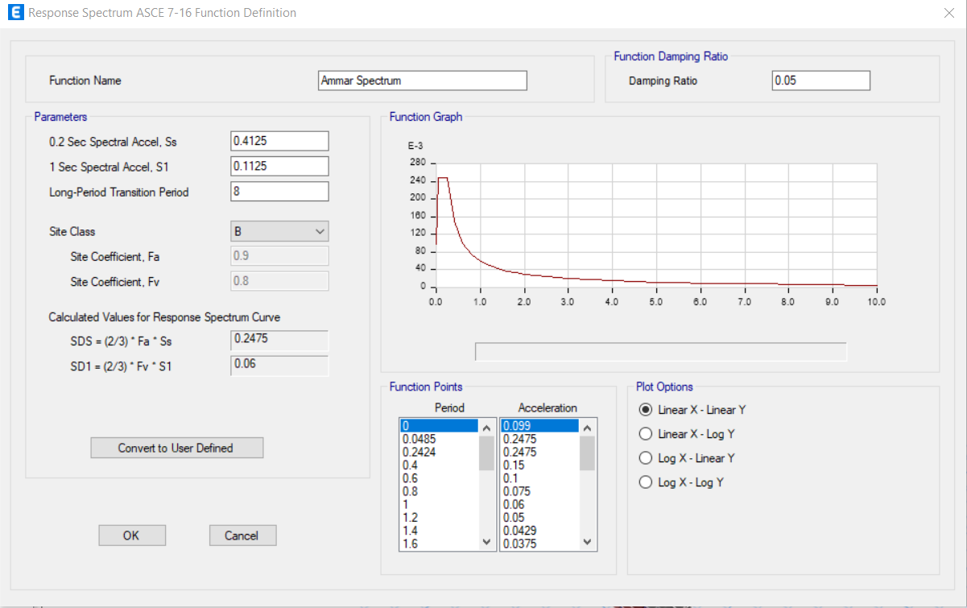
Response Spectrum method.
seismic analysis

Slide 28
Analysis results.
seismic analysis
forces distribution:
Force from Response X(KN) | Story
1309.4909 | Story 25
2040.4849 | Story 24
2325.9373 | Story 23
2254.6798 | Story 22
1995.7456 | Story 21
1799.6382 | Story 20
1864.0019 | Story 19
2129.907 | Story 18
2408.2908 | Story 17
2590.8769 | Story 16
2672.8416 | Story 15
2709.2003 | Story 14
2758.6831 | Story 13
2836.2656 | Story 12
2908.3585 | Story 11
2930.3995 | Story 10
2887.2278 | Story 9
2963.3312 | Story 8
3539.9181 | Story 7
4398.1353 | Story 6
5256.9583 | Story 5
5899.4813 | Story 4
6507.9784 | Story 3
6834.9871 | Story 2
6976.8105 | Story 1
V (KN) | Story
767.7182 | Story 25
1422.357 | Story 24
2032.444 | Story 23
2596.195 | Story 22
3120.229 | Story 21
3602.773 | Story 20
4044.912 | Story 19
4447.767 | Story 18
4812.498 | Story 17
5140.31 | Story 16
5432.458 | Story 15
5690.252 | Story 14
5915.065 | Story 13
6108.344 | Story 12
6271.618 | Story 11
6406.521 | Story 10
6514.804 | Story 9
6692.745 | Story 8
6827.951 | Story 7
6913.062 | Story 6
6959.858 | Story 5
6976.957 | Story 4
6976.957 | Story 3
6979.385 | Story 2
6976.435 | Story 1

Slide 29
The distribution of the base shear on each individual story is shown in the following tables:
seismic analysis
In x direction:
In Y direction:
Vx(KN) | Story
767.7182 | Story 25
654.6383 | Story 24
610.0871 | Story 23
563.7514 | Story 22
524.034 | Story 21
482.5443 | Story 20
442.1389 | Story 19
402.8546 | Story 18
364.7308 | Story 17
327.8122 | Story 16
292.1481 | Story 15
257.7939 | Story 14
224.8132 | Story 13
193.2786 | Story 12
163.2747 | Story 11
134.9024 | Story 10
108.2837 | Story 9
177.9402 | Story 8
135.2059 | Story 7
85.1114 | Story 6
46.7965 | Story 5
17.0983 | Story 4
0 | Story 3
0 | Story 2
0 | Story 1
Vy(KN) | Story
767.7182 | Story 25
654.6383 | Story 24
610.0871 | Story 23
563.7514 | Story 22
524.034 | Story 21
482.5443 | Story 20
442.1389 | Story 19
402.8546 | Story 18
364.7308 | Story 17
327.8122 | Story 16
292.1481 | Story 15
257.7939 | Story 14
224.8132 | Story 13
193.2786 | Story 12
163.2747 | Story 11
134.9024 | Story 10
108.2837 | Story 9
177.9402 | Story 8
135.2059 | Story 7
85.1114 | Story 6
46.7965 | Story 5
17.0983 | Story 4
0 | Story 3
0 | Story 2
0 | Story 1

Slide 30
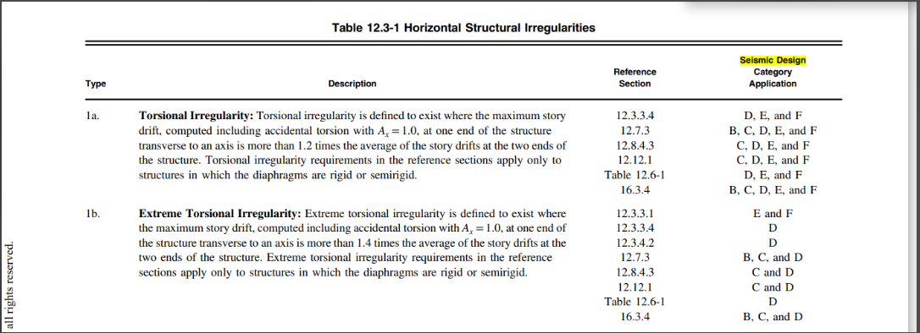
Irregularity check.
seismic analysis
Horizontal irregularity:

Slide 31
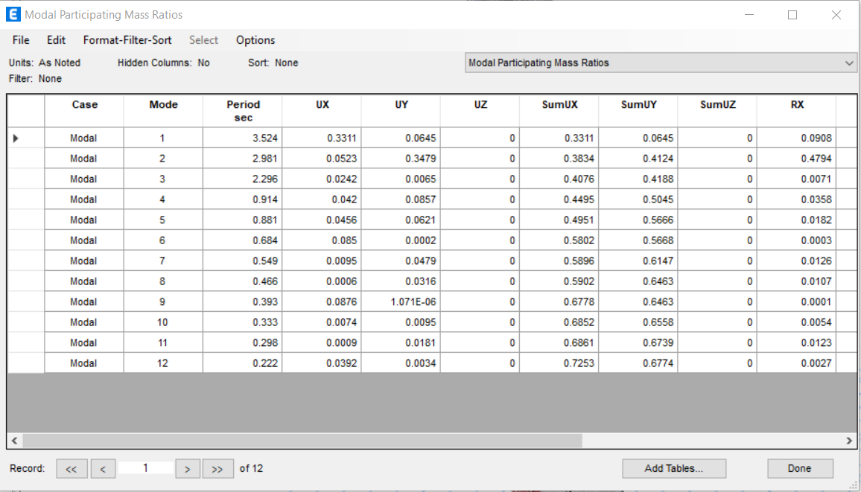
Irregularity check.
seismic analysis
Horizontal irregularity:
value | Modal ratios
0.72 | Sum of UX
0.67 | Sum of UY

Slide 32
The results are confirmed with the results of the torsional irregularity check.
seismic analysis
In x direction:
In Y direction:
Torsional irregularity X
Story Number | Max Drift | AVG Drift | Ratio | Check
Story 25 | 4.83 | 4.824 | 1.00 | regular
Story24 | 4.963 | 4.905 | 1.01 | regular
Story23 | 5.118 | 5 | 1.02 | regular
Story 22 | 5.287 | 5.104 | 1.04 | regular
Story 21 | 5.455 | 5.208 | 1.05 | regular
Story 20 | 5.619 | 5.305 | 1.06 | regular
Story 19 | 5.767 | 5.386 | 1.07 | regular
Story 18 | 5.893 | 5.447 | 1.08 | regular
Story 17 | 5.991 | 5.482 | 1.09 | regular
Story 16 | 6.056 | 5.485 | 1.10 | regular
Story 15 | 6.085 | 5.453 | 1.12 | regular
Story 14 | 6.074 | 5.38 | 1.13 | regular
Story 13 | 6.019 | 5.263 | 1.14 | regular
Story 12 | 5.919 | 5.096 | 1.16 | regular
Story 11 | 5.771 | 4.875 | 1.18 | regular
Story 10 | 5.574 | 4.595 | 1.21 | irregular
Story 9 | 5.339 | 4.236 | 1.26 | irregular
Story 8 | 5.187 | 2.197 | 2.36 | irregular
Story 7 | 5.206 | 2.187 | 2.38 | irregular
Story 6 | 3.899 | 1.647 | 2.37 | irregular
Story 5 | 3.132 | 1.338 | 2.34 | irregular
Story 4 | 2.136 | 0.953 | 2.24 | irregular
Story 3 | 0.501 | 0.347 | 1.44 | irregular
Story 2 | 0.219 | 0.145 | 1.51 | irregular
Story 1 | 0.124 | 0.078 | 1.59 | irregular
Torsional irregularity Y
Story Number | Max Drift | AVG Drift | Ratio | Check
Story 25 | 2.513 | 2.399 | 1.05 | regular
Story24 | 2.658 | 2.53 | 1.05 | regular
Story23 | 2.83 | 2.684 | 1.05 | regular
Story 22 | 3.016 | 2.847 | 1.06 | regular
Story 21 | 3.203 | 3.009 | 1.06 | regular
Story 20 | 3.381 | 3.162 | 1.07 | regular
Story 19 | 3.545 | 3.302 | 1.07 | regular
Story 18 | 3.688 | 3.423 | 1.08 | regular
Story 17 | 3.806 | 3.524 | 1.08 | regular
Story 16 | 3.895 | 3.601 | 1.08 | regular
Story 15 | 3.949 | 3.65 | 1.08 | regular
Story 14 | 3.964 | 3.668 | 1.08 | regular
Story 13 | 3.93 | 3.649 | 1.08 | regular
Story 12 | 3.837 | 3.587 | 1.07 | regular
Story 11 | 3.664 | 3.467 | 1.06 | regular
Story 10 | 3.381 | 3.267 | 1.03 | regular
Story 9 | 2.938 | 2.91 | 1.01 | regular
Story 8 | 2.641 | 2.068 | 1.28 | irregular
Story 7 | 2.693 | 2.112 | 1.28 | irregular
Story 6 | 2.096 | 1.641 | 1.28 | irregular
Story 5 | 1.755 | 1.374 | 1.28 | irregular
Story 4 | 1.221 | 0.963 | 1.27 | irregular
Story 3 | 0.203 | 0.142 | 1.43 | irregular
Story 2 | 0.068 | 0.053 | 1.28 | irregular
Story 1 | 0.051 | 0.039 | 1.31 | irregular

Slide 33
To deal with this irregularity, the eccentricity must be calculated.
seismic analysis
the Center of mass and rigidity
Story | Diaphragms | Mass X | Mass y | C.M |  | Cumulative x | Cumulative Y | XCCM | YCCm | C.R
 |  |  |  | x_{m} | y_{m} |  |  |  |  | XCR | YCR
Story25 | Diaphragm2 | 2042488.85 | 2042488.85 | 45.2803 | 77.8734 | 2042488.85 | 2042488.85 | 45.28 | 77.87 | 46.10 | 75.48
Story24 | Diaphragm2 | 1862736.16 | 1862736.16 | 45.333 | 77.7295 | 3905225.01 | 3905225.01 | 45.31 | 77.80 | 46.05 | 75.33
Story23 | Diaphragm2 | 1862736.16 | 1862736.16 | 45.333 | 77.7295 | 5767961.17 | 5767961.17 | 45.31 | 77.78 | 46.01 | 75.18
Story22 | Diaphragm2 | 1853604.6 | 1853604.6 | 45.2702 | 77.635 | 7621565.77 | 7621565.77 | 45.30 | 77.75 | 45.97 | 75.01
Story21 | Diaphragm2 | 1862812.64 | 1862812.64 | 45.3337 | 77.7303 | 9484378.41 | 9484378.41 | 45.31 | 77.74 | 45.93 | 74.84
Story20 | Diaphragm2 | 1862812.64 | 1862812.64 | 45.3337 | 77.7303 | 11347191.05 | 11347191.05 | 45.31 | 77.74 | 45.88 | 74.65
Story19 | Diaphragm2 | 1862812.64 | 1862812.64 | 45.3337 | 77.7303 | 13210003.69 | 13210003.69 | 45.32 | 77.74 | 45.82 | 74.45
Story18 | Diaphragm2 | 1862812.64 | 1862812.64 | 45.3337 | 77.7303 | 15072816.34 | 15072816.34 | 45.32 | 77.74 | 45.75 | 74.22
Story17 | Diaphragm2 | 1862812.64 | 1862812.64 | 45.3337 | 77.7303 | 16935628.98 | 16935628.98 | 45.32 | 77.74 | 45.65 | 73.96
Story16 | Diaphragm2 | 1862812.64 | 1862812.64 | 45.3337 | 77.7303 | 18798441.62 | 18798441.62 | 45.32 | 77.74 | 45.51 | 73.66
Story15 | Diaphragm2 | 1862812.64 | 1862812.64 | 45.3337 | 77.7303 | 20661254.26 | 20661254.26 | 45.32 | 77.74 | 45.34 | 73.30
Story14 | Diaphragm2 | 1862812.64 | 1862812.64 | 45.3337 | 77.7303 | 22524066.9 | 22524066.9 | 45.32 | 77.74 | 45.09 | 72.85
Story13 | Diaphragm2 | 1862812.64 | 1862812.64 | 45.3337 | 77.7303 | 24386879.54 | 24386879.54 | 45.32 | 77.73 | 44.75 | 72.26
Story12 | Diaphragm2 | 1862812.64 | 1862812.64 | 45.3337 | 77.7303 | 26249692.18 | 26249692.18 | 45.32 | 77.73 | 44.26 | 71.48
Story11 | Diaphragm2 | 1862812.64 | 1862812.64 | 45.3337 | 77.7303 | 28112504.82 | 28112504.82 | 45.33 | 77.73 | 43.53 | 70.35
Story10 | Diaphragm2 | 1862812.64 | 1862812.64 | 45.3337 | 77.7303 | 29975317.46 | 29975317.46 | 45.33 | 77.73 | 42.38 | 68.66
Story9 | Diaphragm2 | 1862812.64 | 1862812.64 | 45.3337 | 77.7303 | 31838130.1 | 31838130.1 | 45.33 | 77.73 | 40.59 | 66.04
Story8 | Diaphragm2 | 3966595.7 | 3966595.7 | 35.6258 | 64.8273 | 35804725.8 | 35804725.8 | 44.25 | 76.30 | 38.49 | 62.99
Story7 | Diaphragm2 | 4131906.92 | 4131906.92 | 35.3321 | 64.239 | 39936632.72 | 39936632.72 | 43.33 | 75.06 | 38.13 | 62.88
Story6 | Diaphragm2 | 4131906.92 | 4131906.92 | 35.3321 | 64.239 | 44068539.63 | 44068539.63 | 42.58 | 74.04 | 37.80 | 62.90
Story5 | Diaphragm2 | 4095492.81 | 4095492.81 | 35.3187 | 64.2501 | 48164032.44 | 48164032.44 | 41.96 | 73.21 | 37.50 | 63.00
Story4 | Diaphragm2 | 4097790.34 | 4097790.34 | 35.3066 | 64.2301 | 52261822.78 | 52261822.78 | 41.44 | 72.50 | 37.12 | 62.85
Story3 | Diaphragm2 | 7137329.14 | 7137329.14 | 31.8843 | 55.747 | 59399151.92 | 59399151.92 | 40.29 | 70.49 | 35.51 | 59.16
Story2 | Diaphragm2 | 7264433.61 | 7264433.61 | 31.7232 | 55.8356 | 66663585.53 | 66663585.53 | 39.36 | 68.89 | 35.37 | 60.09
Story1 | Diaphragm2 | 7178821.08 | 7178821.08 | 32.198 | 55.8127 | 73842406.61 | 73842406.61 | 38.66 | 67.62 | 35.48 | 60.51

Slide 34
To deal with this irregularity, the eccentricity must be calculated.
seismic analysis
the Eccentricity
Eccentricity |  | Dimension |  | ex/Dx result |  | ey/Dy result
e_{x} | e_{y} | Dx | Dy | % |  | %
0.82 | 2.40 | 31 | 39 | 2.6 | Ok | 6.1 | Ok
0.72 | 2.39 | 31 | 39 | 2.3 | Ok | 6.1 | Ok
0.67 | 2.55 | 31 | 39 | 2.2 | Ok | 6.5 | Ok
0.70 | 2.62 | 31 | 39 | 2.3 | Ok | 6.7 | Ok
0.60 | 2.89 | 31 | 39 | 1.9 | Ok | 7.4 | Ok
0.55 | 3.08 | 31 | 39 | 1.8 | Ok | 7.9 | Ok
0.49 | 3.28 | 31 | 39 | 1.6 | Ok | 8.4 | Ok
0.41 | 3.51 | 31 | 39 | 1.3 | Ok | 9.0 | Ok
0.31 | 3.77 | 31 | 39 | 1.0 | Ok | 9.7 | Ok
0.18 | 4.07 | 31 | 39 | 0.6 | Ok | 10.4 | Ok
0.00 | 4.43 | 31 | 39 | 0.0 | Ok | 11.4 | Ok
0.24 | 4.88 | 31 | 39 | 0.8 | Ok | 12.5 | Ok
0.58 | 5.47 | 31 | 39 | 1.9 | Ok | 14.0 | Ok
1.07 | 6.25 | 31 | 39 | 3.5 | Ok | 16.0 | Not Ok
1.81 | 7.38 | 31 | 39 | 5.8 | Ok | 18.9 | Not Ok
2.95 | 9.07 | 31 | 39 | 9.5 | Ok | 23.2 | Not Ok
4.74 | 11.69 | 31 | 39 | 15.3 | Not ok | 30.0 | Not Ok
2.86 | 1.84 | 52 | 81.1 | 5.5 | Ok | 2.3 | Ok
2.80 | 1.36 | 52 | 81.1 | 5.4 | Ok | 1.7 | Ok
2.46 | 1.34 | 52 | 81.1 | 4.7 | Ok | 1.7 | Ok
2.18 | 1.25 | 52 | 81.1 | 4.2 | Ok | 1.5 | Ok
1.81 | 1.38 | 52 | 81.1 | 3.5 | Ok | 1.7 | Ok
3.62 | 3.41 | 70.5 | 96.915 | 5.1 | Ok | 3.5 | Ok
3.65 | 4.26 | 70.5 | 96.915 | 5.2 | Ok | 4.4 | Ok
3.28 | 4.70 | 70.5 | 96.915 | 4.7 | Ok | 4.8 | Ok

Slide 35
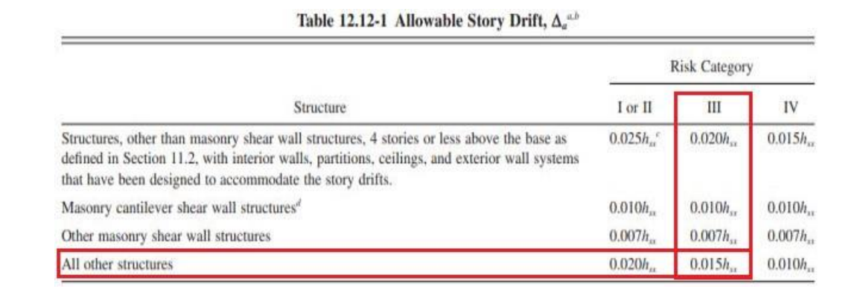
Drift check.
seismic analysis

Slide 36
Drift check.
seismic analysis
In X direction:
Story Drift X
Story | Height(m) | Δ Elastic(mm) | Δ Inelastic(mm) | Δ Service(mm) | Δ Allowable(mm) | Check
25 | 100.6 | 126.816 | 557.9904 | 390.59328 | 1509 | OK
24 | 96.6 | 121.626 | 535.1544 | 374.60808 | 1449 | OK
23 | 92.6 | 116.267 | 511.5748 | 358.10236 | 1389 | OK
22 | 88.6 | 110.711 | 487.1284 | 340.98988 | 1329 | OK
21 | 84.6 | 104.939 | 461.7316 | 323.21212 | 1269 | OK
20 | 80.6 | 98.951 | 435.3844 | 304.76908 | 1209 | OK
19 | 76.6 | 92.753 | 408.1132 | 285.67924 | 1149 | OK
18 | 72.6 | 86.363 | 379.9972 | 265.99804 | 1089 | OK
17 | 68.6 | 79.807 | 351.1508 | 245.80556 | 1029 | OK
16 | 64.6 | 73.119 | 321.7236 | 225.20652 | 969 | OK
15 | 60.6 | 66.339 | 291.8916 | 204.32412 | 909 | OK
14 | 56.6 | 59.511 | 261.8484 | 183.29388 | 849 | OK
13 | 52.6 | 52.685 | 231.814 | 162.2698 | 789 | OK
12 | 48.6 | 45.919 | 202.0436 | 141.43052 | 729 | OK
11 | 44.6 | 39.275 | 172.81 | 120.967 | 669 | OK
10 | 40.6 | 32.823 | 144.4212 | 101.09484 | 609 | OK
9 | 36.6 | 26.645 | 117.238 | 82.0666 | 549 | OK
8 | 32.6 | 21.166 | 93.1304 | 65.19128 | 489 | OK
7 | 28.6 | 15.782 | 69.4408 | 48.60856 | 429 | OK
6 | 24.1 | 10.364 | 45.6016 | 31.92112 | 361.5 | OK
5 | 20.1 | 6.296 | 27.7024 | 19.39168 | 301.5 | OK
4 | 16.1 | 3.017 | 13.2748 | 9.29236 | 241.5 | OK
3 | 12.1 | 0.774 | 3.4056 | 2.38392 | 181.5 | OK
2 | 7 | 0.274 | 1.2056 | 0.84392 | 105 | OK
1 | 3.5 | 0.101 | 0.4444 | 0.31108 | 52.5 | OK

Slide 37
Drift check.
seismic analysis
In Y direction:
Story Drift Y
Story | Height(m) | Δ Elastic(mm) | Δ Inelastic(mm) | Δ Service(mm) | Δ Allowable(mm) | Check
25 | 100.6 | 84.651 | 372.4644 | 260.72508 | 1509 | OK
24 | 96.6 | 81.553 | 358.8332 | 251.18324 | 1449 | OK
23 | 92.6 | 78.282 | 344.4408 | 241.10856 | 1389 | OK
22 | 88.6 | 74.816 | 329.1904 | 230.43328 | 1329 | OK
21 | 84.6 | 71.145 | 313.038 | 219.1266 | 1269 | OK
20 | 80.6 | 67.272 | 295.9968 | 207.19776 | 1209 | OK
19 | 76.6 | 63.208 | 278.1152 | 194.68064 | 1149 | OK
18 | 72.6 | 58.973 | 259.4812 | 181.63684 | 1089 | OK
17 | 68.6 | 54.587 | 240.1828 | 168.12796 | 1029 | OK
16 | 64.6 | 50.076 | 220.3344 | 154.23408 | 969 | OK
15 | 60.6 | 45.468 | 200.0592 | 140.04144 | 909 | OK
14 | 56.6 | 40.794 | 179.4936 | 125.64552 | 849 | OK
13 | 52.6 | 36.087 | 158.7828 | 111.14796 | 789 | OK
12 | 48.6 | 31.388 | 138.1072 | 96.67504 | 729 | OK
11 | 44.6 | 26.74 | 117.656 | 82.3592 | 669 | OK
10 | 40.6 | 22.201 | 97.6844 | 68.37908 | 609 | OK
9 | 36.6 | 17.855 | 78.562 | 54.9934 | 549 | OK
8 | 32.6 | 13.857 | 60.9708 | 42.67956 | 489 | OK
7 | 28.6 | 10.441 | 45.9404 | 32.15828 | 429 | OK
6 | 24.1 | 6.951 | 30.5844 | 21.40908 | 361.5 | OK
5 | 20.1 | 4.232 | 18.6208 | 13.03456 | 301.5 | OK
4 | 16.1 | 1.951 | 8.5844 | 6.00908 | 241.5 | OK
3 | 12.1 | 0.382 | 1.6808 | 1.17656 | 181.5 | OK
2 | 7 | 0.136 | 0.5984 | 0.41888 | 105 | OK
1 | 3.5 | 0.058 | 0.2552 | 0.17864 | 52.5 | OK

Slide 38
Delta effect.
seismic analysis
In X direction:
P-Delta X
Story | Height(m) | Δ Elastic(mm) | Δ Elastic service (mm) | P | Vx | Theta | check
25 | 100.6 | 126.816 | 88.7712 | 35052.525 | 767.7182 | 0.040289 | OK
24 | 96.6 | 121.626 | 85.1382 | 56679.1536 | 1422.3565 | 0.035121 | OK
23 | 92.6 | 116.267 | 81.3869 | 78305.7831 | 2032.4436 | 0.033862 | OK
22 | 88.6 | 110.711 | 77.4977 | 99842.8622 | 2596.1951 | 0.033638 | OK
21 | 84.6 | 104.939 | 73.4573 | 121470.9915 | 3120.2291 | 0.033803 | OK
20 | 80.6 | 98.951 | 69.2657 | 143099.1211 | 3602.7733 | 0.034134 | OK
19 | 76.6 | 92.753 | 64.9271 | 164727.2507 | 4044.9123 | 0.034519 | OK
18 | 72.6 | 86.363 | 60.4541 | 186355.3801 | 4447.7668 | 0.034889 | OK
17 | 68.6 | 79.807 | 55.8649 | 207983.5096 | 4812.4976 | 0.035194 | OK
16 | 64.6 | 73.119 | 51.1833 | 229611.6393 | 5140.3098 | 0.035392 | OK
15 | 60.6 | 66.339 | 46.4373 | 251239.7705 | 5432.4579 | 0.035439 | OK
14 | 56.6 | 59.511 | 41.6577 | 272867.9637 | 5690.2519 | 0.035294 | OK
13 | 52.6 | 52.685 | 36.8795 | 294496.0934 | 5915.0651 | 0.034908 | OK
12 | 48.6 | 45.919 | 32.1433 | 316124.224 | 6108.3436 | 0.034229 | OK
11 | 44.6 | 39.275 | 27.4925 | 337752.354 | 6271.6183 | 0.033197 | OK
10 | 40.6 | 32.823 | 22.9761 | 359380.4843 | 6406.5207 | 0.031746 | OK
9 | 36.6 | 26.645 | 18.6515 | 381008.6146 | 6514.8044 | 0.029803 | OK
8 | 32.6 | 21.166 | 14.8162 | 428796.2769 | 6692.7446 | 0.029118 | OK
7 | 28.6 | 15.782 | 11.0474 | 477298.1388 | 6827.9505 | 0.027002 | OK
6 | 24.1 | 10.364 | 7.2548 | 525085.8006 | 6913.0619 | 0.022865 | OK
5 | 20.1 | 6.296 | 4.4072 | 572873.5137 | 6959.8585 | 0.018048 | OK
4 | 16.1 | 3.017 | 2.1119 | 620684.5519 | 6976.9567 | 0.01167 | OK
3 | 12.1 | 0.774 | 0.5418 | 713367.7733 | 6976.9567 | 0.004578 | OK
2 | 7 | 0.274 | 0.1918 | 798083.5826 | 6976.9567 | 0.003134 | OK
1 | 3.5 | 0.101 | 0.0707 | 884575.5845 | 6976.9567 | 0.002561 | OK

Slide 39
Delta effect.
seismic analysis
In Y direction:
P-Delta y
Story | Height(m) | Δ Elastic(mm) | Δ Elastic service (mm) | P | Vx | Theta | check
25 | 100.6 | 84.651 | 59.2557 | 35052.525 | 767.7182 | 0.026894 | OK
24 | 96.6 | 81.553 | 57.0871 | 56679.1536 | 1422.3565 | 0.023549 | OK
23 | 92.6 | 78.282 | 54.7974 | 78305.7831 | 2032.4436 | 0.022799 | OK
22 | 88.6 | 74.816 | 52.3712 | 99842.8622 | 2596.1951 | 0.022732 | OK
21 | 84.6 | 71.145 | 49.8015 | 121470.9915 | 3120.2291 | 0.022917 | OK
20 | 80.6 | 67.272 | 47.0904 | 143099.1211 | 3602.7733 | 0.023206 | OK
19 | 76.6 | 63.208 | 44.2456 | 164727.2507 | 4044.9123 | 0.023523 | OK
18 | 72.6 | 58.973 | 41.2811 | 186355.3801 | 4447.7668 | 0.023824 | OK
17 | 68.6 | 54.587 | 38.2109 | 207983.5096 | 4812.4976 | 0.024073 | OK
16 | 64.6 | 50.076 | 35.0532 | 229611.6393 | 5140.3098 | 0.024238 | OK
15 | 60.6 | 45.468 | 31.8276 | 251239.7705 | 5432.4579 | 0.02429 | OK
14 | 56.6 | 40.794 | 28.5558 | 272867.9637 | 5690.2519 | 0.024194 | OK
13 | 52.6 | 36.087 | 25.2609 | 294496.0934 | 5915.0651 | 0.02391 | OK
12 | 48.6 | 31.388 | 21.9716 | 316124.224 | 6108.3436 | 0.023397 | OK
11 | 44.6 | 26.74 | 18.718 | 337752.354 | 6271.6183 | 0.022602 | OK
10 | 40.6 | 22.201 | 15.5407 | 359380.4843 | 6406.5208 | 0.021472 | OK
9 | 36.6 | 17.855 | 12.4985 | 381008.6146 | 6514.8044 | 0.019971 | OK
8 | 32.6 | 13.857 | 9.6999 | 428796.2769 | 6692.7447 | 0.019063 | OK
7 | 28.6 | 10.441 | 7.3087 | 477298.1388 | 6827.9505 | 0.017864 | OK
6 | 24.1 | 6.951 | 4.8657 | 525085.8006 | 6913.0619 | 0.015335 | OK
5 | 20.1 | 4.232 | 2.9624 | 572873.5137 | 6959.8585 | 0.012131 | OK
4 | 16.1 | 1.951 | 1.3657 | 620684.5519 | 6976.9568 | 0.007546 | OK
3 | 12.1 | 0.382 | 0.2674 | 713367.7733 | 6976.9568 | 0.00226 | OK
2 | 7 | 0.136 | 0.0952 | 798083.5826 | 6968.9567 | 0.001557 | OK
1 | 3.5 | 0.058 | 0.0406 | 884575.5845 | 6968.169 | 0.001473 | OK

Slide 40
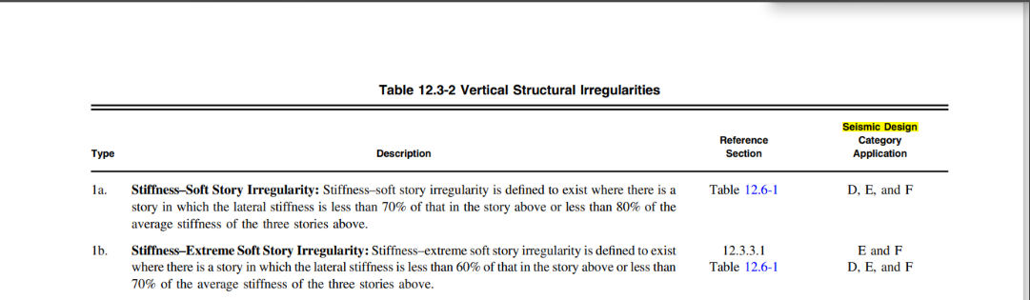
Vertical irregularity.
seismic analysis

Slide 41
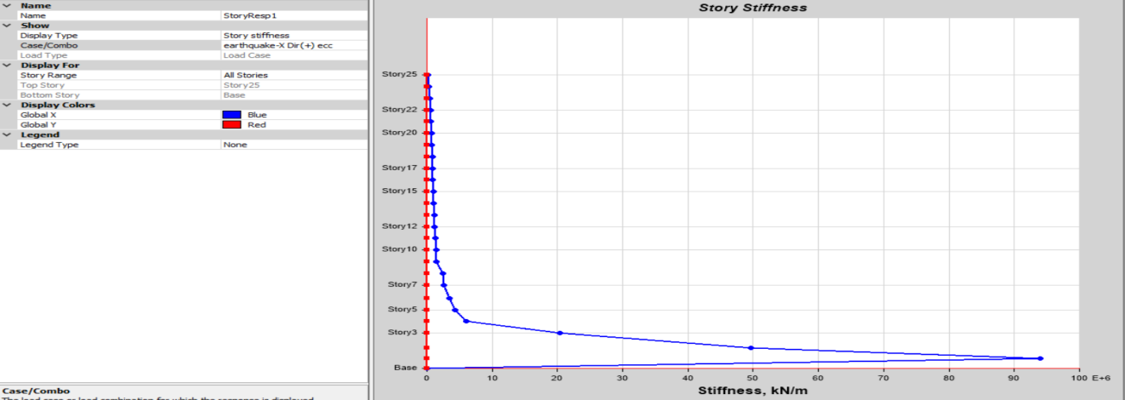
Vertical irregularity.
seismic analysis
In X direction:

Slide 42
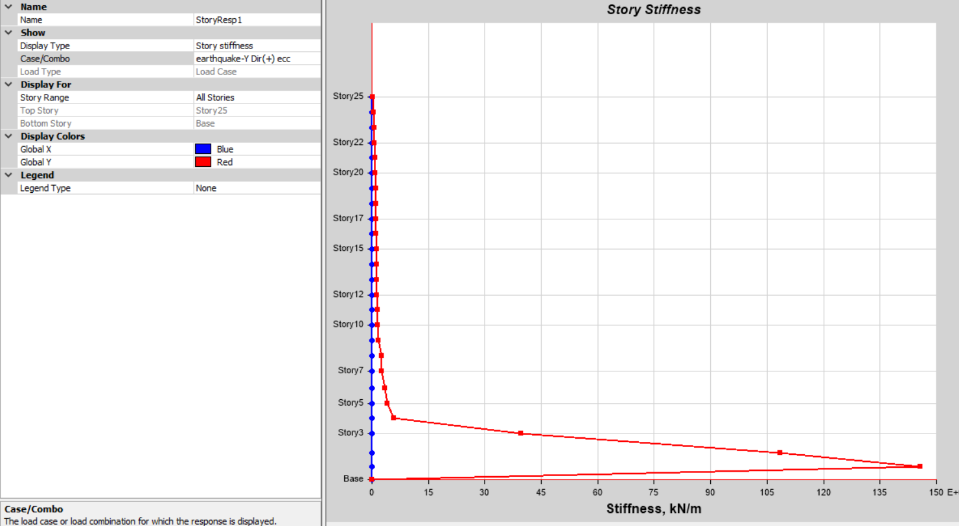
Vertical irregularity.
seismic analysis
In Y direction:

Slide 43
Thank you
all for listening

