Slide 1

Health Care Center
بسم الله الرحمن الرحيم
An-Najah National University
Faculty of Engineering & Information Technology
Department of Building Engineering
Prepared by:
Mohammed Alawneh
Sameh Kamal
Hamza Assi
Supervisor:
Eng. Alaa Shaheen

Slide 2
Outline
Slide 1
Architectural Design
Environmental Design
Structural Design
Mechanical And Safety Design
Quantity Survey And Cost Estimation
Electrical Design

Slide 3
Architectural Aspects
Slide 2

Slide 4
Slide 3
Site Location
.

Slide 5
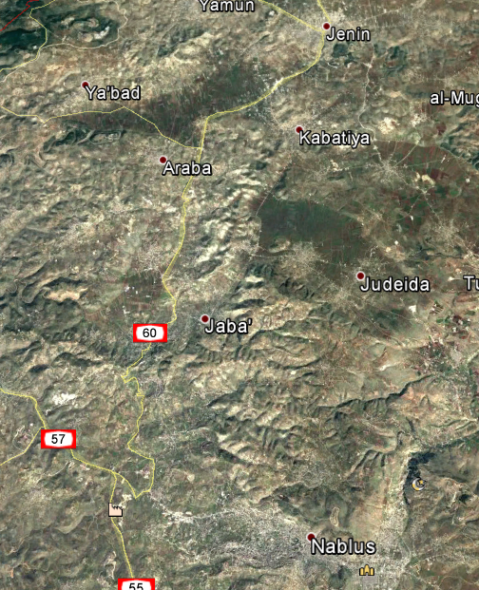
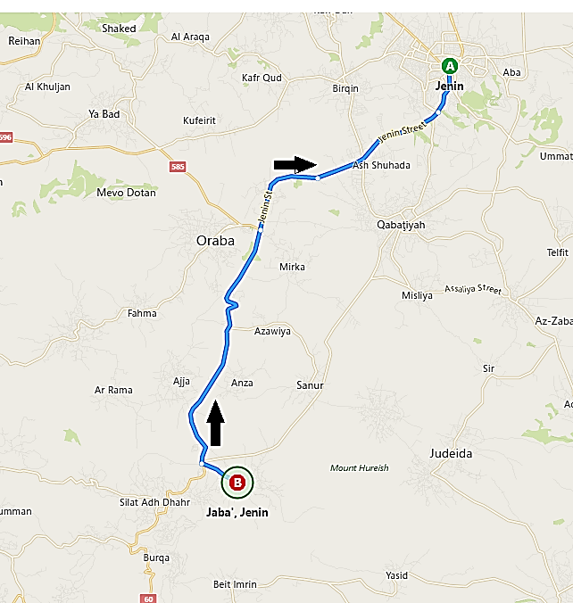
Slide 4

Slide 6
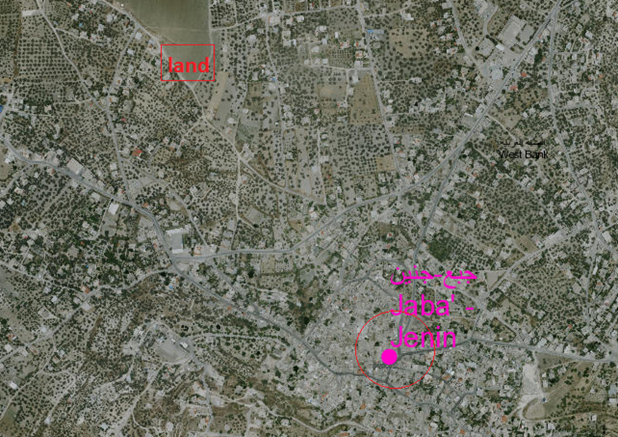
Slide 5

Slide 7
Architectural Design
Slide 6
Site Plan

Slide 8
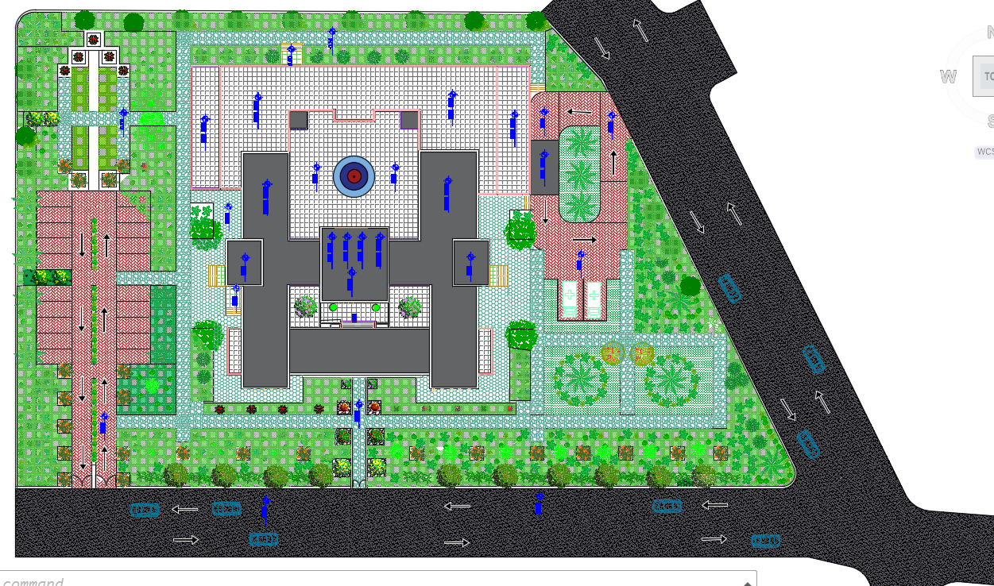
Architectural Design
Slide 7
North

Slide 9
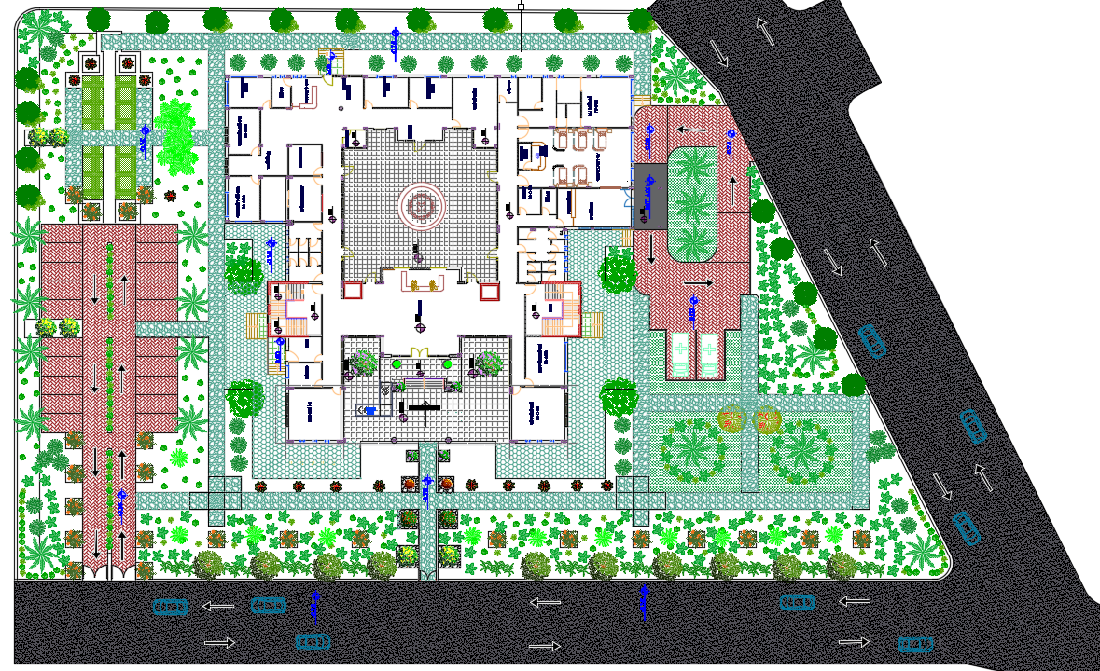
Master Plan
Slide 8
North

Slide 10
Slide 9
Architectural
Design
.

Slide 11
Architectural Design
Slide 10
Floor | Area (m²)
Ground floor | 1300
First floor | 1440
Second floor | 673
.

Slide 12
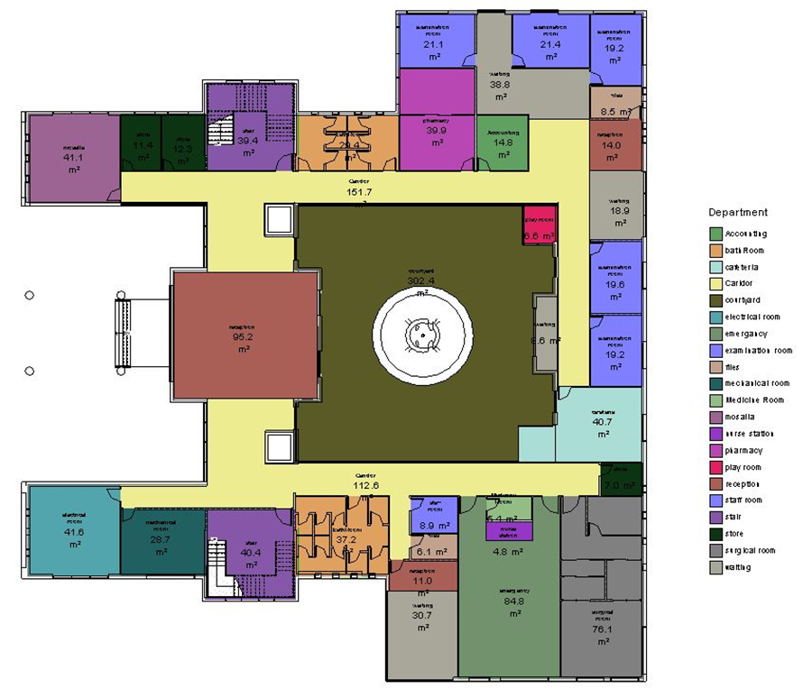
Architectural Design
Slide 11
Ground Floor

Slide 13
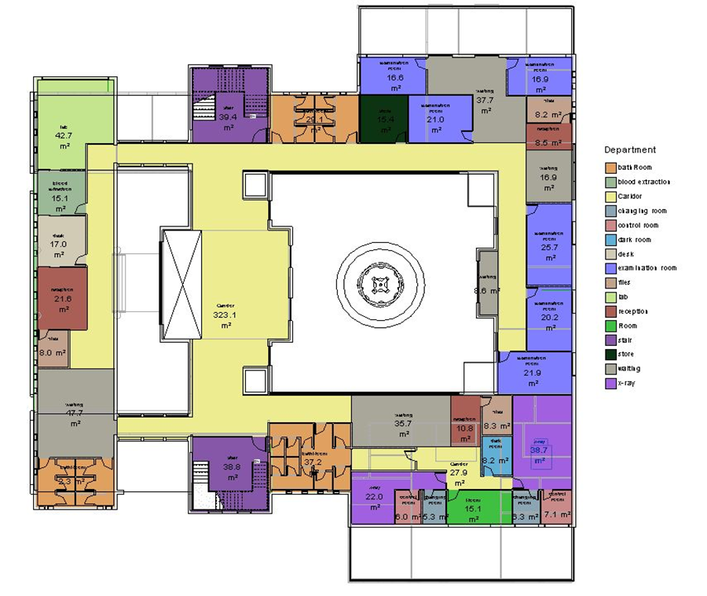
Architectural Design
Slide 12
First Floor

Slide 14
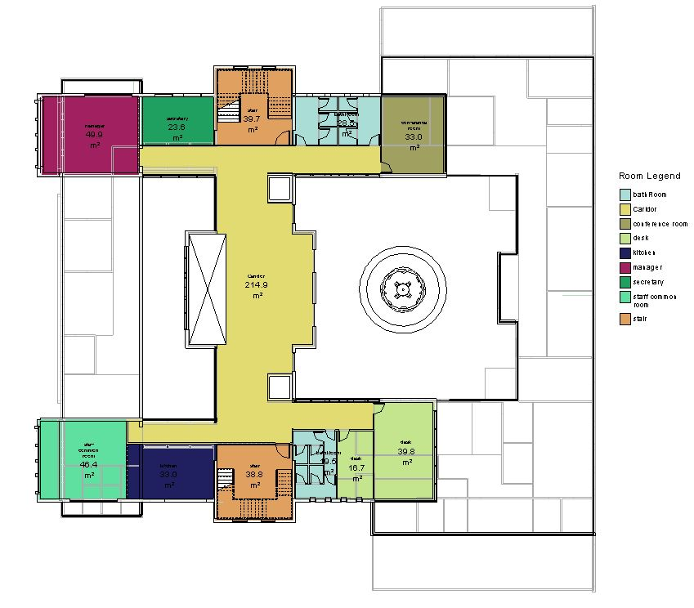
Architectural Design
Slide 13
Second Floor

Slide 15
Architectural Design
Slide 14
Sections

Slide 16
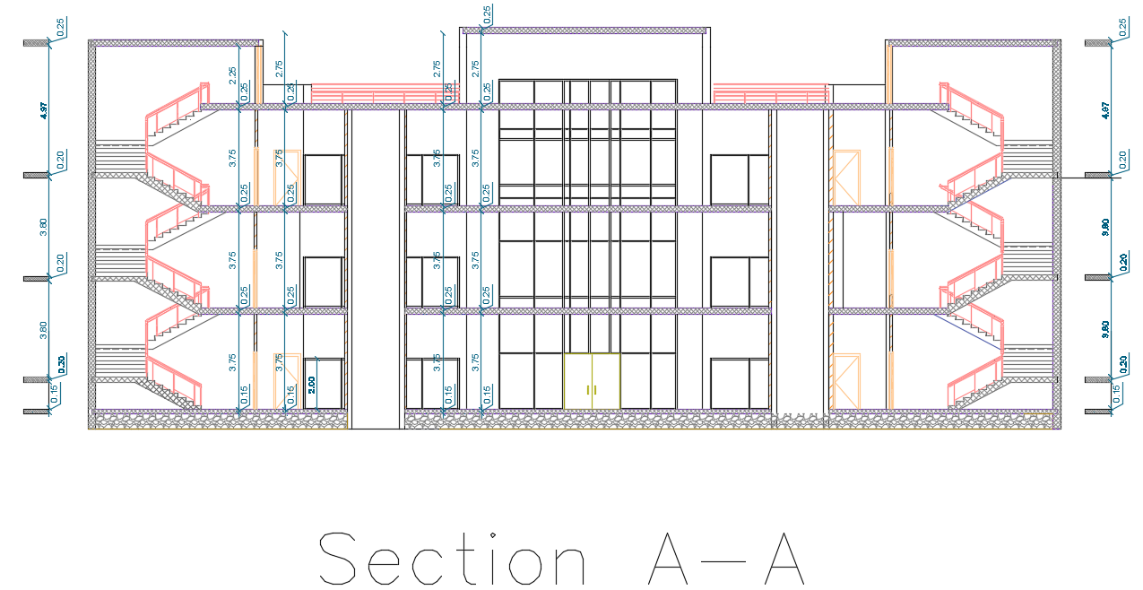
Architectural Design
Slide 15
Section A-A

Slide 17
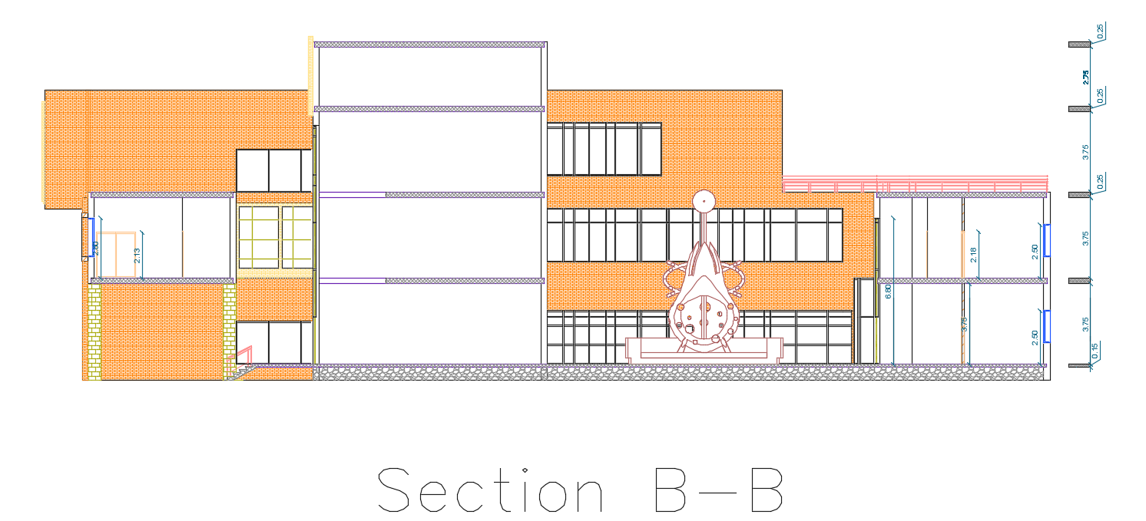
Architectural Design
Slide 16
Section B-B

Slide 18
Architectural Design
Slide 17
Elevations

Slide 19
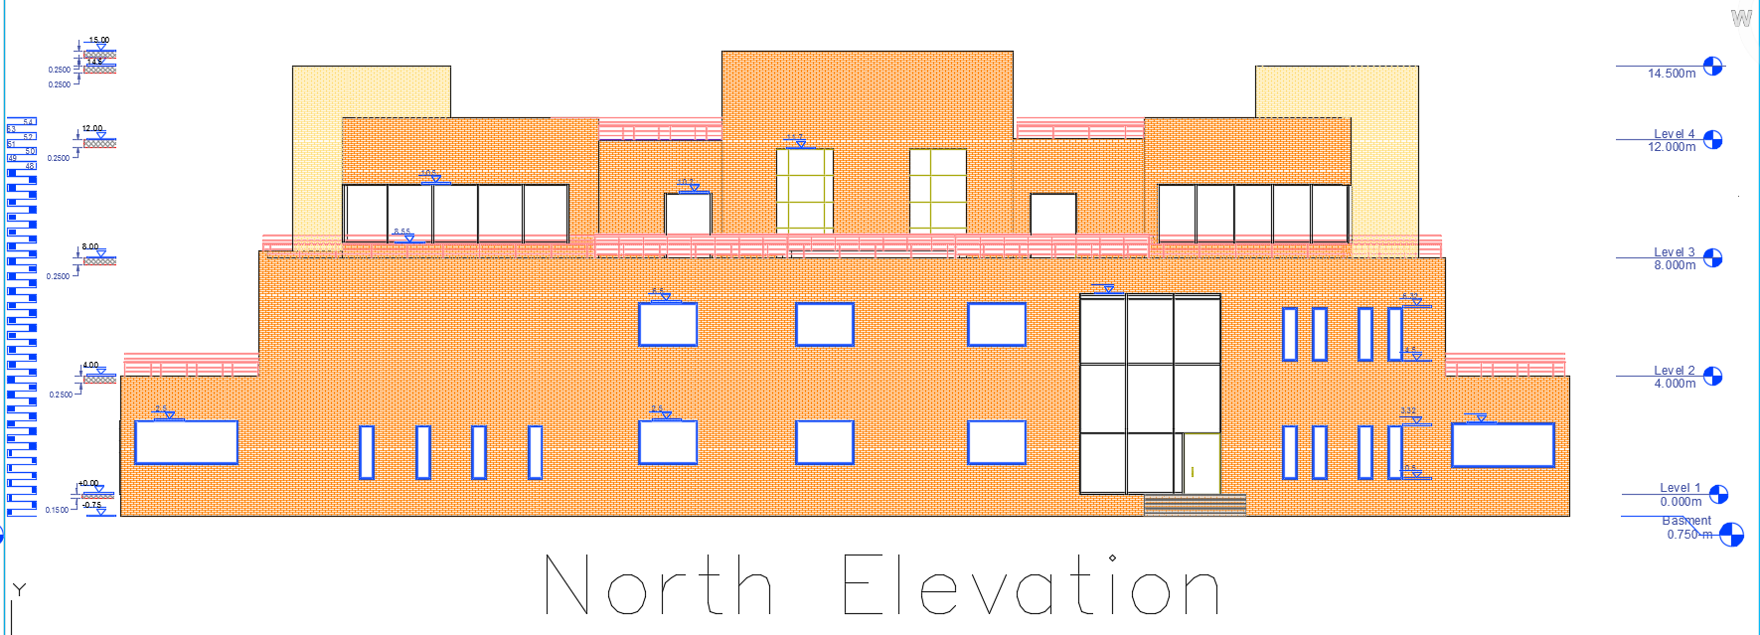
Architectural Design
Slide 18
North Elevation

Slide 20
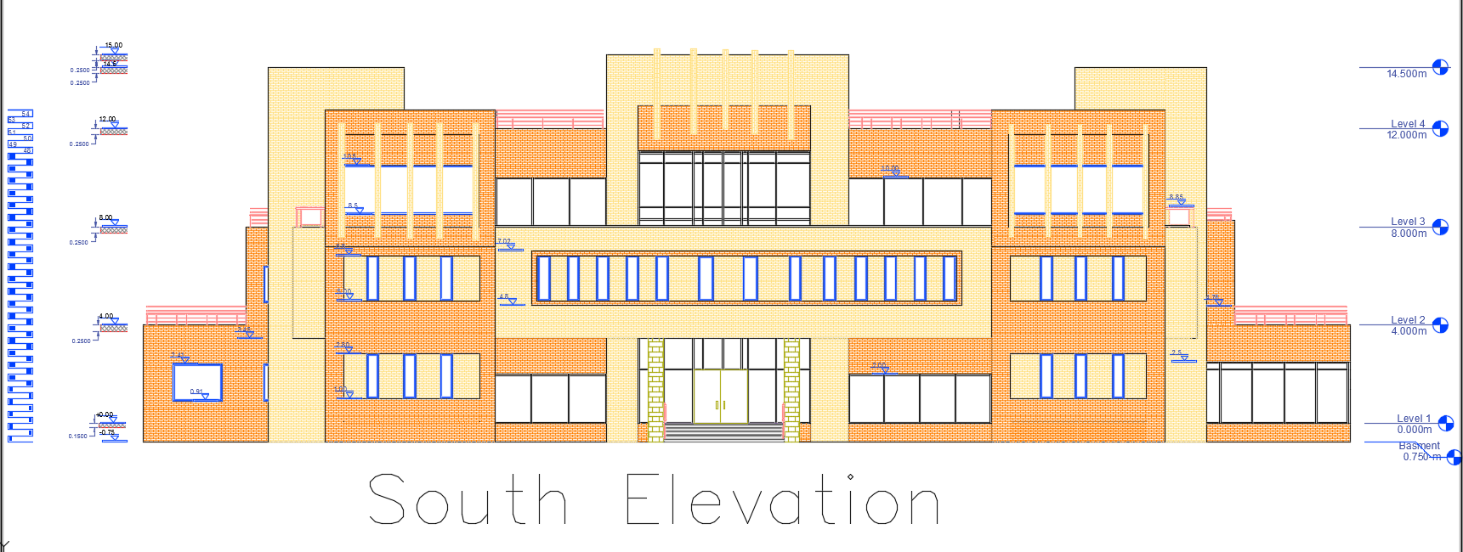
Architectural Design
Slide 19
South Elevation

Slide 21
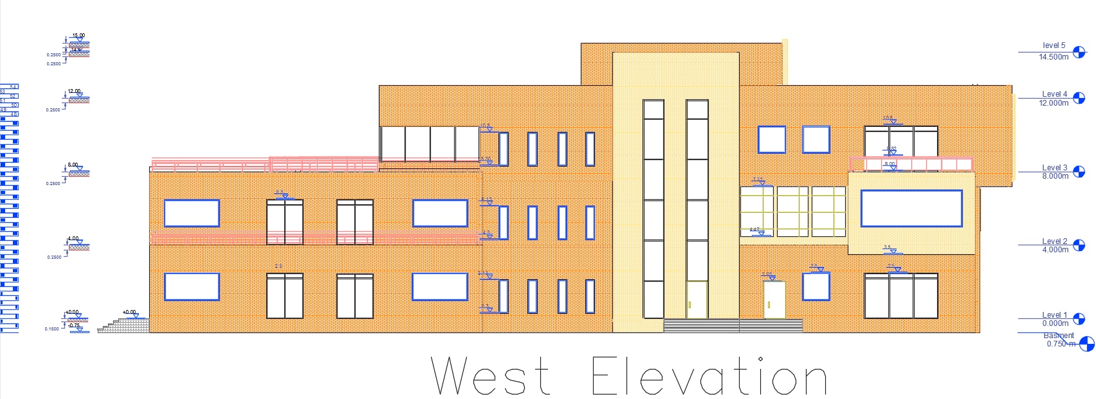
Architectural Design
Slide 20
West Elevation

Slide 22
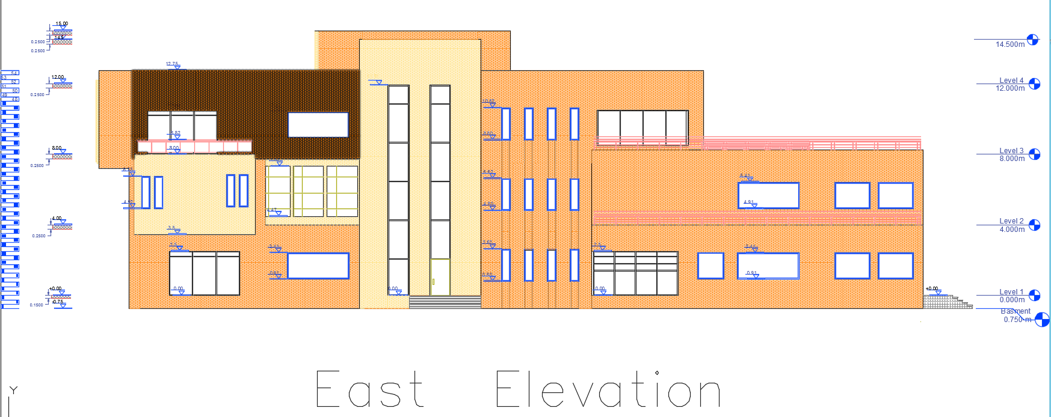
Architectural Design
Slide 21
East Elevation

Slide 23
Architectural Design
Slide 22
3D View

Slide 24
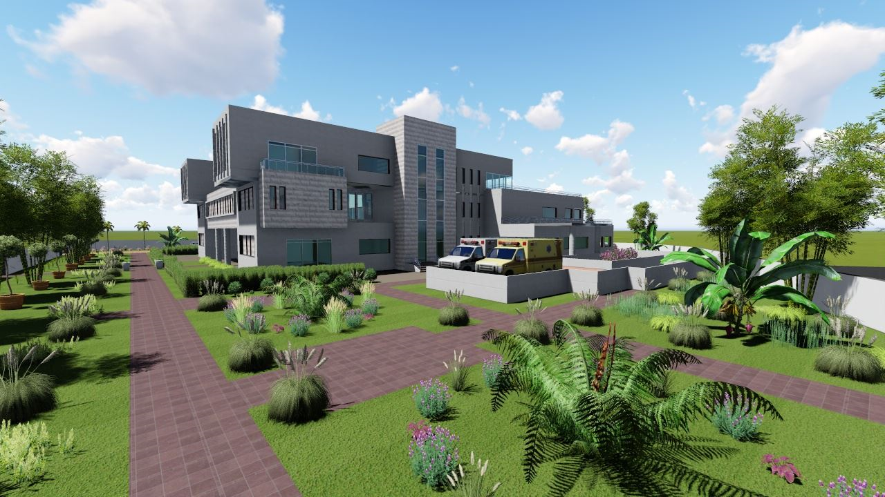
Slide 23

Slide 25
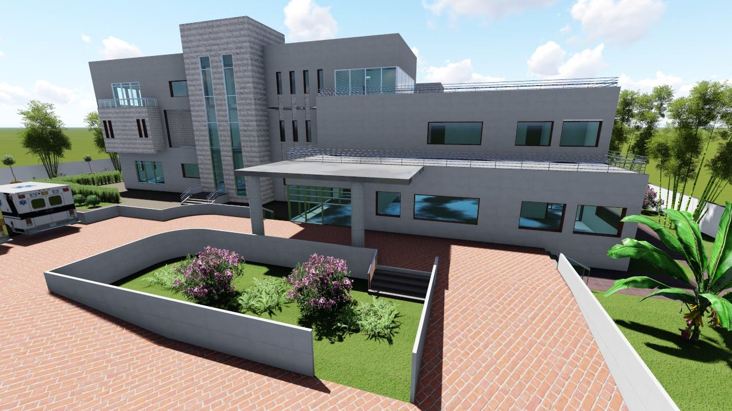
Slide 24

Slide 26
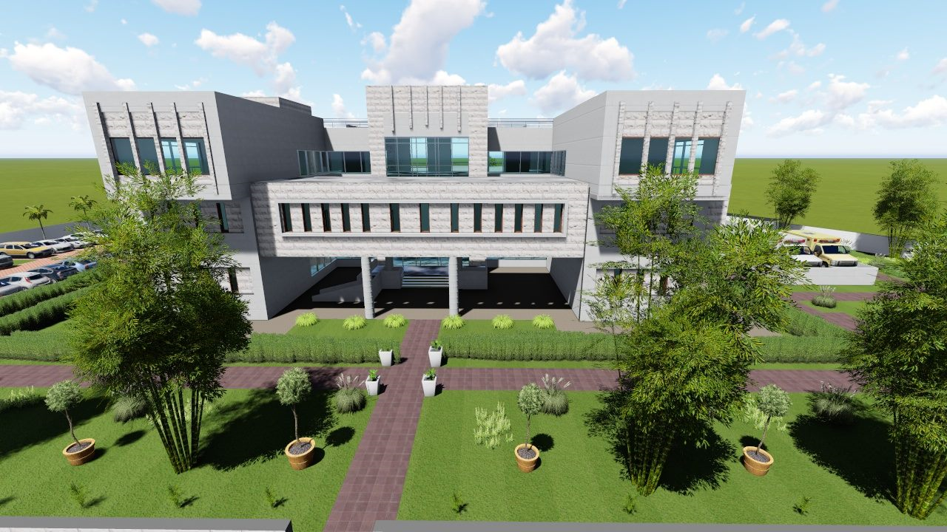
Slide 25

Slide 27
Slide 26
Structural
Design

Slide 28
Structural Design
Slide 27
Design Codes
The American Concrete Institute code (ACI 318-14).
The seismic design according to UBC-97.
The analysis and design for blocks were done using ETABs program,

Slide 29
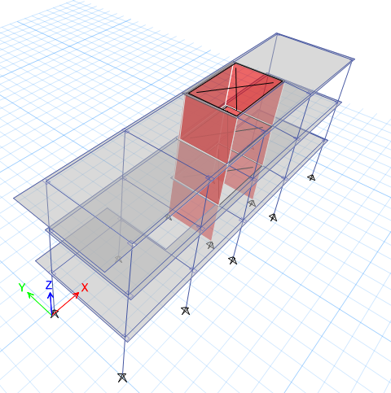
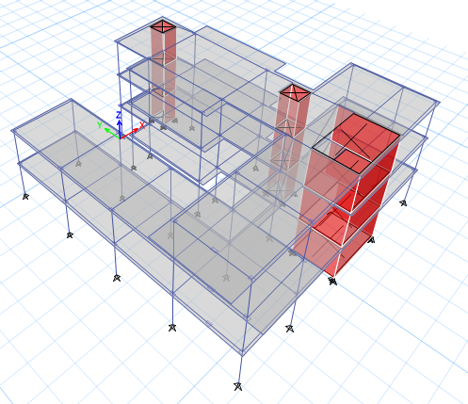
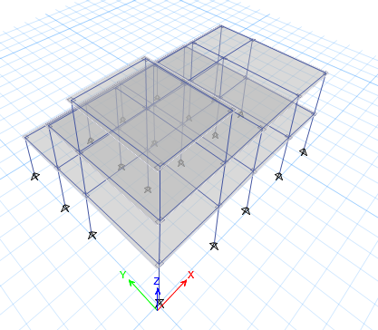
Structural Design
Slide 28
ETABs Models
Block 1
Block 2
Block 3

Slide 30
Structural Design
Slide 29
Structural System
1.
Block 1,2,4,5: Two way ribbed slab with drop beam system.
(H _{slab} = 25cm , H _{beam} = 40cm).
2.
Block 3: Two way ribbed slab using concrete hollow block with drop beam system.
(H _{slab} = 25cm , H _{beam} = 80cm).

Slide 31
Loads:
Slide 30
Type of loads | Load
Live load | 4KN/m2
Super imposed | 4KN/m2
Exterior walls | 24KN/m

Slide 32
Structural Design
Slide 31
Design Date
1.
Type of frame or shells | Compressive strength of Concrete ―f′c. Mpa
Slabs& Beams & Stair case | 24
Columns & walls for Tower (first block) | 28
Columns & walls for second block | 28
Footings | 28
2.
Yielding strength of steel fy = 420 Mpa.

Slide 33
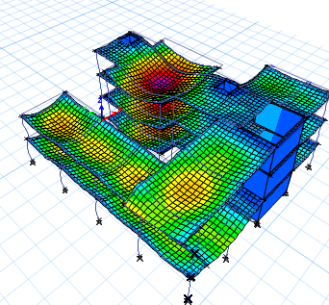
Structural Design
Slide 32
Checks for block 3
1.
Compatibility.
2. Equilibrium.
load | Manual | E-Tab | %Error
dead | 9314 | 9683 | 2%
live | 5164 | 5088 | 1%
S.D | 17328 | 17190 | 1%

Slide 34
Slide 33
3. Stress Strain Check:
 | Manual | E-Tab | Error%
For beam (B20) | 344.8 | 325 | 5.7%
Slab for column strip | 60 | 49.2 | 14%
Column (c13) | 2200 | 2054 | 6.6%

Slide 35
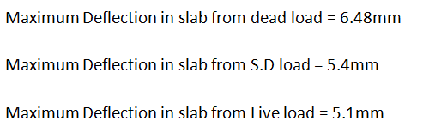
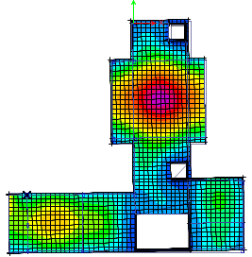
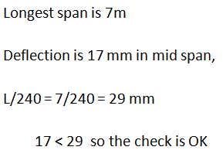
Deflection check:
Slide 34
Deflection from dead load

Slide 36
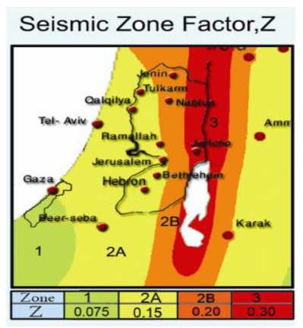
Seismic Design
Response Spectrum
Slide 35
UBC-97
I = 1
Z= 0.2
R= 5.5
Ca= 0.28
Cv= 0.4
T = 0.323 sec
W=28000KN,
Include D.L+S.D+0.25LL

Slide 37
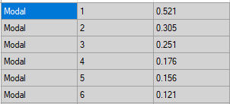

Structural Design
Slide 36
Dynamic Checks for block 1.
1. Modal Participation mass ratio > 90%.
2. Period.
T _{Method B} should be ≤1.4 T _{Method A}
T (allowable) = 1.4 × 0.32 sec. = 0.4 sec.
T From ETABS=0.52
T = 0.4< 0.52
≈
3. Base Shear.
Weight of building = 28000 KN.
Cv × I
R × T
Base shear (V) =
×w
= 3563

Slide 38
Slide 37
The main base shear in the x-direction =3563 .82
The main base shear in the Y-direction = 3562.53
the percentage of error was 0 % for X-Direction
the percentage of error was 0 % for X-Direction
less than 5% . So it is OK

Slide 39
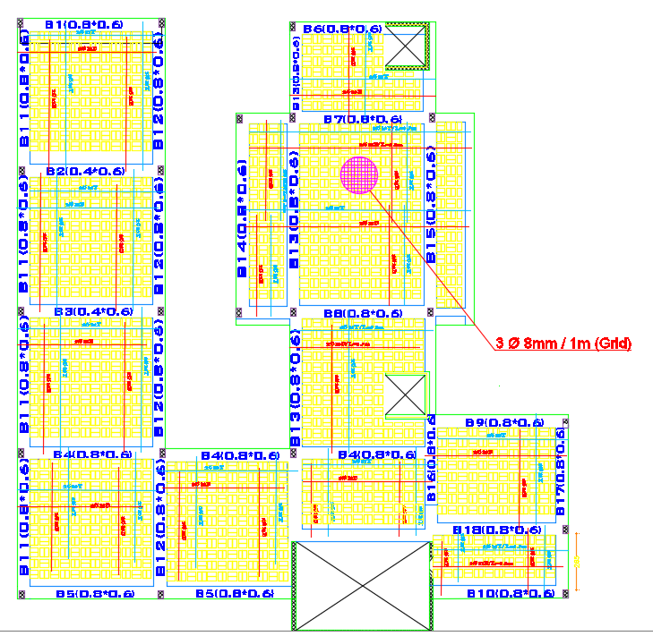
Structural Design
Slab Reinforcement
Slide 38

Slide 40
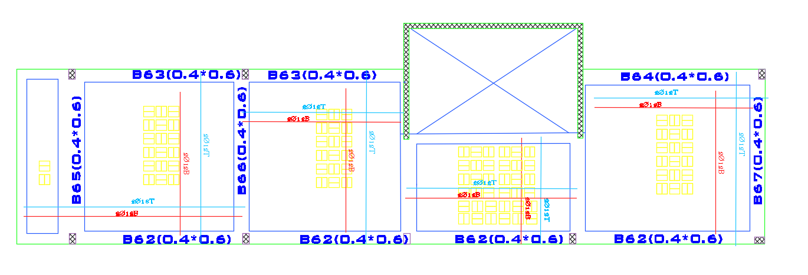
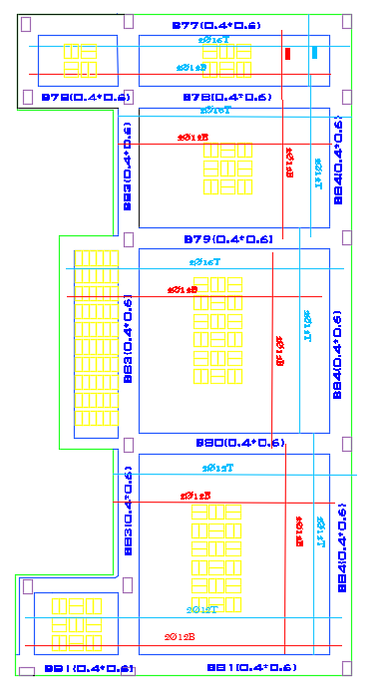
Structural Design
Slide 39
Slab Reinforcement

Slide 41
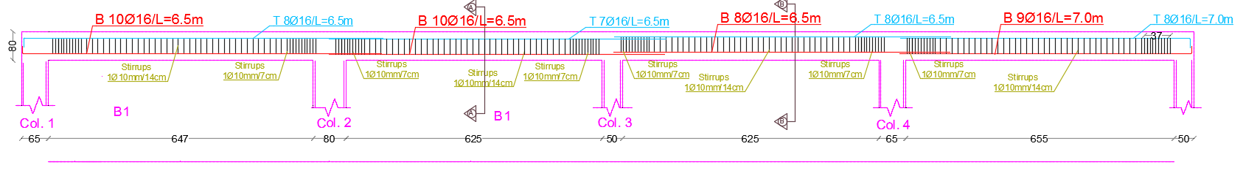
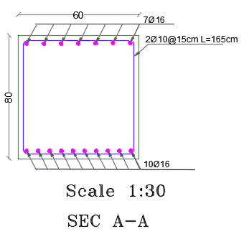
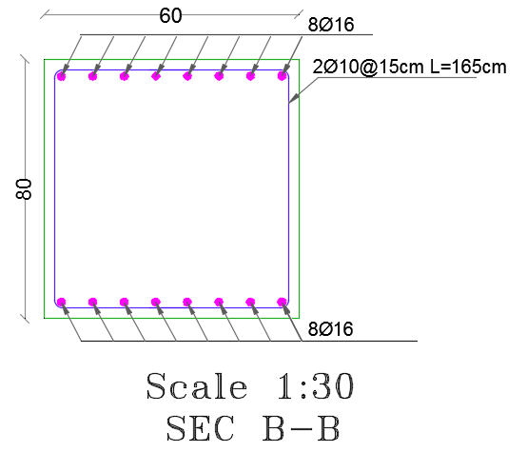
Structural Design
Beam Reinforcement
Slide 40

Slide 42
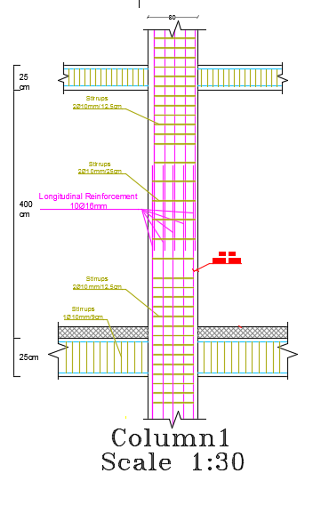
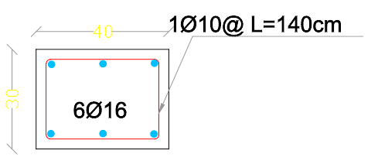
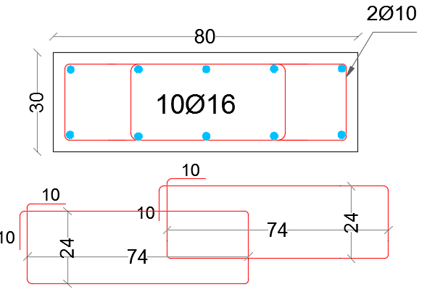

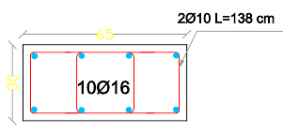

Structural Design
Slide 41
Column Reinforcement

Slide 43
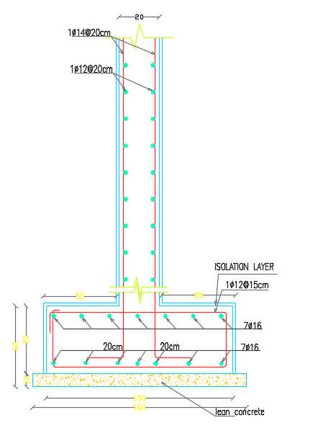
Shear wall Reinforcement
Slide 42

Slide 44
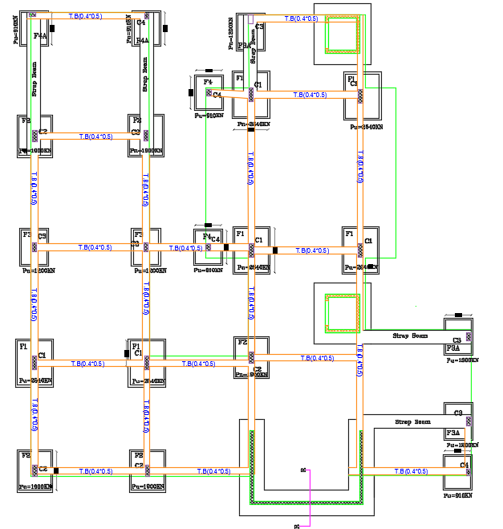
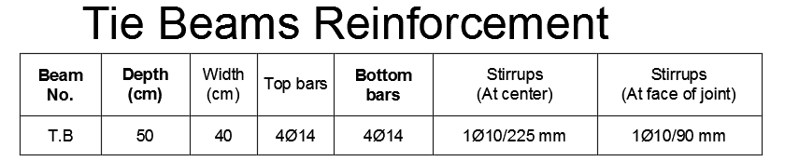
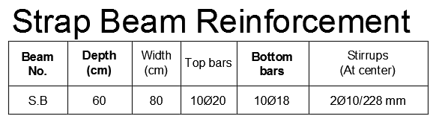
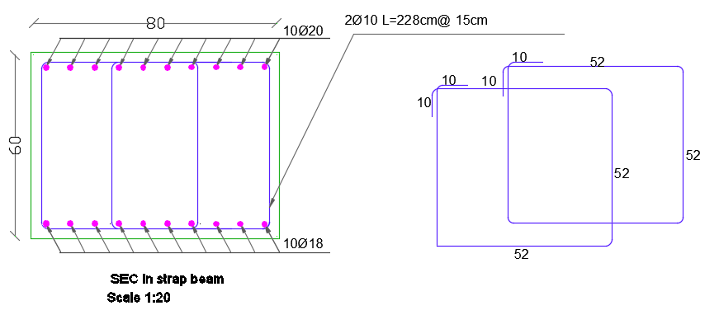
Footings Reinforcement
Slide 43

Slide 45
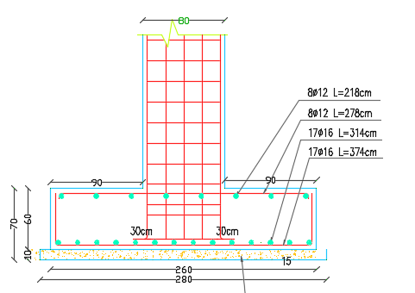
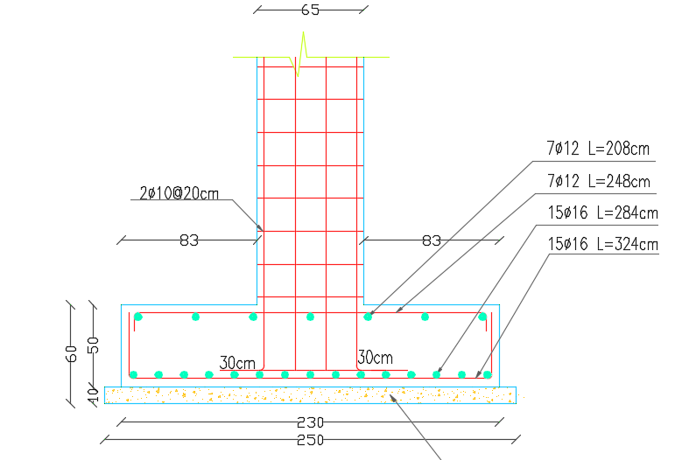
Footings Reinforcement
(Footing2)
Slide 44
(Footing 1)
(Thickness 60cm).
(Thickness 50cm).

Slide 46
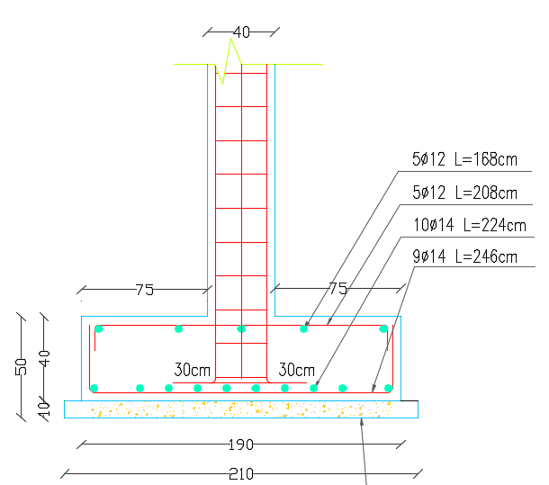
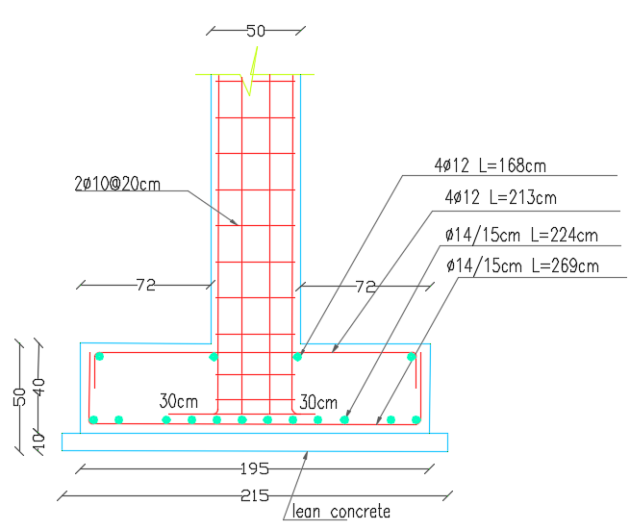
Slide 45
(Footing 4)
(Footing 3)
(Thickness 40cm).
(Thickness 40cm).

Slide 47
Slide 48
Environmental Design

Slide 48
Slide 49
Acoustical analysis

Slide 49
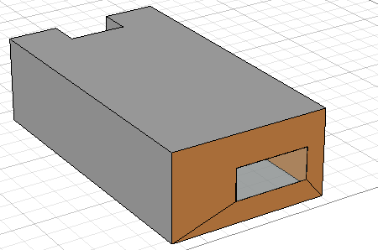
Ecotect model for Emergency room:
Slide 50

Slide 50
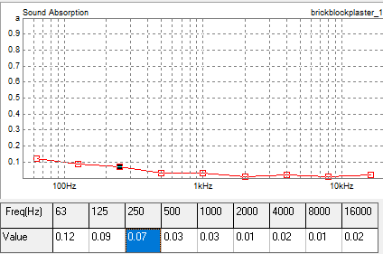
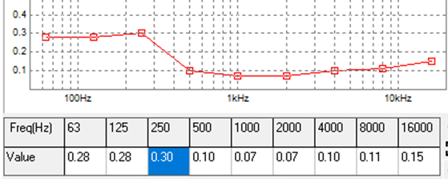
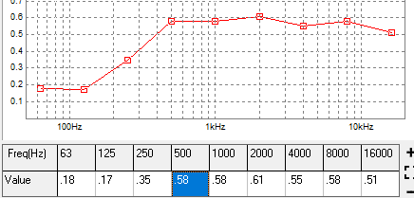
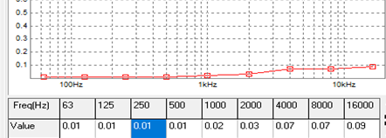

Acoustical Analysis
Slide 51
The materials which used in Emergency room:
External wall: (aluminum, insulation, gypsum board):
Internal wall: (plaster-block-plaster):
Ceiling tile (concrete, air gap, insulation, plaster board):
Floor (glazed tile):
Windows:(single glassed aluminum) frame):

Slide 51


Acoustical Analysis
Reverberation time (RT60) in the Emergency
RT60 range (0.4 – 0.7) s
Slide 52
As Millsingtion-Sette
RT60 for 500HZ=0.65.
RT60 for 1KHZ =0.57
From table and figure, the RT60 of the Emergency Room.

Slide 52

Sound Transmission Class (STC)
Slide 53
STC calculation for Emergency Room:

Slide 53

Composite STC values at different values of frequency.
Slide 54
STC value for external wall with windows
STC =47 its nearly to 50

Slide 54
Slide 55
Electrical Design

Slide 55
Slide 56
Lighting Design
.

Slide 56

Slide 57
Examination Room

Slide 57

Slide 58
Result for Examination Room

Slide 58


Result for Examination Room
Slide 59

Slide 59
Slide 60
Socket distribution
.

Slide 60


Distribution of sockets
Ground Floor
Slide 61

Slide 61
Slide 62
Mechanical and
Safety Design

Slide 62
Slide 63
HVAC
Design

Slide 63


Slide 64
VAV system
Chiller
Fan Coil

Slide 64

HVAC Design
Slide 65
Ground floor

Slide 65
Slide 66
Thermal
Analysis

Slide 66
Slide 67
Thermal Analysis
Total cooling load (KW) = 337.2 KW In 21/7
Total Heating load (KW) = 121 KW In 21/12

Slide 67
Slide 68
The most suitable values of U-value for building in Palestine are as follows:
U value for walls = 0.5 W/m2.K
U value for roof = 0.4 W/m2.K
U value for windows = 2.0 W/m2.K

Slide 68


Materials :
Slide 69
External wall of U = 0.41 W/m2.K
Internal wall of U = 1.61 W/m2.K

Slide 69


Slide 70
Roof of U = 0.26 W/m2.K
floor of U = 0.26 W/m2.K

Slide 70

Slide 71
The windows consist of two layers (double glazing) with air gap =6mm
U = 1.96 W/m2.K

Slide 71
Slide 72
Water supply
.

Slide 72



First floor
water supply design:
Slide 73
Ground floor
Second floor

Slide 73
Slide 74
Drainage system

Slide 74


Piping Design for Drainage system ( sixth floor )
Slide 75
Ground floor
First floor

Slide 75
Slide 76
Safety design

Slide 76



Sprinkler :
Slide 77
Safety Design:
In the health Care center the maximum coverage area for sprinkler is 12 m², and the maximum distance between sprinklers is 4 m.
Fire alarm
Fire extinguishers
Sprinkler

Slide 77
QUANTITY SURVEY
&
Cost Estimates
Slide 78

Slide 78
Slide 79
The quantity survey and cost estimate as shown:
The total cost of the building is 3,300,000 NIS
Total cost per 1 meter square= 1052 NIS/ m²

Slide 79
Slide 80
Thank you

