Slide 1

TCS
Done BY:-
Doa'a Bilal Kilani
Hadeel Abduallah Masri
Farah Riyad Nazzal
Supervised by:-
Dr. Maher Abu Baker

Slide 2
Outline
What is TCS?
Why TCS?
Features
Future work

Slide 3
What is Teshreen Contract System(TCS)?
The project that we have prepared is a contracting company’s website that enables the company to manage the company's projects electronically and the company’s manager can also track projects electronically at any time and anywhere, as the site allows the manager to track the costs of each project, knowing each project how much resources it has consumed, whether products or services And knowing who the employees, workers and engineers are for each project, and how much the workers' salaries are.

Slide 4


Why TCS?
The problem with Tishreen Contracting Company is the company's reliance on a paper system, and the lack of an electronic system that enables the company manager and the project manager to track and manage the costs of the start-up daily or monthly, so the lack of a tracking and management system causes future risks and wrong decisions.

Slide 5
Why TCS?
We seek through our system to provide a solution to this problem by:-
  Reduce dependency on paper, transfer work for projects from paper to computerized.
  Enabling the company manager and project manager to track and manage project costs at any time and anywhere.
  The system helps the company manager and project managers to track and manage projects and their costs on a daily basis.
  The ability to refer to suppliers' data in case they will be dealt with in future projects
  It provides reports to the director of the company, the most important of which is to compare the project budget with the costs paid for it.
Our project is that the new web-based system will reduce costs for the company and reduce delays.

Slide 6




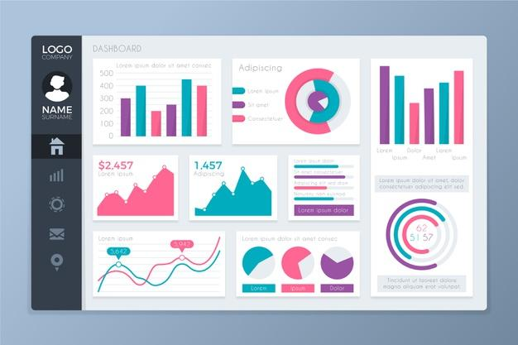
Features?
project management costs
Tracking
Reports
Dashboard

Slide 7
Future work
The following are a list of planned improvements and further services for subsequent releases within this system:
Providing a special page to view the meetings held by the company’s director and give notifications to managers and employees.
Linking the Tishreen company system to other programs that the company is working on.
Notifications if currency rates change.
Provide a page for displaying bids from newspapers or social media.
Connecting the system to Google Map to display the location of projects on the map.
Provide a page to view payments received from clients for their project.

Slide 8
THANK YOU

