Slide 1
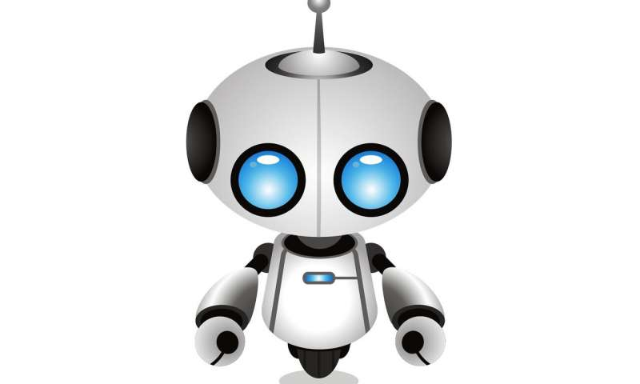
Sorting Balls Robot
By: Rawan Ashayer & Mai Ishtaewi
Supervisor: Dr.Sufyan Samara
Supervisor: Dr.Abdullah Rashed

Slide 2
Outlines:
Problem Statement
What’s Sorting Balls Robot
Tools
Demo
Constraints
Future work

Slide 3
Problem statement
In the Stadium we notes the many balls on the field, for example football, basketball, tennis, if the number of balls is large then the person who arranges them takes a long time, my project Sorting robot is solve this problem .

Slide 4

Football

Slide 5
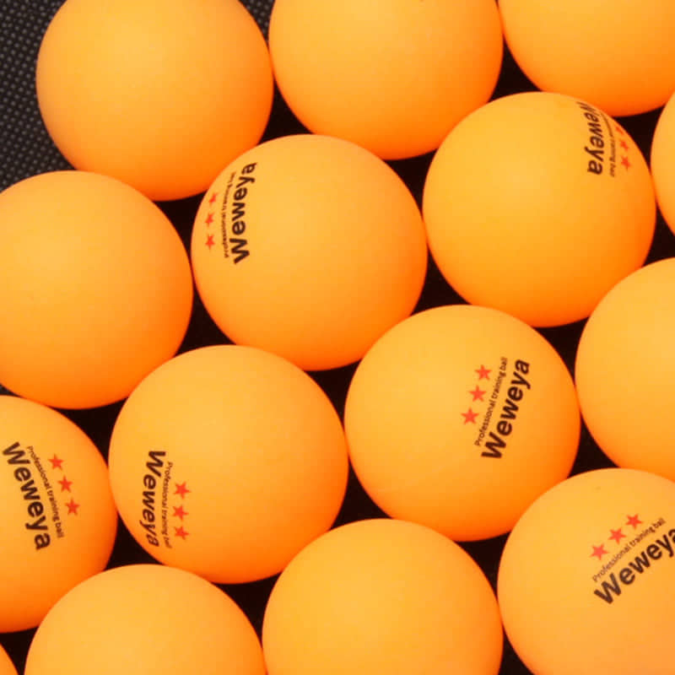
Tennis ball

Slide 6
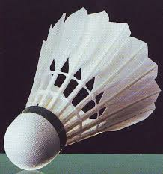

Slide 7
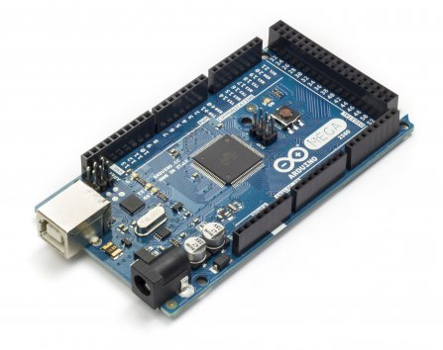
Tools
Ardouino
The main controller of the project.
It controls stepper ,Dc and servo motors .

Slide 8
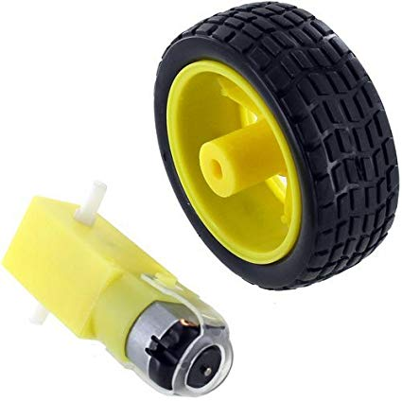
4 wheel with 4 DC motor

Slide 9
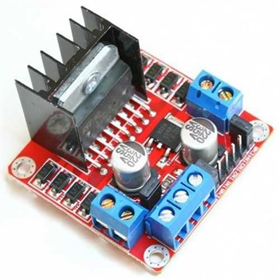
L298N Dual H-Bridge Motor Drive

Slide 10
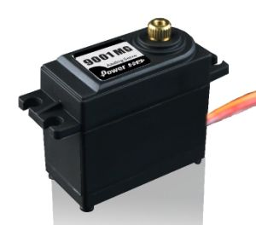
Servo Motor
Servo motor uesd to control open and close
Arm

Slide 11
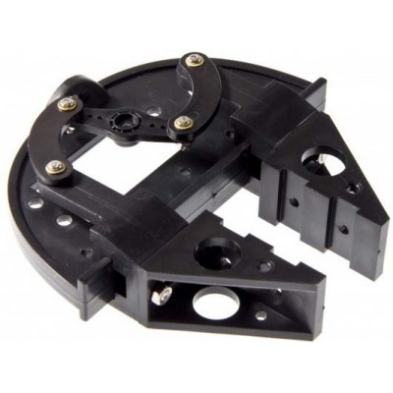
Robot Clamp Gripper

Slide 12
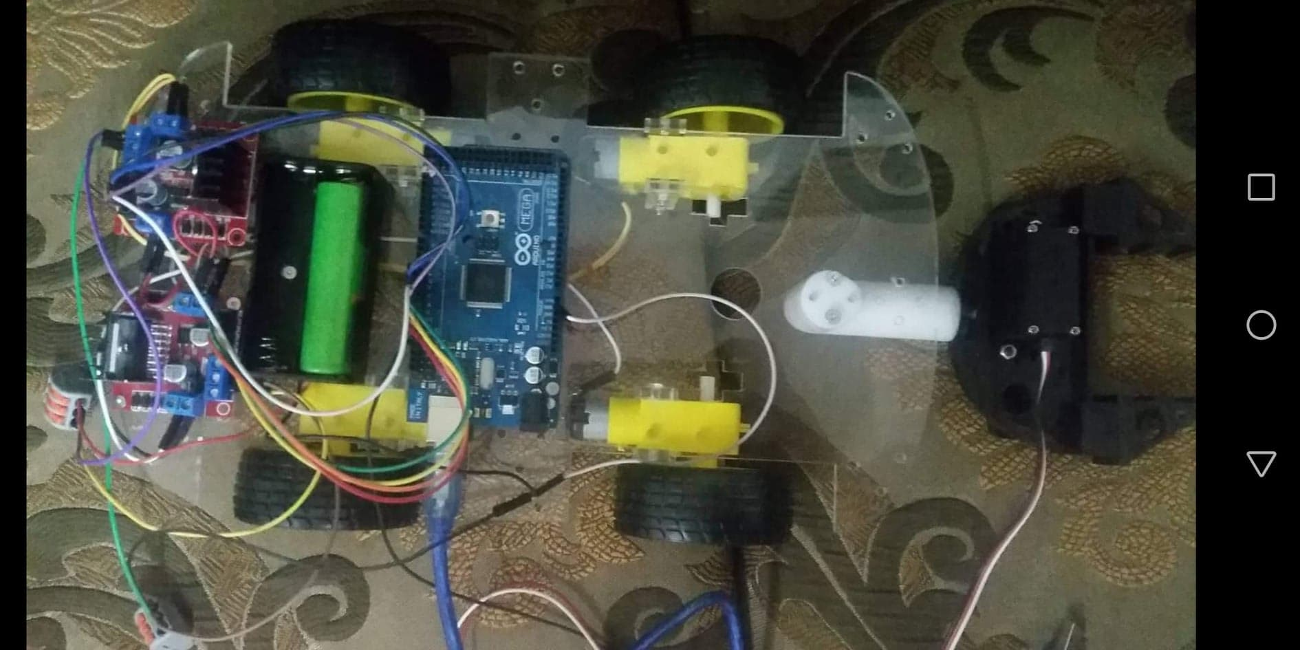
This is the first stage of project

Slide 13
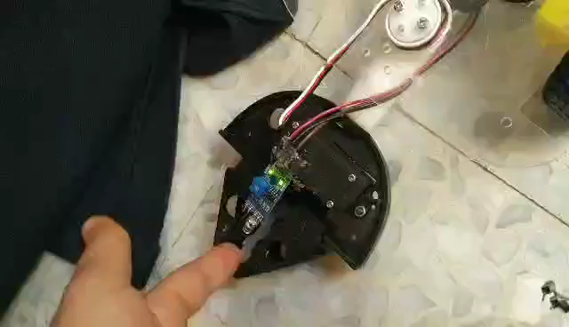

Slide 14
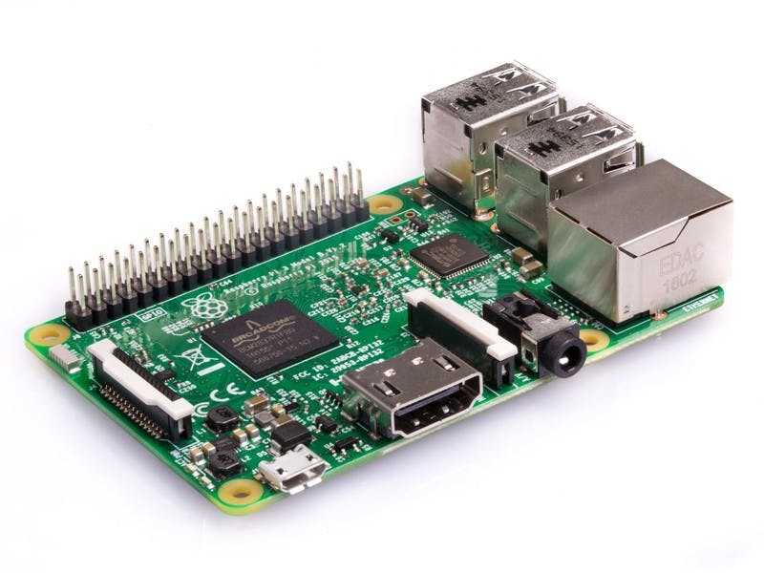
Raspberry PI 3

Slide 15
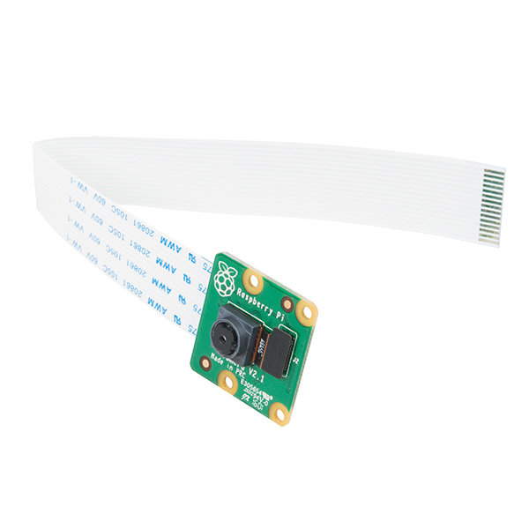
Raspberry Pi Camera

Slide 16
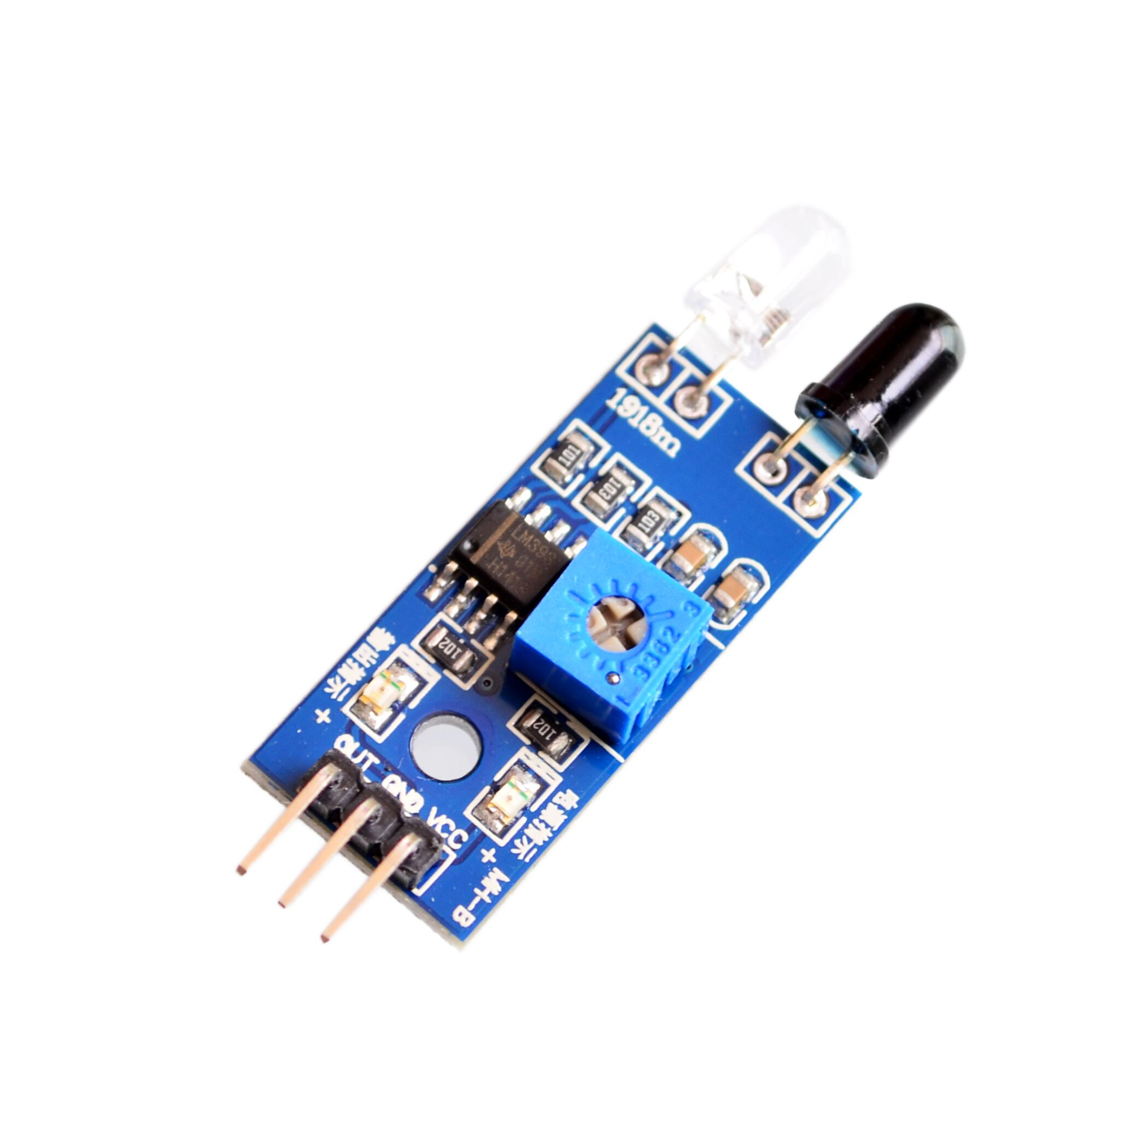
IR Sensor.

Slide 17
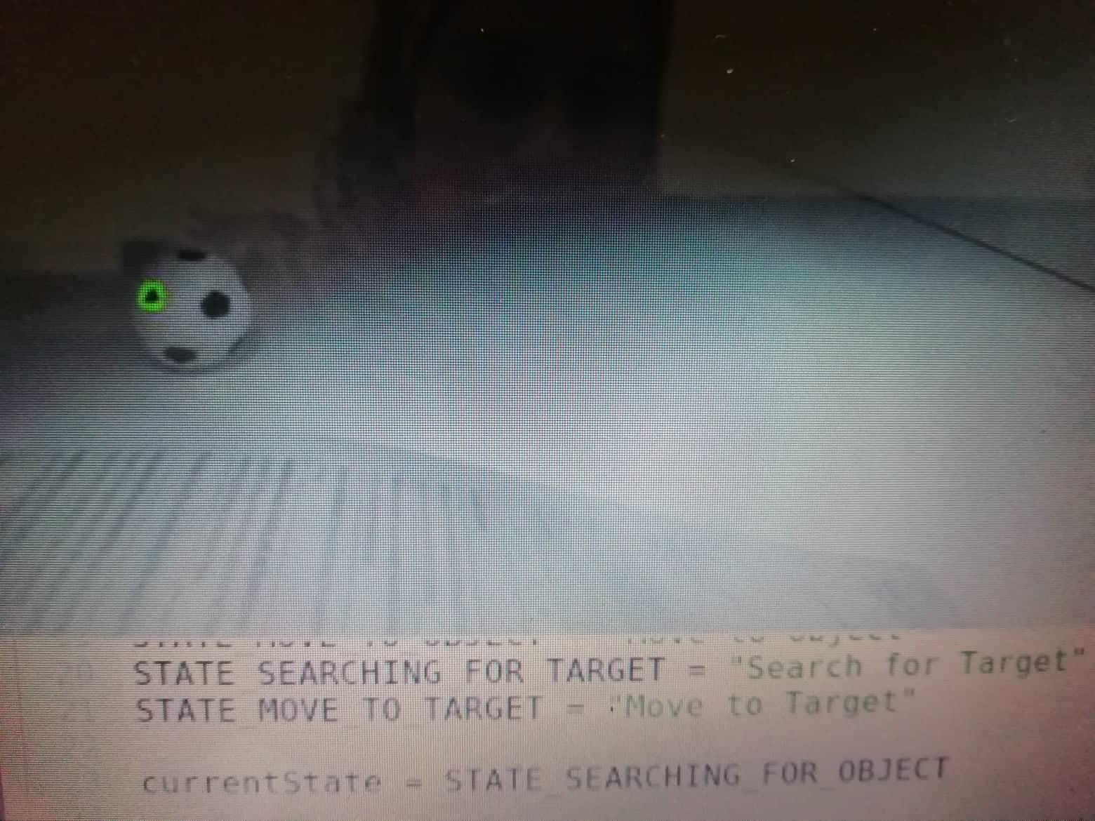
Second stage of project
start detect balls :
Footbal :

Slide 18
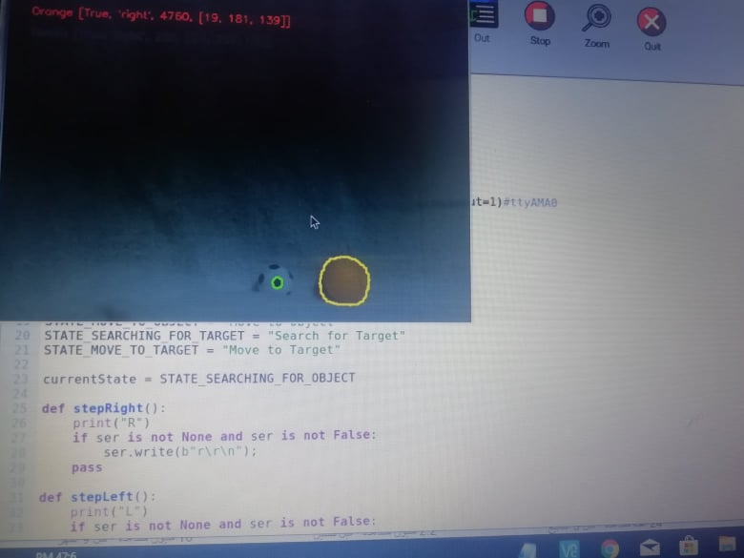
Tennis ball

Slide 19
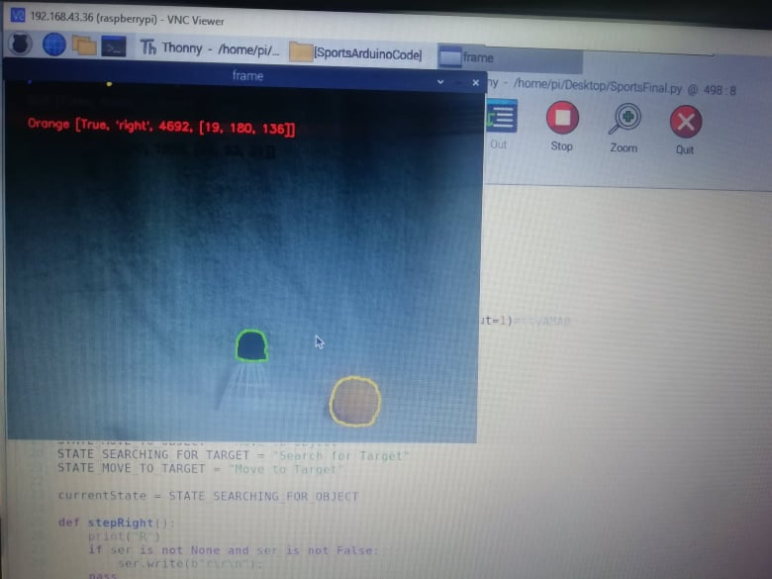

Slide 20
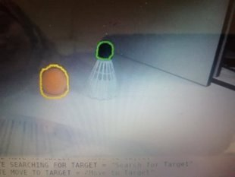
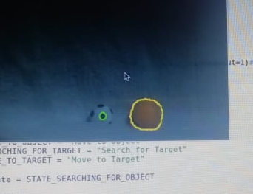

Slide 21
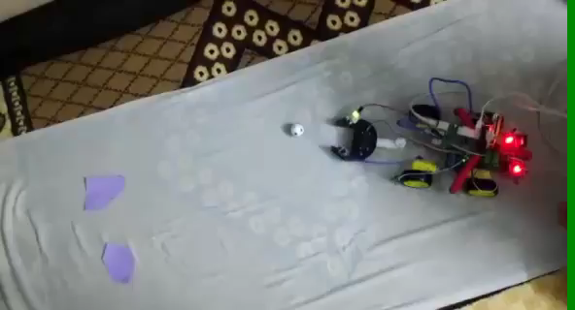

Slide 22
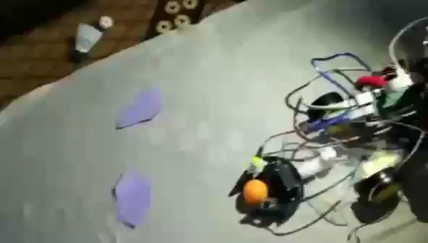

Slide 23
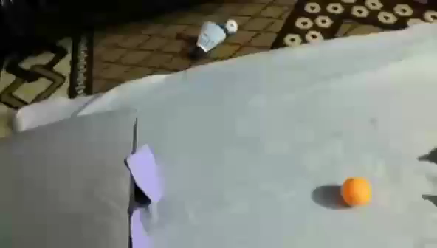

Slide 24
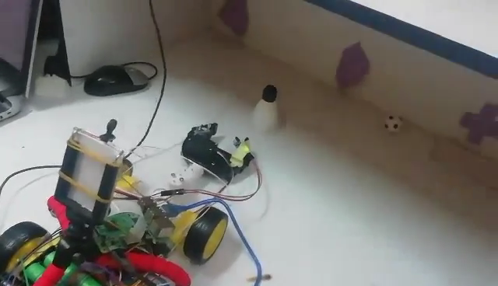

Slide 25
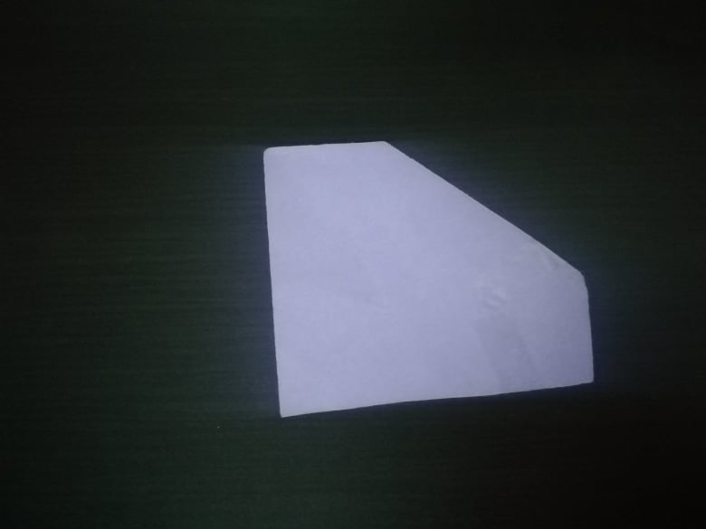
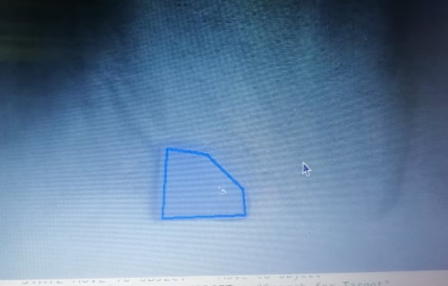
Last stage :

Slide 26
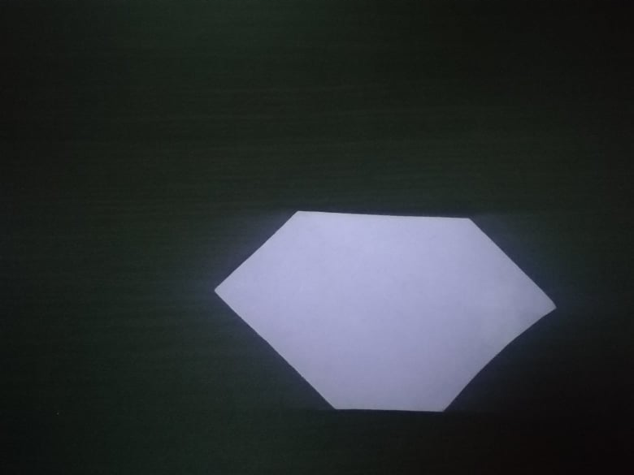
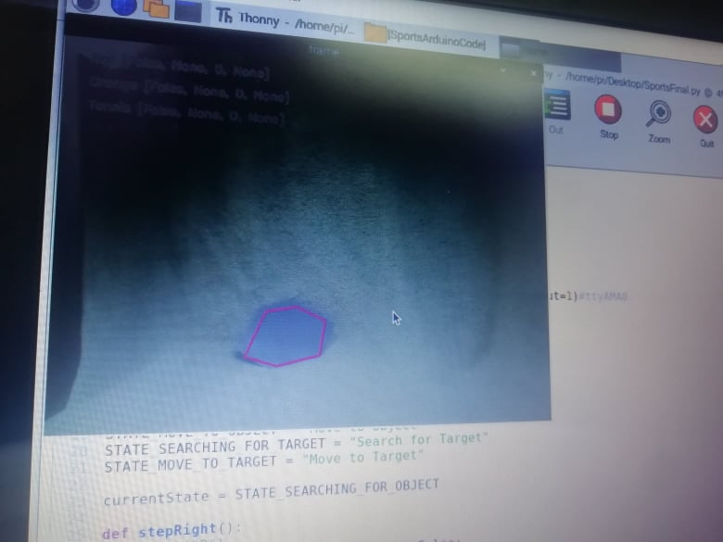
Last stage

Slide 27
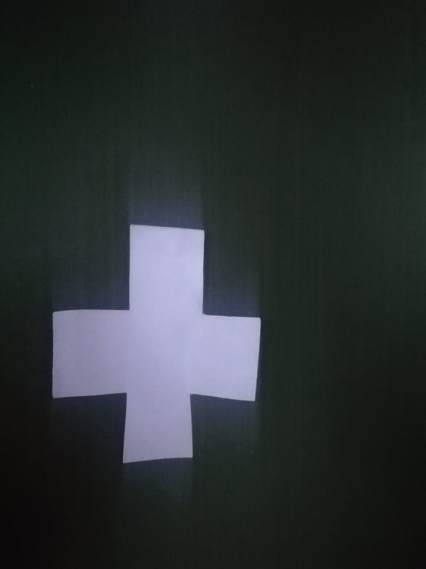
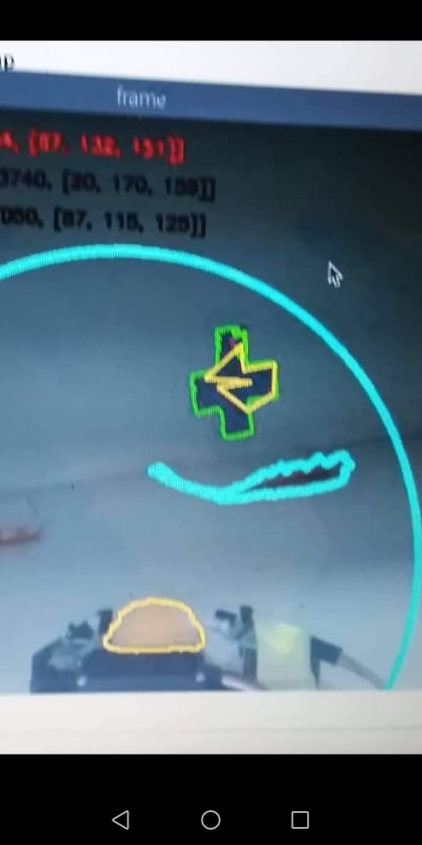
Last stage

Slide 28
Constraints
During the work of the project, we faced many problems, Such as: connect the Raspberry with wireless.
problem which arm can not hold the ball , and was solved by using a IR sensor.
energy problem,Battery charging quickly relieves.
IR sensor
Camera Delay.

Slide 29
Future Work
robot can hold larger size balls ,football, tennis, and badminton, and it can also place balls with different baskets

Slide 30
Demo

Slide 31

Any qoustions

