Slide 1

An Experimental Comparison between Monofacial and Bifacial PV Modules under different Conditions
Students:
Mahmoud Kobari
Ahmad Mallak
Ahmad Titi
Supervisor:
Dr. Adel Juaidi
1

Slide 2
Our Project
Comparison between Monofacial and Bifacial PV Modules under different Conditions
2

Slide 3

Solar Energy
Renewable
Green
Two SDGs Goals
3

Slide 4
Fossil fuel
Solar energy
Energy In Palestine
Electricity
Palestine relies on Israeli occupation for 100% of its fossil fuel imports
Palestine are highly dependent on
electricity provided by the IEC,
around 93.4% of total consumption
Palestine solar energy installed capacity approx. 130 MW
4

Slide 5
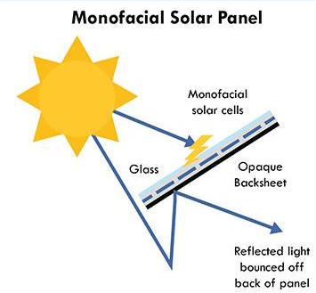
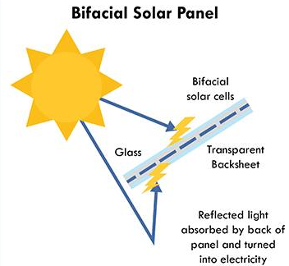
Monofacial vs. Bifacial
5

Slide 6
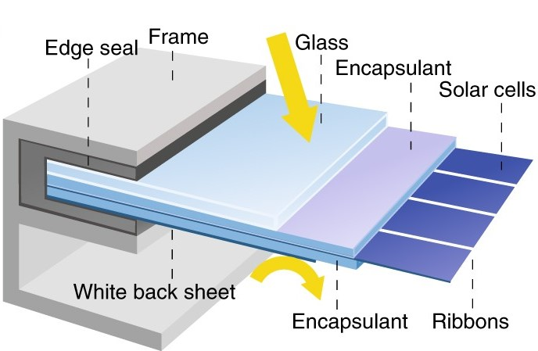
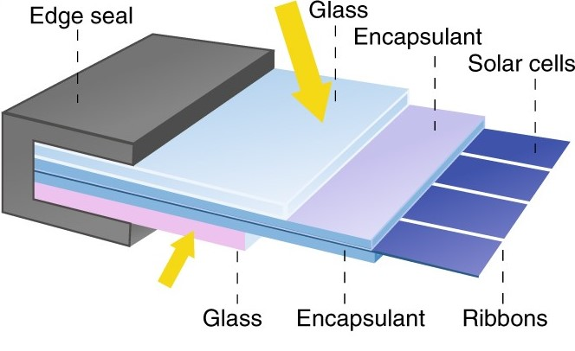
Monofacial vs. Bifacial
6

Slide 7
Monofacial vs. Bifacial
01
Low ability
to absorb the irradiance
01
High ability
to absorb the irradiance
02
Low albedo sensitivity
02
High albedo sensitivity
03
High temperature
03
Low temperature
7

Slide 8


Methodology
Project 1
➔ Surface Change
➔ Orientation Change
Four PV Module
Project 2
Engineering faculty PV System ➔ Surface Change
By PVsyst software
8

Slide 9
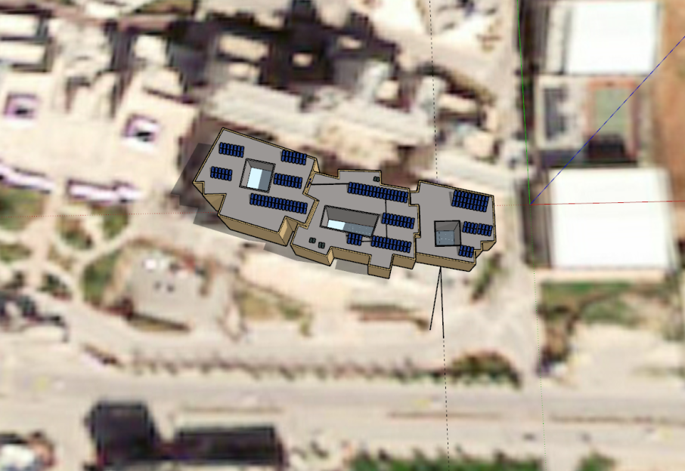
Engineering faculty PV System
9

Slide 10
Albedo
Black Asphalt
0.12
Artificial Green Grass
0.26
Sand
0.35
White Paint
0.90
10

Slide 11
PVsyst Software
Geographical Data
Orientation
System Selection
Shading Analysis
11

Slide 12
Geographical Data
PV GIS
Latitude
Longitude
V.2
32.23 °N
35.22 °E
Orientation
Tilt Angle=28°
Building Azimuth Angle =11.6°
12

Slide 13
System Selection
System Capacity
Monofacial
Bifacial
72.8 KW
Q.POWER-325W
Jinko-325W
13

Slide 14
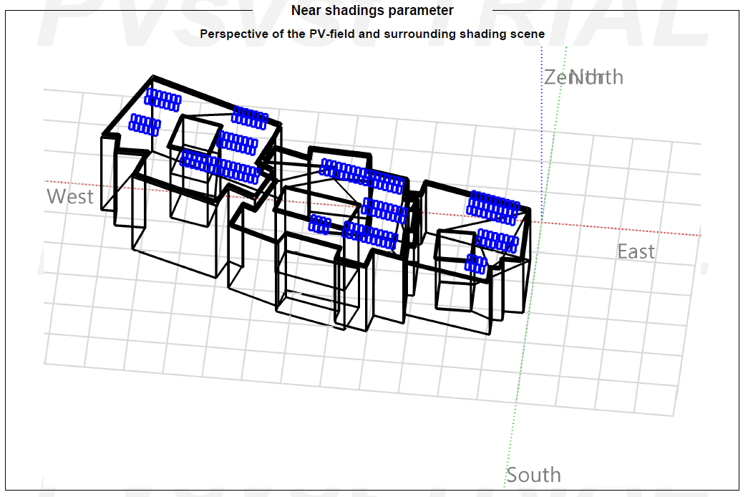
Shading Analysis
14

Slide 15
RESULTS
15

Slide 16
Energy Production
Monofacial
Material Type | Albedo (%) | Produced Energy (kWh/year) | Specific Production (kWh/kWp/year)
Black Asphalt | 0.12 | 132,877 | 1825
Artificial Green Grass | 0.26 | 133,463 | 1833
Sand | 0.35 | 133,839 | 1838
White Paint | 0.90 | 136,122 | 1870
Bifacial
Material Type | Albedo (%) | Produced Energy (kWh/year) | Specific Production (kWh/kWp/year)
Black Asphalt | 0.12 | 142,182 | 1870
Artificial Green Grass | 0.26 | 142,820 | 1878
Sand | 0.35 | 143,230 | 1883
White Paint | 0.90 | 145,719 | 1916
16

Slide 17
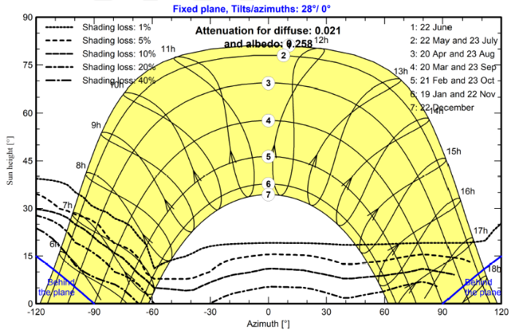
sun path curve (Iso-shadings diagram)
17

Slide 18
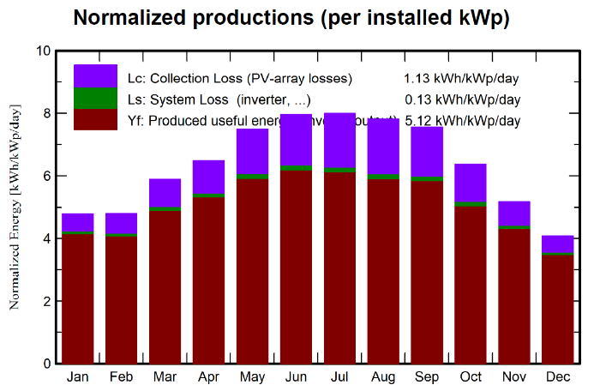
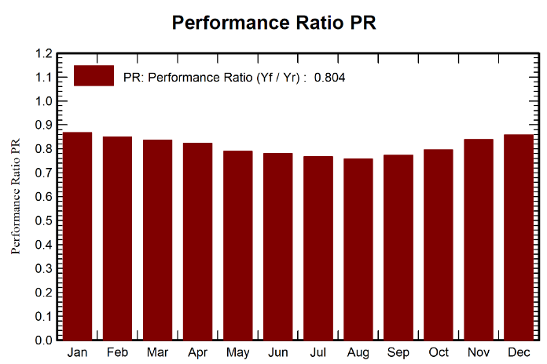
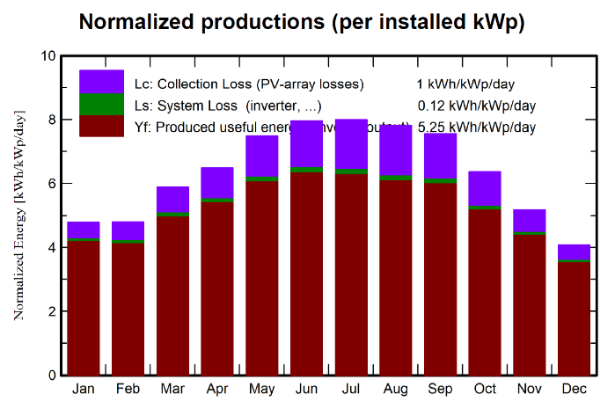
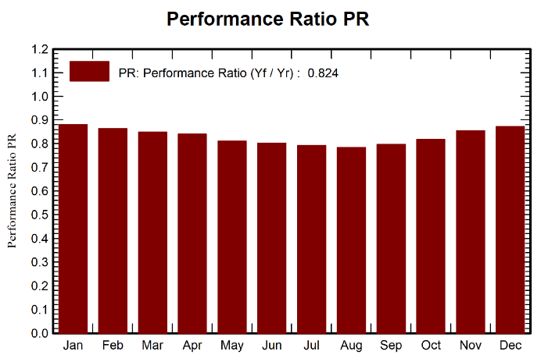
Production, gains and losses curves albedo 0.9
Monofacial
Bifacial
18

Slide 19
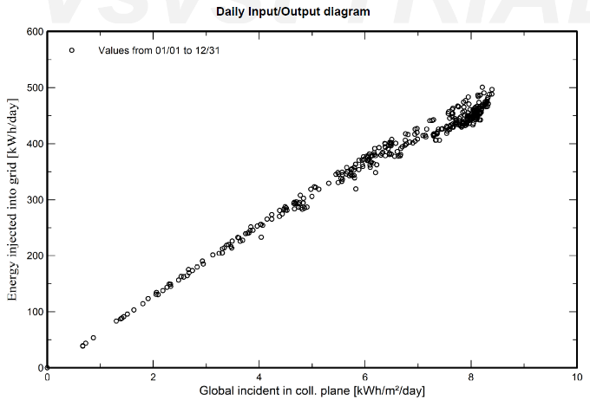
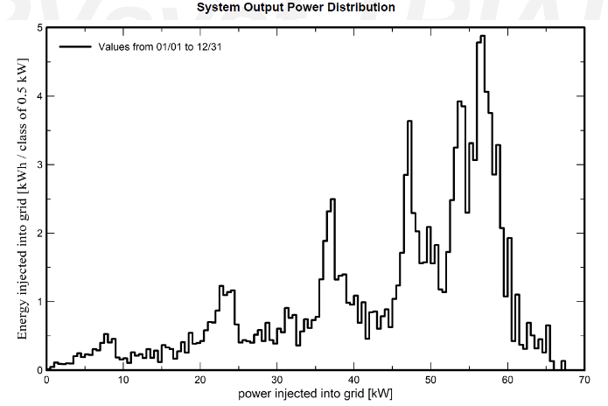
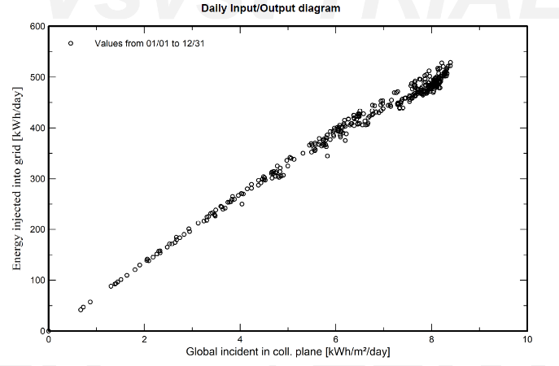
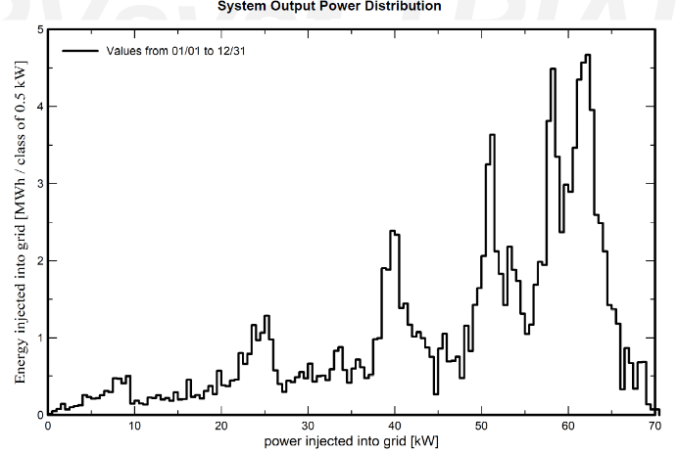
Production, gains and losses curves albedo 0.9
Monofacial
Bifacial
19

Slide 20
Gain Factors
Monofacial
Material Type | Albedo (%) | The global incident in coll. plane | Module Quality
Black Asphalt | 0.12 | +10.5% | +0.37
Artificial Green Grass | 0.26 | +11.3% | +0.37
Sand | 0.35 | +11.8% | +0.37
White Paint | 0.90 | +15.0% | +0.37
Bifacial
Material Type | Albedo (%) | The global incident in coll. plane | Module Quality
Black Asphalt | 0.12 | +10.5% | +0.75
Artificial Green Grass | 0.26 | +11.3% | +0.75
Sand | 0.35 | +11.8% | +0.75
White Paint | 0.90 | +15.0% | +0.75
20

Slide 21
Losses Factors
Monofacial
Material Type | Albedo %)) | Near Shadings: irradiance loss | IAM factor on global | PV loss due to irradiance level | PV loss due to temperature | Mismatch loss, modules and strings | Ohmic wiring loss | Inverter Loss
Black Asphalt | 0.12 | -0.90% | -2.00% | -0.35% | -10.87% | -2.15% | -1.25% | -2.38%
Artificial Green Grass | 0.26 | -1.08% | -2.04% | -0.35% | -10.93% | -2.15% | -1.26% | -2.38%
Sand | 0.35 | -1.20% | -2.06% | -0.35% | -10.97% | -2.15% | -1.27% | -2.38%
White Paint | 0.90 | -1.89% | -2.19% | -0.35% | -11.21% | -2.15% | -1.29% | -2.40%
Bifacial
Material Type | Albedo (%) | Near Shadings: irradiance loss | IAM factor on global | PV loss due to irradiance level | PV loss due to temperature | Mismatch loss, modules and strings | Ohmic wiring loss | Inverter Loss
Black Asphalt | 0.12 | -0.90% | -1.75% | -0.42% | -9.28% | -2.15% | -1.23% | -2.31%
Artificial Green Grass | 0.26 | -1.08% | -1.79% | -0.42% | -9.33% | -2.15% | -1.24% | -2.31%
Sand | 0.35 | -1.20% | -1.81% | -0.41% | -9.36% | -2.15% | -1.25% | -2.33%
White Paint | 0.90 | -1.89% | -1.96% | -0.41% | -9.56% | -2.15% | -1.27% | -2.32%
21

Slide 22
The bifacial module consistently outperforms the monofacial module, with an average increase of 6.81% in energy production and higher specific production
22

Slide 23
THANKS

