Slide 1

Remote Health Monitoring System
Presented by:
Abeer Mukhemir
Razan Mukhemir
Supervised by:
Dr. Luai Malhis

Slide 2

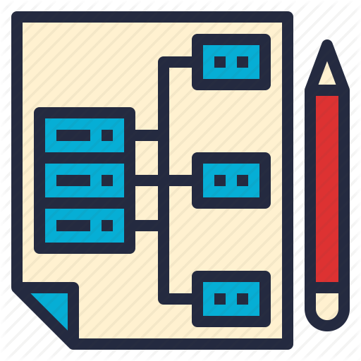


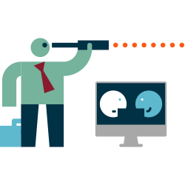
Outline
Overview
System Architecture
Components and functionalities
Demo
Constraints and future work

Slide 3
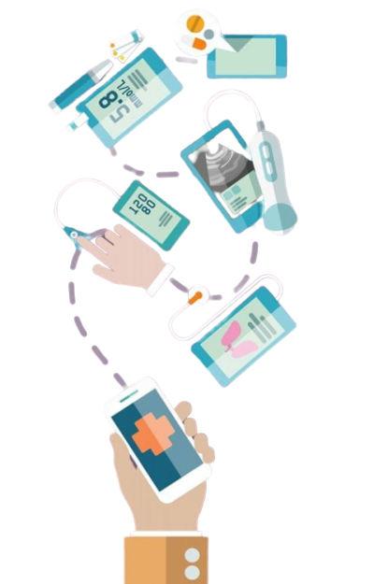
Overview

Slide 4
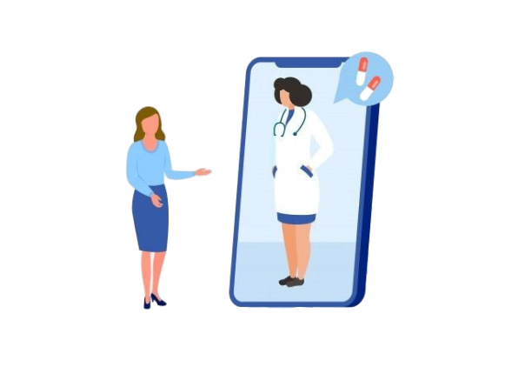


Idea
Transform health monitoring from healthcare centers to homes
+
➔

Slide 5
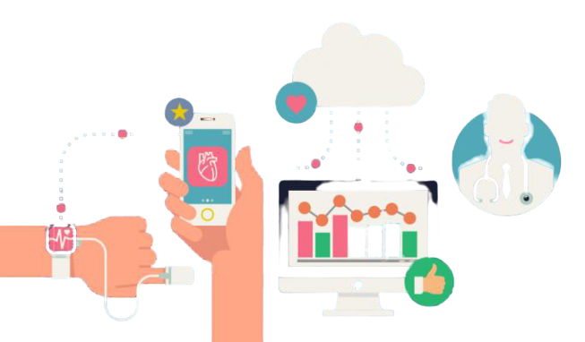
System Architecture

Slide 6
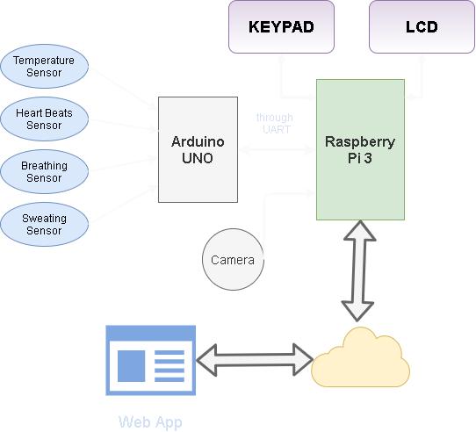

Slide 7



Hardware Components:
Vital Signs Sensors

Slide 8
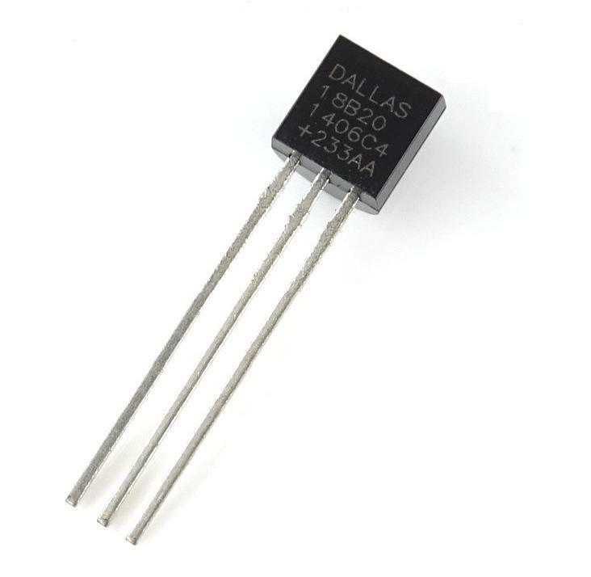

Temperature
Dallas Temperature sensor
- 1-wire
- digital
- accuracy +/- 0.5 C

Slide 9
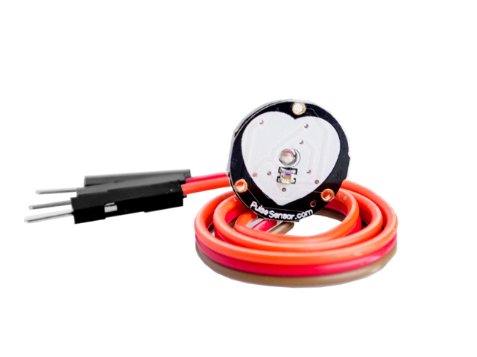


Heartbeats
Heart Pulse sensor
- analog

Slide 10
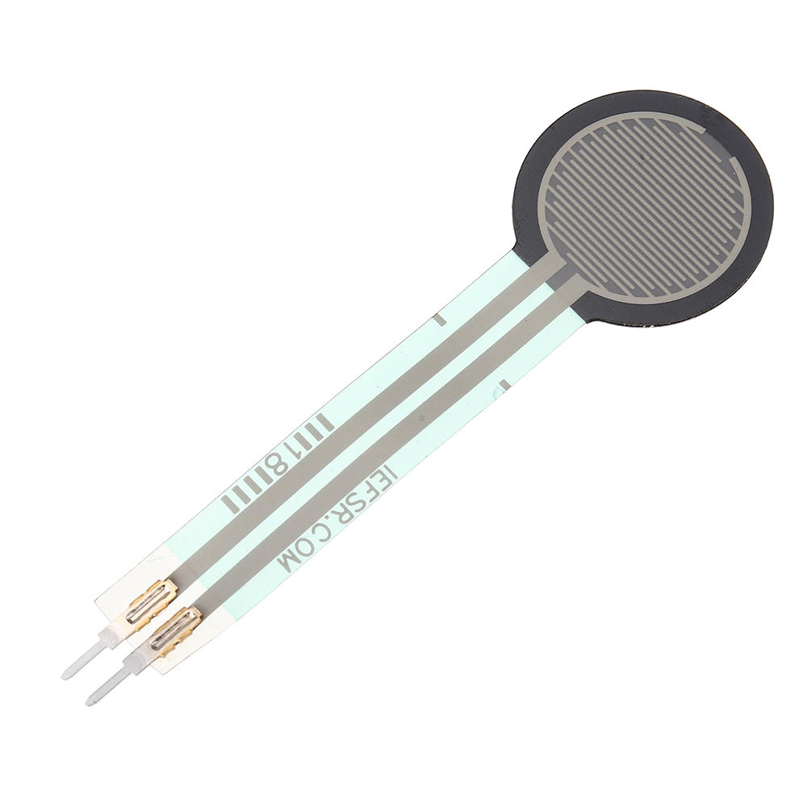

Breathing
Force Sensing Resister
- analog

Slide 11
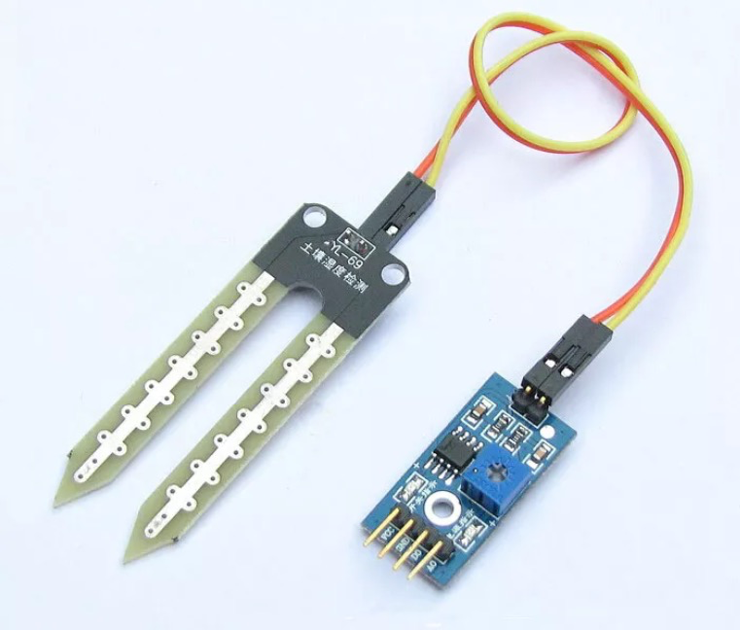

Sweating
Soil Moisture Sensor
- analog

Slide 12


Hardware Components:
Microcontrollers

Slide 13
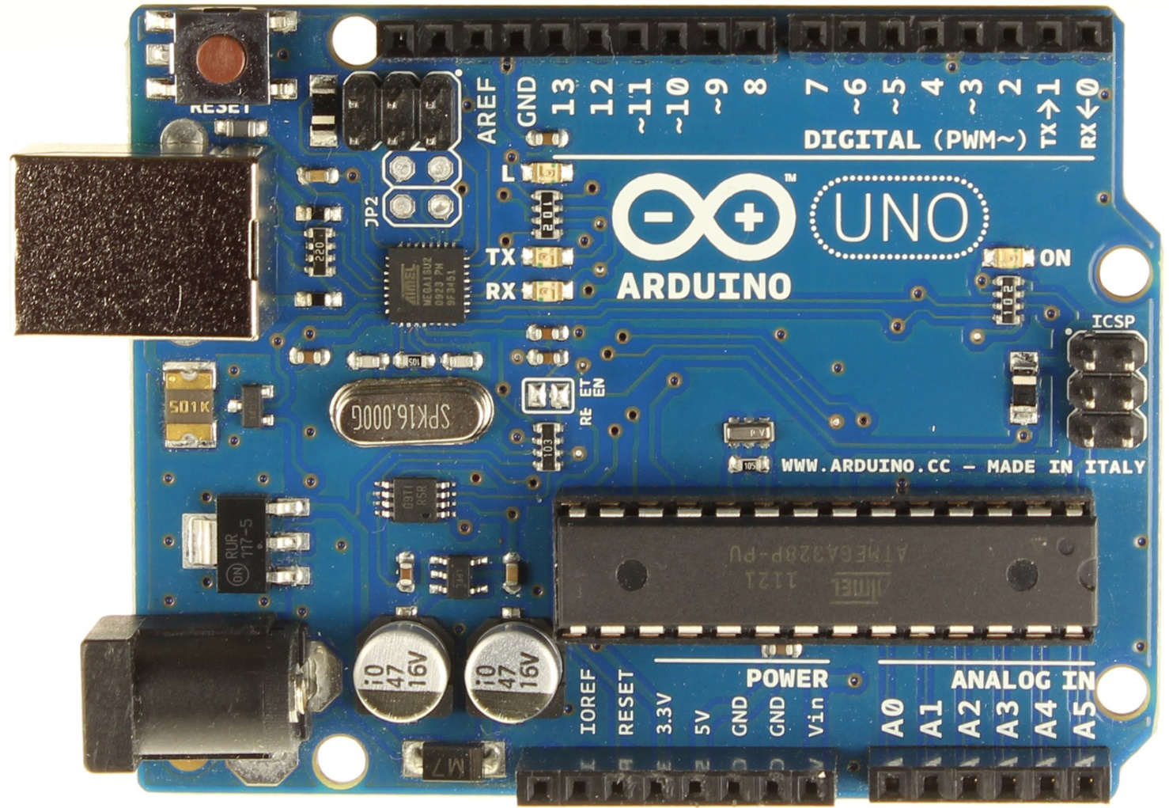
Helper Controller
Arduino Uno
- digital I/O
- analog I/O
- interrupts

Slide 14
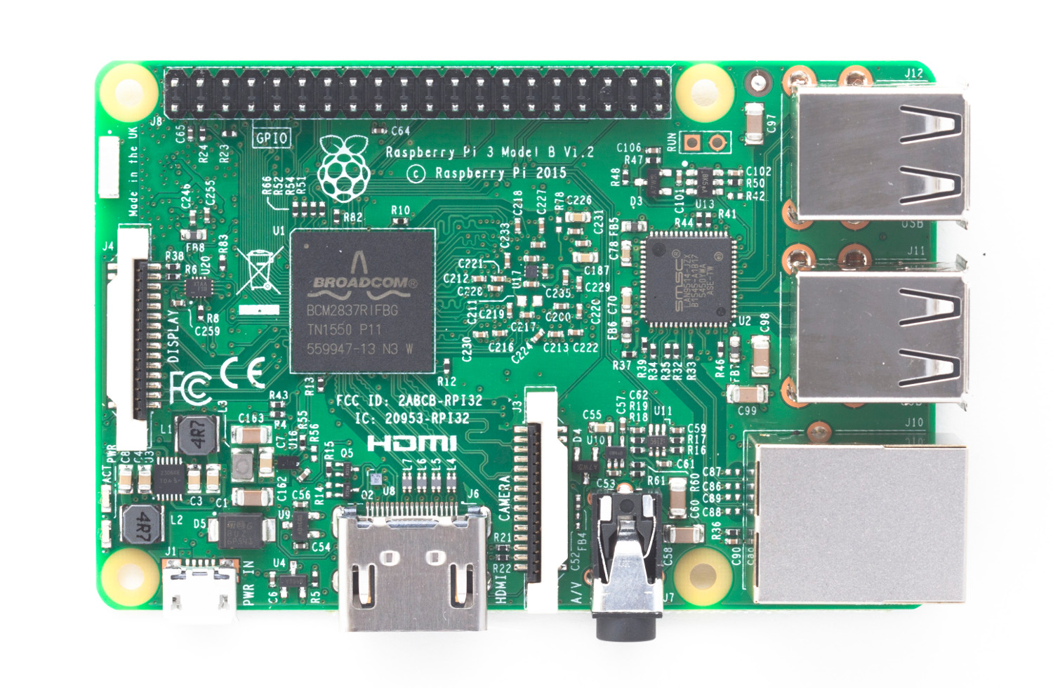
Main Controller
Raspberry Pi 3
- digital I/O
- UART
- Camera port
- I2C
- Wi-Fi

Slide 15

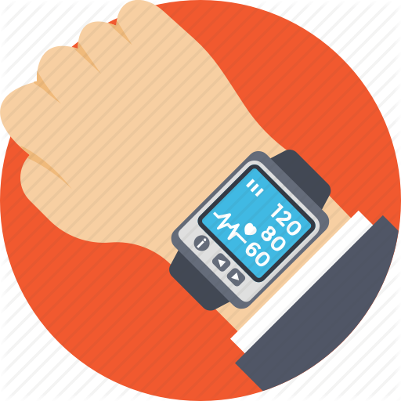
Hardware Components:
Other Components and modules

Slide 16
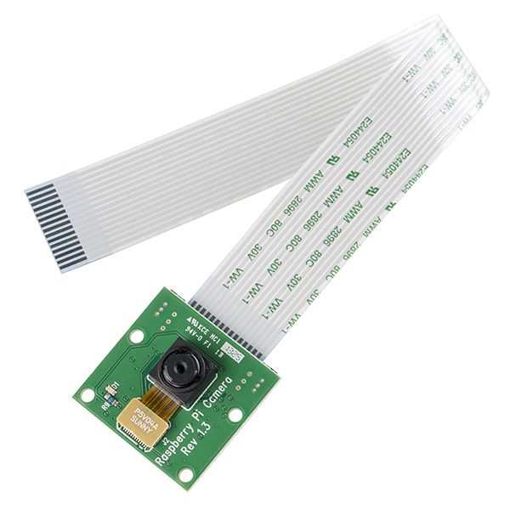

Camera
Raspberry Pi Camera Module

Slide 17
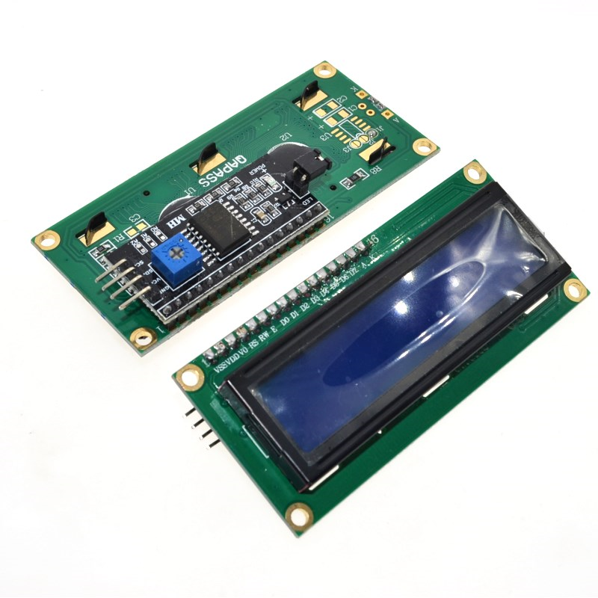
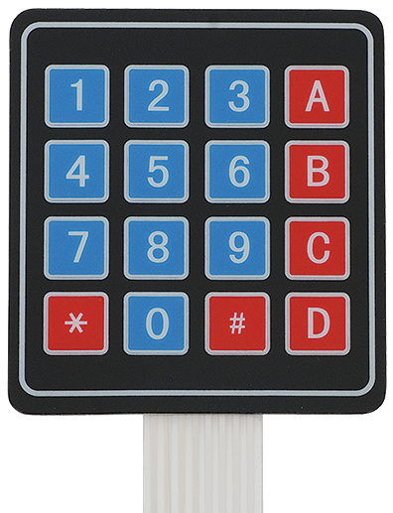
Display and Keypad
16X2 LCD Display
- with I2C driver
4X4 keypad

Slide 18


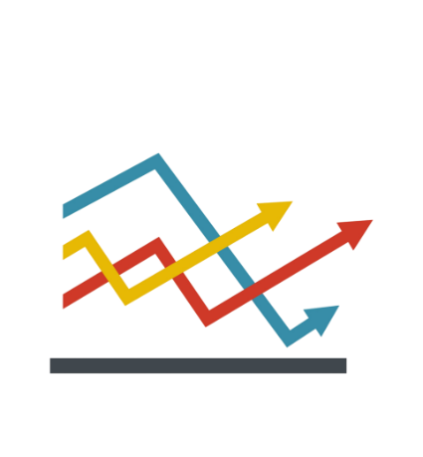


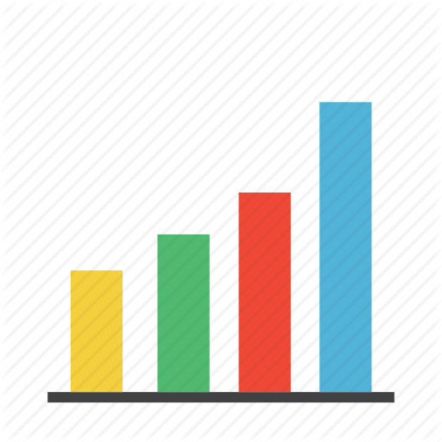


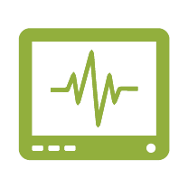
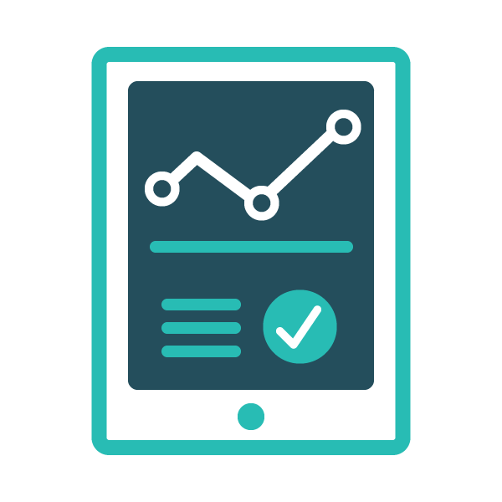
Web App

Slide 19


Demo

Slide 20

Constraints
Unavailability of medical sensors
Cost of components

Slide 21

Future Work
Use medical sensors
Add other important vital signs
- Blood pressure
- Blood glucose levels

Slide 22

Thank You..!!

