Slide 1

BY: YAZAN HABASH & ROLA SALAHAT
PROJECT SUPERVISOR: DR.ANAS TOMA

Slide 2
Outline
Introduction
Features.
Technologies
Constraints.
Future work

Slide 3
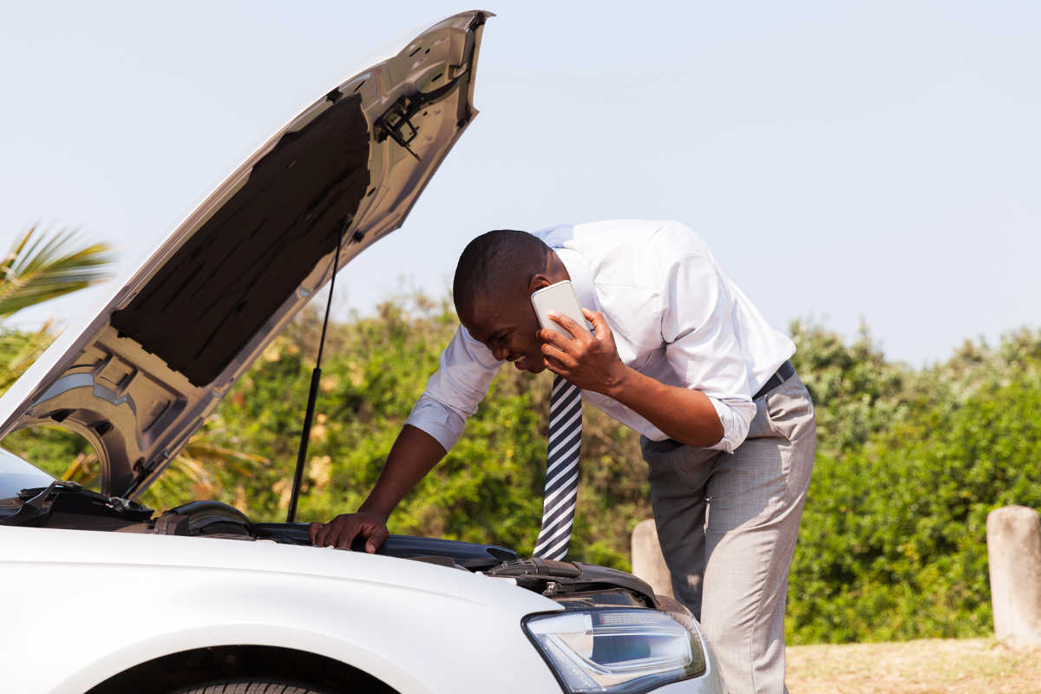
Introduction
Every driver must have experienced being cut off on the road due to a sudden problem and found it difficult to ask for help.
Driver wonders to find the nearest garage, and then wonders if this garage is available, or if the needed service is available in it.
In most cases, drivers do not have enough experience
to know the problem that their car suffers from.

Slide 4
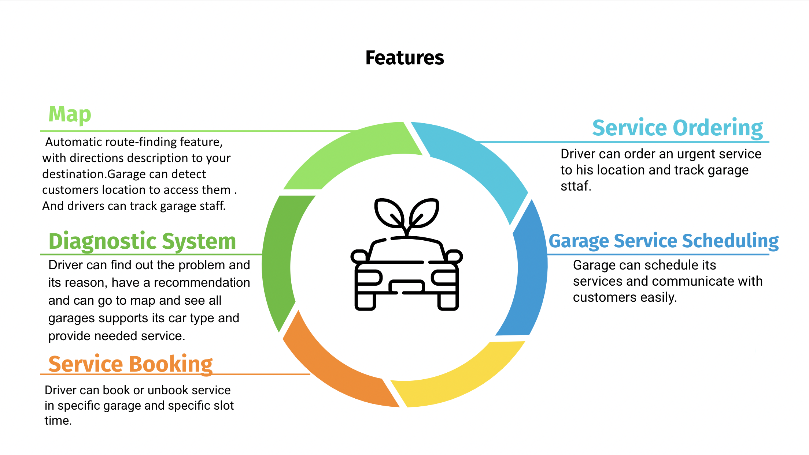

Slide 5





TECHNOLOGIES

Slide 6
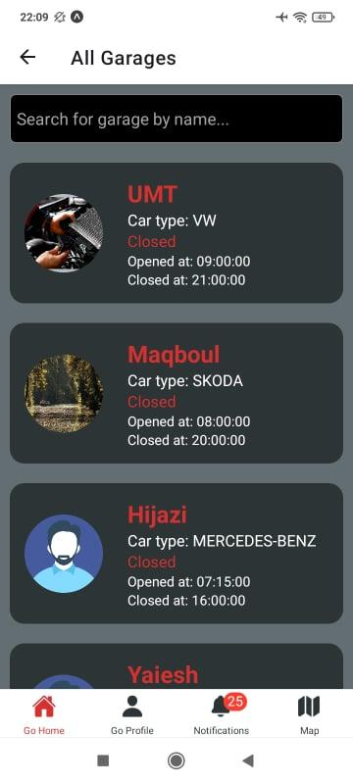
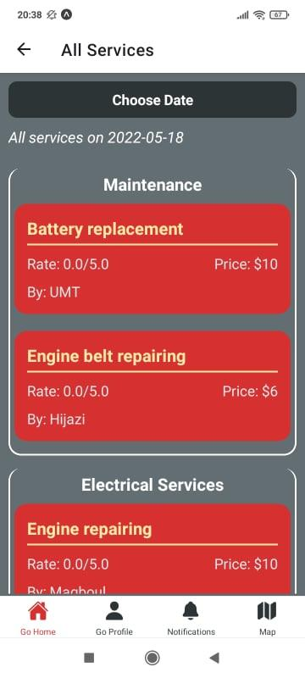
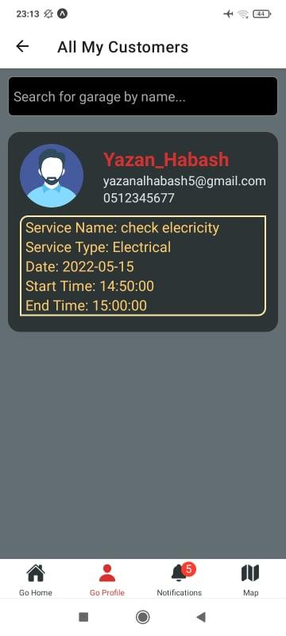
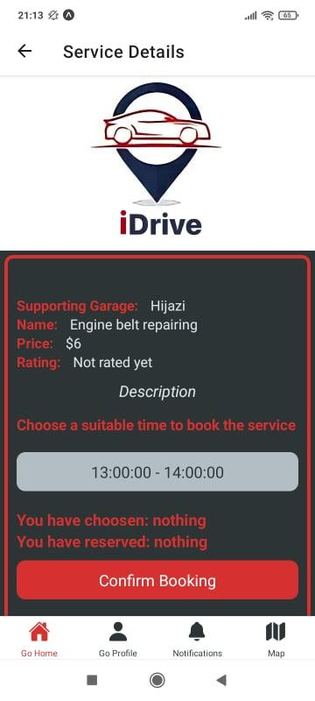
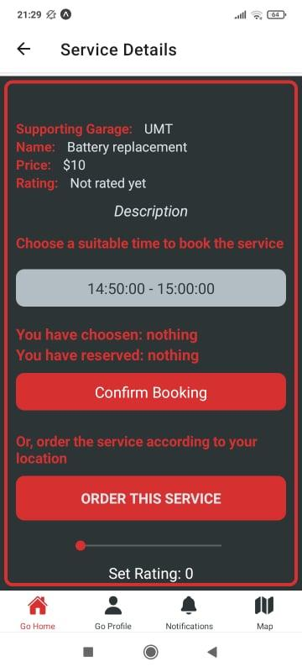

Slide 7
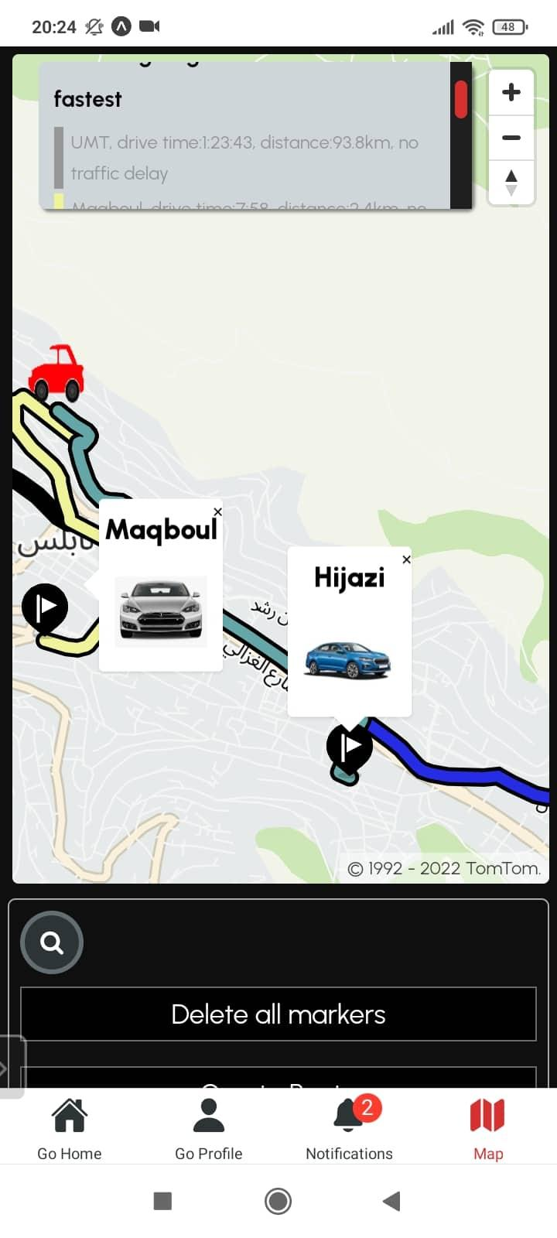
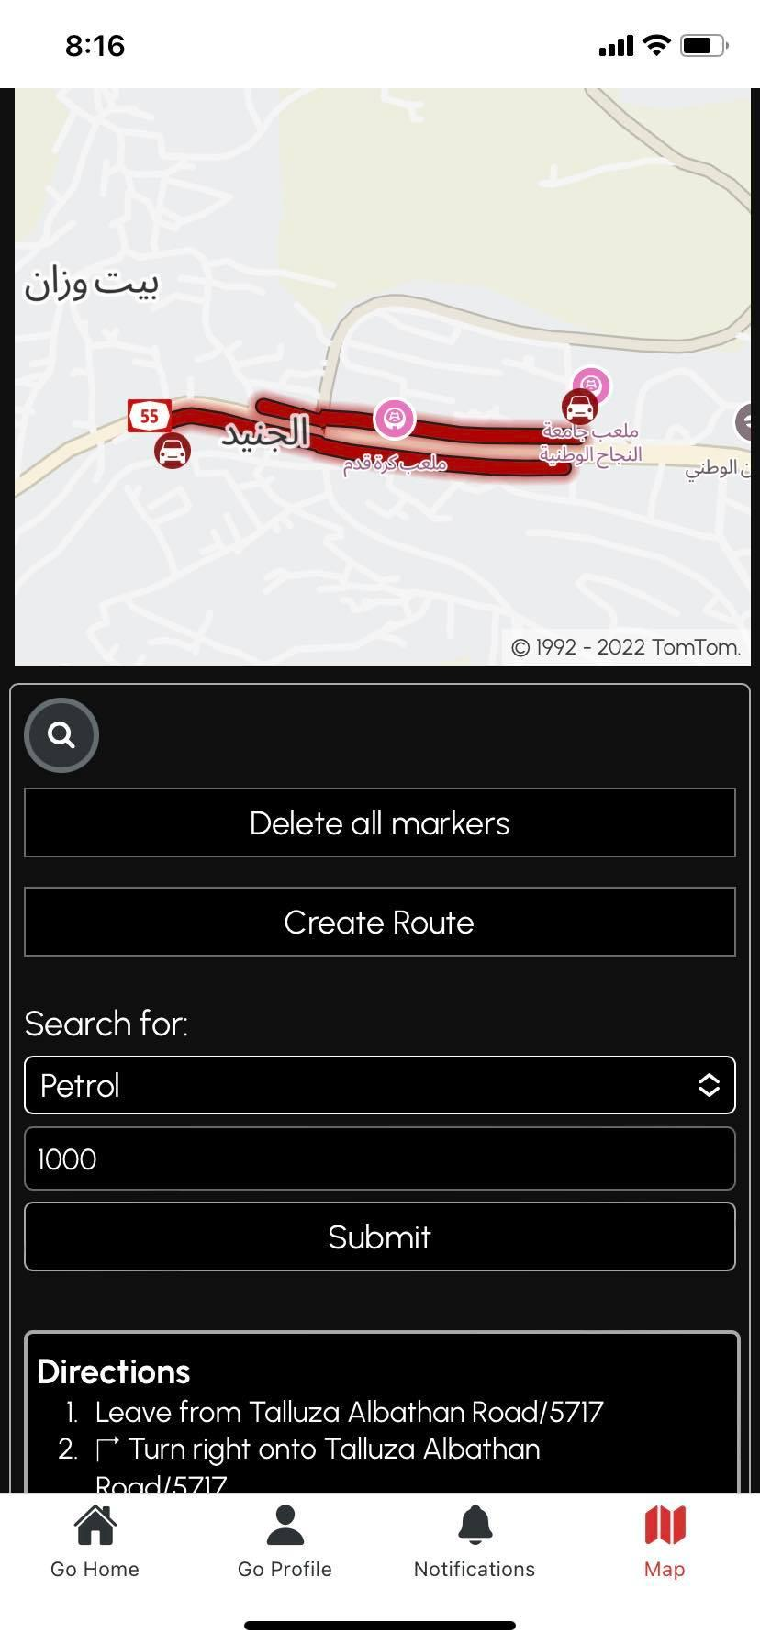
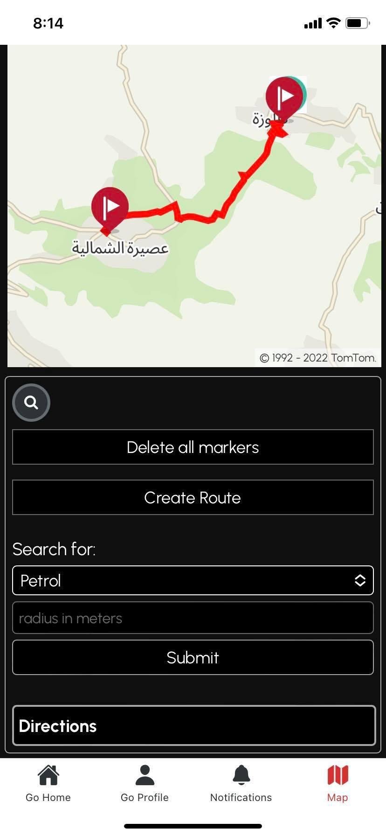
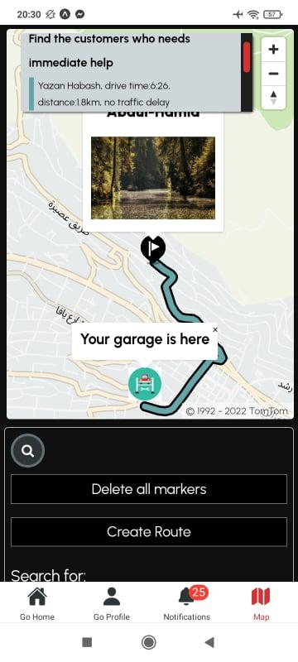
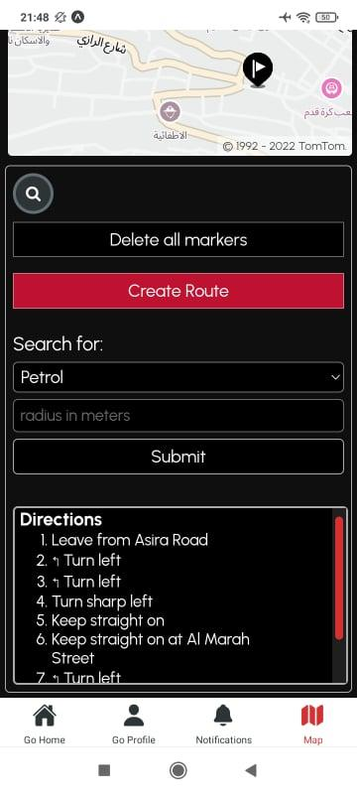

Slide 8
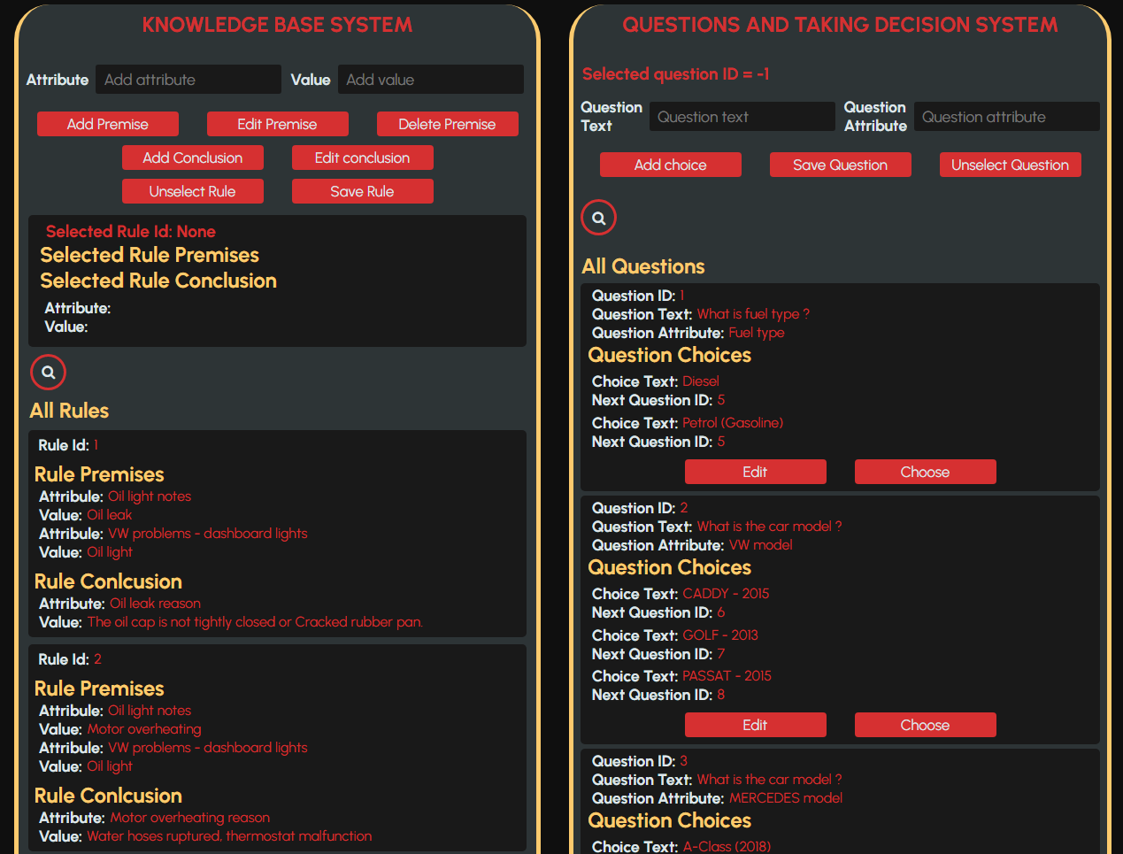
Diagonistic System

Slide 9
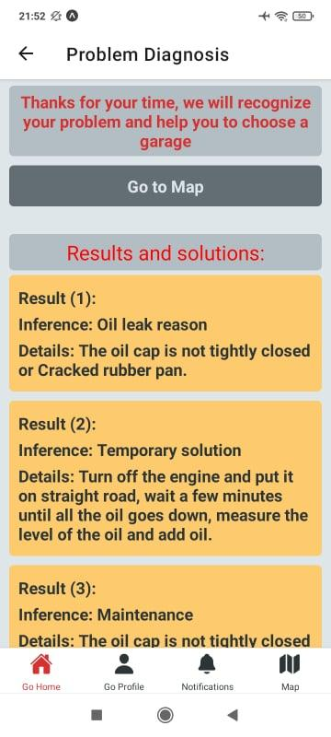
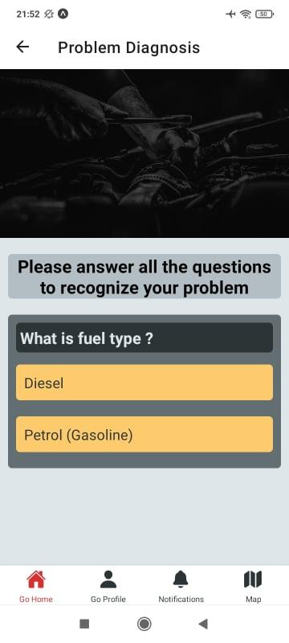

Slide 10
Future Work
Serve drivers of trucks, motors and other vehicles.
Online purchase feature to let driver buy car accessories or even buy a car or another vehicle!
Agreement with taxi offices to serve customers and facilitate the idea of taxi requesting.
Add an audio assistant to read the directions on the road.

Slide 11
THE END...
THANKS!

