Slide 1

Annotation System
A New Annotation System for Dynamic Web Pages Driven by NLP

Slide 2

Introduction
What is the problem?
What is an annotation?
Why use annotation?

Slide 3

DEMO

Slide 4



Related Work
Framework
The problem is:-
  Not open source
  Not for dynamic pages
Framework
voice annotation
Madcow
Dynamic websites
Sketchpad

Slide 5
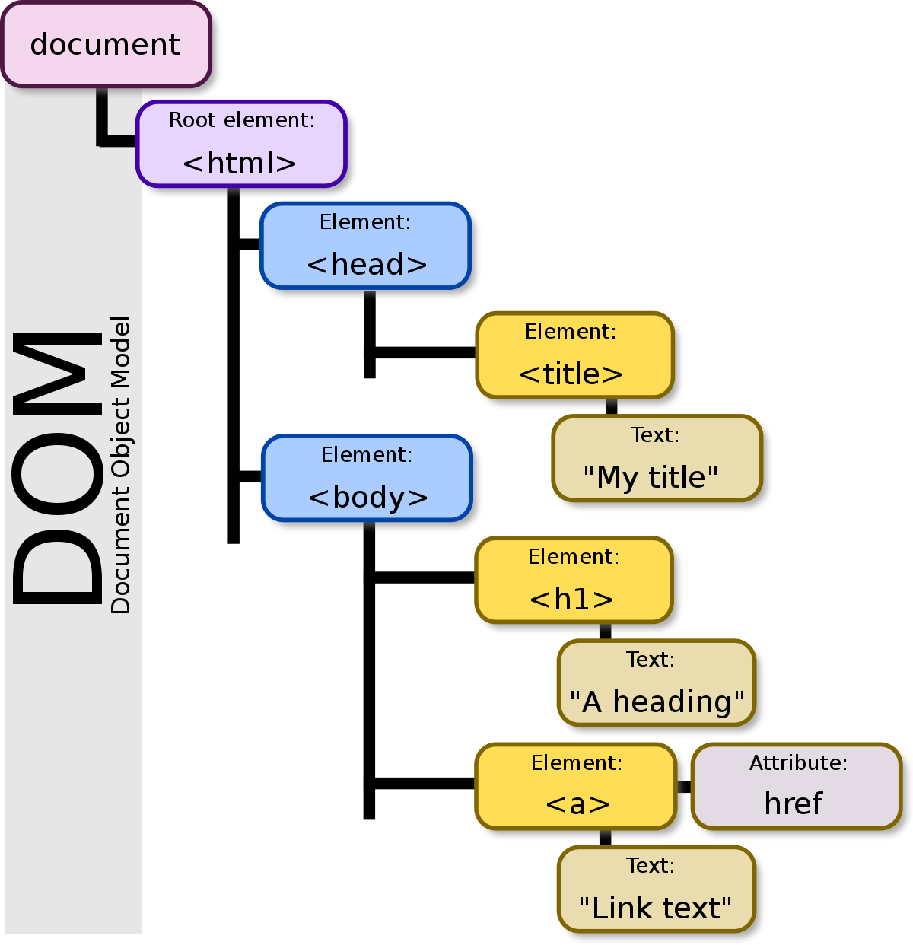
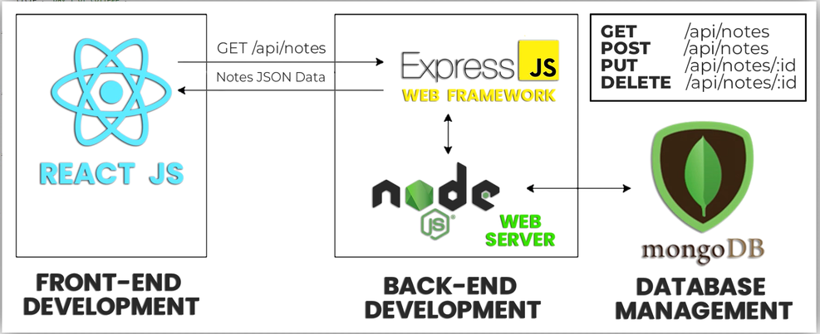
Contributions
Framework
Dynamic websites

Slide 6





System Architecture
NodeJS server
Client Side
Database
Python Server
JavaScript
NLP

Slide 7
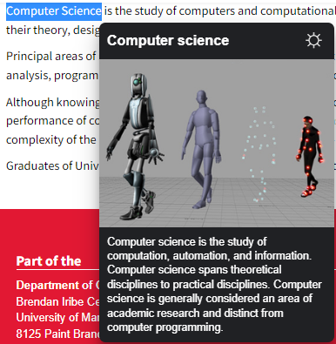

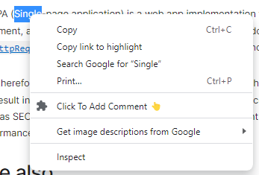
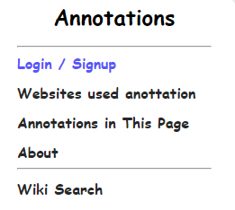
Frontend
Content script
Background
action popup
Main annotation page

Slide 8
Backend
NodeJS
Python NLP
Database

Slide 9
NodeJS
Router
Controller
Services

Slide 10
Database - Mongo dB
Annotation
Comment
User
_id
pageURL
pageName
Text
context
_id
full_name
phone_number
email
password
_id
userId
annotateId
text

Slide 11
Python server using NLP
Pre-Processing Steps:-
  Stemming
  Remove Punctuation
  Remove Stop Words
  Remove URLs
Similarity
Return the value to the view

Slide 12
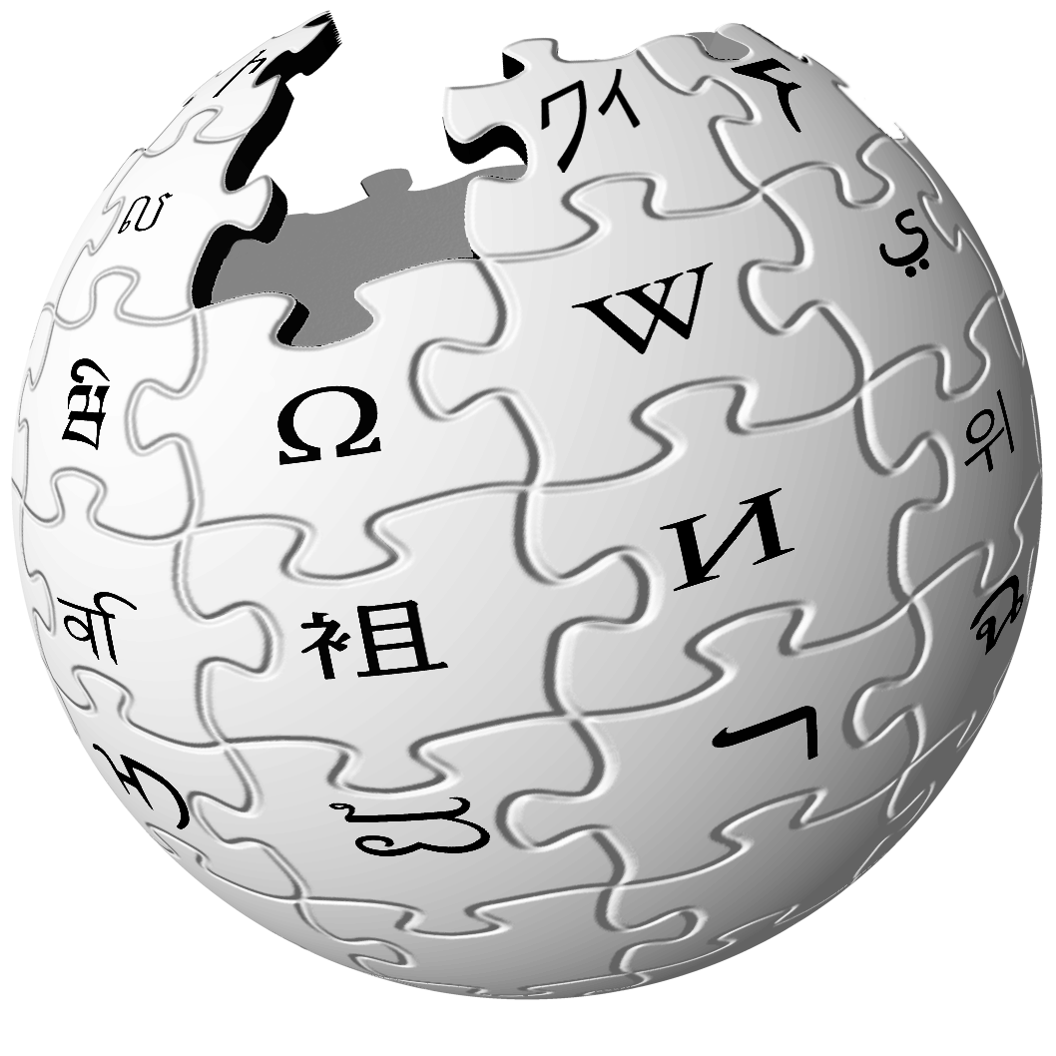

User Interaction
Wikipedia search
Add comment
Show annotations

Slide 13
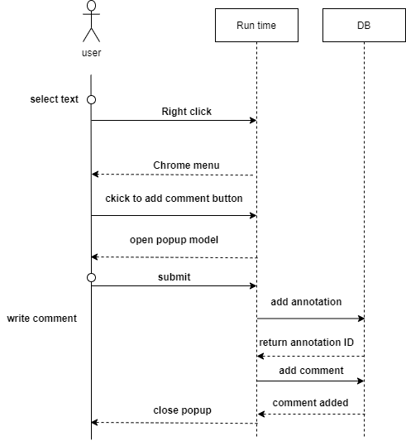
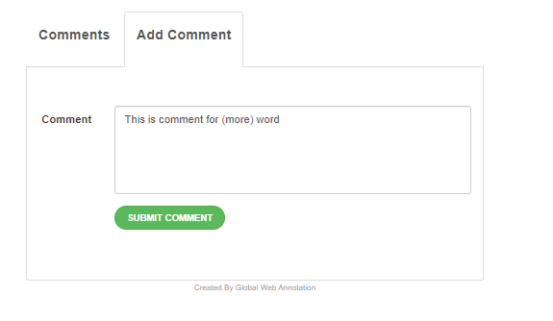
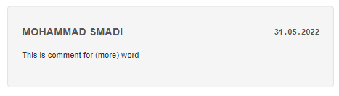

Add comment

Slide 14
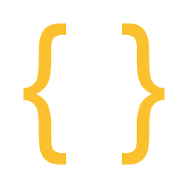
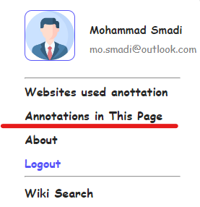

Show annotations
Action Popup
Content Script
GET
/api/annotation/pageURL
Chrome API

Slide 15
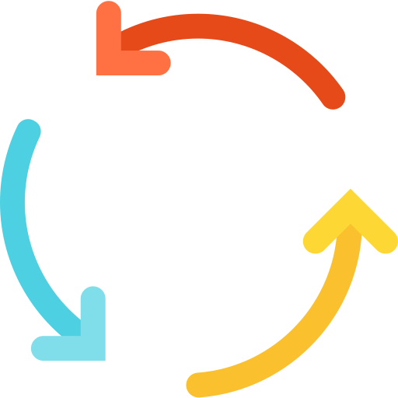
Show annotations
skip and take another text
Search
continue processing

Slide 16

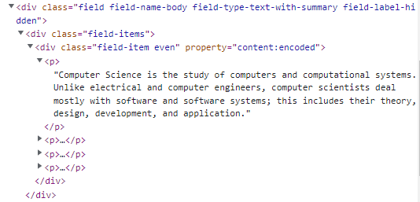

Show annotations
createTreeWalker
Check if innerText
Contain the word

Slide 17
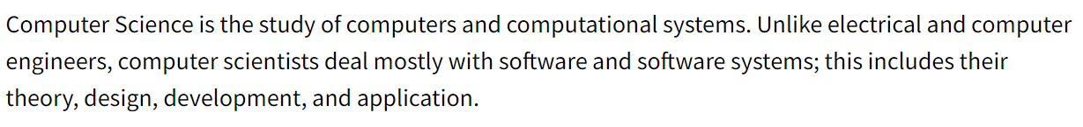



Slide 18
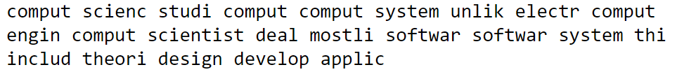
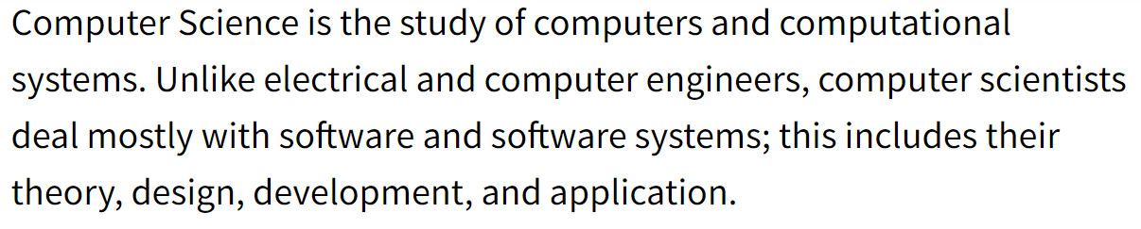
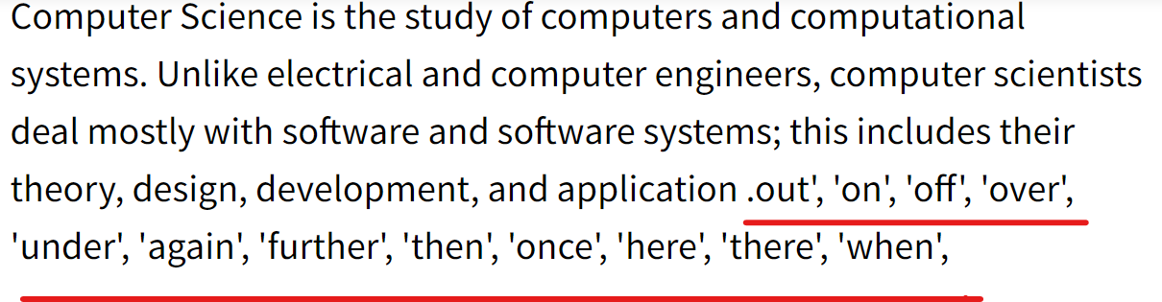

Slide 19
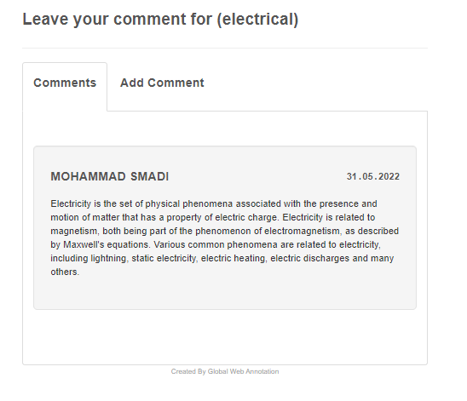

To background

Slide 20
Future Work
Framework
notifications
Framework
restrict comments
chat between users
Reply for the comments
Dynamic websites
Different annotation types

Slide 21

conclusion
Framework
Open-source
dynamic web pages
Interaction between users

Slide 22

Thank you

