Slide 1


ADFollower
By: Ghadeer Aqra & Marah Jabr
Supervisor: Dr. Ashraf Armoush

Slide 2
Outline
What is Adfollower.
What's new in Adfollower.
What we used.
Main features.
Launcher.
Conclusion.

Slide 3

What is Adfollower ?
Adfollower, stands for Alzheimer Disease follower.
Adfollower aims to help Alzheimer's & Dementia patients, Schedule their life and reminds them about important points in their day.
It also helps Alzheimer’s Caregivers and families to be informed and connected with them.

Slide 4
Our project
Adfollower consist of two android mobile application. one for the patient and the other for the patient’s caretaker.
The two applications contains many features to help Alzheimer’s patient. Also it make the communication easier between them.

Slide 5
What's new in Adfollower …
All of the applications exists are one side apps, they are used by the patient or by their families not making a communication way between them.
Also they just give one feature alone.

Slide 6
What's new in Adfollower …
The uniqueness of our project is that it’s provide a two applications to be used by the patients and their caretakers, our project give a lot of features to help the patient in a single application.

Slide 7
What we used?
Programming languages
Android Development
PHP
Libraries
Google map API v2
osmdroid-android-4.2

Slide 8
What we used?
Tools
Eclipse
Android SDK
Mobile Atlas Creator
Database
MySQL for the server
SQLite

Slide 9
Main features…
Pills reminder
Task reminder
Online tracking
Offline tracking
Where is me
Fall Detection
Battery condition Detection
Posting images
Saving new friends

Slide 10
Launcher
The main problem we faced was that the application is for Alzheimer patient. So we need a way to remind the patient about the application.
We solved this issue by making our application a launcher application so that the patient will remember the application when the mobile is near the user.

Slide 11
Services
The patient application use AlarmManager to manage the services.
Services used:
Pills Reminding
Task Reminding
Fall Detection
Battery Detection
Online and Offline Tracking

Slide 12
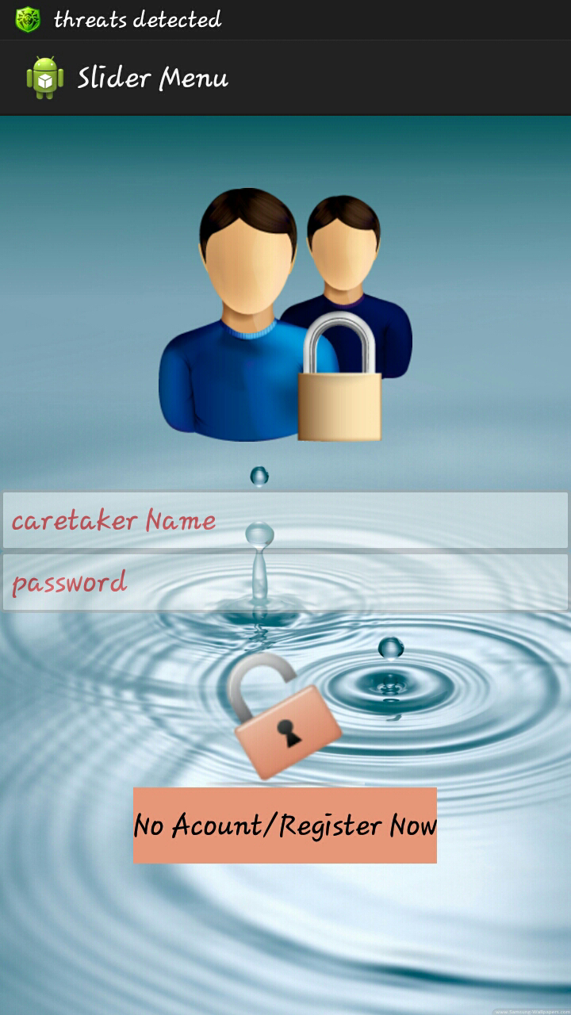
Family app.

Slide 13
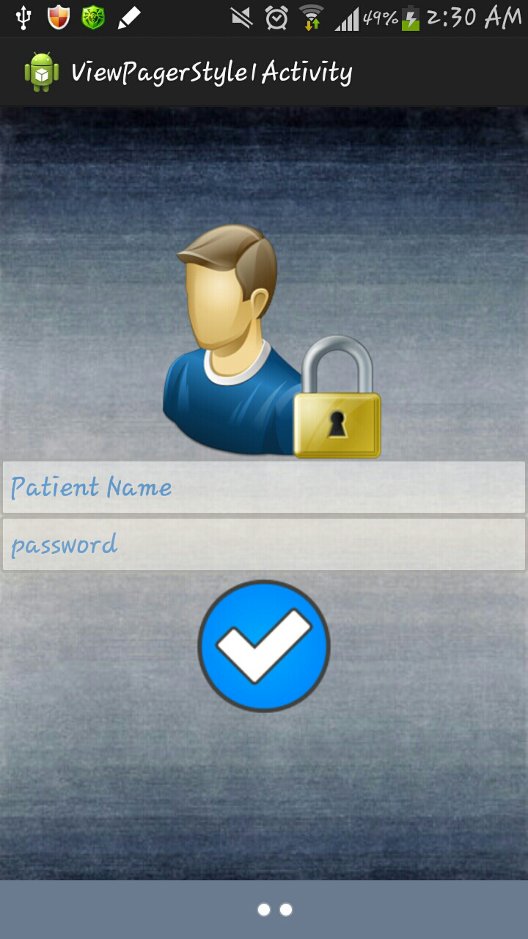
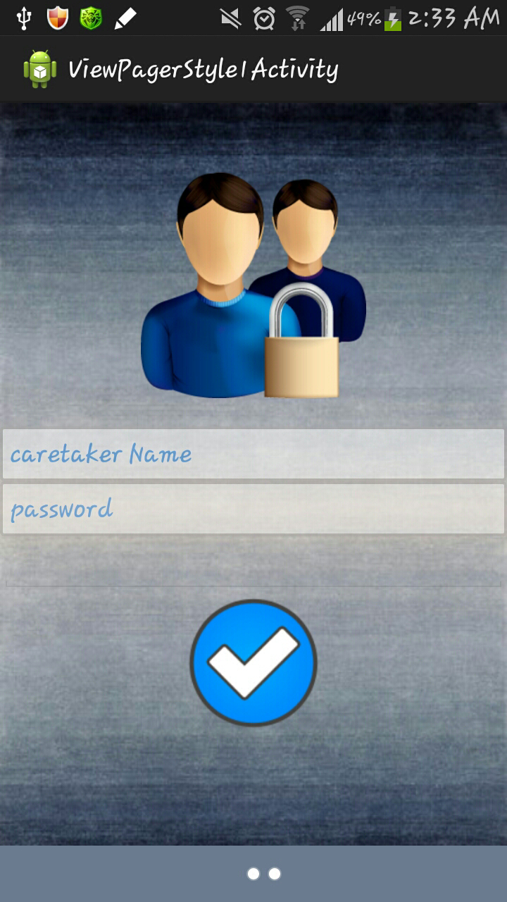
Family app.

Slide 14
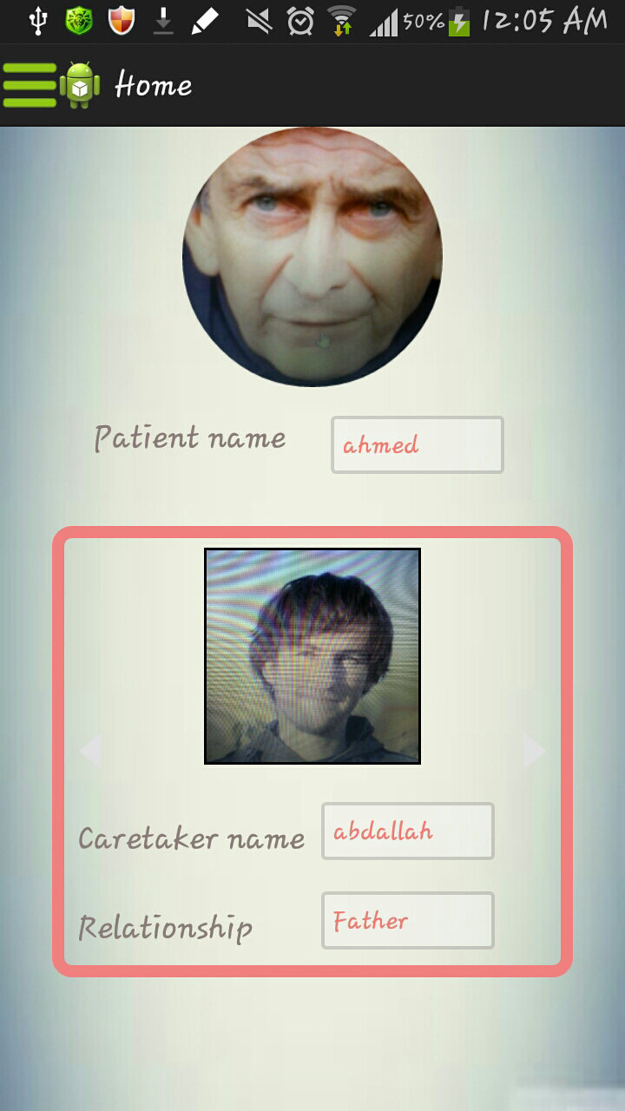
Family app.

Slide 15
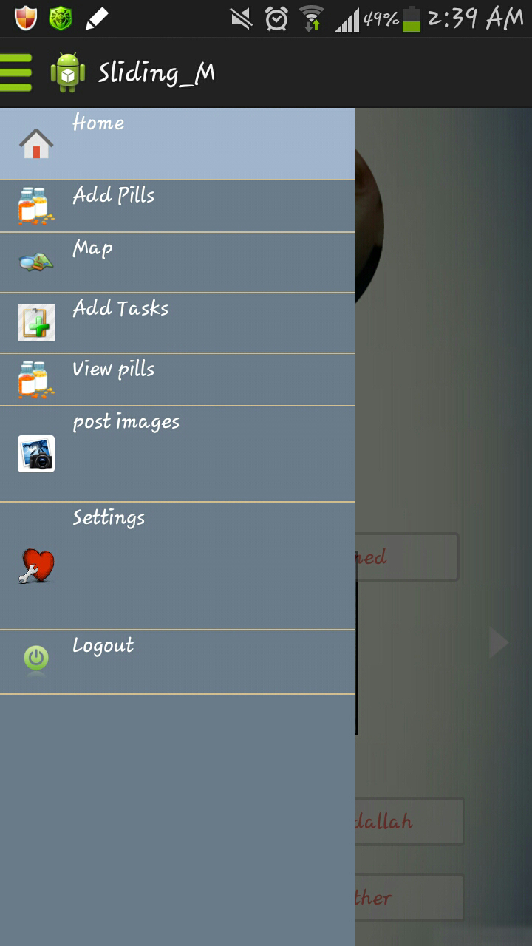
Family app.

Slide 16
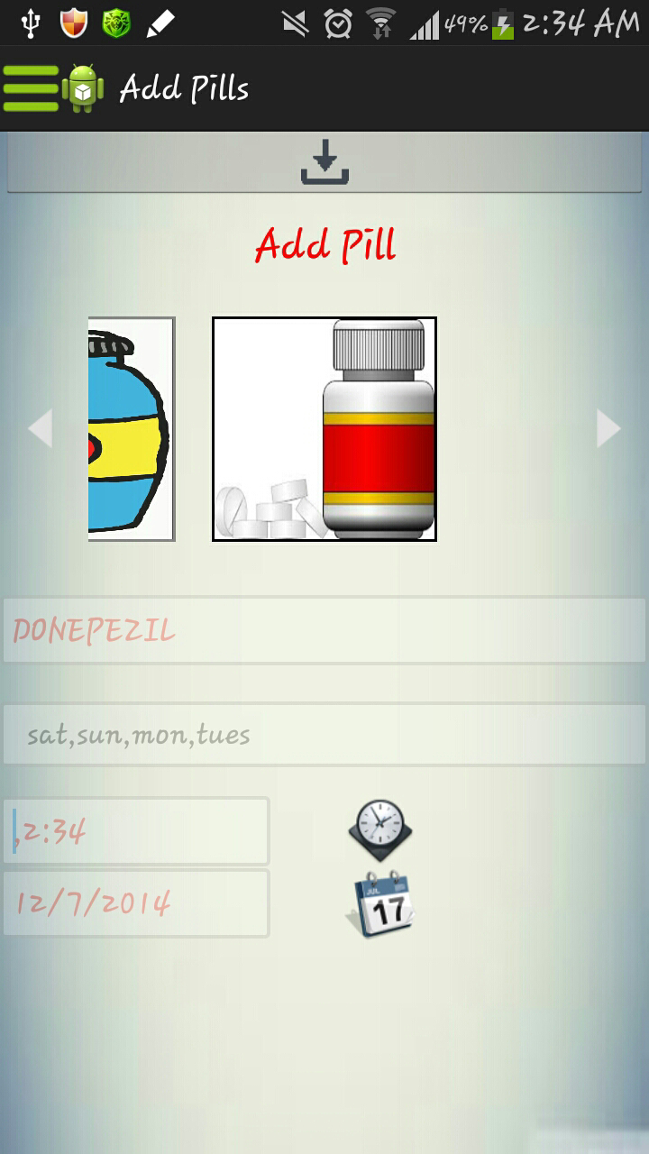
Family app.

Slide 17
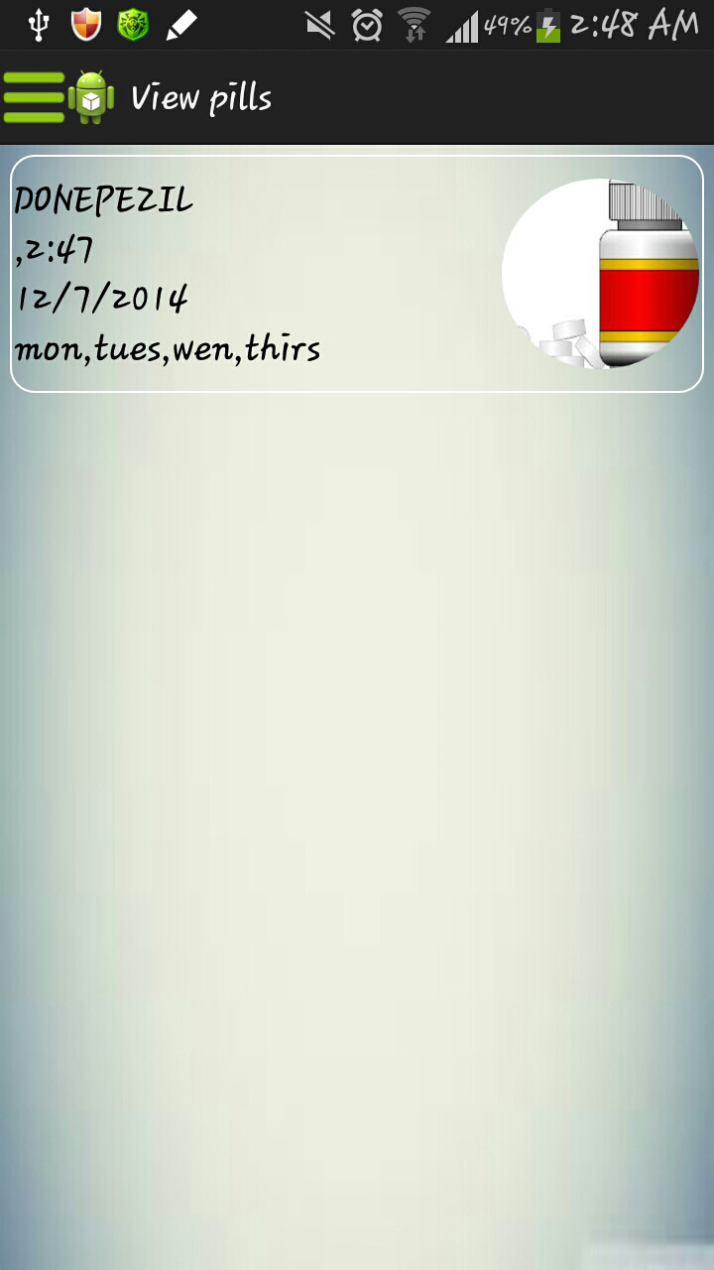
Family app.

Slide 18
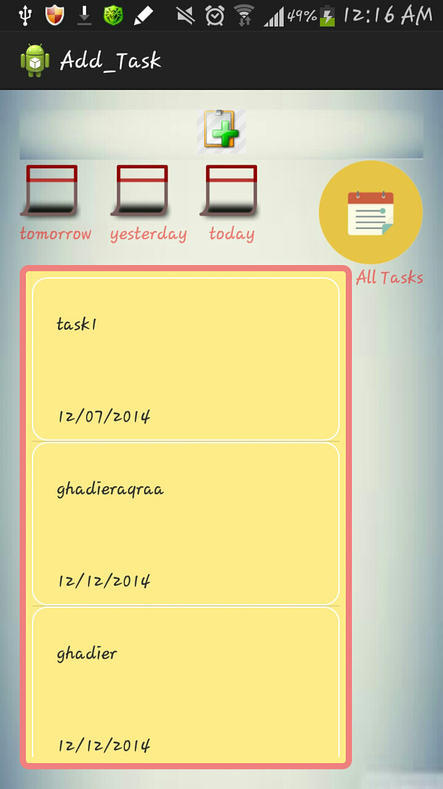
Family app.

Slide 19
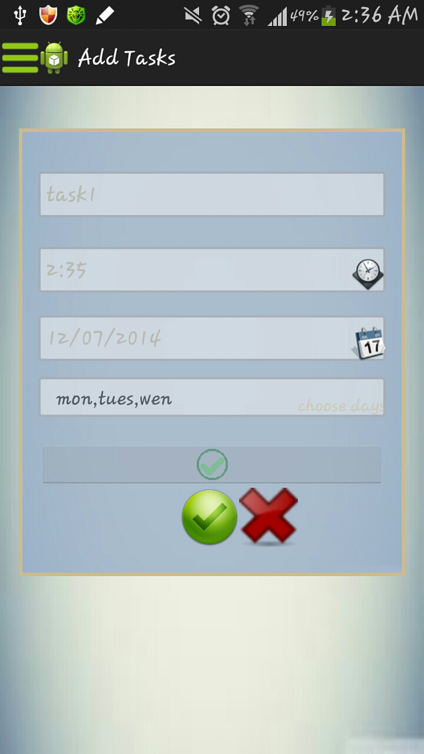
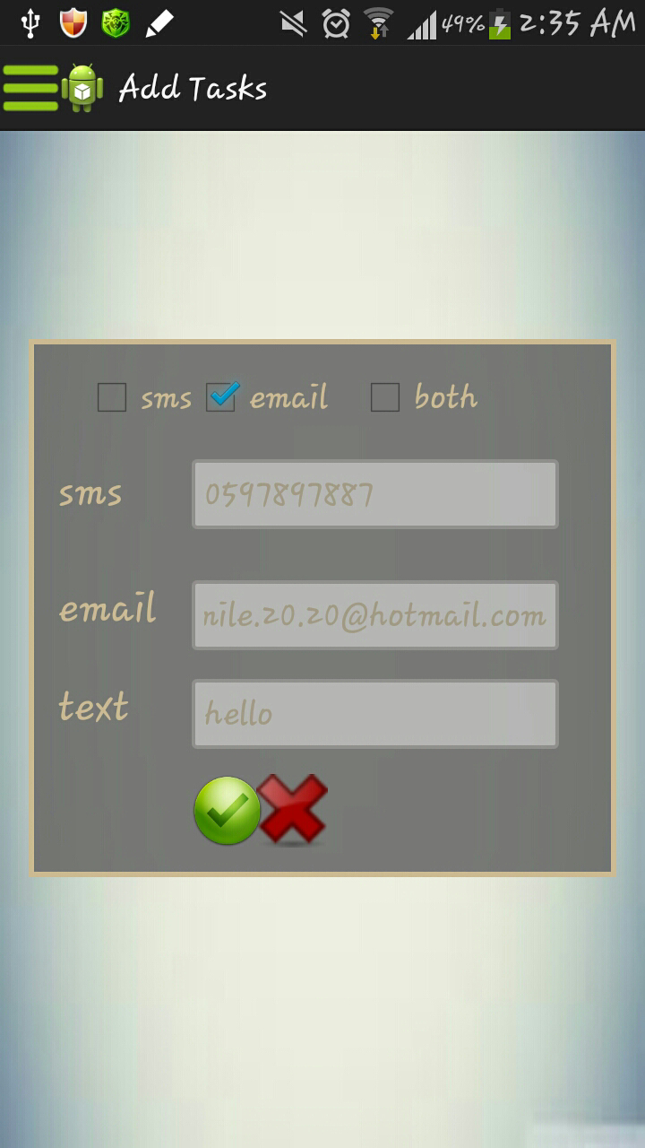
Family app.

Slide 20
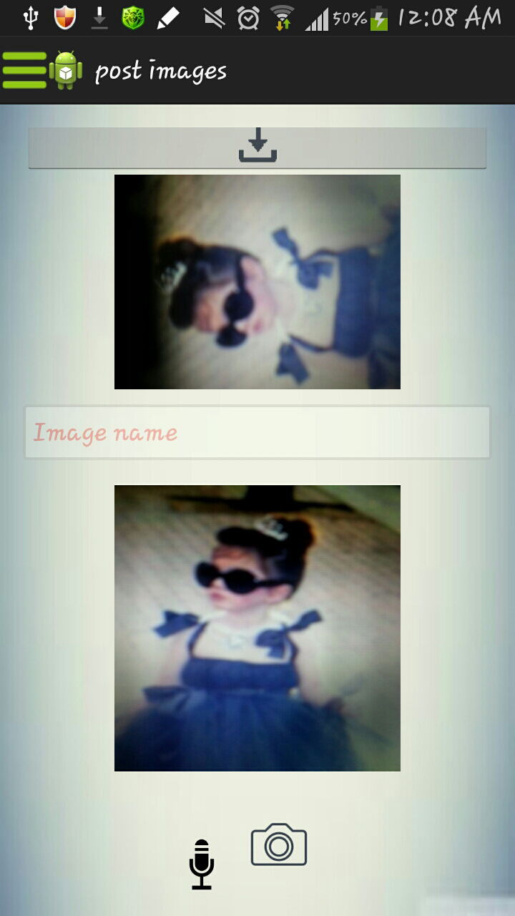
Family app.

Slide 21
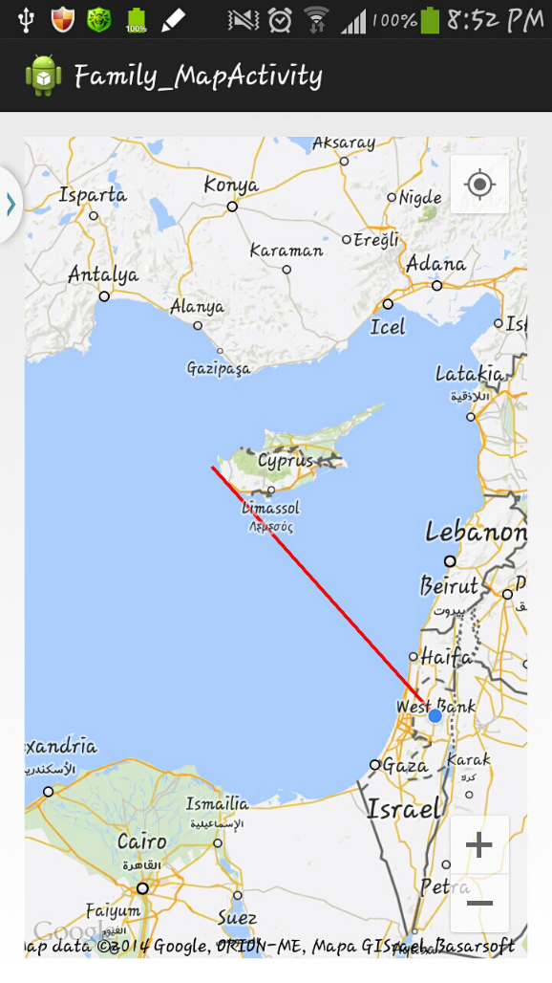
Family app.

Slide 22
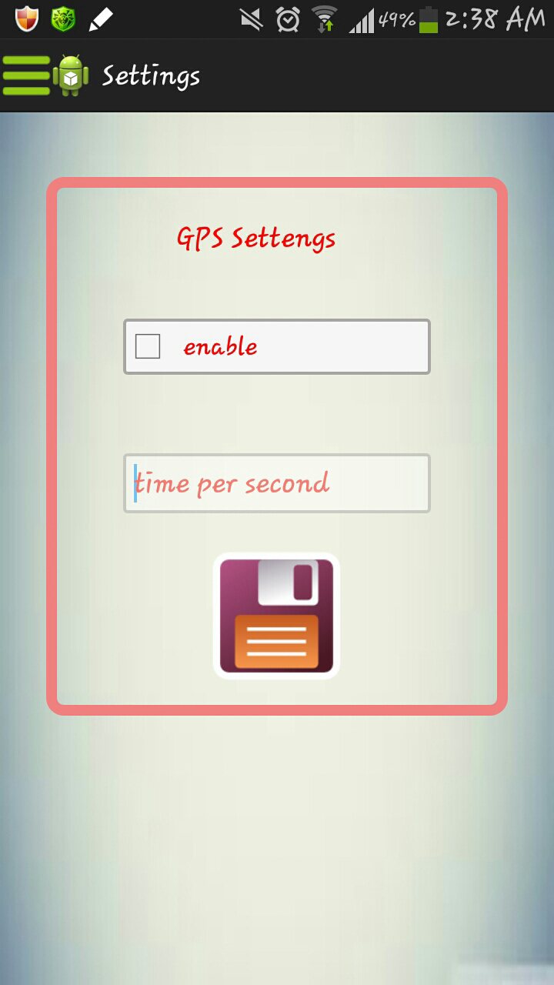
Family app.

Slide 23
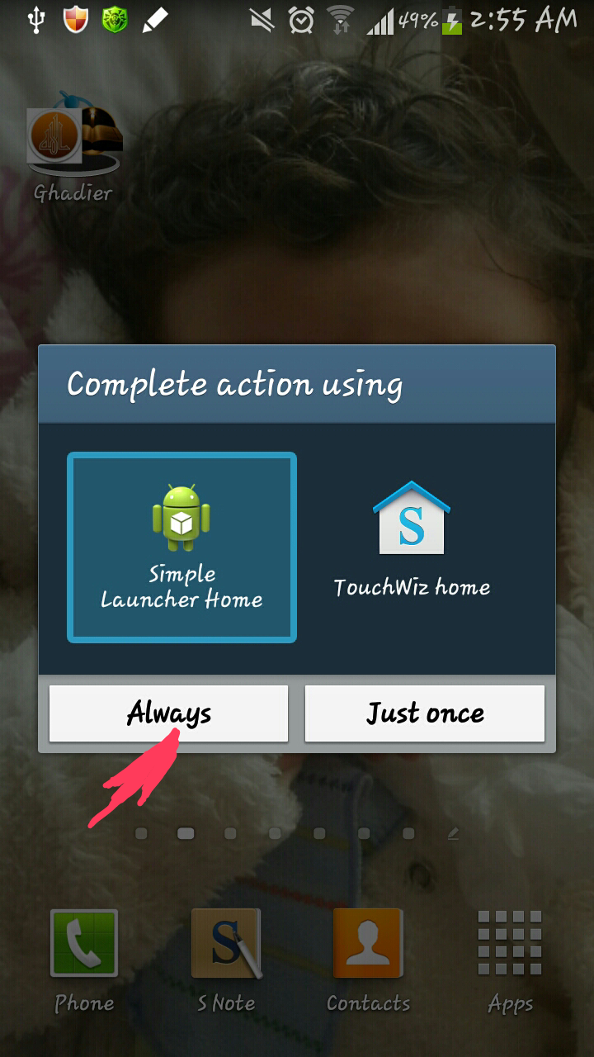
Patient app.

Slide 24
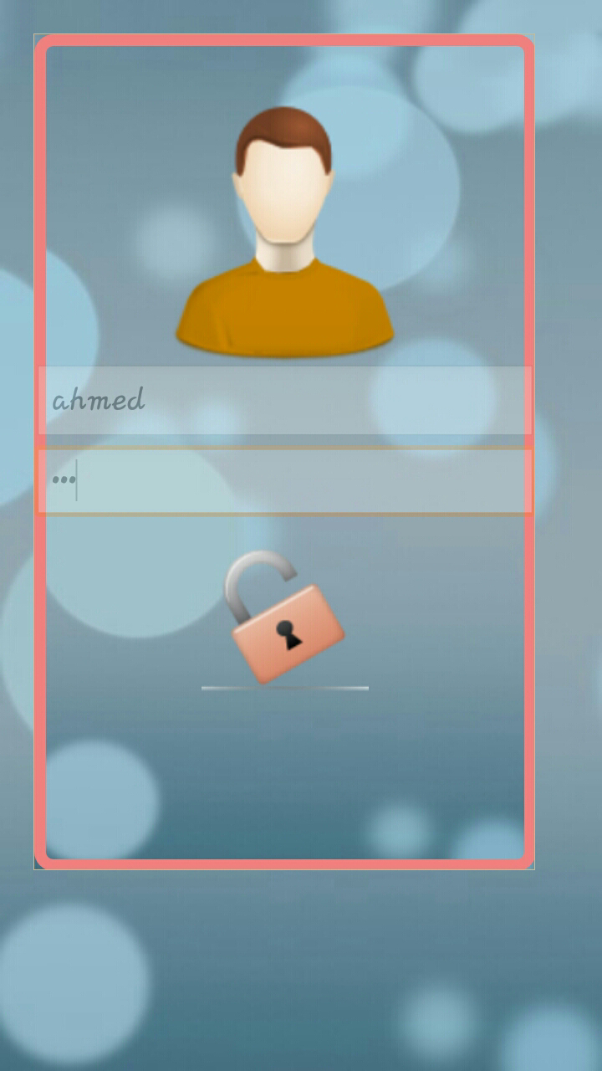
Patient app.

Slide 25
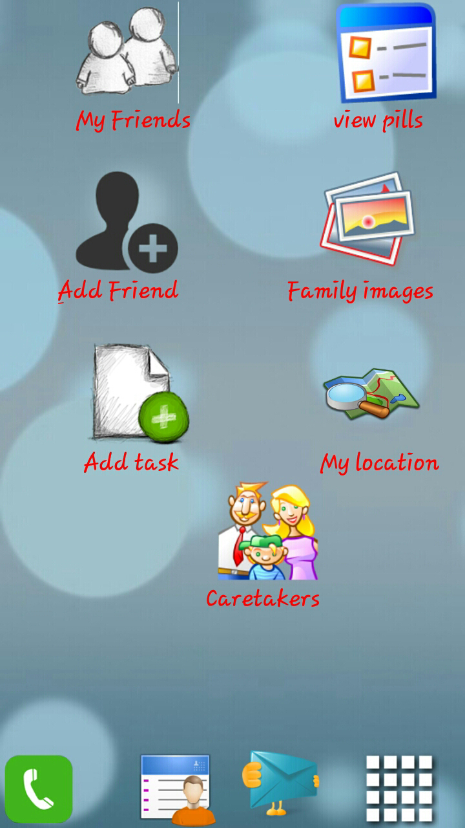
Patient app.

Slide 26
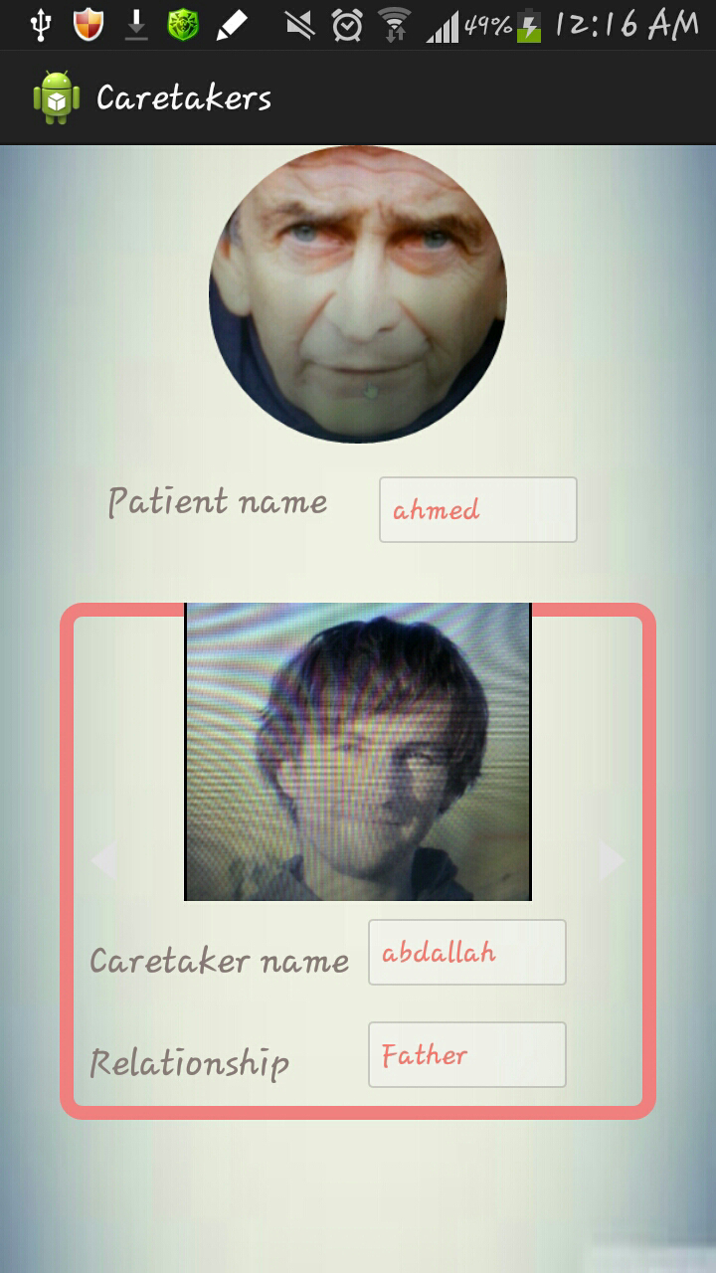
Patient app.

Slide 27
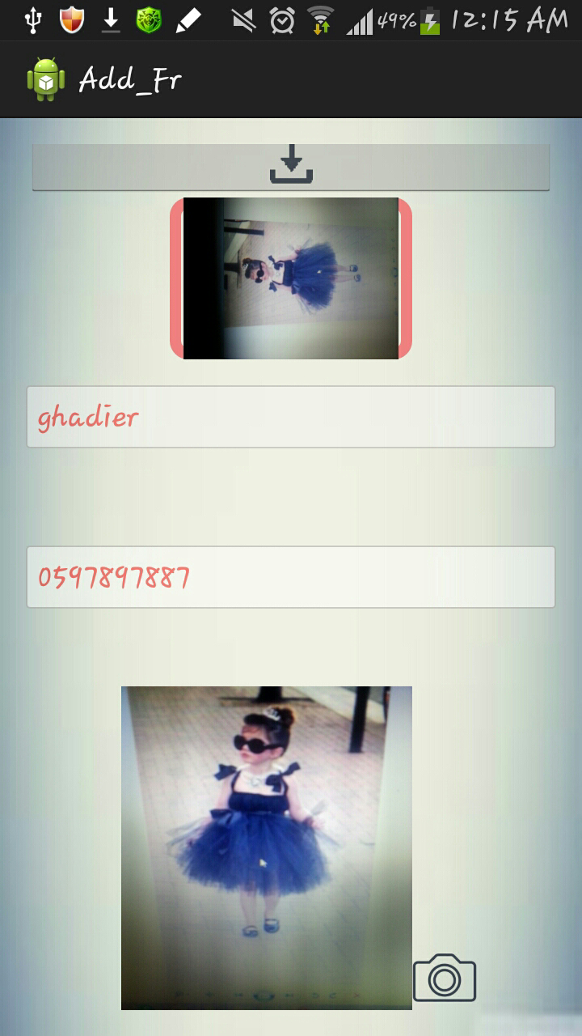
Patient app.

Slide 28
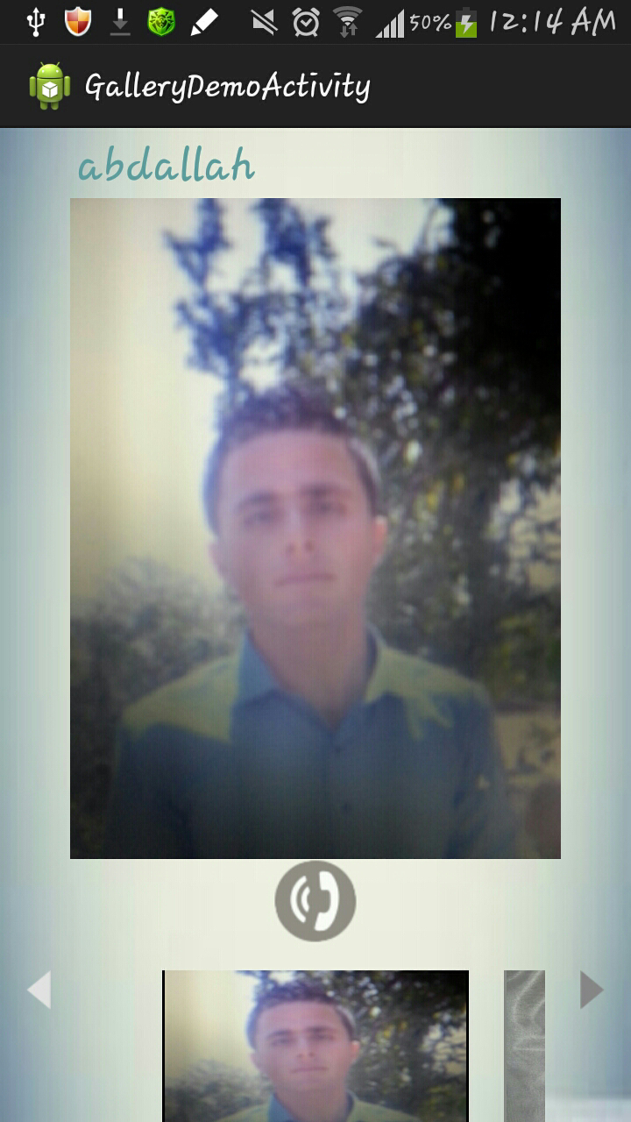
Patient app.

Slide 29
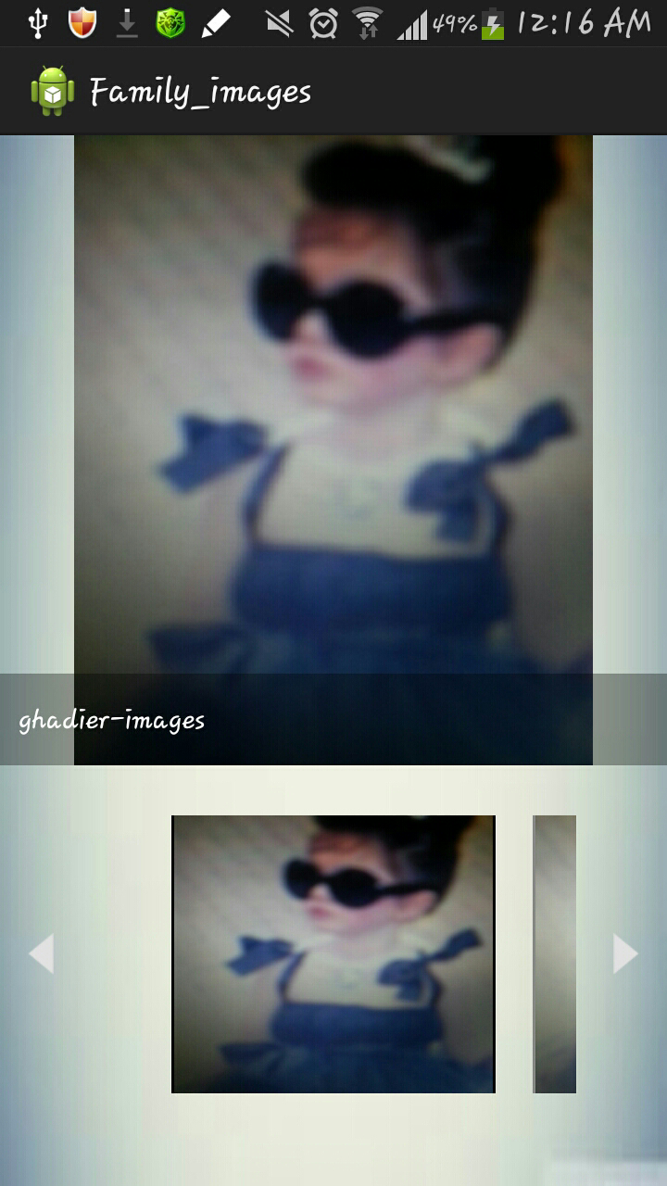
Patient app.

Slide 30
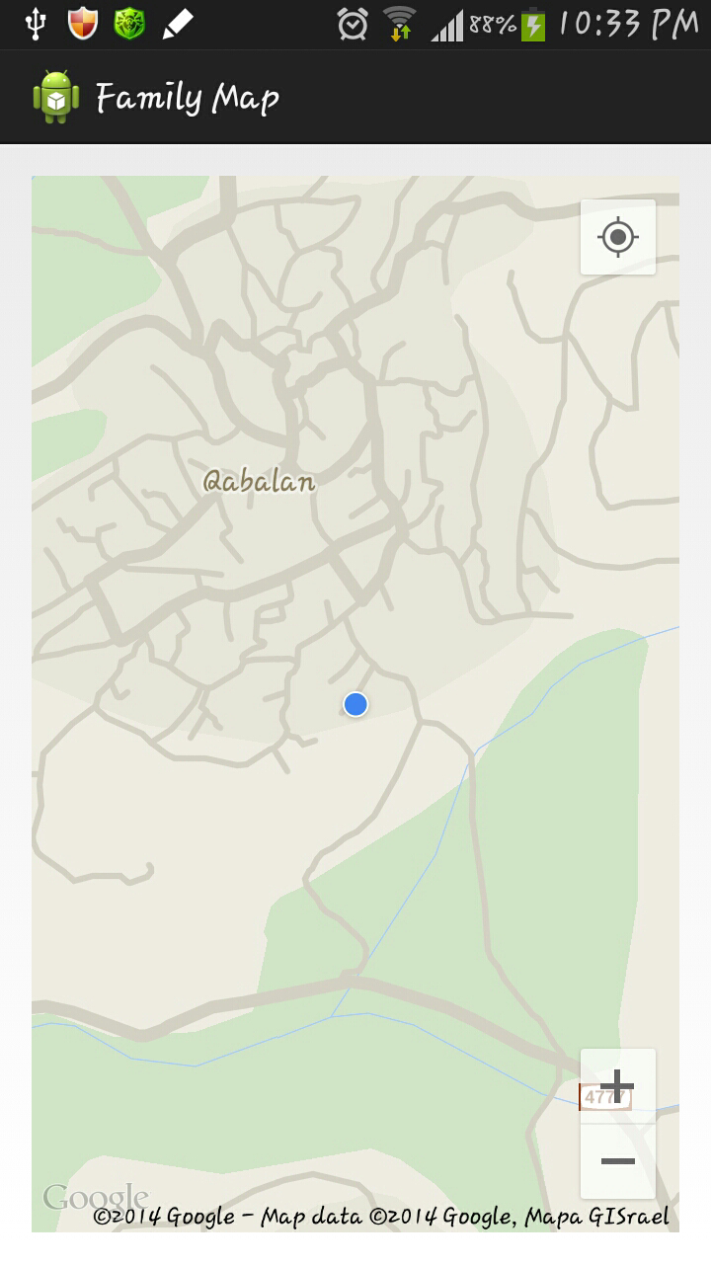
Patient app.

Slide 31
Patient app.

Slide 32
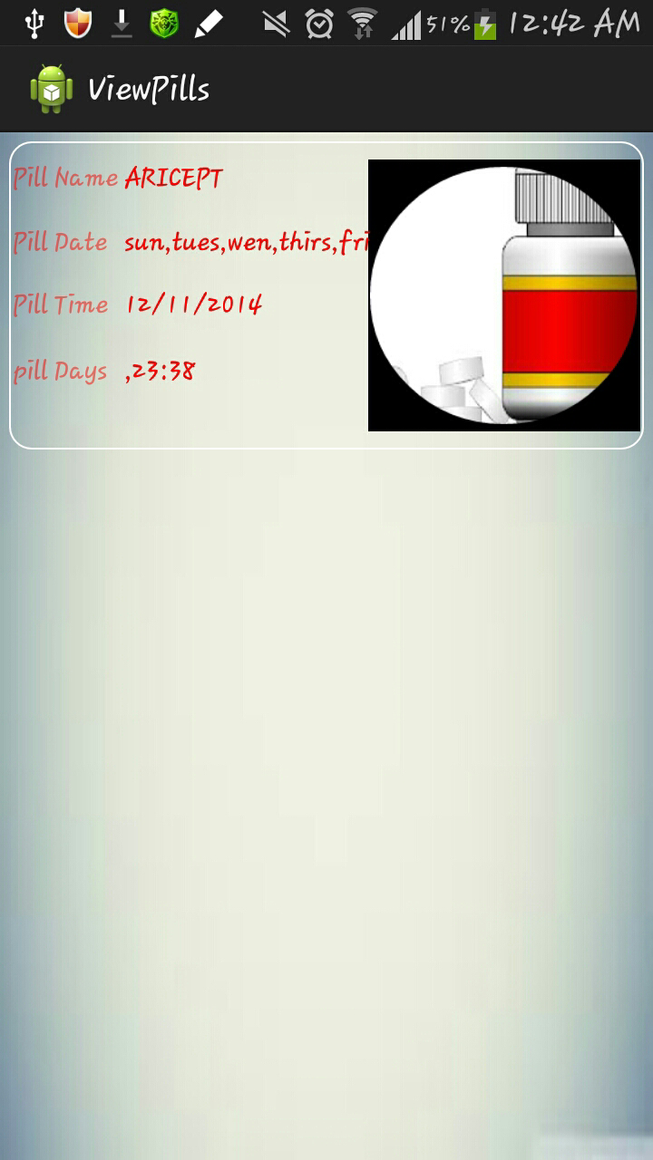
Patient app.

Slide 33
Patient app.
Tracking
Online tracking:
storing the location coordinates in the server.
Offline tracking:
once the mobile is offline, a message with the coordinates will be send.
The family application will extract the coordinates from the message and show them in the map.

Slide 34
Patient app.
Location
Online Location: Show the location using Google map.

Slide 35
Patient app.
Location
Offline Location: Show the location using open street map.

Slide 36
Conclusion
What is ADfollower application?
ADfollower is an android application that is divided into two application one for the Alzheimer’s patients and the other for their Caretakers.

Slide 37
Conclusion
The Goal of our project
Help Alzheimer’s patients by scheduling their tasks, pills, track their movement and detect a falling.
Help the Patients’ caretakers and make taking care of the patient easier for them.

