Slide 1

Graduation project II (10611590)
Autism children institution
Prepared by:
Mohammad Tbaileh Nadeem Abu shams
Supervisor: Eng. Narmeen al barq

Slide 2
Outline:
Introduction
Site analysis
Architectural design
Structural design
Environmental design
Electro-Mechanical design
Fire fighting
Quantity Survey
3D modeling

Slide 3
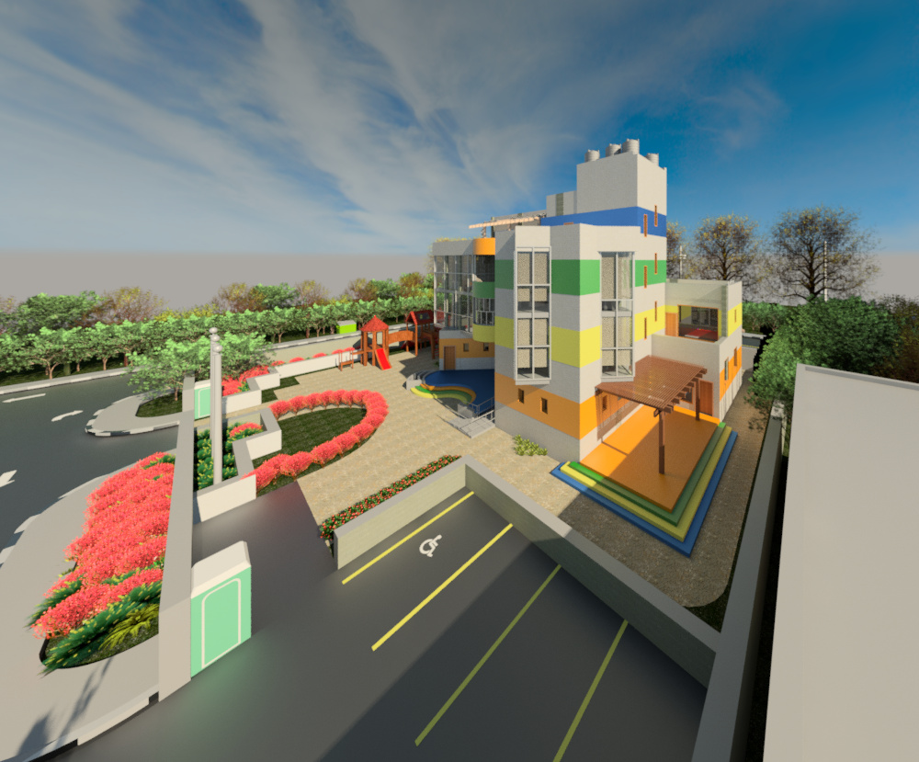
Introduction:
Why did we choose Autism children institution:
→Kids with autism forms a noticeable slice in our society so, we must help them to fit in our society and give them their academic rights.
→The building is still on paper, so we have the chance to submit our design to be constructed.

Slide 4
Site analysis

Slide 5
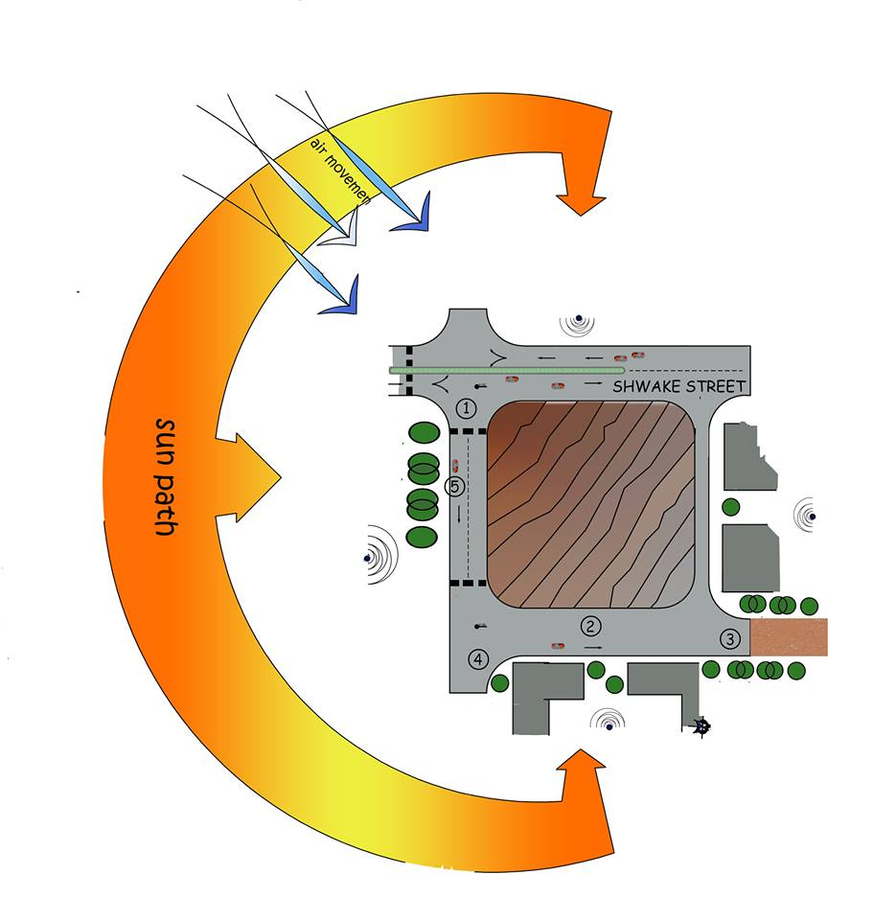
Site analysis:
location
Nearby.
Site area.
Sun path and wind direction.

Slide 6
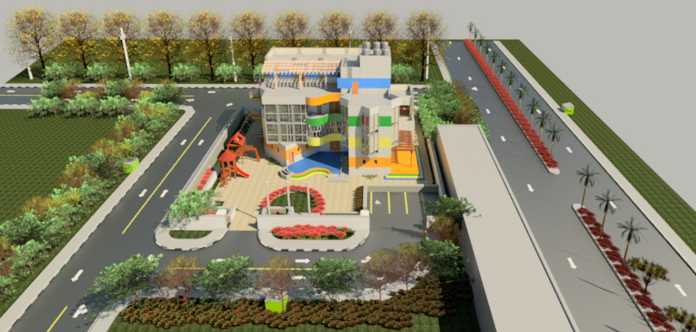
Architectural design

Slide 7
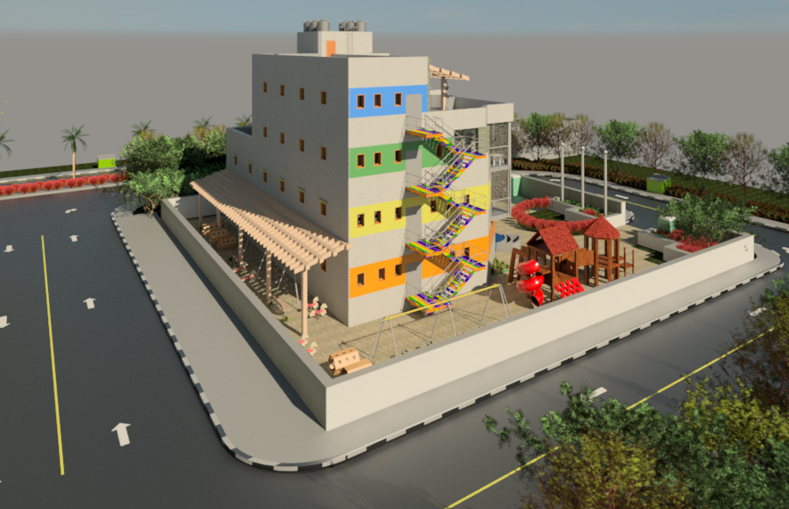
Architectural analysis:
→ Four story building.
3 m
Avg floor area=280 m^2
Total area =1115m^2

Slide 8
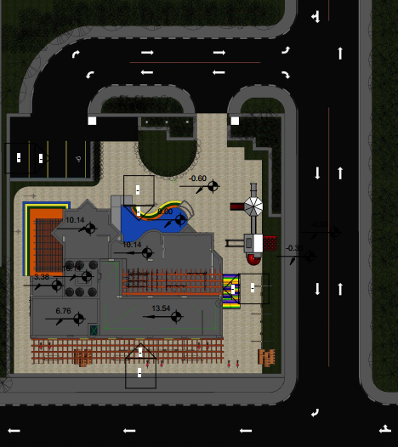
Site plan:

Slide 9
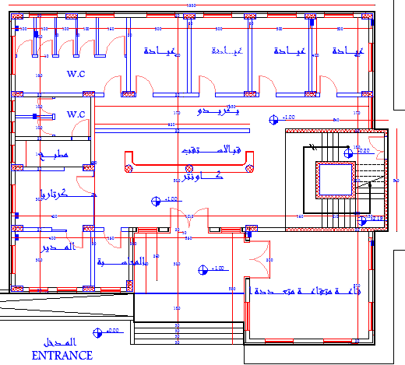
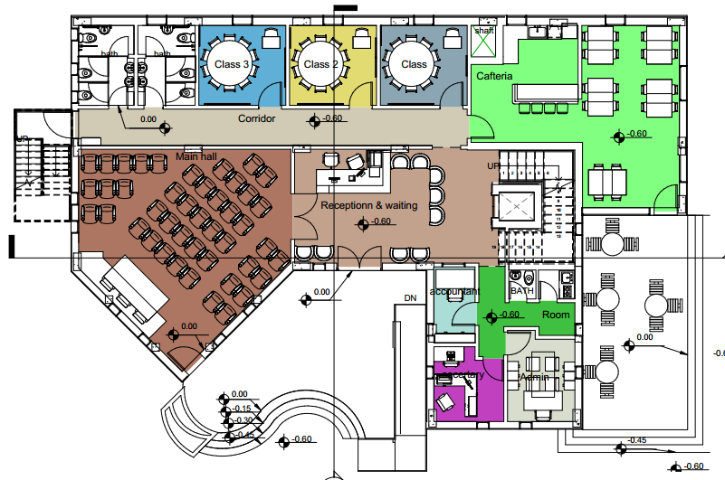
Ground floor:

Slide 10
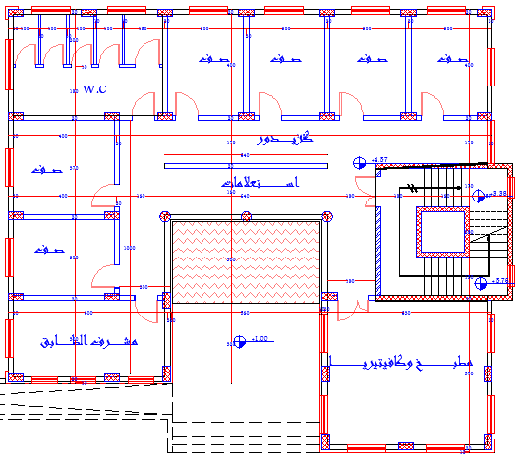
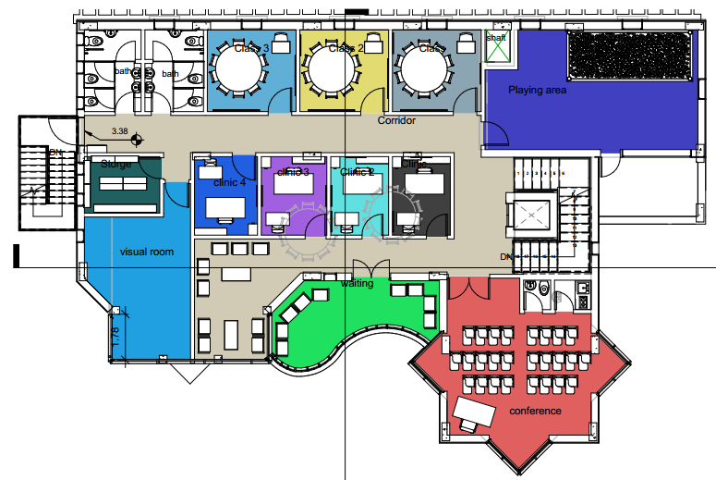
First floor:

Slide 11
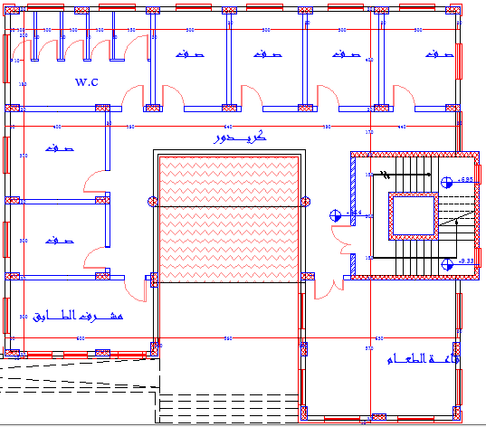
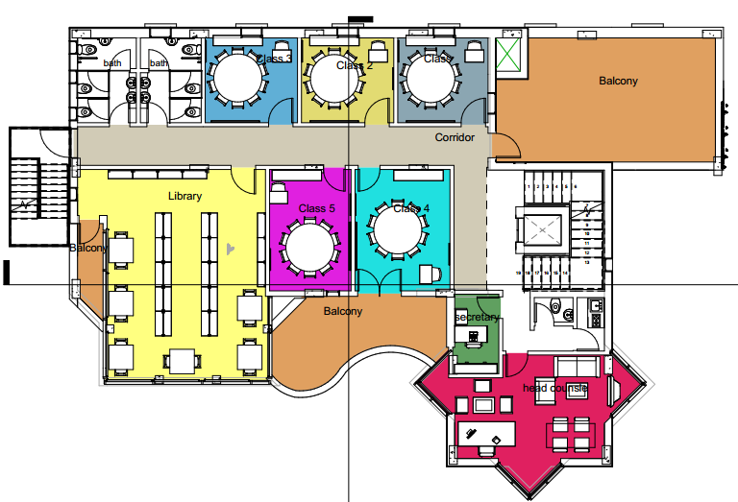
Second floor:

Slide 12
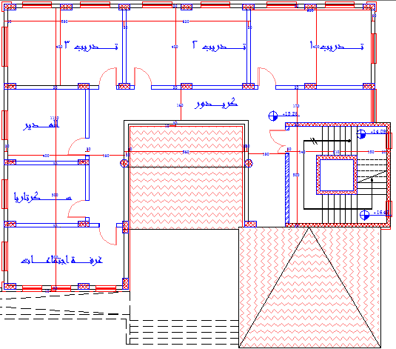
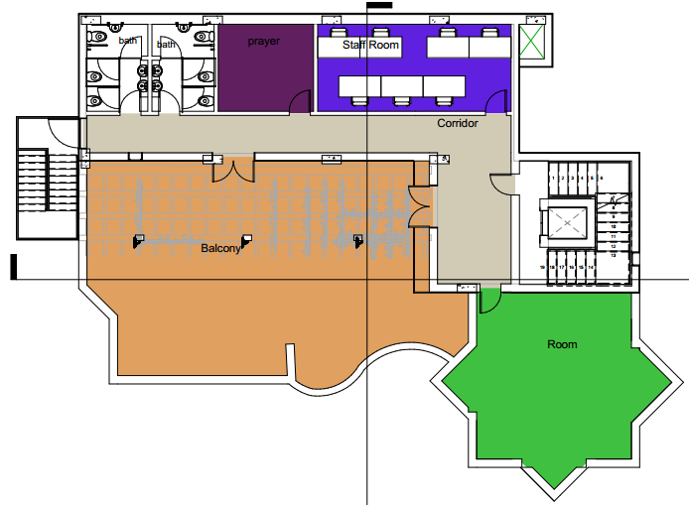
Third floor:

Slide 13
Special design aspects
Must avoid florescent lamps and glare as much as possible.
Furniture must be heavy or bolted to a wall or floor.
Rubber material placed in the sharp corners.
Coloring :
1- Blue is an instant de-stresser which is cool.
2- Green is the safest colors which brings balance.
3- Red is a very powerful color, it can be painful and make the kids angry.

Slide 14
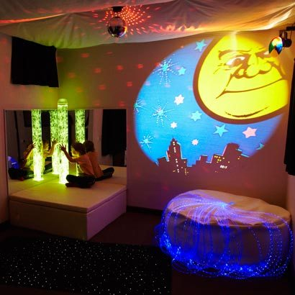
Special design aspects
Visually calming room
Special carpet and seating.
Curtains to block the sunlight
Glowing pipes and LCD projector.
Sound speakers.
Calming and soft patterns.
Calming sounds.

Slide 15
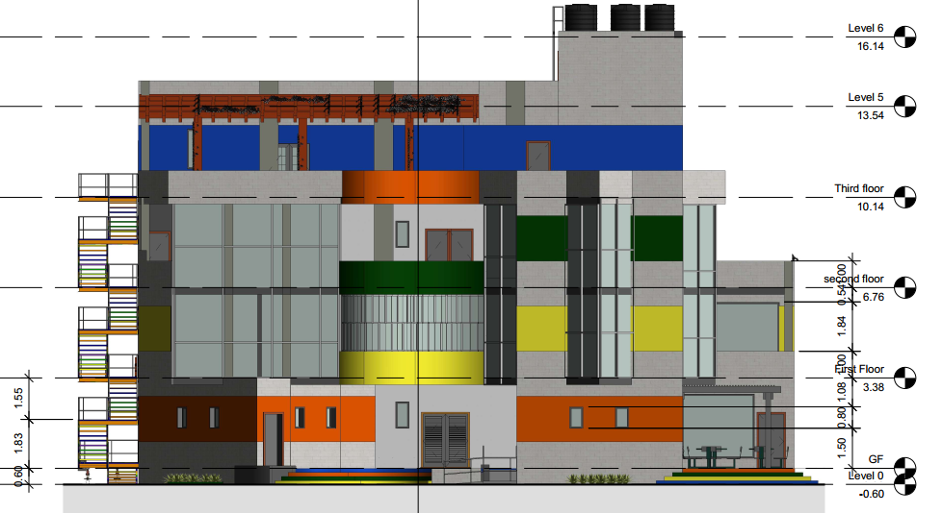
North elevation:

Slide 16
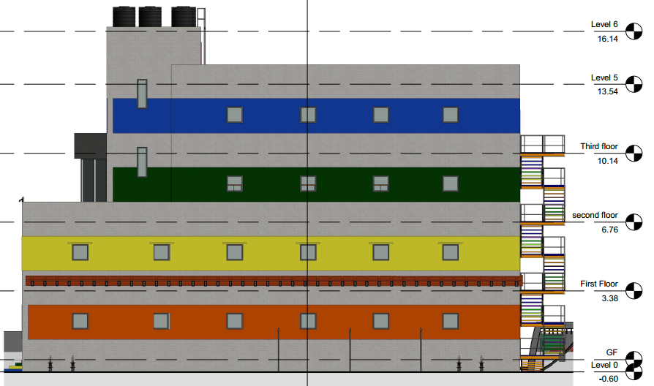
South elevation:

Slide 17
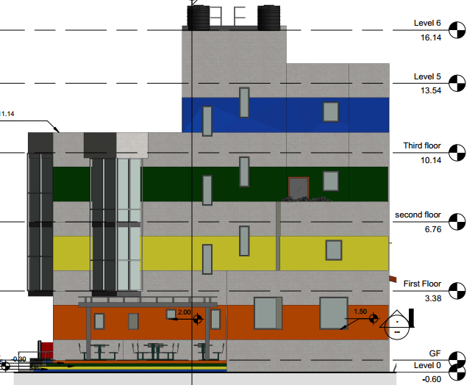
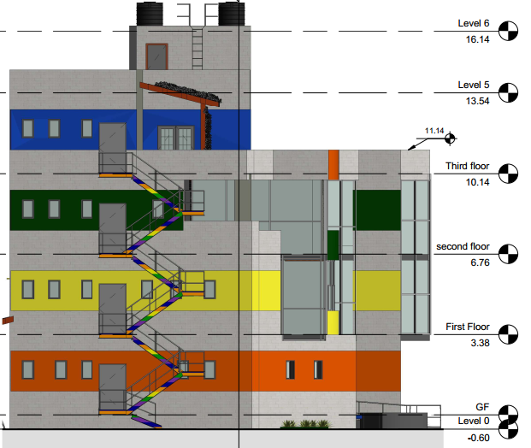
West elevation
East elevation

Slide 18
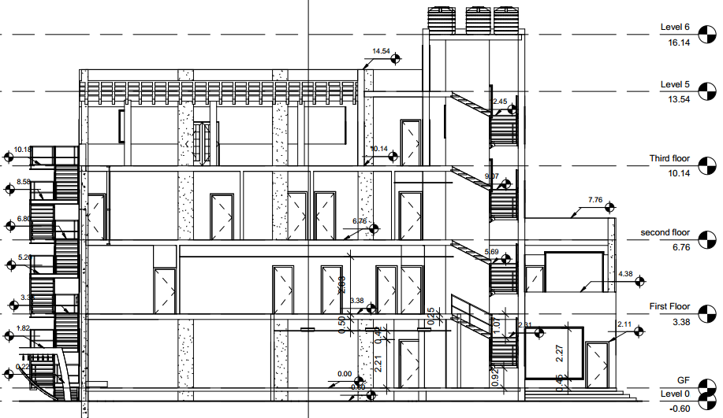
Section

Slide 19
Structural Design

Slide 20
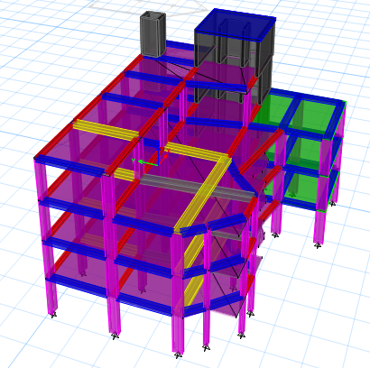
Structural design
Design Codes
ACI -318-14 for Reinforced Concrete Structural Design
UBC -97 for Seismic Load Calculation Design
Design Data
Concrete B350 with fʹ_{c} = 28 MPa for All Structural frame Elements
Concrete B300 with fʹ_{c} = 24 MPa for slabs
Allowable Bearing Capacity for the Soil = 250 KN/m²
Design Loads
Super Imposed Load = 5 KN/m²
Live Load = 4 KN/m²

Slide 21
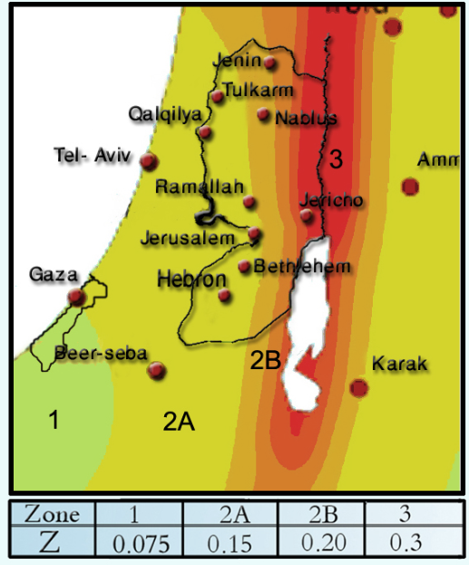
Structural design
Seismic Design Data
Zone 2A
Z = 0.15
Soil type is S_{D}
C_{A} = 0.22
C_{V} = 0.32
I = 1.00
R = 5.5

Slide 22
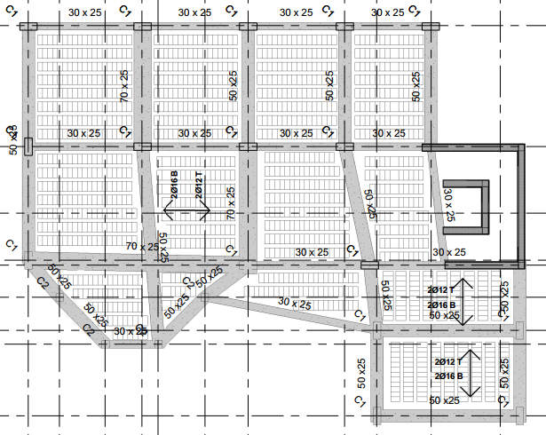
Structural design

Slide 23
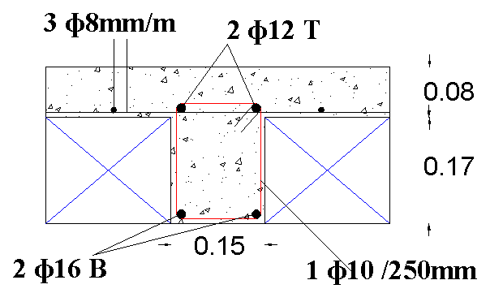
Slab design
One way ribbed slab system is used
Slab thickness=25cm
Block height= 17cm
Slab Reinforcement:
2 ɸ14 bottom steel
2 ɸ12 top steel
3 ɸ8mm/m top mesh

Slide 24
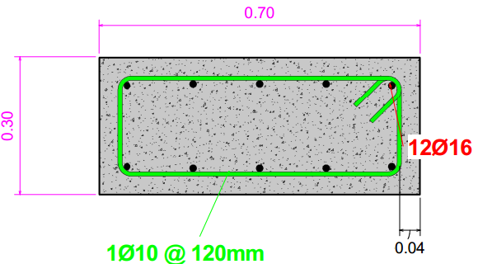
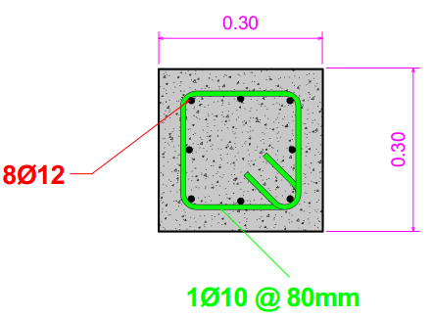
Column design
Columns sections:
(30x70) 12Ø16
(30x30) 8Ø12

Slide 25
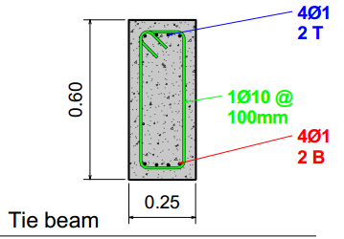
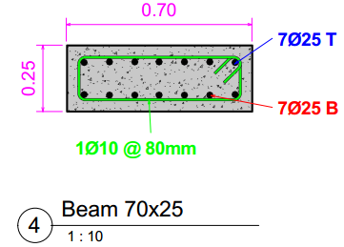
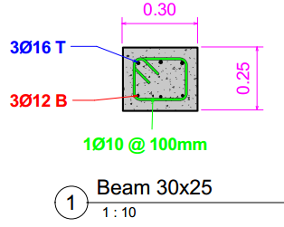
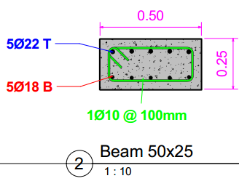
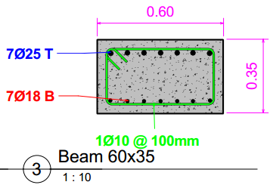
Beam design

Slide 26
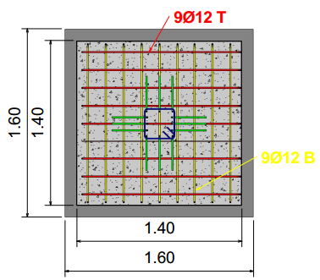
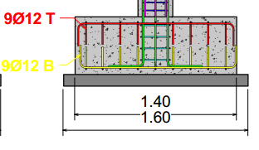
Footing design
Footing sections:
(1.6x1.6x0.5) 9Ø12
(2.4x2.4x0.5) 13Ø16

Slide 27
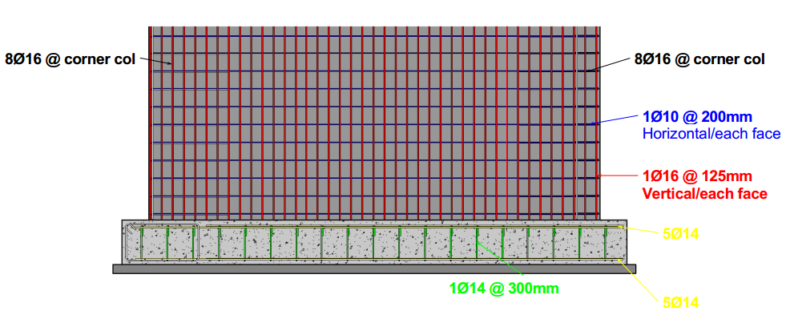
Shear wall design

Slide 28
Environmental design

Slide 29
Environmental
Acoustical
Thermal
Heating&Cooling
Orientation
Daylight

Slide 30
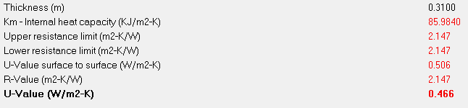
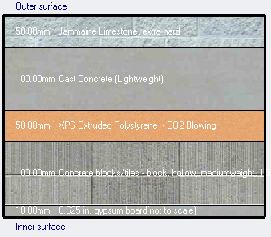
Environmental design:
Thermal properties:
External wall:
total thickness=31cm
U-value = 0.466<0.5
U-value (old) | U-value (new)
0.679 | 0.466

Slide 31
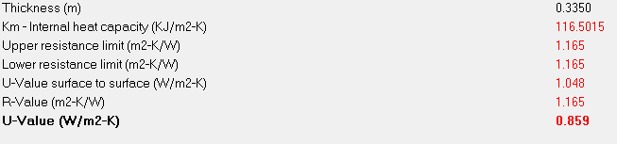
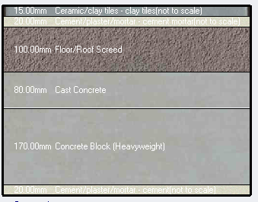
Environmental design:
Thermal properties:
Internal floor:
total thickness=40.5cm
U-value = 0.859<0.9
U-value (old) | U-value (new)
0.97 | 0.859

Slide 32
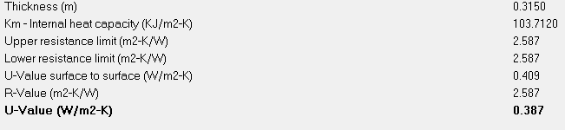
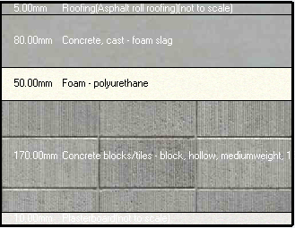
Environmental design:
Thermal properties:
Roof slab:
total thickness=31.5cm
U-value = 0.387<0.39
U-value (old) | U-value (new)
0.44 | 0.387

Slide 33
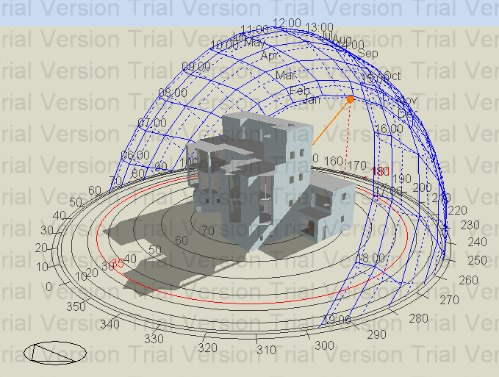
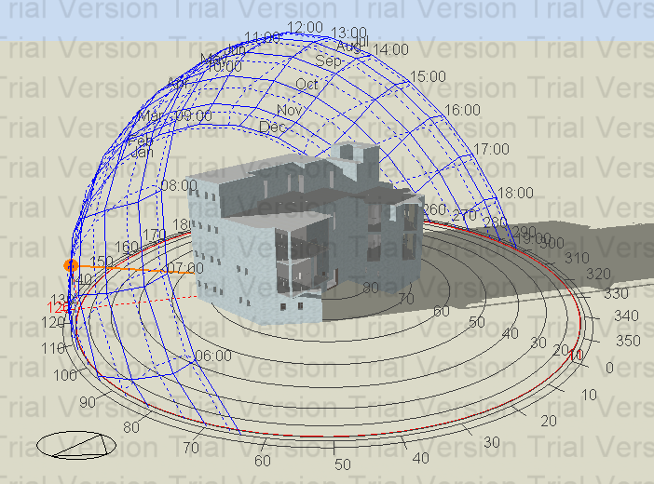
Environmental design:
Natural daylight analysis
In winter 21/12 at 12:00 pm
In winter 21/12 at 08:00 pm

Slide 34
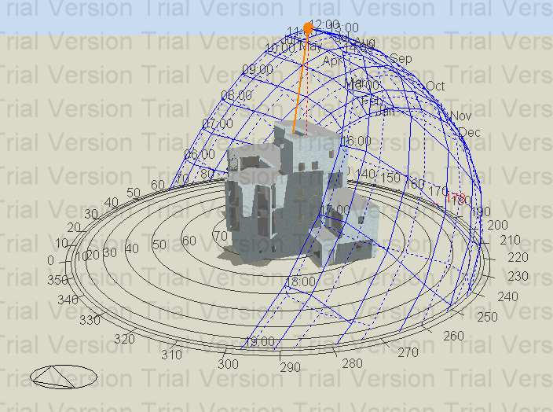
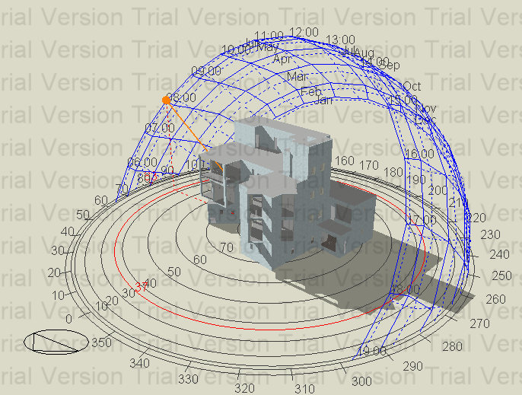
Environmental design:
Natural daylight analysis
In summer 21/6 at 08:00 am
In summer 21/6 at 12:00 pm

Slide 35
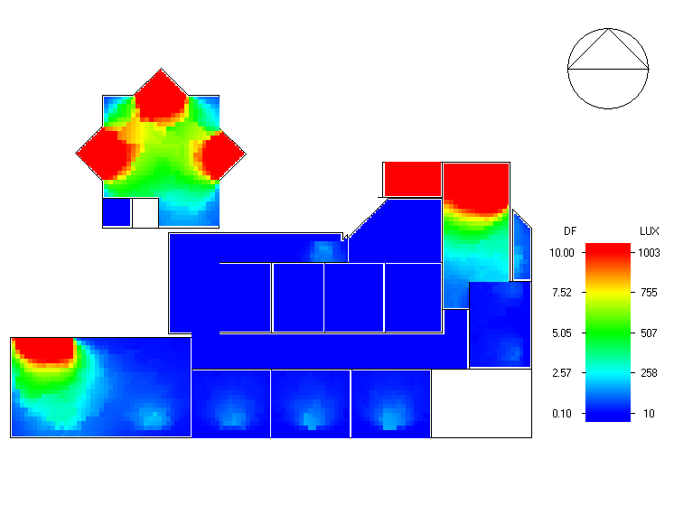
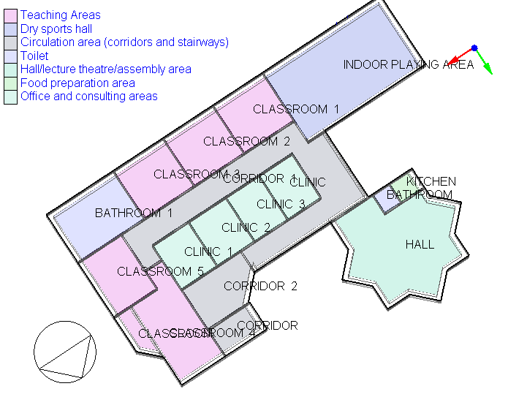
Environmental design:
Natural daylight analysis
Maximum daylight=9

Slide 36
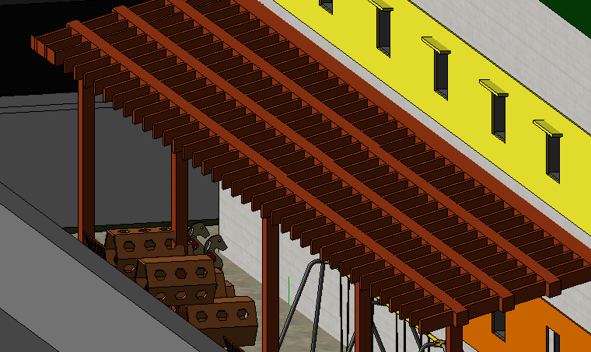
Environmental design:
Shading system :
1- Horizontal overhangs and windows reveal depth

Slide 37
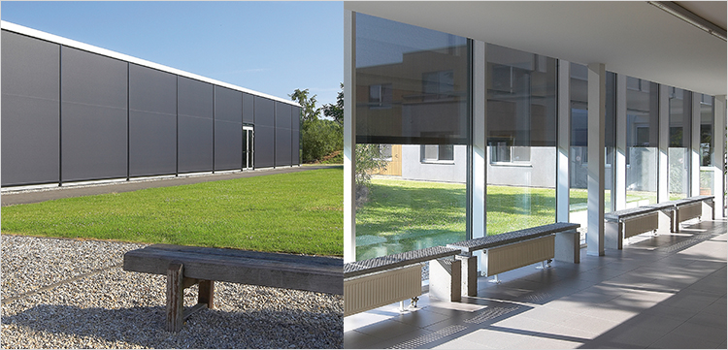
Environmental design:
Shading system :
2- Fix-screen shading system

Slide 38
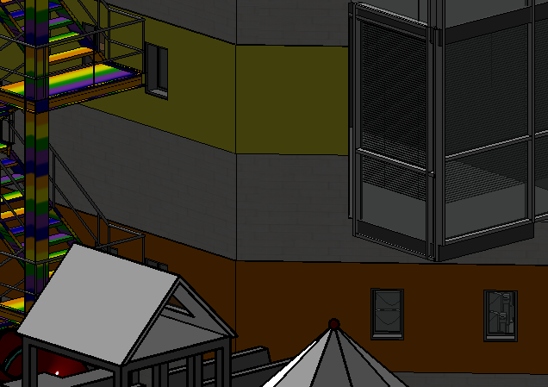
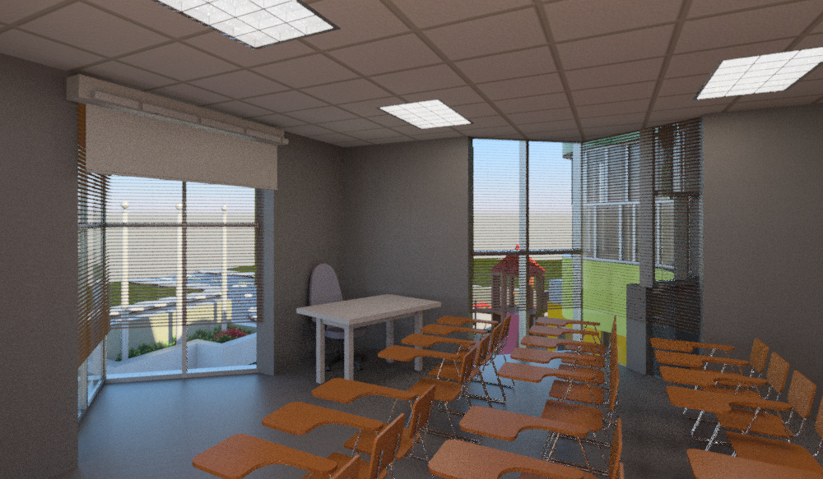
Environmental design:
Shading system :

Slide 39
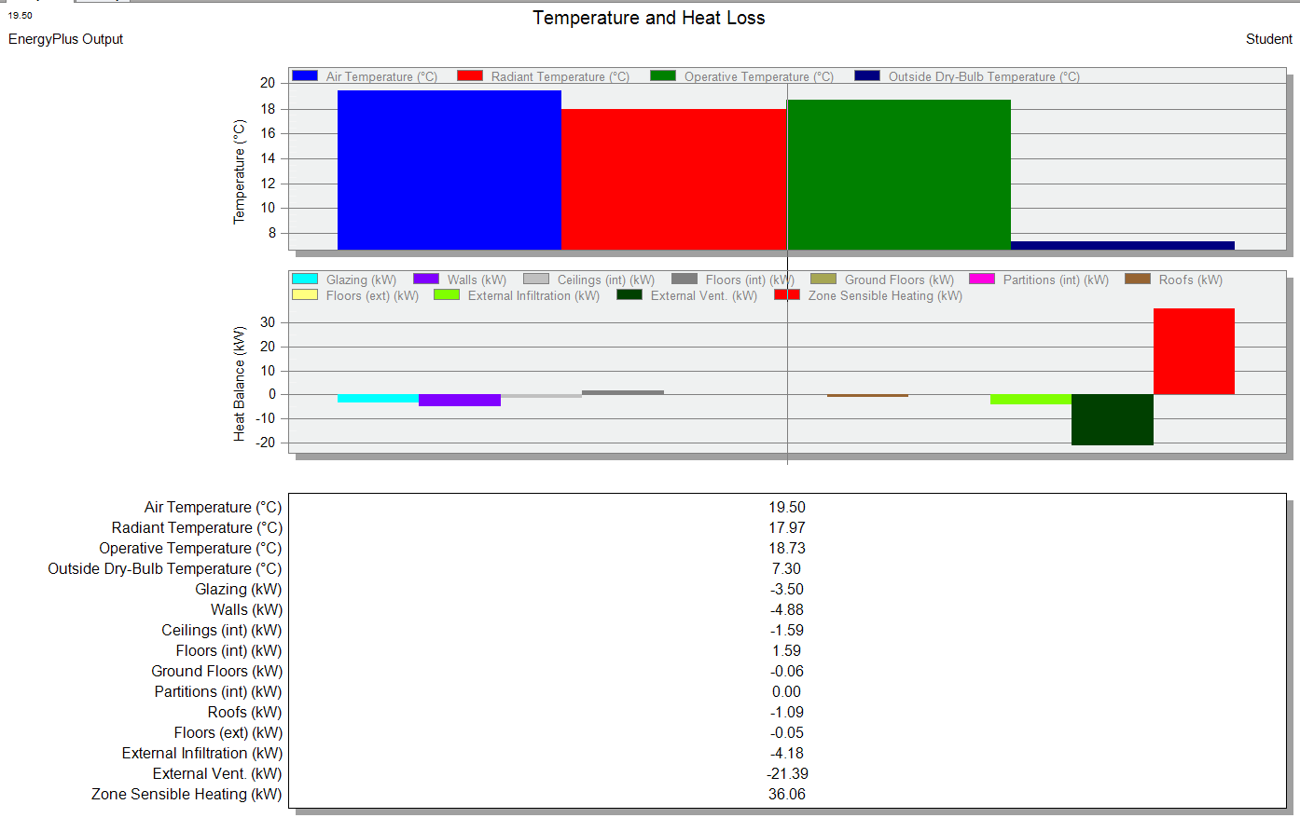
Environmental design:
Heating load:
Total design heating capacity load=45.09 KW
Heating load (old) | Heating load (new)
48 | 45.09
Cooling load:
Total cooling design capacity load=87.78 KW
Cooling load (old) | Cooling load (new)
130 | 87.78

Slide 40

Environmental design:
( pierce pmv set ) varies between the limit of (-0.5 – 0.5) which reflects the comfort level in the building along the year.

Slide 41

Environmental design:
Heating load= 2350.47 kwh
Cooling load= 56470.29 kwh

Slide 42


Acoustical Design
RT60 Range Should be <0.60 for the classroom
From table and figure, the RT60 0.42<0.60
Environmental design:

Slide 43

Acoustical Design
The background noise from outside was calculated to be 85.8db and the STC for the external wall is 50db , so 85.8-50= 35.8db which is less than the maximum value of (40-45)db so the external wall layers are excellent for noise reduction.
Environmental design:

Slide 44

Acoustical Design
The background noise from above classroom was calculated to be 42db.
IIC for the floor is 56db , maximum value of (40-45)db so the internal floor layers are excellent for noise reduction.
Environmental design:

Slide 45
Electro-mechanical design

Slide 46
Electro-mechanical
Lighting
HVAC system
Drainage
Water supply
Firefighting

Slide 47


Electro-mechanical design
Artificial lighting:
1- Classroom:
2x LED luminaires

Slide 48


Electro-mechanical design

Slide 49


Electro-mechanical design
Artificial lighting:
2- Office room:
2x LED luminaires

Slide 50


Electro-mechanical design

Slide 51


Electro-mechanical design
Artificial lighting:
3- Mainhall:
12x LED luminaires

Slide 52


Electro-mechanical design

Slide 53

Electro-mechanical design
Energy consumption:
2nd floor luminaries
The building runs for 7 hours a day (08:00 am- 03:00 pm )
and the working days are 180 day/year , 5days/week
so :
(8.869 KW/hr) x (7hr) x (180 day/year) =11174.94 KW/year

Slide 54

Electro-mechanical design
Energy consumption:
2nd floor sockets
Each 4-5 normal sockets are connected to one branch.
Each special socket is connected to its own branch.

Slide 55


Water Supply
Electro-mechanical design

Slide 56

Water Consumption
Electro-mechanical design
Fresh water demand = (3060L / 1000)=3.060m³ = 4m³ for one day.
Assume the water doesn’t run for 3 days in the building so, we will have:
Total tanks volume = 3 * 4m³= 12m³
Each tank 2m³ so 12/2= 6 Tanks on the roof.

Slide 57


Water drainage system
Electro-mechanical design

Slide 58


Electro-mechanical design
HVAC:
VRV (IV) heat recovery system (package unit/ cassete unit)
Total design capacity load=87.78 KW
→25 Ton required for air conditioning.
The outdoor unit was selected to be REYQ16T (32T) where the cooling capacity 90 Kw>87.78 Kw, so the selected unit is suitable for our building.

Slide 59



Electro-mechanical design
For the ground floor units:
1- Small concealed ceiling unit.
2-Fully flat cassette
3-slim concealed ceiling unit .

Slide 60

Electro-mechanical design
The total flowrate for the building = 10440 m³/hr (from design builder)
So the (AHU) selection was based on the total flowrate.

Slide 61


Electro-mechanical design

Slide 62

Electro-mechanical design

Slide 63

Electro-mechanical Analysis
Firefighting:
Four tanks each 2m³ are placed on the rooftop for firefighting only with booster pumps.

Slide 64


Electro-mechanical Analysis
Firefighting:
Class A → in corridors, classrooms and offices.
Class C → in the administration area for the computers and other electronics.
Class B → kitchen area and cafeteria.

Slide 65
Quantity Survey

Slide 66
Quantity Survey
Stage | Cost
Excavation work & backfilling | 38,652.94 NIS
Structural work | 1,356,236 NIS
Finishing | 310,276.67 NIS
Mechanical work | 327,326.8 NIS
Electrical work | 31,902.5 NIS
Total project cost | 2,039,156.6 NIS
Unit cost | 1,828.84 NIS/m²

Slide 67

Thank You !

