Slide 1

Smart Green Garden

Slide 2


Introduction
The project aims to make it easier for farmers to provide an automatic plant care environment with monitoring through the application.

Slide 3

Problem and Constraints
Time limit

Slide 4



Future work
Introduction
Services
About the project
Budget
Contact us

Slide 5


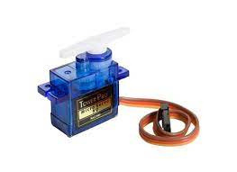
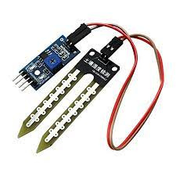



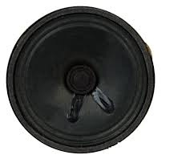
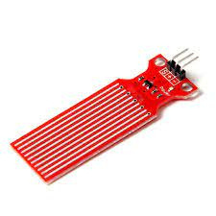

Tools:
Servo motors
Soil sensor
Speaker
Water sensor

Slide 6
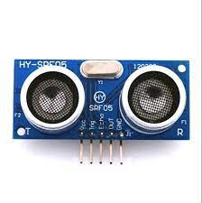
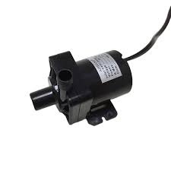
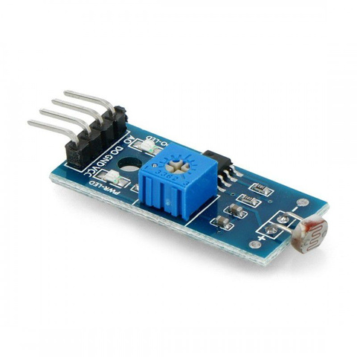
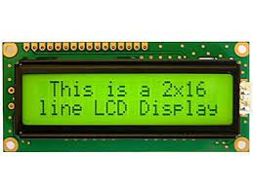
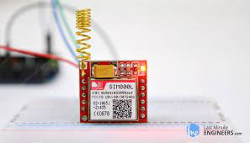
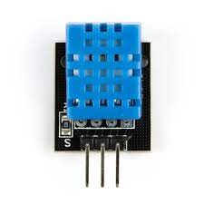
Ultrasonic sensor
Water pumps
Light sensor
2x12 LCD
GSM module
DHT 11 sensor

Slide 7
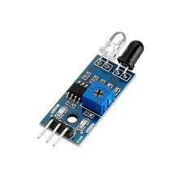
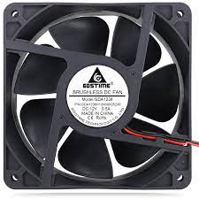
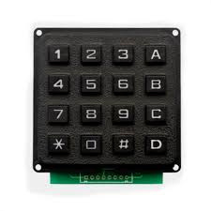
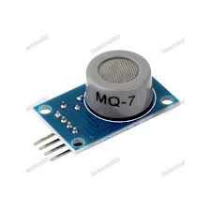

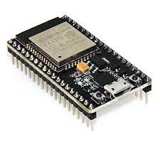
IR sensor
Fan
Keybad
CO sensor
Strip light
ESP32

Slide 8

Project`s Features

Slide 9



Safety when opening the farm door
Automatic ventilation system
Automatic watering system
Fertilization system

Slide 10
Fire sensor system
Lighting and music
Farmer SMS
Mobile app

