Slide 1
Assessment of the current water consumption of
Nablus City & Beit Furik Town
By :
Nagham Al-Reshah
Nadine Hanani

Slide 2

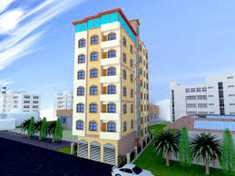
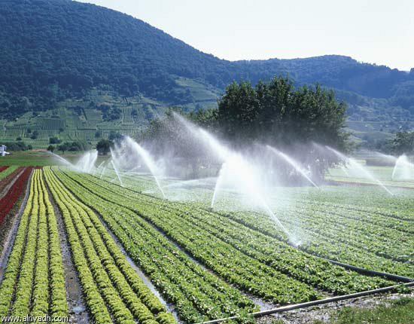
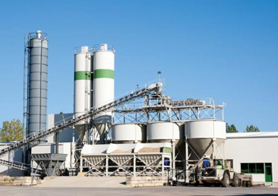
General Background :

Slide 3
Objectives :
The main objectives of this project are:
Assessment of the current situation of water in Nablus City and Beit Furik Town according to the consumption
in the different water using sectors.
2) Compare the current water consumptions of Nablus City with current water consumption of Beit Furik Town.
3) Compare the current water consumptions for different sectors in the study areas with the standard ones.

Slide 4
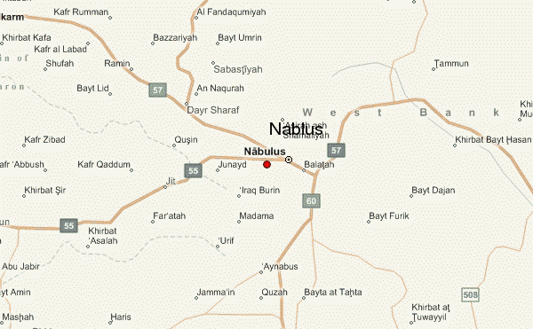
Study area :

Slide 5
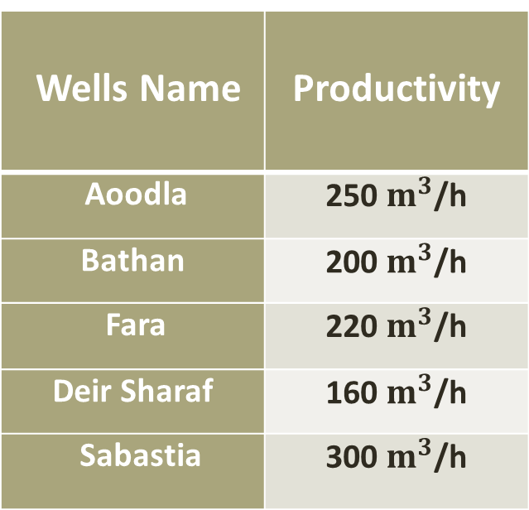
Water resources:
Groundwater aquifers: are considered the only source
of water for the of Nablus City as there are 5 wells and
5 main springs.
Spring Name | Productivity
Ras Al-Ain | 49 m³/h
Ein Beit Al-Maa | 66 m³/h
Qaryoun | 60 m³/h
Ein Dafna | 14 m³/h
Ein Al-Asal | 19 m³/h
Wells Name | Productivity
Aoodla | 250 $m^{3}$/h
Bathan | 200 $m^{3}$/h
Fara | 220 $m^{3}$/h
Deir Sharaf | 160 $m^{3}$/h
Sabastia | 300 $m^{3}$/h

Slide 6
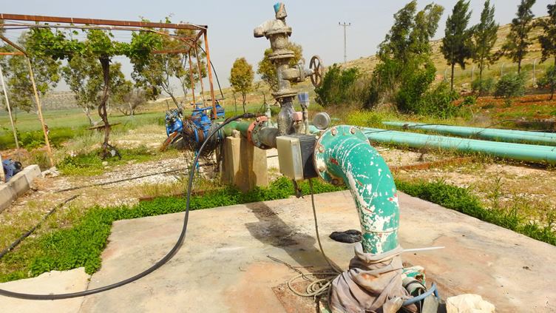
Rainwater harvesting wells and water tankers are a major source Furik, the Town depends mainly on of water in the Town of Beit Furik-Beit Dajan well.

Slide 7



Slide 8
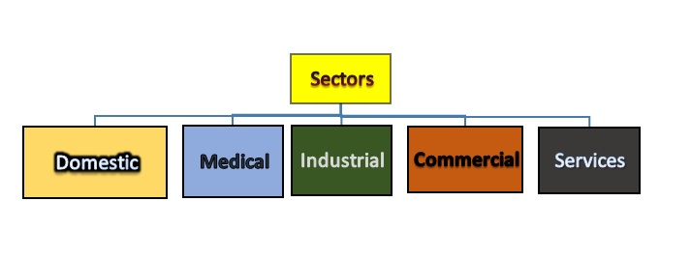
Results
In our graduation project, we selected different sectors that exist in Nablus City and Beit Furik Town as follow:

Slide 9


Domestic water consumptions

Slide 10
Domestic water consumption
Domestic water Consumption
Area
Number Of Family Members

Slide 11
DOMESTIC
Nablus average consumption/day in (L) | Beit Furik average consumption/day in (L) | Type of house
352 | 490 | Individual house
370 | 451 | Individual house
423 | 572 | Individual house
634 | 580 | Individual house
850 | 1006 | Villa
492 | 750 | Individual house
790 | 1030 | Villa
680 | 528 | Individual house
194 | 453 | Individual house

Slide 12
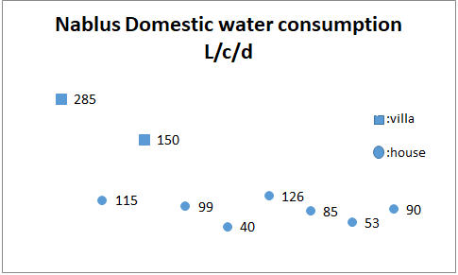

Slide 13
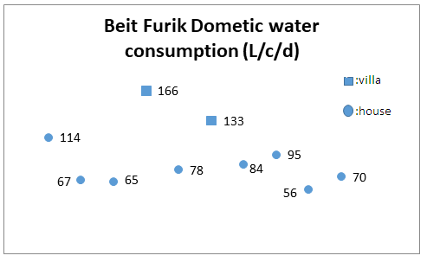

Slide 14
Nablus
40-285 L/c/day
Beit Furik
56-166 L/c/day

Slide 15

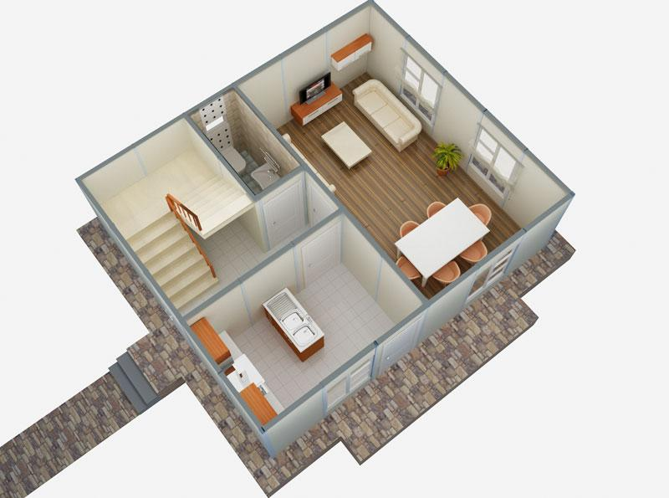

Domestic water consumptions
the variation in water consumptions related to so many reason as :

Slide 16

Hospital
clinics
Medical Consumption
Dispensary

Slide 17
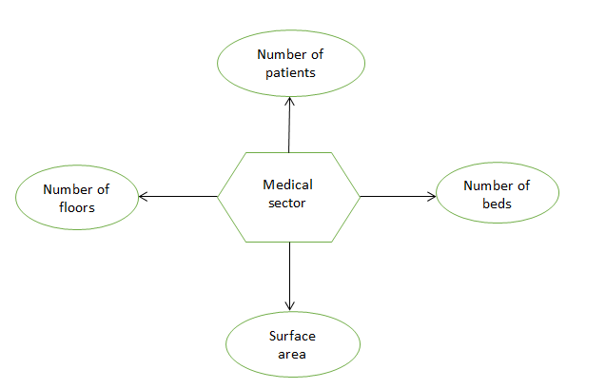

Slide 18
Hospitals water consumptions
Hospitals | Average Consumption per day (m³) | beds | patients (2016) | floors | Consumption per year 2016 (m³)
Private Hospital 1 | 19.35 | 109 | 8509 | 8 | 4280
Private Hospital 2 | 21.02 | 54 | 10972 | 6 | 4160
Dispensary | 2.21 | - | 72192 | 3 | 480

Slide 19
Hospital water consumptions in year 2016
Hospitals | Average Consumption L/patient/day
Private Hospital 1 | 1.39
Private Hospital 2 | 1.05
Dispensary | 0.01

Slide 20
Hospital water consumptions
 | Consumption L/bed/d | Consumption L/m²/d | Consumption L/floor/d
Private Hospital 1 | 389.25 | 5.01 | 2418.75
Private Hospital 2 | 177.52 | 2.48 | 3503.33
Nablus Dispensary | - | 1.48 | 736.6
Beit Furik Dispensary | - | 1.78 | -
Dental clinic | - | 2.29 | -
Eye clinic | - | 1.0 | -
pharmacy | - | 3.91 | -
General clinic | - | 0.71 | -

Slide 21



Hospital water consumptions
The allocation of water at a facility varies depending on so many reasons such as :

Slide 22
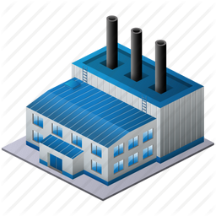

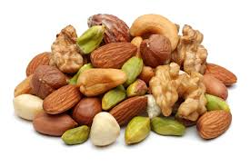
Industrial
Industrial water Consumption
Area

Slide 23
Industrial water consumptions
Factory Type | Average water consumption L/m²/d
Brick Factory | 4.14
Stone | 3.12
Detergents Factory (Nablus) | 2.75
Detergents Factory (Beit Furik) | 2.02
Tile Factory | 1.51
Marble Factory | 1.43

Slide 24
Industrial average water consumptions
Nablus Dessert Shops | Average water consumption L/m²/d
1 | 42.6
2 | 24.25
3 | 7.25
4 | 5.2
Tahinia Factories | Average water consumption L/m²/d
Beit Furik Factory | 31.44
Nablus Factory 1 | 21.66
Nablus Factory 2 | 9.13
Nablus Factory 3 | 4.1

Slide 25
Commercial
Commercial
Restaurants
Gas Stations

Slide 26
Commercial water consumptions
Gas Stations | Average water consumption L/m²/d
Nablus Gas Station | 1.96
Nablus Gas Station | 1.61
Beit Furik Gas Station | 0.84
Restaurants | Average water consumption L/m²/d
(5 star) Restaurant (Nablus) | 14.4
Public Restaurant (Nablus) | 6.6
Normal Restaurant (Nablus) | 2.8
Public Restaurant (Beit Furik) | 1.3
Public Restaurant (Beit Furik) | 2.3

Slide 27
Services
Services
Schools
Wedding halls
Mosques

Slide 28
Services water consumptions
Schools | Average water consumption L/m²/d | Average water consumption L/student/d
Boys Primary School (Nablus) | 0.42 | 1.71
Boys Primary School (Beit Furik) | 0.28 | 1.60
Boys Secondary School (Nablus) | 0.89 | 5.23
Boys Secondary School (Beit Furik) | 0.82 | 2.70
Girls Primary School (Nablus) | 0.79 | 2.17
Girls Primary School (Beit Furik) | 1.38 | 1.40
Girls Secondary School (Nablus) | 0.36 | 1.98
Girls Secondary School (Beit Furik) | 0.35 | 1.1

Slide 29
Services water consumptions
Mosques | Average water consumption L/m²/d
Alsahaba (Beit Furik) | 1.77
Ali Bin Abi Talib ( Beit Furik) | 0.73
Alzeereqe (Beit Furik) | 1.07
Nimr AlNabulsui (Nablus ) | 0.596
AlNasir(Nablus ) | 4.29
Izz Aldin(Nablus ) | 1.51

Slide 30
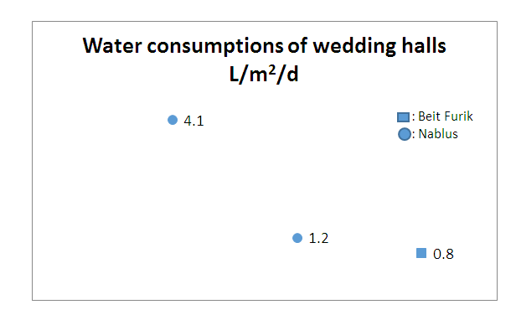
Services water consumptions

Slide 31
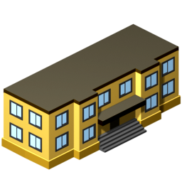


Services water consumptions
The variation of the services water consumption related to reasons as :

Slide 32
Conclusion
 | Hospital (m³/day) | Student (L/day) | Person (L/day )
Palestine | 19-21 | 1.1-5.2 | 40-285
USA | 184_824 | 69 | 325-440
WHO | - | - | 100
Notes:
The Palestinian citizen consumes water less than the American citizen by (1.5-8)times according to the average daily water consumption.
American hospitals water consumption is more than Palestinian hospitals water consumption by (10-40) times.
American student consumes (13-62) times than Palestinian student.
Most of Palestinians consume water less than the consumption rate which is provided by WHO which is 100 liter.

Slide 33


We noticed that there is a few of Palestinian citizens, who forms the rich
class in Palestinian community consume water more than the WHO rate
and that’s related to so many reasons such as:

Slide 34
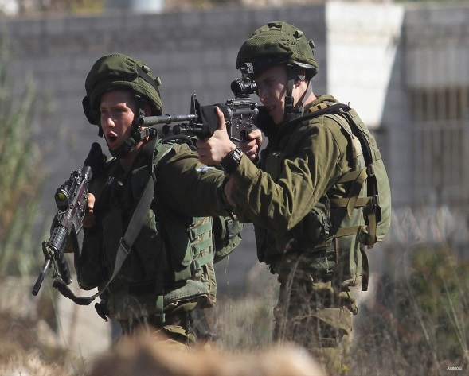
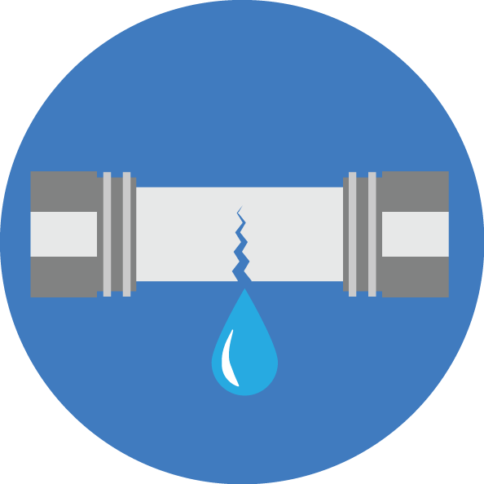
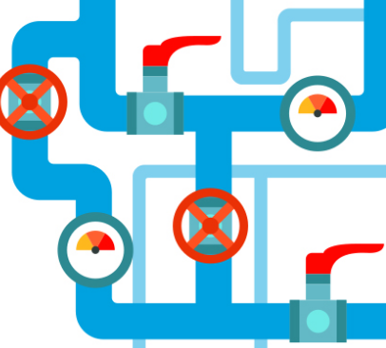
Water Palestinian situation suffers from a deficit that’s represented by
the low amounts of water consumptions, which is related to many reasons
such as:
Notes:
85% of the water in the West Bank aquifer is exploited by Israel which is also imposed
restrictions on water use in West Bank as:
Determining the depth of drilling wells, as it prohibited the Palestinians from drilling wells with a depth of more than 120-140 meters.
Set a limit for the amount of water allowed to be pumped by the owners of wells.
The establishment of several small dams to reserve the surface waters of the valleys and prevent them from reaching to the Palestinian territories.
The process of drilling new wells needs taking a permits.
Stealing large quantities of Palestinian water by digging many wells in Israeli settlements.

Slide 35



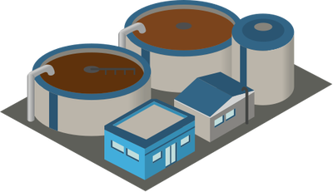
Recommendations

Slide 36
Importance of this project

Slide 37

Problems that we had in our graduation project

Slide 38
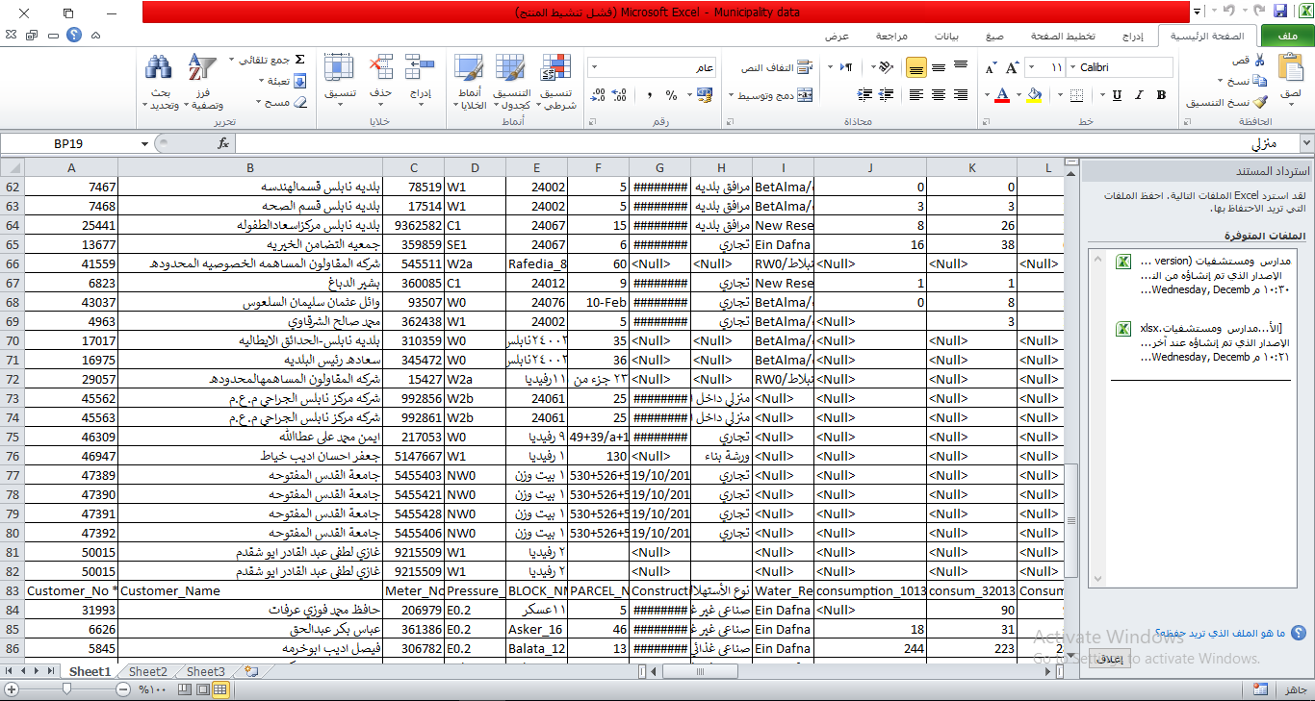

Slide 39
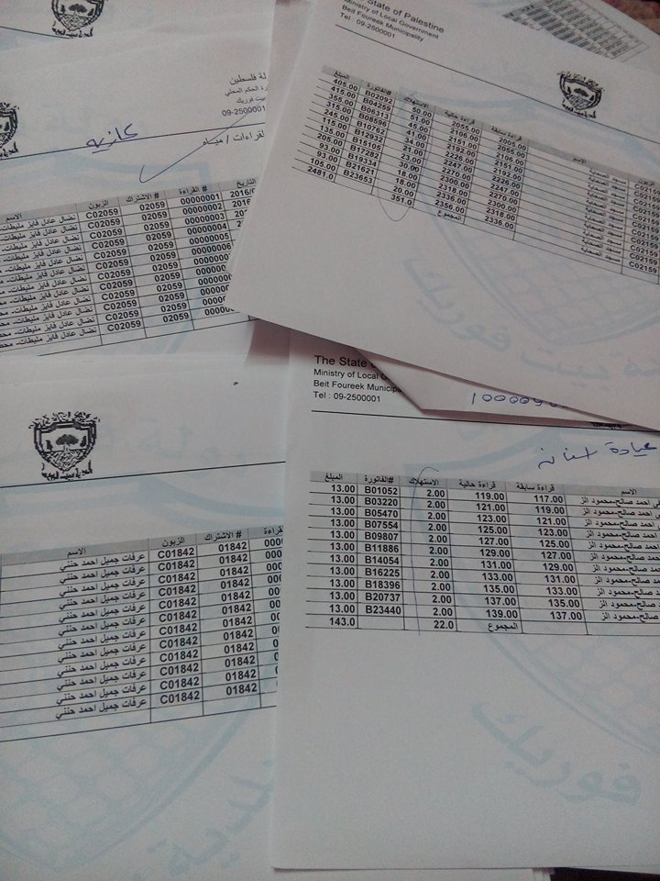

Slide 40



Slide 41


