Slide 1
Color Sorting System (CSS)
Meera Saymeh
Masa Al-Sayyed

Slide 2
Table of contents
01
04
02
05
03
06
Overview
Tools used
Comparision
Future Work
Challenges
Demo

Slide 3
Overview & Main features
Color Sorting System (CSS): is a robotic system that aim to:
Sorting
Retreiving
Metalic Objects according to their color, each color is sorted in a specific column.
Objects either to the beginning point or to a container for exporting.

Slide 4
Our CSS vs. Others
Others, ex: Rice sorting machine , Plastic sorting system, colored balls sorting system
 | Our CSS | Others
Angels | All angels | Diagonal some static
Object Material | Metalic | Plastic
Ability to Retrieve objects after sorting | Yes | No
Simplicity | Complex | Simple

Slide 5
Challenges
Robotic Arm
Color sensor
Magnet
It was hand made which took a lot of time for it to be ready.
Needs to redetect the colored objects RGB values when changing the light of the place , and can’t be exposed to sunlight.
Sence the servo motor didn’t gave it enough flexibility, even though the wire acheived that but still the magnet shift it’s position a little.
Not smooth when moving, since it moves in x and y axis and needed three servo motors.
The first servo motors broke and burnt out.
The area ariund it should be clear from any obstecles otherwise the servo motors will break.

Slide 6
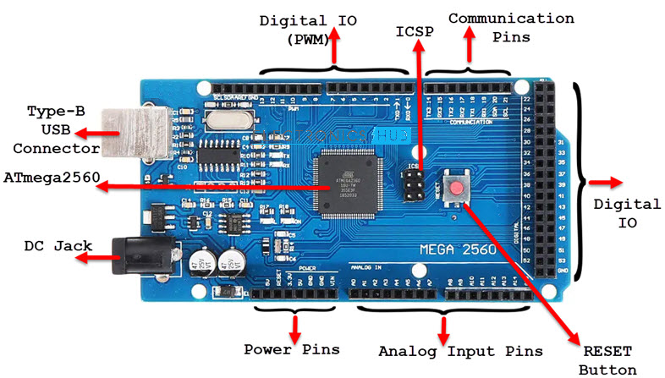
Tools and Devices Used
Arduino mega

Slide 7
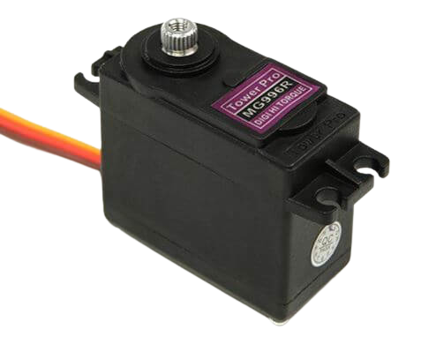
Tools and Devices Used
Servo motors
We Used three servo motors:
- At the base rotates from 0 – 180
- Two used for the arm (shoulder , elbow)

Slide 8
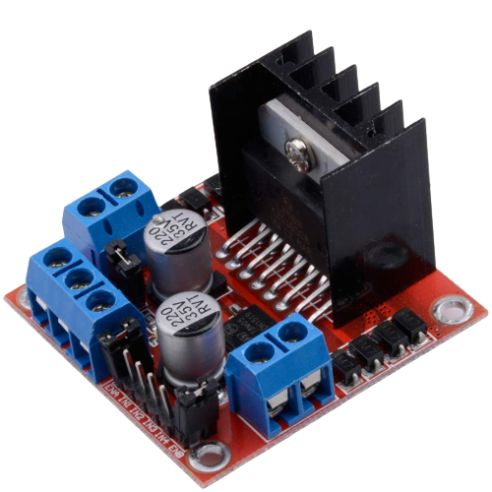
Tools and Devices Used
Dual H-bridge Motor Drive
To provide the magnet with the 12 volts it needs to operate properly.

Slide 9
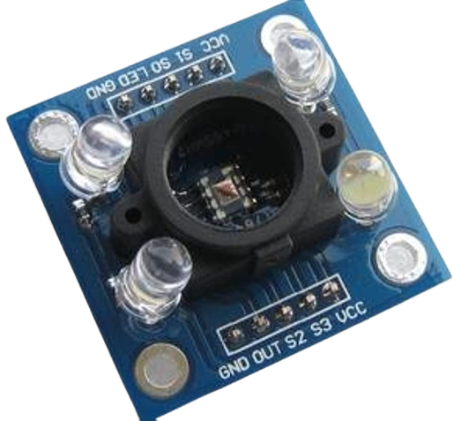
Tools and Devices Used
Color Sensor
TCS3200
Light-to- frequency convertor.
Output: square wave that will be given to the microcontroller to map the frequency to color RGB.

Slide 10
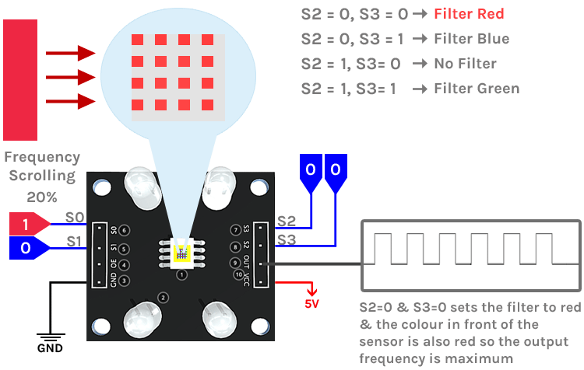
Tools and Devices Used
Color Sensor
TCS3200
S2,S3 (Output) : Used to select the color select the array of photodiodes of the sensor.
S2 | S3 | Color Filter
Low | Low | Red
High | High | Green
High | Low | Blue
Low | High | No filter

Slide 11
Tools and Devices Used
Color Sensor
TCS3200
S0,S1 (Output) : Used for frequency scaling. 20% is the recommended.
S0 | S1 | Frequency
Low | Low | Power-Down
Low | High | 2%
High | Low | 20%
High | High | 100%

Slide 12
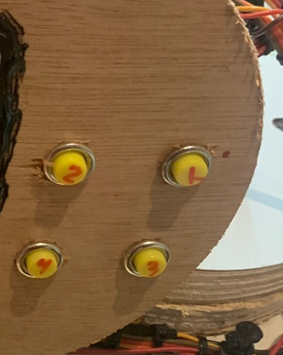
Tools and Devices Used
Push Buttons
Used to retrieve the object according to it’s position near the starting point, first row 1 them row 2.

Slide 13
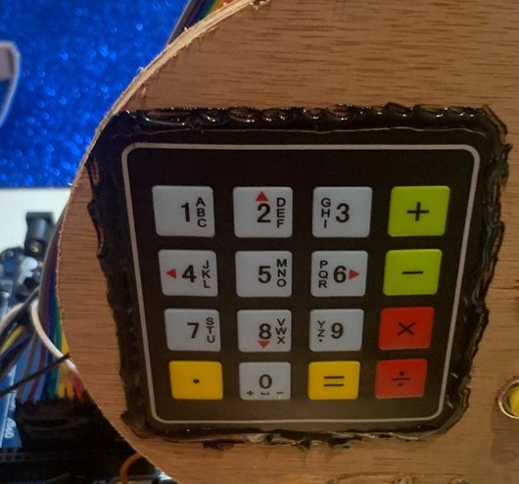
Tools and Devices Used
Keypad
Each object is sorted in a specific cell, when the cell number is pressed from the keypad the object from this cell will be retrieved to a container for exporting.

Slide 14
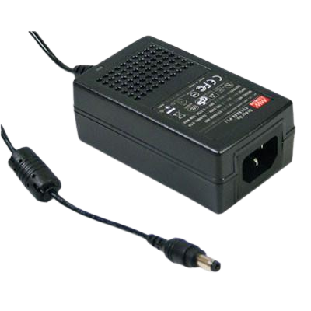
Tools and Devices Used
Power supply

Slide 15
Future Work
Adding sensor for each position.
Increase slot capacity for each color category to hold more goods
Create a simple user interface or mobile application that enables remote monitoring and control of the color sorting system
enhancing the arm to cover a wider range, and to hold heavier objects.

Slide 16
Demo

Slide 17
Thanks
Do you have any questions?

