Slide 1
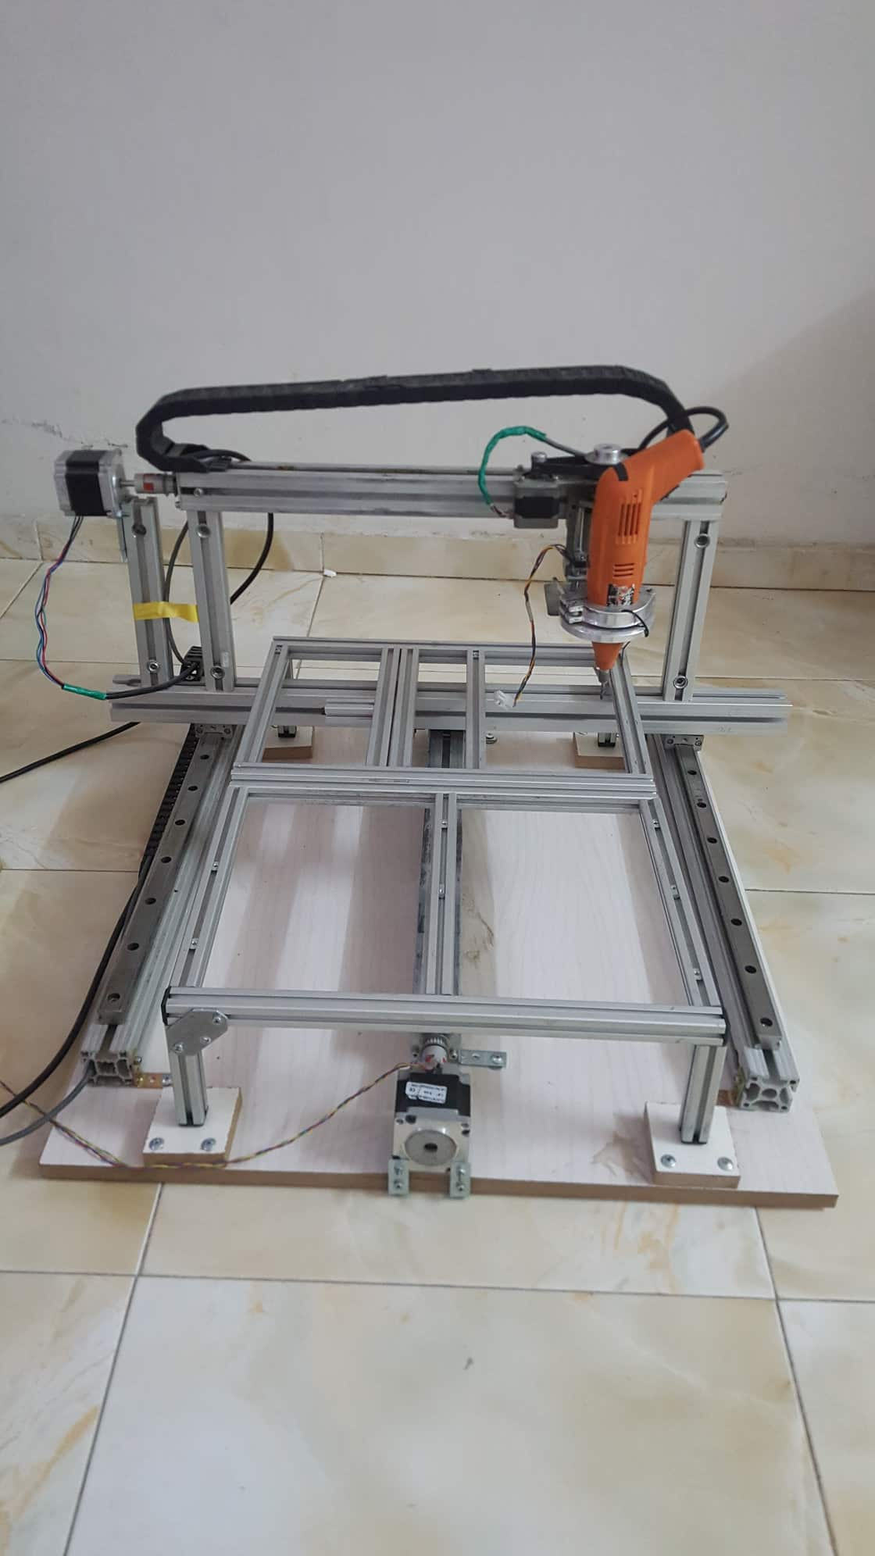
Graduation Project 2
CNC Router Machine
Done By :
Mosab Kamal
Mohammad Damen

Slide 2
Presentation Layout
Introduction
Mechanical part
Electrical part
Programing part
Conclusion

Slide 3
Introduction

Slide 4
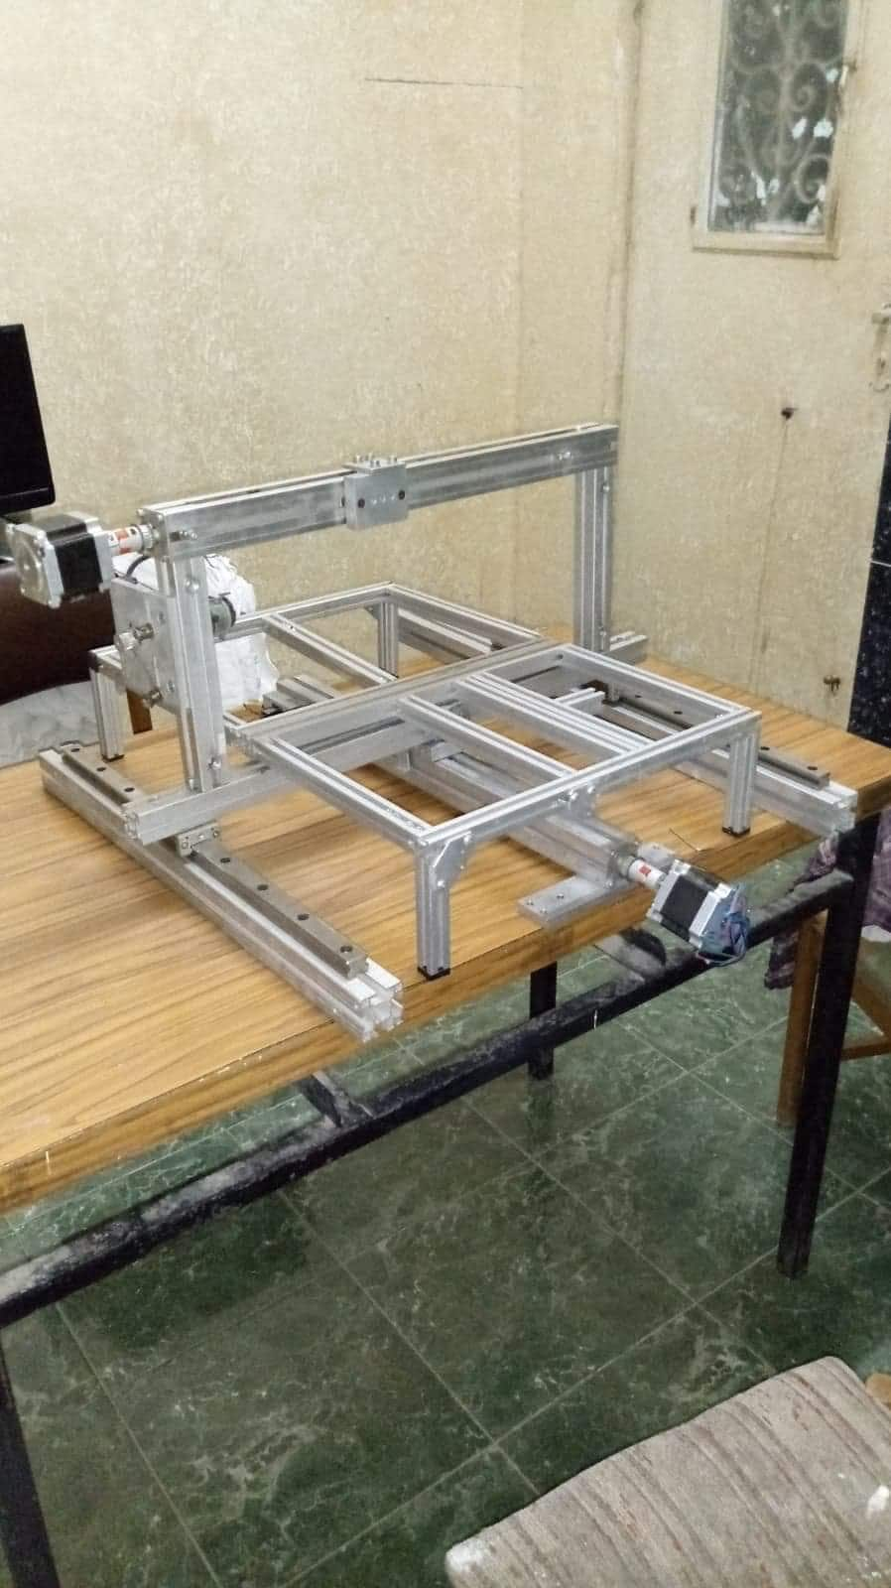
Mechanical part and Transmission systems
Frame Design
workspace (40*40*5)cm

Slide 5
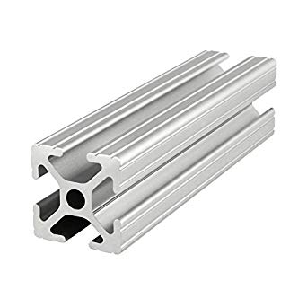
Material: T Slot Aluminum (20*20,30*30,40*40)mm

Slide 6
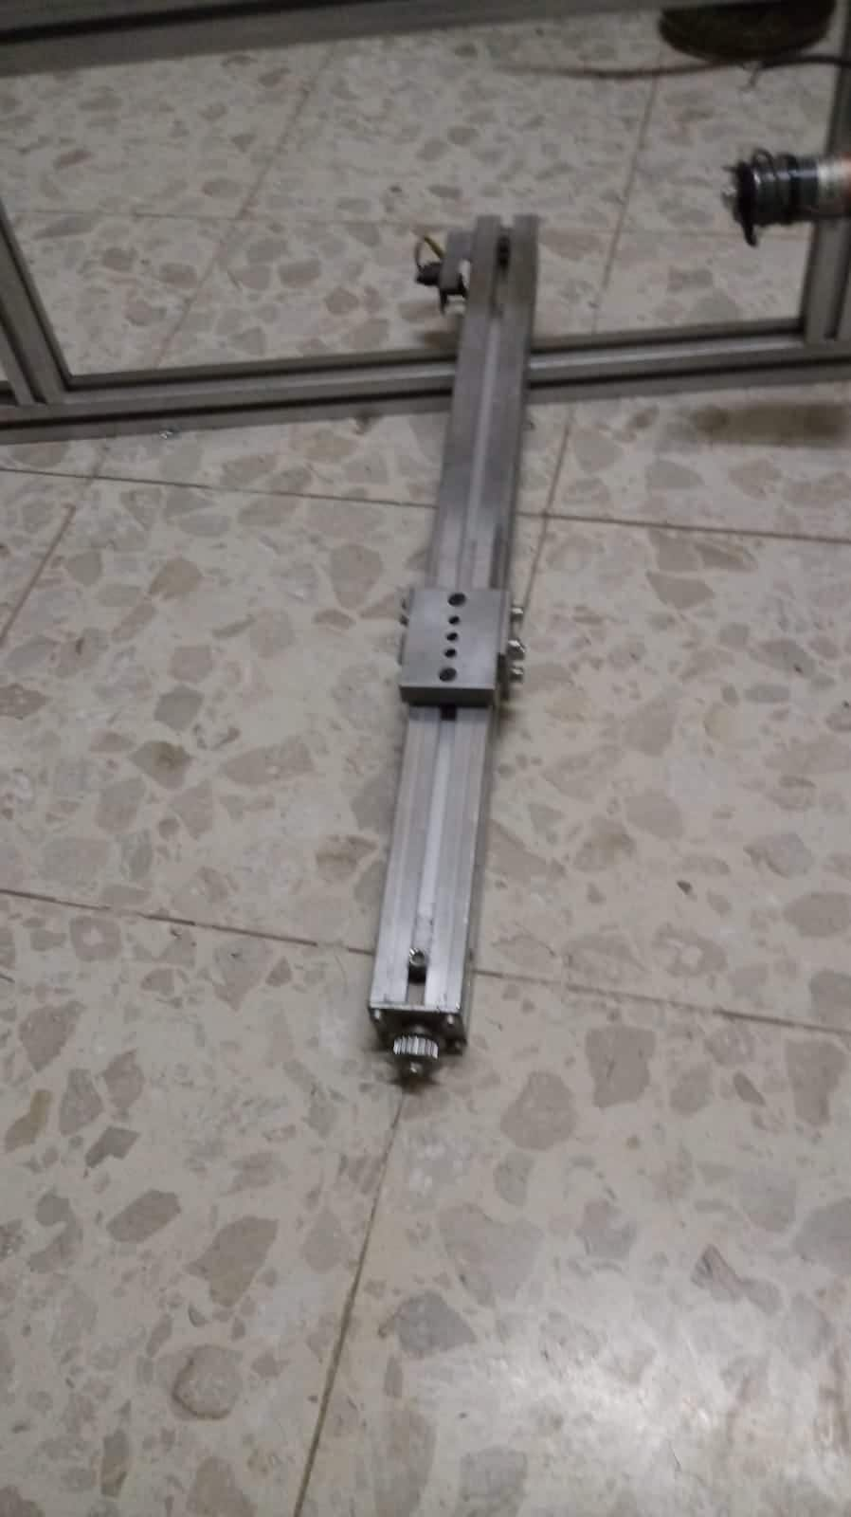
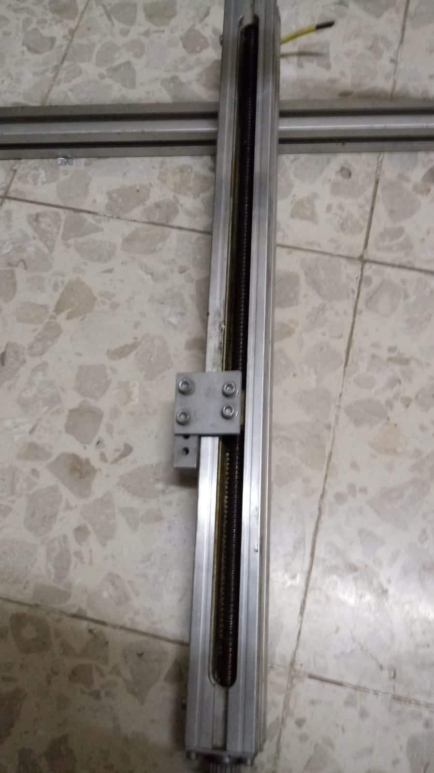
Assembly part
X-axis
Ball screw length(56cm)

Slide 7
Assembly part
Y-axis
Ball screw length(56cm)

Slide 8
Assembly part
Z-axis
Ball screw length(13cm)

Slide 9
Final Design

Slide 10
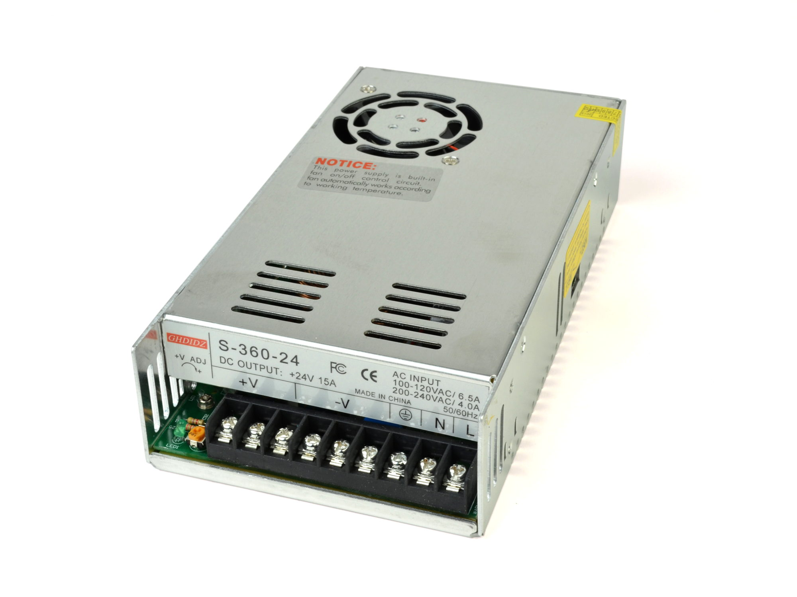
Electrical part
Power Supply
24 volt

Slide 11
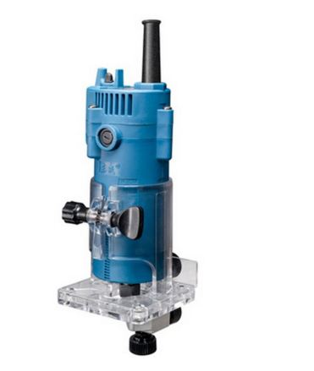
spindle
Stepper motor

Slide 12
Stepper motor
What are stepper motors good for?
Good position control : Since steppers move in repeatable steps.
Speed control : allow for excellent control of rotational speed for process automation and robotics, by sending a pulses with different frequency.
Low-speed torque : A Stepper motor has maximum torque at low speeds, so they are a good choice for applications requiring low speed.

Slide 13
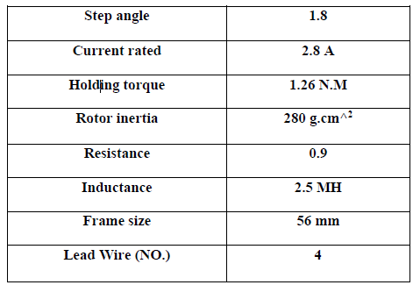
Stepper motor specifications

Slide 14
Stepper Driver
TB 6560

Slide 15
Controller Unit
break out board

Slide 16
Wiring diagram

Slide 17
Programing Part
There are three types of software that will be used with creating a part on a CNC machine:
CAD (CorelDRAW) DWG
CAM (ArtCam) G-Coad
MACH3

Slide 18
Conclusion
Some of the work done by our machine

Slide 19
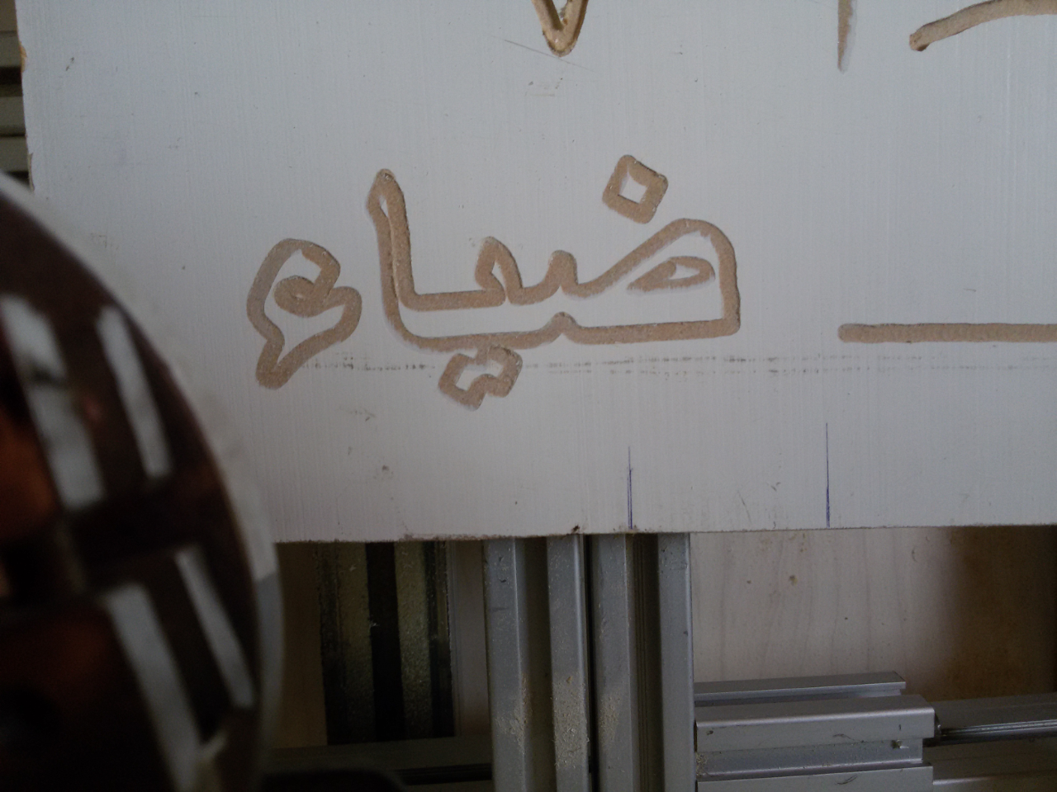

Slide 20
