Slide 1
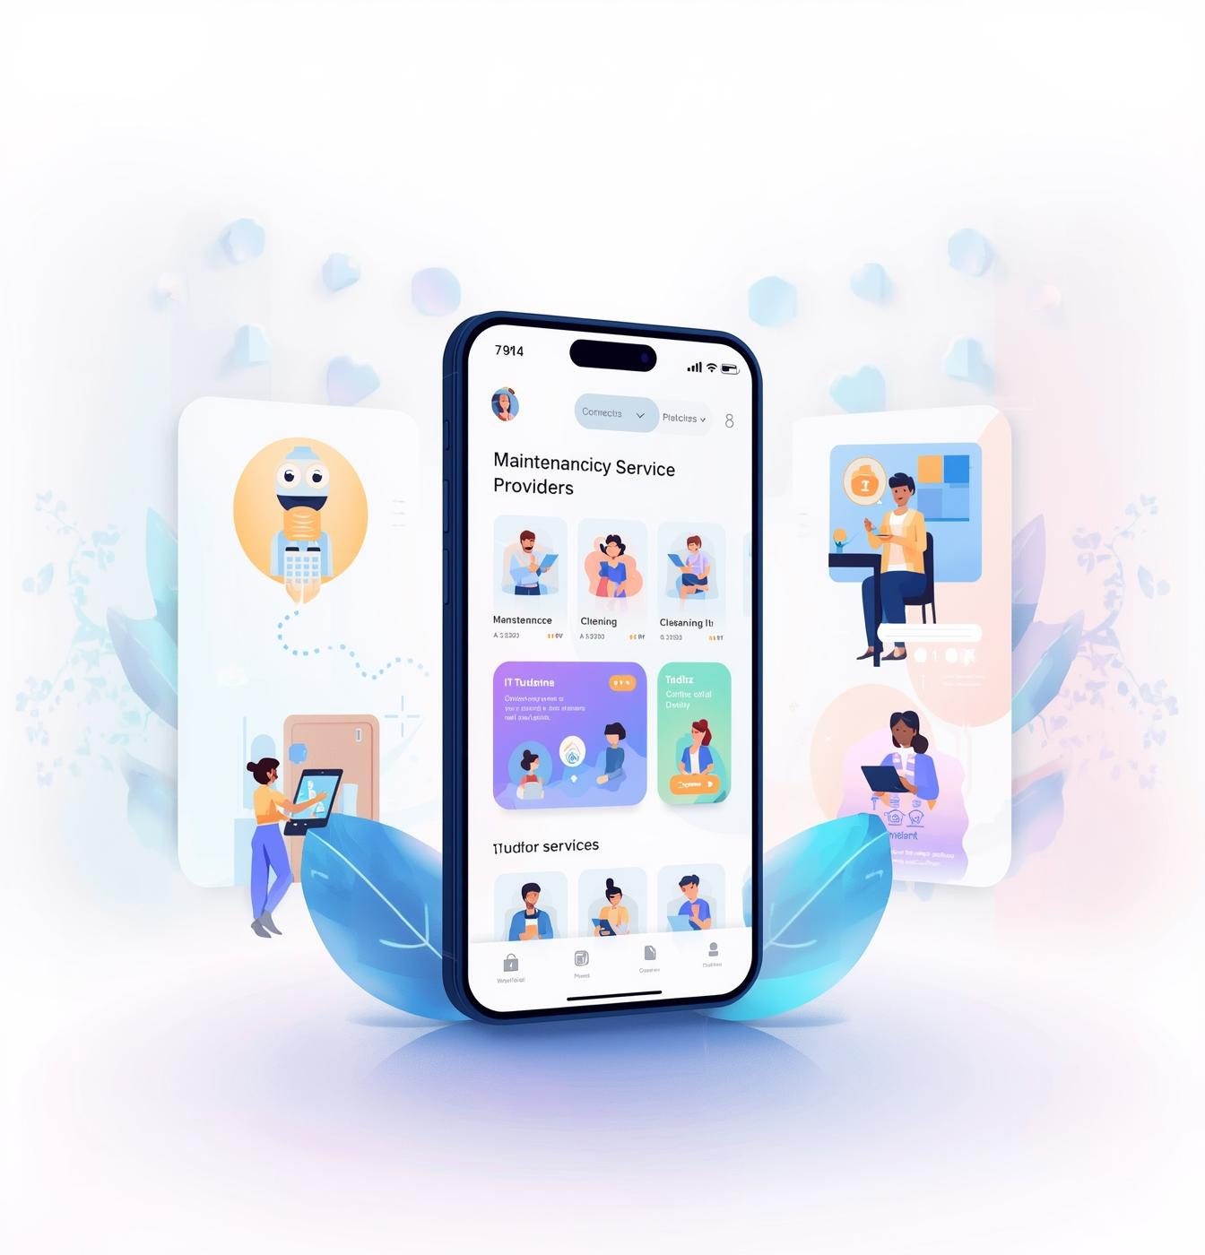

ServLink --- Your Smart Service Connection
ServLink is a mobile application built to bridge the gap between people needing help and trusted local professionals.
Students:
Shams Abd Al-Aziz
Rand Nofal
Supervisor:
Dr. Manar Qamhieh

Slide 2

Problems
  Weak mobile access: Many platforms aren’t mobile-first; users want on-demand services anywhere.
  Service fragmentation: Single-niche apps force users to use multiple apps.
  Low trust/unclear quality: Hard to find reliable local pros and verify service quality.
Solutions
  One unified platform: All service categories in one AI-powered ecosystem.
  3-step mobile booking: Search → Book → Done; providers manage jobs in one app.
  Verified trust system: Ratings + admin approval using certifications and work samples.

Slide 3



User Roles
Three Pillars of the Ecosystem
Customer (User):
Search/filter/book services, pay (card/cash), rate providers, and get real-time booking updates.
Service Provider:
Register credentials, set availability/pricing, accept jobs, and track revenue & performance.
Administrator:
Manage accounts, approve providers, monitor platform metrics, and handle commissions/disputes.

Slide 4

App Features

Slide 5
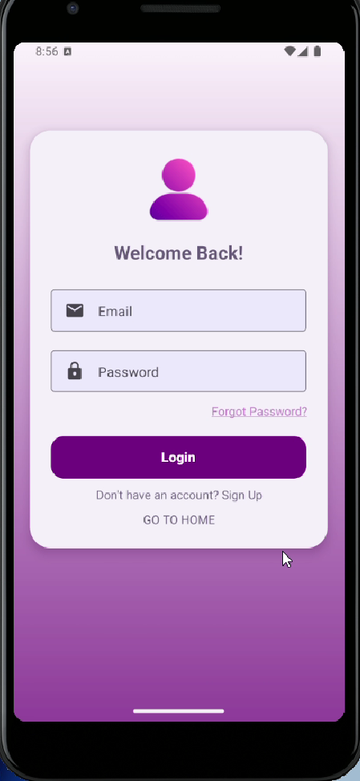
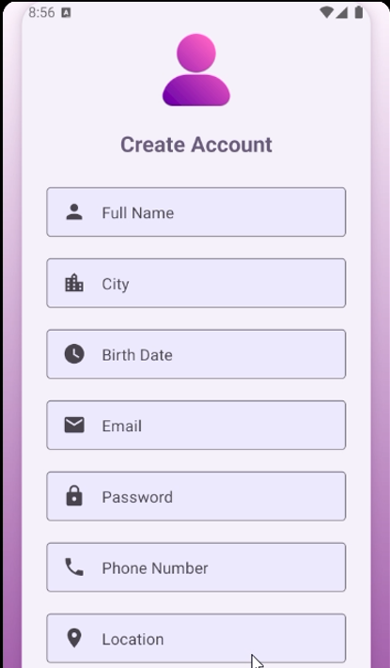
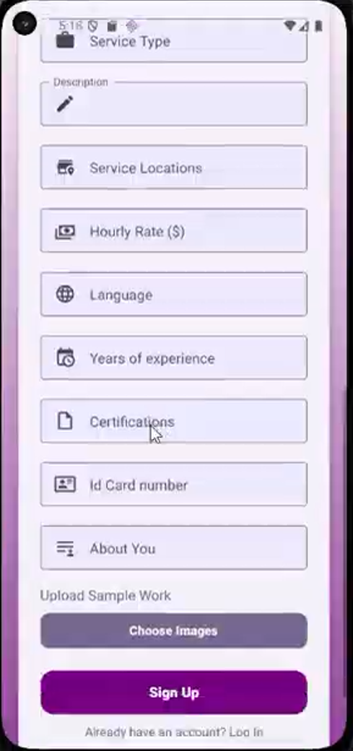
  Registration and Auth: unified system to sign up as a customer or service provider and securely log in.

Slide 6
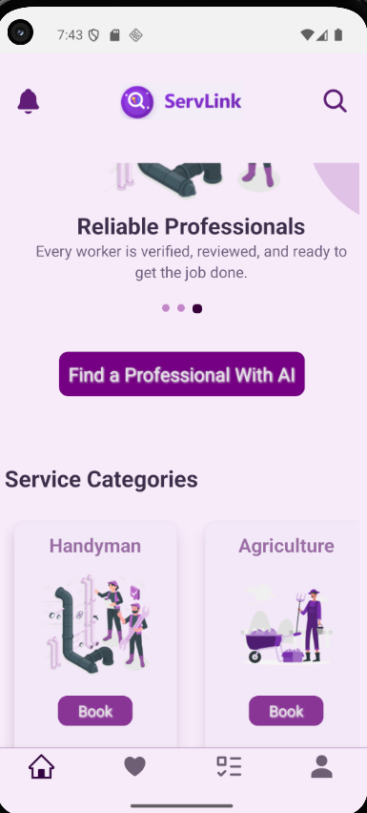
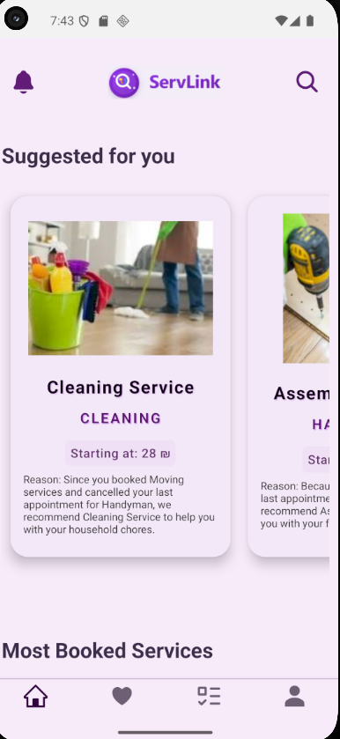
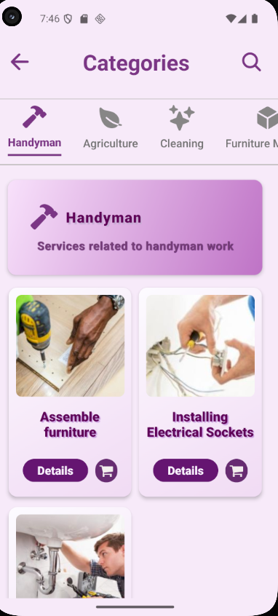
User Features
• Discovery Home: Browse service categories, current offers, and most-booked services, top providers and recommendation services system for user that used AI.

Slide 7
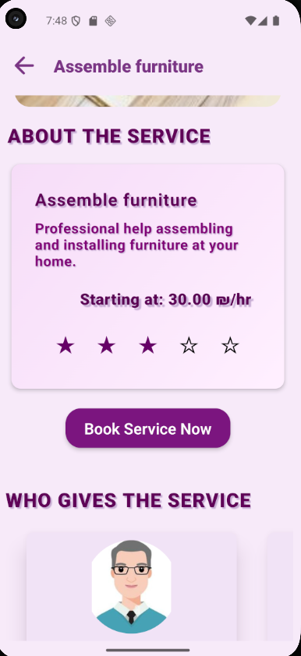
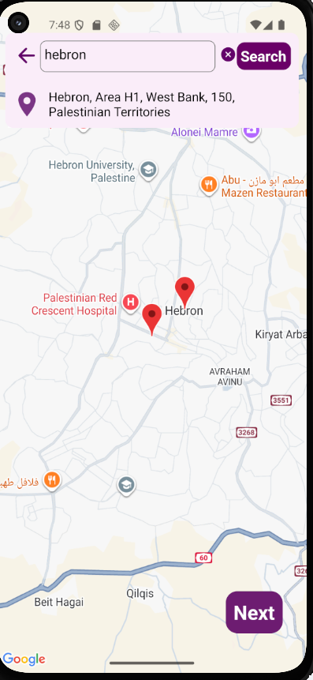
Direct Booking
• Map Integration: Pinpoint service locations using an interactive map interface.

Slide 8
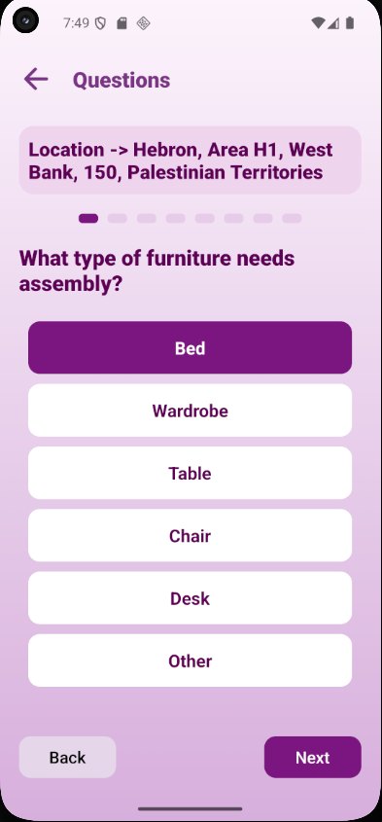
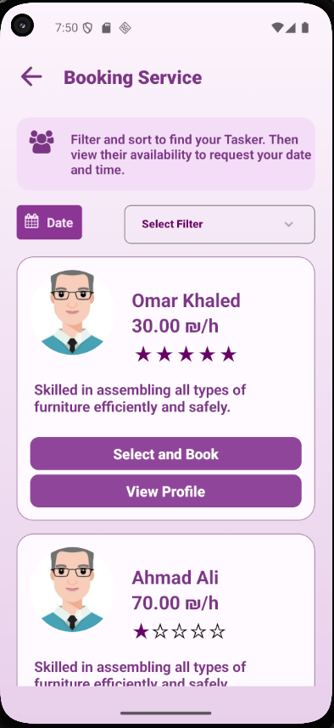
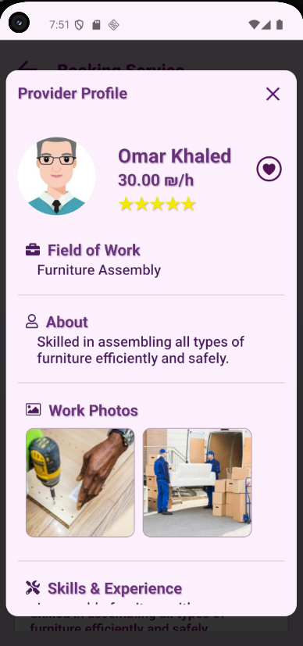

Slide 9
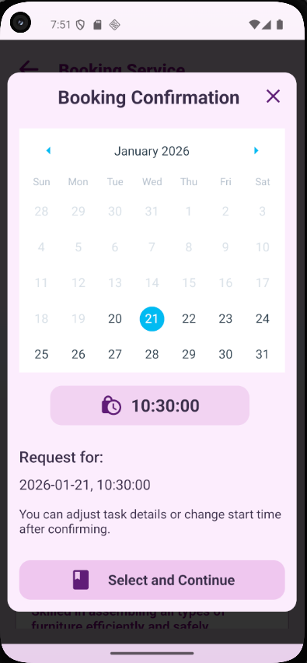
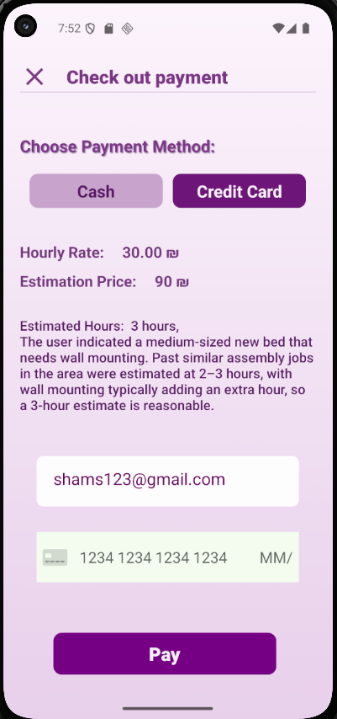
• Flexible Payment: Pay for services securely through either credit card or cash.

Slide 10
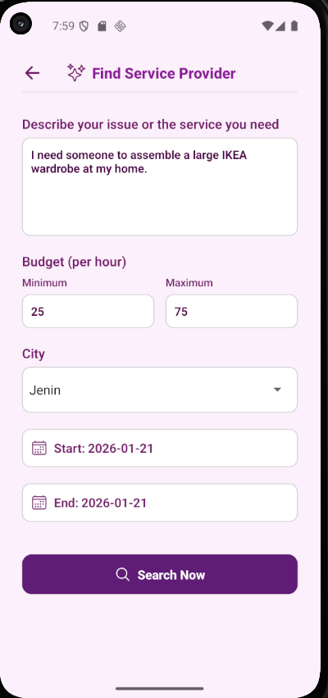
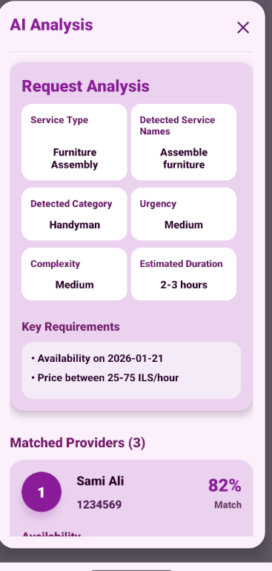
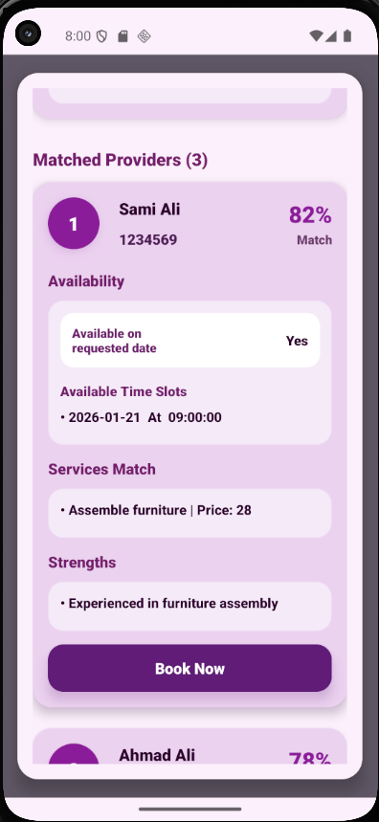
• AI Service Matcher: Describe a problem and let AI suggest the best professional for the job.

Slide 11
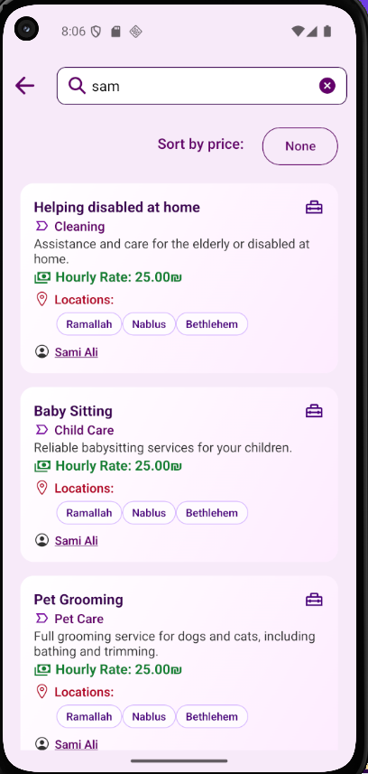
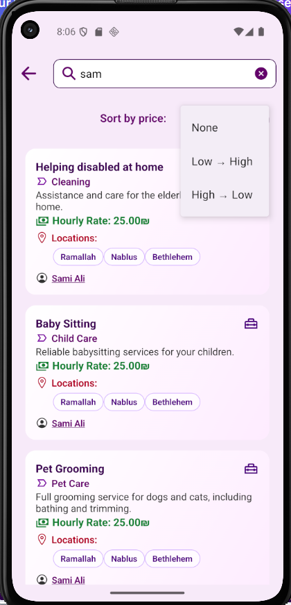
• Smart Search :
Find services using keywords with results filtered by category or provider.

Slide 12
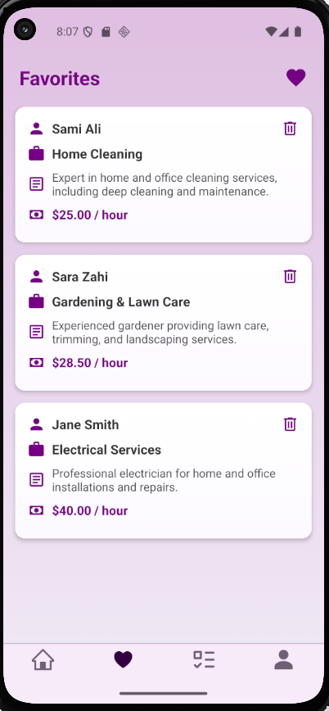
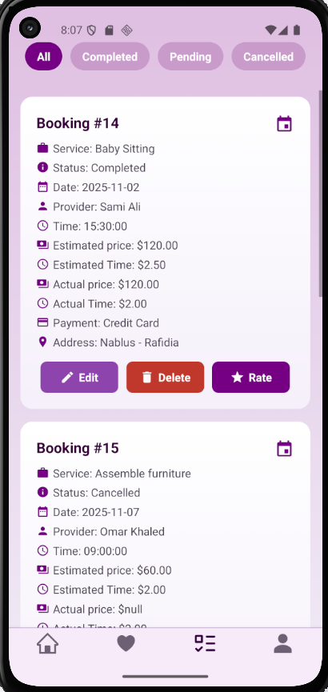
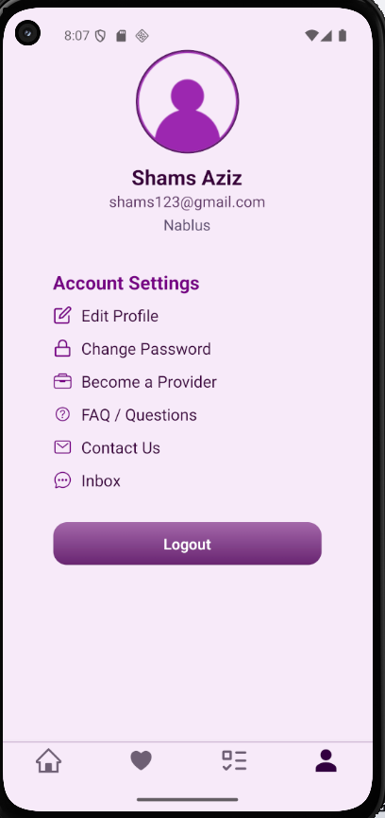
Other Features
• Notifications: Get real-time push alerts for booking confirmations or changes.
Also, Tasks Management, Favorites List, Feedback & Ratings, Inbox.

Slide 13
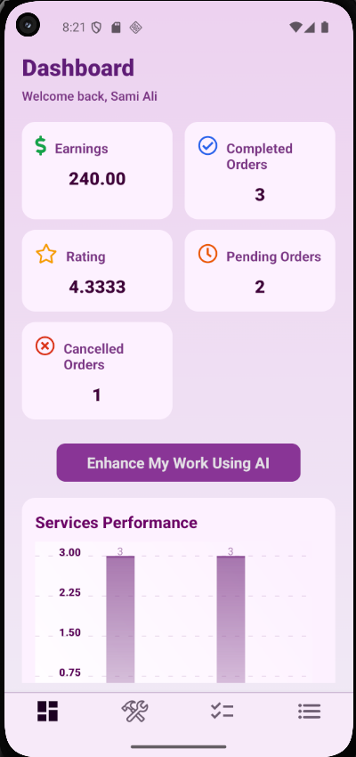
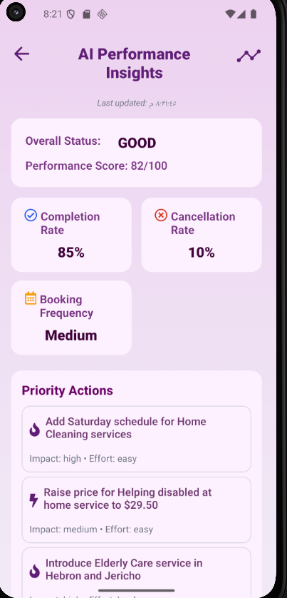
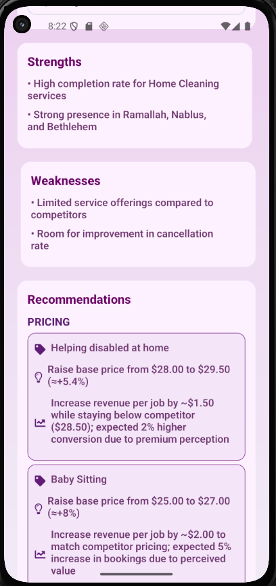
Provider Features
• Provider Dashboard:
Monitor profits, and order status through visual charts.
• AI Performance Insights:
Access AI reports analyzing business strengths, weaknesses, and pricing tips.

Slide 14
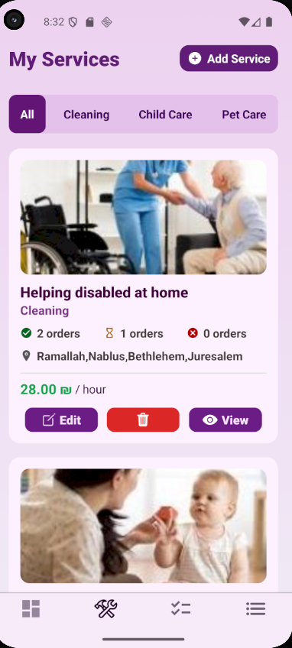
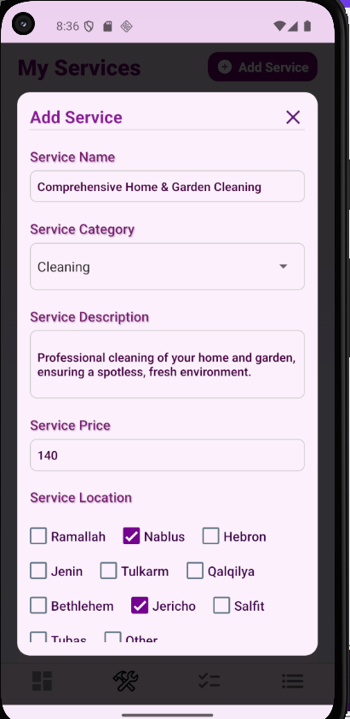
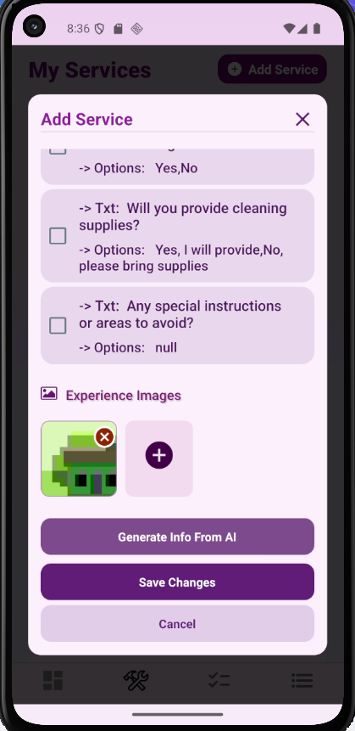
• Service List
Create and manage a portfolio of services including descriptions and base prices.
• AI Service Optimizer
Use AI to generate marketable service names and professional descriptions.

Slide 15
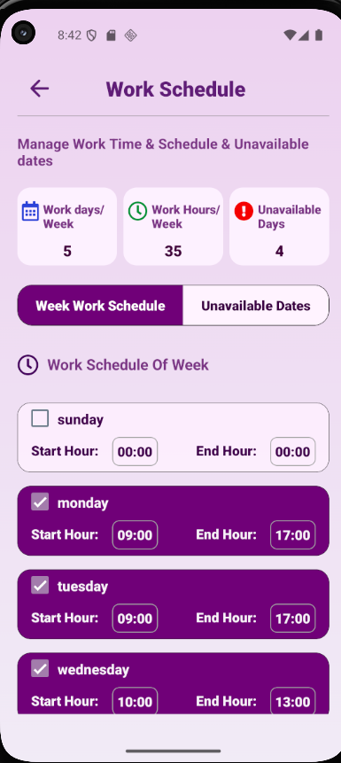
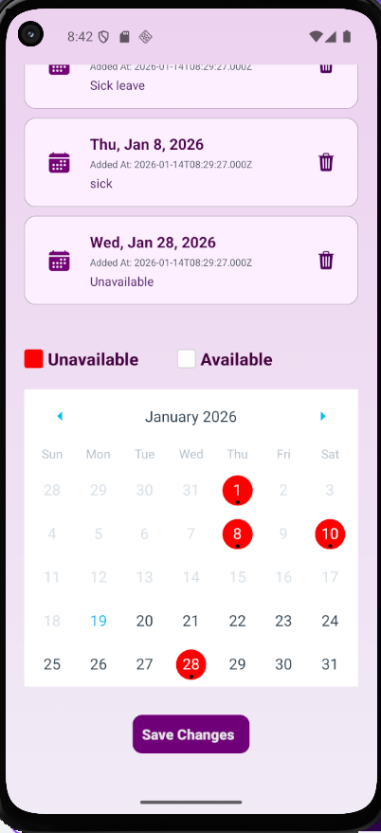
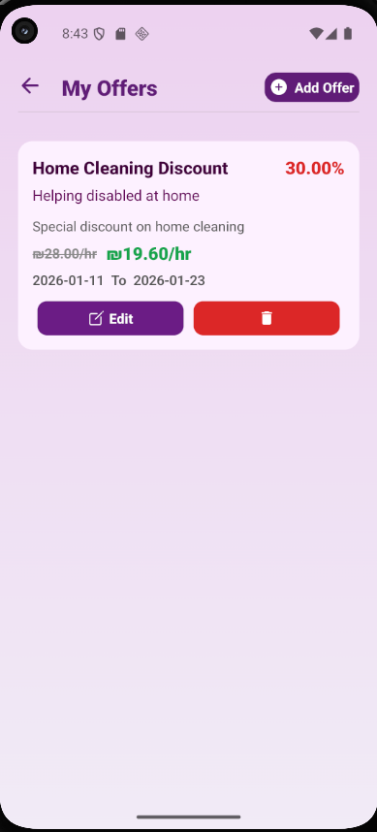
• Schedule Settings:
Define a weekly work calendar with specific start and end times.
• Unavailable Dates: Mark specific holidays or personal days on the calendar to block bookings.
• Offer Manager: Create time-bound discounts and promotional pricing to attract customers.

Slide 16
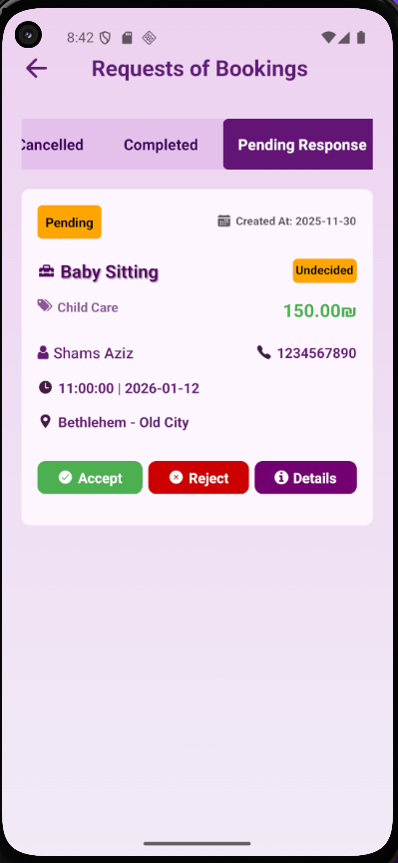
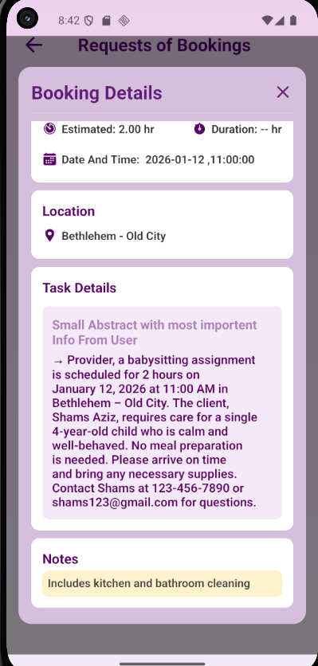
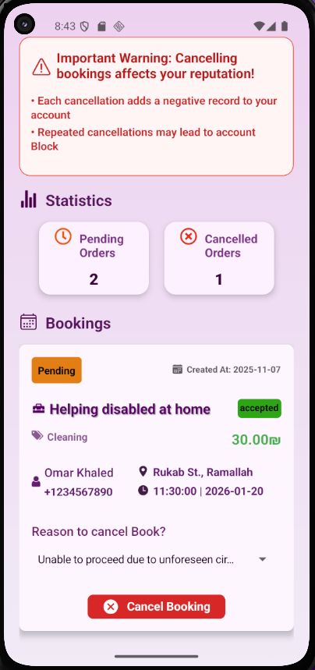
• Request Management:
Review AI-summarized job details and accept or reject requests.
• Auto-rebooking System:
If an accepted booking is canceled, AI automatically finds and offers a replacement booking.

Slide 17
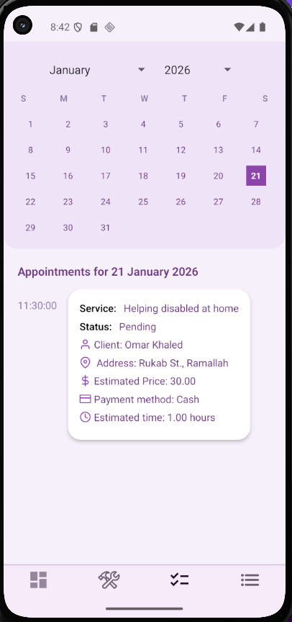
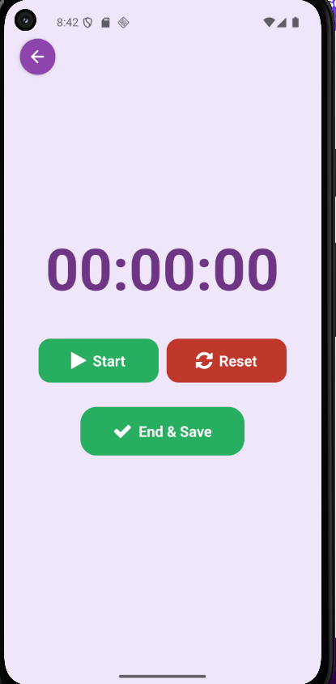
• Smart Calendar & Task Timer:
Calendar that list show daily appointments, with a live timer to track duration and auto-calculate the final price that user must pay with 20% for app and 80% for provider.

Slide 18
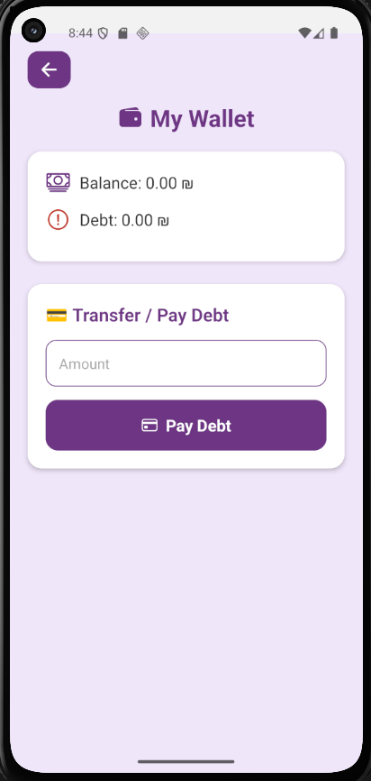
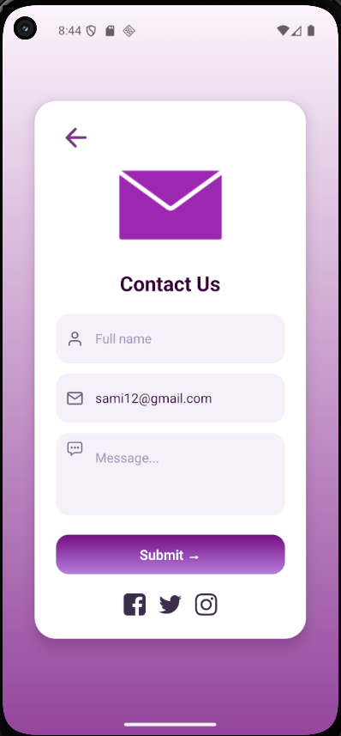
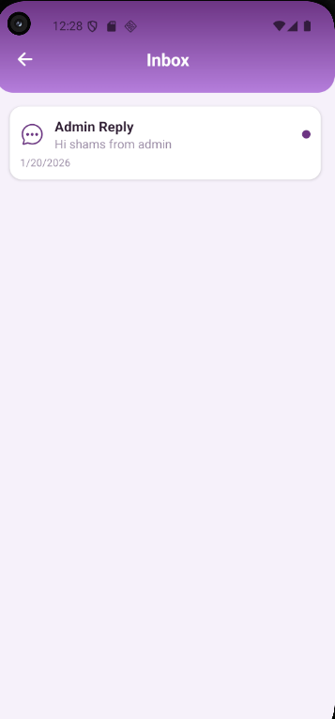
• In-App Wallet:
For every completed job, the service provider receives 80% of the total price, while the platform retains a 20% commission to cover operational costs
• Contact Us & Support:
Simple contact form that sends user inquiries directly to the admin dashboard.
• Support Inbox:
User inbox for admin replies with read/unread status and push notifications..

Slide 19
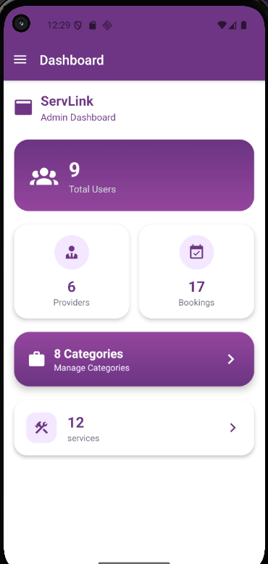
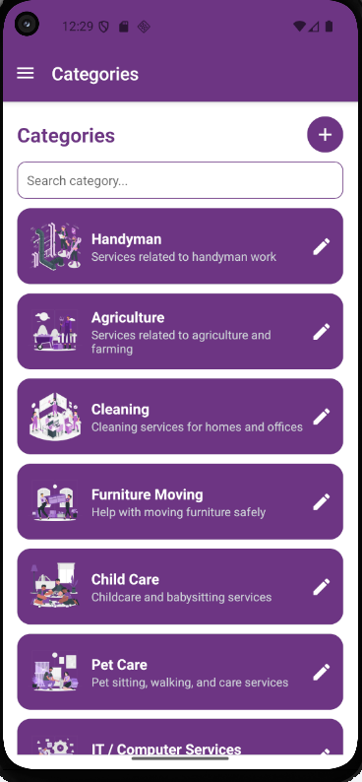
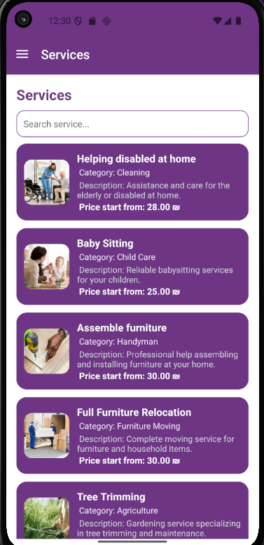
Admin Features
Global Dashboard:
Monitor platform-wide metrics including total users, providers, and revenue.
Category Controller:
Add or edit marketplace categories with AI-suggested names and descriptions.
Service Oversight:
Manage the global list of all services offered across the platform.

Slide 20
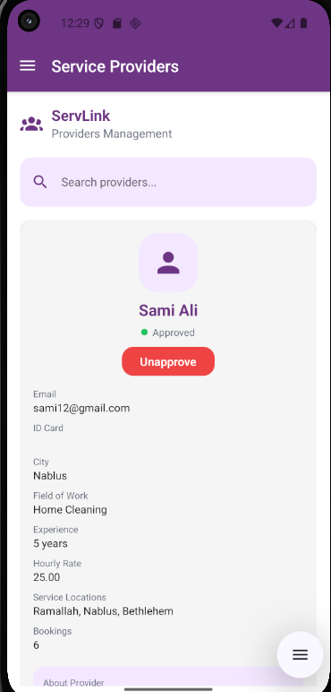
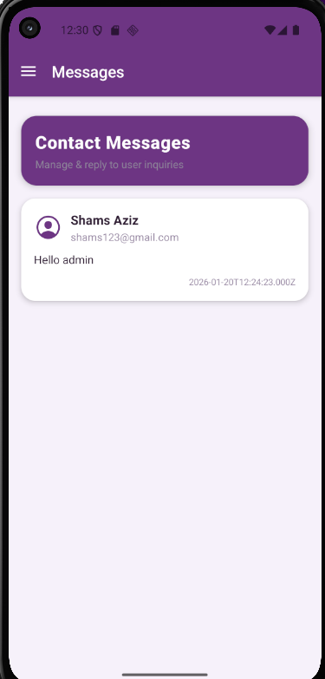
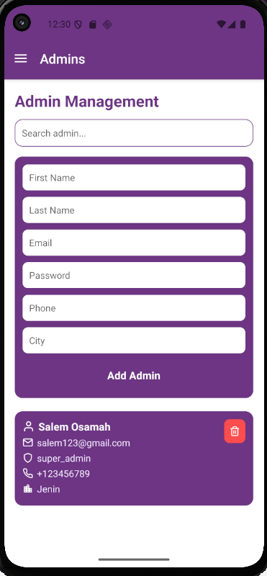
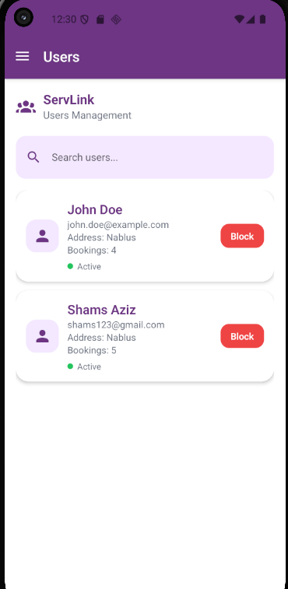
Provider Verification:
Review professional applications and approve or reject their registration.
Support Center:
Reply to contact messages using AI-generated polite response suggestions.
Admin Team Management:
Super admins can add, delete, or manage roles for other staff
User Management:
Search and monitor all customer accounts with the ability to block violators.

Slide 21
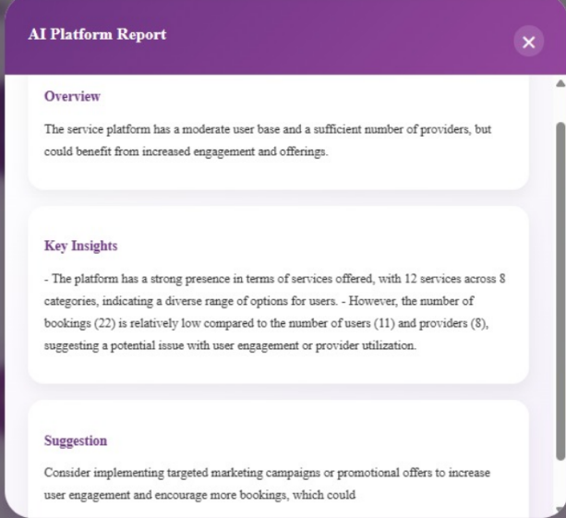
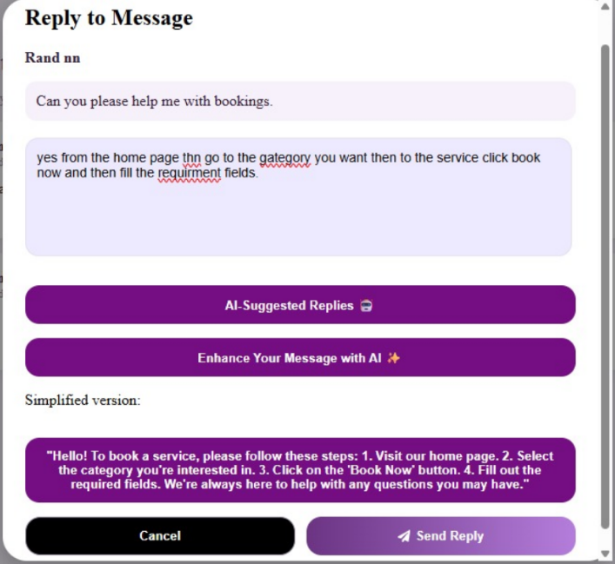
AI Strategy Reports:
Generate comprehensive platform health reports with strategic suggestions.
AI Reply Enhancement:
Automatically suggests, rewrites, and simplifies customer replies to send clearer, more professional messages faster.

Slide 22
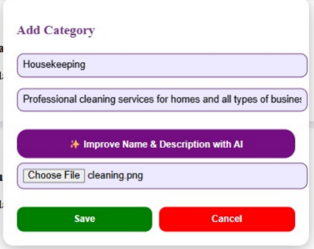
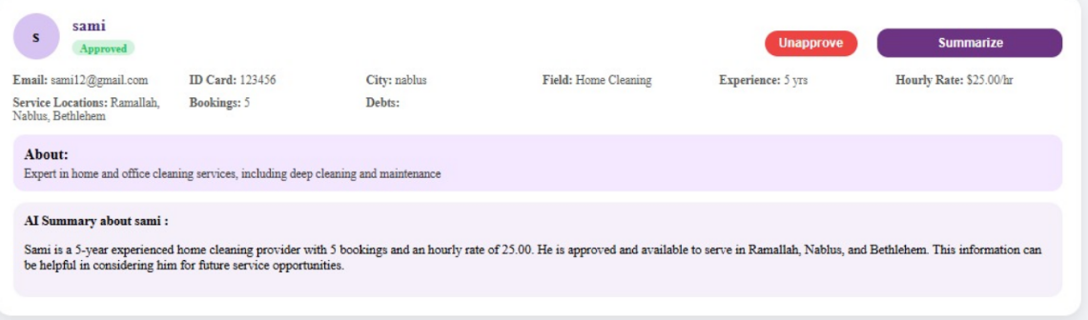
AI to improve Category name & description when add new one.
AI to give admin summary about provider Info

Slide 23










Technologies Used

Slide 24
Future Work
• Implementing comprehensive multi-language support, including a full Arabic.
• Expanding the payment gateway to support diverse methods via Stripe, such as digital wallets.
• Integrating an advanced, wider map system with real-time route optimization for better provider navigation.
• Upgrading the support system into a real-time live chat for instant coordination between customers and providers.

Slide 25
Conclusion
ServLink successfully bridges the gap between community needs and professional expertise by creating a smart, reliable service ecosystem . By integrating AI-driven matching and estimation with a robust mobile-first architecture, the platform simplifies daily life through a seamless "search-book-pay" process ,. Ultimately, it stands as a technology-driven solution designed to empower local professionals while providing customers with speed, clarity, and real usability.

