Slide 1
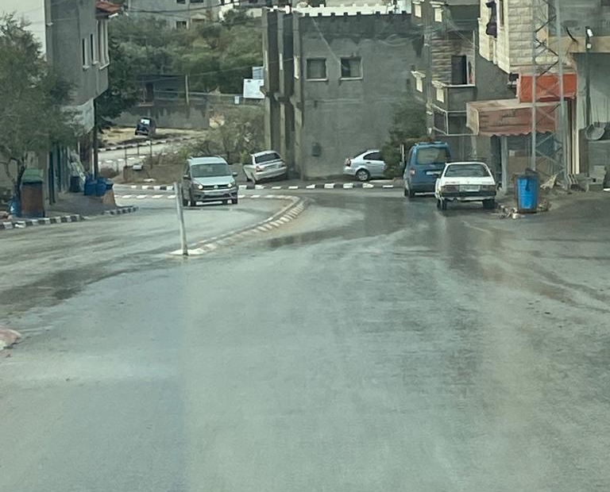
Analysis and Design of Beit-Imreen - Jabaa Street
By students:
1. Baraa Awni Faqeeh .
2. Ameed Mohammed Hasson .
3. Anas Mohammed Hasson .
Notes:
NOTE:
To change the image on this slide, select the picture and delete it. Then click the Pictures icon in the placeholder to insert your own image.

Slide 2
Outline
Introduction
Methodology
Data Collection
Traffic & Pavement Analysis
Pavement DESIGN.
TRAFFIC design

Slide 3
Introduction

Slide 4
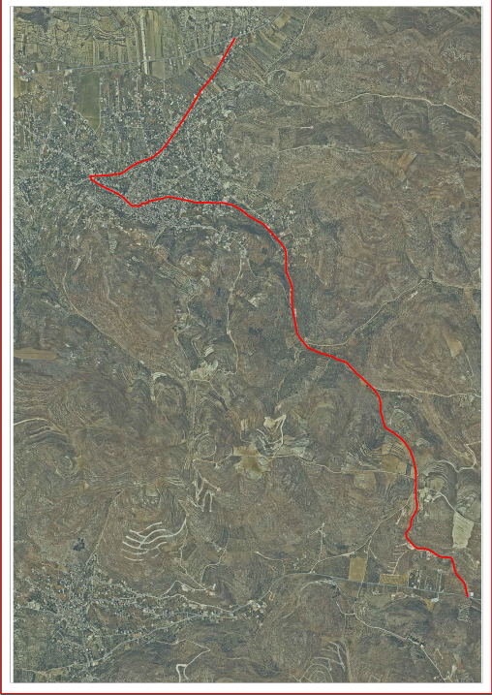
Background
Transportation is one of the most crucial sectors to the economy and development of any region.
Transportation importance is affected by other problems as population and economic inflation.
This Graduation Project (GP) is focused on Beit-Imreen - Jabaa Street as a case study.
This street is very important as it serves important facilities.

Slide 5
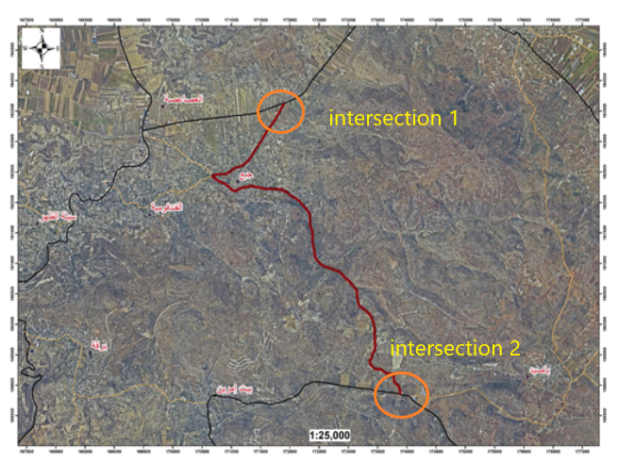
Study Area
The street extends for about 7500 m (7.5km) from Jabaa to Beit Imreen; it consists of one segment between two intersections located at the ends of the street.

Slide 6
Objective of the Project
Collect required data regarding the streets condition from available sources.
Traffic analysis & Pavement-structure analysis.
geometric design and pavement design .
for current condition and for 20 years to come.

Slide 7
Methodology

Slide 8
Methodology
Data
Importance
Soil & Traffic
CBR & PI Test for soil
Peak hour analysis & Level of service
Structure & Design
Current ability
After 20 years

Slide 9
Standards and Specifications
AASHTO Guide for Design of Pavement Structures. [AASHTO, 1993].
Highway Capacity Manual. [HCM, 2010].
“Traffic and highway engineering” by Garber & Hoel. [Garber & Hoel, 2009].

Slide 10
Data collection

Slide 11
Soil Study
we test 5 samples were taken so that each sample represents 1500 meters of the length of the street . The results were obtained in following table.
Sample No. | %finer sieve #200 | Soil Classification | CBR Value
1 | 68.60 | A-7 | 6.60
2 | 63.37 | A-4 | 7.70
3 | 87.96 | A-6 | 4.60
4 | 63.89 | A-6 | 12.11
5 | 49.40 | A-6 | 14.40

Slide 12
Traffic Study
 | PH | PHF | PHV | DHV
Critical segment | (8:00 - 9:00) am | 0.88 | 436 | 496
 | Passenger car | Taxi | Taxi van | Bus | Truck | Others
Total | 360 | 24 | 44 | 4 | 2 | 2
Percentage % | 83 | 5 | 10 | 1 | 0.5 | 0.5

Slide 13
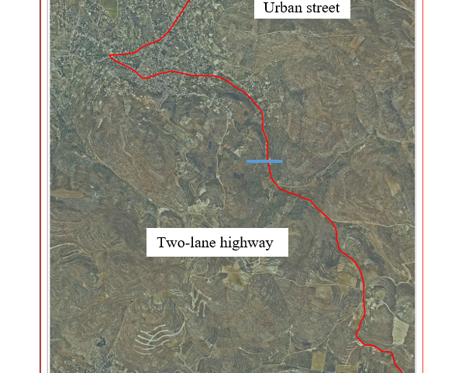
Traffic & Pavement Analysis

Slide 14
Traffic Street
The lane width is 3m & the road has no shoulder and we have two segment :
Urban segment :
FFS = BFFS-FLS-FA = 60 – 8.5 – 0.18 = 51.32kph. So,the LOS of this urban segment is A.
2. Two-Lane Highway segment :
FFS = 90 – 8.5 – 0.18 = 81.32kph. So ,the LOS of this two-lane highways segment is D.

Slide 15
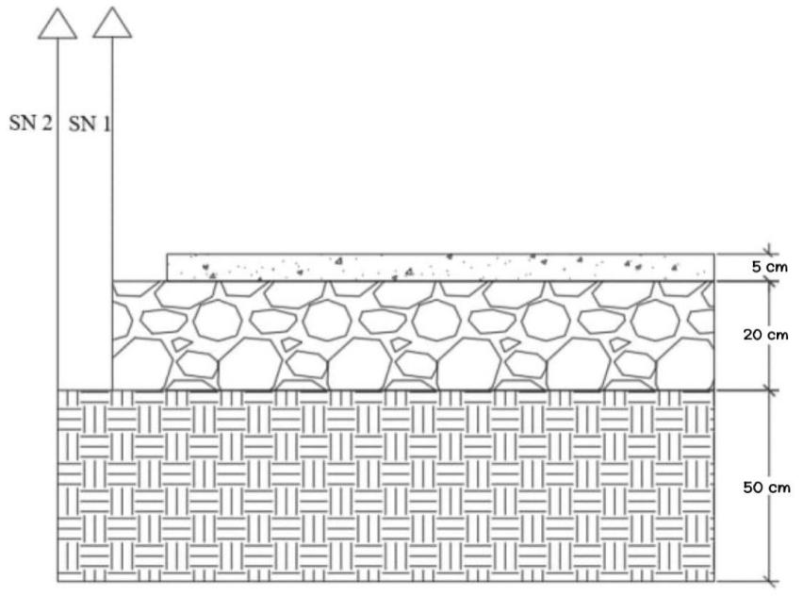
Pavement Analysis
The current situation has D1 = 5 cm or 2 inches, D2 = 20 cm or 8 in , D3 = 50 cm or 20 in .

Slide 16
Current and Future Traffic Load
Current ESAL and damage ratio
The current ESAL = 5,496.93 which is very low.
Damage ratio = 5496.93 / 150,000 = 3.66%
Future ESAL and damage ratio
The future ESAL = 428,760.42.
Damage ratio = 428,760.42 / 150,000 = 285.8%.

Slide 17
Pavement DESIGN

Slide 18
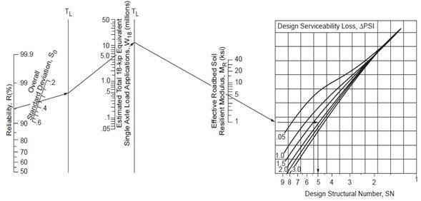
STRUCTURAL DESIGN
First of all, it is necessary to define the structural number (SN). It represents the overall structural requirement needed to sustain the design's traffic loading ,The SN could be found from the following graph:

Slide 19
STRUCTURAL DESIGN
Based on soil test we have two segmant :
first segment from station (0.0-5.5 km) &(6.5-7.5 km) ,we design with replace the soil,
SN for base course SN1 = 1.9
SN for sub base SN2 = 2.5
SN for subgrade SN3 = 5.7
The corresponding thicknesses are as follows:
D1 = 2.8 inches = 7 cm … ( thickness of asphalt layer)
D2 = 12 inches = 30 cm… (thickness of base course layer)
D3 = 24 inches = 60 cm… (thickness of rock fill layer)

Slide 20
STRUCTURAL DESIGN
in the second segment (5.5-6.5 km) we design without replace the soil
SN for base course SN1 = 1.9
SN for sub base SN2 = 3.1
The corresponding thicknesses are as follows:
D1 = 2.8 inches = 7 cm … ( thickness of asphalt layer)
D2 = 16 inches = 40 cm… (thickness of base course layer)

Slide 21
TRAFFIC design

Slide 22
Analysis for the Future Condition
Traffic volume is expected to increase at peak hour from 436 to 574 vehicles.
The volume of vehicles in the analysis direction equals 574 veh/h, and in the opposing direction equals 381 veh/h.
Percent of no-passing zones is about 4% per year for the total segment.
the LOS of the street still D.

Slide 23
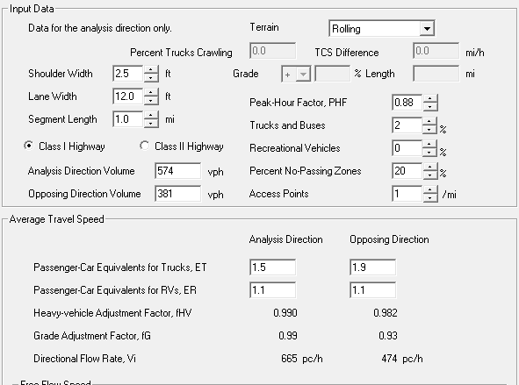
Analysis for the Future Condition
All the previous data is entered on the HCS software as shown in the following figure .

Slide 24
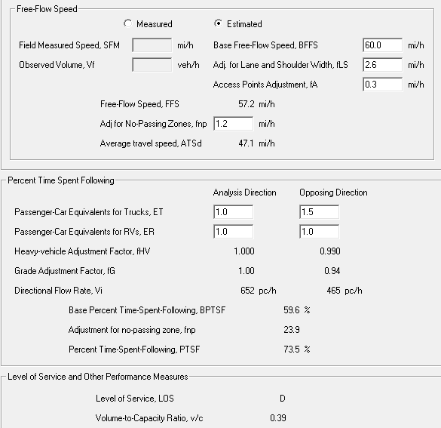
Analysis for the Future Condition
According to this result, the street still serve at a LOS of D for more than 20 years which is acceptable.

Slide 25
GEOMETRIC design

Slide 26
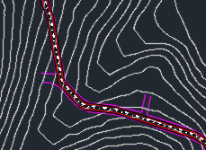
Horizontal Curves
In order to connect straight (tangent) sections of roadway with a horizontal curve, several options are available. The most suitable option is the simple curve and reverse curve to satisfies the design speed of the road.

Slide 27
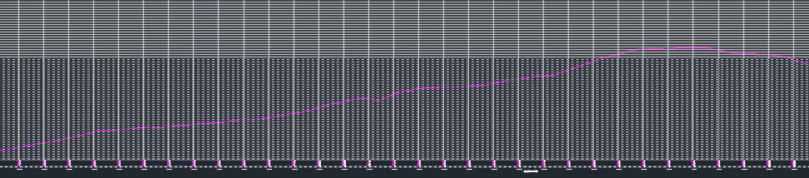
Vertical Alignment
In addition to horizontal curves that go to the left or right, roads also have vertical curves that go up or down. A vertical curve provides a transition between two slopes roadways, allowing the vehicle to cross the elevation rate change at a gradual rate rather than a sharp cut.
There are two types of vertical curves: sag curves and crest curves. Sag curves are used where the change in grade is positive, such as valleys, while crest curves are used when the change in grade is negative, such as hills.

Slide 28
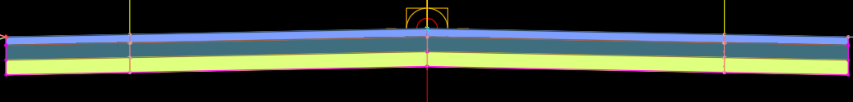
Cross Section
The shoulder width is 0.8m and the lane width is 3.6m

Slide 29
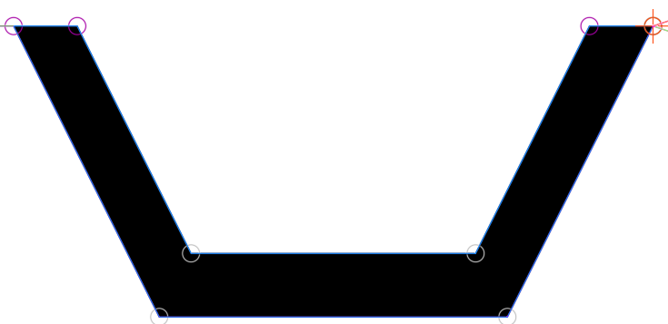
Side Ditches
Drainage ditches perform the vital function of collecting and conveying surface water from the road right-of-way.

Slide 30
Thank you

