Slide 1

By:
Ahmad hanini
Tareef Shtayeh
Mohammad Abu Baker
Supervised By:
Dr. Husam A. Halim

Slide 2
CONTENTS
Project Idea
Software Used
Challenges
Design Diagrams
Future Works

Slide 3
IDEA
The idea is to have an A mobile application that connects doctors with their patients and adding some features by utilizing OCR and other resources.

Slide 4
SOFTWARE
Android Studio Version (3.0.1)
Google Firebase Engine
OCR.Space Api

Slide 5
CHALLENGES
Learn Android and Programming at the same time.
Find an Online Web Server.
Plotting the graph by having getting the data from the data base .
Compatibility issues between different versions of android causing unexpected bugs .

Slide 6
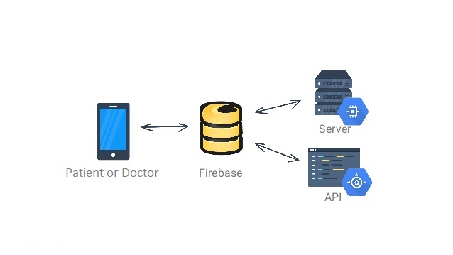
SYSTEM ARCHETICURE

Slide 7
Data Base
We used Firabase webserver provided by google to handle our data and manipulate it the way we want to .
it is more responsive and quicker given that we utilize the synchronization it provides without overloading it.
How we used it ?

Slide 8
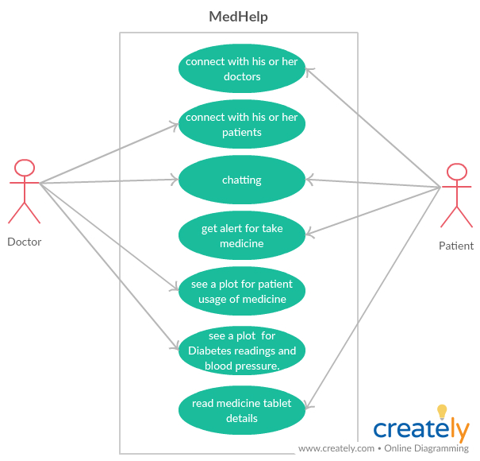
USE CASE

Slide 9
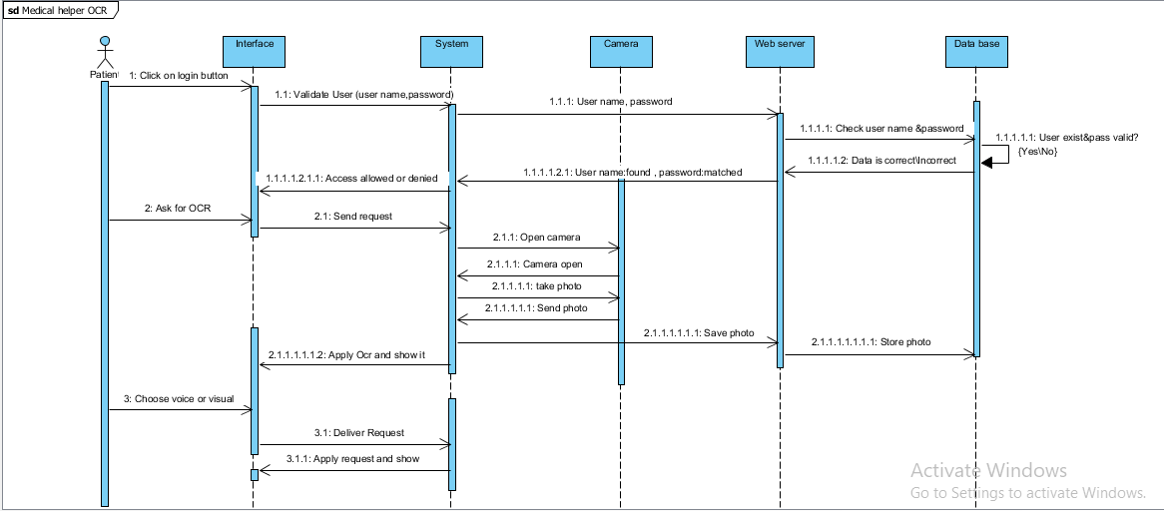
SEQUENCE DIAGRAM - OCR

Slide 10
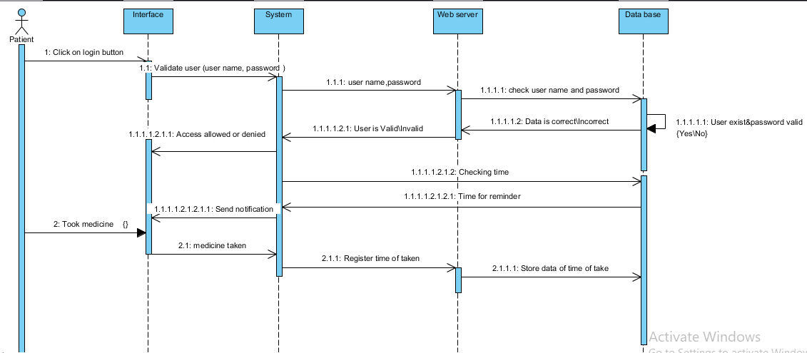
SEQUENCE DIAGRAM - Reminder

Slide 11
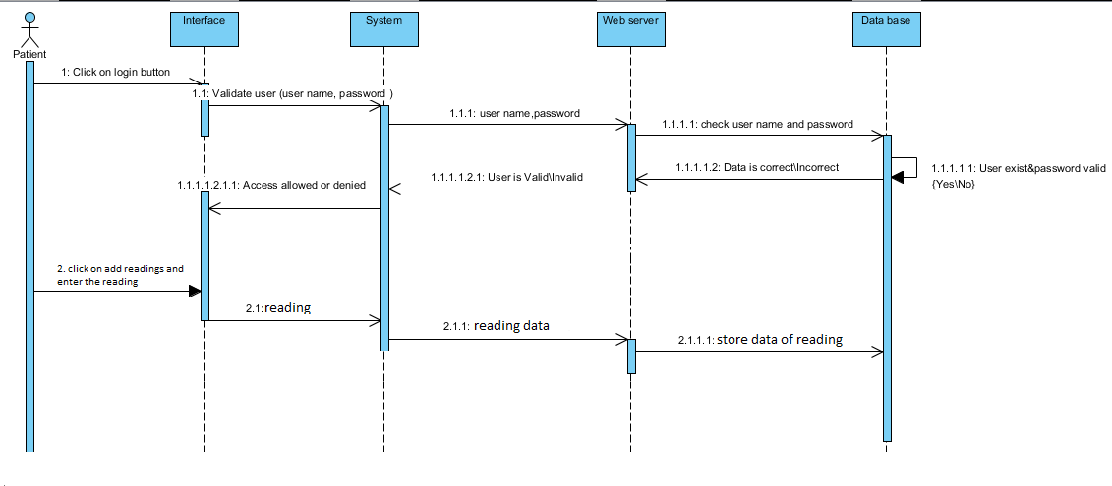
SEQUENCE DIAGRAM – Measurements

Slide 12
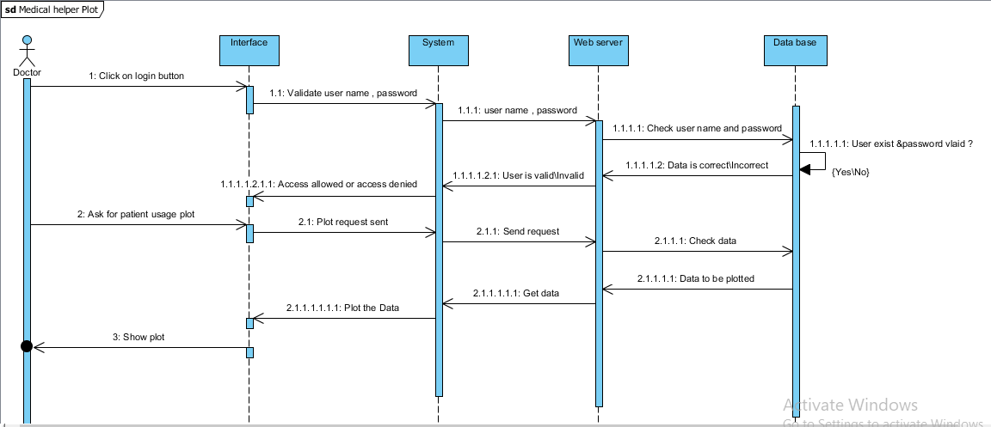
SEQUENCE DIAGRAM – plot

Slide 13
FUTURE WORK
add voice and video call between the two parties.
improvements Implementing Arabic voice readings.
Make some improvements on the alarm system.
Deriving from an image test results of patients to doctors.

