Slide 1

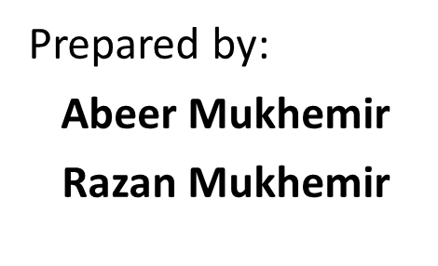
Freshy
Supervisor:
Dr. Manar Qamhieh

Slide 2



Outline
Introduction And Motivation
Development Environments
Demo
Constraints
Future Work

Slide 3
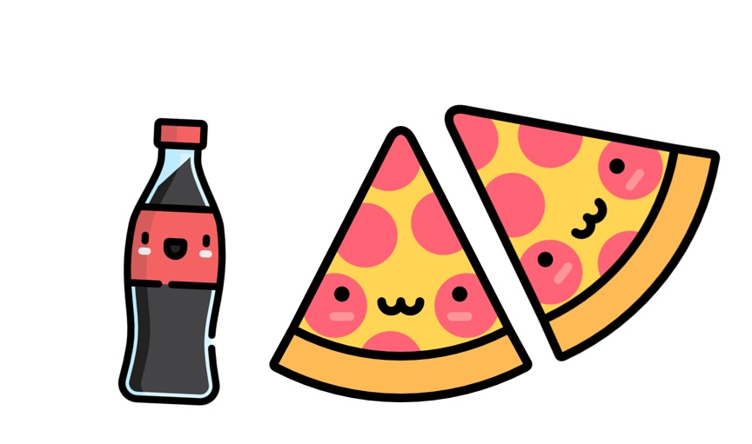

Introduction And Motivation
Freshy = Cooking App
Motivation :
- Lack of Cooking Apps in Arab World
- It deserves a GOOD one

Slide 4





Development Environments

Slide 5



Demo

Slide 6




Constraints
➔ Limitation of resources
➔ Limitation of data

Slide 7



Future Work
Auto Read Bills
Hand-Free Mode
Learning Mode

Slide 8
