Slide 1


Integrated Information and Treatment Tracking System for Al-Arda Dermatology Clinic
Supervised By:
Dr. Maher Abu Baker
Prepared By:
Aya Maani Shahd Abuzant
2025

Slide 2
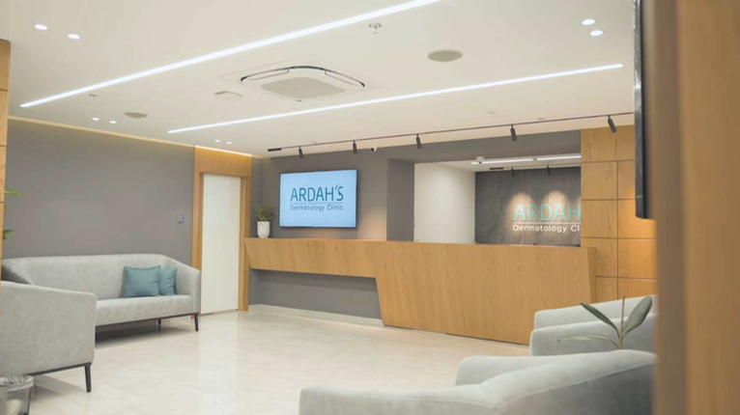
Ardah Clinic

Slide 3



About Ardah Clinic
Located in Nablus – Beit Wazan Main Street – Jafra Commercial – Second Floor.
A specialized and integrated medical center. Focused on dermatology and cosmetic medicine.
Provides the latest medical services with top standards. Supervised by a team of expert specialists.

Slide 4











CONTENTS
Problems
Why Odoo?
Objectives
Information System And Trackinoft System

Slide 5










Problems
Why Odoo?
Objectives
Information System And Trackinoft System
Delay in accessing patient information when needed
Difficulty tracking, changing, or canceling patient appointment
Lack of accurate analytics for the management and medical team No alerts or reminders for patient appointment
No unified record for diagnosis and treatment history Repetitive data entry and increased error rates

Slide 6



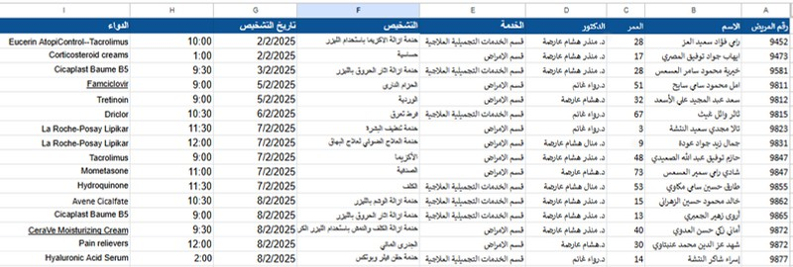

About Ardah Clinic
Daily work statistics for dermatology clinic patients and diagnoses are recorded manually in Excel.

Slide 7



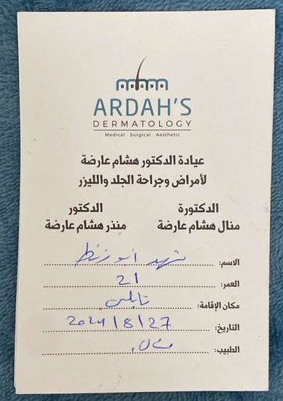
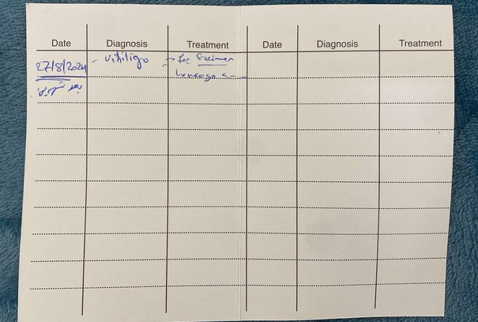

About Ardah Clinic

Slide 8


One-in-all application
User Friendly
Integrated
Why Odoo?
Security
Cost-effective

Slide 9











MODULES
Clinic management system
Appointement
Financial issues
Inventory
Website
Livechat
Email
marketing
SMS
marketing
Dashboard

Slide 10


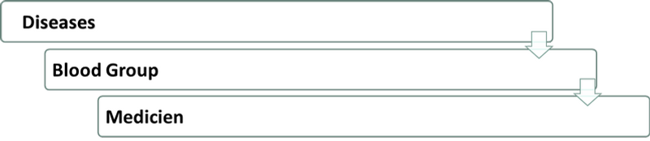
Clinic management system
Configuration:
There are several things we need to set for a configuration in odoo

Slide 11


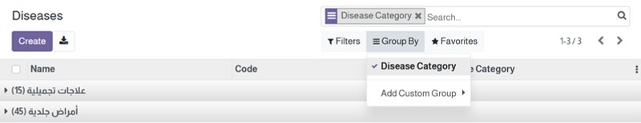


Clinic management system
Diseases Category

Slide 12
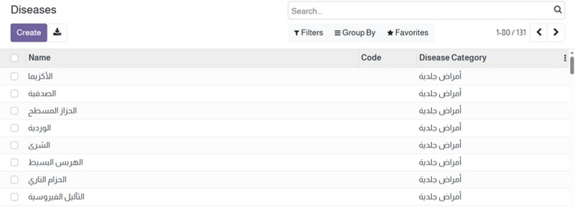

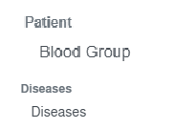

Clinic management system
Diseases Category

Slide 13

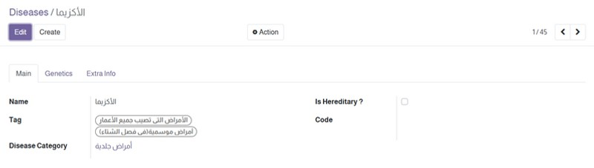
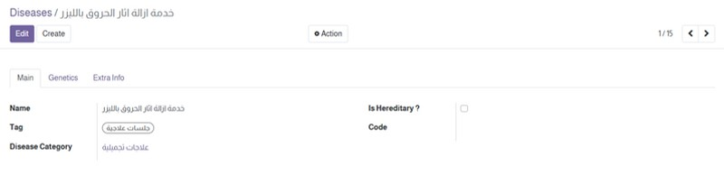
Clinic management system
Configuration (Diseases)
Diseases
Services

Slide 14
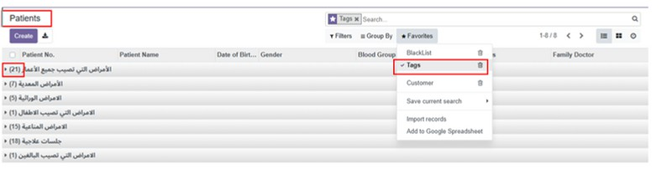
Clinic management system
Configuration (Diseases Tags)
Helps staff quickly locate patient records based on diagnosis (e. g., vitiligo, psoriasis, acne).
Enables filtered views for easier case management and improve search precision

Slide 15


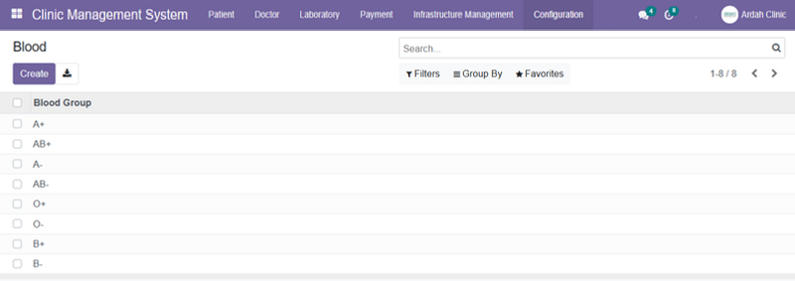

Clinic management system
Configuration (Blood group)

Slide 16
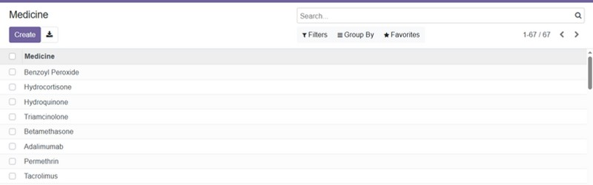

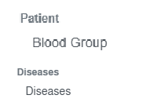
Clinic management system
Configuration ( Medicine)

Slide 17


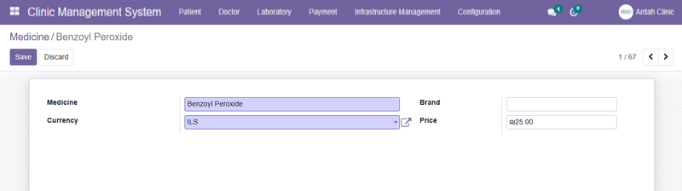

Clinic management system
Configuration ( Medicine)

Slide 18

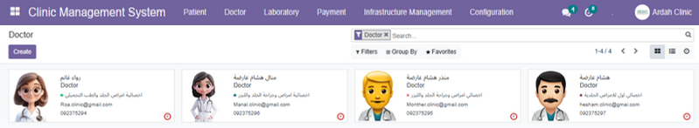
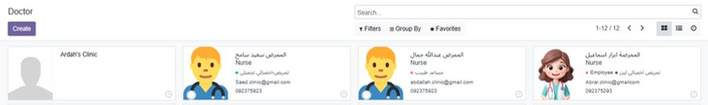
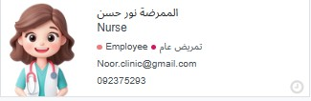

Clinic management system
Doctors

Slide 19
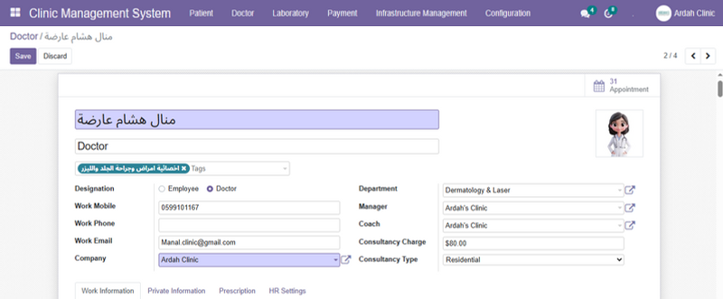


Clinic management system
Doctors

Slide 20

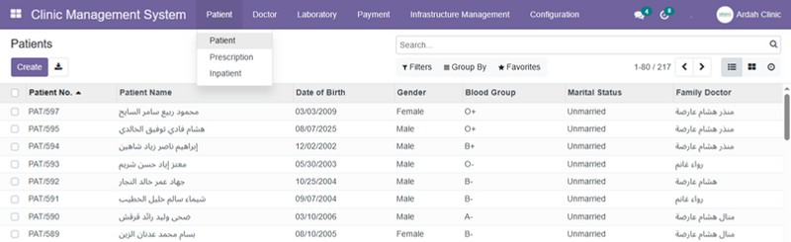

Clinic management system
Patient

Slide 21

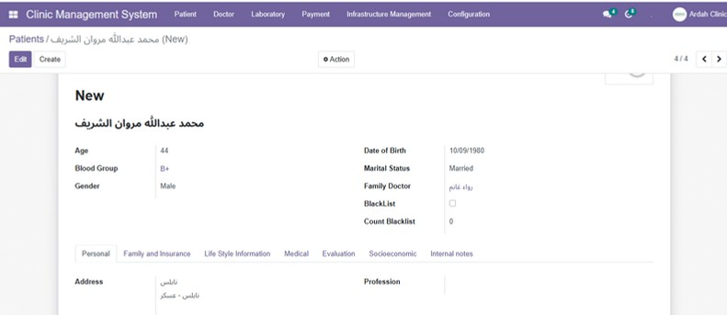






Patient
Clinic management system

Slide 22
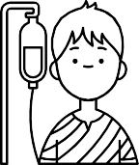
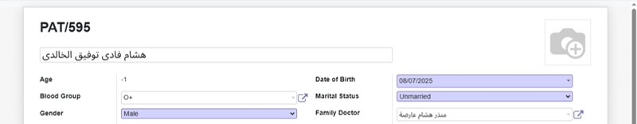

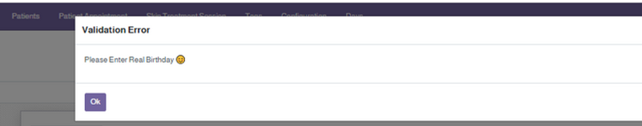
Clinic management system
Patient

Slide 23


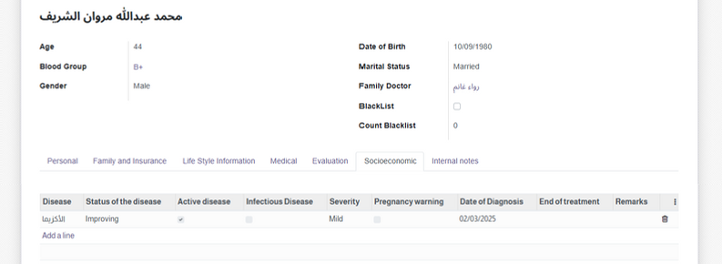

Clinic management system
Patient (Disease)

Slide 24
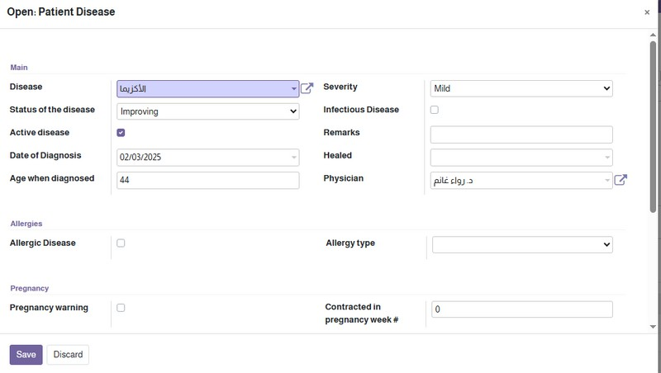
Clinic management system
Patient (Disease)

Slide 25

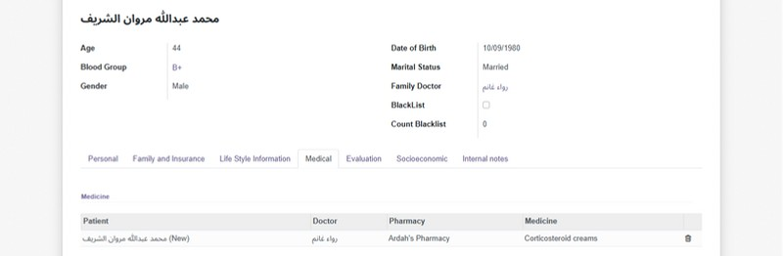


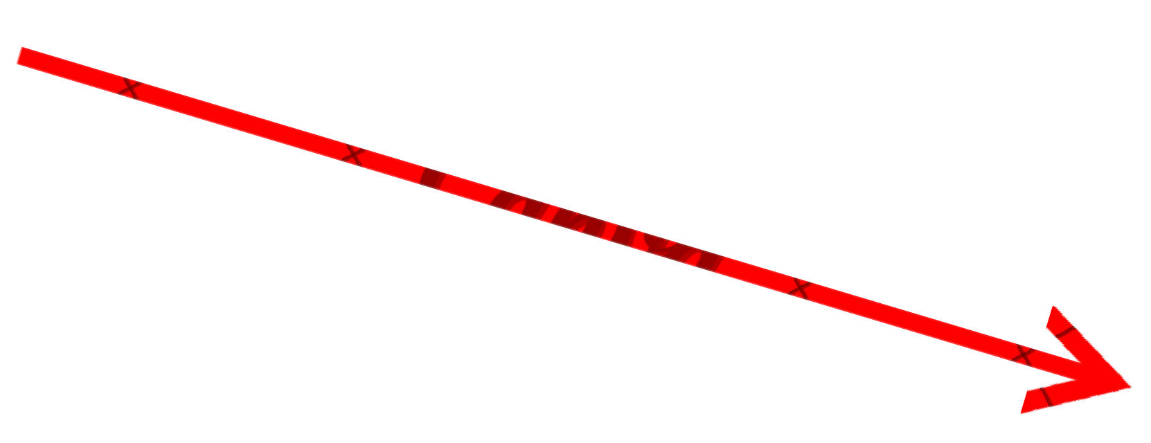

Clinic management system
Patient (Medical )

Slide 26
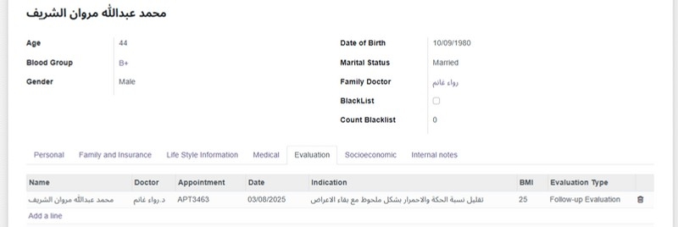


Clinic management system
Patient(Evaluation )

Slide 27


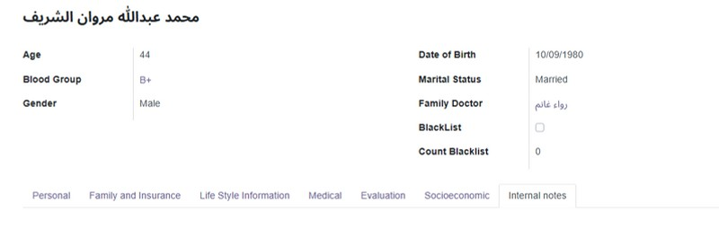

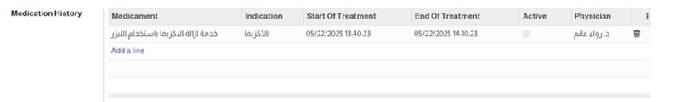
Clinic management system
(Medication)
The next session will also be recorded when it takes place.

Slide 28
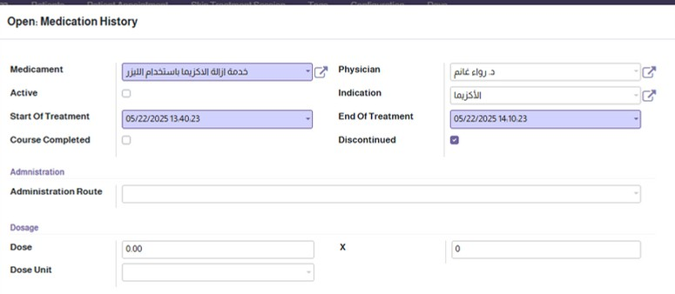
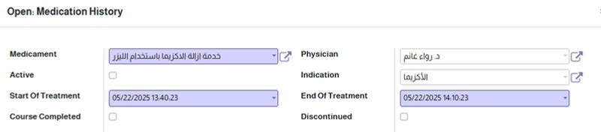


Clinic management system
(Medication)

Slide 29


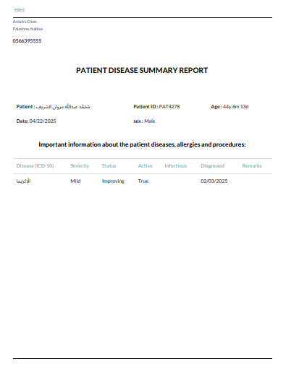
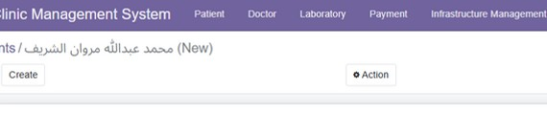


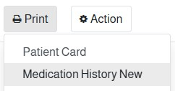

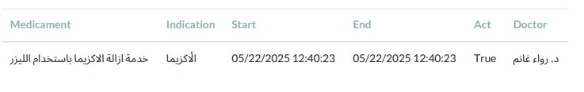
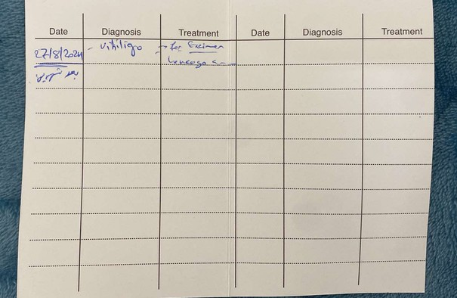
Clinic management system
Patient card
Notes:
(8) ﺮﻬﺷ ﻲﻓ - رﻮﻬﺷ ثﻼﺛ ﺪﻌﺑ ﻪﻴﻟﺎﺘﻟا ﺔﺴﻠﺠﻟ ا

Slide 30
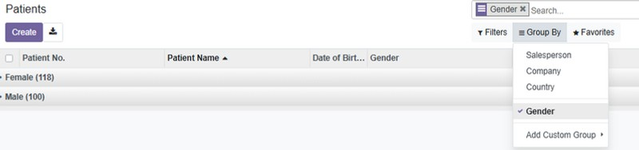
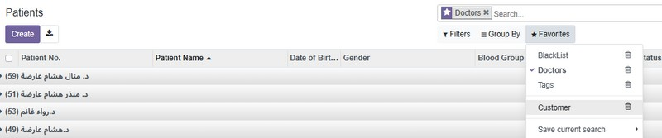
Clinic management system
Patient Filter for(Gender)
Patient Filter for (Doctor)

Slide 31




Financial issues
The Financial module is essential for a dermatology clinic because:
Organizes and manages patient payments accurately.
Generates invoices for both medical services and treatment products.
Enhances financial management within the clinic. Facilitates effective tracking of sales and revenues.

Slide 32


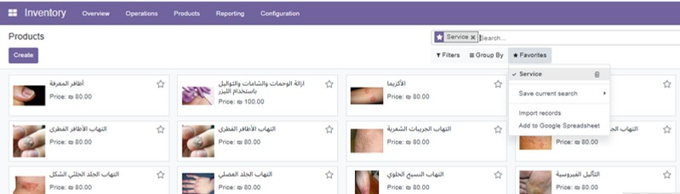
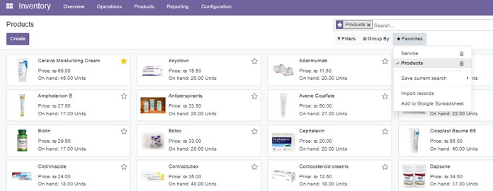
Inventory Module
The inventory contains all medications as a (Product) and services available at the clinic.

Slide 33


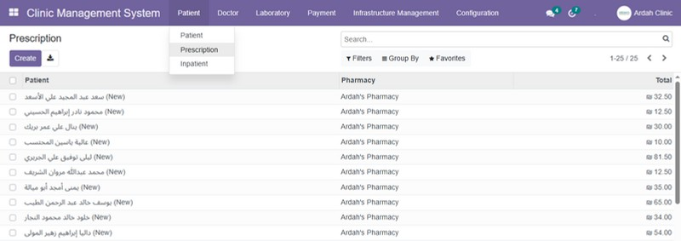

Clinic management system
prescriptions

Slide 34


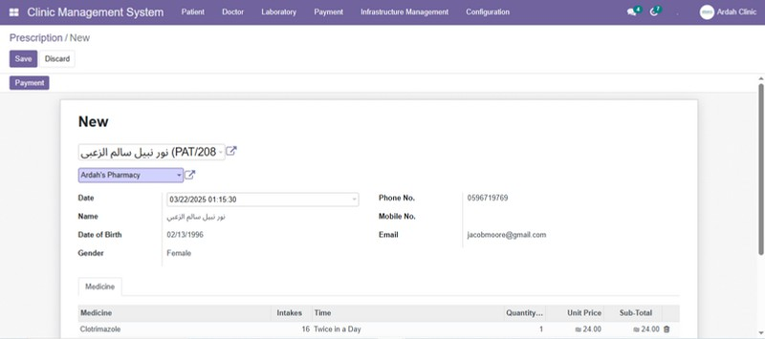



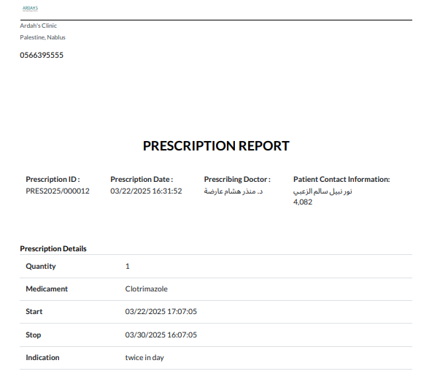
Clinic management system
prescriptions

Slide 35




Clinic management system
prescriptions
Then when clicking on Payment it make a invoice for this Prespection And the service for this patient is appear

Slide 36

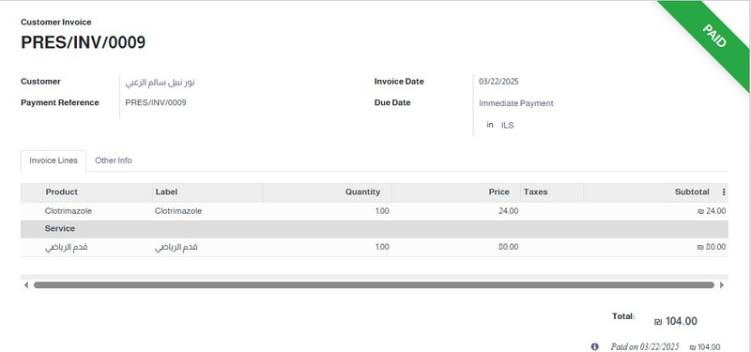
Clinic management system
prescriptions(Invoicing)
We created invoices for patients that include both medical services and treatment products at the clinic.

Slide 37




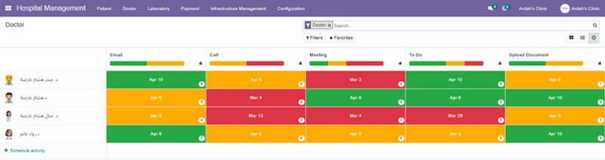

Clinic management system
Scheduled Activities
We have set up scheduled activities for each doctor to manage their tasks and duties efficiently.

Slide 38

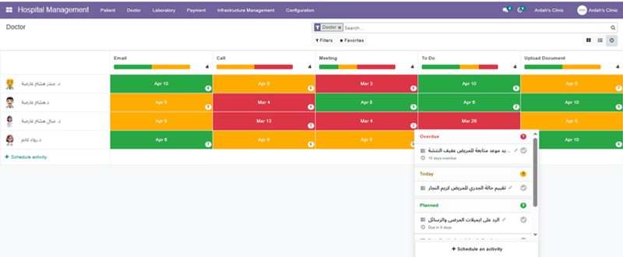
Clinic management system
Scheduled Activities
(To Do Activity)
Helps doctors stay organized by tracking tasks, appointments, and follow-ups efficiently.

Slide 39
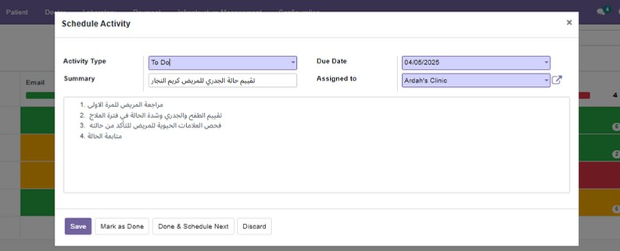
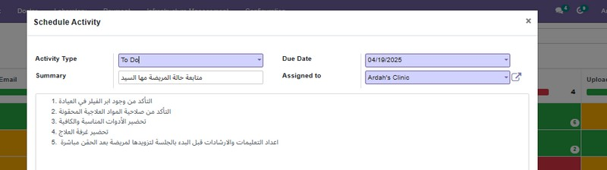
Clinic management system
Scheduled Activities (To Do Activity)
One task to do Today
One task to do in the Future

Slide 40

Clinic management system
Scheduled Activities (Uploading documents)
Helps doctors stay on track with uploading important documents, ensuring nothing is missed .

Slide 41


Clinic management system
Scheduled Activities (Uploading documents)
One document need to be upload Today
One document need to be uploaded in future

Slide 42

Clinic management system
Scheduled Activities (Uploading documents)

Slide 43

SMS and Email Marketing
Email Marketing

Slide 44



SMS Marketing
Awareness

Slide 45


SMS Marketing
Discount

Slide 46


Email Marketing

Slide 47

Website

Slide 48




Website
Home page

Slide 49


About us
Website
Doctors

Slide 50



Website
Services

Slide 51


Website
Your experiences with us

Slide 52




Form for Patient

Slide 53


Live Chat

Slide 54

Website and appointment

Slide 55


Website and appointment

Slide 56





Website and appointment

Slide 57


Website and appointment

Slide 58





Website and appointment
Monther.clinic@gmail.com

Slide 59





Website and appointment
Monther.clinic@gmail.com
2025/05/08

Slide 60







Website and appointment
Monther.clinic@gmail.com
2025/05/08

Slide 61





Slide 62





08
Monther.clinic@gmail.com
2025/05/08

Slide 63







Roa.clinic@gmail.com

Slide 64






Roa.clinic@gmail.com

Slide 65


Appointment
This interface is shown when the system is accessed by a doctor.

Slide 66


Website

Slide 67







1. Early booking due to appointment cancellation
2. Reminder appointment
3.Cancellation Appointment due to being
10 minutes late

Slide 68



Filter :patient blacklist

Slide 69





Dashboard
Patients Dashboard

Slide 70


Dashboard

Slide 71






Dashboard

Slide 72








Slide 73




Dashboard

Slide 74



To Do List For " Today "

Slide 75




