Slide 1

An-Najah National University
Faculty of Engineering & Information Technology
Department of Building Engineering
A comprehensive design of Dorms For Nursing College
Mutaz Jaber← Prepared by →Mohammad Abulail
Supervisor: Eng Amer Aker

Slide 2
Outline:
Definition of the Dorms.
Architectural Design.
Environmental Design.
Structural Design.
Mechanical And Safety Design.
Electrical design.
Quantity Survey And Cost Estimation.
1

Slide 3
What is Dorms ?
Dormitory: means a building provides sleeping and residential quarters for large numbers of students , often boarding school, college or university students.
Dormitory also means a room containing several beds accommodating students in campus

Slide 4
Questionnaire
A questionnaire was conducted at the Faculty of Nursing and the following results were obtained:-
67% of students live in university housing and 43% of students are males
thus 67% of 1000 students = 670 students
And males 43% of 650 students = 288 male students
Therefore we must provide a suitable accommodation for This large number of students.

Slide 5
Architectural Aspects

Slide 6
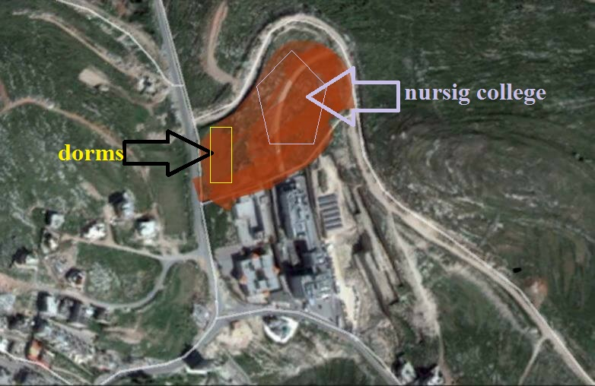
Site Analysis
Annual average of humidity
(61%).
26,000 m²
Background Noise= 38dB
Wind speed 10 Km/hr.

Slide 7
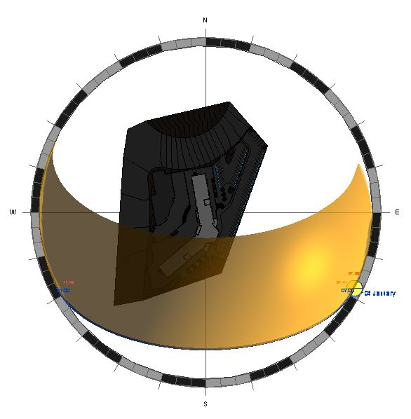
Sun path
Summer:
Winter:

Slide 8
Conceptual Design
Dorms
Studios
Entertainment
Reading rooms
Sitting Rooms.
Multipurpose
Parking
Reading rooms

Slide 9
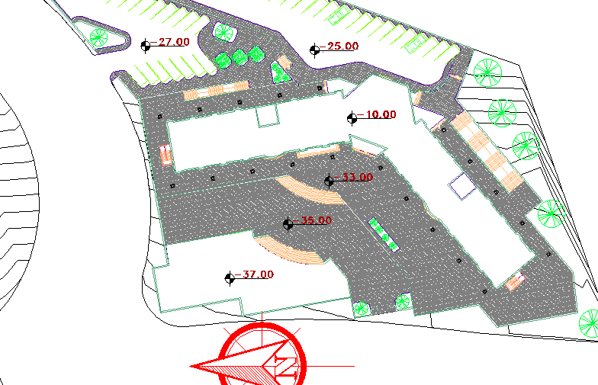
Site plan:

Slide 10
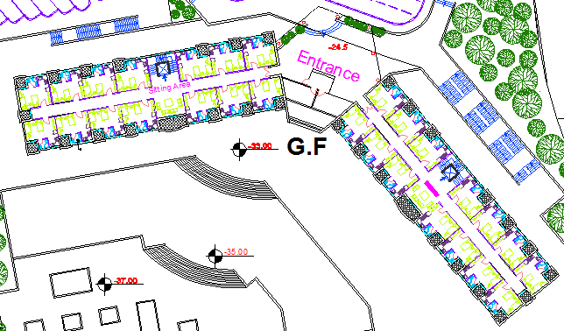
Ground Floor plan

Slide 11
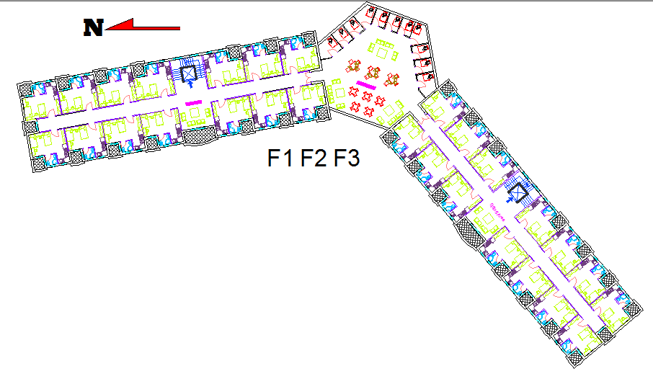
First ,Second & third Floor plans:

Slide 12
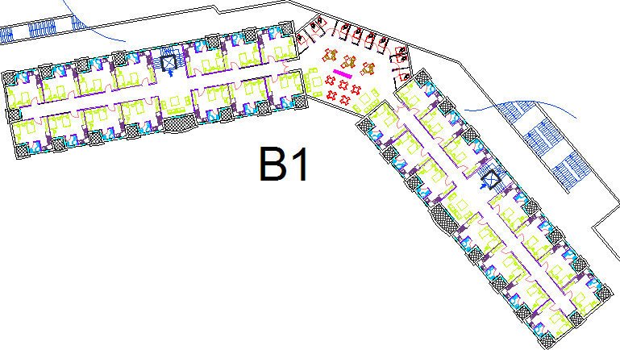
Basement {1} Floor plan:

Slide 13
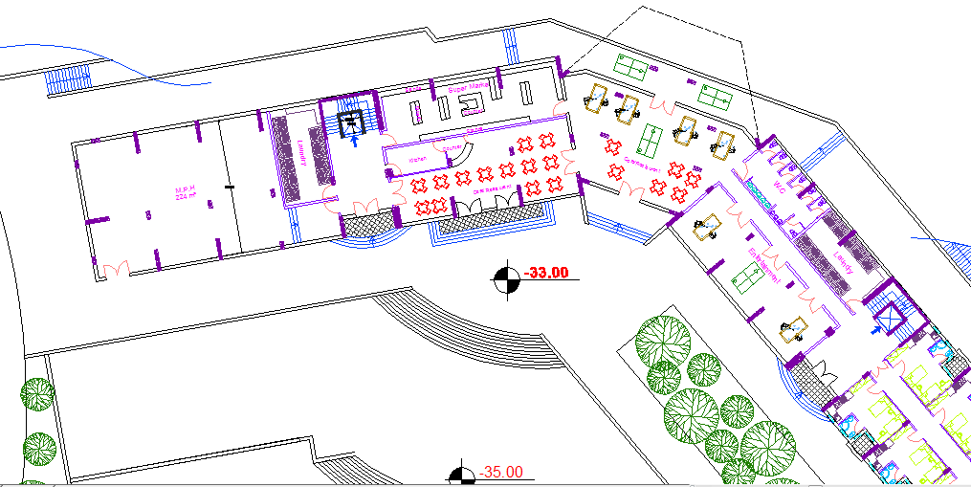
Basement {2} Floor plan:

Slide 14
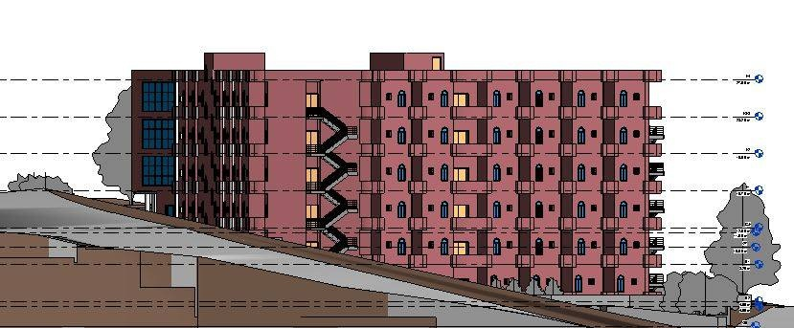
North elevation

Slide 15
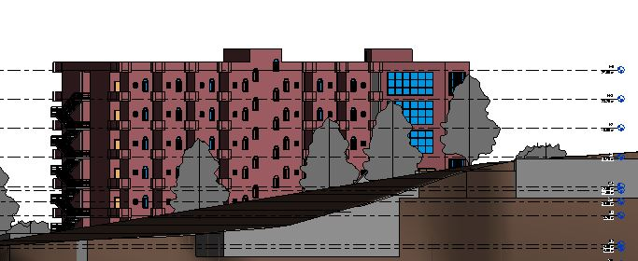
South Elevation

Slide 16
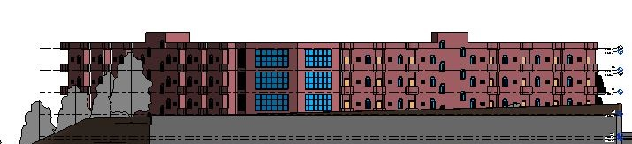
East Elevation

Slide 17
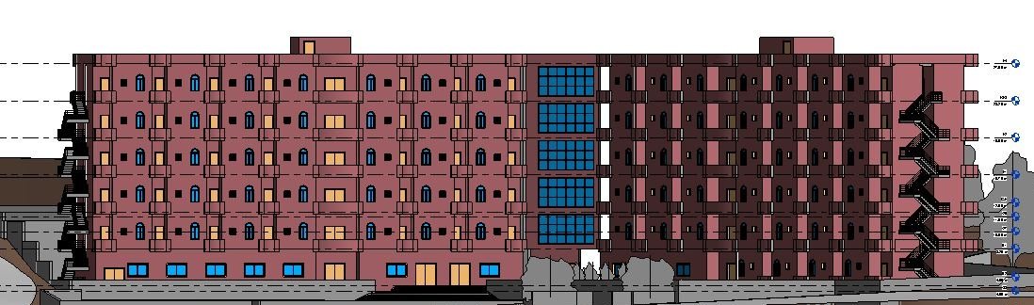
West Elevation

Slide 18
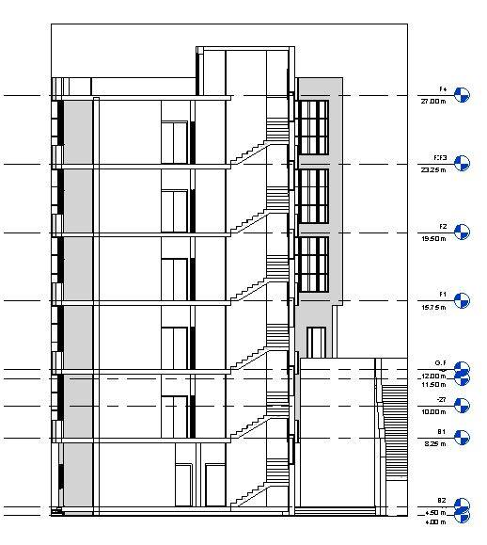
Section 1:

Slide 19
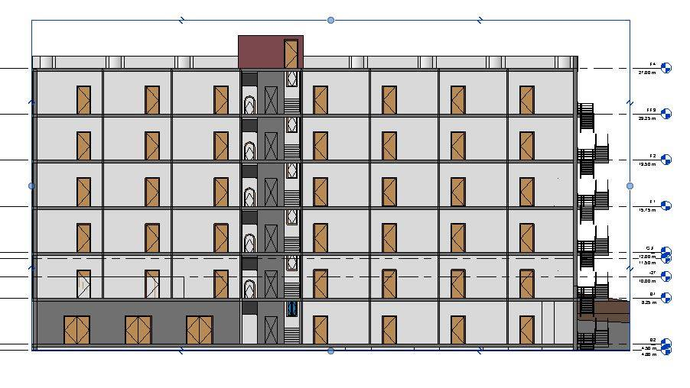
Section 2 :

Slide 20
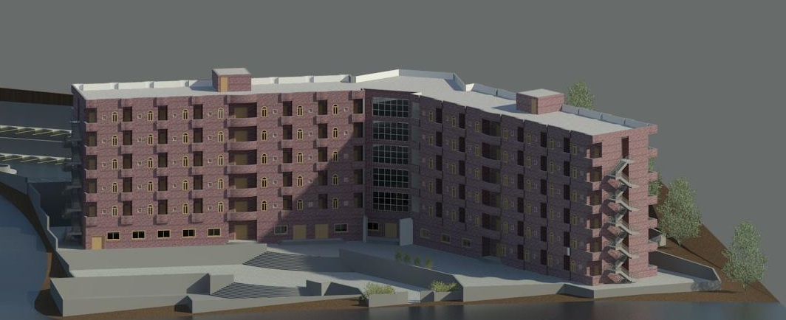
General views of the dorms :

Slide 21
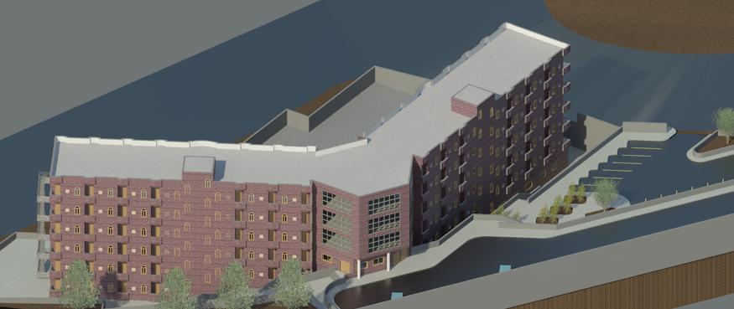

Slide 22
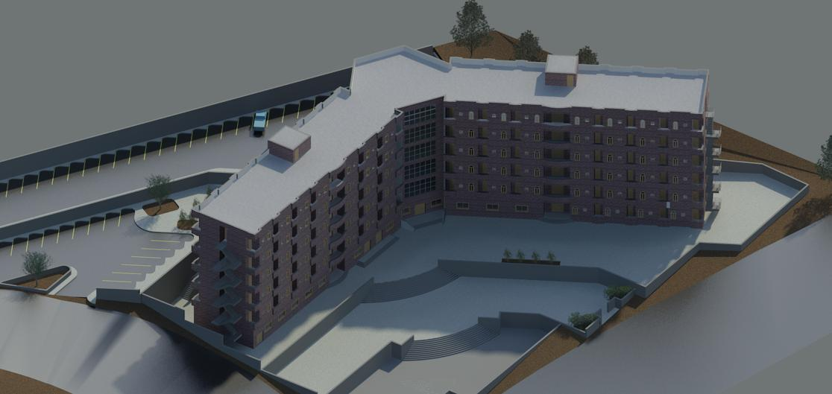

Slide 23
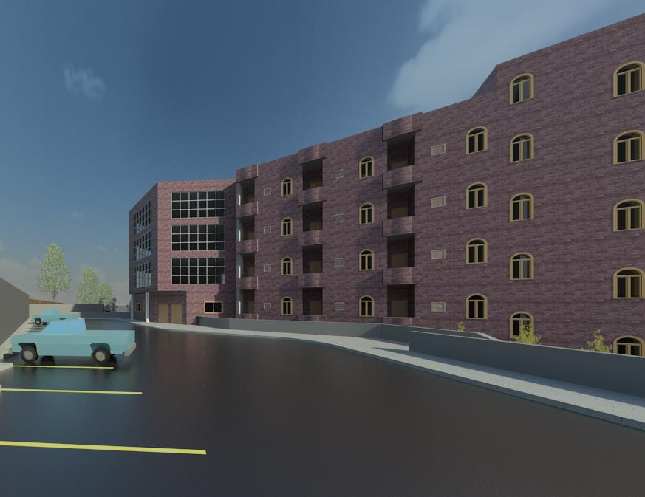
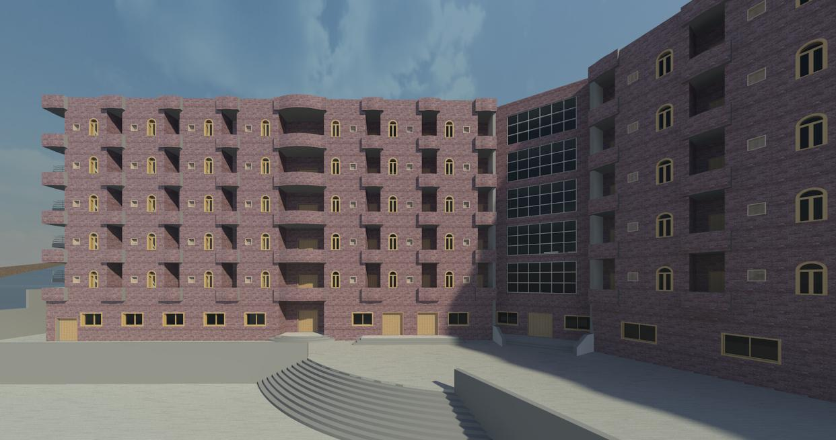
Entrances

Slide 24
Environmental Aspects

Slide 25
Environmental Aspects
Environmental Aspects
Thermal and energy.
Acoustical Analysis.
Natural lighting analysis.

Slide 26
Thermal Analysis
External wall (30cm)
Roof:
Floor:
Limestone (50 mm)
Concrete (80 mm)
Polystyrene (50 mm)
Block (100 mm)
Plaster (20 mm)
Asphalt (10 mm)
Concrete foam (40 mm)
Polyurethane (50 mm)
Concrete (200 mm)
Plaster (10 mm)
Tiles (10 mm)
Mortar (30 mm)
Sand (150 mm)
Polystyrene (50 mm)
Concrete (300 mm)
U-Value = 0.525 W/m2.k
U-Value = 0.45 W/m2.k
U-Value = 0.9 W/m2.k

Slide 27
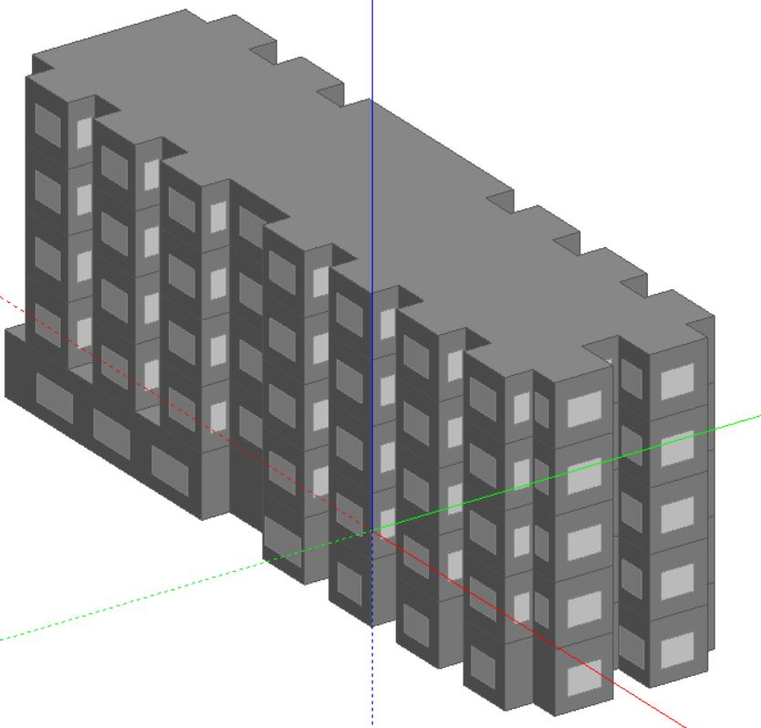
Block 1 Model from Design Builder

Slide 28
Energy simulation
the following results was calculated for one Studio
Maximum Heating Load = 1180 Watt
Maximum Cooling Load = 1320 Watt
Total Heating Load for the building = 68.5 KW
Total Cooling Load for the building = 118.4 KW

Slide 29
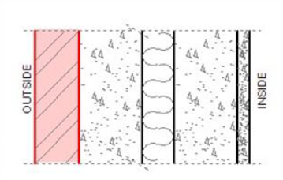
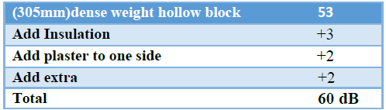
Acoustical analysis
STC for external wall:

Slide 30
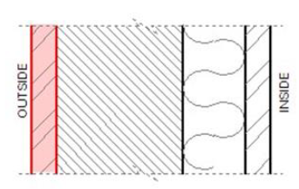
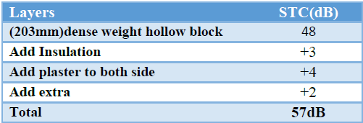
STC for partition:

Slide 31
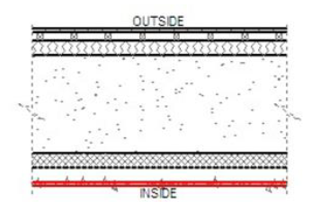
IIC of floor/ceiling = 70 dB
Studios RT60 = 0.6 sec
RT60 in studios ranges between 0.50 to 1.20 second.
Reading Area RT60 = 0.65 sec
The RT60 in reading area is in standard range (0.50-1.0) sec.

Slide 32
Natural Lighting
  Daylight factor for some of the main spaces:
DF % | Room
4.13 | studios
3.91 | Reading rooms
4.41 | cafeteria
4.04 | entertainment
3.85 | Internal Space
2.70 | Laundry
4.15 | Average

Slide 33
Structural Design

Slide 34
Design Data:
Concrete Fʹc = 24 MPa for slabs.
Concrete Fʹc = 28 MPa for beams, columns, and footings.
Allowable Bearing Capacity of Soil = 300 kN/m²
Loads:
Super imposed load = 6.6 kN/m²
Live load = 3.5 kN/m²

Slide 35
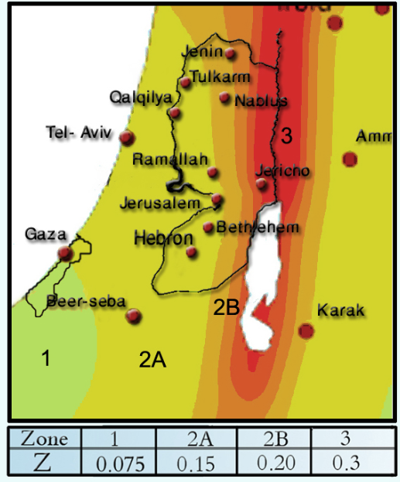
Seismic Design Data
Standard Occupancy, I = 1.0
Soil Profile Type is SD
R = 5.5 (intermediate)
Ca = 0.28
Cv= 0.4
Location → Nablus
Zone =2B → Z=0.20

Slide 36
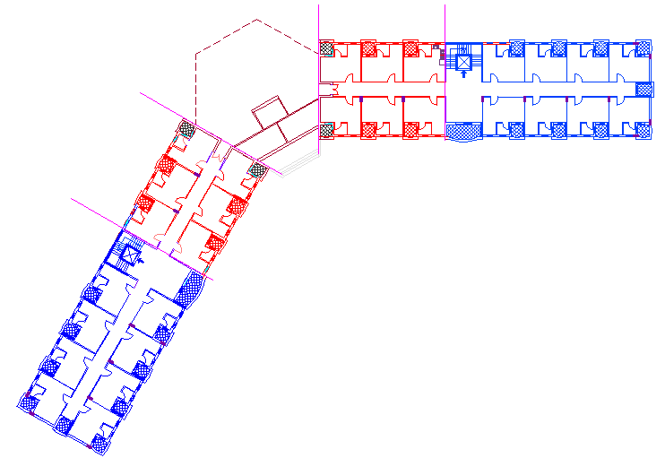
Structural plan(blocks):

Slide 37
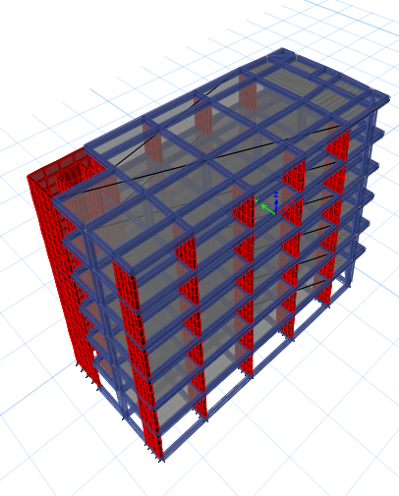
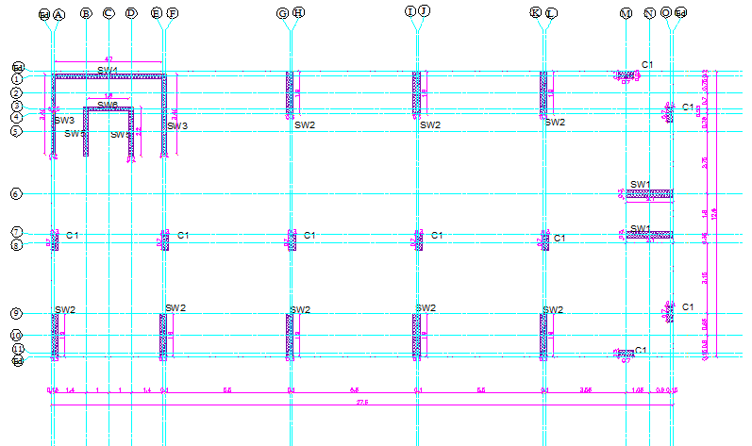
Plan of structural designed block (1)
Block 1 Model from ETABS
350m2@6floors

Slide 38
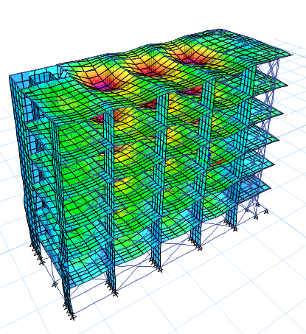
Deformed shape of the building:
The model is valid for:
1- Compatibility.
2- Equilibrium.
3- Stress & Strain relationship.
4- Drift check.
5- period check.

Slide 39
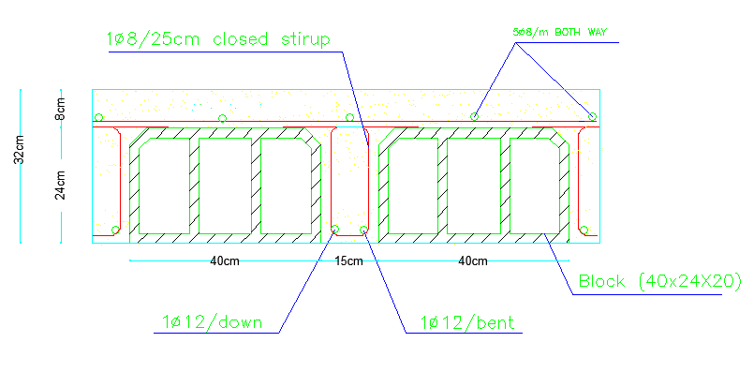
Results:
Slap Thickness= 320mm
Reinforcement:
2∅12 mm/rib
As shrinkage 5∅8 mm/m
1) Slab design:

Slide 40
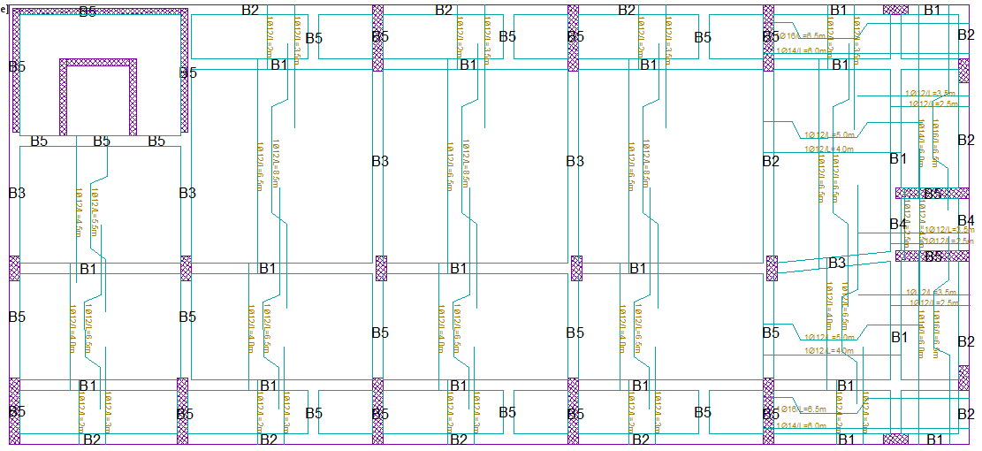
2)Beams distribution layout

Slide 41
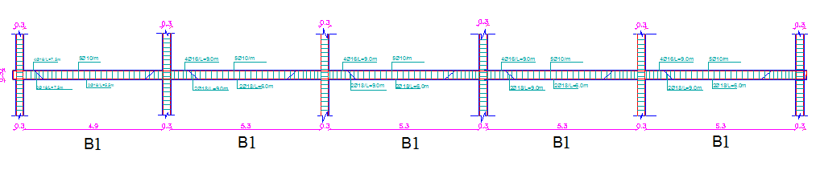
Beam design details:

Slide 42
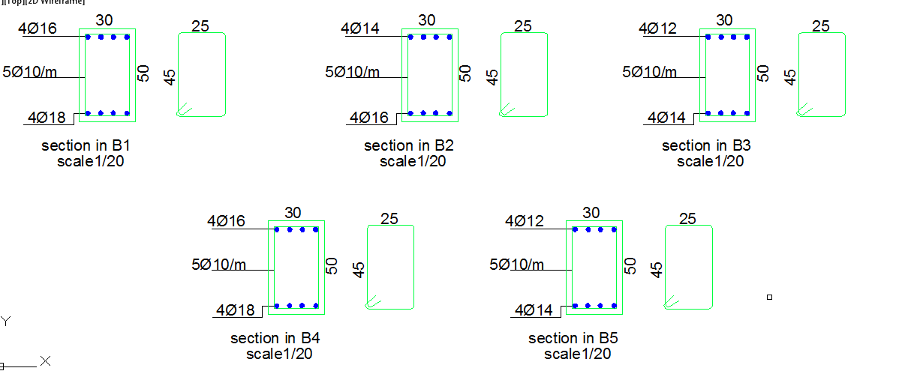
Beam design details:

Slide 43
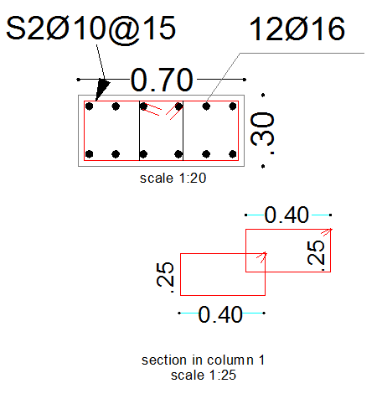
3) Column design details:

Slide 44
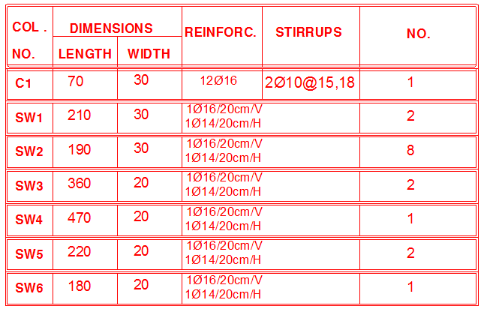

Slide 45
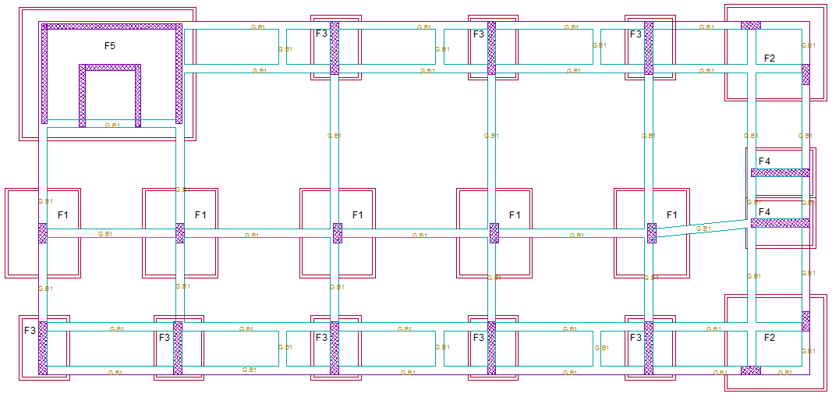
4) Footings Distribution layout

Slide 46
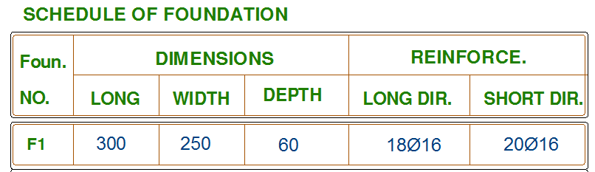
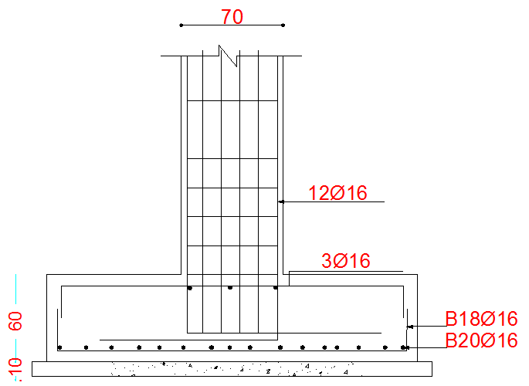
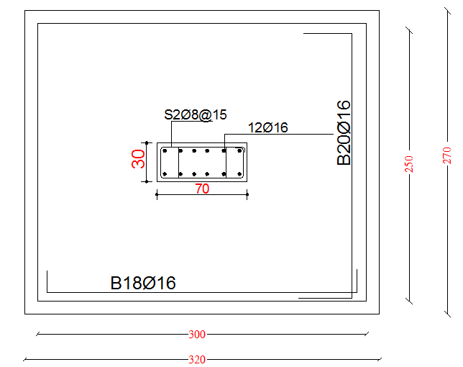
Footing (1) design details:

Slide 47
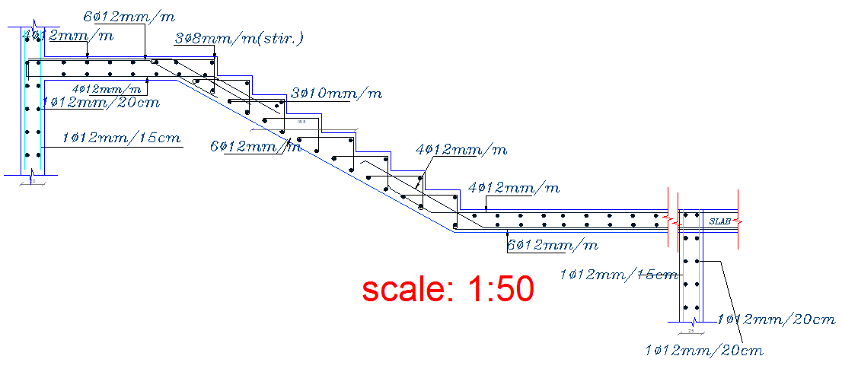
Stairs design details

Slide 48
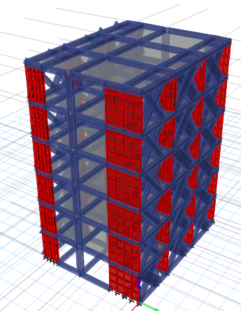
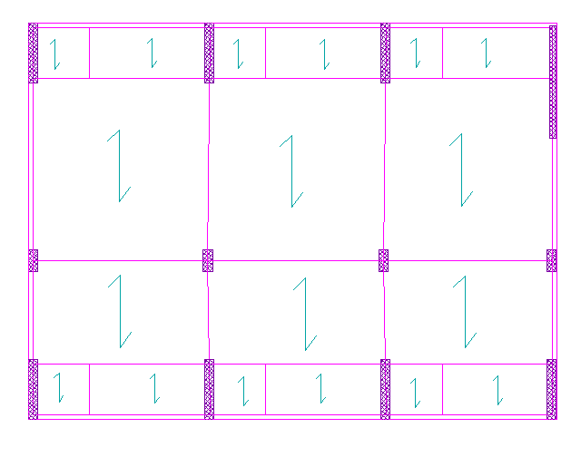
Plan of structural designed block (2)
Block 2 Model from ETABS
212 m2@6floors

Slide 49
Mechanical Aspects

Slide 50
Mechanical Aspects
HVAC system.
Water supply.
Sanitation system.
Fire resistance system
Mechanical Aspects

Slide 51
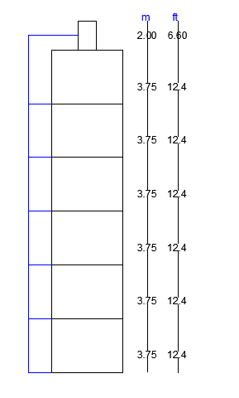
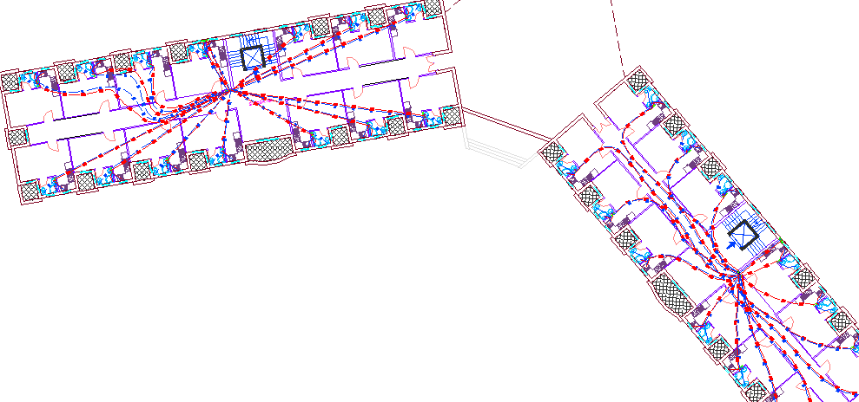
1) Water supply system

Slide 52
Water supply system
Floor/Pipe | Vertical | Horizontal | Branch
B1 | 2.5 in | 2 in | 1 in
For the second floor the piping system that will be used is as same as the system in the first floor with using 6 Psi pump. For the third floor 12 Psi will be used.
Floor/Pipe | Vertical | Horizontal | Branch
B2 | 2.5 in | 2 in | 1 in
Floor/Pipe | Vertical | Horizontal | Branch
Ground floor | 2.5 in | 2 in | 1.25 in
Floor/Pipe | Vertical | Horizontal | Branch
F1,F2,F3 | 2.5 in | 2 in | 1.25 in

Slide 53
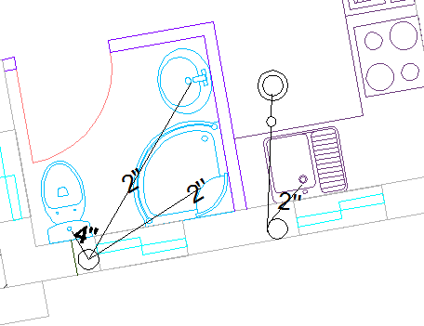
2) Sanitation system
Type of water drainage:-
1 – Black water: come from w.c, urinals, sink.
2- Gray water: water don't have a organic waste
3- Storm water: from rain fall
Each W.C represents 4Dfu.
Each Lavatory represent 1 Dfu.
Each kitchen sinks Represent 2 Dfu.
Max Total Dfu of stakes is less than 240 Dfu so use main stack 4". Use ventilation stack 4''.
The sewers for lavatory which reach to the main drainage = 2"
The sewers for kitchen sink which reach to the main drainage =2"
The sewers for W.C which reach to the main drainage = 4".

Slide 54
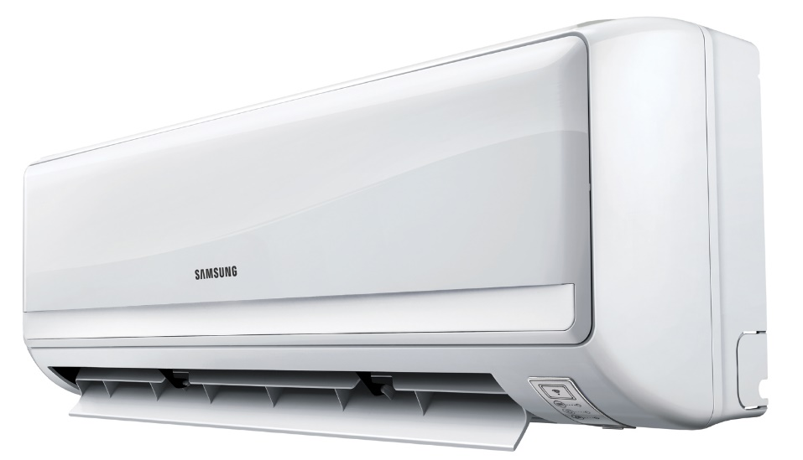
3) HVAC system design
The method of the HVAC system is VRF system, which allow for cooling and heating at the same time.
The internal unit that is used is suspended on walls unit.
Selected Indoor Unit
Type | Wall Mounted-GEN4
Cooling Capacity | 5500 BTU/hr. (1.6 KW)
Heating Capacity | 6100 BTU/hr. (1.8 KW)
Power Supply | 208-230V/ 60Hz/ 1ᶲ
Model Number | ARNUO53SBL4

Slide 55
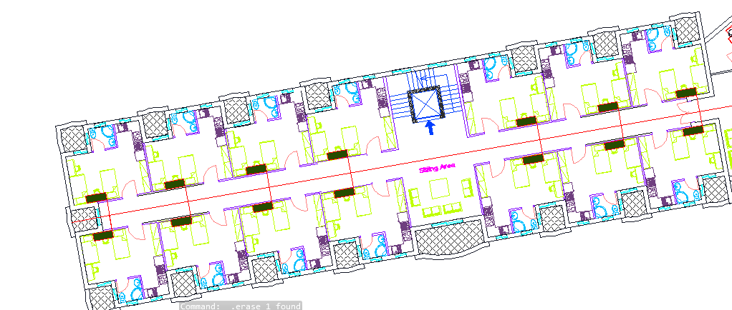
HVAC Units distribution for block.

Slide 56
4) Fire resistance systems
1. Fire extinguishers and fire blankets
2. Sprinklers
3.Detection and alarms

Slide 57
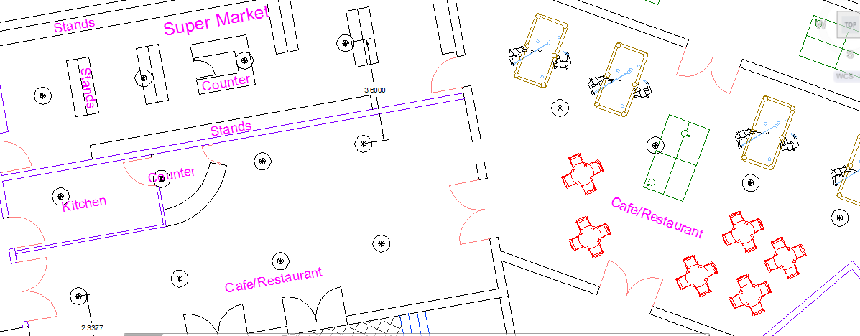
4) Sprinklers Fire resistance system
Sprinklers in the Cafeteria = 18 Sprinklers

Slide 58
Artificial Lighting

Slide 59
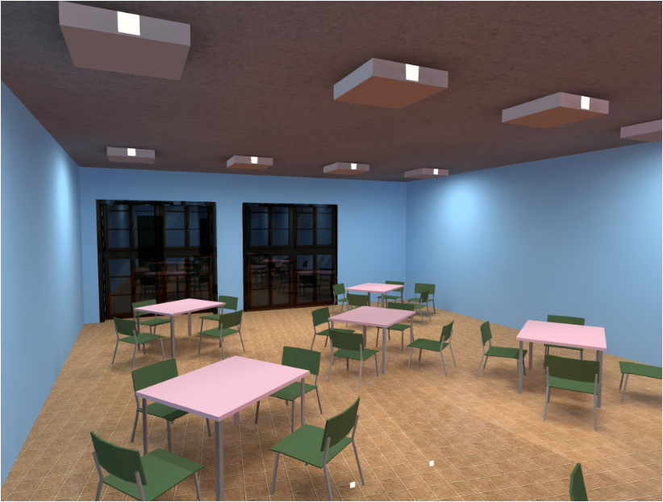
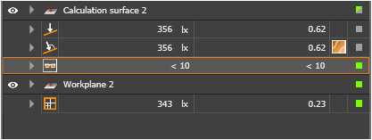
1) Cafeteria
E(avg) = 343 Lux
U = 0.62 UGR < 10

Slide 60

Cafeteria luminaire

Slide 61


2) Studios
E(avg) = 306 Lux
U = 0.66 UGR < 10

Slide 62


Slide 63

Studios luminaire

Slide 64



3) Reading Rooms
U = 0.61 Ugr < 10
E avg = 573 lux

Slide 65


Slide 66

Distribution of lights

Slide 67
Quantity survey & cost estimation

Slide 68
Quantity survey & Cost estimation
Beams and tie beams:
Item | Form work (M²) | Concrete (M³) | Steel Ton
T.B | 33.8952 | 282.46 | 4.7
B (B2) | 67.9184 | 20.37552 | 11.1
B (B1) | 67.9184 | 20.37552 | 11.1
B (G.F) | 67.9184 | 20.37552 | 11.1
B (f.1) | 67.9184 | 20.37552 | 11.1
B (f.2) | 67.9184 | 20.37552 | 11.1
B (f.3) | 67.9184 | 20.37552 | 11.1
Sub total | 414.8 | 404.7 | 71.34
Cost/ unit Nis | 25 | 300 | 2500
Total cost | 10370 | 121410 | 178350
Total cost of beams and tie beams = 178,350 NIS

Slide 69
Quantity survey & Cost estimation
Shear walls and columns:
Item | Form work (M²) | Concrete (M³) | Steel TON
Columns | 1198 | 165.2 | 2.274
Shear Walls | 3112 | 388.92 | 1.695
Sub total | 4310 | 554.12 | 3.969
cost / unit Nis | 50 | 300 | 2.500
Total cost | 215,500 | 166,236 | 9923
Total cost of shear walls and columns= 391,659 NIS

Slide 70
Quantity survey & Cost estimation
Slabs:
Item | Form work (M²) | Concrete (M³) | Steel Ton
Slab(B2) | 832.262 | 133.174 | 16.1
Slab(B1) | 832.262 | 133.174 | 16.1
Slab(G.F) | 832.262 | 133.174 | 16.1
Slab (f.1) | 832.262 | 133.174 | 16.1
Slab (f.2) | 832.262 | 133.174 | 16.1
Slab (f.3) | 832.262 | 133.174 | 16.1
Sub total | 4993.572 | 799.0447 | 96.6
cost / unit NIS | 25 | 300 | 2500
Total cost | 124839.3 | 239713.2 | 241500
Total cost of slab = 606,052 NIS

Slide 71
Quantity survey & Cost estimation
Footings:
Item | Steel Ton | Excavation (M³) | Concrete (M³) | Backfilling (M³) | Disposal (M³) | Formwork (M²)
Footing | 8.12 | 435.1 | 277 | 192.5 | 544.3 | 347.6
cost / unit NIS | 2500 | 25 | 300 | 15 | 5 | 25
Total cost | 40600 | 10875 | 83100 | 2887 | 2722 | 8675
Total cost of footing = 148,859 NIS

Slide 72
Quantity survey & Cost estimation
Finishing work:
Item | Quantity | Unit | cost / unit Nis | Total cost
Plastering | 7088 | (M²) | 16 | 113408
Painting | 7088 | (M²) | 17 | 120496
Tiling | 4296 | (M²) | 50 | 214800
Doors | 368 | (M²) | 600 | 220800
Stone | 3162 | (M²) | 110 | 347820
Mortar | 7088 | (M²) | 20 | 141760
Internal walls | 1000 | (M²) | 25 | 25000
Glass | 108 | (M²) | 800 | 86400
 |  |  |  | 1270484
Total cost of Finishing works = 1,270,484 NIS

Slide 73
Quantity survey & cost estimation
Final quantity & cost for the block:
item | quantity | unit | cost/Nis | total cost
Concrete | 2035 | CM³ | 300 | 610500
Steel | 180.029 | Ton | 2500 | 450072.5
Excavation | 435.1 | CM | 25 | 10877.5
Disposal | 544.3 | CM | 5 | 2721.5
Backfilling | 192.5 | CM | 15 | 2887.5
Formworks | 10066 | SM | 20 | 201320

Slide 74
Quantity survey & cost estimation
Final cost :
The total cost of the whole project without finishes = 6,391,895 NIS ( 1,229,210 JD).
Area of the building = 7800 m2
1650 NIS \ m2 = 320 JD \ m2
The total cost of the whole project with finishes = 12,744,315 NIS (2,450,829 JD).

Slide 75


