Slide 1

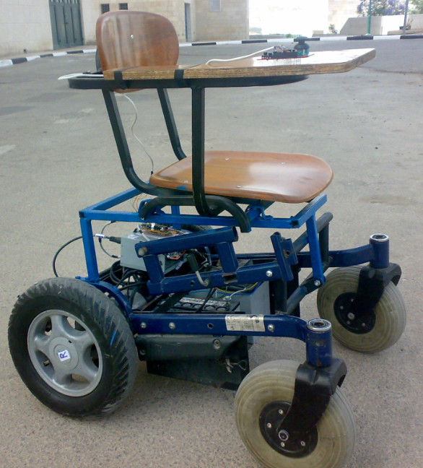
An-Najah National University
Electrical Engineering Department
Electric Wheel Chair
Prepared by :
Hazem Saleh
Jehad joma’a
Supervisor : Dr. Samer Mayaleh

Slide 2
Contents
Introduction
Project description
Mechanical structure
Dynamics calculations
Motor selection
Transmission option
Motor control
Battery and charger
Future improvement

Slide 3

Introduction
In this project we design and
build an electrical wheel chair
trying to help the special
needs segment , and provide
them electric chairs which
are highly performance with
low price compared with those in the local market .

Slide 4


Cont.
A people with special needs is( 3_4)% of the total population.
And the latest statistics for the disabled have proved that there is in Palestine, the highest proportion of disability in the Middle East but in the world by population
and the reason for the high number of disabled people is the occupation that uses bombs and missiles banned international and train soldiers on kill Palestinian , or you must shoot in his place cause paralysis until a permanent disability, we find that most of the injuries of the spine.
http://gudp.org/ar/?action=home

Slide 5
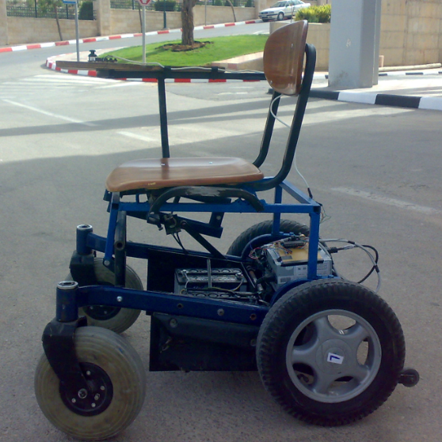
Project describtion:-
As shown in figure the project consists of:
Two motors.
Four wheels.
Simple structure chair.
Battery.
Microcontroller circuits.
Control unit (push buttons,
joystick…)

Slide 6
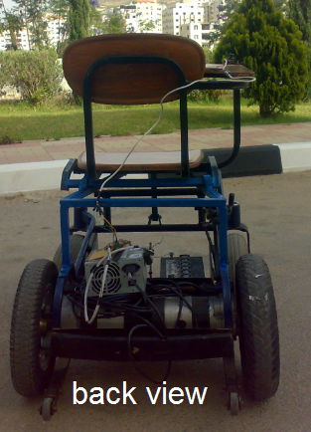
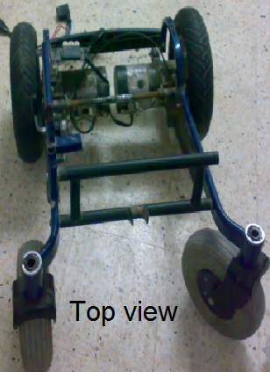
Cont.
This wheel chair should be able :
Move forward.
Move backward.
Turn right.
Turn left.

Slide 7
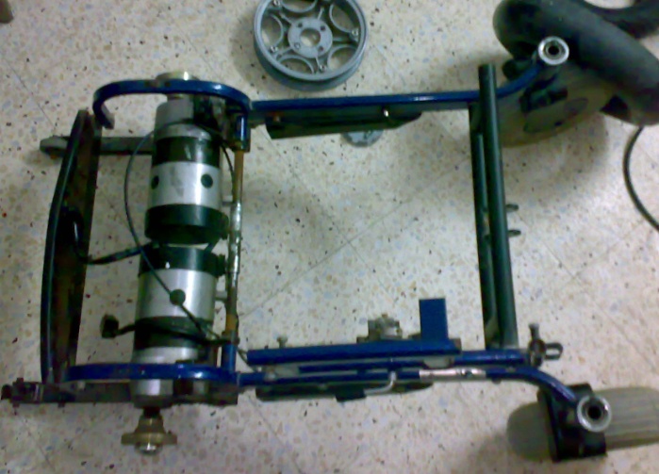
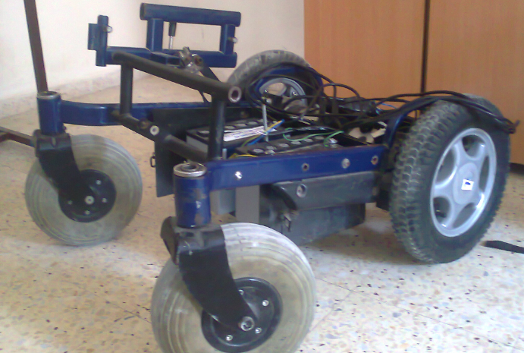
Mechanical structure
Satisfies the international std.
Satisfies the main target
Simple to implement

Slide 8
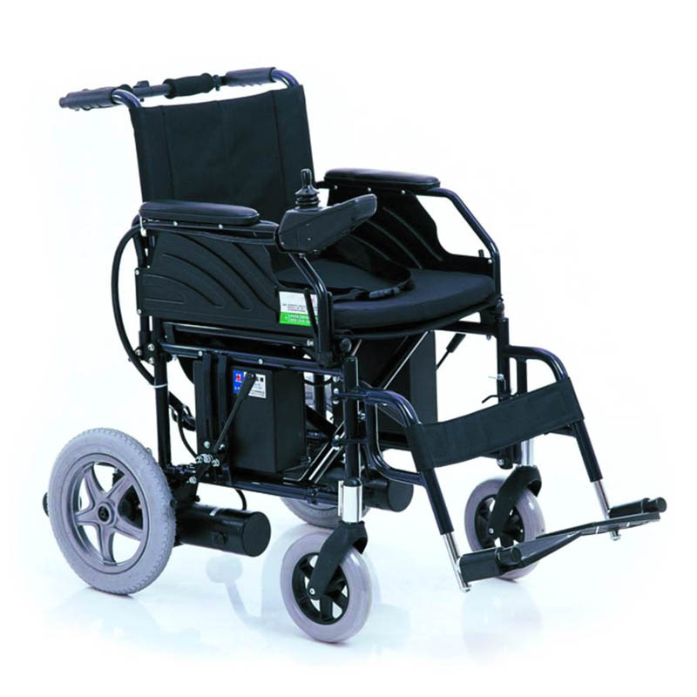
Design specifications
Weight Capacity: 165 Lbs. , 75 kg
Maximum Speed: flat surface 6 MPH, 9.5 kmh, : incline sufrace 4 MPH, 6.4 kmh
Turning Radius: 33'' , 83.8 cm
Ground Clearance: 4.5" , 11.4 cm
Range of Travel: 25 miles per charge , 40.25 km
seat Width 18", 20" / 45.7 cm , 50.8 cm
Seat Length 16’’ / 40.6
Seat Depths : 16" , 40.6 cm
Seat-to-Floor Height 19.5" / 49.5
Backrest Height 17.5’’ / 44.5
Overall Length: 41" , 104.1 cm
Overall Width: 23.5" to 27.5" , 59.7 cm to 69.9 cm
Overall height : 36.5 , 93 cm
Wheels: 12.5' , 31.8 cm" Drive /8' , 20.3 cm" Caster
Heaviest Piece: 100 Lbs ,45 kg

Slide 9
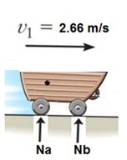
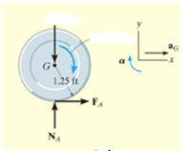
Dynamics calculations
On a flat area:-
V=6 mph V=9.6km/h
Tm = 18.3 N.m
Pe = 460 watt.

Slide 10
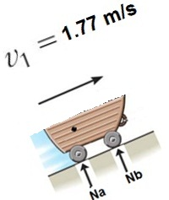
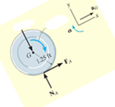
Dynamics calculations
On an incline area
V = 4 mph , V = 6.4km .
Tm = 33.6 N.m
Pe = 450 watt .

Slide 11
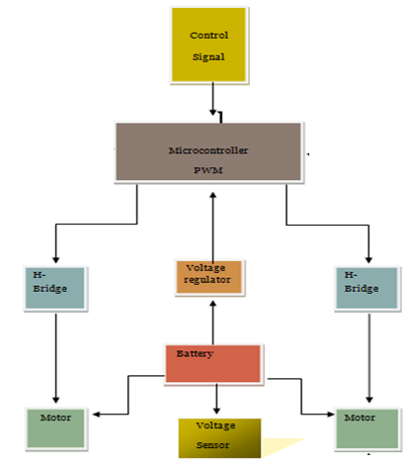
Project block diagram:

Slide 12
The Electrical Element Required:
Two DC permanent magnet motors.
Two Batteries 12V,26A
Voltage regulators.
Microcontroller.
the joystick
Optocouplers.
Power transistors.
Relays

Slide 13
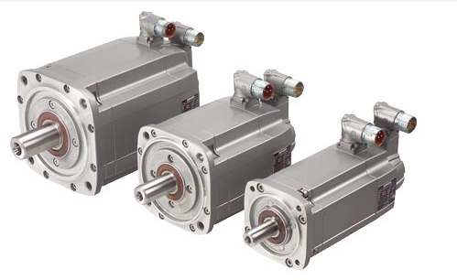
Guiding factors for motor selection can be classified into four main categories as follows:
Electrical Considerations: starting and running characteristics, speed control
and braking requirements.
Mechanical Considerations: type of enclosure, bearings, cooling, noise level and method of transmission.
Size and Ratings: requirement for
continuous or variable load
cycle and overload capacity.
Cost: capital and running costs.

Slide 14
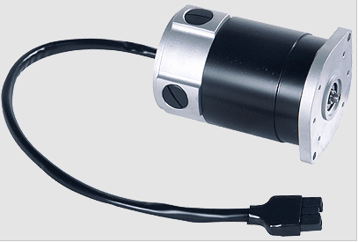
Motor selection: Electric Motor GP 90
AMT electrical motors are DC permanent magnet motors.
high degree of efficiency (up to 88%) and by low operating noise (45dB)
Motors can be run for a short time up to four times their rated torque.
rated power from 350 Watt to 550 Watt
2 poles.
rated speed from 1500 to 4000 rpm(revolutions/minute)
Operating voltage 24V.
Outfitting with electromagnetic brakes possible.

Slide 15
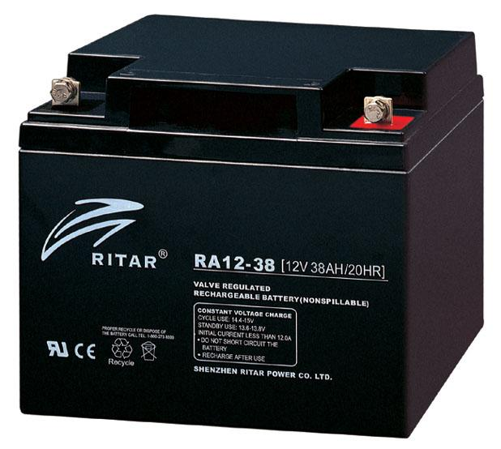
Battery
(2×26Ah) 12v dry battery
Rechargeable
Safe operation
Long life cycle

Slide 16
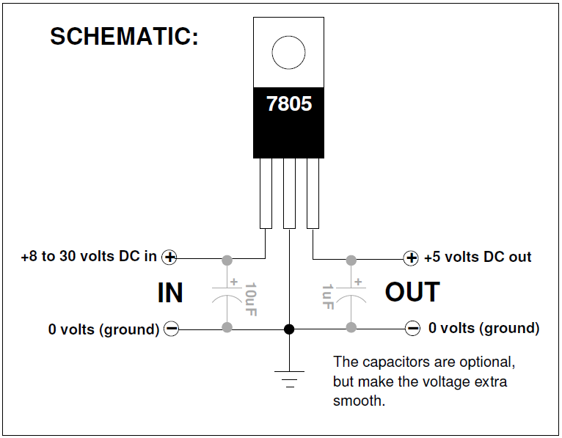
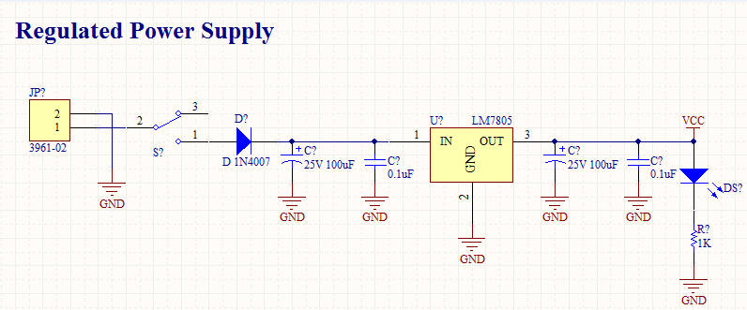
Voltage regulators:
The 7805 is a VOLTAGE REGULATOR, It looks like a transistor but it is actually an integrated circuit with 3 legs.
turn it into a nice, smooth 5 volts DC.
You need to feed it at least 8 volts and no more than 30 volts to do this.
It can handle around .5 to .75 amps, but it
gets hot. Use a heat sink.
run off of 5 volts.
It can take a higher, crappy DC voltage and
Use it to power circuits than need to use or run off of 5 volts.

Slide 17
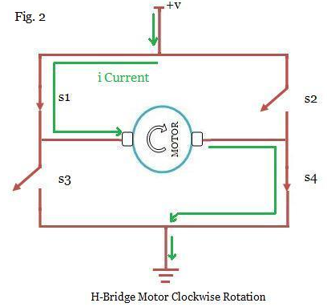
H-Bridge
An H-Bridge is a most commonly used for controlling devices like motors that requires current to flow in either direction, rather than just being turned on or off.
Simple to implement .
Easy to control
Wide range control
Forward
Reverse

Slide 18
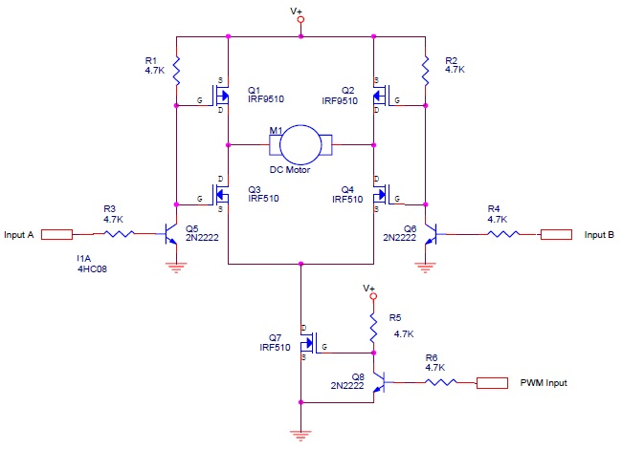
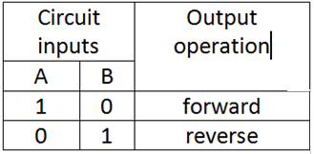
H-Bridge

Slide 19
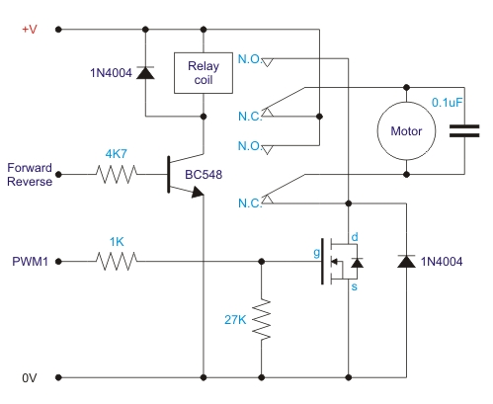
H-Bridge USING RELAYS:
We use one relay to build the h-bridge :
Available
Low cost
could do same function
high current rating

Slide 20
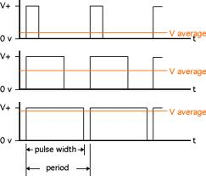

Pulse width modulation (PWM)
The presence of PWM technique enables the motors to be speed contrled .

Slide 21
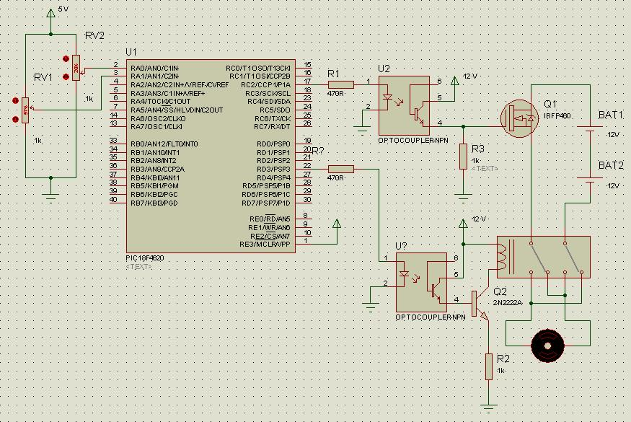
Circuit diagram

Slide 22
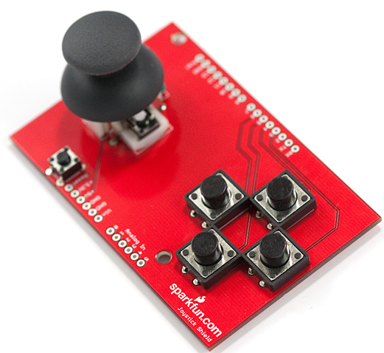
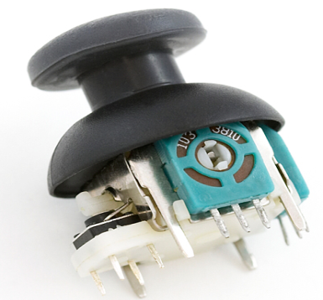
joystick:
The position of the joystick is calculated from the two potentiometers in the joystick.
The joystick can move in two dimensions which typically would represent any two dimensional quantity (X and Y ).
To read the potentiometers we use the analogRead() function(ADC).

Slide 23
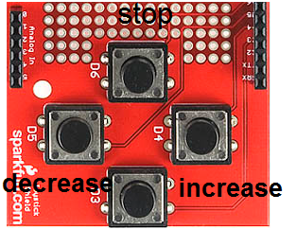
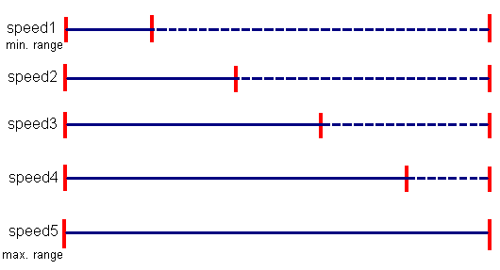
Cont.
we use 3 push buttons :
the first push button used As stop
second push button used to increase the speed
the third push button used to decrease the speed

Slide 24
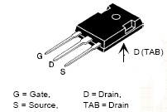

IRF P460:
Features :
Fast switching times
Low RDS(on)
Rugged polysilicon gate cell structure
High Commutating dv/dt Rating
Mosfet ratings
VDss = 500 V
ID cont = 20A
RDSon = 0.27 Ω
dv\dt = 3.5 V\ns

Slide 25
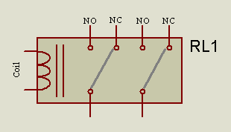
Relay
All relays operate using the same basic principle. Our example will use a commonly used 6 -pin relay.
A de-spiking diode is connected in parallel with the relay coil. in reverse biased position when the relay is turned on no current will flow through the diode. When the relay control circuit turned OFF, current stops flowing through the coil, causing the magnetic field to collapse. inducing a counter voltage

Slide 26
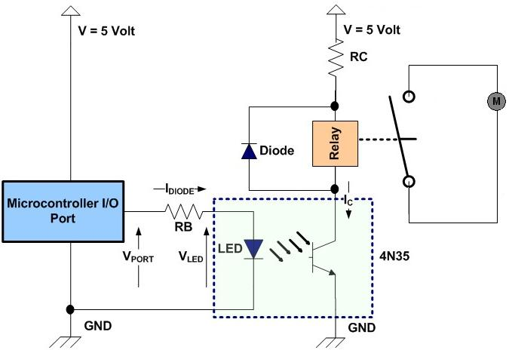
Isolating the pic I\O ports

Slide 27
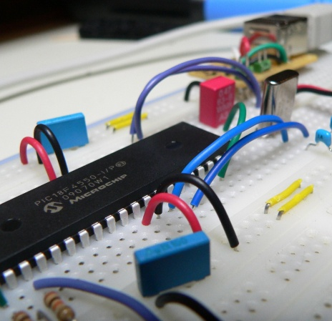
PIC18 F4620
2- ADC inputs
2-PWM outputs
3-outputs(relay)
3-interrupts (input)

Slide 28
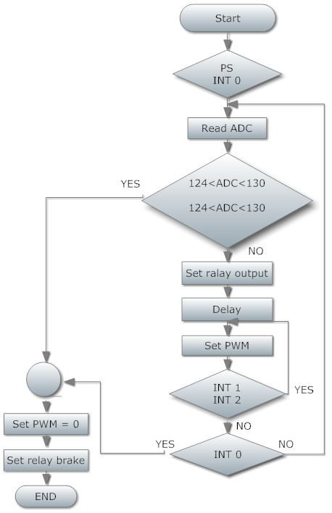

Slide 29
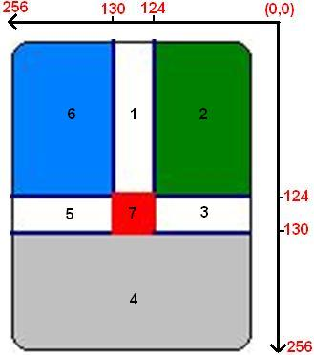
Interaction between joystick and pic
Relay status |  |  | Margin
Relay3 | Relay2 | Relay1
0 | 0 | 0 | 1
0 | 0 | 0 | 2
0 | 1 | 0 | 3
0 | 1 | 1 | 4
0 | 0 | 1 | 5
0 | 0 | 0 | 6
1 | 0 | 0 | 7

Slide 30
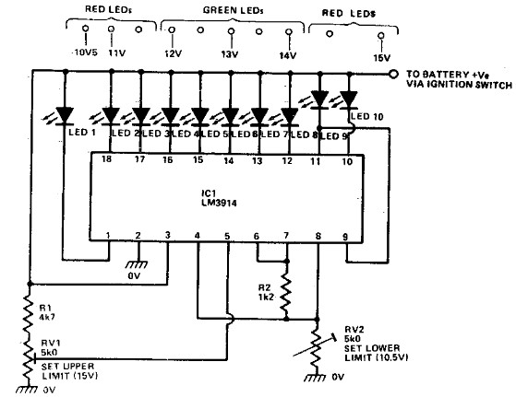
Battery level
LM 3914 Bar mode

Slide 31
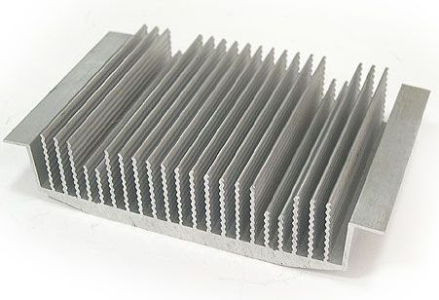
Heat sink & cooling system:
All semiconductor devices have some electrical resistance, just like resistors and coils , etc. This means that when power diodes, power transistors and power MOSFETs are switching or controlling reasonable currents, they dissipate power as heat energy, the heat must be removed to protect damaging the device .
The most common way to do this is by using a heat sink

Slide 32
Future improvement
Multi input signals
- wire less signal
- touch bad
(according to kind of disability)

Slide 33
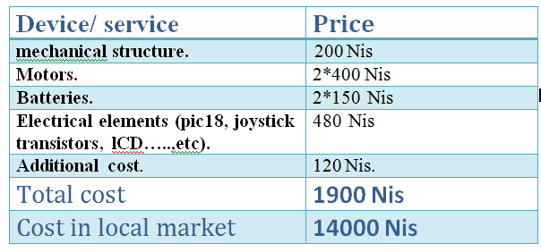
Economical STUDY:

Slide 34

Any questions?

Slide 35


