Slide 1
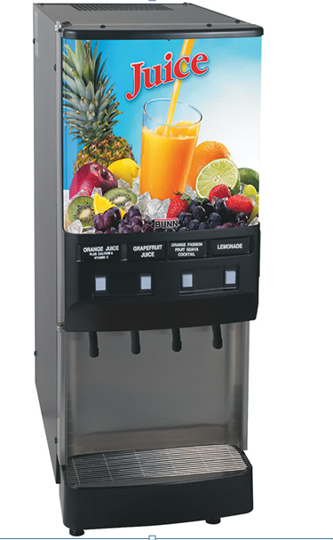
Drink Dispenser
Graduation Project2
Supervised by: Dr.bashir Alnouri.
Students : Aseel Sawaftah.
Eman Ahmad.
Shaima’ kharaz.
Notes:
Add

Slide 2
Outlines
Introduction
Background
Mechanical parts
Building the machine
Conclusion
Future work
Objectives
Components
Project1
Fluid system
Electrical parts
Work steps

Slide 3
Introduction
Background
Project 1
Objective

Slide 4
Project 1

Slide 5
Components
Mechanical
Fluid
Electrical

Slide 6
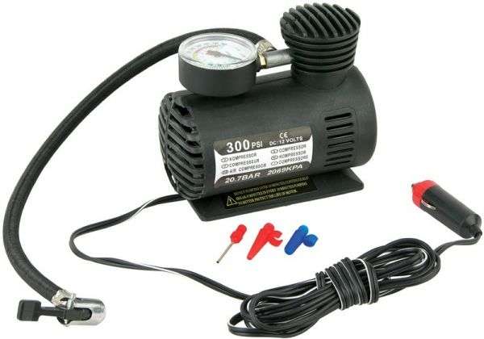
Mechanical Parts
1.
Air Compressor

Slide 7
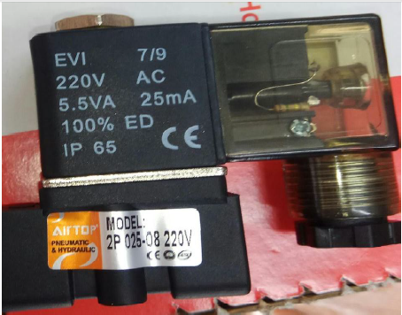
2.
Solenoid Valve

Slide 8
Fluid system parts
Nozzle
Water filter
Tubes
Manifold

Slide 9
LCD
Key-Pad
Relay
IR sensor
Pressure sensor
Electrical parts
Micro controlling

Slide 10
Work principle of IR sensor on the cup
start
IR sensor input
If ther is acup
Buzzer on

Slide 11
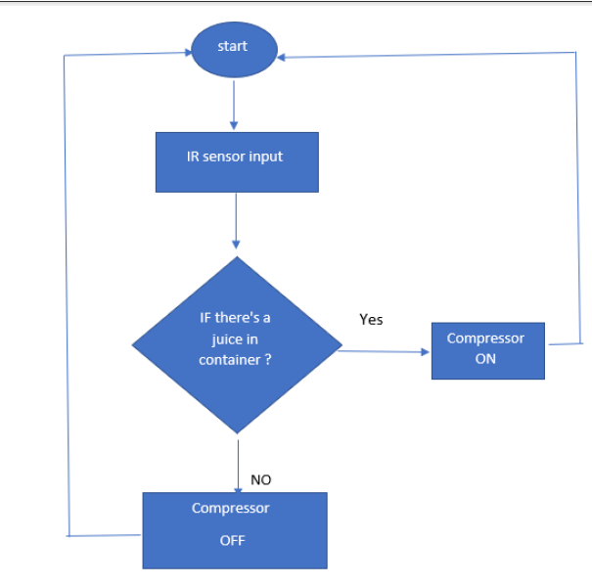
Work principle of IR sensor on the bottles

Slide 12
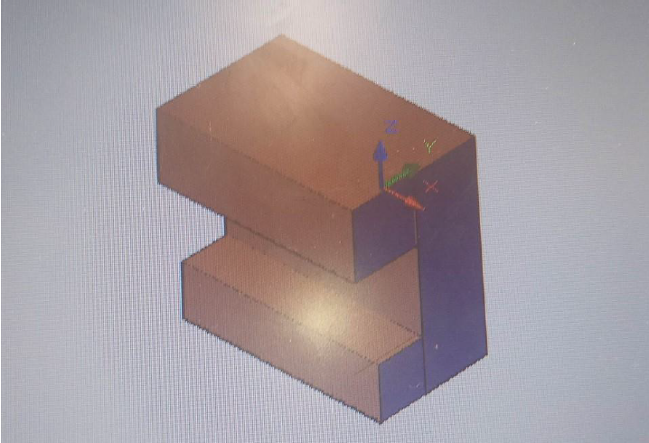
Building a Drink Dispenser Machine
1. external structure

Slide 13
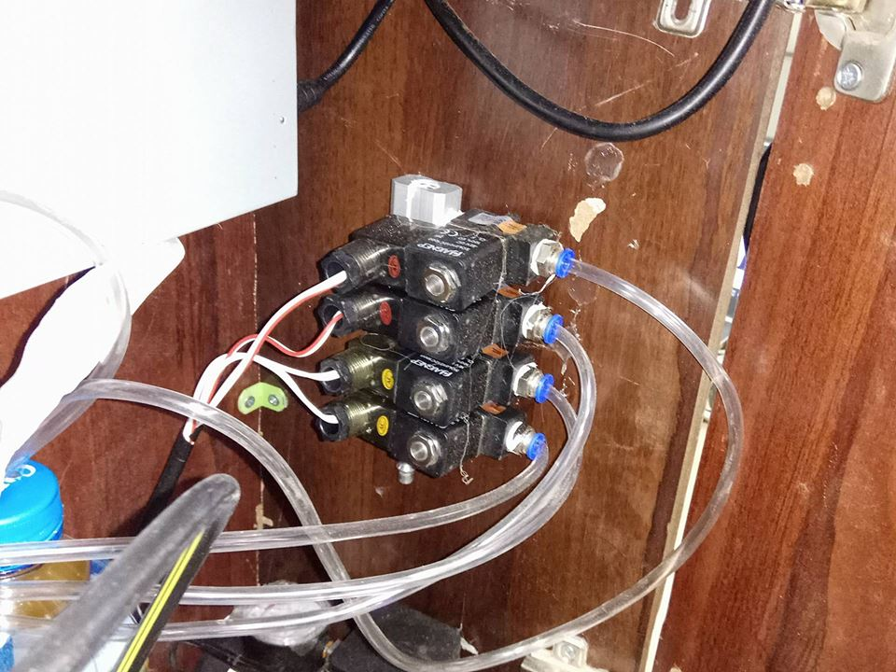
2. mechanical system

Slide 14
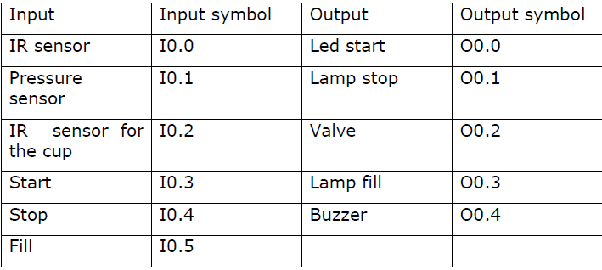
2. Control system
The ladder diagram symbols.

Slide 15
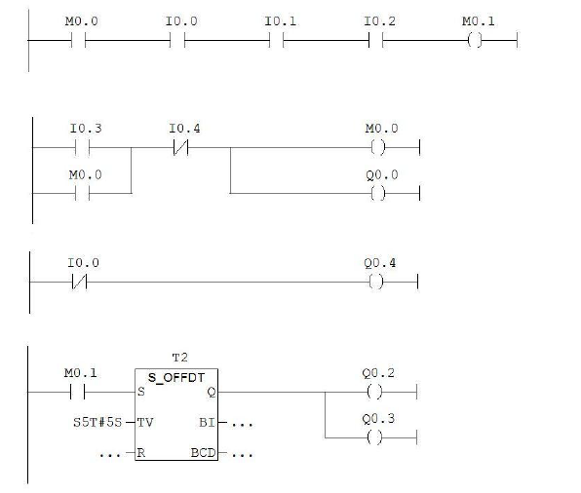
Ladder diagram for drink dispense design.

Slide 16
Conclusions
Future work

Slide 17
Thank You

