Slide 1
Smart Baby’s Cot
Prepared by: Fatimah Njwan & Bisan darawsheh
Submitted to: Dr.Haya Samaaneh.

Slide 2
Outline
Introduction.
Problem.
Solution.
Features
Hardware components.
Methodology.
Constraints.
Future Work.
Demo Time.

Slide 3

introduction
What is Smart Baby’s Cot ?

Slide 4

problem
As a parent how can I do all my work beside taking care of my baby?

Slide 5

Problem (con’t)
Parents don’t trust today’s babysitter.

Slide 6
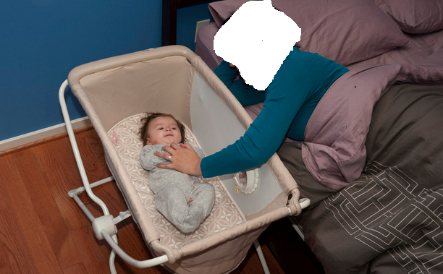
Problem (con’t)
It’s too boring to keep swinging the baby whenever he cries.

Slide 7
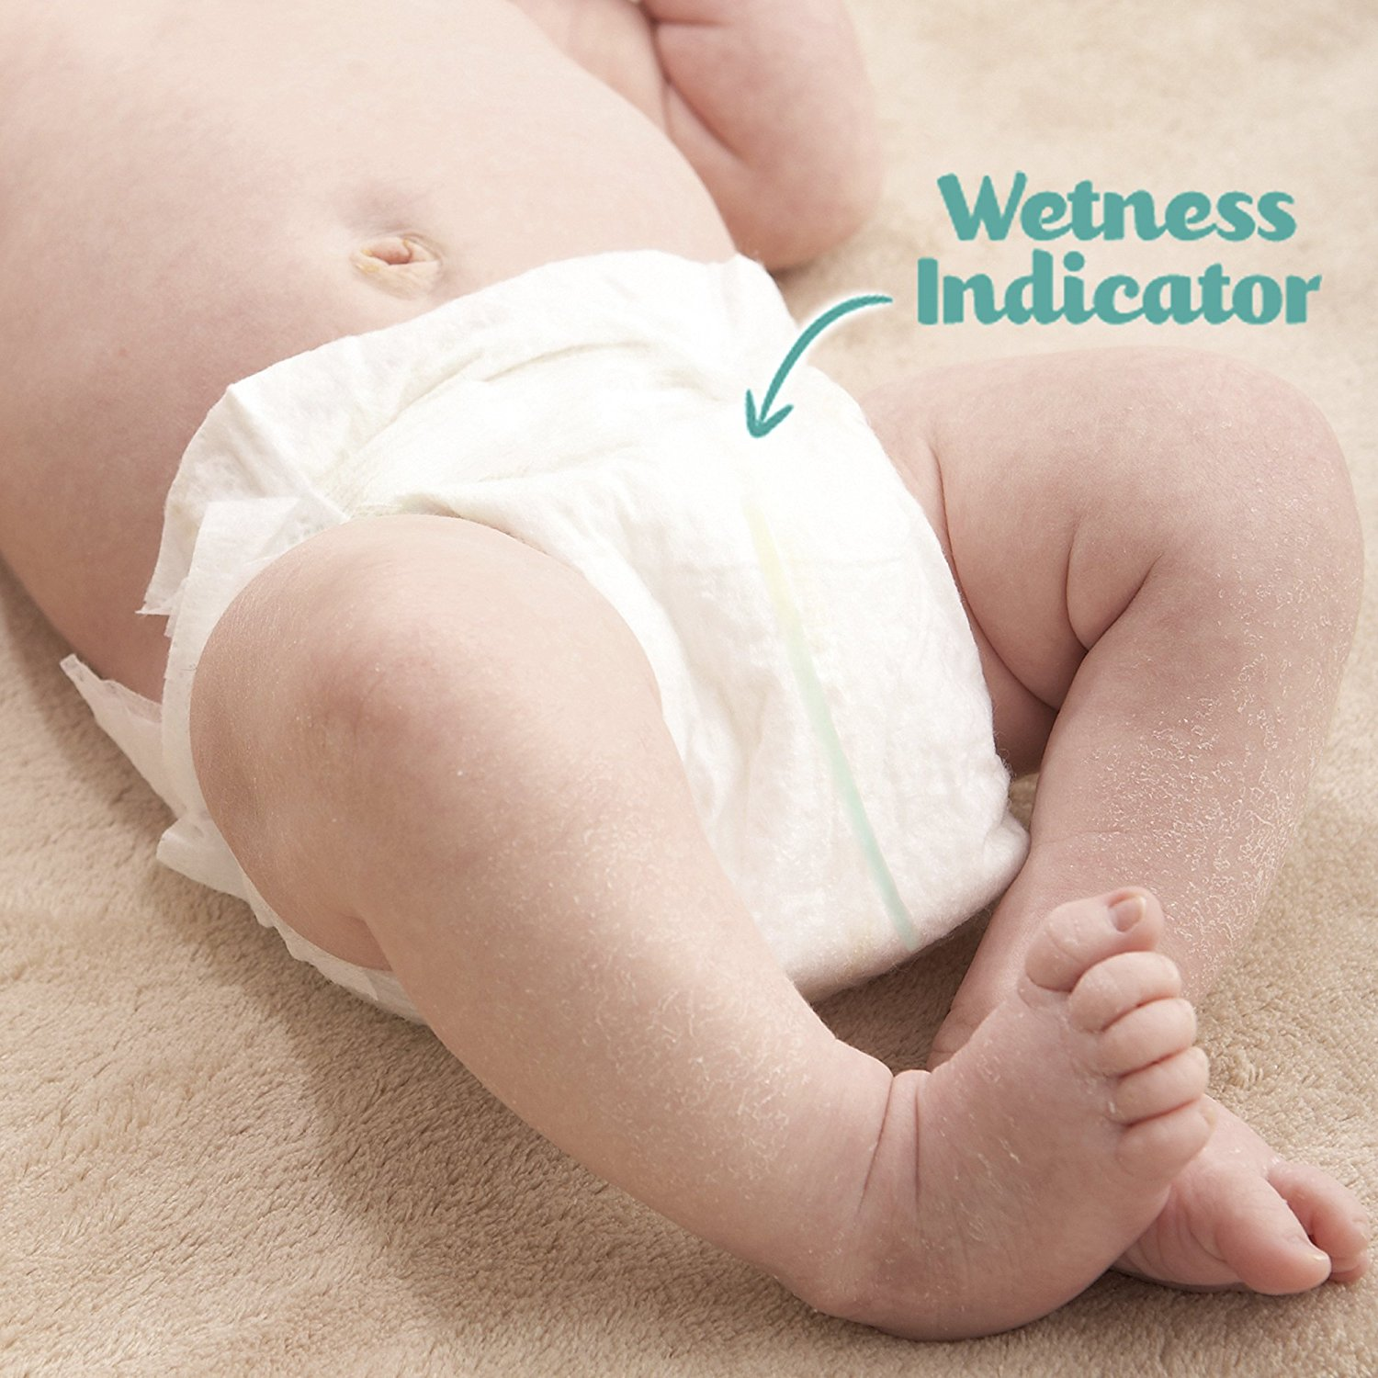
Problem (con’t)
What if there is something that detects the wetness of the baby’s diaper.

Slide 8

Find me a solution!

Slide 9
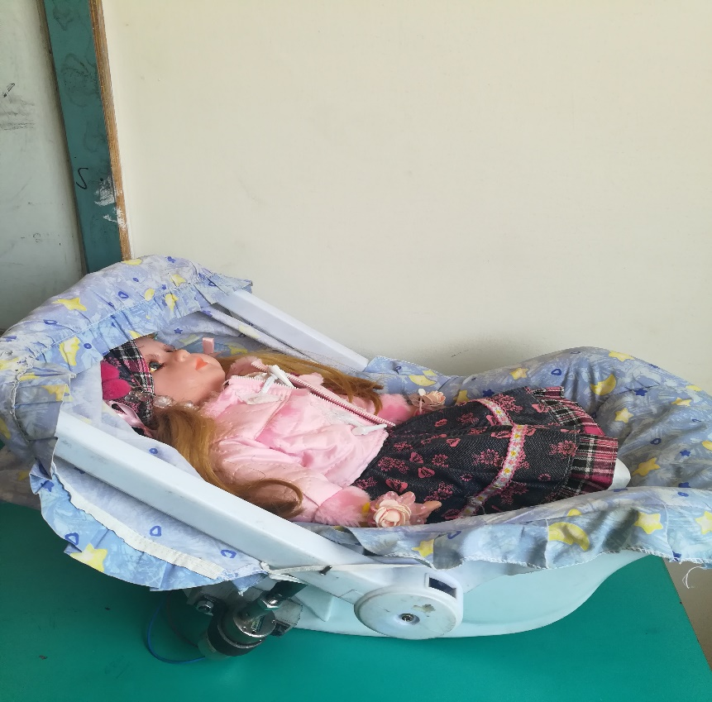
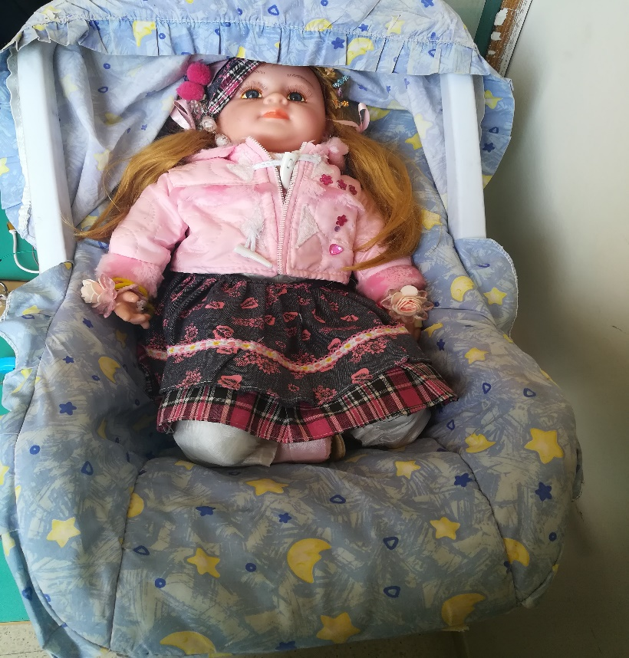
Solution!
Smart Baby’s Cot

Slide 10
Features:
Detect baby crying.
Swing the Cot automatically whenever the baby cries.
Check the baby’s diaper wetness condition.
Enable parent to send his phone number to the Cot using Bluetooth technology.
Send SMS messages that contains the wetness, still crying conditions.
Detect weather conditions.
Cover the Cot automatically based on weather conditions.

Slide 11
Hardware Components:
1. Arduino Mega2560.
2. Voice Recognition Module V3.1.
3. GSM A6_module_V3.
4. Relay module jqc-3ff-s-z.
5. DC Gear Motor.
6. H_Bridge motor driver L298N.
7. Plastic wheel.
8. Wet sensor.
9. Temperature sensor.
10. Light sensor.
11. Male-Female, Male_Male, Female_Female wires.
12. Baby's cot.
13. power supply (12v, 5v).
14. Bluetooth module HC-06.

Slide 12
Methodology

Slide 13
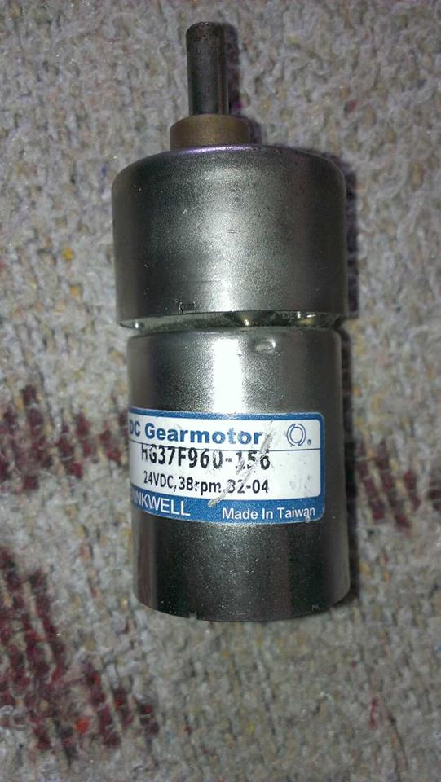
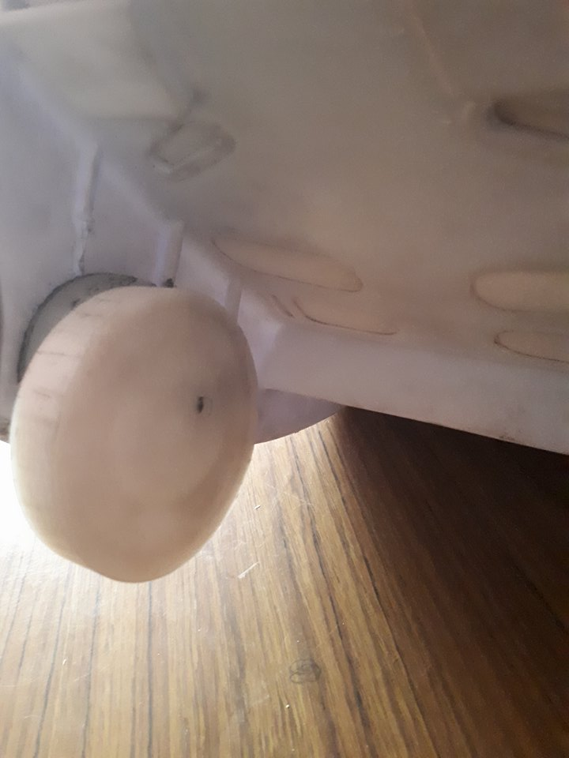
Detect baby crying and swinging feature.
+
DC Gear Motor
Plastic wheel

Slide 14
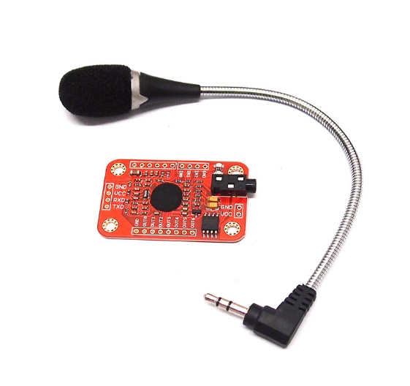
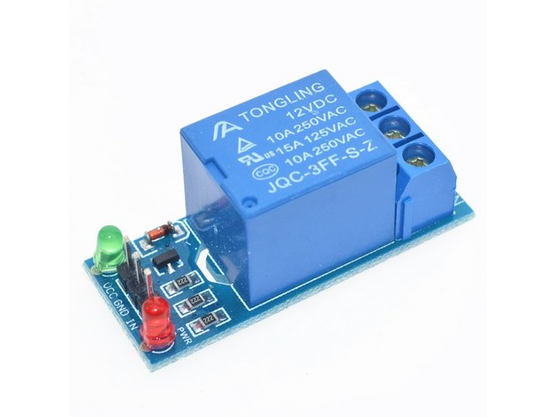
Detect baby crying and swinging feature (Con’t).
+
Voice Recognition Module
Relay Module

Slide 15
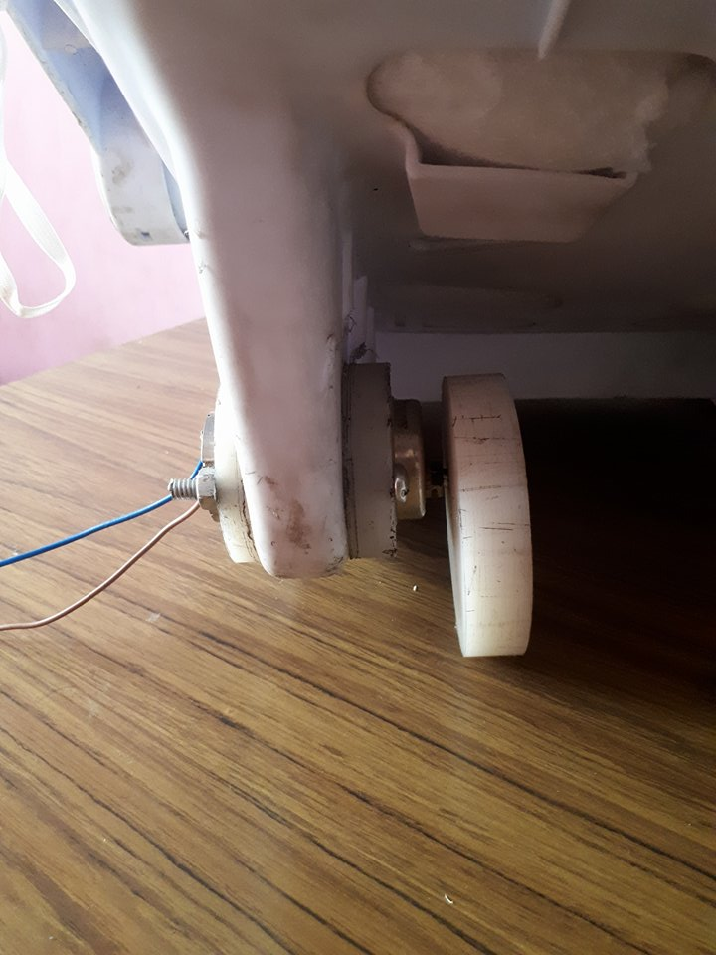
Detect baby crying and swinging feature (Con’t).

Slide 16
Detect baby crying and swinging feature (Con’t).
Demo!

Slide 17
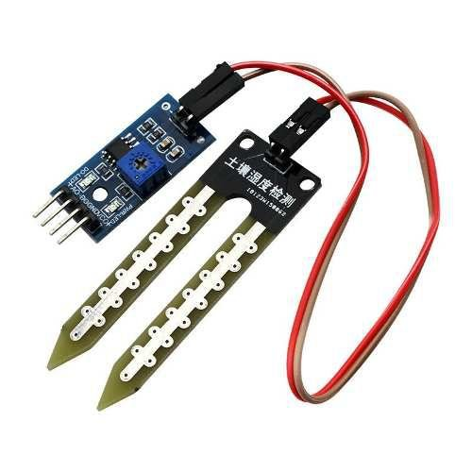
Check diaper wetness.
Wet sensor

Slide 18
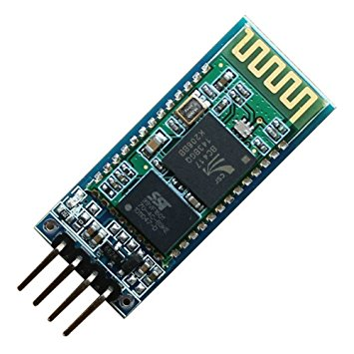
Enable parent to send his phone number to the system.
Bluetooth module.

Slide 19
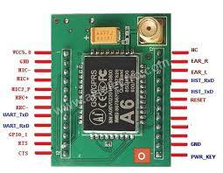


Send SMS messages.
GSM-A6 Module

Slide 20
Demo!

Slide 21
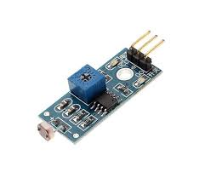
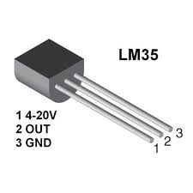
Detect weather conditions
light sensor.
temperature sensor.
Wet sensor.

Slide 22
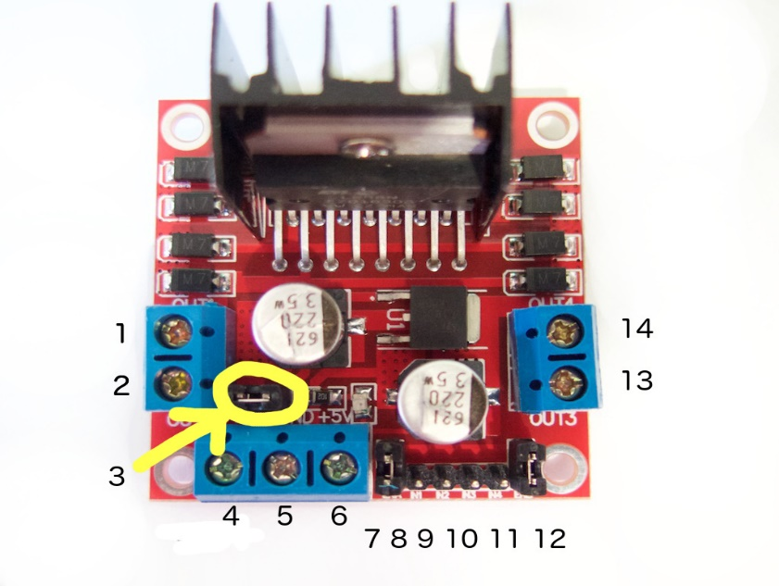
Cover the Cot automatically based on weather conditions .
DC Gear Motor
H_Bridge Driver

Slide 23
Cover the Cot automatically based on weather conditions (Con’t)
Demo!

Slide 24
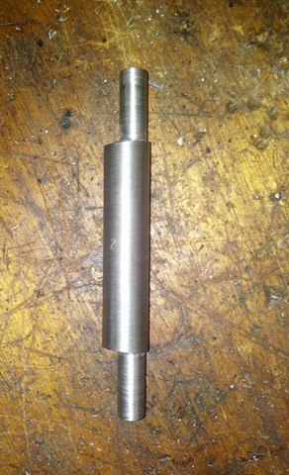
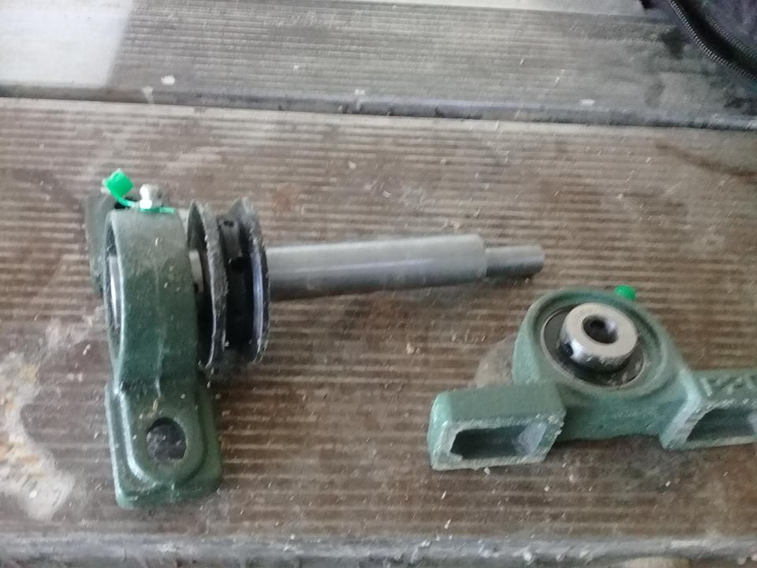
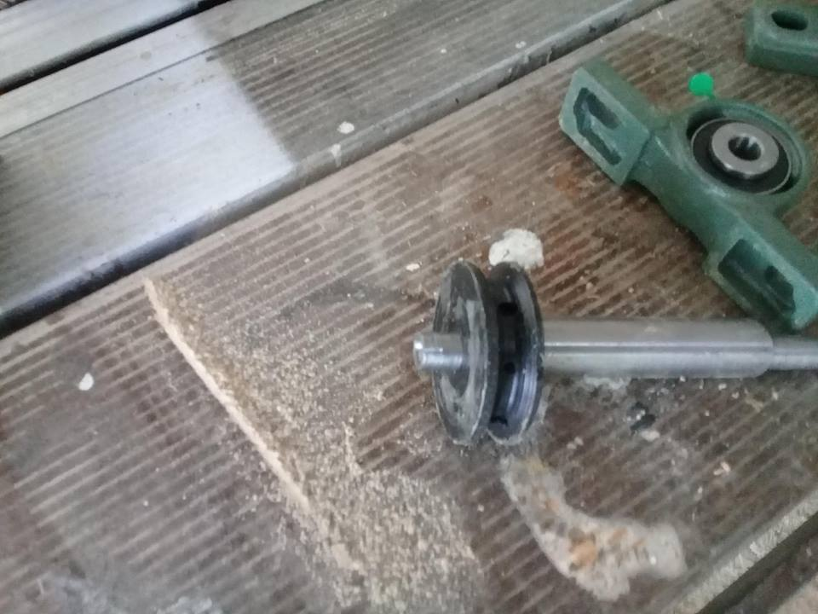
Constraints:
Axial spindle which based on decentralized movement.

Slide 25
Future work
We will :
Add camera to keep track child movement.
Add pressure sensor in order to know if the child still in its place or not

