Slide 1
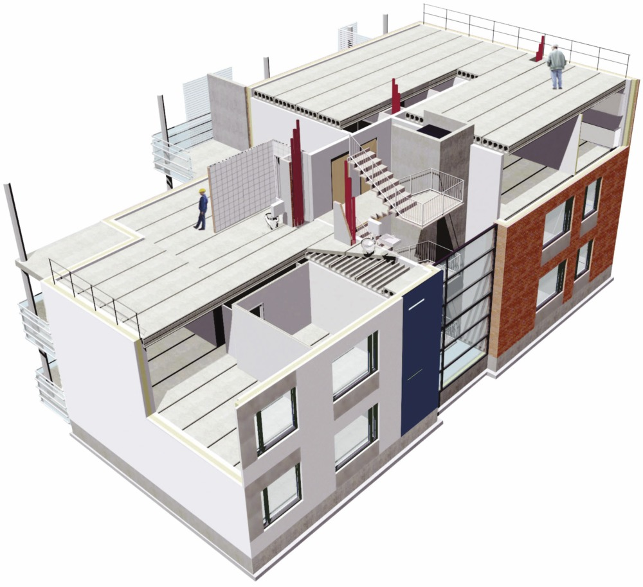
Feasibility study for precast concrete factory
Group Members :
Ashraf Al Amleh
Dalal Nabulsi
Jehad Hasiba
Lama Emad
Wala' Bostami
Supervised by:
Eng.Suleiman Daifi

Slide 2
Outline
Introduction
Problem Statement
Market Study
Technical Study
Financial Analysis
Conclusion & Recommendations
Questions

Slide 3
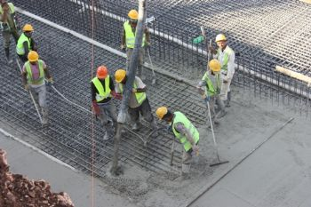
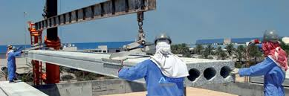
Introduction
Concrete is one of the main materials used in the construction of most buildings in the world.
There are two methods for producing concrete:
In site concrete.
Precast concrete.

Slide 4
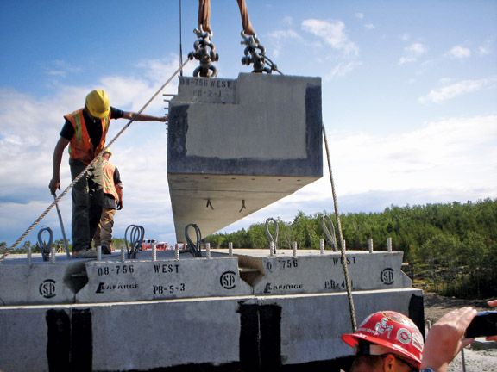
Some Advantages of Precast
Quality
Durability
Speed of construction
Design flexibility
Can be cut to suit
High margins of design safety
Reduces noise from building sites

Slide 5
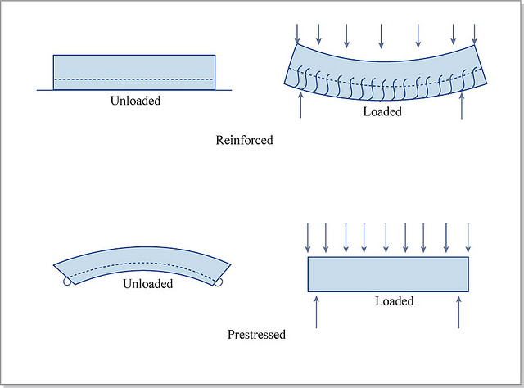
Prestressed Concrete

Slide 6
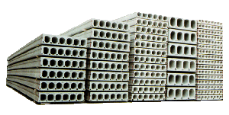
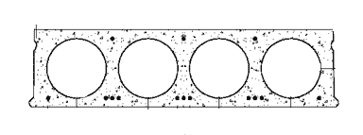
Hollow Core Slabs
Features :
1- Light Weight
2-Large spans
3-Material savings
4-Hold heavy loads
5-Sound insulation

Slide 7
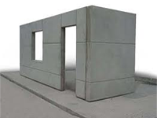
Walls & Panels
Features:
1-High level of insulation
2-Complex shapes
3-less finishing process
4- Speed in construction

Slide 8
Problem Statement
The idea of the project comes from the attributes that is characterized by precast concrete compared with in place concrete.
Widespread use of precast concrete around the world and not used in Palestine.
This project deals with undertake a feasibility study, with all of its components .

Slide 9
Feasibility Study Components
Market Study
Financial Analysis
Feasibility Study
Technical Study

Slide 10

Market Study
Market Study estimates the demand of precast concrete
products, and the market share of new products.
Market Study methodology to estimate the demand on precast concrete products:
Interviews
Questionnaires

Slide 11

Interviews
We made Conservation contractors in order to :
To observe the opinion about precast concrete
To take a general view about the engineers ability to accept this type of factory
To know the advantages of precast concrete

Slide 12
Interviews Results
Many contractors confirm the necessity of establishing a Precast Concrete
There is an appetite for this type of products, and that enhances us to continue the feasibility
Precast concert have many benefits to the society and also for customers
Most preferred area were in Ramallah as the percentage of construction is increasing there quickly

Slide 13
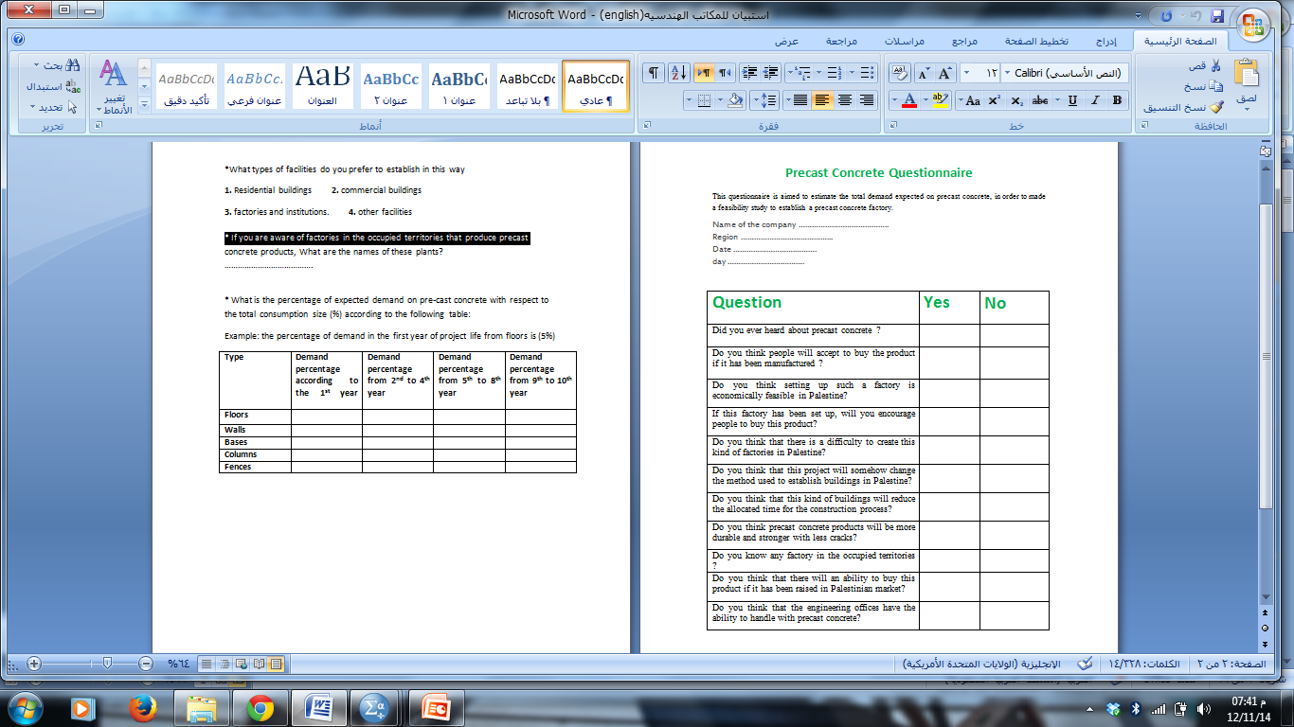
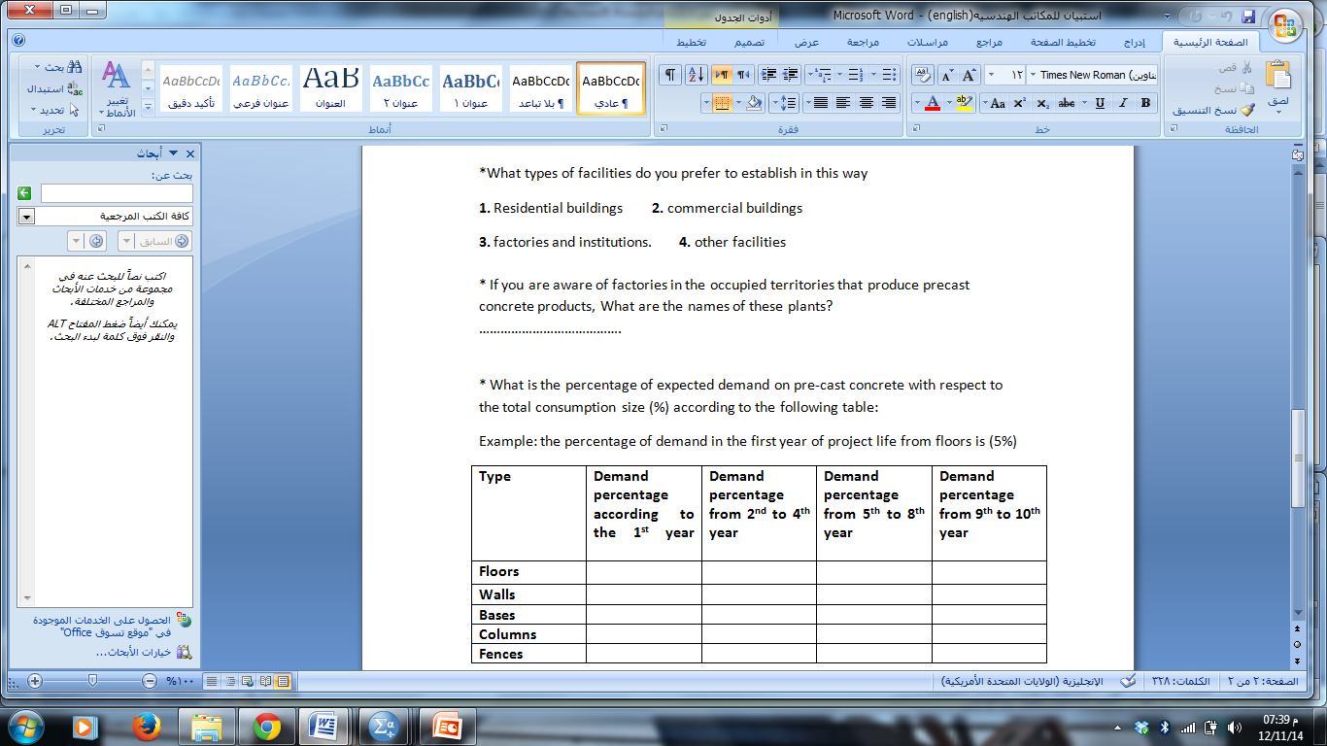
Questionnaire Form

Slide 14

SPSS Analysis
Percentage of expected areas on precast concrete with respect to the total consumption size
Type | Demand percentage according to the 1st year | Demand percentage from 2nd to 4th year | Demand percentage from 5th to 8th year | Demand percentage from 9th to 10th year
Floors | 13.27% | 21.10% | 30.85% | %41.16
Walls | 14.86% | 23.34% | 32.87% | 43.66%
Bases | 3.12% | 4.58% | 7.37% | 10.48%
Columns | 4.14% | 7.05% | 10.45% | 12.98%
Fences | 16.34% | 24.97% | 34.68% | 43.97%

Slide 15
Questionnaire Results
Noticeable acceptance of this product is shown if it is established here in Palestine.
Preferable products to be produced were walls and floors
Expected demand on precast concrete products with respect to the total consumption size

Slide 16
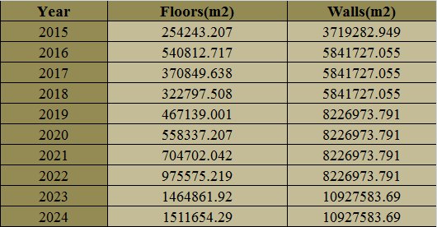
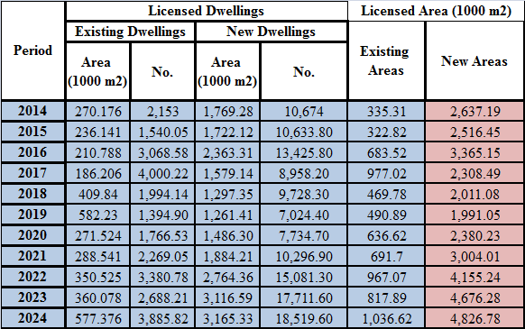
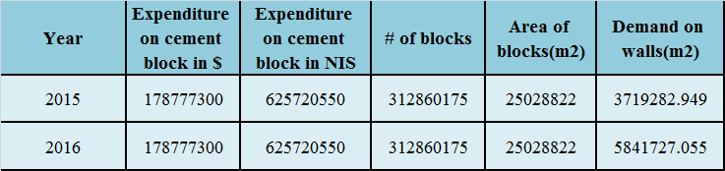
Total Expected Demand

Slide 17
Market Share
30% market share of the demand
Year | Floors | Fences | Walls
2015 | 76272.96 | 35964.42 | 1115785
2016 | 162243.8 | 69389.11 | 1752518
2017 | 111254.9 | 46299.03 | 1752518
2018 | 96839.25 | 50279.17 | 1752518
2019 | 140141.7 | 50422.1 | 2468092
2020 | 167501.2 | 55520.73 | 2468092
2021 | 211410.6 | 73912.55 | 2468092
2022 | 292672.6 | 108255.6 | 2468092
2023 | 439458.6 | 161193.2 | 3278275
2024 | 453496.3 | 168546.9 | 3278275

Slide 18
Technical Study :
Technical Study should include the following:
Floors Production
Walls Production
Plant Layout
Gantt Chart
Establishment Cost
Operational Cost

Slide 19
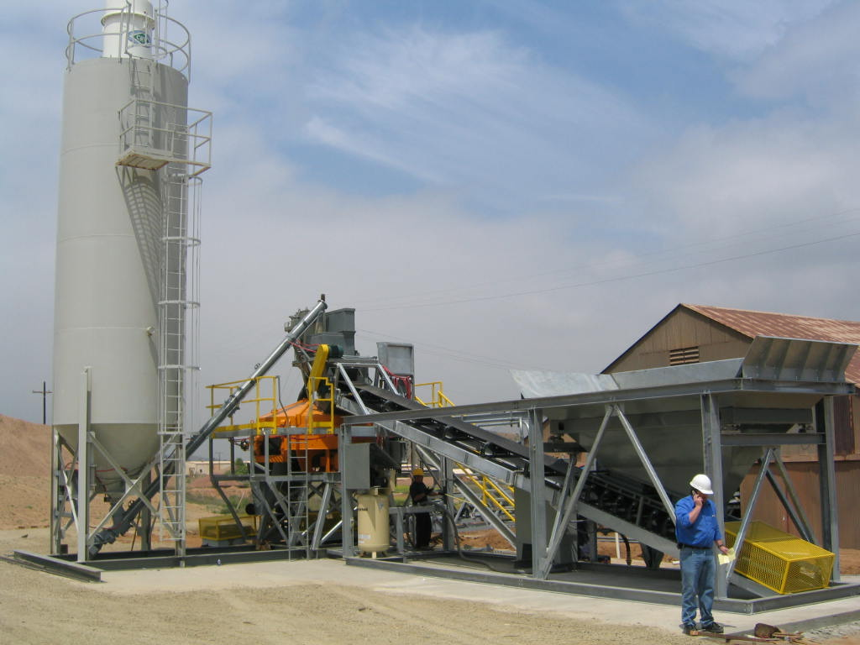
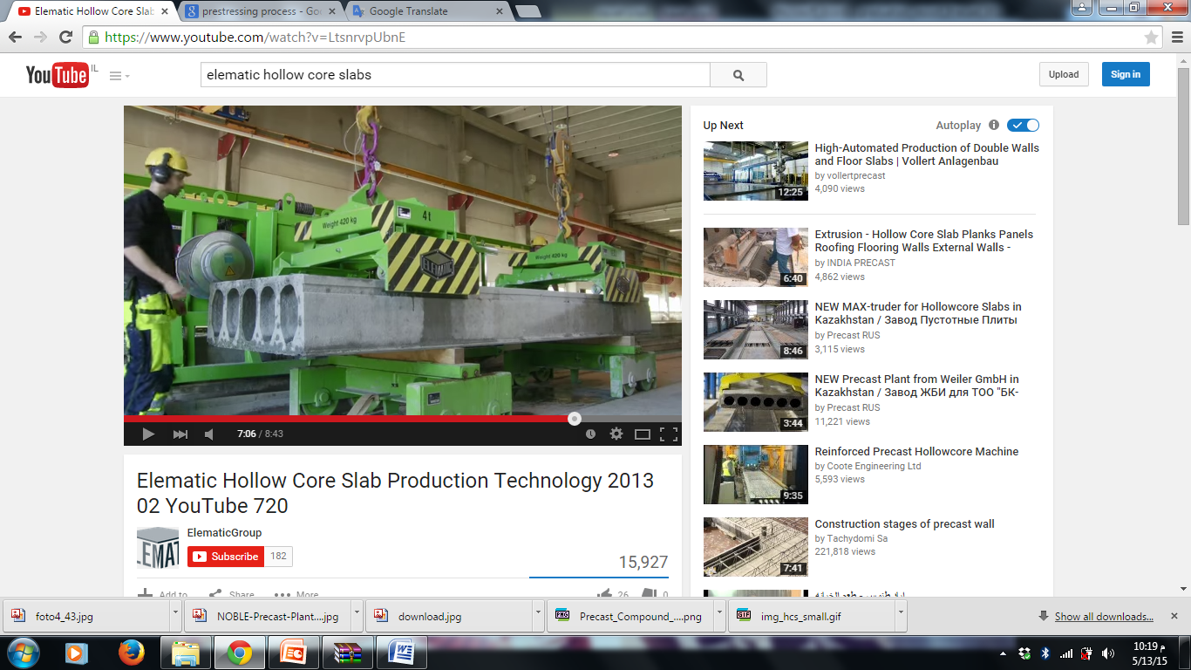
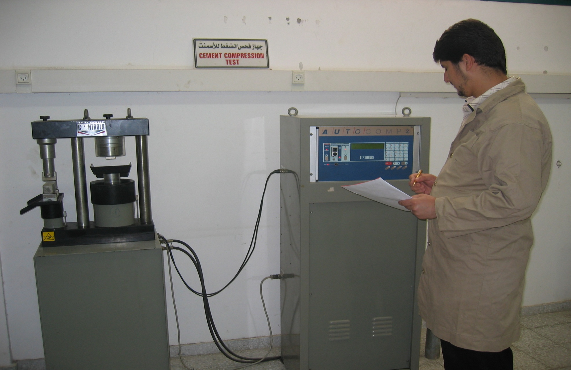
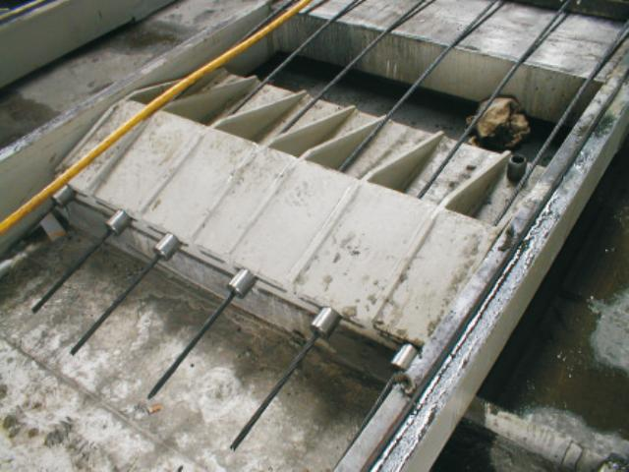
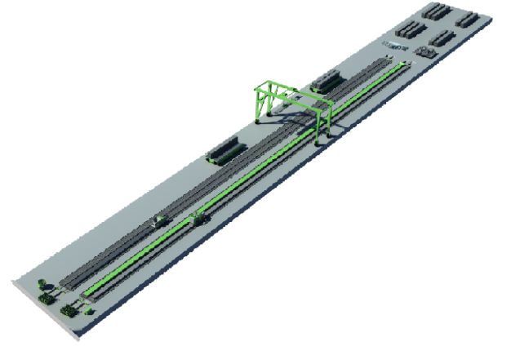
Floors Production Steps
Prestressing
Concrete transporting
Bed Preparation
Casting
Cutting
Storing

Slide 20
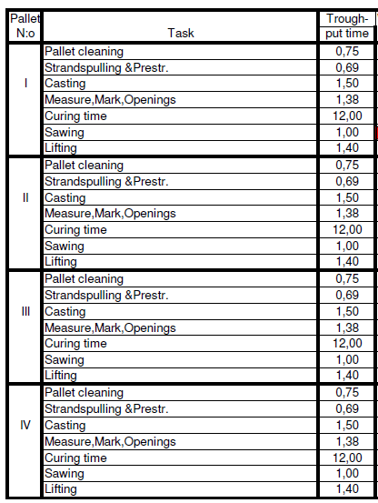
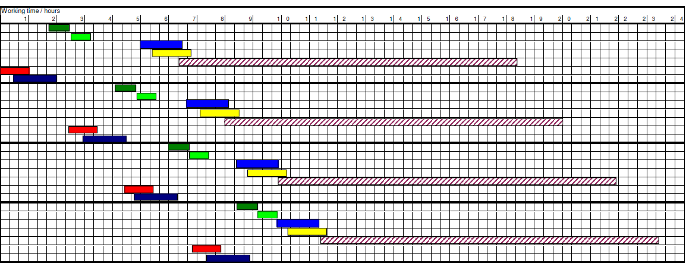
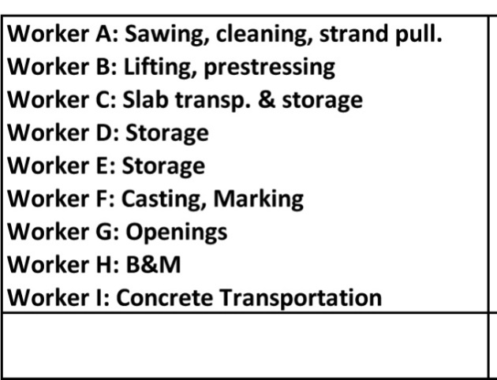
Gantt Chart

Slide 21
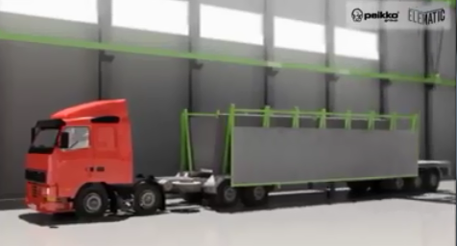
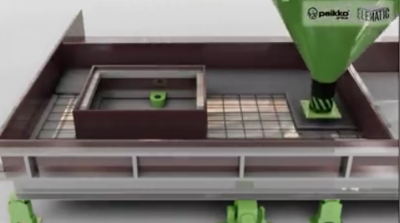
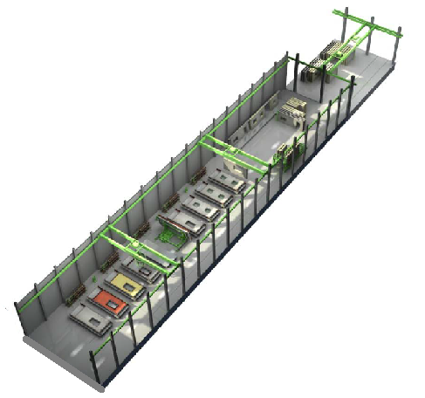
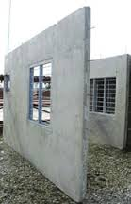
Walls Production

Slide 22
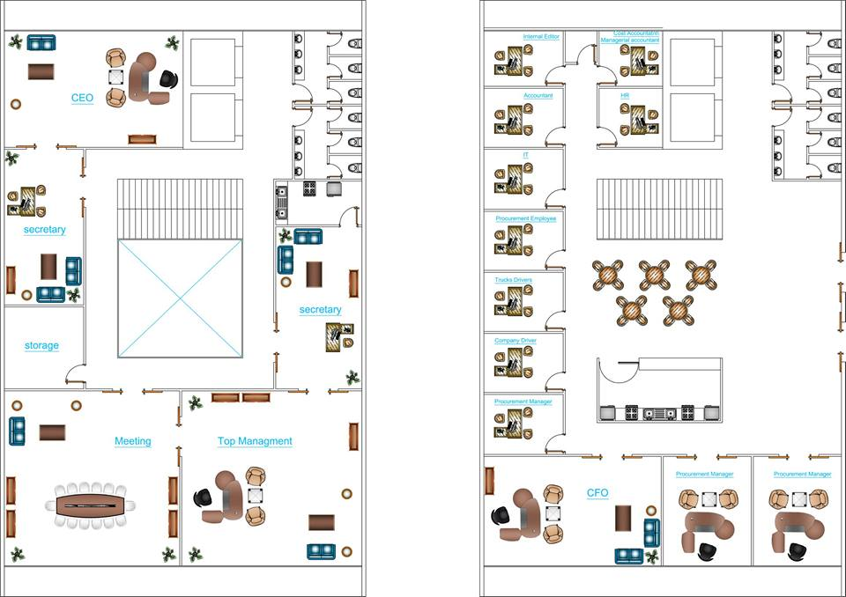
Administrative Building

Slide 23
Organizational Structure
Production &Manufacturing
Sales & Marketing
Finance & Accounting
HR
Quality Department
Maintenance
Production management
Inventory management
CRM
Procurement
Accounting
IT
Sales
Transportation & Movement unit
Company car driver
Forklift driver
CAT driver
HR
marketing
Administration

Slide 24
Plant Layout
Storage area
Production lines
Batching and mixing
Parking
Administrative building

Slide 25
Establishment Cost
$ 5,185,953.42
Item | Cost( $ )
Land space required | 260,526.316
Precast concrete plant | 1,712,231.76
Batching and Mixing Plant | 145,322.45
factory licenses | 5,000
Water network for the administrative buildings | 868.42
Electricity | 1,200
tel. & internet | 276.315
admin. Building construction | 217,105.63
admin. Furniture | 20,000
Fences | 15,000
Hangers | 1,252,800
control lab. | 10,000
Guard room | 5,862
Item | Cost ( $ )
Equipment | 2,895
Forklift | 80,000
CAT | 100,000
Company car | 48,000
Cameras | 3,263.15
Fire fighting system | 10,000
Gates | 7,000
Inside factory water network | 3,000
Inside Factory Electricity network | 10,000
Working capital | 775,602.38
Reserve for emergencies and unforeseen costs | 518595.3

Slide 26
Operational Cost
Staff salaries
Raw Materials
Electricity
Depreciation
Maintenance
Administrative Expenses
The annual operating cost of the factory is estimated by
$ 8,002,013

Slide 27
Total Salaries
Production & Manufacturing
Finance and accounting
Transportation & movement
Human Recourses
Sales & marketing
# of employees = 55
The total yearly salaries
$ 332,968.38/yr

Slide 28
Production Capacity of The Precast Concrete Products
Walls Production Capacity = 900 m²
80% for Interior (Walls (720m²
20% for exterior walls (180m²)
production capacity of HC-slab
570 m²/day.

Slide 29
Cost of Materials Used to Produce Walls
Direct Material for Exterior Walls ( 180m²)
Direct material | Quantity (kg/m3) | Quantity (kg/m2) | Material cost ($/kg) | Material cost ($/m2)
Cement | 360 | 72 | 0.13157 | 9.473684211
Coarse aggregate | 1145 | 229 | 0.6842 | 1.566842105
Water | 160 | 32 | 0.00289 | 0.092631579
Fine aggregate (Sand) | 630 | 126 | 0.017 | 2.155263158
Steels | 86.91358025 | 17.38271605 | .7631 | 13.26575699
D.M.C for 1 m² |  |  |  | 26.55417804
Monthly D.M.C |  |  |  | 114,714.0491
Yearly D.M.C |  |  |  | 1,376,568.6

Slide 30
Cost of Materials Used to Produce Walls
Direct Material for Interior walls ( 720 m² )
Direct material | Quantity (kg/ m³) | Quantity (kg/ m²) | Material cost ($/kg) | Material cost ($/m²)
Cement | 360 | 72 | 0.13157 | 9.473684211
Coarse aggregate | 1145 | 229 | 0.6842 | 1.566842105
Water | 160 | 32 | 0.00289 | 0.092631579
Fine aggregate (Sand) | 630 | 126 | 0.017 | 2.155263158
Steels | 15.80246914 | 3.160493827 | .7631 | 2.411955815
D.M.C for 1 m² |  |  |  | 15.70037687
Monthly D.M.C |  |  |  | 271,302.5123
Yearly D.M.C |  |  |  | 3,255,630.142

Slide 31
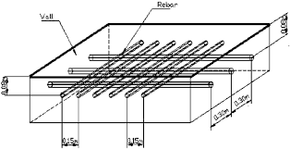
Steel Usage for Walls
for 1m length the weight of steel = (D²/162)
Cost of1 m² = weight * # of bars * Price
8 mm diameter
interior
$ 2.41
12 mm diameter
$ 13.26
exterior

Slide 32
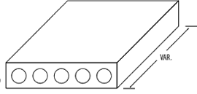
Cost of Materials Used to Produce HC-slab
D =14.52 cm
20 cm
1.2 m
Direct material | Quantity (kg/m2) | Material cost (NIS/kg) | Material cost ($/1.2m2)
Cement | 9.36 | 0.131 | 1.23
Coarse aggregate | 247.6 | 0.68 | 1.69
Water | 2573.16 | 0.00289 | 7.44
Fine aggregate (Sand) | 4.25 | 0.017 | 0.072
Cables | 3.16 | .7631 | 2.41
Total D.M.C for (1 m2) |  |  | 12.85
Total D.M.C for(1.2 m2) |  |  | 15.43
Monthly cost for 1.2 m2 |  |  | 211,108.3
Yearly cost for 1.2 m2 |  |  | 2,533,300.7

Slide 33
Electricity Consumption In The Factory
Electricity of the factory include
Administrative building electricity
= $3,092/yr
Batching & mixing electricity
HC-slab electricity
Walls electricity

Slide 34
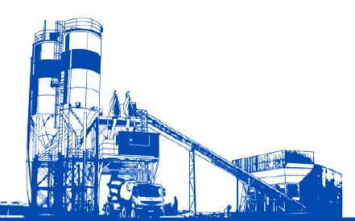
Batching & Mixing Electricity
Machines Electricity =84.2 kw
1 kw = .68 NIS
$15.067/hr
Batching & Mixing
1/3 Floors
2/3 Walls

Slide 35
HC-slab Electricity
Total electricity cost for hollow core slab/hr =
22.913 + 0.33 * 15.067
= $ 27.93
Yearly cost = $ 64,364.3136/yr
# | Machine | Electricity (kw) | Electricity ($)/hr | Electricity ($)/hr
1 | Electric skip for HC-slab production | 1.1 | 0.197 | 0.196
2 | Stressing abutment p7-300 | 5.5 | 0.984 | 0.984
3 | Maturity control e9-8mc | 5 | 0.895 | 0.894
4 | Casting module extruder s5-1200e | 0.38 | 0.068 | 0.068
5 | Saw preparer s5-400p | 116 | 20.758 | 20.757
6 | Lifting clamps p7-4 | 0.066 | 0.0118 | 0.0118
 | Total cost |  |  | 22.9

Slide 36
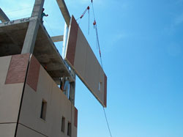
Total electricity cost walls = $101,113/year
Walls Electricity
Total electricity cost = 4.56 + 0.66 * 15.067= $ 14.6/hr
# | Machine | Electricity(kw) | Electricity ($)/day
1 | Pulling device for transfer wagon | 5.5 | 0.98
2 | Multifunction wagon s5-26 | 15 | 2.68
3 | Maturity control e9-8mc | 5 | 0.894
 | Total | 25.5 | 4.56

Slide 37
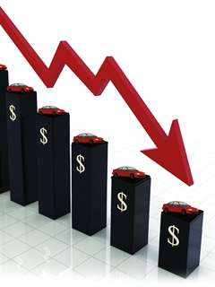
Depreciation for Production Lines
HC-slab Depreciation =
$44,361/yr
Walls Depreciation =
$ 48,515/yr

Slide 38
Depreciation of other items
 | Expected life | Cost($) | Depreciation/year | Dep./month
Admin. Building construction | 40 yr | 217105.6 | 5427.6 | 452.3
Admin. Furniture | 10 yr | 20000 | 2000 | 166.66
 | Expected life | Cost($) | Depreciation/year | Dep./month
Admin. Building construction | 40 yr | 217105.6 | 5427.64075 | 452.3
Admin. Furniture | 10 yr | 20000 | 2000 | 166.66
Fences | 20 | 15000 | 750 | 62.5
Hangers | 20 | 1252800 | 62640 | 5220
control lab. | 20 | 10000 | 500 | 41.66
Guard room | 40 | 5862 | 146.55 | 12.2125
Equipment | 5 | 2895 | 579 | 48.25
Forklift | 20 | 80000 | 4000 | 333.33
CAT | 20yr with S.V $20000 | 100000 | 4000 | 333.33
Company car | 10yr | 48000 | 3010.3488 | 250.368
Cameras | 10 | 3263.15 | 326.315 | 27.19
Gates | 20 | 7000 | 350 | 29.16
Total cost |  |  | 88,729.85 | 7393.66

Slide 39

Company Car Depreciation Calculations
Item | Value
Car price($) | 3,482
Expected car life(km) | 500,000
salvage value ($) | 13,158
Expected car life(yr) | 10
Distance(km)/yr | 43,200
Rate | 0.0864
Year | Market Value | Usage Percent | Dep. Value /yr | Dep./month
0 | 34842 | 0 | 0 | 0
1 | 31831 | 0.0864 | 3010.3 | 250.8
2 | 29081 | 0.0864 | 2750.2 | 229
3 | 26568 | 0.0864 | 2512.6 | 209
4 | 24273 | 0.0864 | 2295.5 | 191.2
5 | 22176 | 0.0864 | 2097.2 | 174.7
6 | 20260 | 0.0864 | 1916 | 159.6
7 | 18509 | 0.0864 | 1750.4 | 145.8
8 | 16910 | 0.0864 | 1599.2 | 133.2
9 | 15449 | 0.0864 | 1461 | 121.7
10 | 13158 | 0.0864 | 1334.8/yr | 111.2

Slide 40
Operational Cost Summery
# | Item | Cost($)
1 | Total salaries | 332968
2 | Material for walls | 4632198
3 | Materials for HC-slab | 2533300
4 | Electricity for administrative building | 3092
5 | Electricity for HC-slab | 64364
6 | Electricity for walls | 101113
 | Deprecation (walls) | 48515
7 | Depreciation (HC-slab) | 44361
8 | Depreciation of other items | 85970
9 | Water consumption (administrative building) | 3157
10 | Other operational costs | 152,968
 | Total costs | 8,002,013

Slide 41

Financial Evaluation
Reveals the project's ability to generate income to cover its financial obligations.
Financial Study includes the following :
Pay Back Period
Net Present Value-NPV
Break-Even Point
National profitability of the project
Sensitivity Analysis
Risk Analysis

Slide 42
Pricing :
variable cost per unit ($)
HCS | 13.7
Interior walls | 16.3
Exterior walls | 27
Fixed Cost($) | 34910
Over Head($) | 8216.8
Cost for each unit in $ =Total variable cost+(( Fixed + Overhead) /31920)
Product Type | Cost/Unit ($)
HCS | 15
Interior walls | 17
Exterior walls | 28

Slide 43

Price of the Factory Products
HCS = $ 17.9
Interior walls =$ 21
Exterior Walls = $ 34

Slide 44
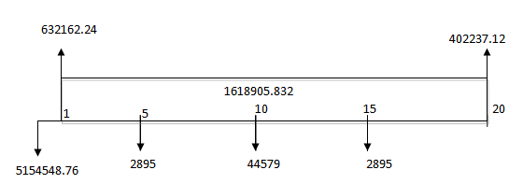
Financial Analysis
i = 5%
Net Present Value = $ 15,743,225
The Rate Of Return = 34.44%
Pay Back Period = 3.1 year

Slide 45
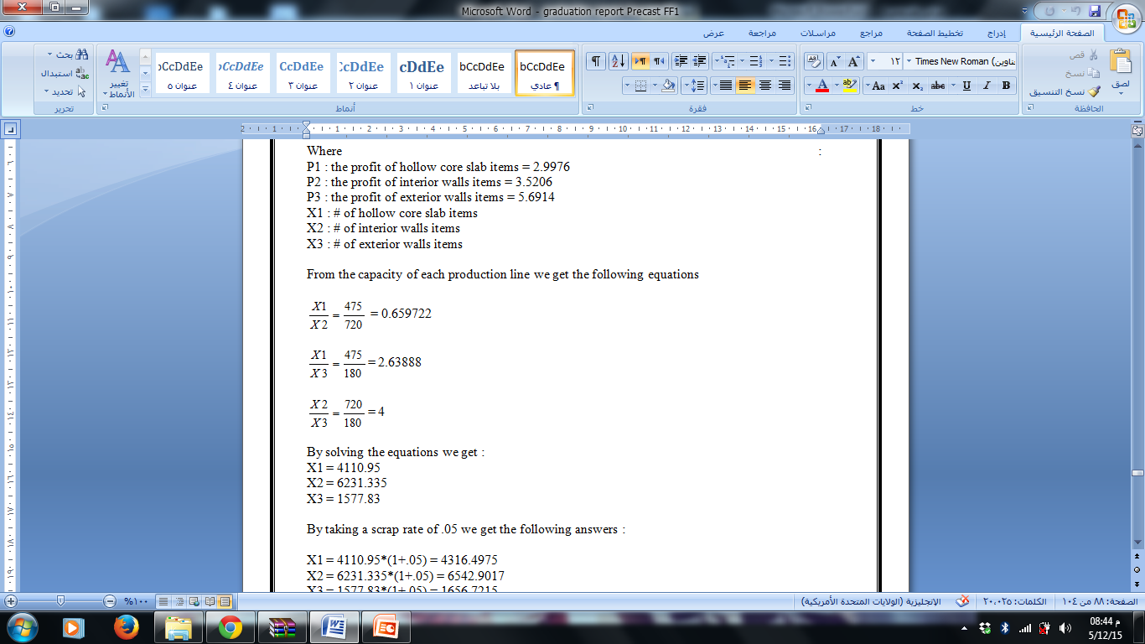

Break Even Point
Overhead + Fixed Cost = P1X1+ P2X2 + P3X3
Where :
X1 : # of hollow core slab items
X2 : # of interior walls items
X3 : # of exterior walls items
By solving the equations we get :

Slide 46
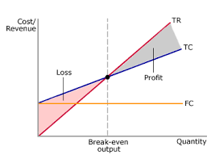
Break Even Point
X1 = 4110
X2 = 6231
X3 = 1577
With 0.05 scrap rate Break Even Point
For HC-S = 4110*(1+.05) =
4316
Exterior walls = 6231*(1+.05) =
6542
Interior walls = 1577*(1+.05) =
1656

Slide 47
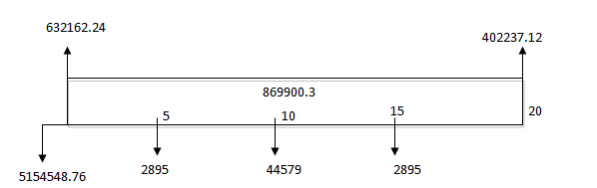
Sensitivity Analysis
Steel price is increasing 25% of its value
Cement price is increasing by 10% of its original value
70% of plant full capacity is used
i = 5%
Net Present Value = $ 6408966
Rate Of Return = 18.18 %
Pay Back Period = 6.22 years
Break Even Point = Hollow core slabs = 4316
Interior walls = 6542
Exterior walls =1656

Slide 48
Simulation Analysis
By using excel we used Random Between function and doing 1000 iteration to compute NPV for the expected life of the project
then we estimated the average NPV=15,049,866 , and standard deviation = 339,101

Slide 49
Simulation Analysis
95% confidence that the NPV is more than 114502825

Slide 50

Comparison
 | Fresh concrete | Precast concrete
Cost | For solid slabs ($65-$70) + Bleaching cost($8) T.C = $75 | For HC-slabs $21 +installation cost($3)+ transportation cost ($10) T.C=$34
 | For exterior walls $60 + bleaching cost ($8) T.C= $68 | For exterior walls $40+$3+$10 T.C=$53
 | For interior walls(concrete) $35+bleaching cost ($15) T.C=$50 If bricks T.C=$17+$15 T.C=$32 | For interior walls T.C = $18+$3+$10 T.C =$31
Time needed to build floor of 500 m2 | Exterior walls= 2 weeks Interior walls =2 weeks Bleaching = 3 weeks Total = 7 weeks | 7-10 days

Slide 51

Conclusion :
From the results of Market study, Technical Study and Financial analysis results we can see that the project is Feasible

Slide 52

Risk Analysis
Refusal of the Israeli national electricity company to provide the needed electricity
Finding suitable land with 12 donum area, with a suitable location
Using suitable Crain for precast products
The stability of the political and economic situation, in order to increase the demand on precast products.

Slide 53

Production Line Recommendations :
Use material economically
Contract with best vendors (quality, logistics and price)
Avoid excess amount of concrete to reduce waste cost
Avoid excess inventory
On time delivery
Reduce defective products (training)
Establish preventive maintenance
Using mobile crane to facilitate the assembly in construction site
Contract with best transportation companies

Slide 54

General Recommendations
Starting the implementation of the project after obtaining the necessary licenses from the relevant authorities.
Choose suitable land which needs less settling to reduce the cost of preparation
Engineering association should spread awareness between people about precast and its advantages comparable to fresh concrete
Buying trucks in future to transport precast products since the cost of precast products doesn't include transportation cost and the one who purchase precast products incurred the cost of transportation

Slide 55



