Slide 1
Introduction

Slide 2
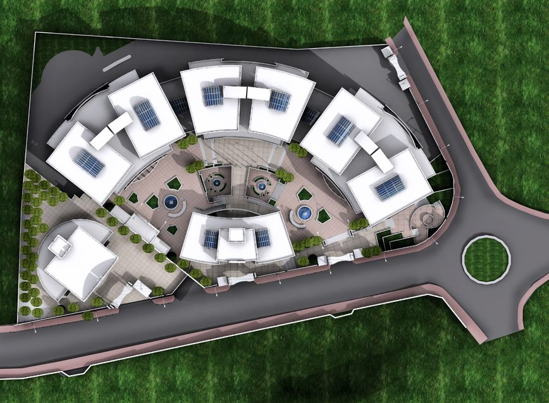
Project A

Slide 3
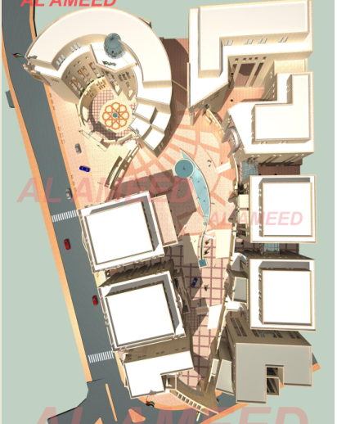
Project B

Slide 4
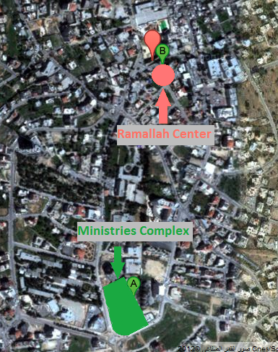
Site analysis
Location:

Slide 5
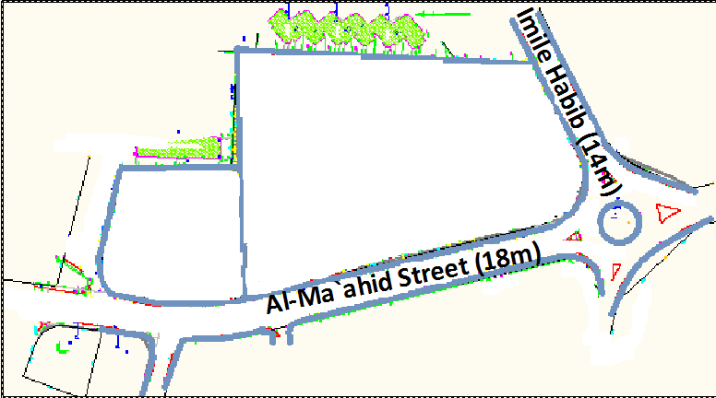
Surrounded streets:

Slide 6
Architectural design

Slide 7
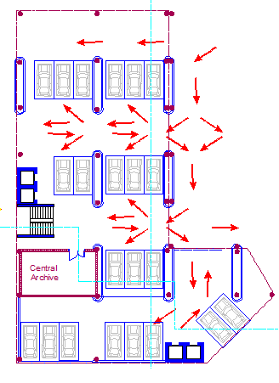
Third basement floor

Slide 8
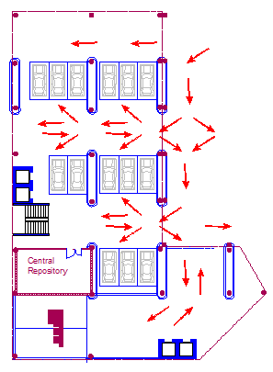
Second basement

Slide 9
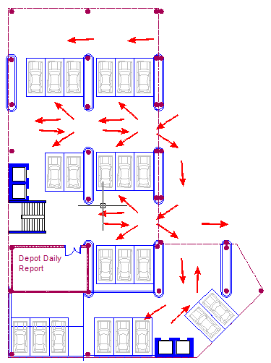
First basement

Slide 10
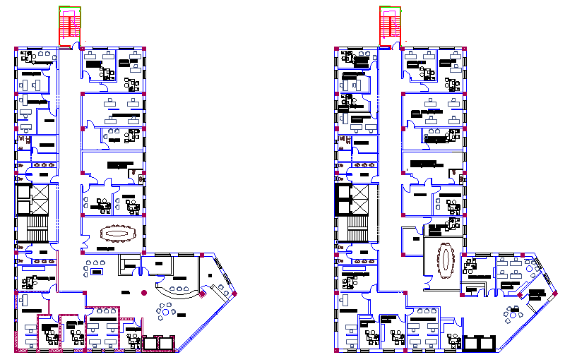
Ground and first floors

Slide 11
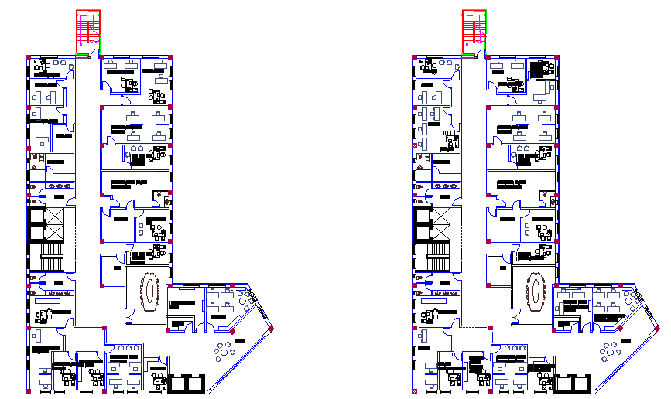
Second and third floors

Slide 12
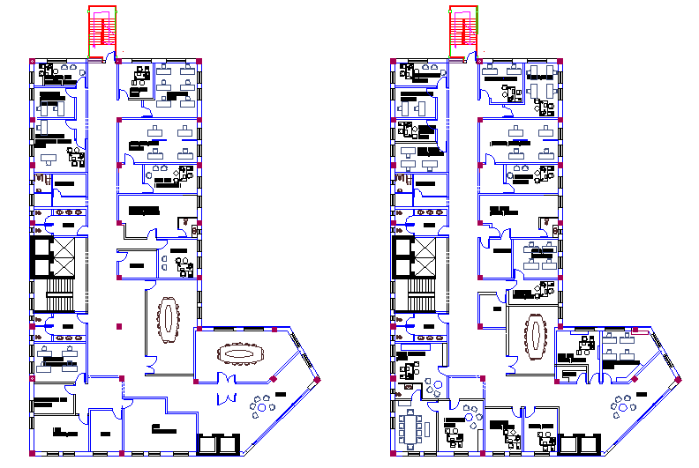
Fourth and fifth floors

Slide 13
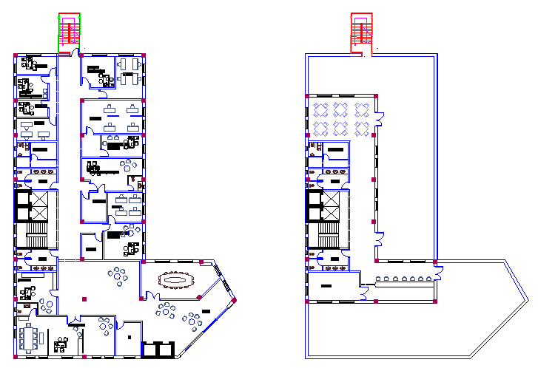
Sixth and seventh floors

Slide 14
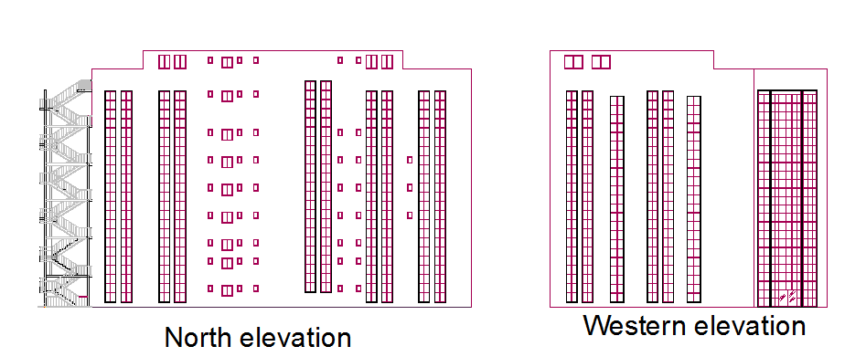

Slide 15
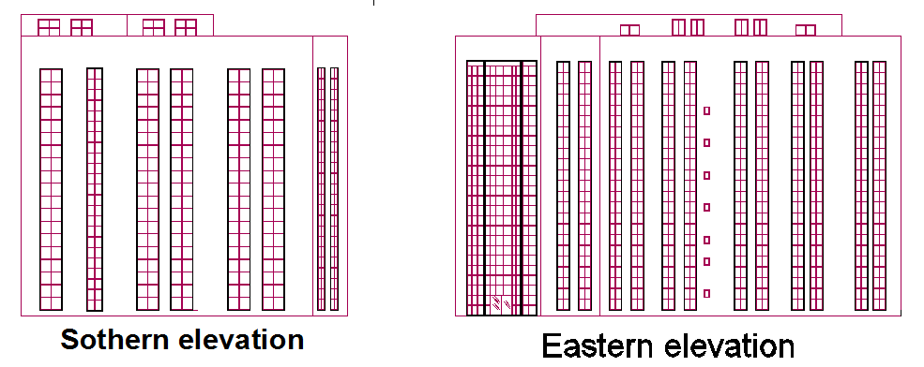

Slide 16
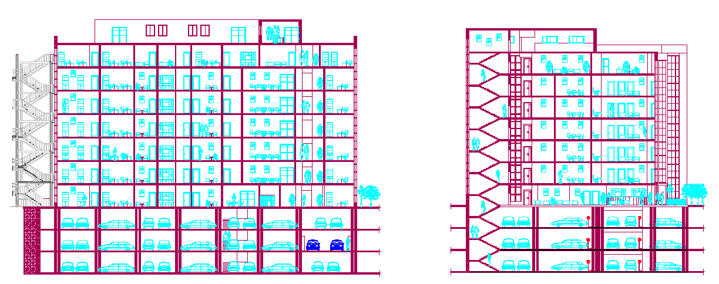
The section

Slide 17
Mechanical design
HVAC , water supply
drainage system, fire system.

Slide 18
HVAC system
  - Heating design.
U | The element
0.72 | Outside wall
0.87 | ceiling
0.61 | floor
3.5 | window
7 | Aluminum door

Slide 19
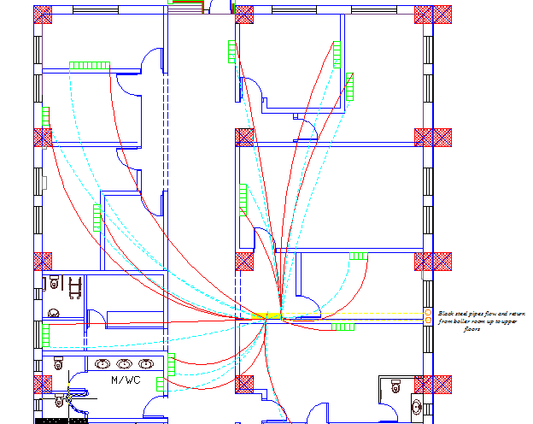

Slide 20
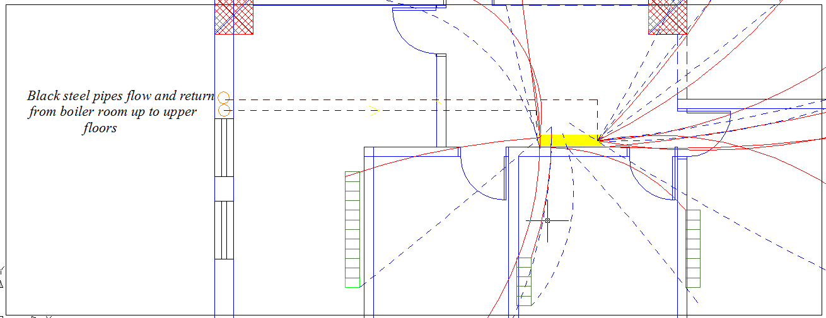

Slide 21
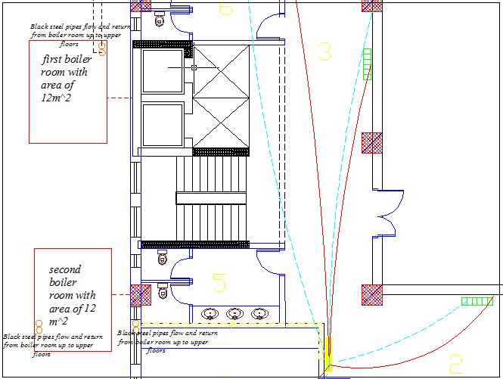

Slide 22
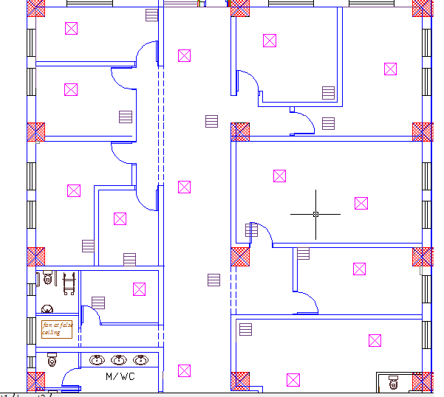
-The selection diffuser is a square supply air diffusers of four way flow pattern with size of 46*46 cm
- cooling design.

Slide 23
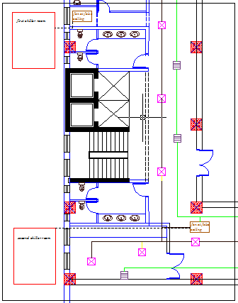

Slide 24
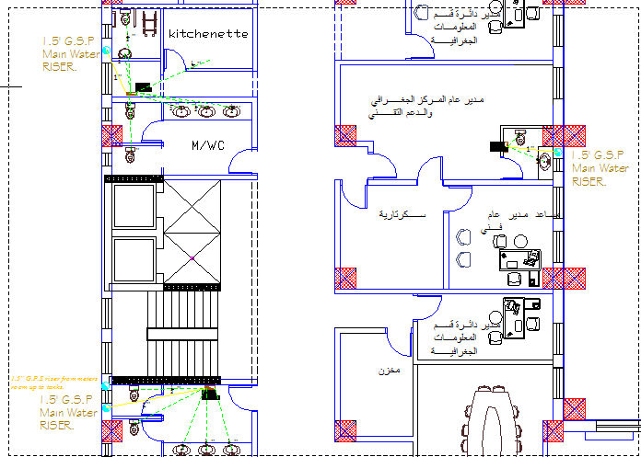
Water supply

Slide 25
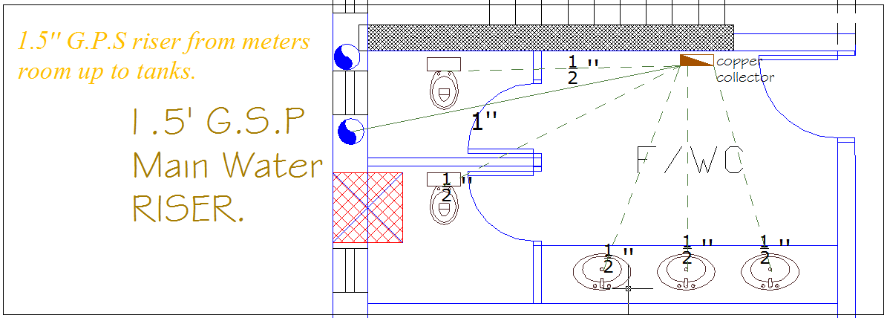

Slide 26
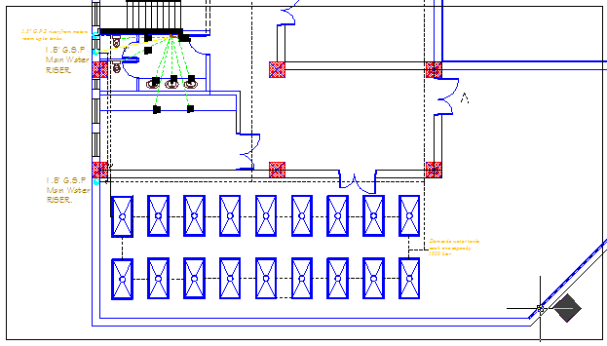

Slide 27
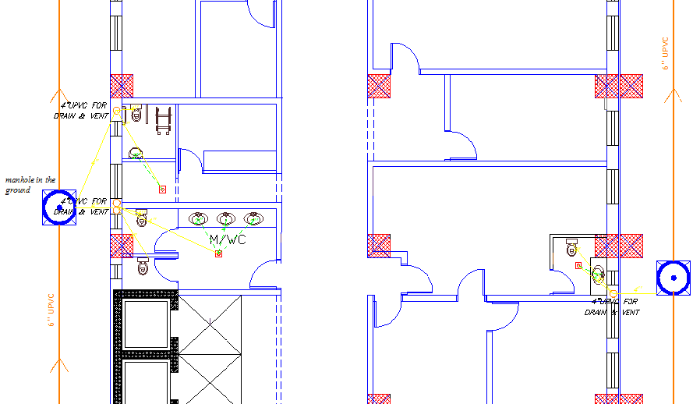
Drainage system

Slide 28
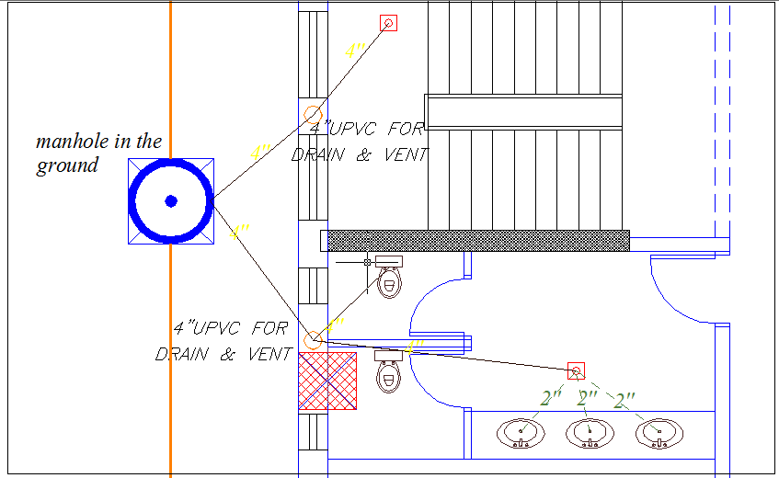

Slide 29
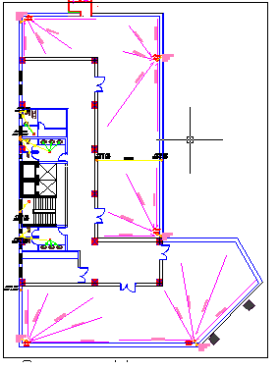

Slide 30
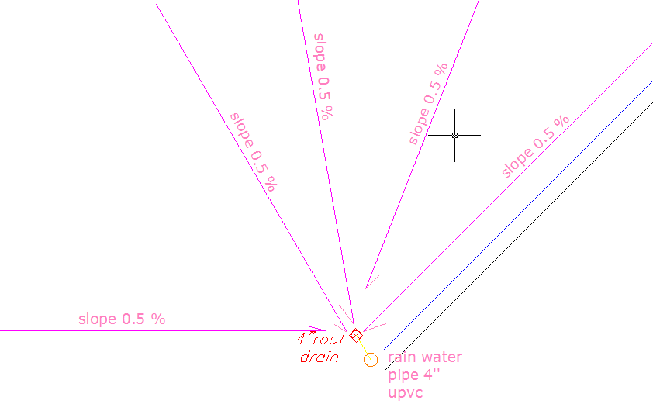

Slide 31
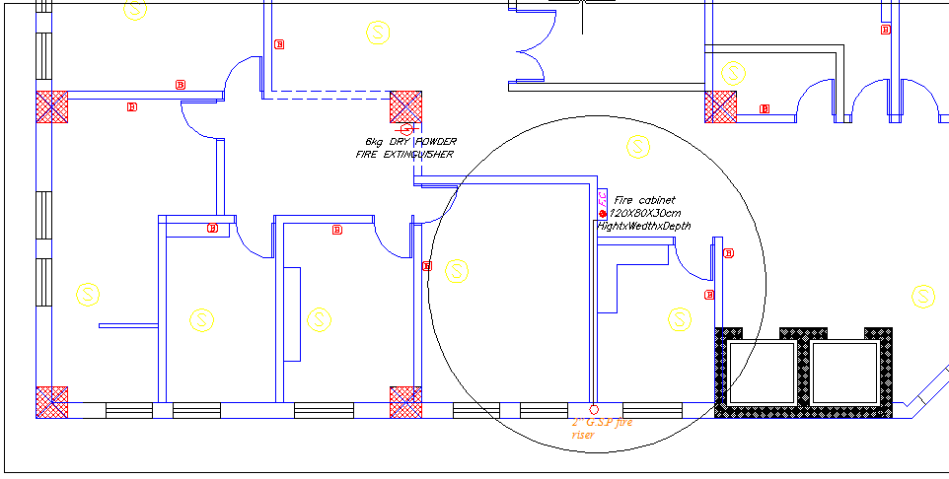
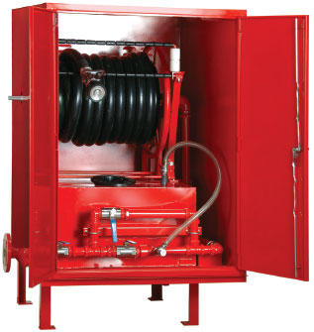
Fire system

Slide 32
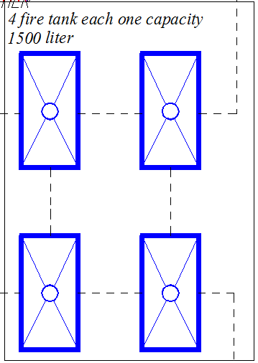

Slide 33
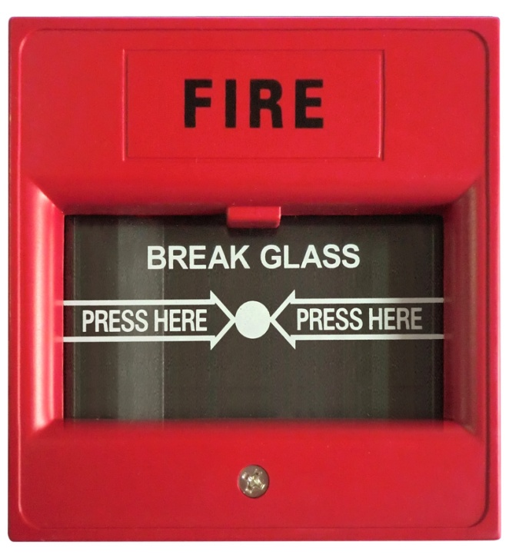
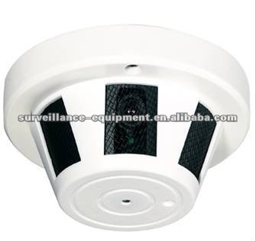

Slide 34
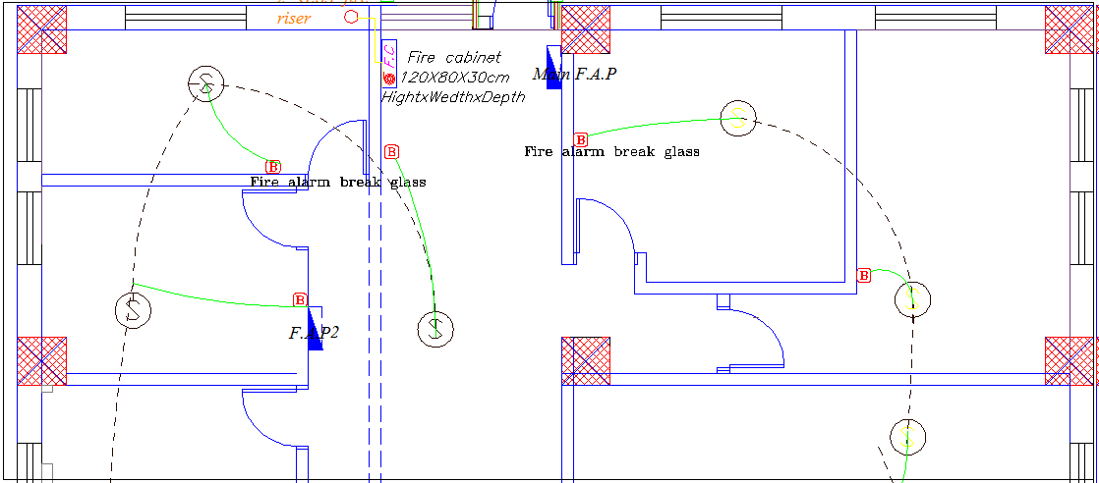

Slide 35
Electrical design

Slide 36
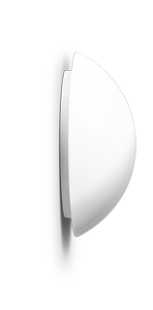
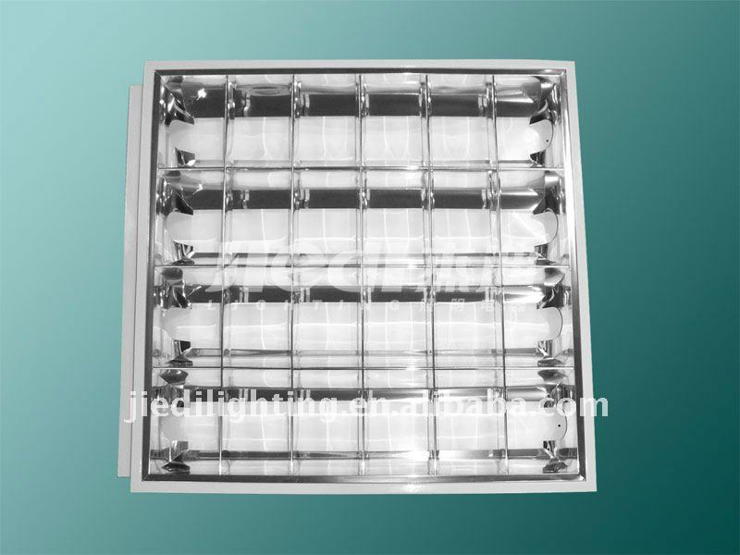
Artificial lighting
Florescent lamp (4*T8 18 watt) BEGA 5524 3 TC-D 26W
Luminaire Luminous Flux =5400 lm Luminaire Luminous Flux =5400 lm

Slide 37
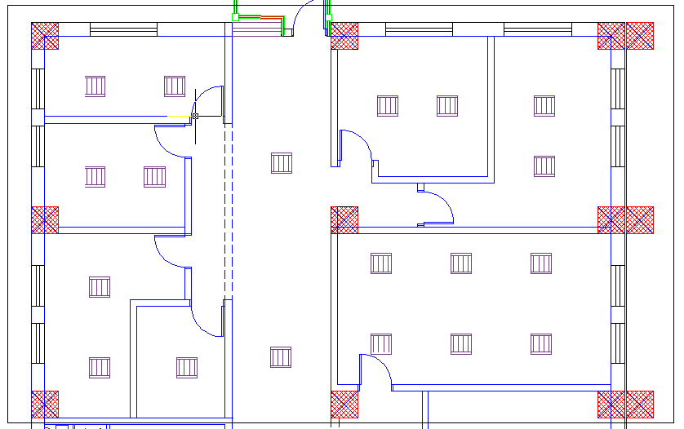
Number of luminaries for each space have been calculated

Slide 38
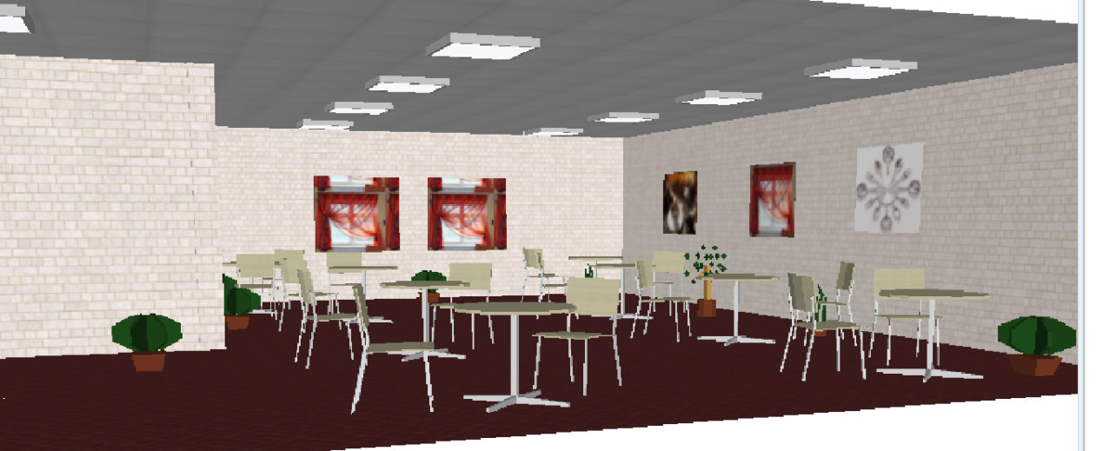
the seventh floor was design by daualux program lamps that were used are of a type SECOLUX-E PL-L 136EVG. with 36 watt.

Slide 39
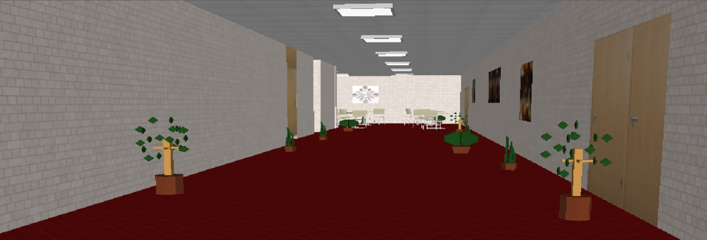

Slide 40
Cost estimation

Slide 41
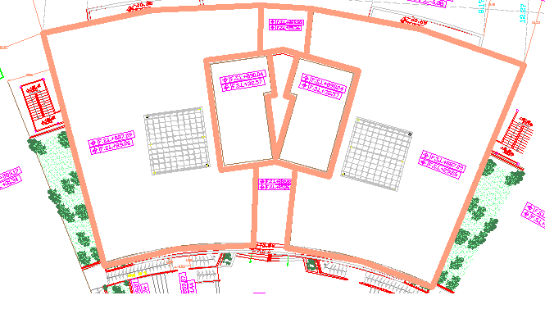
Total cost=45300000 NIS
Total area=14885.92m² Project A cost/m²=3043.14 NIS

Slide 42
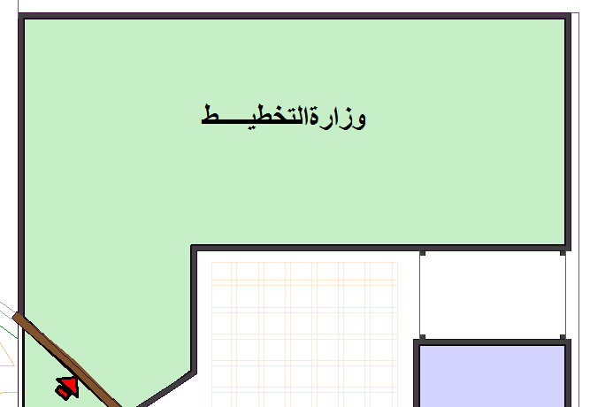
Total cost =25900000 NIS.
Total area= 8957.69 m² Project B
Total cost /m²=2891.3 NIS
cost | Work
25586010 NIS | Structural & architectural cost
216930 NIS | Mechanical cost
97060 NIS | Electrical cost

