Slide 1


An Najah National University
Civil Engineering Department
Analysis and design of AL- Ashqar
commercial mall
By:
-Eman Abu jazar.
-Saja Issa.
-Noor Ghorpeyha.
Supervisor : Dr. Riyad Awad.

Slide 2
Outline
Introduction.
What we do in graduation project 1.
Dynamic analysis:
-Modes and period.
-Response spectrum analysis.
Design of structural element.

Slide 3

Introduction
AL –ashqar mall is a commercial building located in Tulkarem city, it consists of three basements, ground floor and five floors.
Structural elements will be designed as reinforced concrete members according to strength and serviceability criteria as specified in ACI 318 for gravity load and as specified in UBC 97 for seismic load.

Slide 4
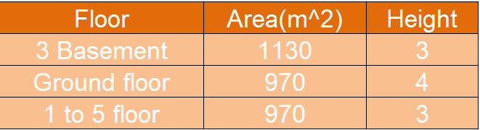
* 3 Basements are garages.
*Ground floor & 1to 3 floors are stores .
* 4 &5 floors are offices.

Slide 5
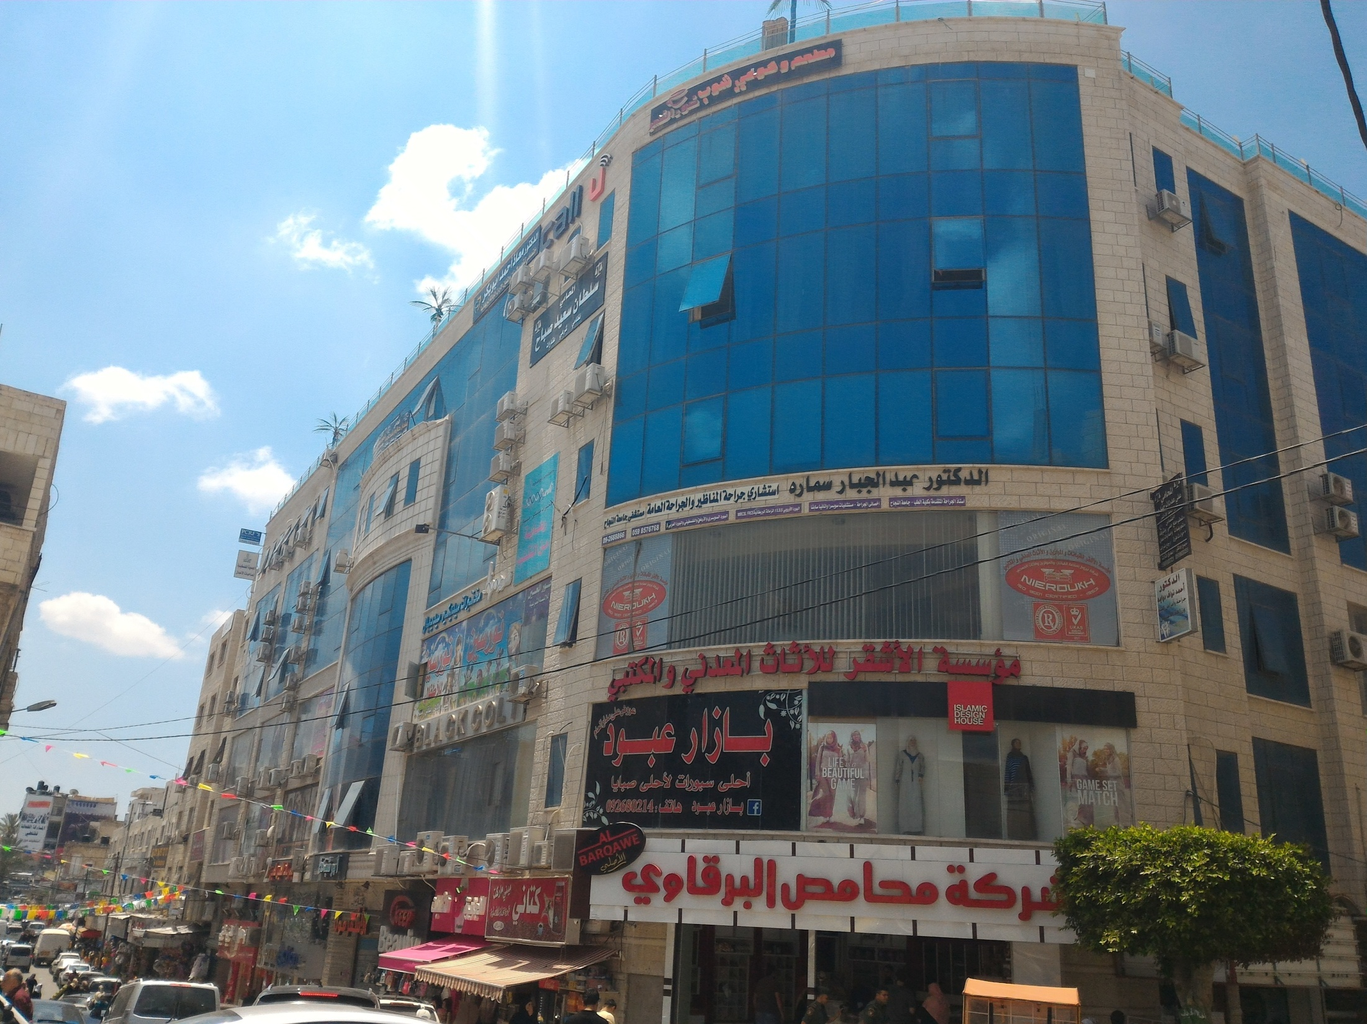

Slide 6
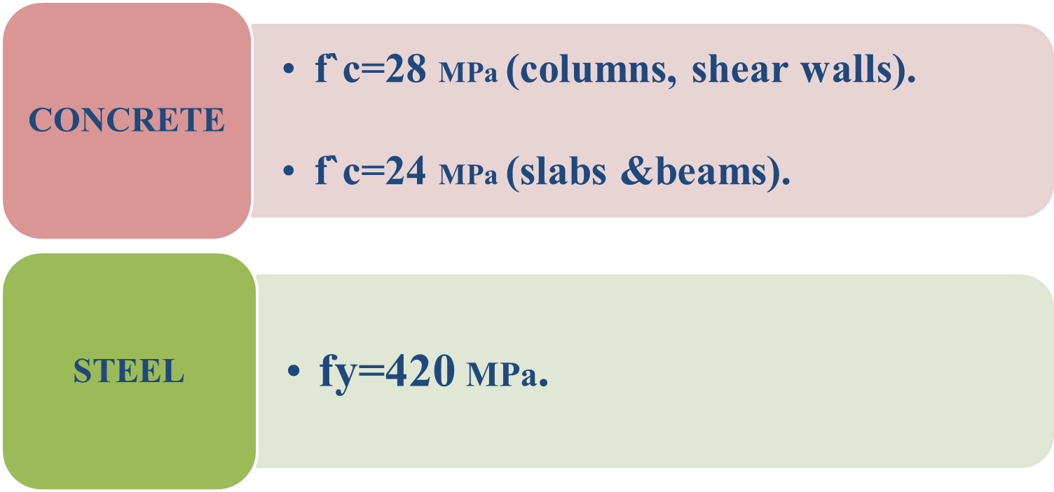
What we do in GP1?
Definitions Of Material.

Slide 7




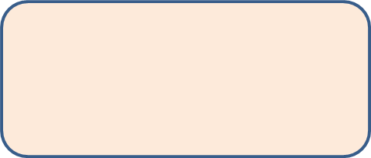
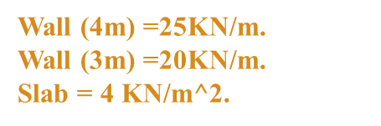

What we do in GP1?
Gravity Load
Dead
Superimposed
Live
Garages &stores =5kN/m^2
Offices=2.5KN/m^2

Slide 8
Structural Systems
Two way solid slab
3 Basements
Two way ribbed slab
GF &1to 5 floor
30cm thickness
20cm thickness

Slide 9

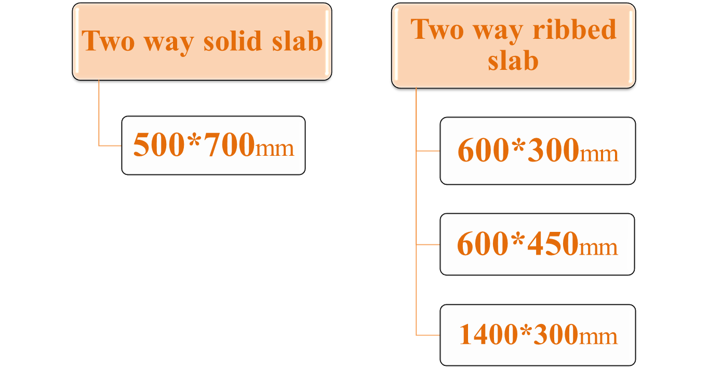
Design and dimensions

Slide 10

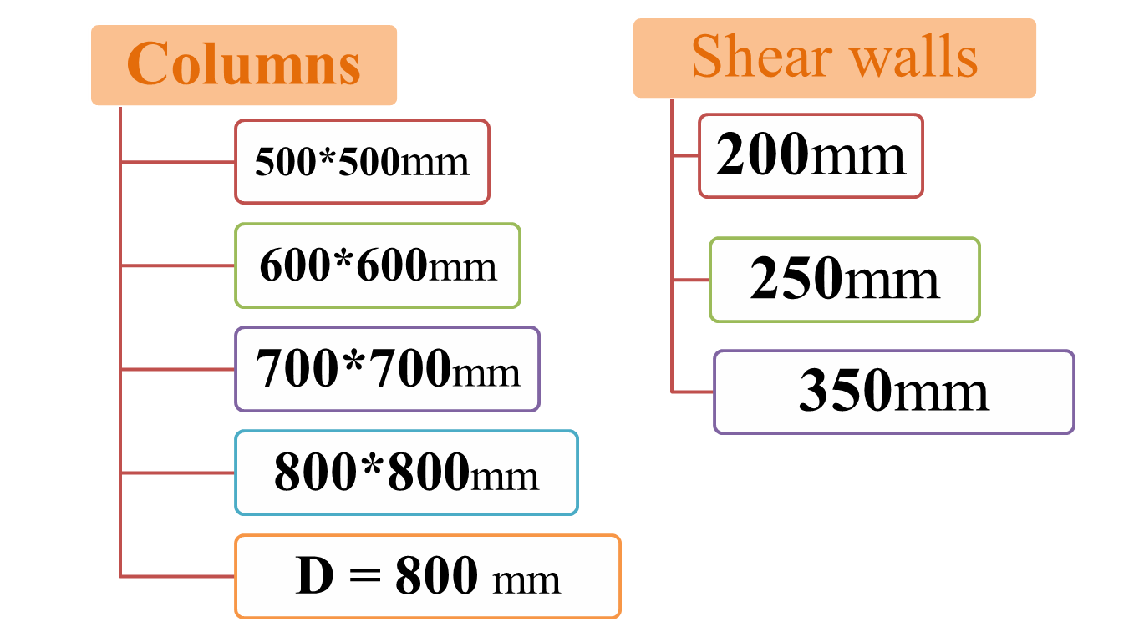

Slide 11
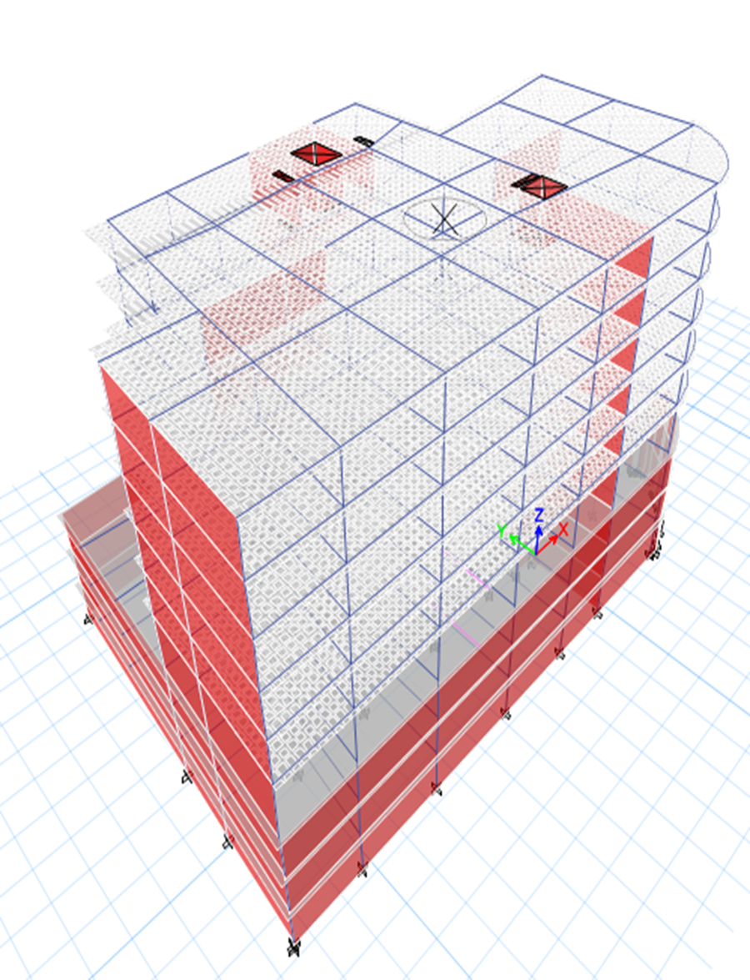
3D Model

Slide 12
DYNAMIC ANALYSIS
Response Spectrum Analysis
Modes and Period
Drift Check

Slide 13
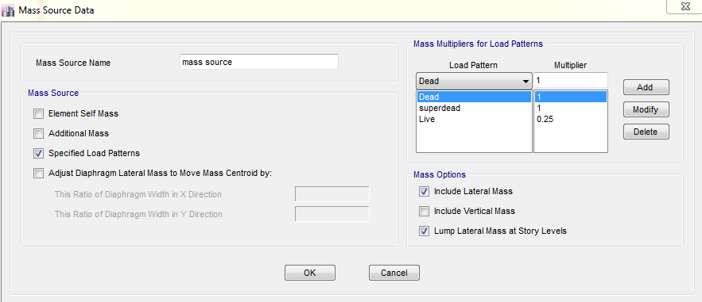
Definition of mass resource

Slide 14
Seismic Parameters
0.15 | z
Soft Rock(SC) | Soil
0.18 | Ca
0.25 | Cv
1 | I
5.5 | R

Slide 15
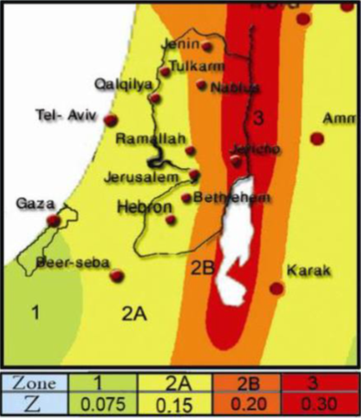
Seismic Zone Factor Z

Slide 16
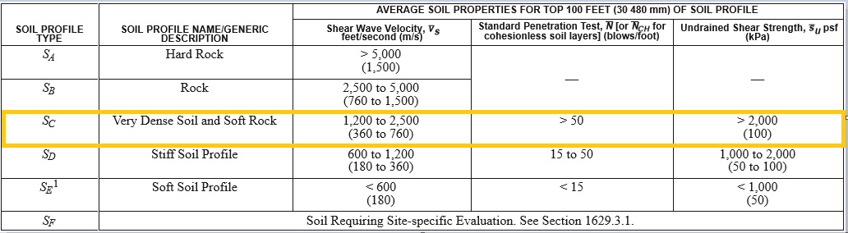
Site Classification Sc

Slide 17
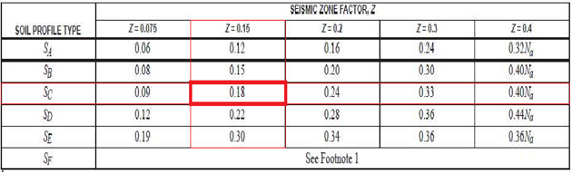
Seismic Coefficient Ca

Slide 18
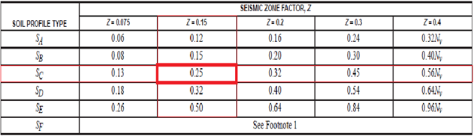
Seismic Coefficient Cv

Slide 19
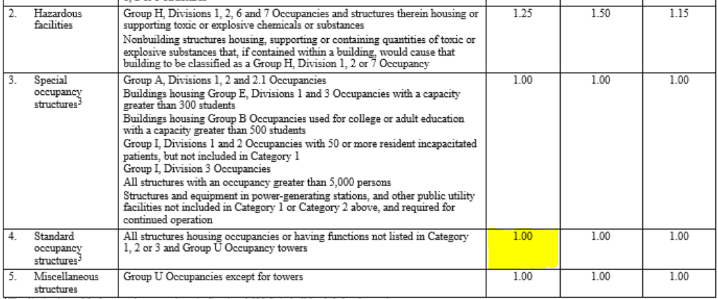
Seismic Importance Factor I

Slide 20
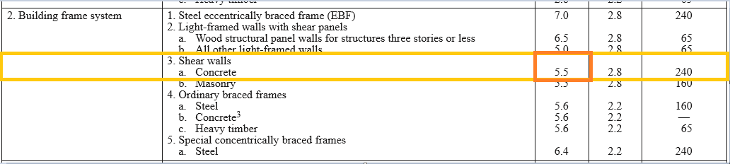
Response Modification Coefficient R

Slide 21
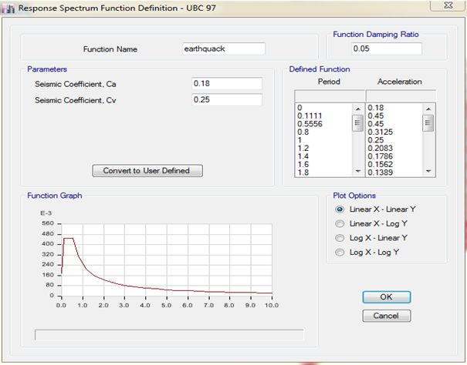
Define Of Response Spectrum Function

Slide 22
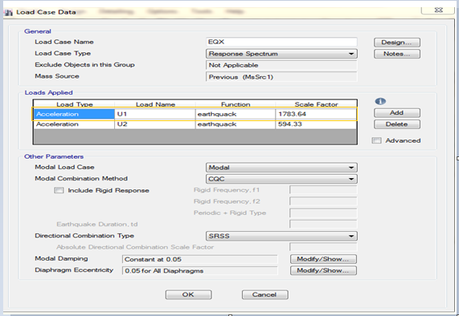

Response Spectrum In X-Direction
gI/R = 9810 * 1 /5.5 = 1783.64
(1/3)*1783.64
=594.33

Slide 23
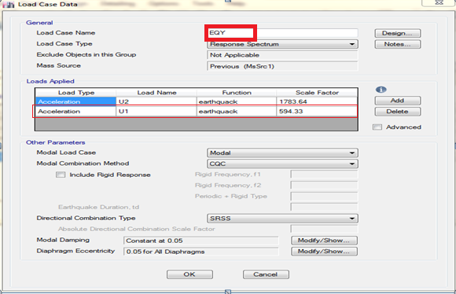


Response Spectrum In Y-Direction
gI/R = 9810 * 1 /5.5 = 1783.64
𝐸y=𝐸y+0.3 𝐸x
(1/3)*1783.64
=594.33

Slide 24
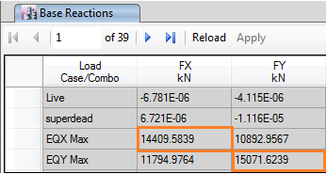
Finding the Base Shear by equivalent lateral force method (V):
from UBC code
min from → 2.5Ca = 2.5*0.18=0.45
Cv/T=0.25/0.594=0.4209
min = 0.4209
→ (0.4209/5.5)*192825.6 = 14755.55
EQx = 14409.58 < 14755.55→ ( not OK)
EQy = 15071.6 > 14755.55→ (OK)
try to change scale factor
So we try EQ = 16000

Slide 25
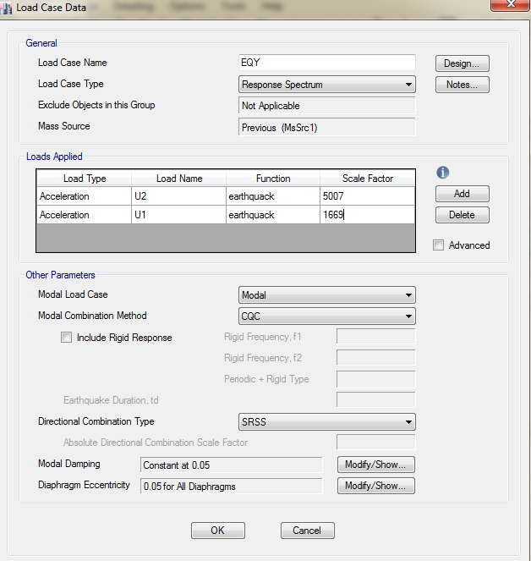

Slide 26


Slide 27
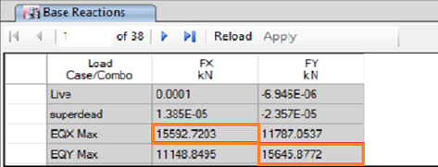
EQx max =15592.7 > 14755.55
EQy max =15645.9 > 14755.55
→ ( OK).

Slide 28
Modal Mass Participation Ratio
According to UBC Code, we should have Modal Participating Mass Ratio (MPMR) more than 90% in both directions
at 10 modes we achieve 90%

Slide 29
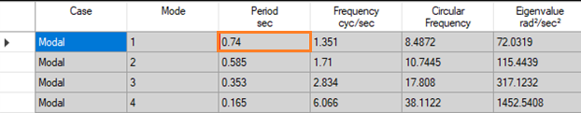
Check Period
Period in mode 1 → T= 0.74 sec.

Slide 30
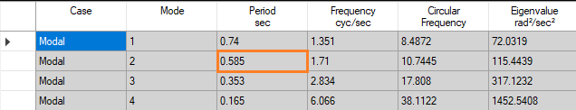
Period in mode 1 → T= 0.585 sec.

Slide 31
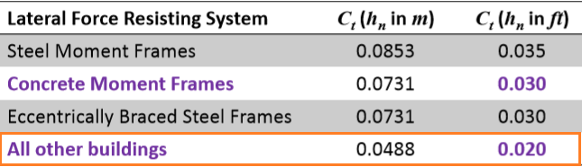
T from UBC code
$$T=Fundamental period of the structure=C_{T}h_{n }^{x}$$
→ T = Ct*h^{3/4}
= 0.0488*28^{3/4} = 0.594
→ T = 1.4*0.594 = 0.83
T from ETABS < T from UBC code

Slide 32

Drift Check
the elastic drift from ETABs
the plastic drift from UBC code
Δ plastic X = 0.7*5.5*2.97=11.4mm
Δ plastic Y = 0.7*5.5*1.96=7.55mm
Δ (allowable) from Code = L/50 = 3000/50 =60mm
Δ plastic X = 11.4 < 60mm → (OK)
Δ plastic Y =7.55 < 60mm → (OK)

Slide 33
Verifications of structural analysis
Equilibrium Check
Local equilibrium check
Check deflection(Immediate and long term )
Check shear

Slide 34
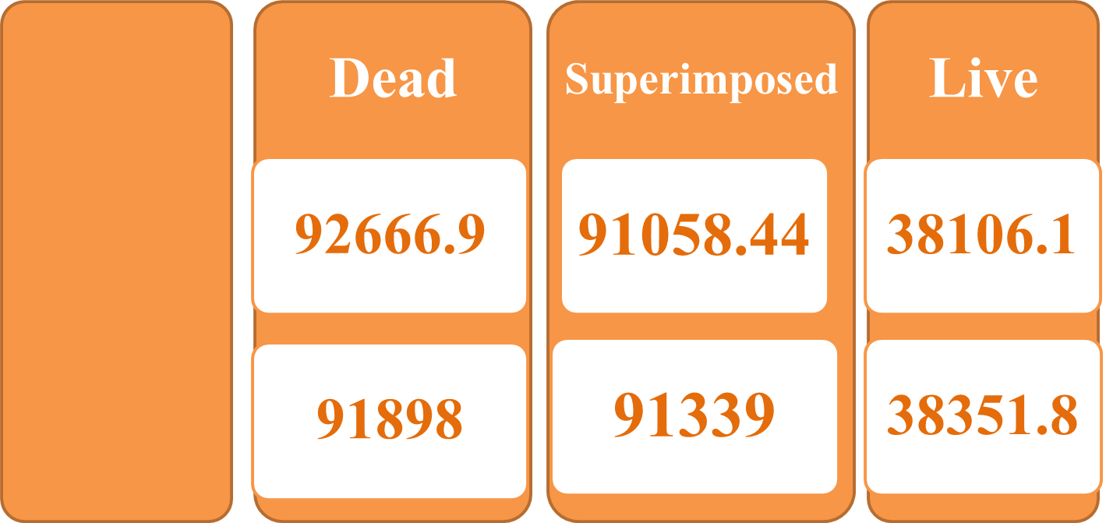

Equilibrium
Hand calculations
Hand Calculation
ETABS

Slide 35
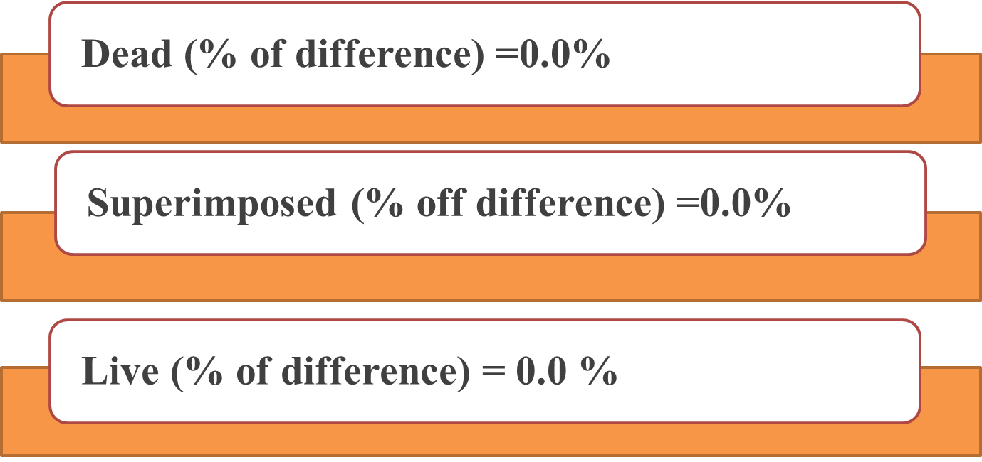
Equilibrium

Slide 36
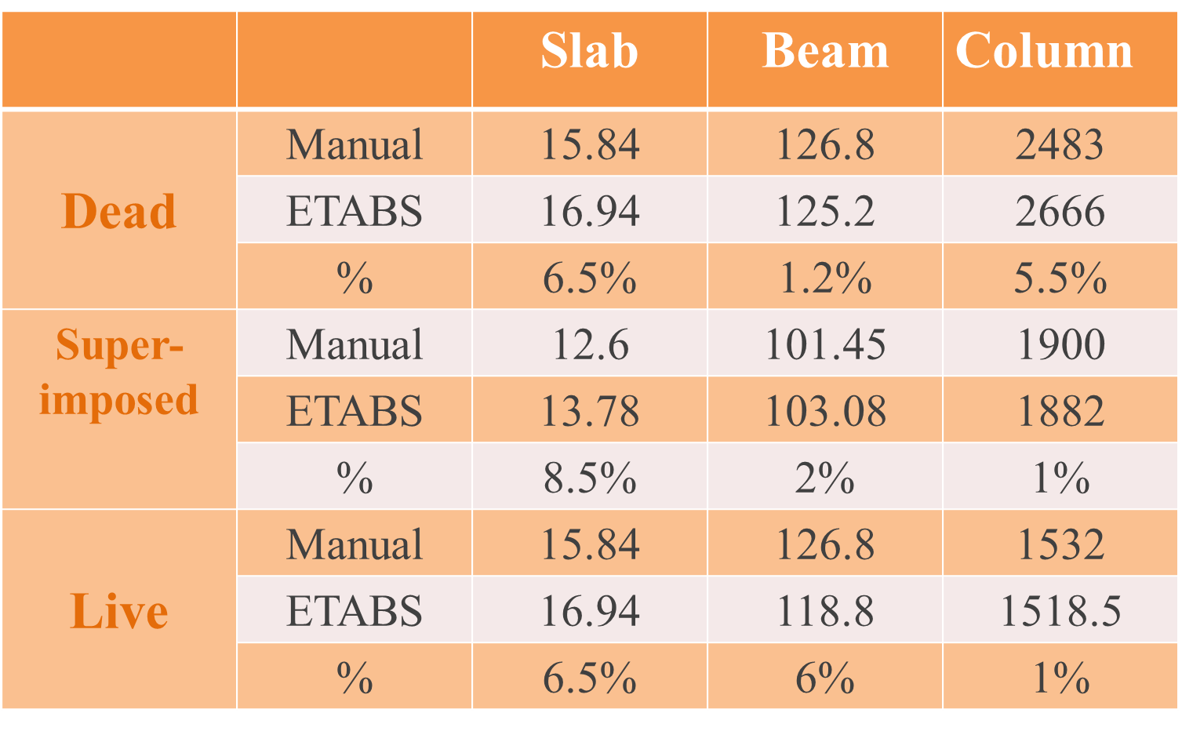
Stress-strain

Slide 37
Immediate deflection
* Allowable Deflection on solid slab:
From ACI 318-08 maximum deflection
= L/240
=(7.12*1000)/240=29.6 mm.
* Allowable Deflection on ribbed slab:
From ACI 318-08 maximum deflection
= l/240
=(7.3*1000)/240=31.5 mm.

Slide 38
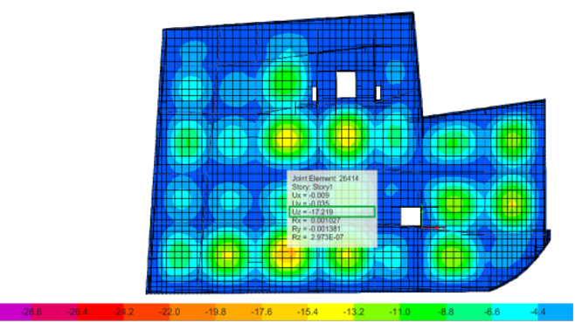

Immediate deflection in solid slab
maximum deflection in Solid slab = 17.291 mm
$$17.219 mm<29.6mm →OK.$$

Slide 39
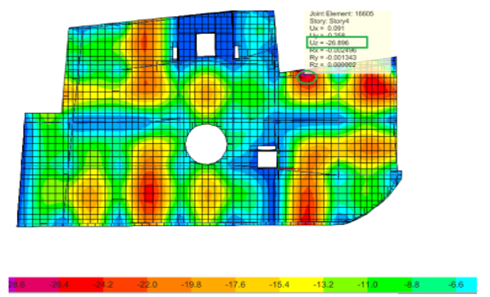

Immediate deflection in ribbed slab
maximum deflection in ribbed slab
= 26.896
$$26.896 mm<31.5 mm →OK.$$

Slide 40
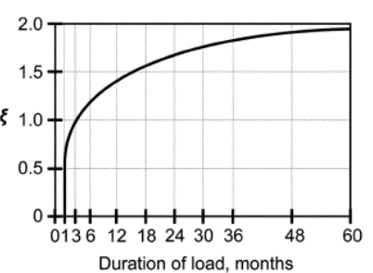

Long Term Deflection
The long term deflection is given by the following equation:
Δ Long term = Δ L + λ∞ x Δ D + λt x Δ SL
To find T
Where:
λt = λ∞ , since we assumed that the live load will sustained for 5 years ≈ ∞
λ = (such that is the compression steel ratio, T is a multiplier for long term deflection)
Δ L= deflection due to live load
Δ D= deflection due to dead load
Δ SL= deflection due to sustained live
As we notice from the figure at time 5 years
(60 months):
λ=$\frac{2}{1+50×0}$ = 2

Slide 41
Long Term Deflection
* ∆_{Lt} on ribbed slab
=5.2 + 2 × 11.4 + 2 × 2.8 = 33.5 mm > 31.5 mm
→ 33.5mm more than allowable deflection but we can assume it OK.
* ∆_{Lt} on solid slab
=5.9 + 2 × 6.6 + 2 × 2.9 = 24.9 mm< 29.6
→(OK).

Slide 42
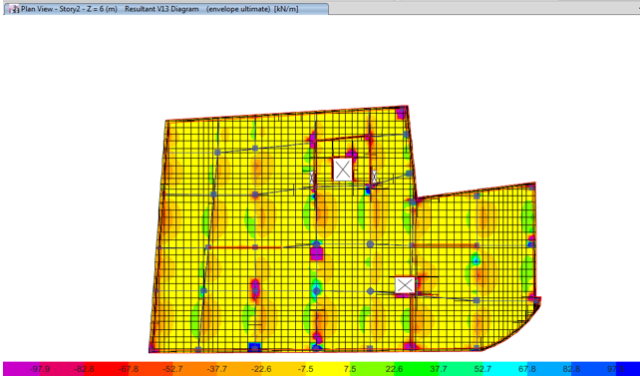
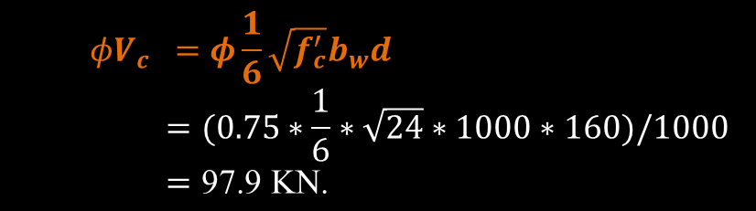
Check shear
$$φV_{c} =φ\frac{1}{6}\sqrt{f_{c}^{′}}b_{w}d=(0.75∗\frac{1}{6}∗\sqrt{24}∗1000∗160)/1000=\text{97}\text{.}\text{9 }\text{KN}\text{.}$$
Vu from ETABs = 82.8KN.
→ 82.8 < 97.9 KN.
→ ( OK ).
Solid Slab

Slide 43
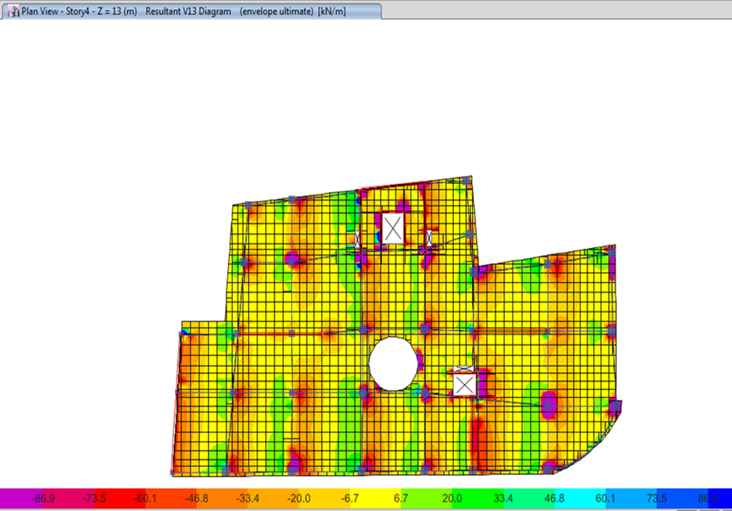
Check shear
φVc = (1/6)*0.75*√24*150*260*1.1/(1000*(0.55*0.55))
= 86.85KN.
Vu from ETABs=73.5KN.
→ 73.5 < 86.85 KN.
→ ( OK ).
Ribbed Slab

Slide 44
Design of structural element.
Load combinations
DESIGN OF SLAB
DESIGN OF BEAMS
DESIGN OF COLUMNS
Design of shear wall
Design of stair
DESIGN OF FOOTINGS

Slide 45
Load Combination
U = 1.4D (9-1)
U = 1.2D + 1.6L + 0.5(Lr or S or R) (9-2)
U = 1.2D + 1.6(Lr or S or R) + (1.0L or 0.5W) (9-3)
U = 1.2D + 1.0W + 1.0L + 0.5(Lr or S or R) (9-4)
U = 1.2D + 1.0E + 1.0L + 0.2S (9-5)
U = 0.9D + 1.0W (9-6)
U = 0.9D + 1.0E (9-7)
Where:
U: ultimate load
D: dead load
L: live load
W: wind load
E: earthquake Load
H: load due to weight or pressure of soil
ACI 318M-11-Equations (9.1-9.7)

Slide 46
DESIGN OF SLAB
design of Ribbed slab
DESIGN OF solid SLAB

Slide 47
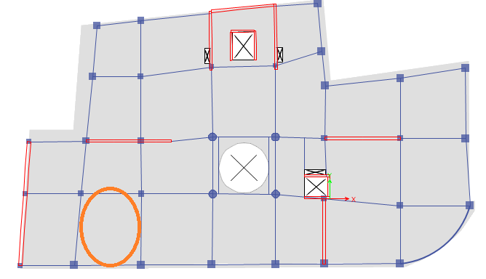

Slide 48
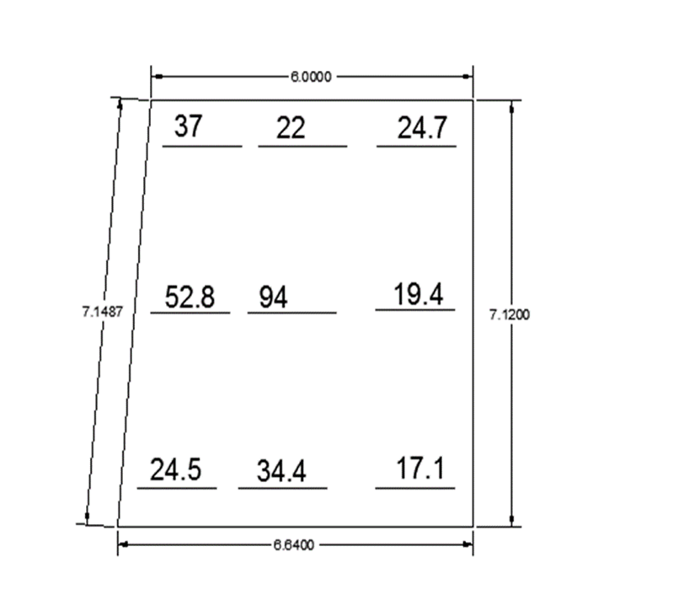
M22 in X direction:
Width of column strip : 1.325m/S.C
Max negative moment in C.S
→ Mu = 37 KN.m/S.C.
Mu /rib = 37/(1.325/0.55) =15.36KN.m/rib .
ρ = 0.00418 .
As =163.02 mm2.
→ use 2φ12
M22 for section cut in ribbed slab

Slide 49

M22 in X direction:
Width of column strip : 1.325m/S.C
Max positive moment in C.S
→ Mu = 52.8 KN.m/S.C.
Mu /rib = 52.8/(1.325/0.55)
= 22 KN.m/rib .
ρ = 0.00159 <ρ(min) = 0.00333 .
As(min) =129.87 mm2.
→ use 2φ12
M22 for section cut in ribbed slab

Slide 50

M22 in X direction:
Width of middle strip : 3.39m/S.C
Max negative moment in M.S
→ Mu = 34.4 KN.m/S.C
→ use 2φ12 .
Max positive moment in M.S
→ Mu = 94 KN.m/S.C
→ use 2φ12/rib.
M22 for section cut in ribbed slab

Slide 51
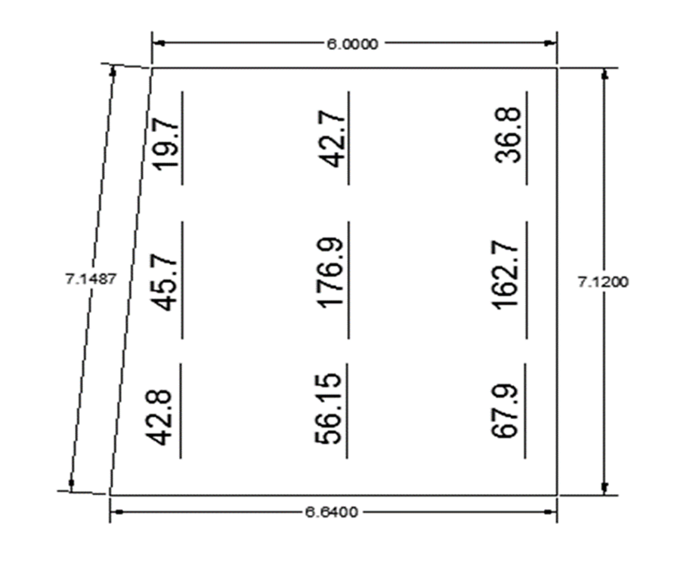
M11 in Y direction:
M11 for section cut in ribbed slab

Slide 52
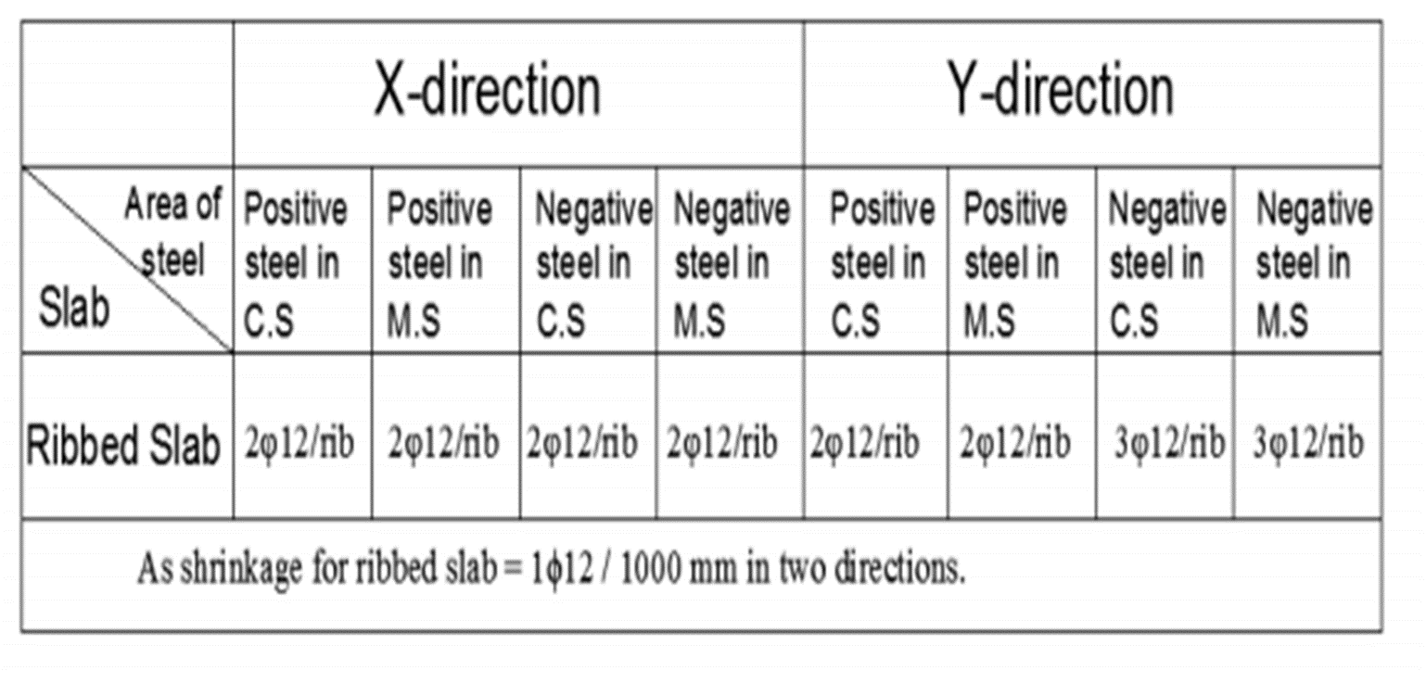
Design of ribbed slab for flexure

Slide 53
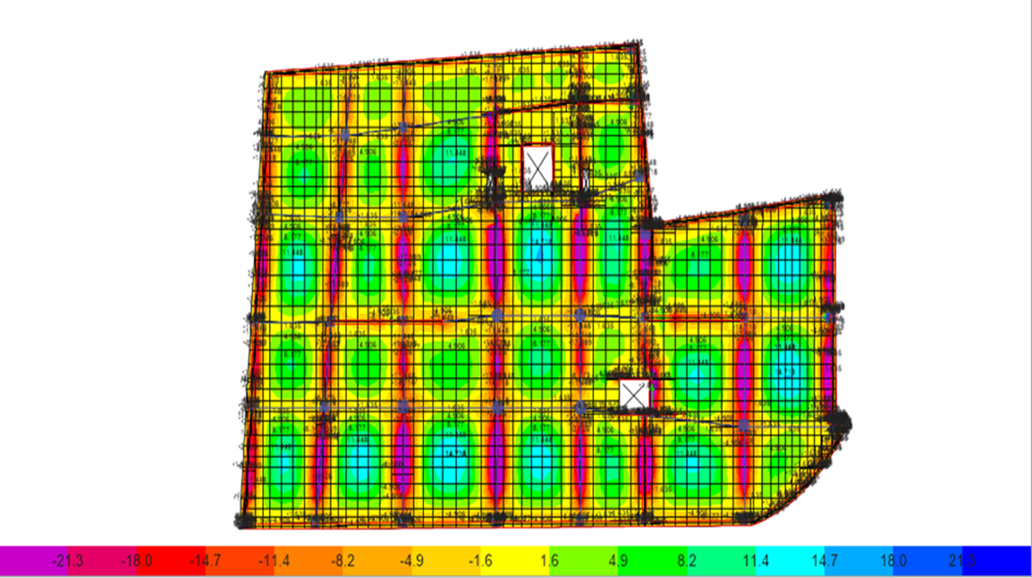
two way solid slab
As min= 360mm2.
→ use 4φ12mm/1000mm.
φMn =21.3 KN.m
M11 from ETABS in solid slab

Slide 54
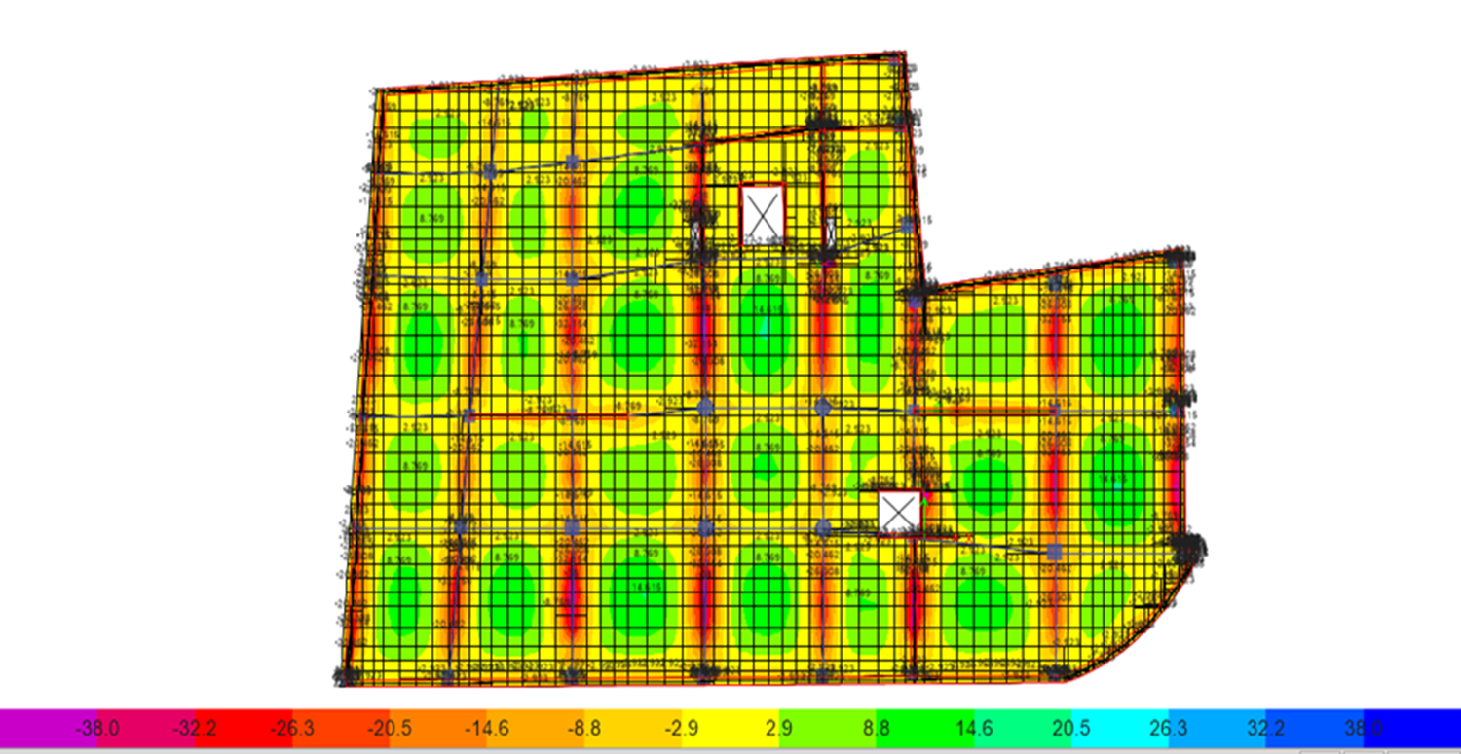
Top steel (Moment (11))
→ use 6φ12mm/2000mm.

Slide 55
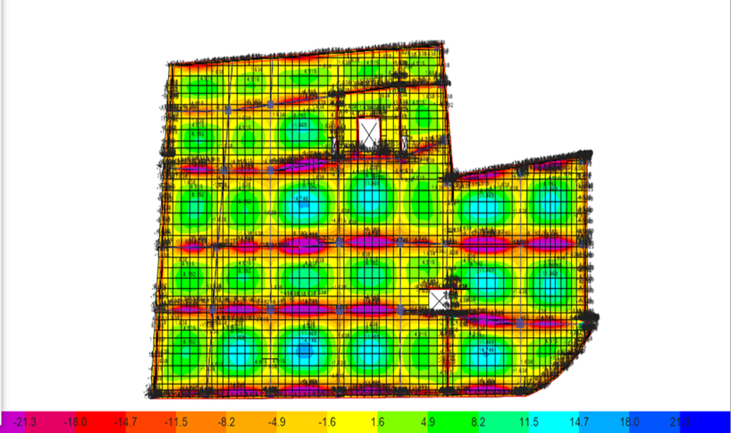
two way solid slab
As min= 360mm2.
→ use 4φ12mm/1000mm.
φMn =21.3 KN.m
M22 from ETABS in solid slab

Slide 56
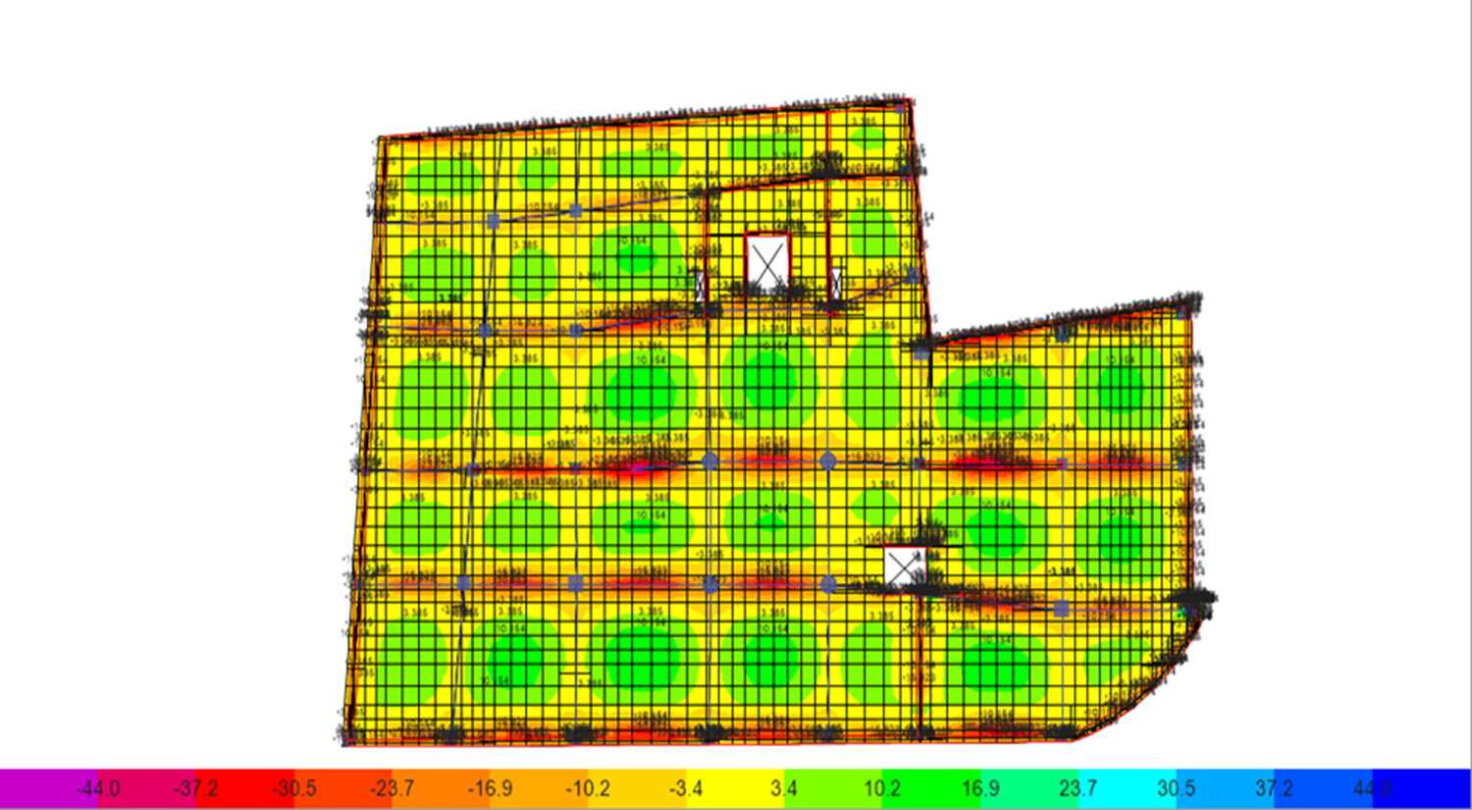
Top steel (Moment (22))
→ use 7φ12mm/2000mm.

Slide 57
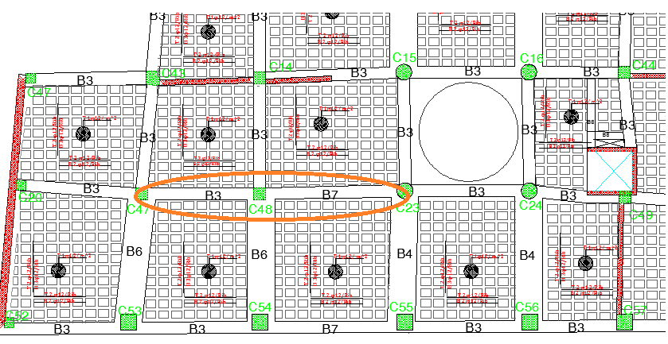
Design of beams

Slide 58
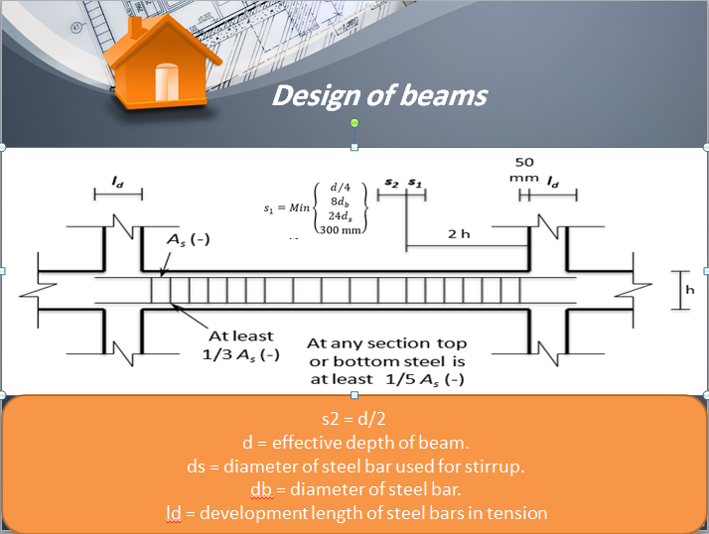

Slide 59
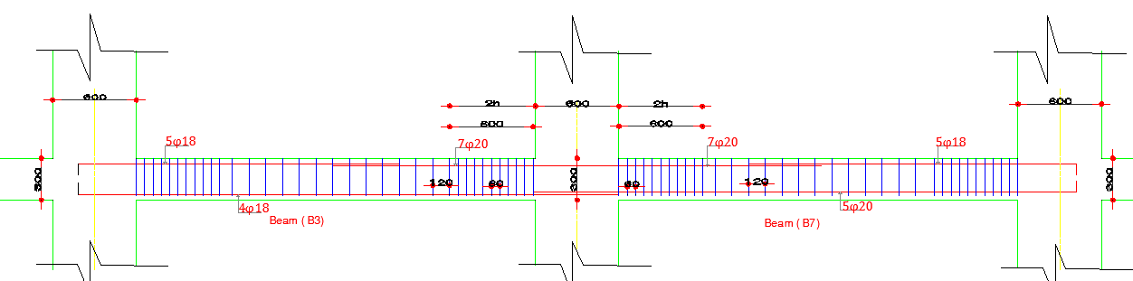
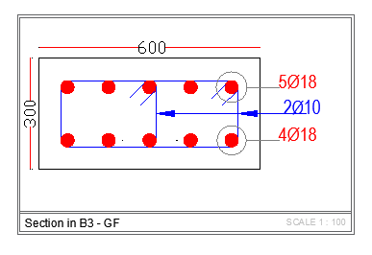
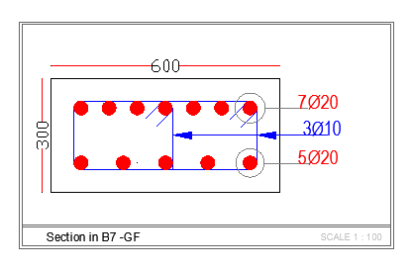
Designed Beam

Slide 60
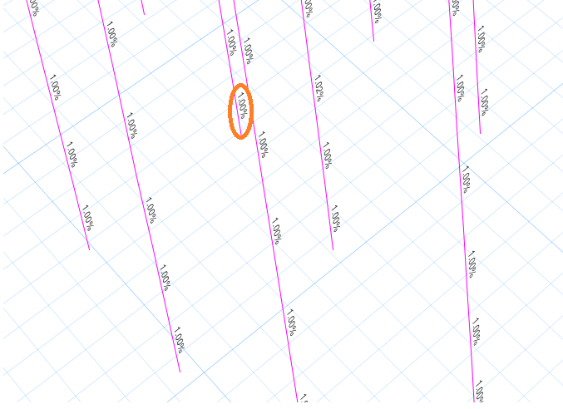
Design of columns

Slide 61
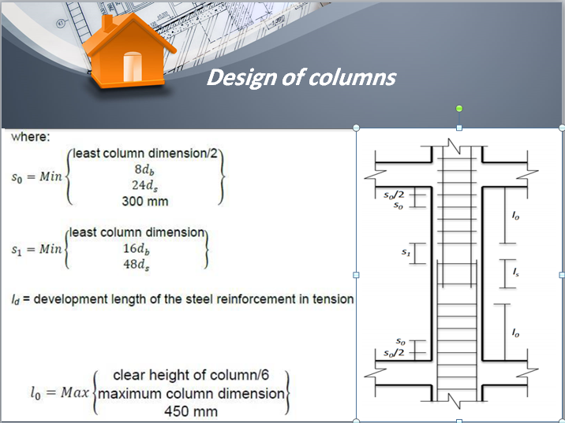

Slide 62
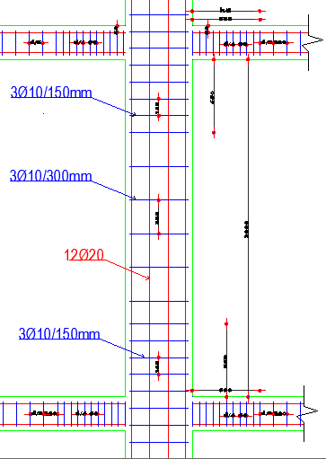

Designed column
Cross section in C14 (600*600)
Longitudinal section on column600*600

Slide 63

Designed shear wall under gravity load
𝑆ℎ𝑒𝑎𝑟 𝑤𝑎𝑙𝑙 ( 𝑋∗𝑌)
= ( 250𝑚𝑚∗6500𝑚𝑚).
𝐶𝑜𝑣𝑒𝑟 =40𝑚𝑚.

Slide 64

Designed shear wall under gravity load

Slide 65
𝐶ℎ𝑒𝑐𝑘 for 𝑠ℎ𝑒𝑎𝑟
X-Direction
Y-Direction
Shear Reinforcement
Vu
φVc
NO Need
Minimum
402.8KN
11.23 KN
680 KN
121.5 KN

Slide 66

For Pu = 5939 KN , Mux(M2) =260 KN.m.

Slide 67

For Pu = 5939 KN , Mux(M2) =10 KN.m

Slide 68
Design Of Shear Wall
Use minimum Shear reinforcement.
→Use 𝜌min=0.0025
𝐴𝑠,ℎ𝑜𝑟𝑖𝑧𝑜𝑛𝑡𝑎𝑙
= 𝜌𝑚𝑖𝑛∗𝑏∗ℎ=0.0025∗1000∗250=625𝑚𝑚².
625/2=312.5 𝑚𝑚² on each side.
Assume ϕ10→4 ϕ10 / m in each side.
As, Vertical :
𝑈𝑠𝑒 𝐴𝑠,𝑚𝑖𝑛 = 𝜌𝑚𝑖𝑛∗𝑏∗ℎ=0.0025∗1000∗250=625 𝑚𝑚².
Assume ϕ10 → 4 ϕ10 / m in each side.

Slide 69
Design Of Stair
Thickness of flight = 20cm
Load on stair:
*Dead = 5 𝑘𝑁/𝑚²
*Live = 5 𝑘𝑁/𝑚²
*Superimposed = 3 𝑘𝑁/𝑚²

Slide 70

Checks for stair
Checks for deflection
Max immediate deflection due to service load from
Etabs( Δ )=0.3mm.
Deflection limitation:-
Δ 𝐿,𝑎𝑙𝑙𝑎𝑤𝑎𝑏𝑙𝑒 ≤ 𝑙/240
=2210/240 =9.2𝑚𝑚

Slide 71

Check For Shear
∅ 𝑉𝑐 = 112.4 𝑘𝑁 /𝑚
The counter range from -33 - 38.5
→ all reading smaller than 112.4KN.
→ then no need for shear. reinforcement

Slide 72

Design of Flexure for stair
Flight
𝐴𝑠,𝑚𝑖𝑛 = 0.0018 ∗ 𝑏 ∗ ℎ =
0.0018×200×1000=360𝑚𝑚² (2∅16/𝑚).
→ use 2φ16mm/1000mm
Max M22 (positive) = 9.6 KN.m
→ ρ = 0.00088 < 0.0018
Use ρ = 0.00018
Moment (22)

Slide 73
Landing
Max M22 (positive) = 9.6 KN.m
→ ρ = 0.00023 < 0.0018
Use ρ = 0.00018
𝐴𝑠,𝑚𝑖𝑛 = 0.0018 ∗ 𝑏 ∗ ℎ
=0.0018×200×1000=360𝑚𝑚² (2∅16/𝑚).
→ use 2φ16mm/1000mm

Slide 74

Design for Transverse steel
𝐴𝑠 𝑠ℎ𝑟𝑖𝑛𝑘𝑎𝑔𝑒 = 𝐴𝑠 𝑚𝑖𝑛 =0.0018×200×1000=360𝑚𝑚².
in both face (Use 2 ∅16/1m for each layer)
Moment (11)

Slide 75

Design Of Mat Foundation
Mat foundation dimensions:
Assume h=110mm.

Slide 76

Checks of Mat Foundation
Check for deflection

Slide 77

Bearing capacity of the soil (𝑞𝑎𝑙𝑙 ) =250 kN/m²
Check for stress

Slide 78

Check for punching

Slide 79
Check Of Punching
Load on this column:
- Dead =2669.2KN.
-Superimposed dead = 1877.7 KN.
- live =1514.4 KN.
Ultimate load on column (Vu)
1.2*(2669.2+1877.7)+1.6*(1514.4) = 7879.3 KN.
∅Vc=0.75/3*√28*6480*1020/1000=8744 KN
Vu< ∅Vc→ OK

Slide 80

Design for Flexure
𝐴𝑠,𝑚𝑖𝑛 = 0.0018 ∗ 𝑏 ∗ ℎ = 0.0018 ∗ 1000 ∗ 1100 = 1980𝑚𝑚²/𝑚 (7∅20/𝑚).
→ use 7φ20mm/1000mm
φMn,min =750.3 KN.m
Moment (11)

Slide 81

Design for Flexure
→ use 7φ20mm/1000mm
φMn,min =750.3 KN.m
Moment (22)

Slide 82


