Slide 1
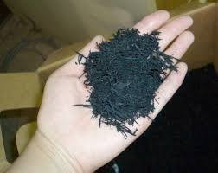
soil improvement using shredded rubber tires
Supervisor Name :
Dr.Isam Jardaneh
By: Ezedin Hamad
Wael Alaqma
Ahmad Bdair
Bahaa Hamdan

Slide 2
Outline
Introduction.
Methodology .
Design of R.W with typical backfill material only.
Design of R.W with typical backfill material mixed with shredded tires.
Comparison of cost between two cases.
conclusion.

Slide 3
Introduction
Soil improvement methods are many , one of these methods adding lighter material to the fill like polystyrene ,straw , plastic ,shredded tires ……etc.
Shredded tires application for backfill is one of the cheapest and easiest way for use because old tires are found everywhere and can be shredded if equipment are available

Slide 4
Introduction
Remember from previous semester
from the previous semester , after do the experiments we obtained that adding shredded tires to the soil will make it lighter and will decrease the dry unit weight at a certain percent .
Dry unit weight had been determined by using modified proctor compaction test .

Slide 5
Introduction
Remember from previous semester
Results was as follows :
Before adding shredded tires
After adding shredded tires (the best value)
at 10% shredded tires
γ_{d} max. | 2.28 | gm/cm³
OMC | 5.5 | %
γ_{d} max. | 1.72 | gm/cm³
OMC | 3.6 | %

Slide 6

Methodology
One of the ways to judge the efficiency of this method of soil improvement is design cantilever retaining wall that carry lateral loads .
Design done by using PROKON program

Slide 7
Methodology
Two cases for design:
Retaining wall with backfill material only
Retaining wall with backfill mixed with shredded tires .

Slide 8
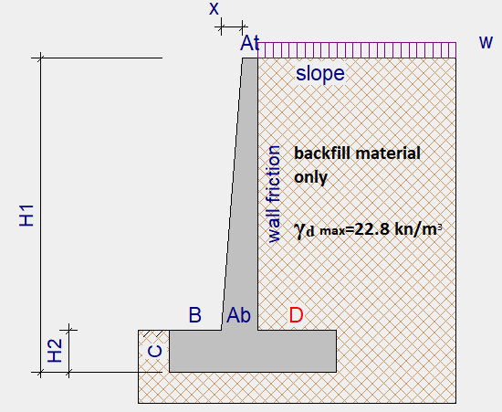
Cantilever retaining wall with backfill material only
in this case we consider that the dry unit weight of the backfill material 2.28 gm/cm3 = 22.8 kn /m3

Slide 9
Cantilever retaining wall with backfill material only
The expected soil under base will be:
Clay soil (Qall=150 kpa)
Marl (Qall=220 kpa)
Rock (Qall=350 kpa)

Slide 10
Cantilever retaining wall with backfill material only
The retaining wall will be design in different heights as below
R.W #1=2m
R.W #2=3m
R.W #3=4m
R.W #4=5m
R.W #5=6m
R.W #6=7m

Slide 11
Cantilever retaining wall with backfill material only
Assumptions
No water table and no seepage
No shear key , Active pressure not applied on back of shear key for sliding
Coulomb theory is applied , no seismic loads
At = .3 m , H3= 0 m
Cov. wall= 50 mm
Cov. base= 50 mm
W = 10 kn/m²

Slide 12
Cantilever retaining wall with backfill material only
Sample design of retaining wall number 5 (6m height)for clay soil under base
Input data :
H1=6m (R.W height)
H2=0.8m (height of the soil in front of the wall)
B=1.3m (horizontal base dimension in front of the wall)
D=1.8m (horizontal base dimension at the back of the wall)
C=0.8m (depth of base)
At=0.3m (wall thickness at the top)
Ab=0.7m ( wall thickness at the bottom)
W=10 kn/m2 (distributed load behind the wall)
ɸ=35° (angle of internal friction)
δ=20° (angle of friction between wall and soil)
ρ Conc=25 kn/m³ (density of concrete)

Slide 13
Cantilever retaining wall with backfill material only
ρ Soil= 22.8 kn/m³ ( density of soil )
fc`=25 Mpa( concrete cube compressive strength)
fy=450 Mpa( reinforcement yield strength )
SF overt. =2-2.5(allowable safety factor for overturning)
SF slip. =1.5( allowable safety factor for slip )
ULS DL Factor=1.4 (ultimate limit state dead load factor)
ULS LL Factor=1.6 (ultimate limit state live load factor)
Pmax=150 kpa (design bearing pressure at serviceability limit state)
Soil Poisson ʋ=0.5

Slide 14
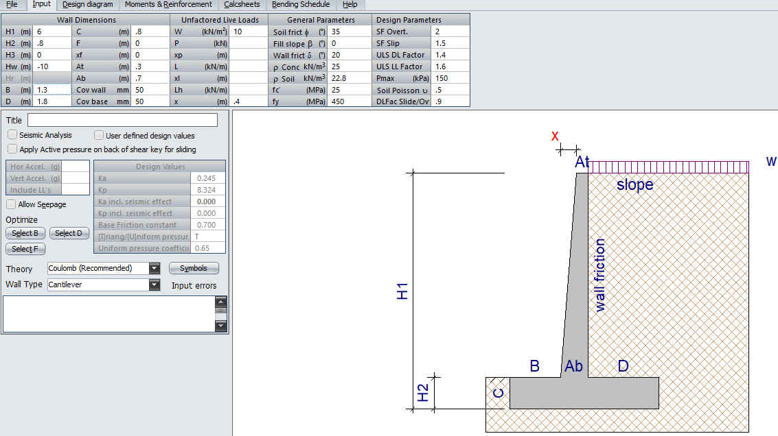
Cantilever retaining wall with backfill material only

Slide 15
Cantilever retaining wall with backfill material only
Design diagram
In design diagram the program will do checks for bearing capacity under base, sliding, and overturning.
Sliding factor of safety > 1.5
Overturning factor of safety > 2-2.5
Pressure acts on soil bearing layer < bearing capacity (Qall)

Slide 16
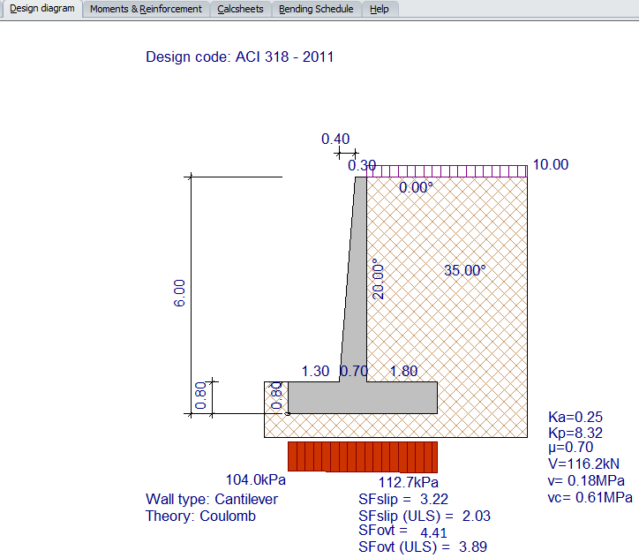
Cantilever retaining wall with backfill material only

Slide 17
Cantilever retaining wall with backfill material only
Checks :
Pressure under base=112.7 kpa < 150 kpa ( ok for pressure)
slipping F.S=3.22 > 1.5 (ok for slipping)
Overturning F.S=4.41 > 2 (ok for overturning)

Slide 18
Cantilever retaining wall with backfill material only
Bending schedule
In bending schedule the program will give atypical rebar for each part of retaining wall and draw the distribution for the reinforcement steel in the retaining wall
Note that the entered rebar area must not be less than the required and nominal

Slide 19
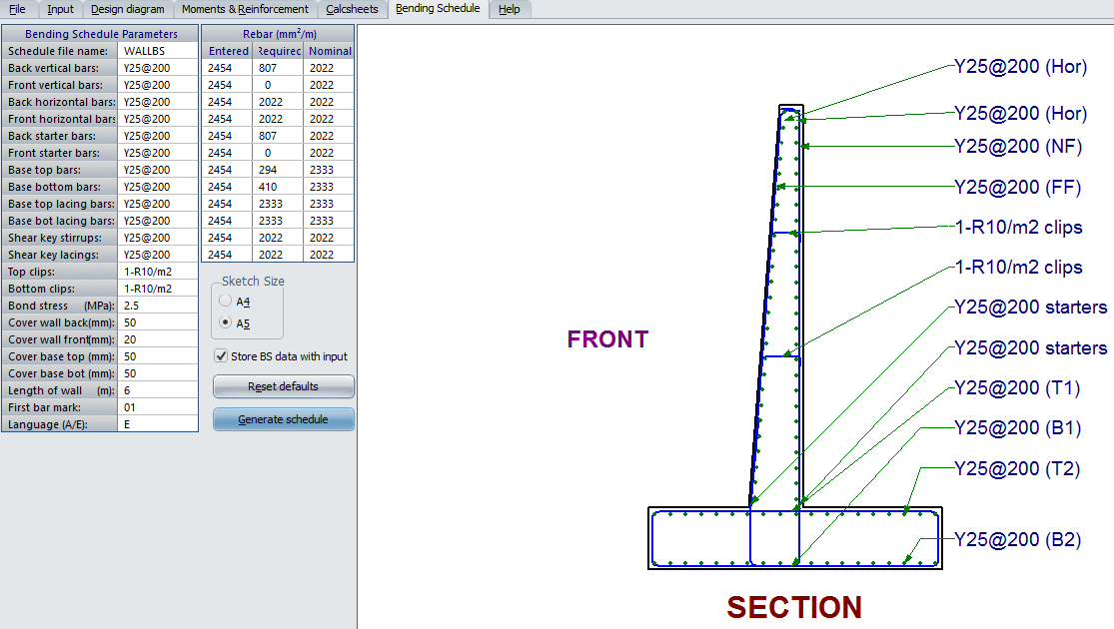
For example , for back vertical bars entered rebar = 2454 mm2 and it is larger than nominal rebar which is 2022 mm2
The same way of design for the others retaining walls.

Slide 20
Cantilever retaining wall with backfill material mixed with shredded tires
The same way of design for previous section
The obtained dry unit weight for this backfill material mixed with shredded tires is γ_{d}max=1.72 gm/cm³=17.2 kn/m³

Slide 21
Cantilever retaining wall with backfill material mixed with shredded tires
Sample design of retaining wall number 5 (6m height)for clay soil under base
Input data :
H1=6m
H2=0.7m
B=1.1m
D=1.5m
C=0.7m
At=0.3m
Ab=0..65m
W=10 kn/m2
ɸ=35°
δ=20°
ρ Conc=25 kn/m³

Slide 22
Cantilever retaining wall with backfill material mixed with shredded tires
ρ Soil= 17.2 Kn/m³
fc`=25 Mpa
fy=450 Mpa
SF overt. =2-2.5
SF slip. =1.5
ULS DL Factor=1.4
ULS LL Factor=1.6
Pmax=150 kpa
Soil Poisson ʋ=0.5

Slide 23
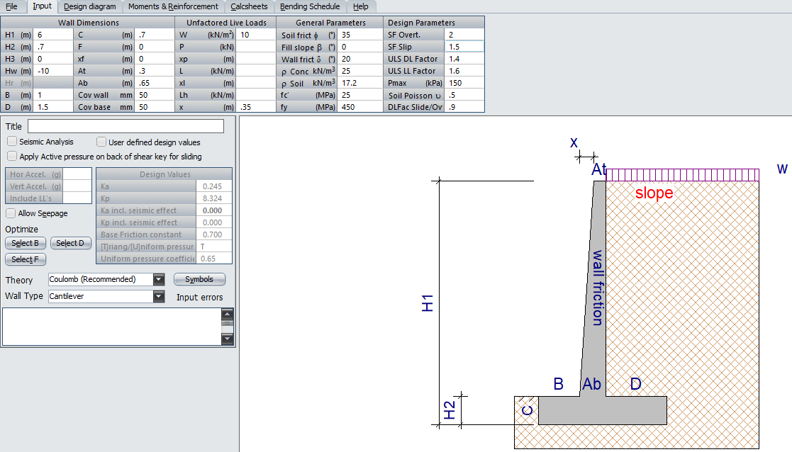
Cantilever retaining wall with backfill material mixed with shredded tires

Slide 24
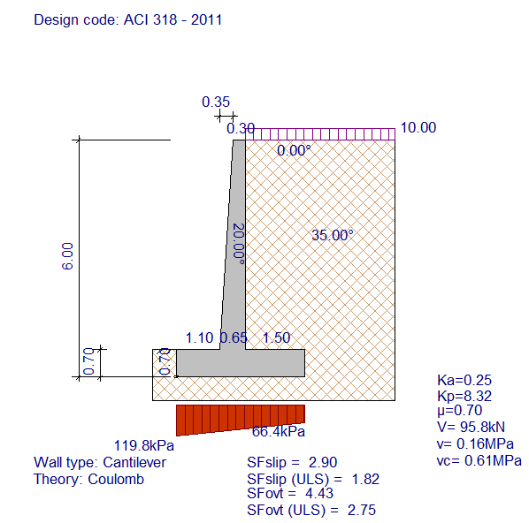
Cantilever retaining wall with backfill material mixed with shredded tires
Design diagram
Slipping F.S=2.9 > 1.5
Overturning F.S=4.43>2
Pressure=119.8 kpa <150 kpa

Slide 25
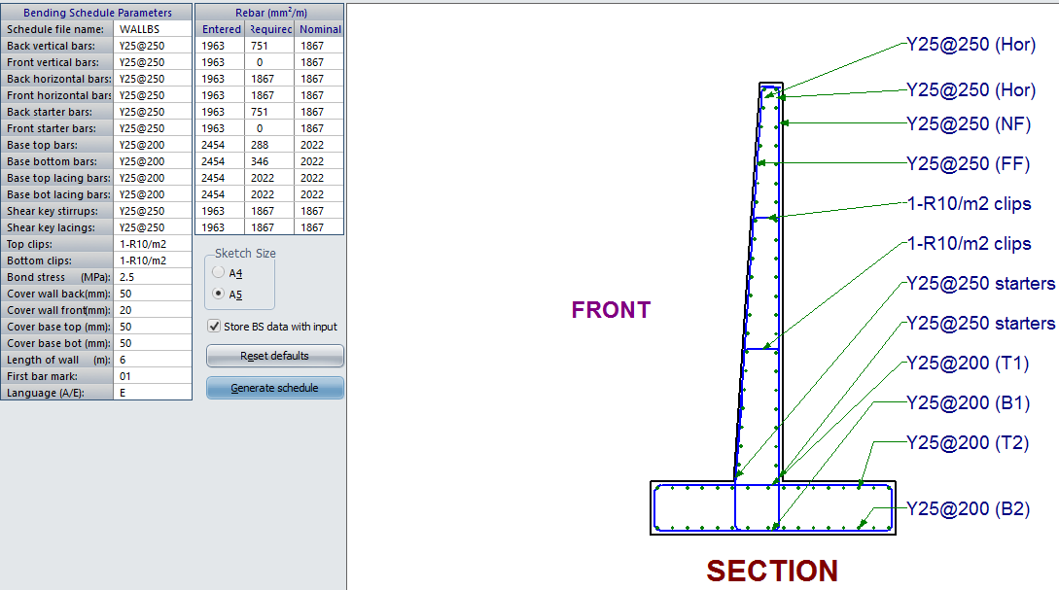
Cantilever retaining wall with backfill material mixed with shredded tires
Bending schedule

Slide 26
Comparison of cost between two cases
comparison of cost per meter run for retaining walls between the two cases and the cost conclude the two main and most expensive parameters:
concrete
Steel
we use Excel to compute the quantities of concrete and steel , net cost and percent saved .

Slide 27
Comparison of cost between two cases
For the same wall (6m) before mixing with shredded tires for clay
Concrete cost
Steel cost
R.W# | B(m) | C(m) | D(m) | H1(m) | H2(m) | H1-H2(m) | At(m) | Ab(m) | Volume(m3) | cost(nis)
5(6m) | 1.3 | 0.8 | 1.8 | 6 | 0.8 | 5.2 | 0.3 | 0.7 | 5.64 | 1804.8
H1(m) | total weight(kg) |  | cost (nis)
6 | 421.5659 |  | 1096.07134

Slide 28
Comparison of cost between two cases
Total cost
RW# | concrete cost(nis) | steel cost(nis) | net cost (nis)
5(6m) | 1804.8 | 1096.07 | 2900.87

Slide 29
Comparison of cost between two cases
After mixing with shredded tires for clay
Concrete cost
Steel cost
R.W# | B(m) | C(m) | D(m) | H1(m) | H2(m) | H1-H2(m) | At(m) | Ab(m) | volume(m3) | cost(nis)
6(2m) | 1.1 | 0.7 | 1.5 | 6 | 0.7 | 5.3 | 0.3 | 0.65 | 4.7925 | 1533.6
H1(m) | total weight(kg) |  | cost (nis)
6 | 396.9446 |  | 1032.05605

Slide 30
Comparison of cost between two cases
Total cost
RW# | concrete cost(nis) | steel cost(nis) | net cost (nis)
5(6m) | 1533.6 | 1032.05 | 2565.65

Slide 31
Comparison of cost between two cases
Total percent saved
RW# | Total cost before(nis) | Total cost after(nis) | deference(nis) | %saved
5(6m) | 2900.87 | 2565.65 | 335.22 | 11.55584

Slide 32
conclusion
we recognized some methods used to improve soil and one of these methods is by using shredded rubber tires and add them to the soil with a certain percent and we obtained by experiment that the best percent is 10% which gives the lower dry unit weight equal 1.72 gm/cm³ and with optimum moisture content equal 3.6 % ,and this value of dry unit weigh can be decreased more if we use a crushed pieces of tires which make the mix homogeneous more than before but this need a special machines which is not available widely in Palestine (limited) and this is an obstacle if we want to apply this in reality .
Then we design retaining walls using PROKON software in two cases, the first case is before we add the shredded tires on the backfill material (backfill only) with the original unit weigh equal 2.28 gm/cm3 and the second case is after we mix shredded tires with backfill material with the new dry unit weight which equal 1.72 gm/cm³ and based on the obtained results from the program we conclude that the second case can give us less dimensions for the retaining wall than the first case at same heights for both cases and this is logical because when the density of the backfill decreased this means the lateral loads apply on the wall will decrease .
After that, in the we made comparison of cost per meter run for retaining walls between the two cases and the cost conclude the two main and most expensive parameters concrete and steel and then we compute the percent save for each type of soil bearing (clay, marl, rock) and we obtained that the highest percent saved is for retaining wall number 1 (2m height) which is 23% from the old cost.

Slide 33
Thank you

