Slide 1
Wireless charging
AN-NAJAH NATIONAL UNIVERSITY
FACULTY OF ENGINEERING AND INFORMATION TECHNOLOGY
ELECTRICAL ENGINEERING DEPARTMENT
Supervised by: Dr. Moien Omar
Prepared by: Maram fatouh.
Amani mansour.

Slide 2
Outlines
Introduction
The importance of this project .
General view about the project .
Design .
Hard ware.
Results.
Conclusions(summary , cost , future work).

Slide 3
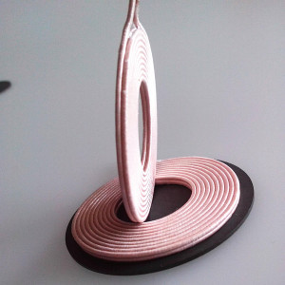
Introduction
Charging is the process of transferring electrons from one device to another one.
Wireless charging is one methods of charging batteries without using cable which called inductive coupling.

Slide 4
The importance of this project
The main objective of the wireless charging:
Suitable for emergency cases.
Reliable.
Efficient.
Fast.
Low maintenance cost.

Slide 5
Advantages
Greater convenience for the charging of everyday electronic devices
No wires.
Reduce cost.
Safe power transfer .
Eliminate sparks and debits associated with wired contact.

Slide 6
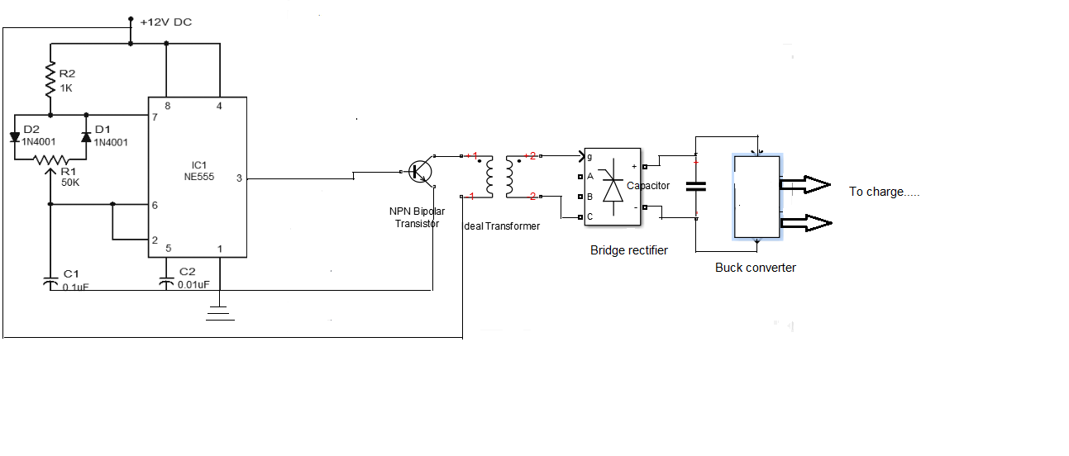
General view about the project
The project work as the below figure show :

Slide 7
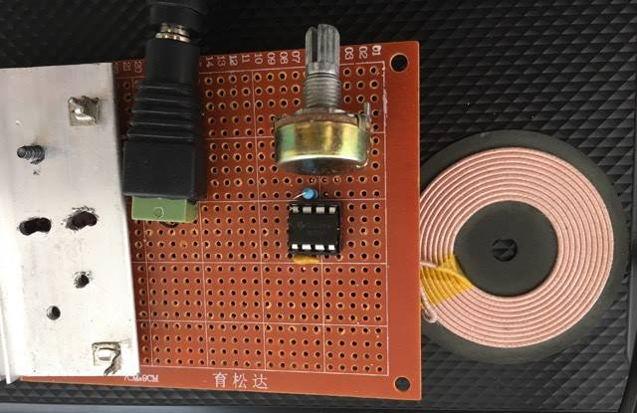
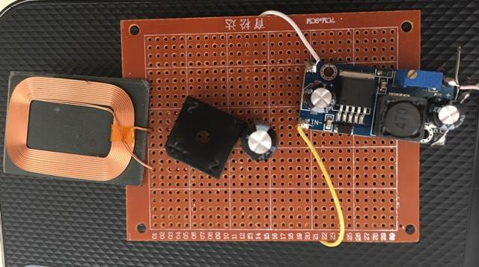
Design
Main scheme diagram of wireless charging

Slide 8
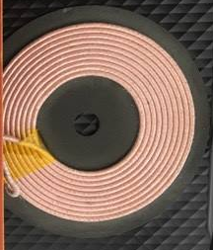
Hard ware
Primary side
Coils:
Made from copper.
10 turns.
Diameter of the wire(1 mm).
With a base of non conducting
Magnetic material to decrease the losses.

Slide 9
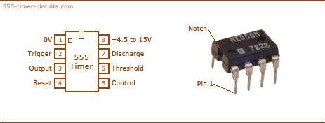
NE555P IC (Timer):
To create high frequency pulses(40-50 KHZ), then this pulses drive a transistor which switches on and off are at the primary winding of the coil.

Slide 10
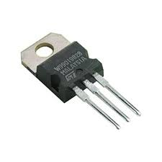
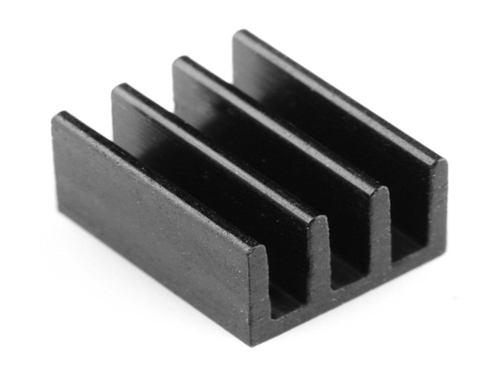
Transistor with heat sink
The transistor works as a switch and it amplifies the current.
The heat sink made from aluminum to reduce the heat of transistor.

Slide 11
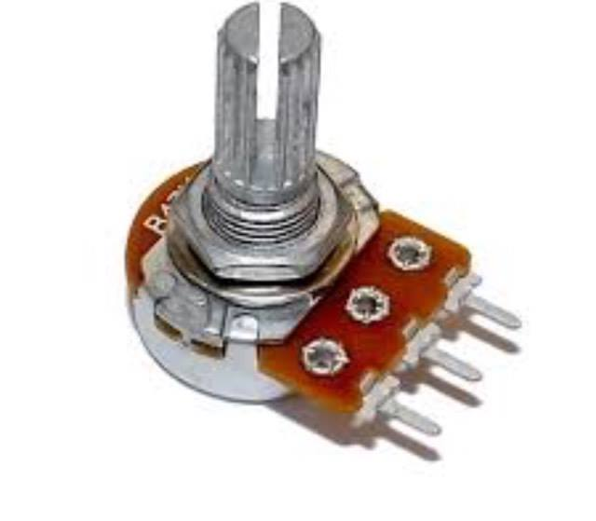
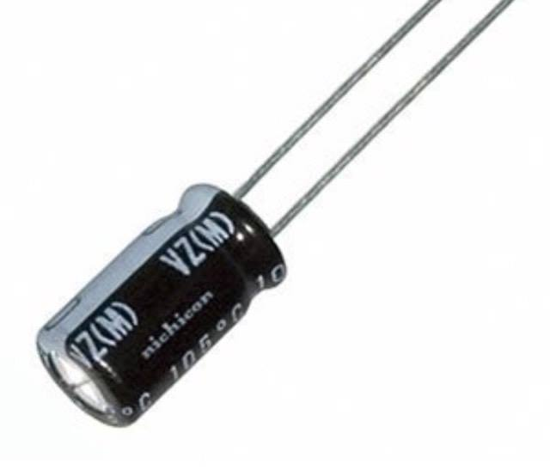
Potentiometer & Capacitors
Use the potentiometer 100 k connected with the timer.
Capacitor to Store energy in the on area and discharge it in the off area.

Slide 12
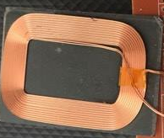
Secondary side
Coils
Made from copper.
40 turns.
Diameter of the wire(0.1mm).
With a base of non conducting
Magnetic material to decrease the losses .

Slide 13
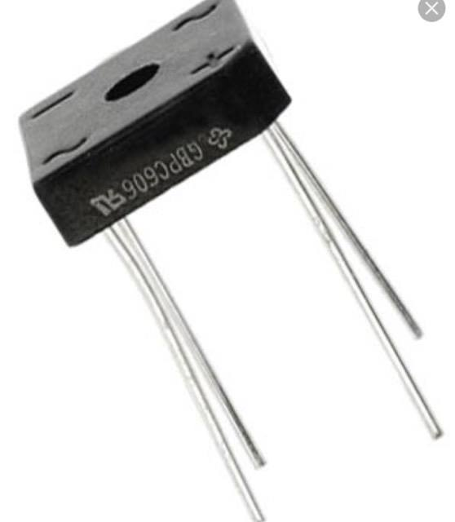
Bridge recifier
It consist of 4 diodes 1N4935
Convert from AC to DC.

Slide 14
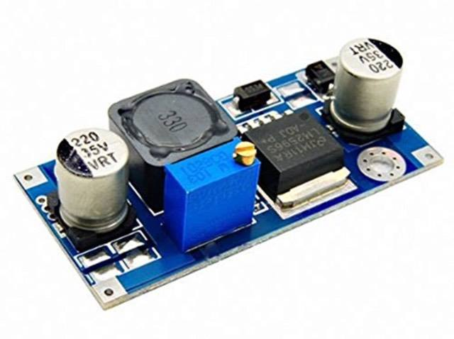
Buck converter
step-down converter is a DC-to-DC power converter which steps down voltage from its input (19.3 volt) to its output (load 5 volt ). It typically containing at least two semiconductors )diode and a transistor(.

Slide 15
parameters affects the wireless charging
Distance
Maximum efficiency is achieved when the devices are relatively close to one another.
The distance between two coil around(0.5) cm.

Slide 16
parameters affects the wireless charging
Frequency
Adjusting the frequency of the timer in the range of (40- 50) kilo hertz that the transferring operation reaches the maximum status .
When increase the frequency the volt increaseat the secondry
V= N*4.44*f*flux .

Slide 17
Conclusion
Summary
Overall, this finished project met all the expectations. It was stated in the proposal to design a mobile wireless charger that eases the daily life of people, especially in the emergency cases, transfer power wirelessly to charge electronic equipment, vehicles, and other mobile systems.

Slide 18
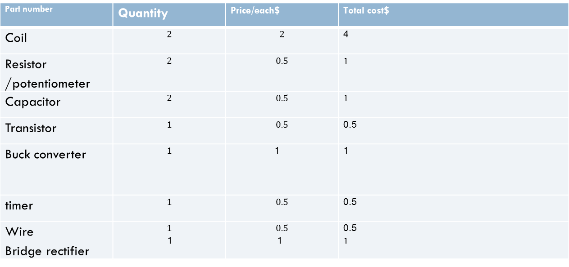
Conclusion
Cost Details and Economical Dimensions
The following table shows all the elements and their related cost:
Part number | Quantity | Price/each$ | Total cost$
Coil | $$2$$ | $$2$$ | 4
Resistor /potentiometer | $$2$$ | $$0.5$$ | 1
Capacitor | $$2$$ | $$0.5$$ | 1
Transistor | $$1$$ | $$0.5$$ | 0.5
Buck converter | $$1$$ | 1 | 1
timer | $$1$$ | $$0.5$$ | 0.5
Wire Bridge rectifier | $$1$$ 1 | $$0.5$$ 1 | 0.5 1

Slide 19
Conclusion
Future Work
It can improve the project in many ways:
Display the charger at more distance between the coils.
Increase the efficiency by increasing the output power

