Slide 1


An-Najah National University
Faculty of Engineering & Information Technology
Department of Building Engineering
Graduation Project
Redesign of the Qusra boys and girls elementary school
Students:
Islam Sawalmeah Bilal Melhem
Supervisor : Eng. Narmeen Al-Barq

Slide 2

Outline :
Introduction
Description of Project
Architectural Analysis and Re-design
Structural Analysis and Re-design
Environmental Analysis and Evaluation
Electromechanical design
cost estimation
Picture from Lumion

Slide 3
Introduction:
Through this project we will make redesign of Qusra boys and girls elementary school where redesign process includes Architectural, structural, electromechanical and environmental aspects.
After study and analyses the building in first part complete the re-design in second part to include the structural and electromechanical aspects.
In this part will integrate all design to prevent the detection between each other.

Slide 4
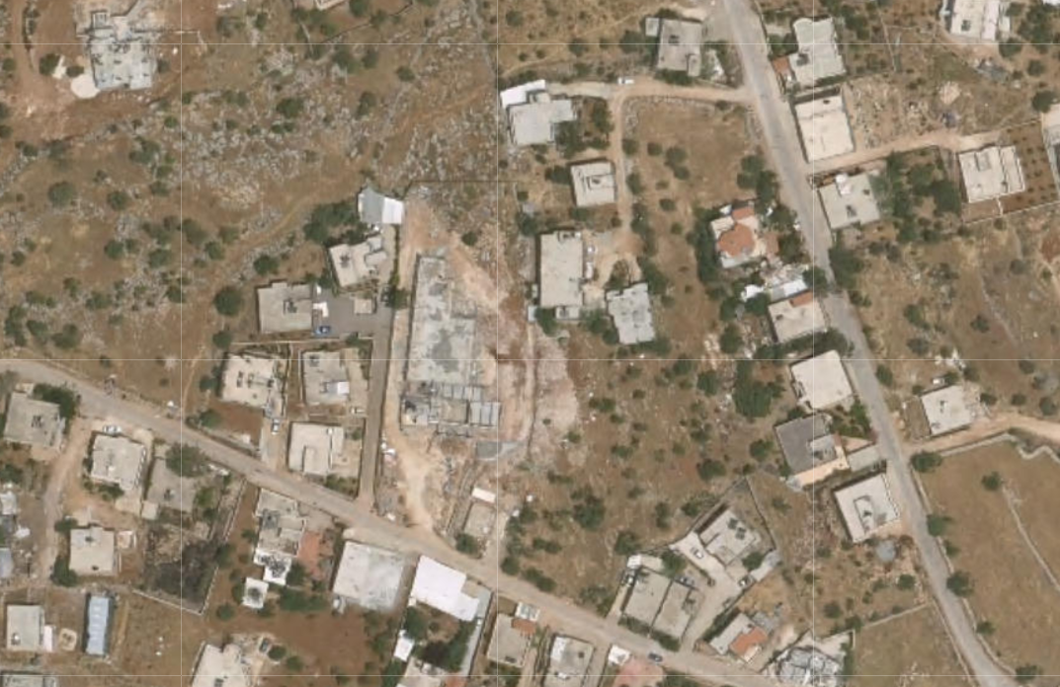
Description of our project :
Location :
Our project locates in Qusra village in southeast of Nablus city on the land with area 4.3 dunums.

Slide 5
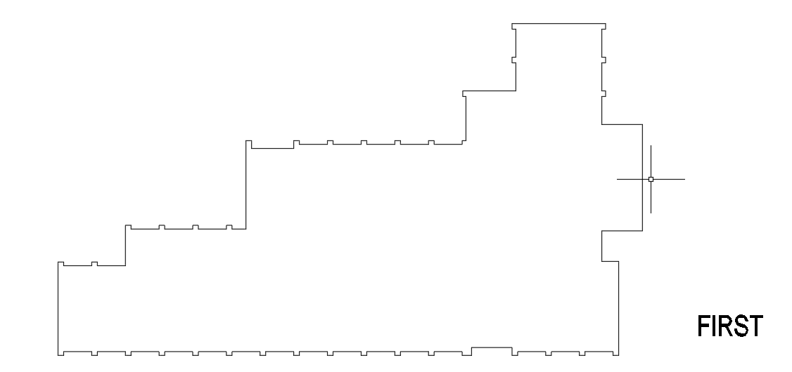
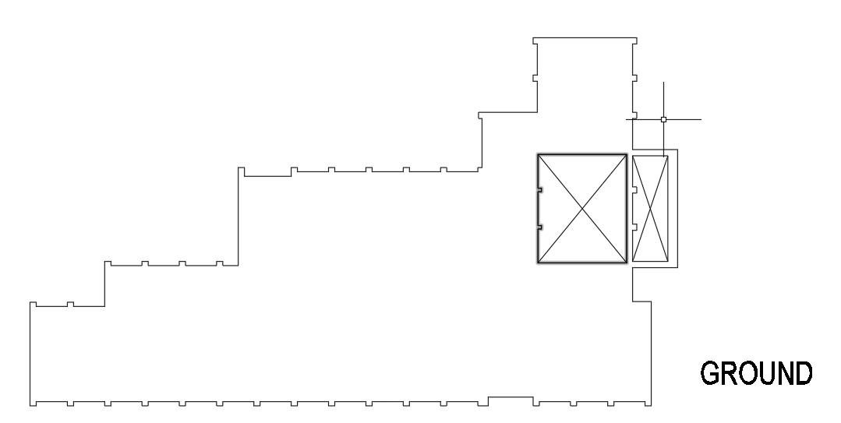
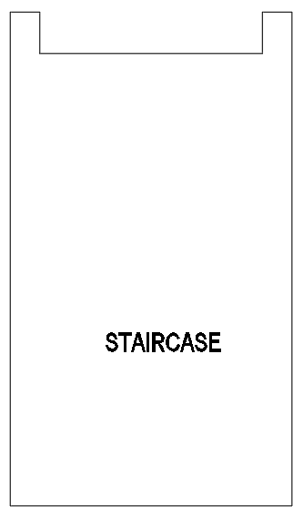
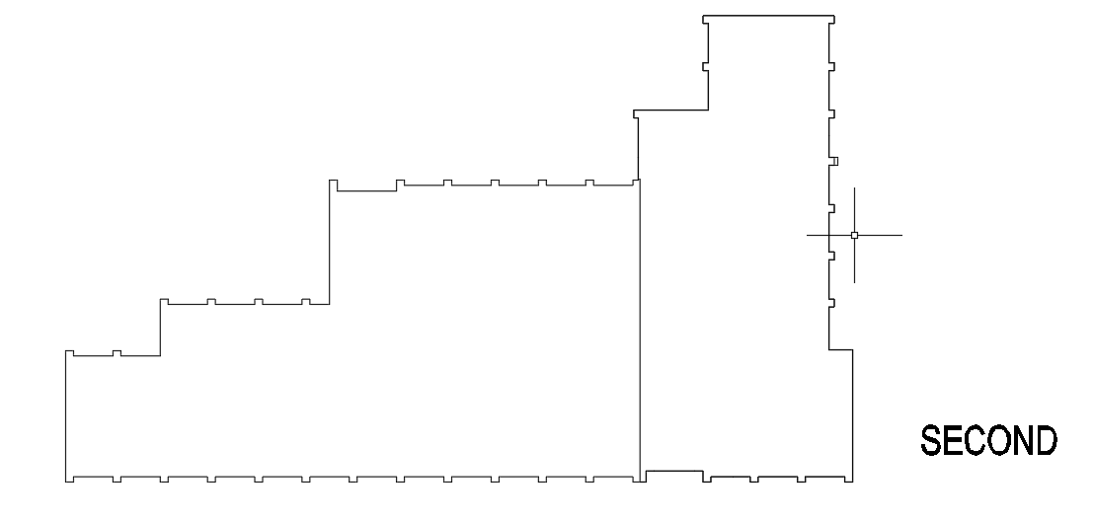
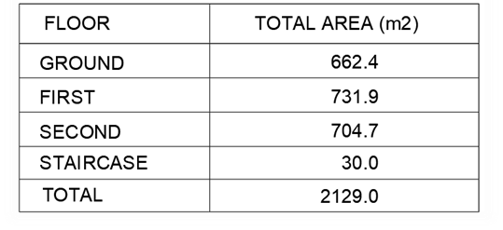
Description of our project :
Area and number of stories of building :
The school has total area 2.1 dunums which distributed on 3 floors ground, first and second floor.
Area for each floors

Slide 6
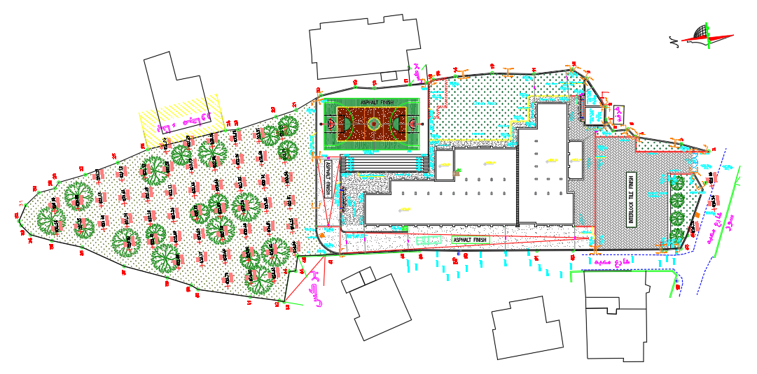
Description of our project :
Site and land boundary
The total area of the site around the building equals 4327m²
The description | Raito
Building it self | 48.69%
The paly ground area | 9.3%
Route | 12.15%
Space area | 10.8%
Green area | 19.06%

Slide 7
Architectural analysis and redesign
In this section study the all spaces in the our project according to the codes and standard and find the following modification .

Slide 8
Architectural analysis and redesign
Building it self
Secretary room | Add door between the secretary room and head master room
Waiting area | Increase it area to be 15-20 m²
Teacher room | Move it from the first floor to ground floor
Technology lap | Reduce it area to be 50m²
Canteen | Convert it to kitchen and cafeteria
lobby | Add another lobby to make relation between the lineup and building
Toilet | Change the location of the toilet space
Vertical move | Add external stairs for fire fighting and elevator
Horizontal move | Add ramps for handicap
Site
1.Add another entrance to car separated from students entrance
2.Add 23 parking space
3.Change the location of play ground area to make line up area

Slide 9
Architectural analysis and redesign
Architectural redesign
After analyzed each space and study functional relation with other spaces and study the site with it’s components then find the result form this analysis, we will redesign the building according to standards take in consideration integration between architectural and structural designs and another building .

Slide 10
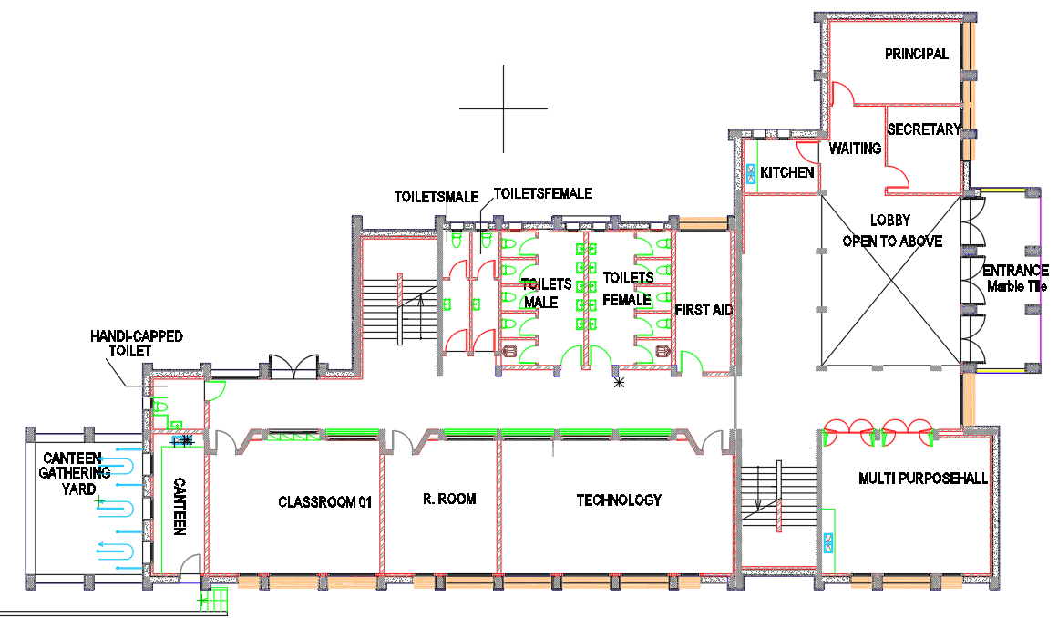
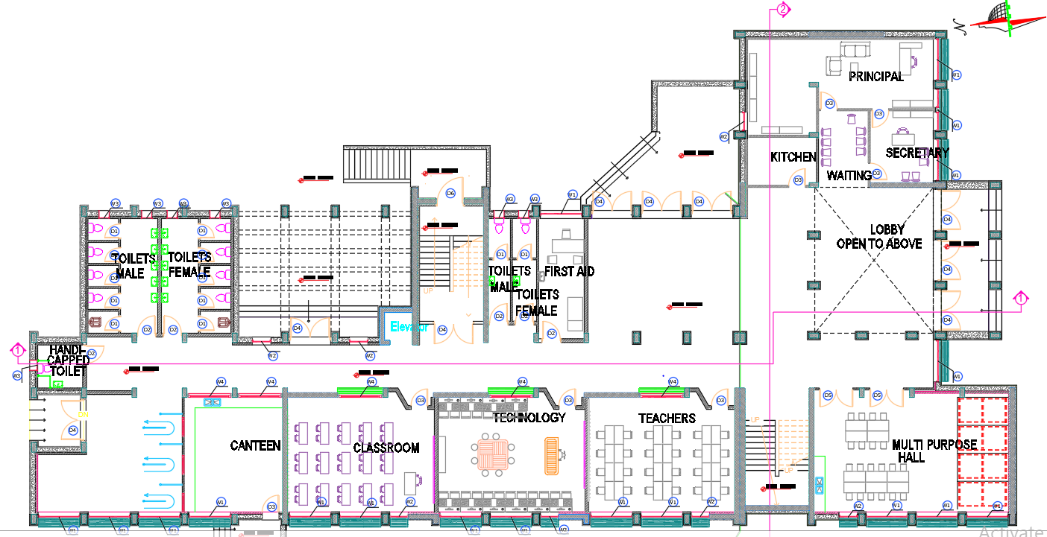
Architectural analysis and redesign
Ground floor plan after redesign
Before
After

Slide 11
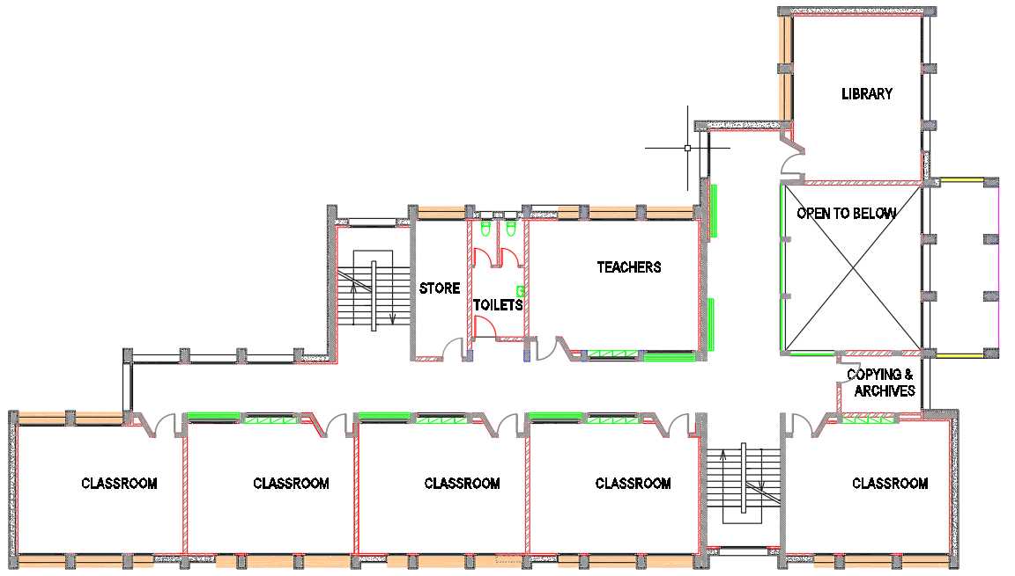
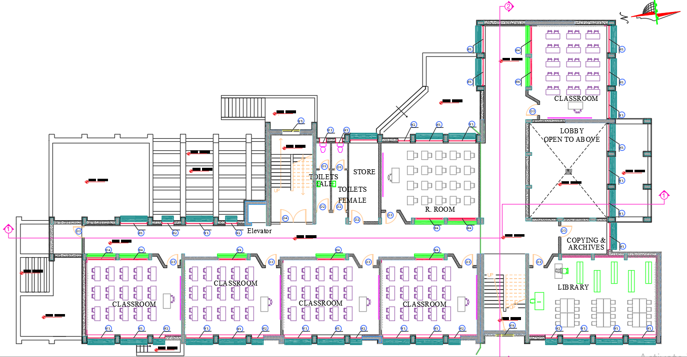
Architectural analysis and redesign
First floor plan after redesign
Before
After

Slide 12
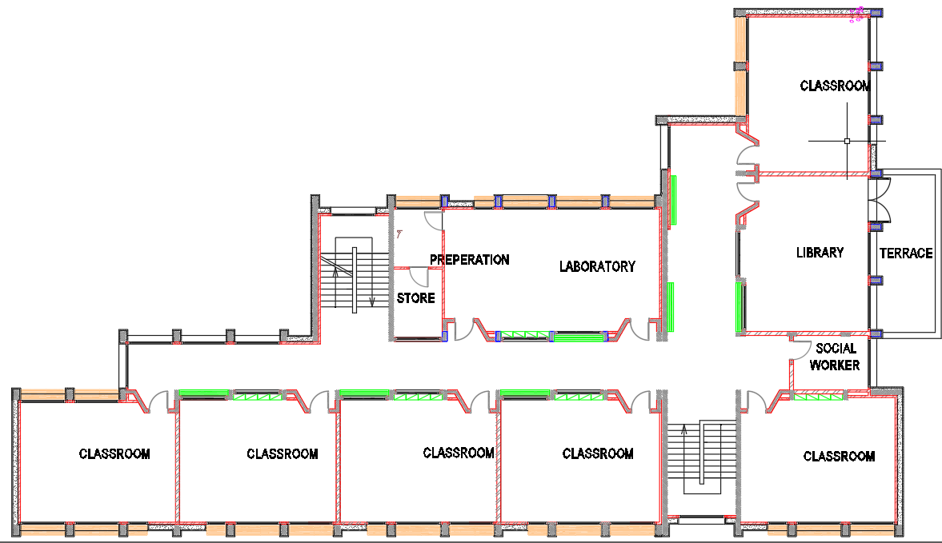
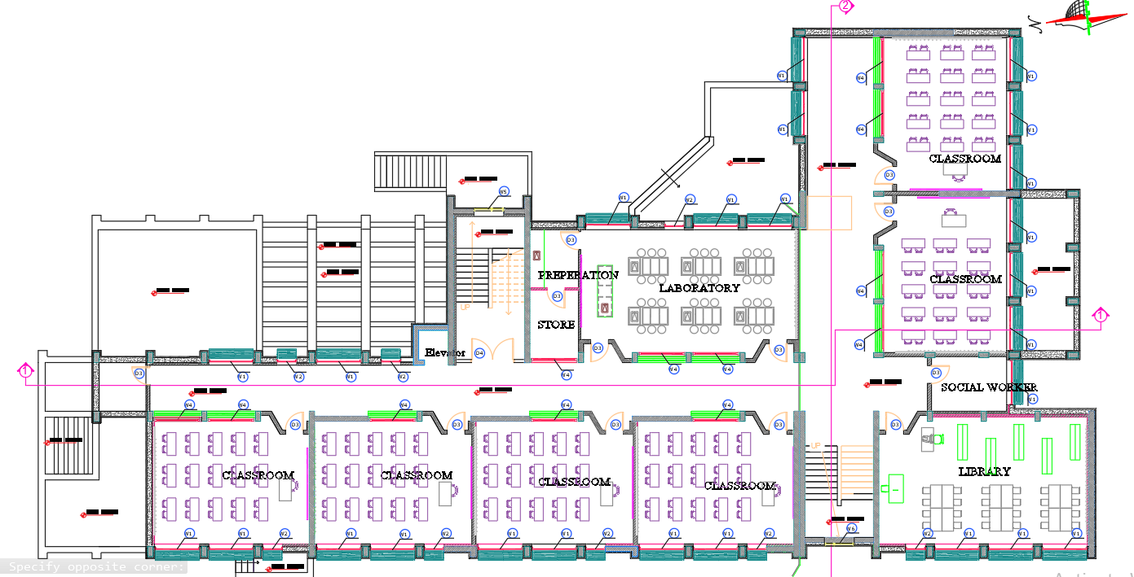
Architectural analysis and redesign
Second floor plan after redesign
Before
After

Slide 13
Architectural analysis and redesign
Site before redesign

Slide 14
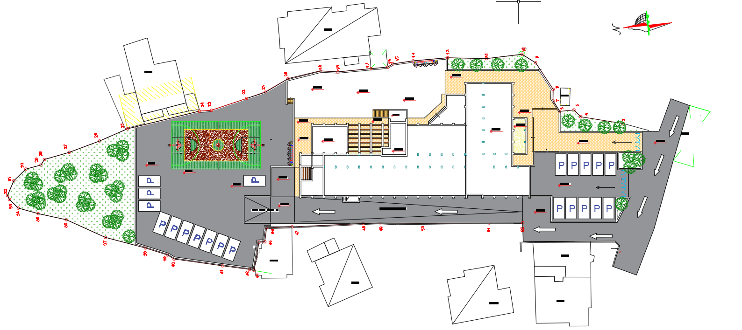
Architectural analysis and redesign
Site after redesign

Slide 15
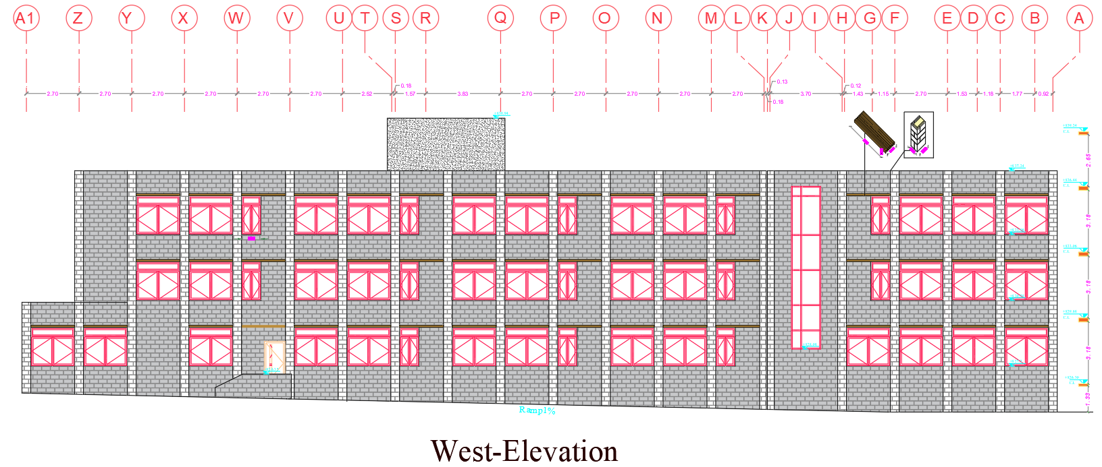
Architectural analysis and redesign
Section and elevation after redesign

Slide 16
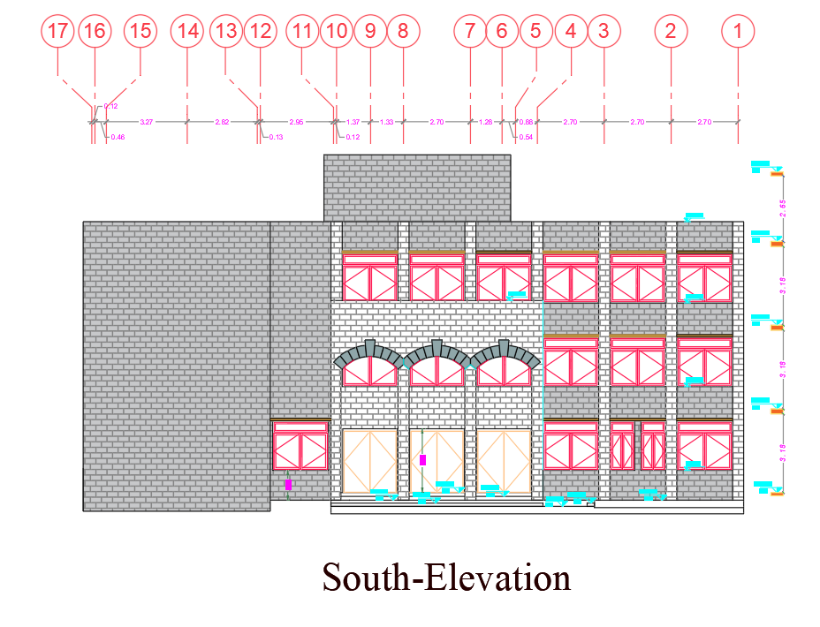
Architectural analysis and redesign
Section and elevation after redesign

Slide 17
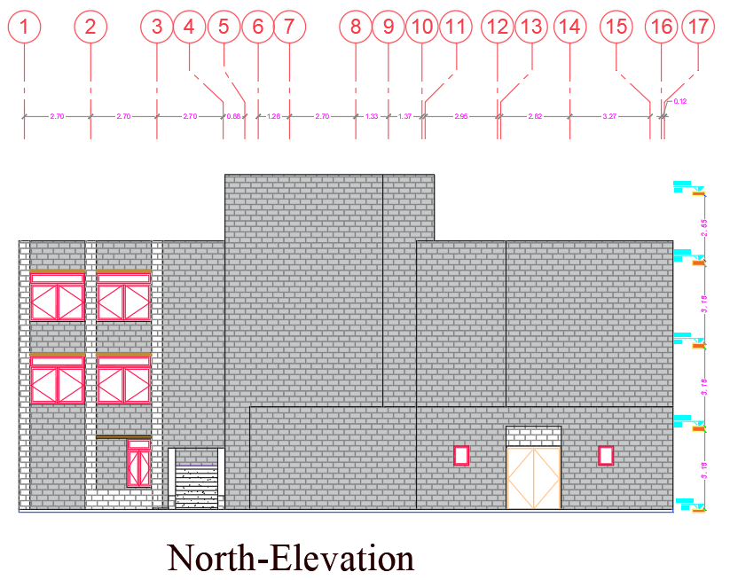
Architectural analysis and redesign
Section and elevation after redesign

Slide 18
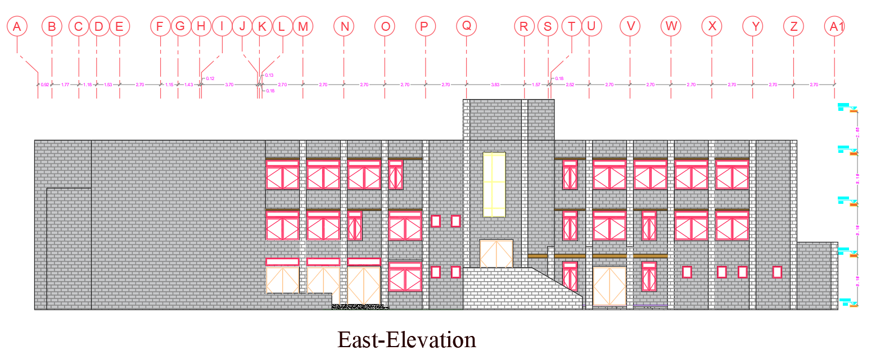
Architectural analysis and redesign
Section and elevation after redesign

Slide 19
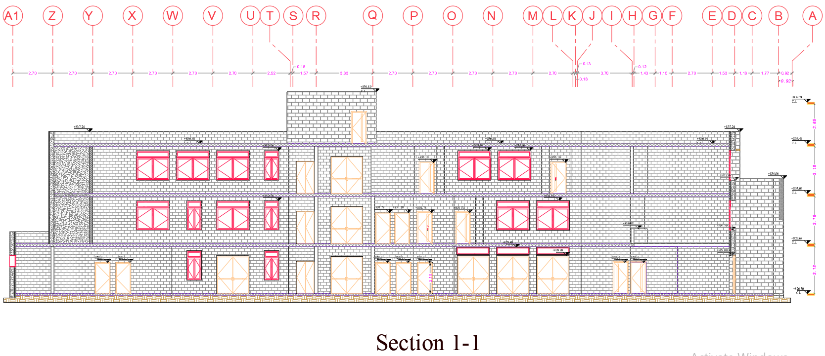
Architectural analysis and redesign
Section and elevation after redesign

Slide 20
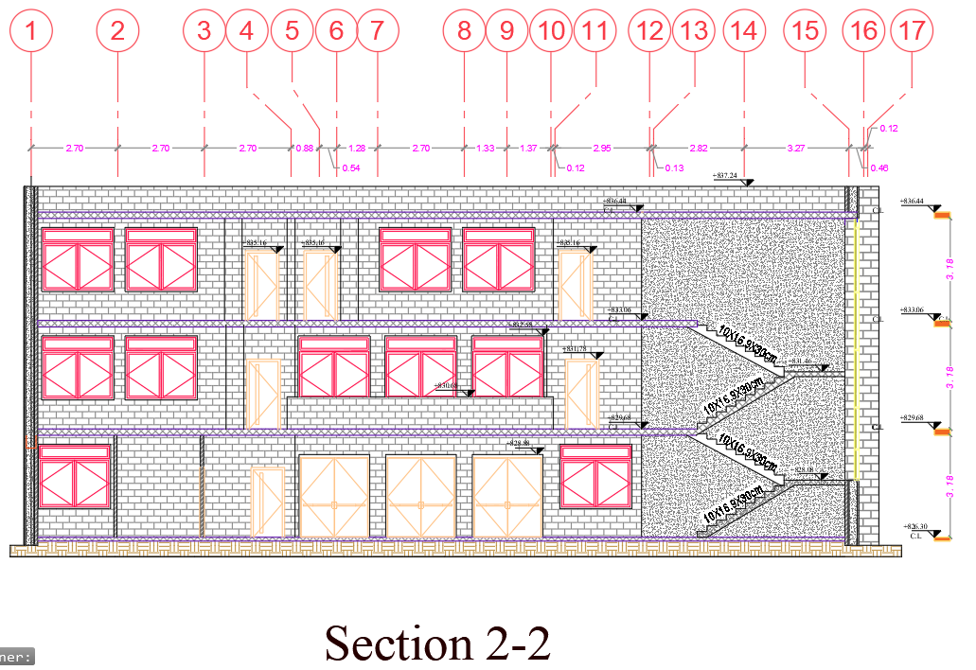
Architectural analysis and redesign
Section and elevation after redesign

Slide 21
Structural design
General information
Design code :
American Concrete Institute ACI 2014.
The Uniform Building Code -UBC-97 for seismic design and its load combinations.
Materials :
Concrete.
f´c = 28 Mpa for shear walls and columns
f´c = 24 Mpa for beams , slabs and footings .
Specific weight of Reinforced concrete (Ɣ) = 25 KN/m³
Yielding strength of steel (Fy = 420 Mpa)
Bearing capacity of soil = 450 KN/m².

Slide 22

Structural analysis
General information
Loads
Live Load= 5 KN/m²
Superimposed dead load = 4.5 KN/m²
Weight of Masonry wall = 21 KN/m
Seismic analysis:
Seismic zone : 2B with (Z = 0.20) .
Soil profile : SB.
Acceleration-dependent seismic coefficients Ca=0.20.
Velocity-dependent seismic coefficients Cv= 0.20.
Importance factor I=1.
Force reduction factor R=5.5

Slide 23
Structural analysis
Structural element used
- Slab:
One way rib slab with 20cm thickness.
- Columns:
The columns are dimensional (0.25* 0.50) m
- Shear walls:
Thickness 25 cm for walls.
- Main beams:
The main beams dimensions are assumed to be 0.60m depth and 0.30m width .
-Secondary beams :
The secondary beams dimensions are assumed to be 0.4m depth and 0.25m width .

Slide 24
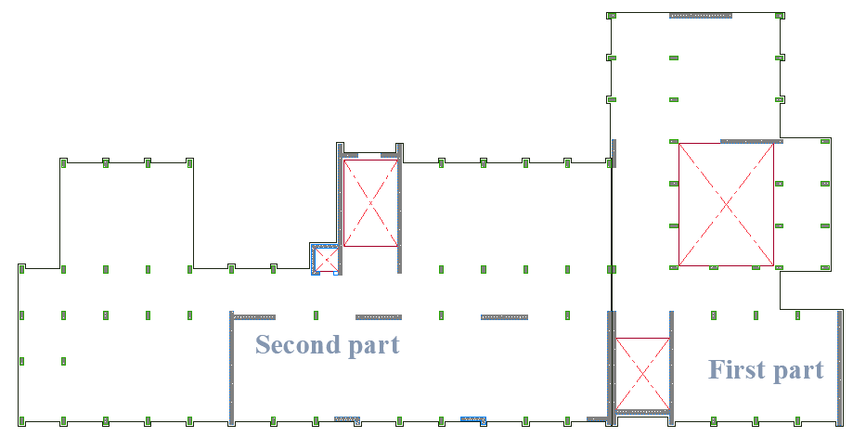
Structural analysis
Structural layout
The structural layout of the building

Slide 25
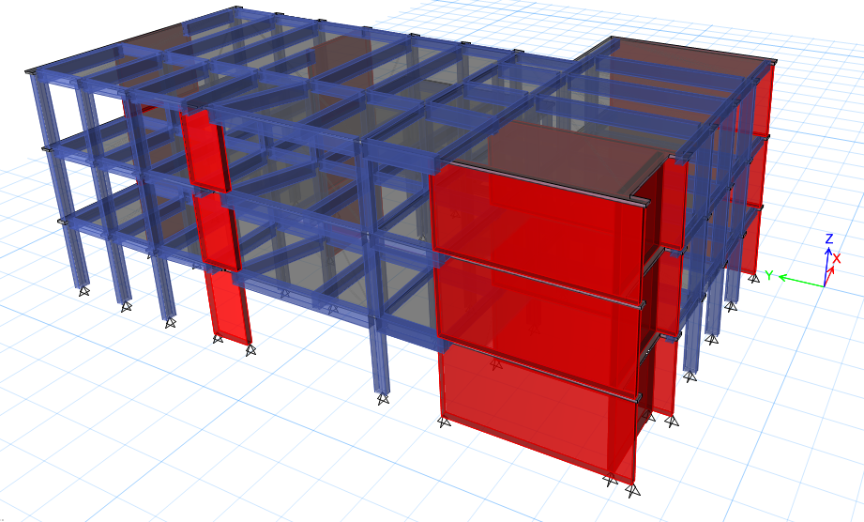
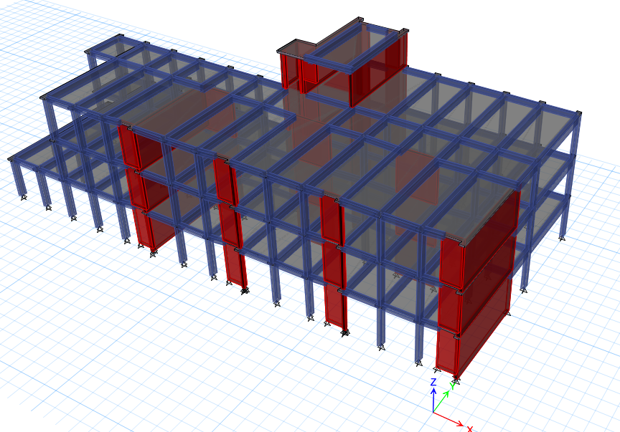
Structural analysis
Structural ETABS model
Figure :3D model for the first part
Figure :3D model for the second part

Slide 26
Structural analysis
ETABS checks
To ensure that the calculation is done correctly from ETABS; some checks are required :
Compatibility check
Equilibrium check
Internal force check
Deflection check
Period check
Modal mass participate ratio check (MPMR)
Drift check
Base Shear cheek

Slide 27
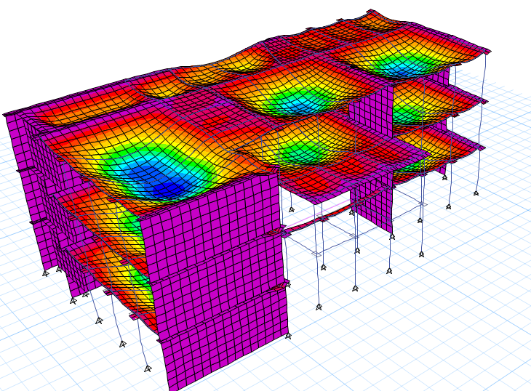
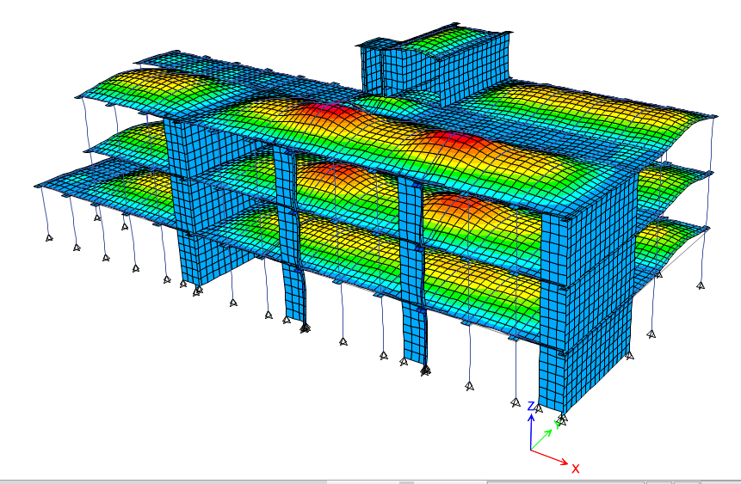
ETABS checks
Compatibility check
Compatibility check for the first part
Compatibility check for the second part

Slide 28
Equilibrium check
This check done for Dead, SID and Live load within difference less than 5 %.
Table :Equilibrium check for the first part
Table :Equilibrium check for the second part
Load | Etabs(KN) | Parts | Manual(KN) | %Error
Live | 4472.827 | Slabs | 4474.2 | 0.03%
SID | 8111.432 | Slabs | 4026.78 | 0.012%
 |  | Walls | 4083.66
 |  | Total (KN) | 8110.44
Dead | 7440.922 | Slabs | 3355.65 | 1.87%
 |  | Columns | 971.75
 |  | Walls | 1039.35
 |  | main beams | 1575.225
 |  | secondary beams | 641.4
 |  | Total (KN) | 7583.375
Load | Etabs (KN) | Parts | Manual (KN) | %Error
Live | 7169.35 | Slabs | 7178.2 | 0.12%
SID | 11095.52 | Slabs | 6460.38 | 0.44%
 |  | Walls | 4586.4
Total (KN) |  |  | 11046.78
Dead | 11507.44 | Slabs | 5383.65 | 1.45%
 |  | Columns | 1425.938
 |  | Walls | 1497.438
 |  | main beams | 2437.245
 |  | secondary beams | 932.5
Total (KN) |  |  | 11676.77

Slide 29
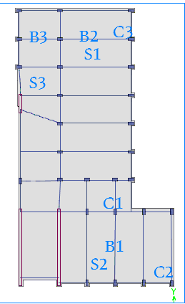
Internal force check
Table :Internal forces check for the first part
Beams, columns and slabs were selected to be internal force check
Element | Manual (KN) | ETABS (KN) | Difference % | Assessment
Column 1 | 918.237 | 1022.3 | 10% | OK
Column 2 | 728.328 | 727.63 | 0.09% | OK
Column 3 | 856.71 | 841 | 0.86% | OK
Element | Manual (KN.m) | ETABS (KN.m) | Difference % | Assessment
Beam 1 | 266.5679625 | 261.775 | 1.83% | OK
Beam 2 | 266.5679625 | 254.25 | 4.84% | OK
Beam 3 | 79.94016563 | 78 | 2.48% | OK
Slab 1 | 12.888 | 13.281 | 2.95% | OK
Slab 2 | 12.888 | 12.415 | 3.80% | OK
Slab 3 | 12.888 | 12.8185 | 0.54% | OK

Slide 30
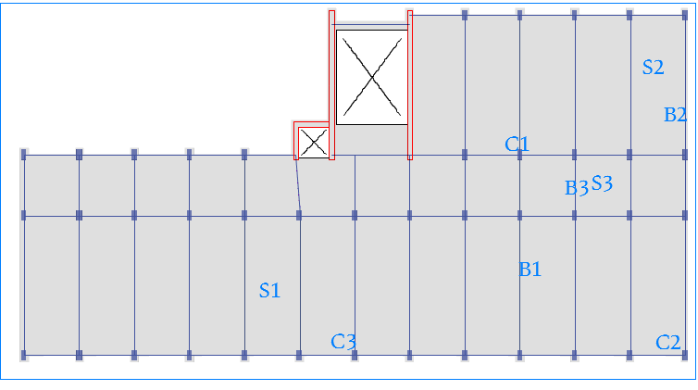
Internal force check
The beams ,columns and slab were selected to be check second part
Table :Internal forces check for the second part
Element | Manual (KN) | ETABS (KN) | Difference % | Assessment
Column 1 | 837.642 | 862.15 | 2.84% | OK
Column 2 | 471.6078 | 452.03 | 4.33% | OK
Column 3 | 856.71 | 815.36 | 5.07% | OK
Element | Manual (KN.m) | ETABS (KN.m) | Difference % | Assessment
Beam 1 | 266.5679625 | 264.175 | 0.90% | OK
Beam 2 | 146.6793563 | 152.01 | 3.50% | OK
Beam 3 | 40.31429063 | 38.565 | 4.53% | OK
Slab 1 | 12.888 | 12.549 | 2.70% | OK
Slab 2 | 12.888 | 12.01 | 7.31% | OK
Slab 3 | 12.888 | 13.672 | 5.73% | OK

Slide 31
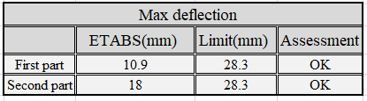
Deflection check
The allowable deflection = L/240
Table : Deflection check

Slide 32

Period check
ETABS in x and y- Axes should not exceed UBC code limit
Table : Period check
 | Method A | 1.4 Method A | ETABS | Result
Period for first part | 0.274 | 0.388 | 0.31 | Ok
Period for second part | 0.334 | 0.467 | 0.441 | Ok

Slide 33
Modal mass participate ratio check (MPMR)
Table : MPMR for the first part
Case | Mode | Period | UX | UY | UZ | Sum UX | Sum UY
 |  | sec
Modal | 1 | 0.31 | 0.8188 | 2.49E-05 | 0 | 0.8188 | 2.49E-05
Modal | 2 | 0.204 | 1.50E-05 | 0.1915 | 0 | 0.8188 | 0.1915
Modal | 3 | 0.176 | 3.57E-05 | 0.6162 | 0 | 0.8188 | 0.8078
Modal | 4 | 0.123 | 0.0896 | 0.0002 | 0 | 0.9084 | 0.808
Modal | 5 | 0.111 | 0.005 | 0.0032 | 0 | 0.9134 | 0.8112
Modal | 6 | 0.105 | 0.0019 | 0.0003 | 0 | 0.9153 | 0.8115
Modal | 7 | 0.092 | 0.0016 | 0.0007 | 0 | 0.9169 | 0.8123
Modal | 8 | 0.086 | 0.0047 | 0.1044 | 0 | 0.9216 | 0.9167
Modal | 9 | 0.073 | 0.0038 | 0.0001 | 0 | 0.9254 | 0.9168
Modal | 10 | 0.071 | 0.0011 | 0.0024 | 0 | 0.9265 | 0.9192
Modal | 11 | 0.07 | 0.0002 | 0.001 | 0 | 0.9266 | 0.9202
Modal | 12 | 0.069 | 0.0012 | 0.0054 | 0 | 0.9279 | 0.9255

Slide 34
Modal mass participate ratio check (MPMR)
Table : MPMR for the Second part
Case | Mode | Period | UX | UY | UZ | Sum UX | Sum UY
 |  | sec
Modal | 1 | 0.441 | 0.7381 | 0.0066 | 0 | 0.7381 | 0.0066
Modal | 2 | 0.257 | 0.0061 | 0.1256 | 0 | 0.7441 | 0.1322
Modal | 3 | 0.188 | 0.002 | 0.0172 | 0 | 0.7462 | 0.1494
Modal | 4 | 0.174 | 0.0099 | 0.3227 | 0 | 0.7561 | 0.4721
Modal | 5 | 0.164 | 0.0014 | 0.3219 | 0 | 0.7574 | 0.794
Modal | 6 | 0.122 | 0.1567 | 0.0181 | 0 | 0.9141 | 0.8121
Modal | 7 | 0.113 | 0.0012 | 0.0002 | 0 | 0.9153 | 0.8124
Modal | 8 | 0.111 | 0.0103 | 0.0065 | 0 | 0.9256 | 0.8189
Modal | 9 | 0.098 | 0.0286 | 0.0004 | 0 | 0.9542 | 0.8193
Modal | 10 | 0.09 | 0.0075 | 0.0007 | 0 | 0.9617 | 0.82
Modal | 11 | 0.075 | 3.07E-05 | 0.0002 | 0 | 0.9617 | 0.8202
Modal | 12 | 0.07 | 0.0033 | 0.0647 | 0 | 0.965 | 0.8849
Modal | 13 | 0.066 | 0.0008 | 0.0007 | 0 | 0.9659 | 0.8855
Modal | 14 | 0.065 | 0.0127 | 0.058 | 0 | 0.9785 | 0.9435

Slide 35

Drift check
Table : Drift check for first part
Story | Height | Dis_X | Dis_Y | Drift_X | Drift_Y | Delta_X | Delta_Y | Delta_Limit
0 | 0 | 0 | 0
1 | 3380 | 0.74 | 0.38 | 0.74 | 0.38 | 2.85 | 1.46 | 84.50
2 | 3380 | 1.77 | 0.85 | 1.03 | 0.47 | 3.97 | 1.81 | 84.50
3 | 3380 | 2.65 | 1.35 | 0.88 | 0.5 | 3.39 | 1.93 | 84.50
Table : Drift check for second part
Story | Height | Dis_X | Dis_Y | Drift_X | Drift_Y | Delta_X | Delta_Y | Delta_Limit
0 | 0 | 0 | 0
1 | 3380 | 0.91 | 0.25 | 0.91 | 0.25 | 3.50 | 0.96 | 84.50
2 | 3380 | 2.57 | 0.72 | 1.66 | 0.47 | 6.39 | 1.81 | 84.50
3 | 3380 | 4.41 | 1.15 | 1.84 | 0.43 | 7.08 | 1.66 | 84.50
4 | 2680 | 5.64 | 1.43 | 1.23 | 0.28 | 4.74 | 1.08 | 67.00

Slide 36

Base Shear check
Table : Base Shear check for first part
Axis | T(sec) | T_limit (sec) | T_used (sec) | W (KN) | V_manual (KN) | V_Etabs (/KN) | Old S.F | New S.F
X | 0.31 | 0.388 | 0.31 | 16584.149 | 1507.65 | 1507.655 | 1782 | 2187.6
Y | 0.204 | 0.388 | 0.204 | 16584.149 | 1507.65 | 2118.99 | 1782 | 1782
Table : Base Shear check for second part
Axis | T(sec) | T_limit (sec) | T_used (sec) | W (KN) | V_manual (KN) | V_Etabs (/KN) | Old S.F | New S.F
X | 0.441 | 0.468 | 0.441 | 24830.705 | 2047.471 | 2047.263 | 1782 | 2301.4
Y | 0.257 | 0.468 | 0.257 | 24830.705 | 2257.337 | 2880.712 | 1782 | 1782

Slide 37
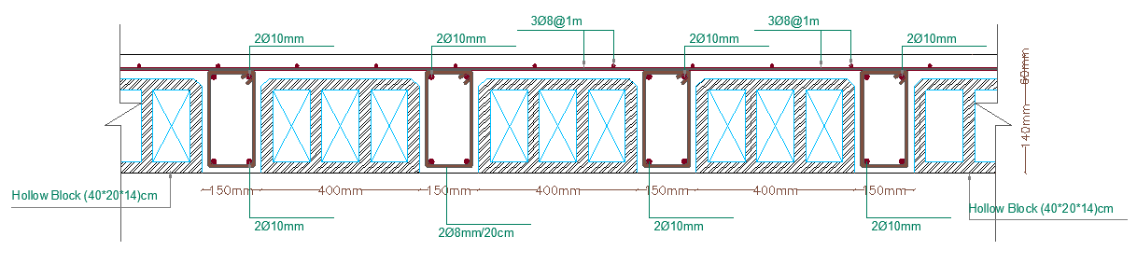
Structural analysis
Design of structural elements
1. Slabs:
Figure : Section of one way rib slab

Slide 38
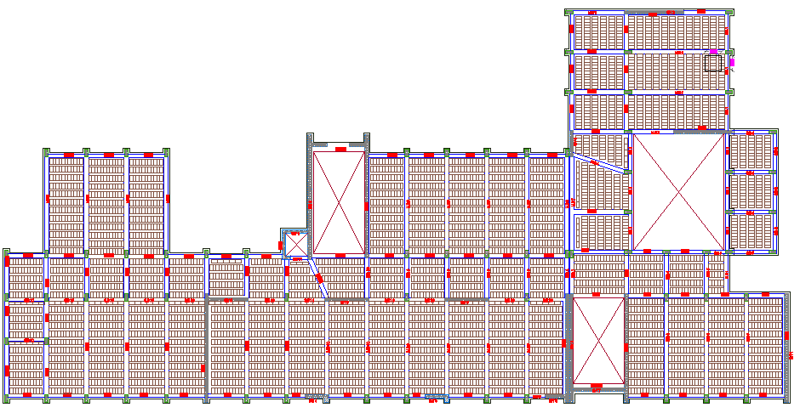
Structural analysis
Design of structural elements
1. Slabs:
Figure : Detailing for one way ribbed slab

Slide 39
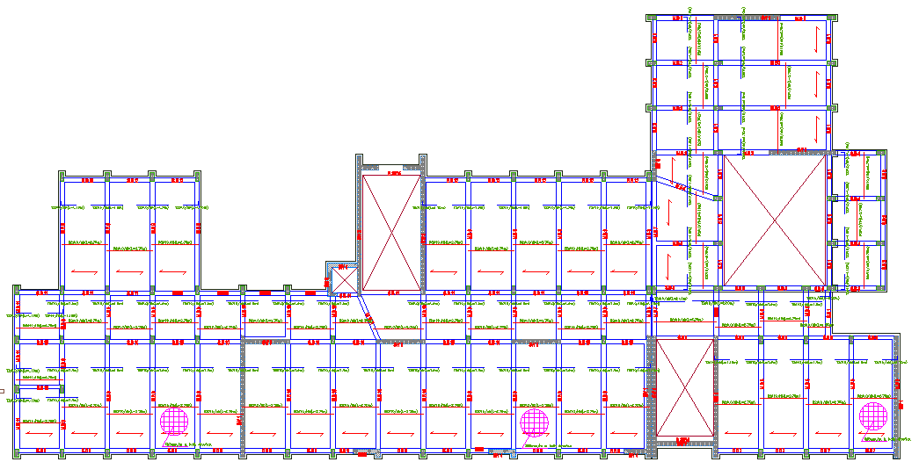
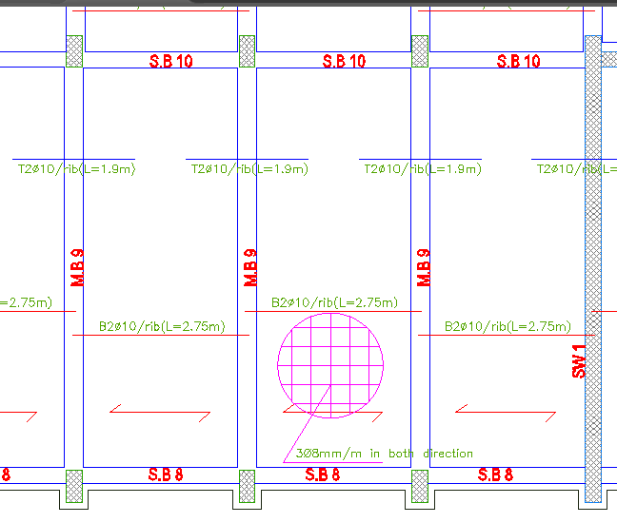
Structural analysis
Design of structural elements
1. Slabs:
Figure : Steel detailing

Slide 40
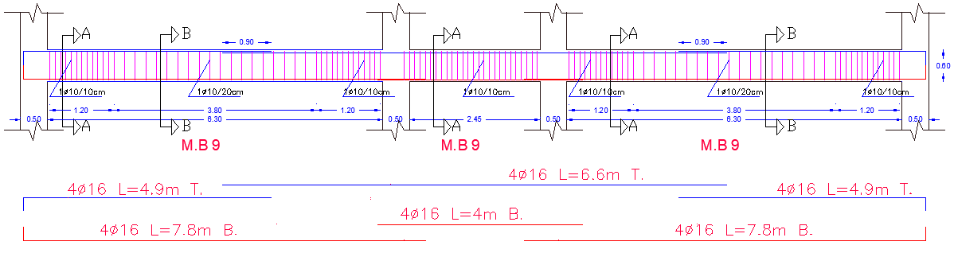
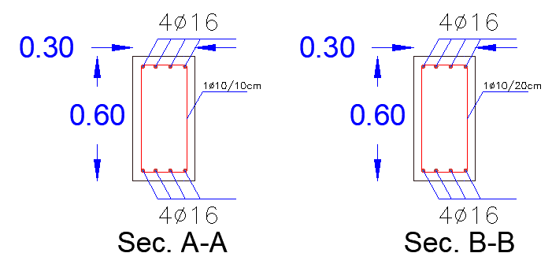
Design of structural elements
2. Beams :
Figure : Detailing for main beam

Slide 41
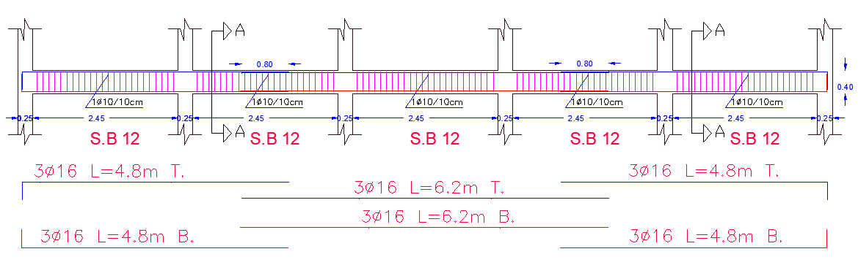
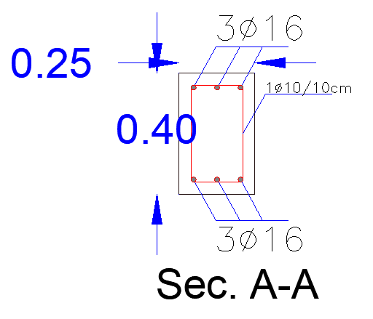
Design of structural elements
2. Beams :
Figure : Detailing for secondary beam

Slide 42
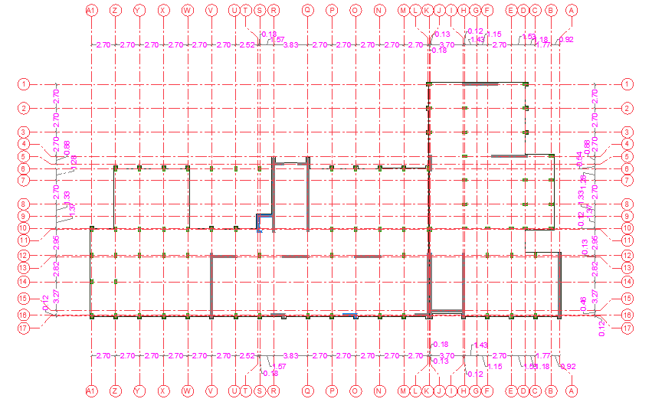
Design of structural elements
3. Columns :
Figure : Center line

Slide 43
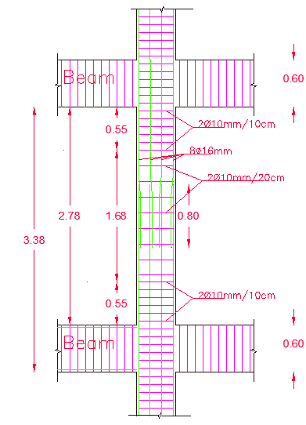
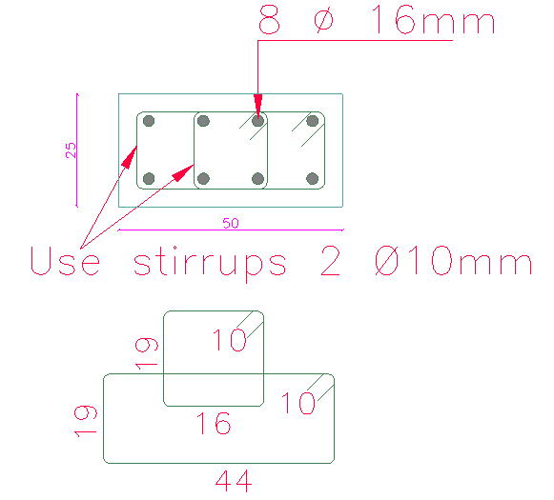
Design of structural elements
3. Columns :
Figure : Detailing for column
Figure : Section for columns

Slide 44
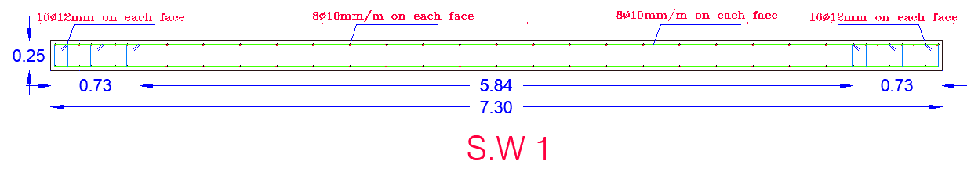
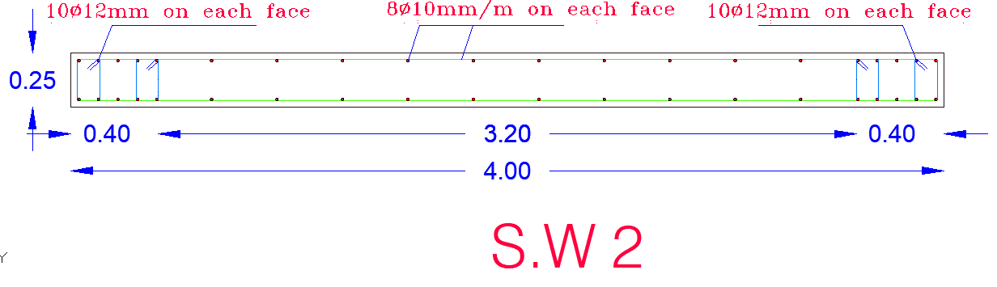
Design of structural elements
4. Shear walls:
Figure : Cross section for shear walls

Slide 45
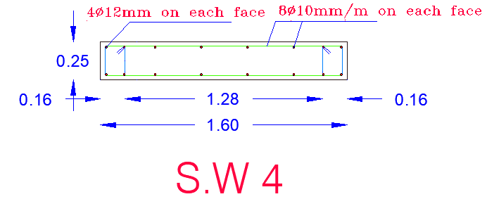
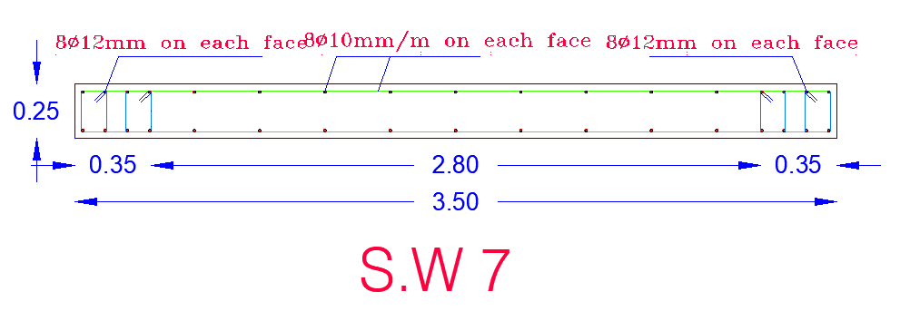
Design of structural elements
4. Shear walls:
Figure : Cross section for shear walls

Slide 46
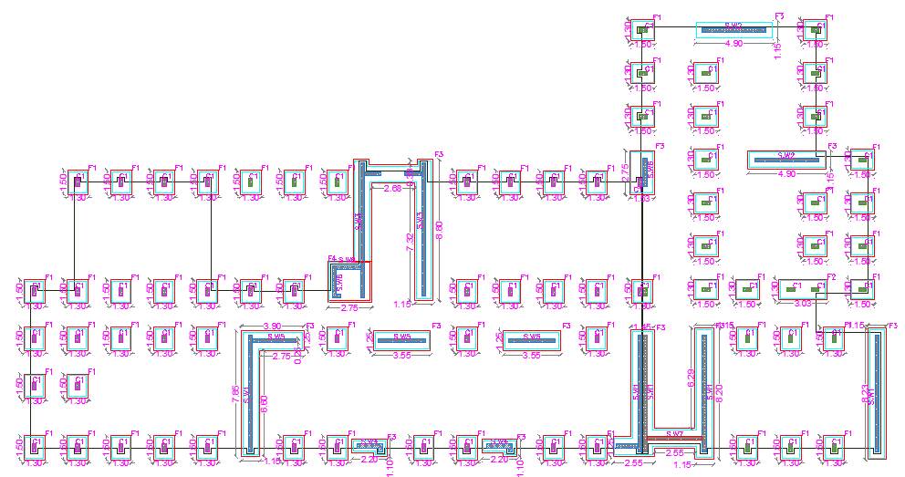
Design of structural elements
5. Footing
Figure : Footings layout

Slide 47
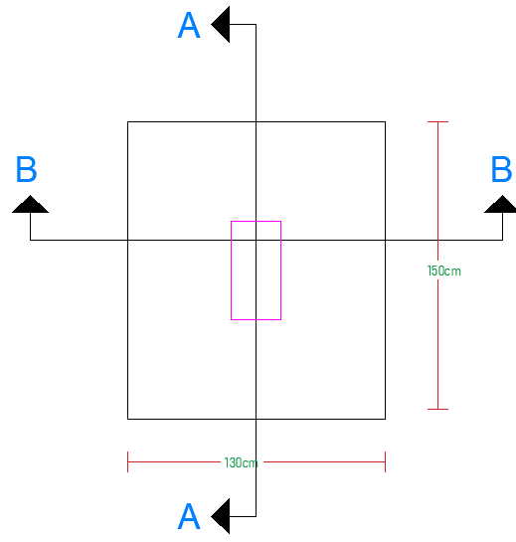
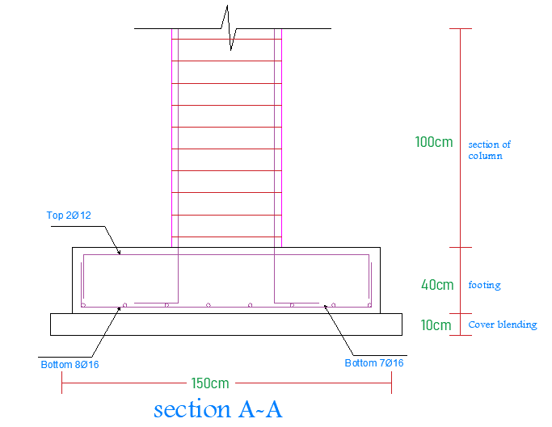
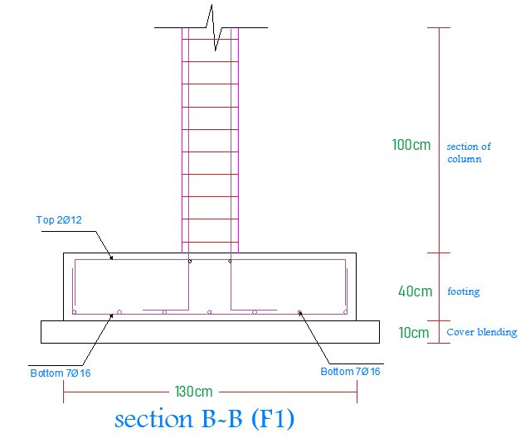
Design of structural elements
5. Footing
Figure : Detailing for isolated footing

Slide 48
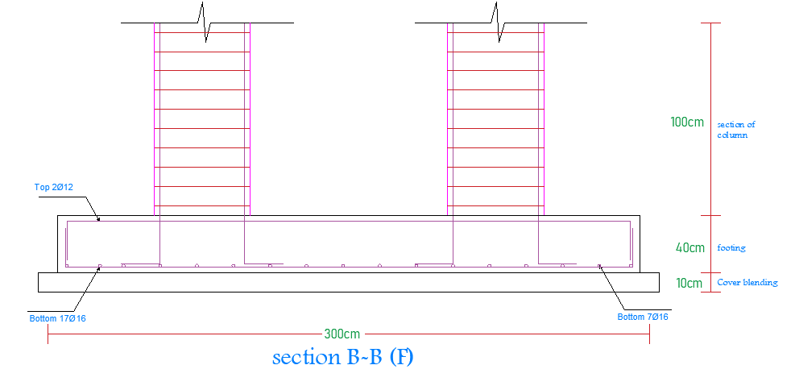
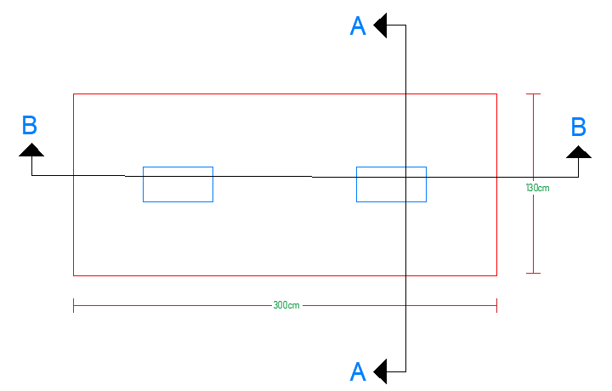
Design of structural elements
5. Footing
Figure : Detailing for compound footing

Slide 49
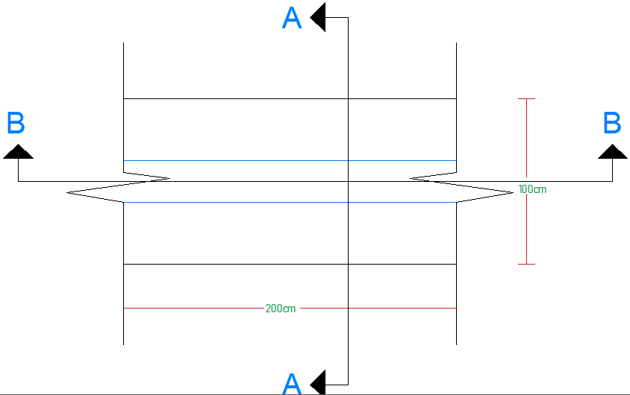

Design of structural elements
5. Footing
Figure : Detailing for wall footing

Slide 50


Design of structural elements
6. Stairs:
Figure : Stair detailing

Slide 51
Environmental analysis and evaluated
Site analysis
Shading system
Daylight factor
Thermal design
Heating system
Acoustical design

Slide 52

Environmental analysis and evaluated
Site analysis
Sun path the sun moves from east to west passing through south so the south elevation is the most will exposure to the sun heat .
Wind direction the general direction in our country is from the north-west direction.
The noise the our building it self is the sources of the noise if measure noise according to the noise from the neighboring building .
The orientation of building the Qusra school building has orientation in the southern- north axis to avoid the exposure sun rays .

Slide 53


Environmental analysis and evaluated
Shading system
According to the sun path we need to treatment the south elevation with horizontal louvers , the west and east elevation whit vertical louvers.
Qusra school has shading system in vertical and horizontal which was evaluated.
Horizontal shading system
The best time to evaluate the horizontal shading system at 11:00 A.M in 21 July by the following equation so the width of horizontal shading system is acceptable .
$x=\frac{the heaight of the window }{\tan{(alt)}}$ = $\frac{2m}{\tan{72.4}}=0.63m$

Slide 54


Environmental analysis and evaluated
Vertical louvers
The best time to evaluate vertical shading system at 01:00 P.M in 1 July by Revit show shading

Slide 55

Environmental analysis and evaluated
The daylight factor for Qusra school
We used Revit program to determine average daylight factor before and after adding shading system also we found daylight factor between 1-3%. in the main space.

Slide 56

Environmental analysis and evaluated
The daylight factor for stories
For ground floor before

Slide 57

For ground floor after

Slide 58

Environmental analysis and evaluated
Environmental analysis and evaluated
The daylight factor for stories
The daylight factor for stories
For first floor before

Slide 59

For first floor after

Slide 60
Environmental analysis and evaluated
Thermal design use the design builder where molding the project on program and analysis it and design it for heating load
Thermal mass study the thermal mass for elements by find the U-value by using design builder
External wall .
0.5 W/m2-k | U-Value

Slide 61
Environmental analysis and evaluated
Thermal mass
internal wall .
1.18 W/m2-k | U-Value

Slide 62
Environmental analysis and evaluated
Thermal mass
Floor ground .
0.26 W/m2-k | U-Value

Slide 63
Environmental analysis and evaluated
Thermal mass
Roof .
0.54 W/m2-k | U-Value

Slide 64
Environmental analysis and evaluated
Thermal behavior
Total Cooling and heating load for building
58.5 k.w | Cooling load
151.39 k.w | Heating load
Site and source energey

Slide 65
Environmental analysis and evaluated
Thermal simulation

Slide 66

Electromechanical design
Heating system design
Use the radiator system
U-Value for :
External wall is 0.5.
Internal wall is 1.18 .
Ground Floor = 0.26.
Floor is=0.54 .

Slide 67

Electromechanical design
Heating system design
The radiator will use is cast iron radiator from the ANCONA company

Slide 68

Electromechanical design
Heating system design

Slide 69
Environmental analysis and evaluated
Acoustical design in our project study the sound from arichitctairal part where found the STC and RT60 for wall and spaces
STC external wall
The OITC = 56, it is acceptable and with required value for 76 - 80 dBA outdoor background noise level that was equal 50 dB

Slide 70
Environmental analysis and evaluated
Acoustical design
STC internal wall

Slide 71
Environmental analysis and evaluated
Acoustical design
RT60 Class room
The classroom recommended RT60 = (0.5 – 0.9).
before
After use Fabric acoustical panels
appley the same solution for all room need modification

Slide 72
Electromechanical design
Water supply system
Drainage system
Fire fighting system
Lighting system
Outlet Socket
Photovoltaic system

Slide 73
Electromechanical design
Water supply system
Consumption of water
The cold water needed=15*360 =5400 liter.
The hot water =360*4.5=1620 liter.
The system will use the roof tank for cold and hot water and feed from underground water whit 120m3 which feed from Municipality.

Slide 74

Electromechanical design
Water supply system
Pipe sizing divide the building to the collectors where each one collect group of fixture unit

Slide 75

Electromechanical design
Water supply system

Slide 76

Electromechanical design
Drainage system
-bath room need to 4"pipe with slope 1% ,
-water closet need 4"pipe with slope 1%
-each 3 lavatory connect with other in one by 3" pipe 4"pipe with slope 1% .
- Vents 4" where it is important and use C.O clean out in the end of each branch .
-Manholes with dimensions 50 c.m* 50 c.m and external pipe with 6" to the septic tanke -with dimensions 3*4*5 m and use floor derange with dimensions 0.15c.m*0.15c.m.

Slide 77

Electromechanical design
Drainage system

Slide 78
Electromechanical design
Fire fighting system
- Fair extinguisher
- Fire hose in each floor
Smoke detector in each place where it is important
Emergency stair

Slide 79


Electromechanical design
Fire fighting system

Slide 80


Electromechanical design
Fire fighting system
Ground floor
First floor

Slide 81


Electromechanical design
Lighting System
DIALux program was used to design lighting system in school .
Figure : Class room from DIALux
Figure : Principal from DIALux

Slide 82

Electromechanical design
Lighting System
Three type of luminaire used for design the school artificial lighting .
Table 17: Specifications of luminaire used in project
 | Luminaire type | Manufacturer | Dimensions (m) | Lux | Watt | Quantity | Luminous efficacy
1 | TCS165 | PHILIPS | 0.575*0.575*0.080 | 4800 | 61 | 310 | 54.2
2 | SOL CL-XL | PROLED | 0.3*0.3 | 2800 | 30 | 21 | 93.3
3 | TCS260 | PHILIPS | 1.515*0.155*0.084 | 3325 | 38 | 6 | 54.2
Total |  |  |  |  |  | 337

Slide 83



Electromechanical design
Lighting System
Figure : UGR for teacher desk
Figure : Lux distribution for class room

Slide 84

Electromechanical design
Lighting System
Figure : Lighting design for ground floor

Slide 85


Electromechanical design
Lighting System
Figure : Lighting design for first floor

Slide 86

Electromechanical design
Lighting System
Figure : Lighting design for second floor

Slide 87


Electromechanical design
Outlet Socket
Figure Outlet Socket for second floor

Slide 88


Electromechanical design
Main Distribution board
Table : Main circuit breaker calculation.
Figure : The main distribution board

Slide 89

Electromechanical design
Distribution board (Ground Floor)
Figure : The distribution board ground floor

Slide 90

Photovoltaic System Design (PV)
Figure : Landscape distribution in AUTOCAD

Slide 91

Photovoltaic System Design (PV)
Table : Summary For tilted modules

Slide 92




Cost estimation
total cost NIS
2779283.61
total area m2
2386.23
Cost NIS/m2
1200

Slide 93


Slide 94


Slide 95


Slide 96
Thank you

