Slide 1

An – najah national university
Faculty of Engineering
“ Optimization of Electricity Consumption in Nablus West
Wastewater Treatment Plant”
Prepared by:
Oday Al-Faqeh
Ghossoun Hamdallah
Waed Juma
Sanad Waked
Ayman Khodairy
Summitted to :
Dr. Abdel Fatth Hassan
Dr. Abdelhaleem Khader

Slide 2
Agenda :
Introduction
Project objectives
Characteristics of wastewater
Literature review and Methodology
Result, Conclusion and Recommendations

Slide 3
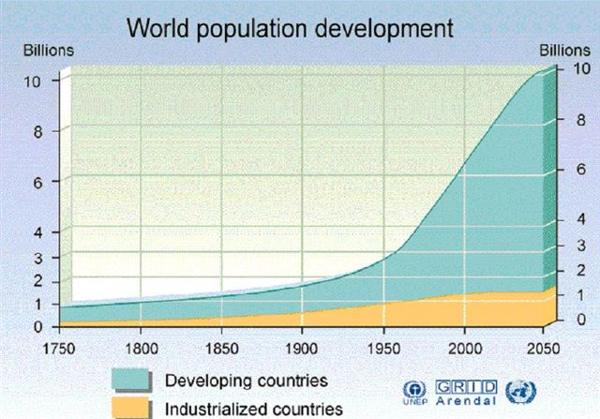
Introduction :
As a result of huge increase in population, the world start looking for another sources of water, and a continuous increase in quantities of WW.
This increase of WW lead to search for environmentally sound methods for disposal or reuse like WWTP.

Slide 4
Introduction :
serves the western area of Nablus and five neighboring
villages(BeitWazan , Zawata, BeitEba, Qusin,
DeirSharaf.
Population ₂₀₀₇ = 321,000 capita
Population ₂₀₂₀ = 471,000 capita
Q _{in 2020} = 14,000 m³/day
Q _{out} ₂₀₂₀ = 10,000m³/day

Slide 5
Project objectives :
To perform optimization to all alternative power sources.
Choosing the best type of power in accordance with cost , availability and feasibility to use.

Slide 6
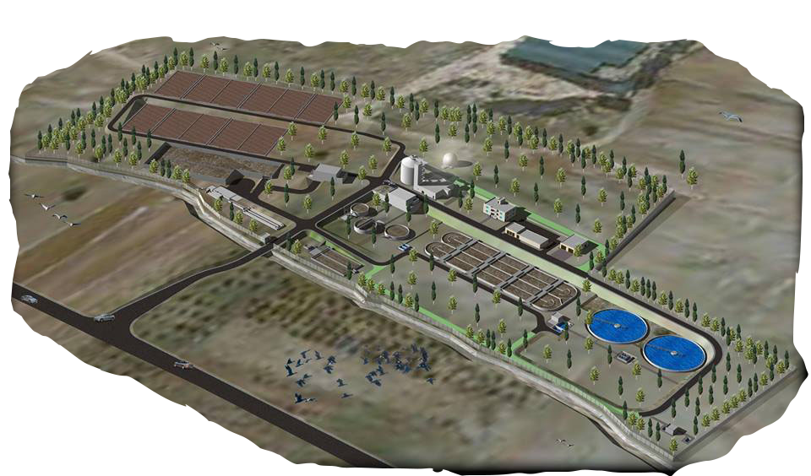
Layout of NW-WWTP

Slide 7
Background:
income rate is low
Israel control of electricity
EXPENSIVE

Slide 8
Background :
Alternatives
Solar panel
Methane gas
Wind energy
carbonization

Slide 9
Characteristics of Wastewater :
Any sewerage systems needs standards and specification rules which must be implemented.

Slide 10
wastewater treatment criteria
WWTP
allow future adjustment and expansion
outflow should be meet the standards of its end-use.
Palestinian standards
capable to treat the estimated wastewater quantities

Slide 11
Wastewater characteristics for :Nablus WWTP
In Nablus west –WWTP, three are construction stages as
Have been planned:
Stage 1 with design horizon in 2020.
Stage 2 with design horizon in 2025.
Stage 3 with design horizon in 2035.

Slide 12
Wastewater characteristics for Nablus WWTP
Design influent wastewater characteristic for Nablus WWTP.
Concentration (mg/L) | 2020 | 2025 | 2035
BOD₅ | 562 | 628 | 610
COD | 1110 | 1256 | 1205
SS | 648 | 733 | 703
Total Nitrogen | 111 | 106 | 121
P total | 18 | 17 | 20

Slide 13
Wastewater characteristics for Nablus WWTP
Nablus WWTP effluent standards.
Standard | 2020 | 2025 |  | 2035
BOD5(mg/L) | ≤20 | ≤10 | ≤10
COD(mg/L) | -- | ≤70 | ≤70
SS(mg/L) | ≤30 | ≤10 | ≤10
Total Nitrogen(mg/L) | 111 | ≤25 | ≤25
Fecal Coli.(mL) | -- | ≤10/100 | ≤10/100

Slide 14
Wastewater characteristics for :Nablus WWTP
Design influent and effluent wastewater characteristic for Nablus WWTP in (1-28 /09/2013)
Variation | Design,2013 | Current value
Q(m³/d) | 11000 | 9400
COD_{in}(ppm) | 1100 | 989
COD_{out} (ppm) | 60 | 57
BOD_{5in}(ppm) | 550 | 494.6
BOD_{5out} | 20 | 11.44
TSS_{in} (ppm) | 500 | 448
TSS_{out}(ppm) | 30 | 20.59

Slide 15
Wastewater characteristics for Nablus WWTP
From the previous tables, we can say that the design process of NW-WWTP can produce effluent that meets the Palestinian Guide lines for wastewater reuse and the growth rate design is decrease with increase design period.

Slide 16

Wind Power:
The conversion of wind energy into useful form the energy such as wind turbines to generate electricity.

Slide 17
Wind Power:
Wind Power
Do not produce any greenhouse emission
Plentiful
Renewable
Clean

Slide 18
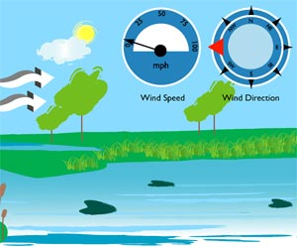
:Wind Power
In Nablus city the wind comes from south west in general and the average velocity of the wind is about 10 Km/hour yearly approximately 2.8 m/sec

Slide 19
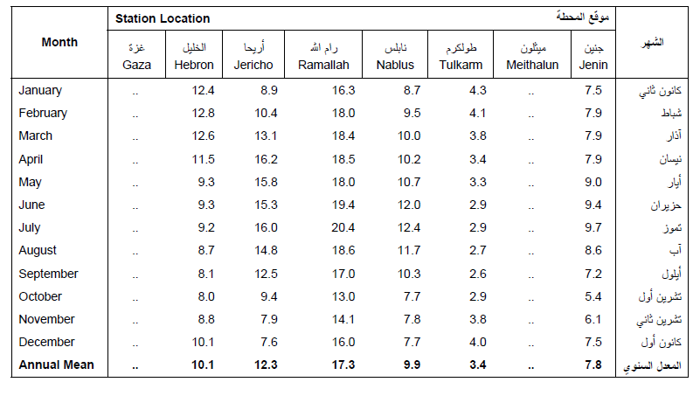
Wind Power
Average speed=2.8m/sec

Slide 20
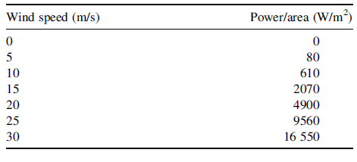
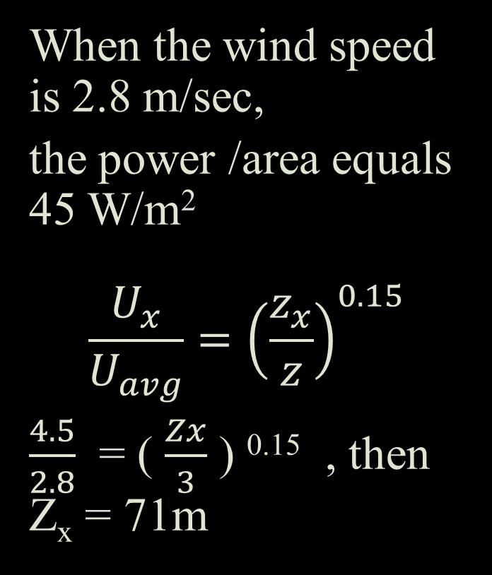
Wind Power:
When the wind speed is 2.8 m/sec,
the power /area equals 45 W/m²
$$\frac{U_{x}}{U_{avg}}={\left(\frac{z_{x}}{z}\right)}^{0.15}$$
$\frac{4.5}{2.8}$ = ( $\frac{Zx}{3}$ ) ^{0.15} , then Z_{x} = 71m

Slide 21

Solar power:
Solar power is the conversation of sunlight into electricity, either directly using photovoltaic (PV), or indirectly using solar power (CSP)

Slide 22

Solar Power
A
Solar energy is renewable sources of energy
D
Solar energy is clean sources
V
The total amount that would be saved make the price of the panel seems small

Slide 23
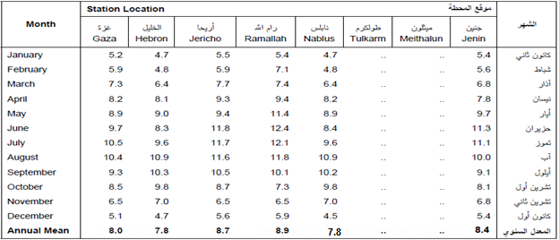
Solar power
Average solar radiation = 7.8 hr/day

Slide 24
Assumptions:
By using on grid type of solar panels
Average solar radiation =7.8hr/day
Power per one cell = 250 watt/hr
The cost of one cell =280$
The price of generator = 60000 – 70000 NIS
For 6000 m² we can use 1800 cells.

Slide 25
Calculation
KW/d | (1800*250*7.8)/1000 =3510 | Average total energy produced by solar cells
$ | 1800 *280 = 504,000 | Operational Cost
$ | Approximately 620,000 | Construction cost + grid equipment
KWh/d | 8000/0.6842= 11,692 | The total required electricity from Municipality
This means the solar panels power will produce about 30% of the total consumption of the of electricity.
Return period of the panels cost = (1,108,000/7)/620,000 =1.8 years.

Slide 26
Sludge
Total amount of sludge after digest in
Kg Ds/d=6885

Slide 27
Sludge
Beneficial uses of sludge
Improve soil quality and Productivity
Soil amendment in land scaping
Produce CH4
Land fill cover

Slide 28
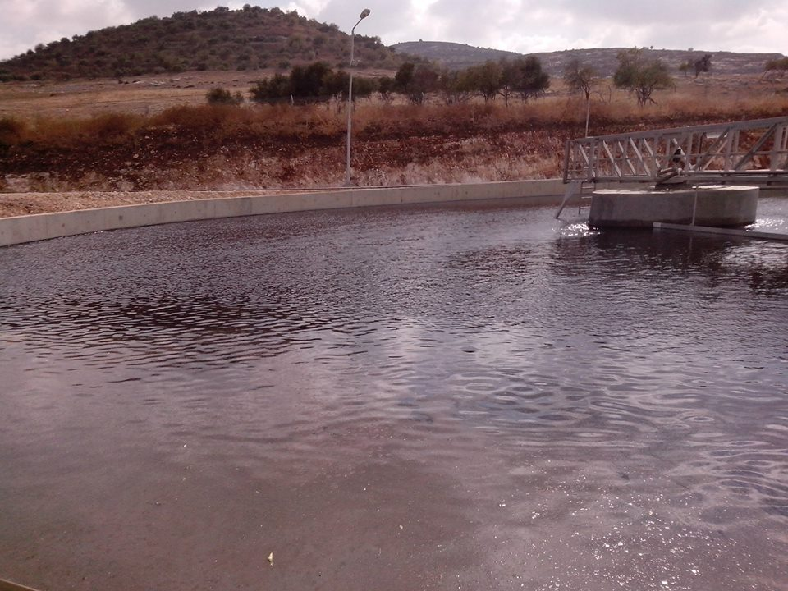
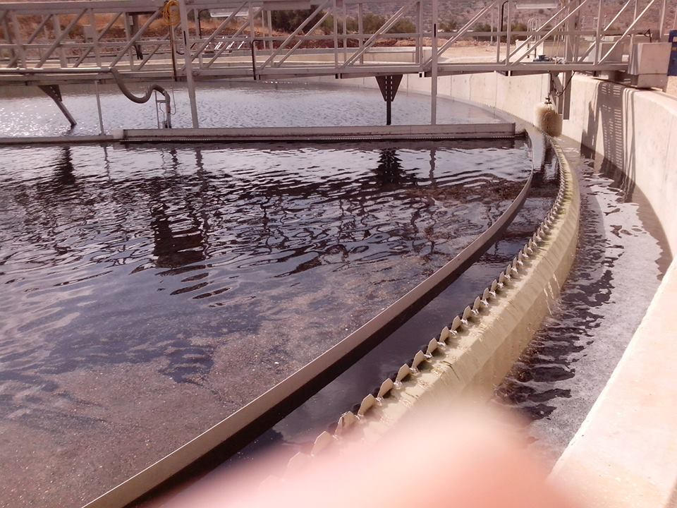
Sludge
Sludge Process
Primary Sludge
Secondary Sludge
Primary Sludge
Secondary Sludge

Slide 29
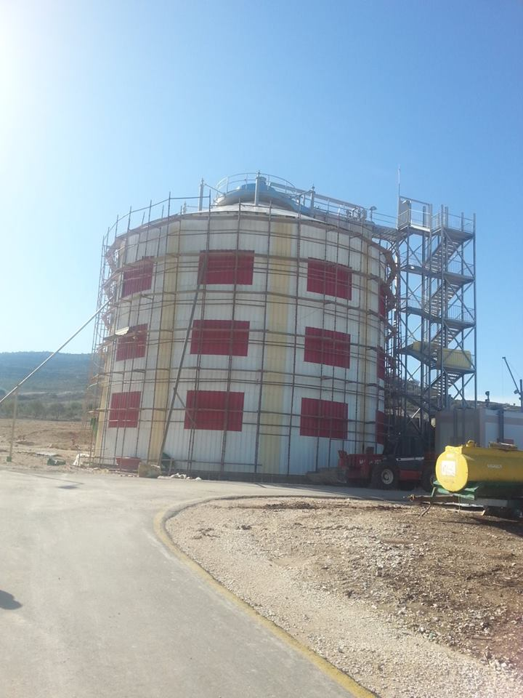
Biogas from Anaerobic digestion:
Methane
Hydrogen
Hydrogen Sulfide
Nitrogen
Carbon Dioxide

Slide 30
carbonization
Sludge Carbonization is a process that converts sewage sludge to bio coal to produce gases and solid fuel.
A type of solid biomass that can partially substitute for coal during power generation.

Slide 31
Advantages of carbonization process
Small quantity of N₂O generation.
Efficient utilization of thermal content of sludge.

Slide 32
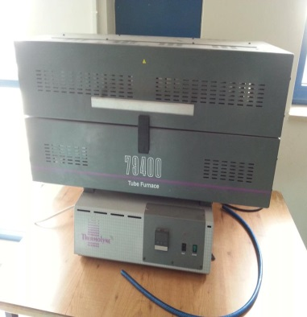
Tube Furnace

Slide 33
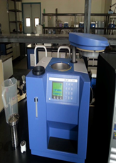
  Bomb Calorimeter

Slide 34
procedure
In order to convert the sample into coal under nitrogen gas, put it in tube furnace device for 2 hours at temperature of 450° C.
To measure energy content in (J/g) , put 58 g of the resulted coal in bomb calorimeter device.

Slide 35
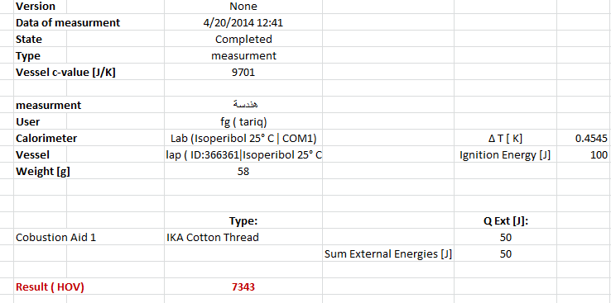
Methodology

Slide 36
Calculation
Every 1 Kg of sludge produces 2 KWh
Assume, 50% losses in energy
1Kg of sludge produces 1 KWh
14054.723/2 = 7027.3615 KWh/d
7027.3615/ 11692 = 60%

Slide 37

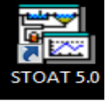
Data analysis
STOAT modeling
STOAT, is the program that will be used for modeling purposes in treatment plant.

Slide 38
How to model the Treatment plant of STOAT?
Define inlet unit by input the characteristics of influent.
Mean influent pattern characteristic.
Value | Type
619.00 | Flow (m³/hr)
15.00 | Temperature (deg.C)
05.00 | Volatile fatty acids (mg COD/L)
830.00 | Soluble biodegradable COD
355.70 | Particulate biodegradable COD
60.00 | Volatile solids (mg/L)
70.00 | Ammonia (mg/L)
00.00 | Nitrates (mg/L)

Slide 39
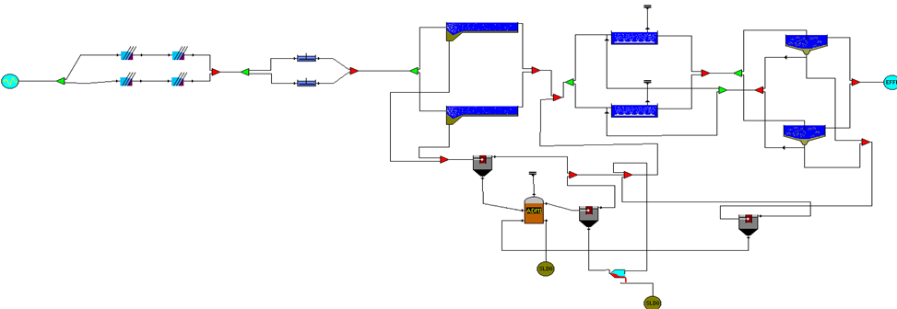
How to model the Treatment plant of STOAT?
Define the ADM digester by fill the input data.
How to model the Treatment plant of STOAT?
WWTP model by STOAT

Slide 40
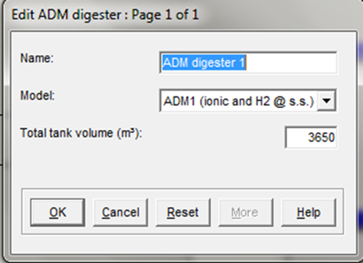
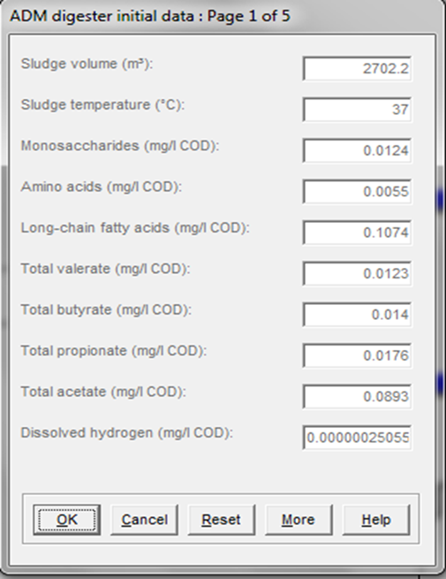
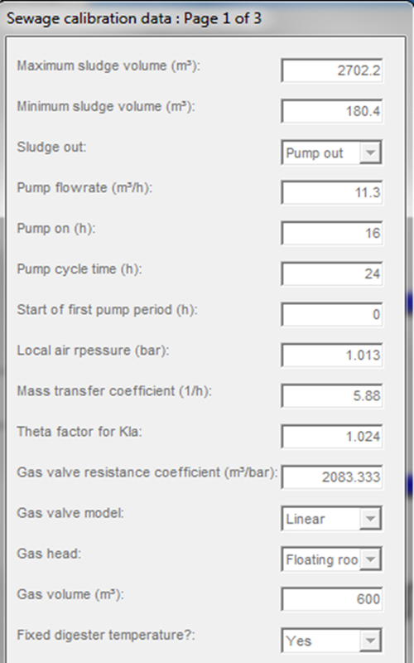
STOAT Modeling
Name and Dimensions Initial Condition Sewage Calibration data

Slide 41
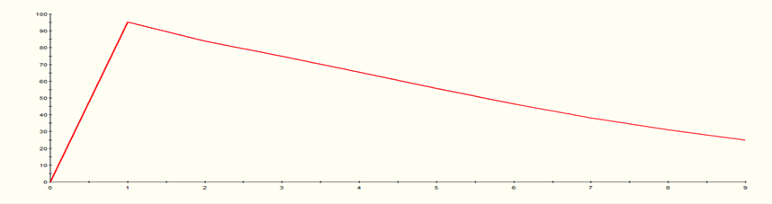


STOAT Modeling
Graph gas flow in m3/hr from ADM digester

Slide 42
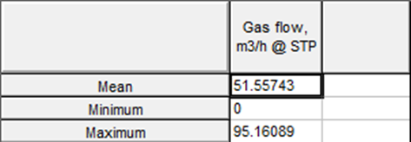
STOAT Modeling
Calculation:
1 m³ biogases produce about 6 KWh.
Working hour: 24
Then,
[51.55743*6*24]/11692 = 63.5 ≈ 64%
Summary statics for the gas flow in m3/hr

Slide 43
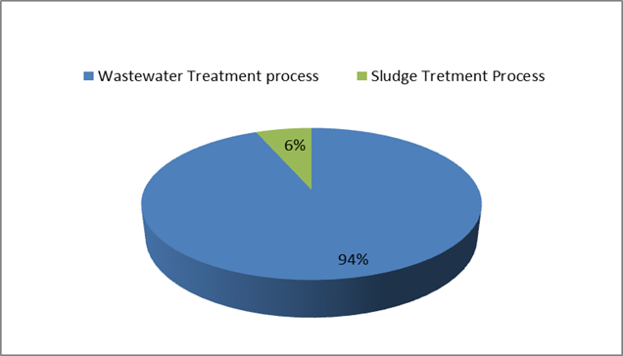
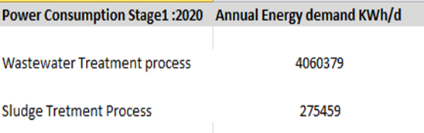
Result and Conclusion
Power Consumption
Power Consumption distribution in 2020

Slide 44
Result and Conclusion
Power Alternatives
Percent of Energy for Alternative
Percentage (%) | Alternative
30 | Solar panels
60 | Carbonization of sludge
64_{calculated},65_{expected} | Methane gas
Neglected | Wind
154% | SUM

Slide 45
Result and Conclusion
Power Alternatives
Average reduce cost for Alternative
Average reduce cost ($/d) | Alternative
686 | Solar panels
1371.5 | Carbonization of sludge
1462.8 | Methane gas
3520.3 | SUM

Slide 46
Recommendation
NW-WWTP can do the following:
[2015-2020]: use solar cells to produce “30%” from energy total consumption.
[2017-2020]: NW-WWTP can save 686$/day.
[2020-2025]: use of other alternatives, methane gas and solid fuel, to save 2834.3$/day.

Slide 47


