Slide 1

GRADUATION PROJECT
Air Mouse
Presented by:
Majdoleen Abu-taqa
Tawaddod Nabeel Sous

Slide 2

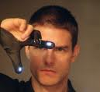
The Idea:
  To build a new input device based on the free hand movement.
  Multi-pointing
  Wireless
  Customizable

Slide 3
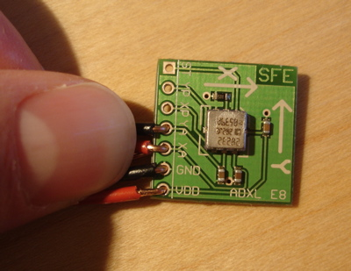
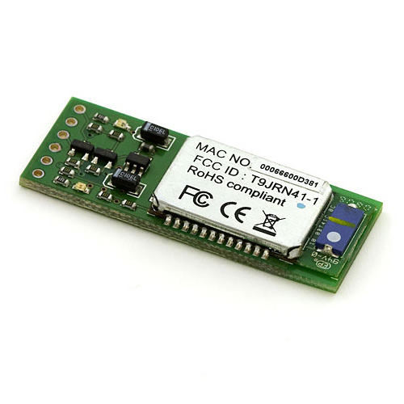
Implementation
*Using Accelerometers And Bluetooth Module.
    MMA7260Q
    SparkFun

Slide 4
What is an Accelerometer?
An accelerometer measures the acceleration it experiences relative to freefall. Single- and multi-axis models are available to detect magnitude and direction of the acceleration as a vector quantity, and can be used to sense orientation, vibration and shock.

Slide 5

*Advantages
- Can be more accurate and precise.
- Can be used with a Projector.
*Drawbacks
- Accelerometers can be expensive
- Needs 10 Accelerometers to implement the
2-finger mutli-pointing device. (1 for each
finger!)

Slide 6
Bluetooth Module
The BlueSMiRF is the latest Bluetooth wireless serial cable replacement from SparkFun Electronics! These modems work as a serial (RX/TX) pipe. Any serial stream from 9600 to 115200bps can be passed seamlessly from your computer to your target.

Slide 7
Software Used
  Built on Ubuntu 8.10 and 9.04
    8.10 crashed so we moved to 9.04
  Using Bluez implementation of Bluetooth for Linux
  Used Python Programming Language
    Open source
    Write-less-do-more
  Libraries
    pybluez - python API for accessing bluez
    pymouse - python library for accessing mouse preferences
    pygtk - Graphical components Libraries

Slide 8
How it Works?
  * X acceleration is used to compute the displacement of the x-axis mouse position
    Y -> y-axis
    Z -> Based on criteria -> press and release
  * Special movements and gestures to do more stuff
    Launching programs, music, videos...etc
    Based on some criteria
  * Giving the user the choice to enable the special gestures or not
    Not to interfere with the mouse movement or other functions
    Needed because we use only one accelerometer

Slide 9
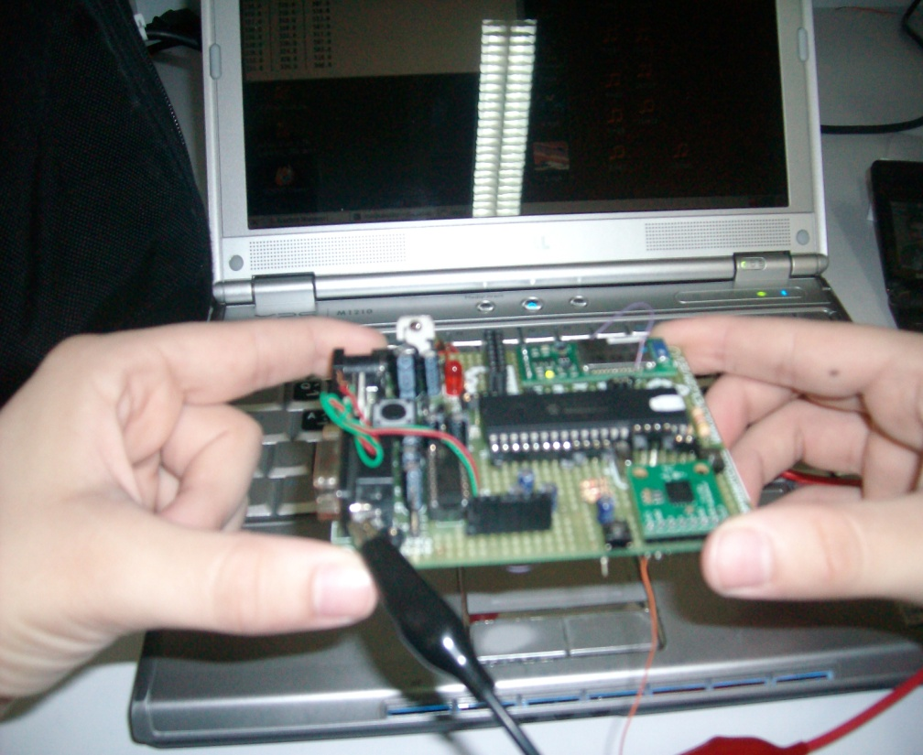
Stable Position

Slide 10
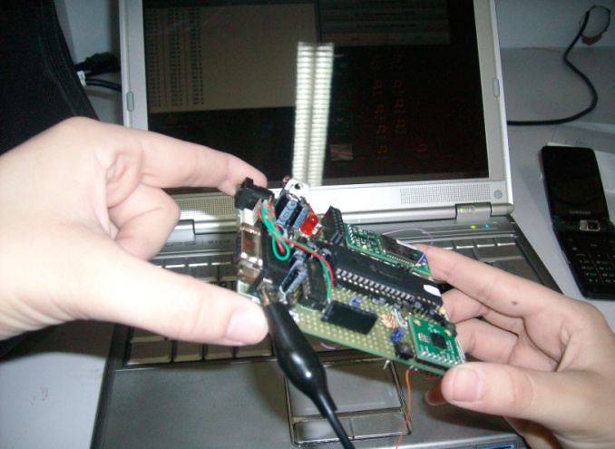
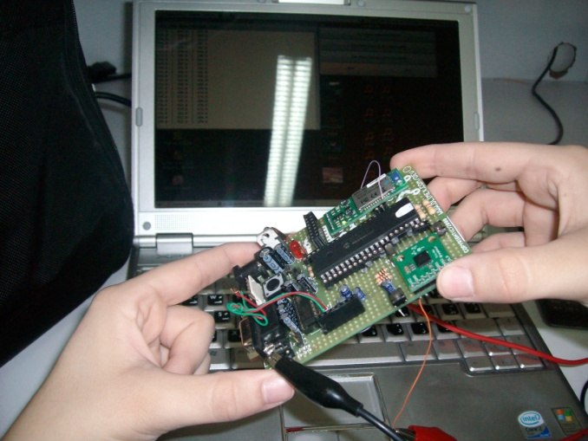
Right Position
Left Position

Slide 11
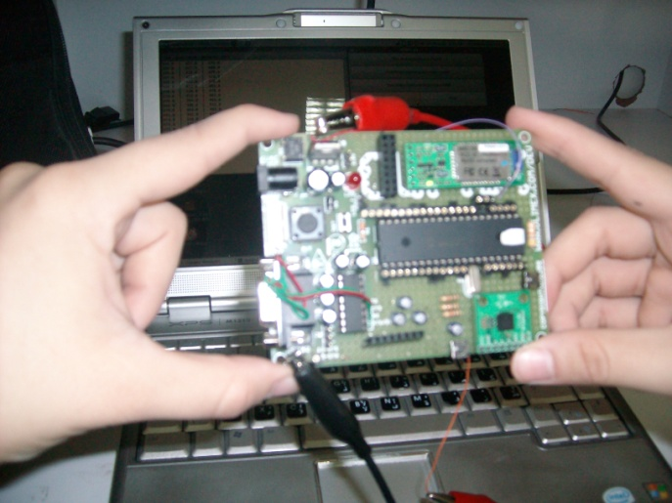
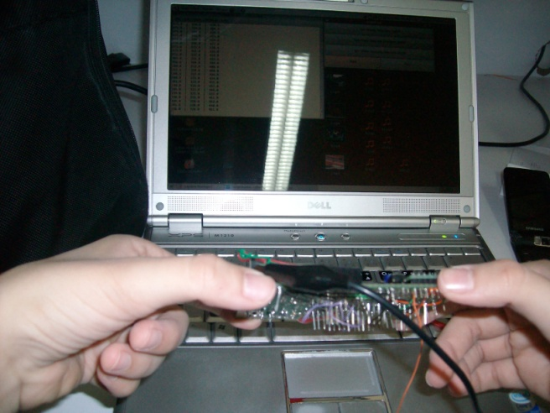
Down Position
Up Position

Slide 12
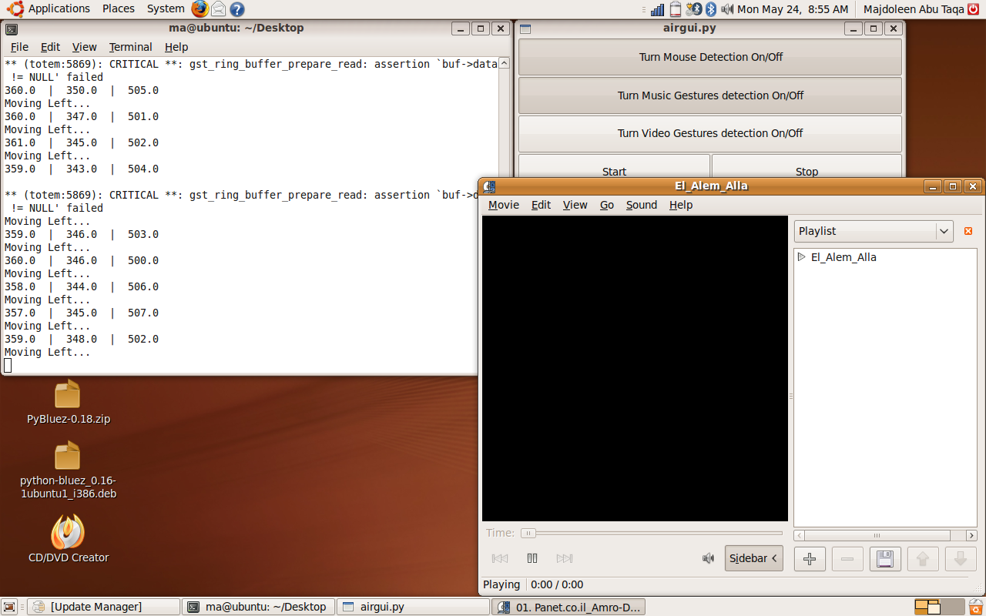

Slide 13
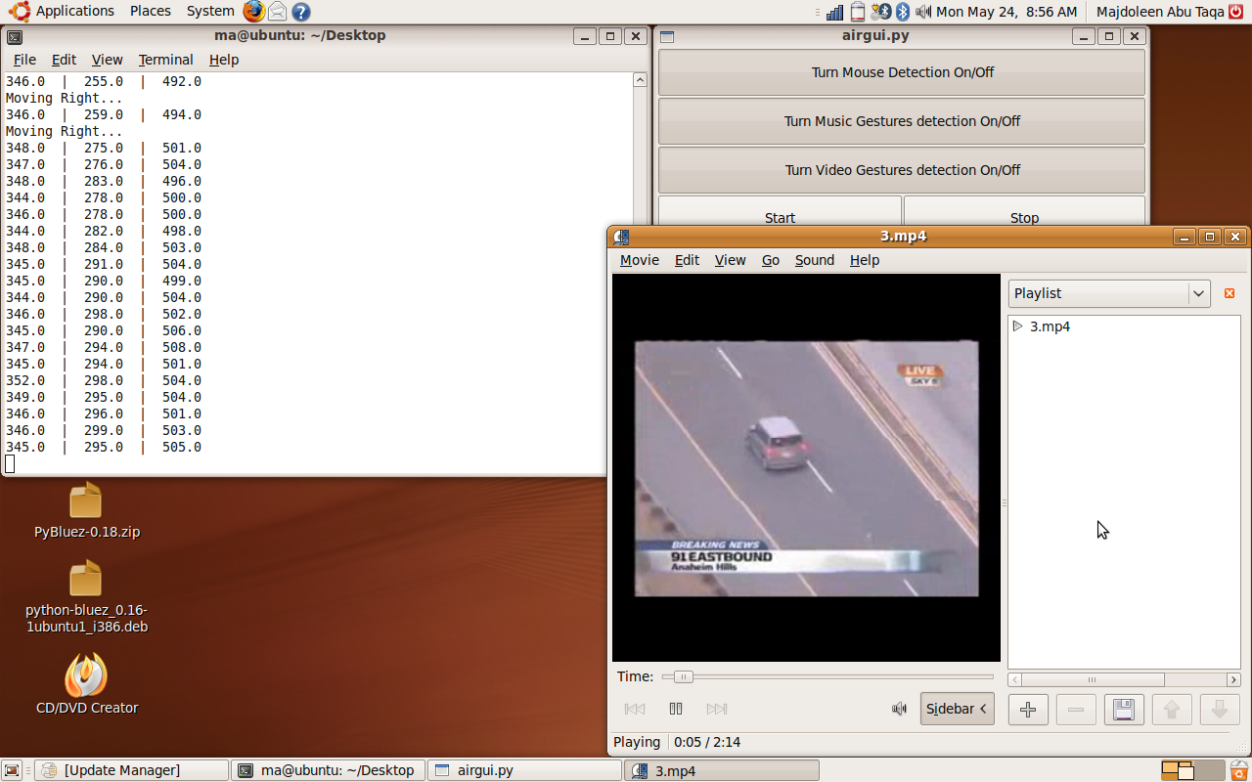

Slide 14
Results and Conclusion
  A single accelerometer doesn't provide an accurate indication of the real movement of the user's hands
    Multiple accelerometers
      Raise the accuracy
      Provide more combinations for more gestures
      Multi-pointing
      Too expensive!
    Bluetooth embedded Accelerometers
      No need for a bluetooth or a PIC modules!
      Simplify the design and the hardware!
      Expensive!

