Slide 1


Al-Najah National University
Faculty of Engineering
Building Engineering Department
“Graduation project 2”
“Analysis of Cinema building in Nablus”
prepared by:
Mohammad Sreide
Ahmad Omar
Tayyeb Almohor
Mohammad Salameh
Supervisor Name: Dr. Mohammad Jehad Dweikat

Slide 2
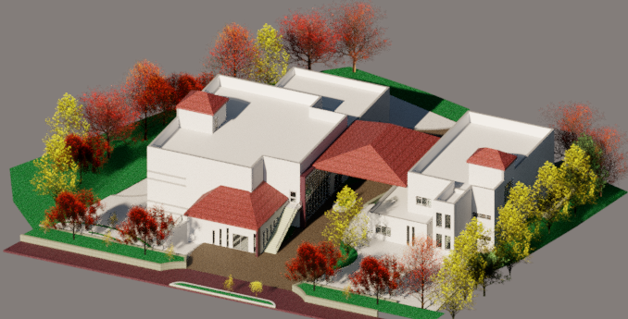

Slide 3

  Outline :
  Site analysis
  Architectural analysis
  Environmental analysis
  Structural analysis
  Electrical analysis
  Mechanical analysis
  Quantity serving & cost estimate

Slide 4
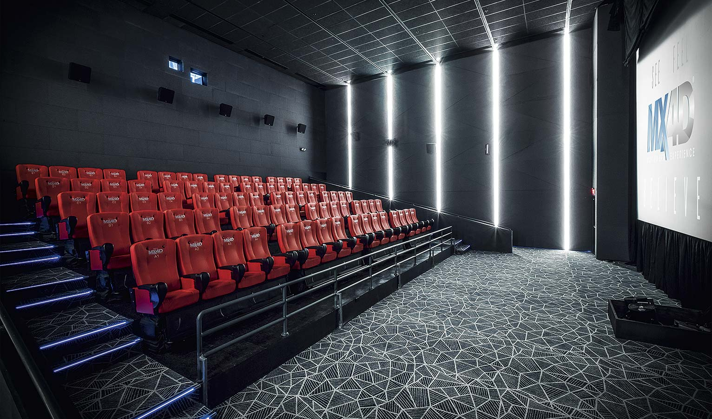
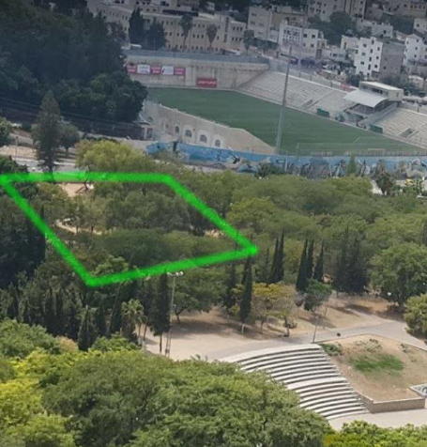
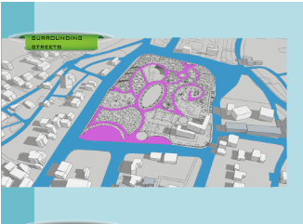

Site analysis
Location : Jammal Abdelnasser park
Area of the project = ${1150m}^{2}$

Slide 5
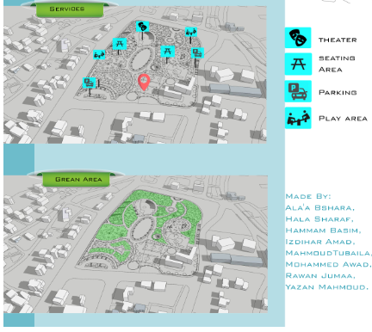
Site analysis

Slide 6
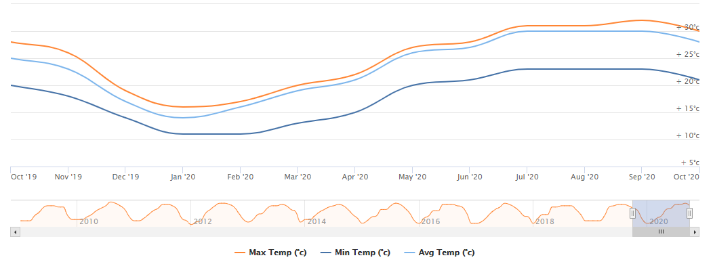
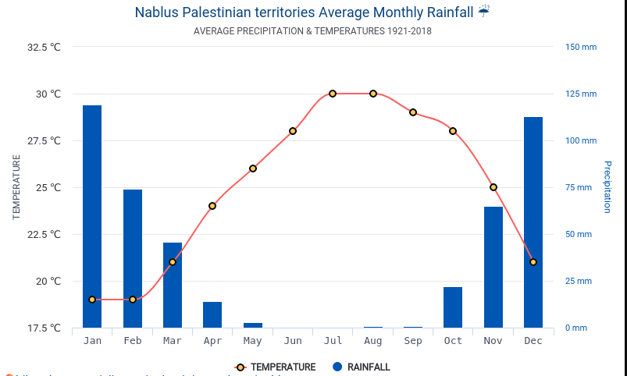
Climate

Slide 7
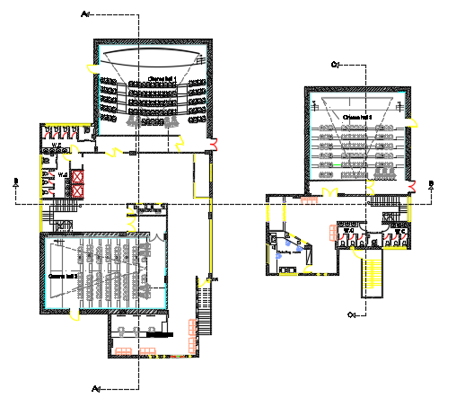
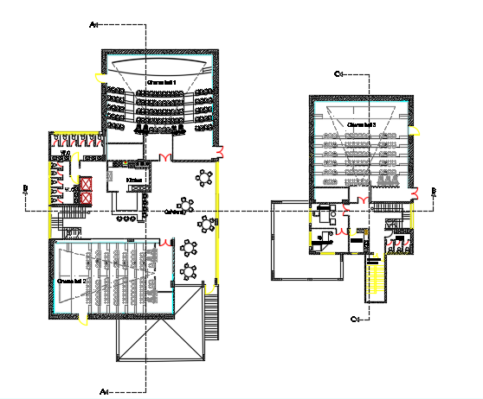
Architectural design
First floor
Second floor

Slide 8
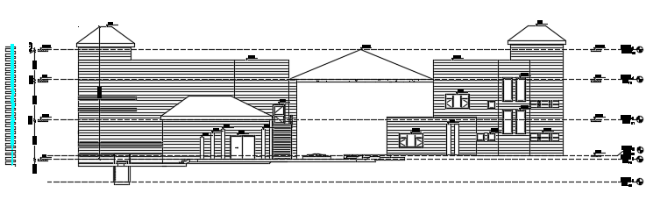
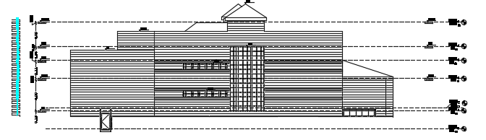
Elevations
SW elevation
NW elevation

Slide 9
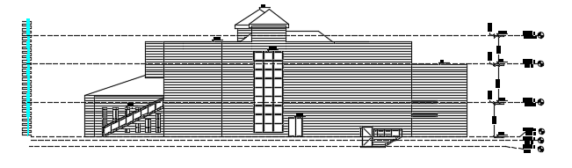
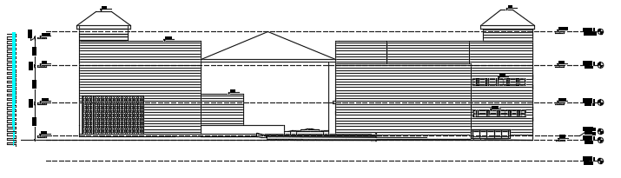
Elevations
SE elevation
NE elevation

Slide 10
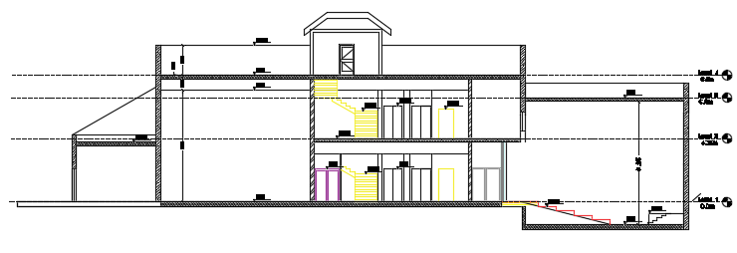
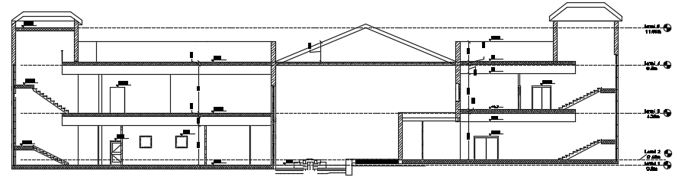
Sections
Section A-A
Section B-B

Slide 11
Environmental analysis
Environmental Adjustments
Materials and layers
Daylight Factor
Shadow Analysis
Heating and cooling Load
Acoustical design

Slide 12
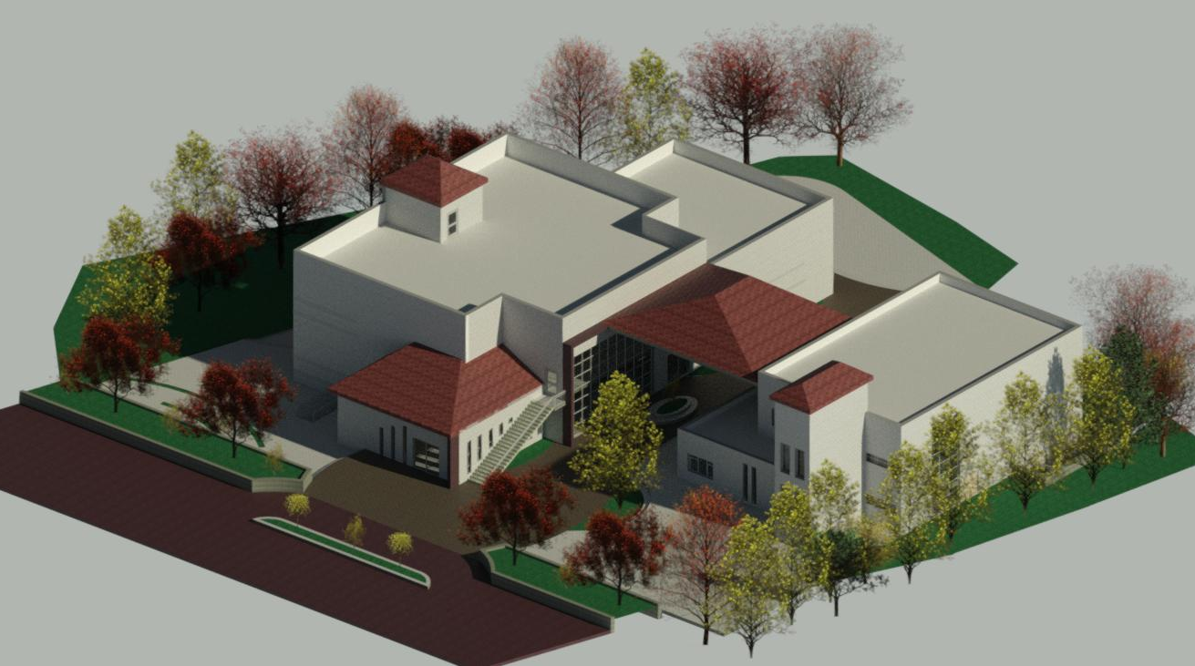
Environmental Adjustments
3D modeling for the building

Slide 13
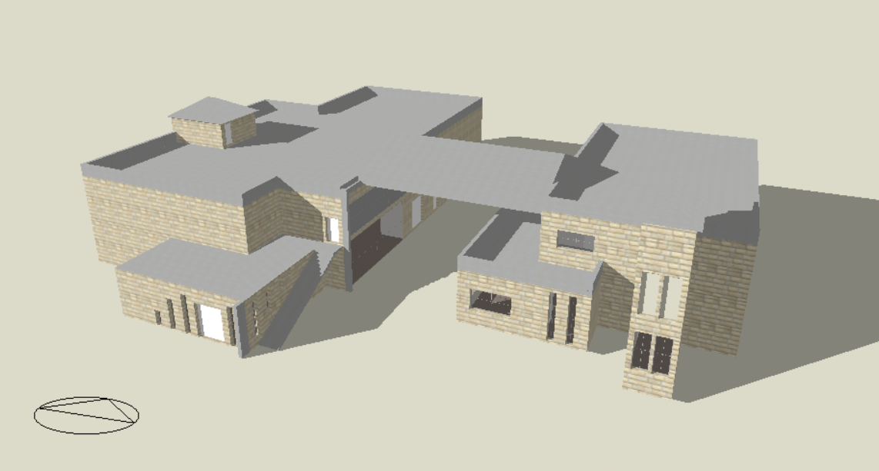
Environmental analysis
3D modeling for the building

Slide 14
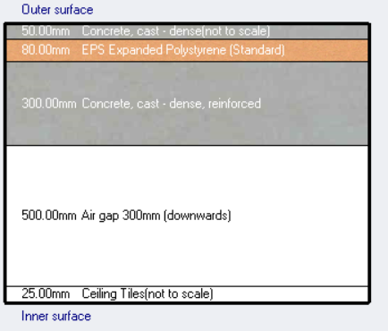
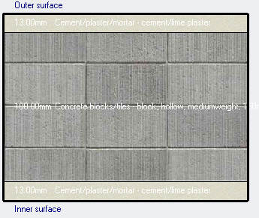
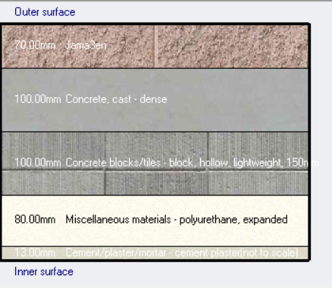
Materials and layers
Cross section for roof
U-value is 0.333 W/m²
Cross section for partition
U-value is 2.964 W/m²
Cross section for external wall
U-value is 0.252 W/m²

Slide 15
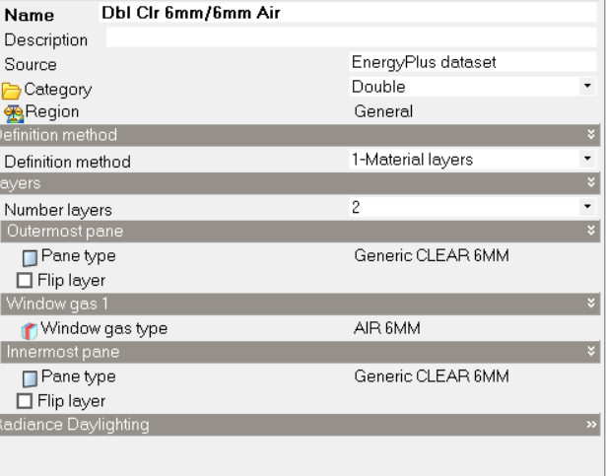
Materials and layers
Glazing

Slide 16
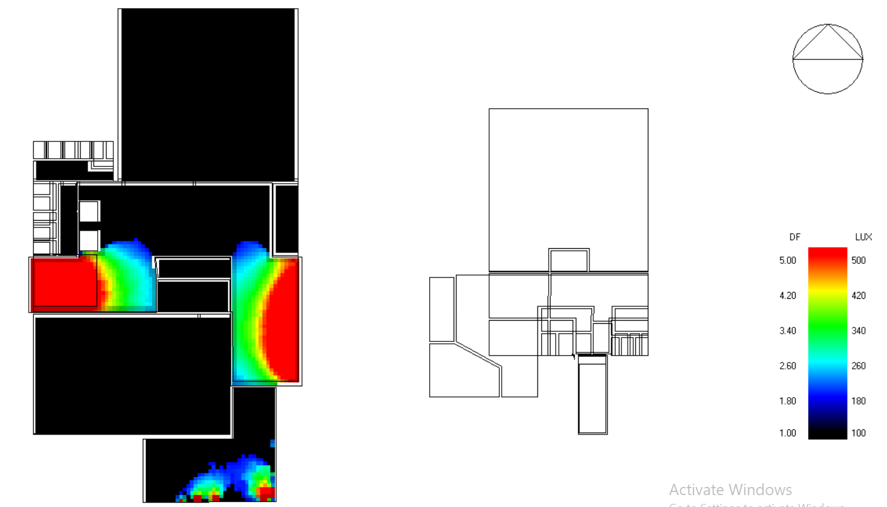
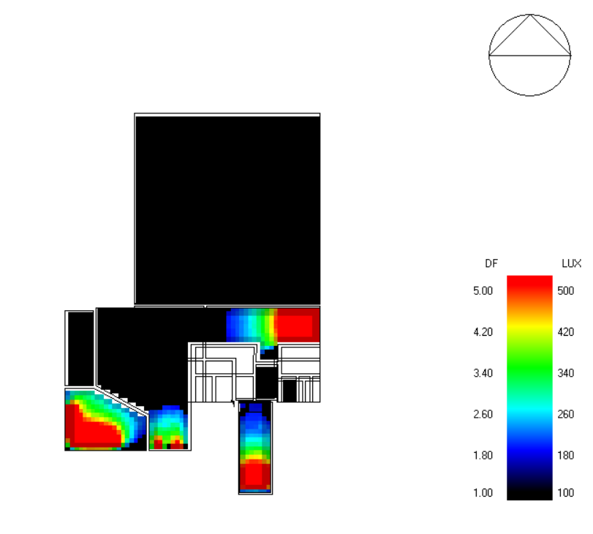
Daylight factor
Daylight factor for ground floor

Slide 17
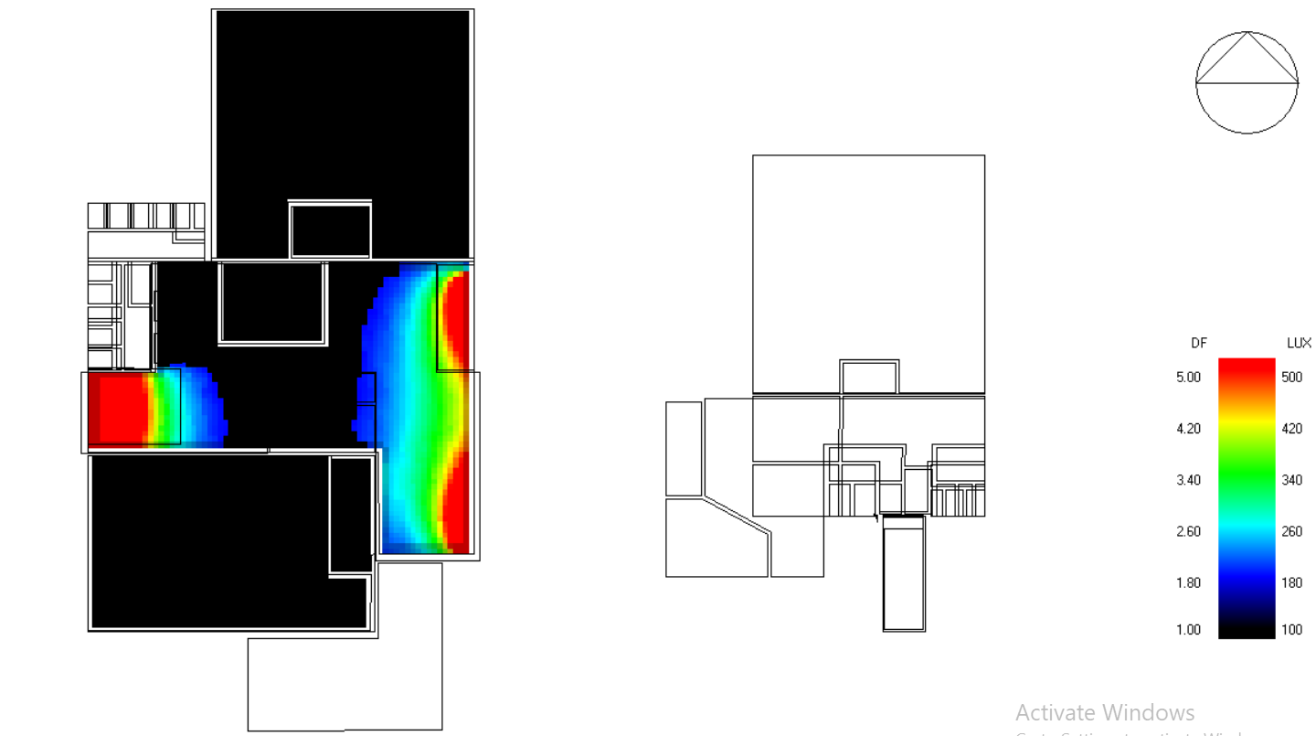
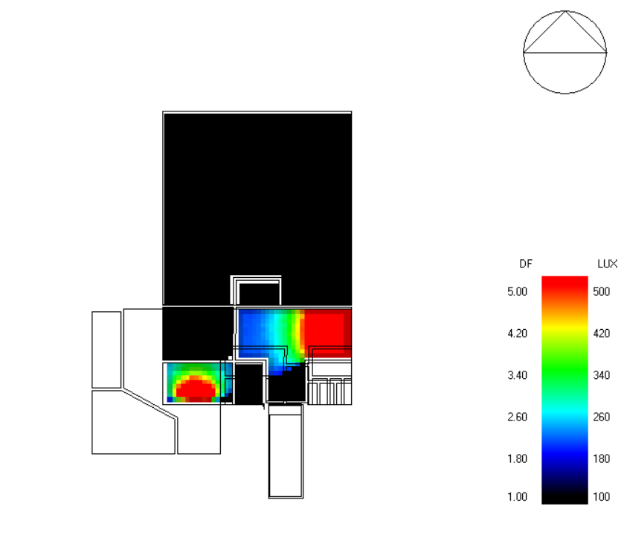
Daylight factor
Daylight factor for first floor

Slide 18
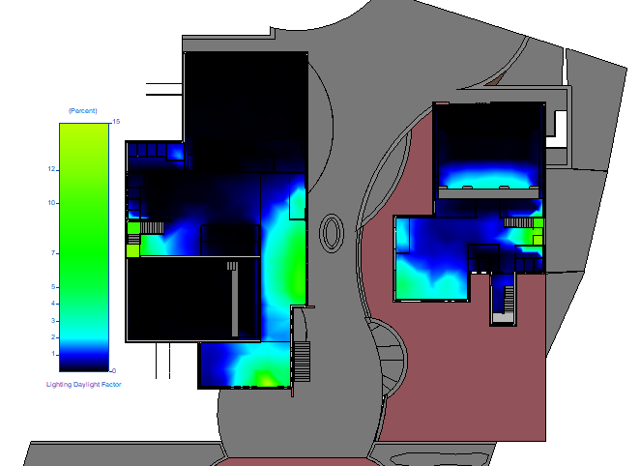
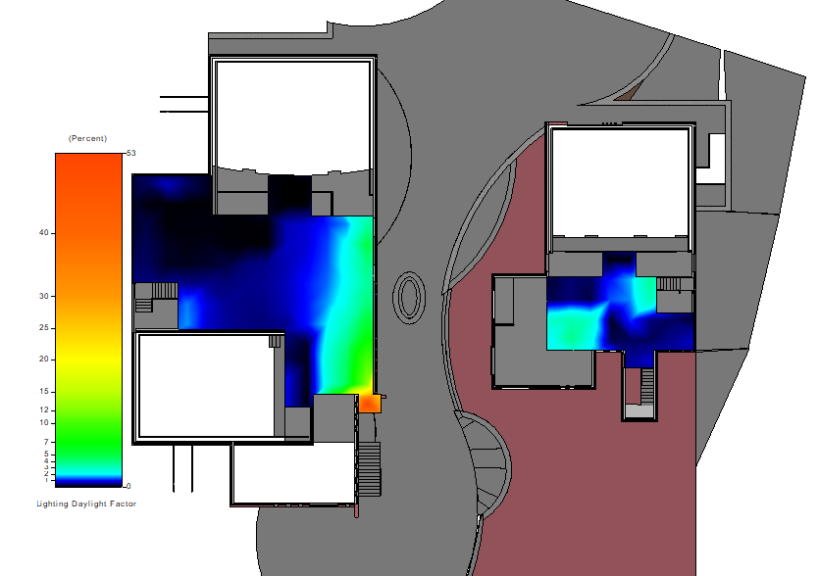
Daylight factor
Daylight factor for building
Ground floor
First floor

Slide 19
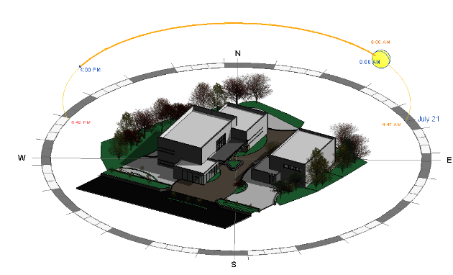
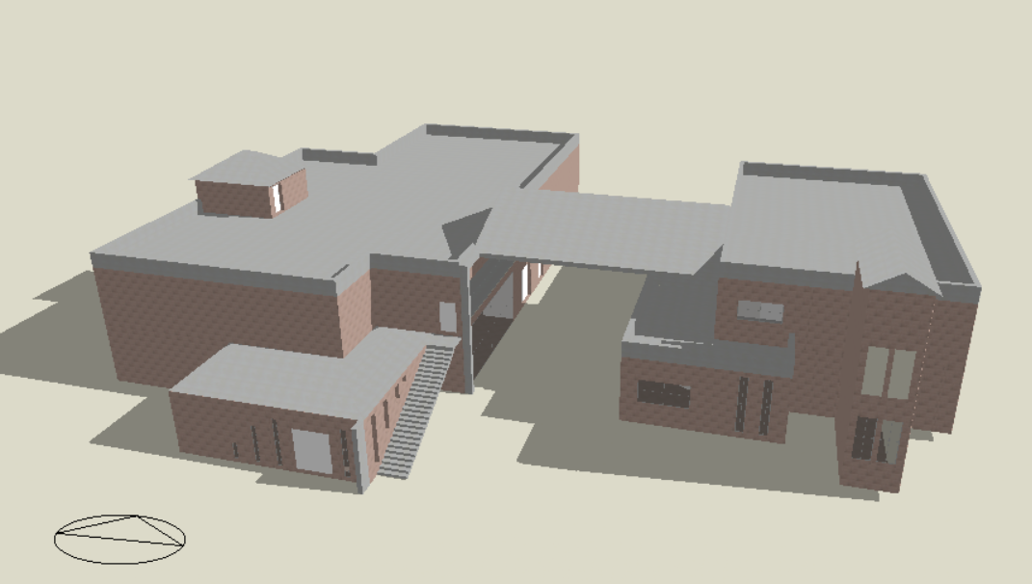
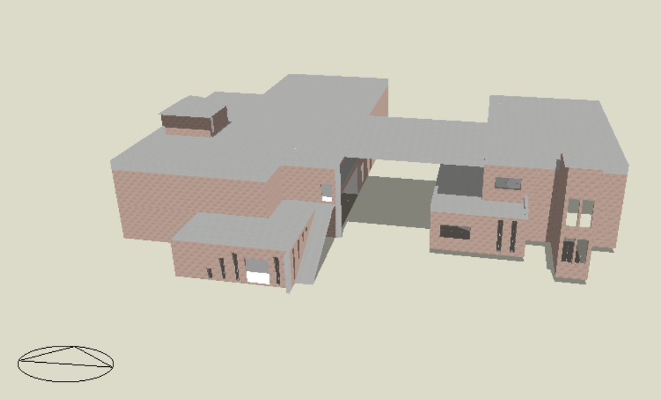
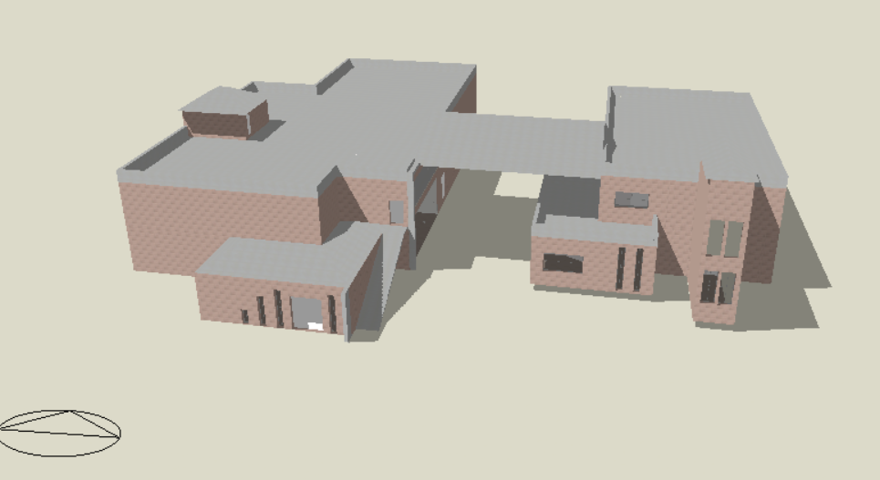
Shadow analysis
Sunbath diagram in Summer
Shadow at 8:00 AM in Summer
Shadow at 12:00 PM in Summer
Shadow at 2:00 PM in Summer

Slide 20
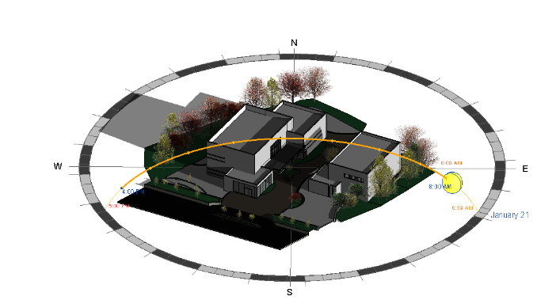
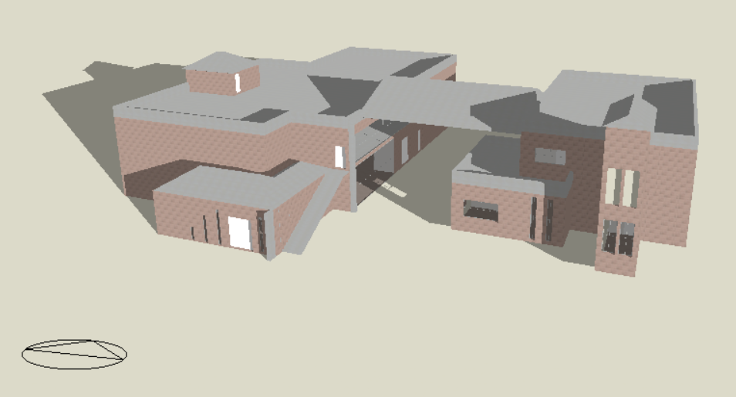
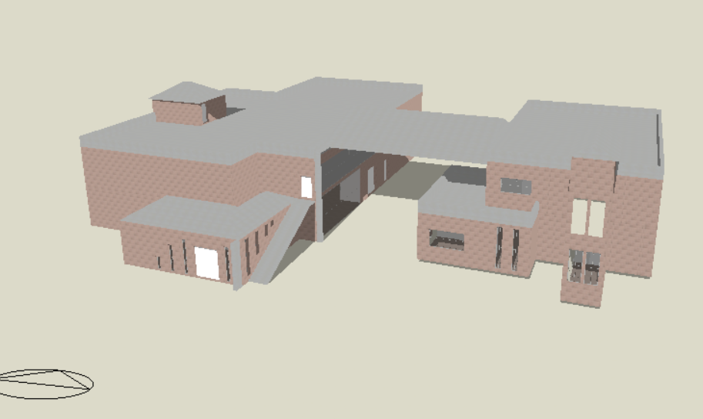
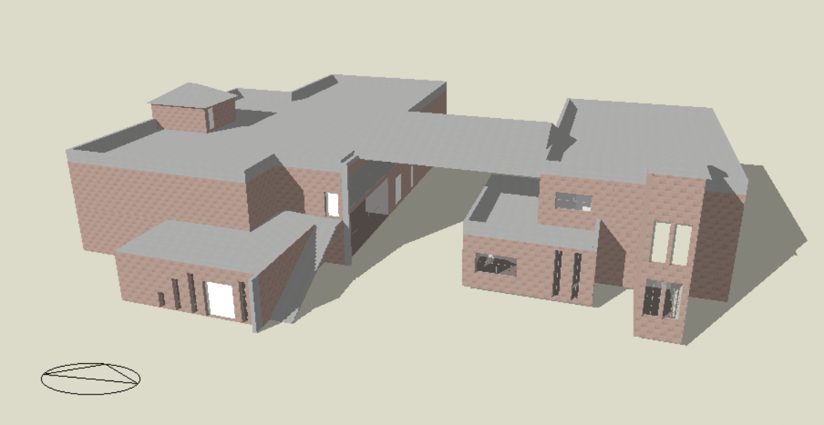
Shadow analysis
Sunbath diagram in Winter
Shadow at 8:00 AM in Winter
Shadow at 12:00 PM in Winter
Shadow at 2:00 PM in Winter

Slide 21
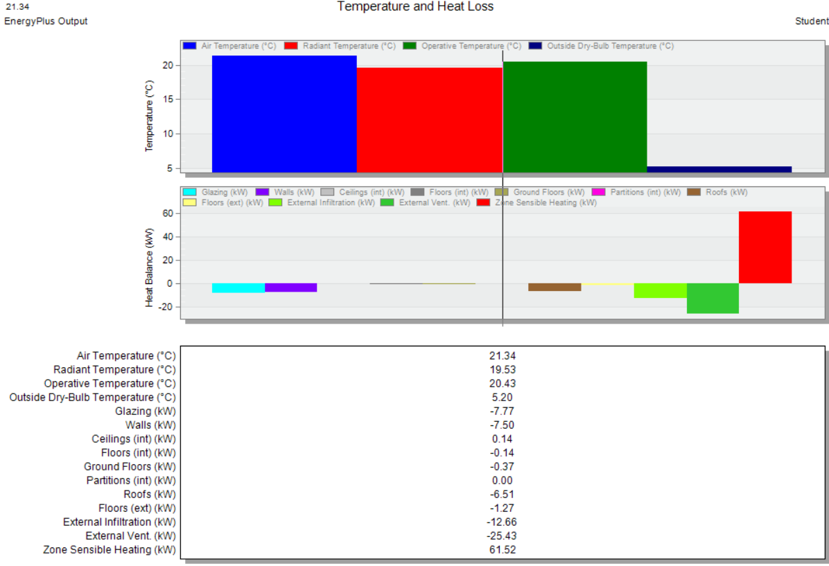
Heating and cooling load
Heating load = 76.97 KW

Slide 22
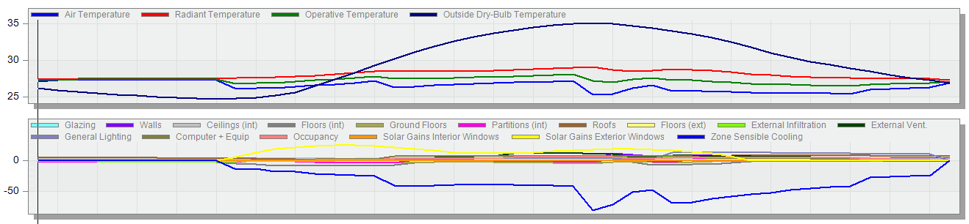
Cooling load
Cooling load = 196.25 KW

Slide 23
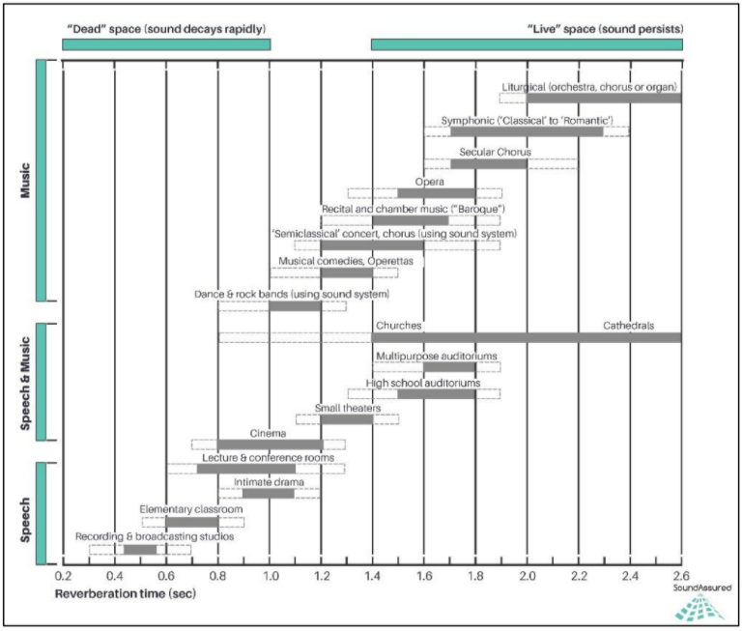
Acoustical analysis
Reverberation time

Slide 24
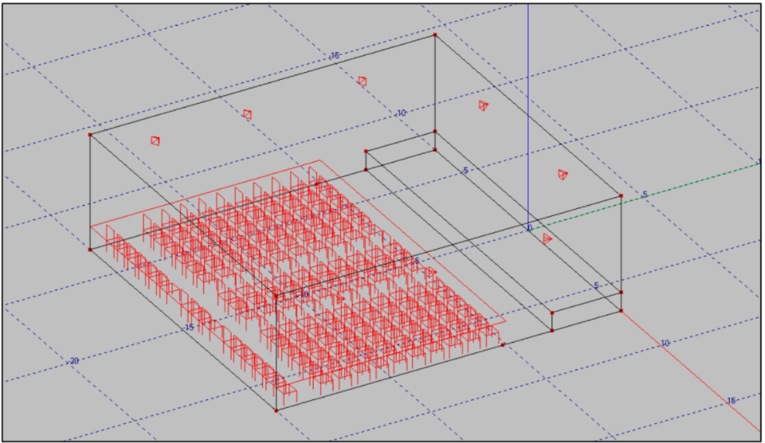
Acoustical analysis
3D modeling for cinema hall

Slide 25
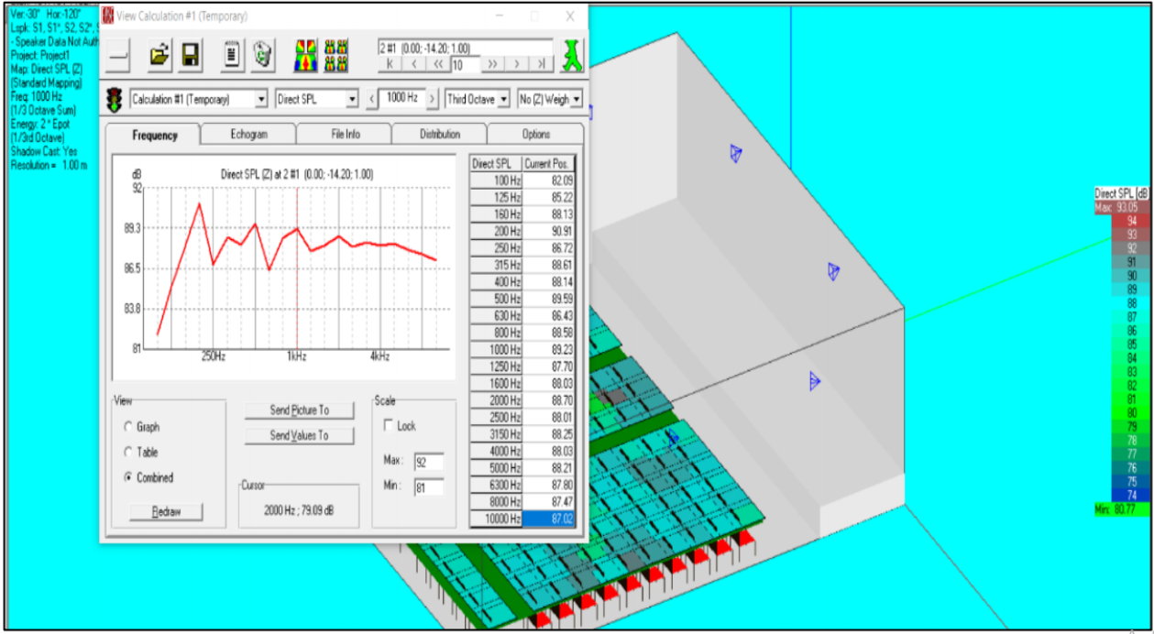
Acoustical analysis
Direct SPL on chairs

Slide 26
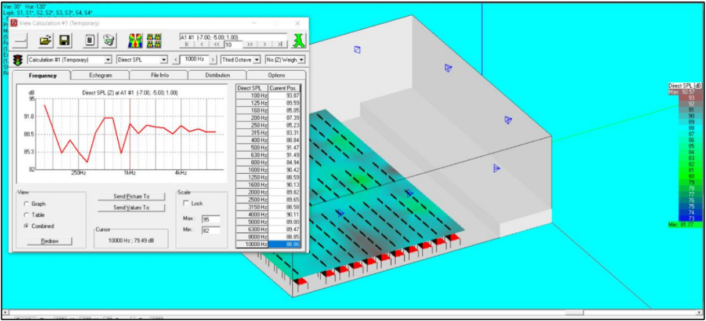
Acoustical analysis
Direct SPL on hall area

Slide 27
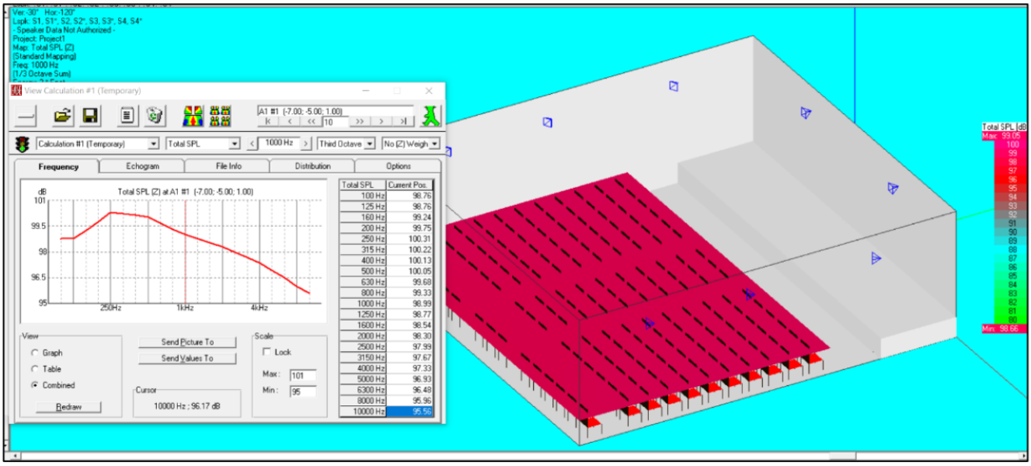
Acoustical analysis
Total SPL for chairs

Slide 28
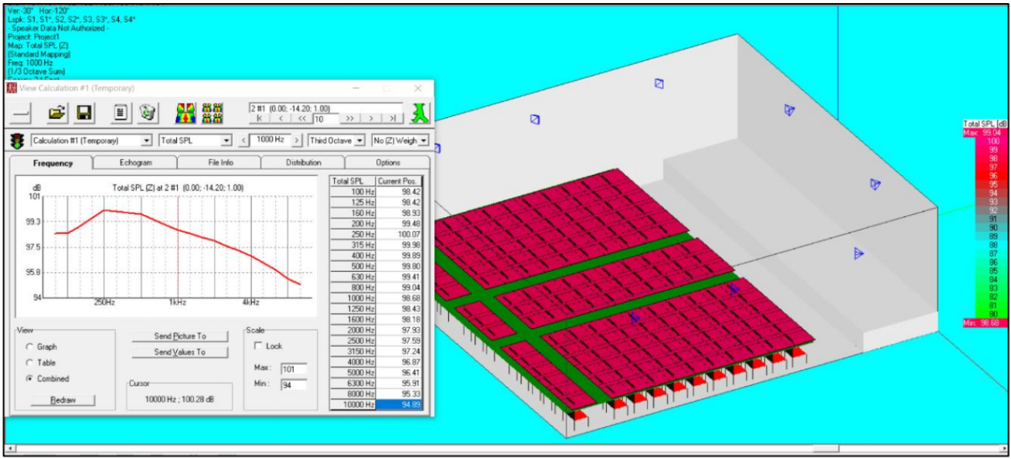
Acoustical analysis
Total SPL on hall area

Slide 29
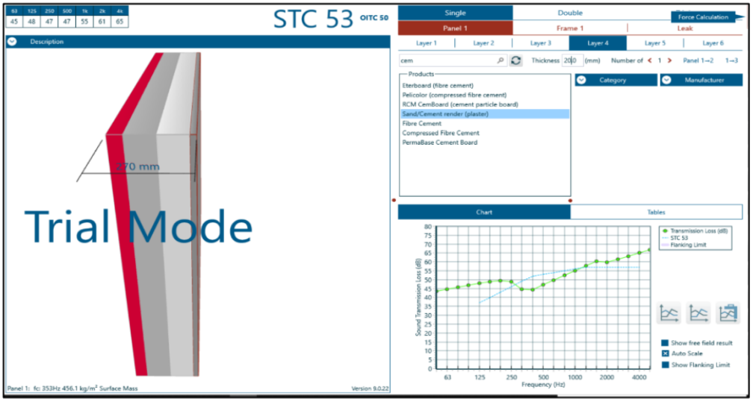
Acoustical analysis
Sound transmission loss for external walls

Slide 30
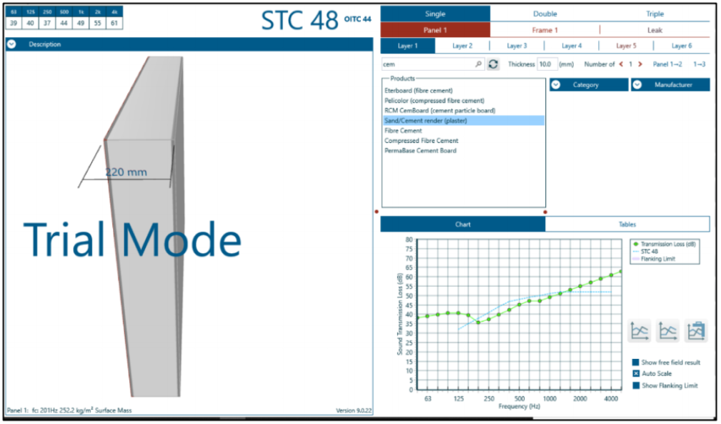
Acoustical analysis
Sound transmission loss for partition walls

Slide 31
Structural analysis
Codes
ACI 318
ASCE 7
UBC 97
Material
concrete: concrete strength (f'c) = 28 Mpa ,ɣ concrete = 25 KN/m3 .
steel rebar: steel yield strength (Fy) = 420 Mpa , modules of elasticity = 200 Gpa and ɣ steel = 78.5 KN/m3 .

Slide 32
Structural analysis
Design Load
Dead load (DL)
Super imposed dead load (SID) = 4.5 KN/m2.
Live load (LL) for office = 3 KN/m2.
Live load (LL) for cafeteria = 5 KN/m2.
Seismic factor
Z = 0.20
Ca = 0.28
Cv = 0.40
I = 1
R = 5.5

Slide 33
Structural analysis
Analysis checks
Compatibility Check(ok).
Equilibrium check (ok).
Stress Strain check (ok).
Design check.
Deflection (ok).
Shear check (ok).
Seismic check.
1. Period check (not ok).
2. Modal mass participation ratio check (ok).
3. Base shear check (ok).
4. Drift check (ok).
5. P-delta check (ok).

Slide 34
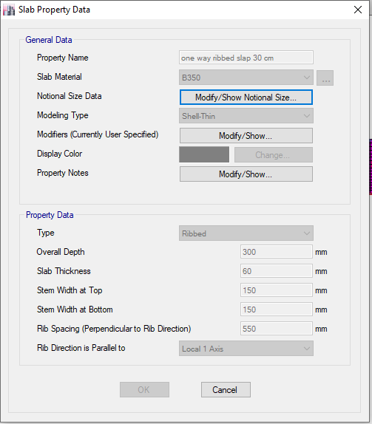
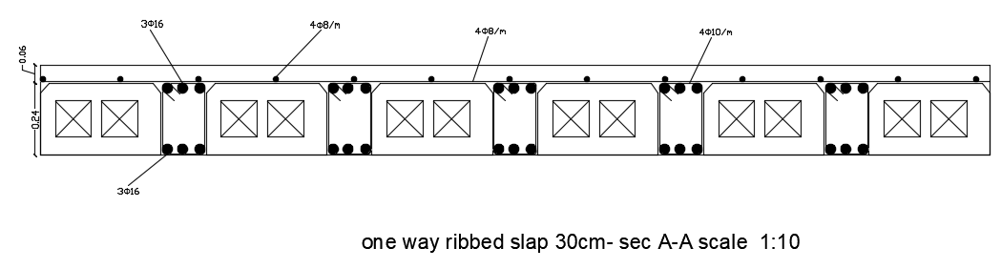
Structural analysis
Slap design
One way ribbed slap 30cm

Slide 35
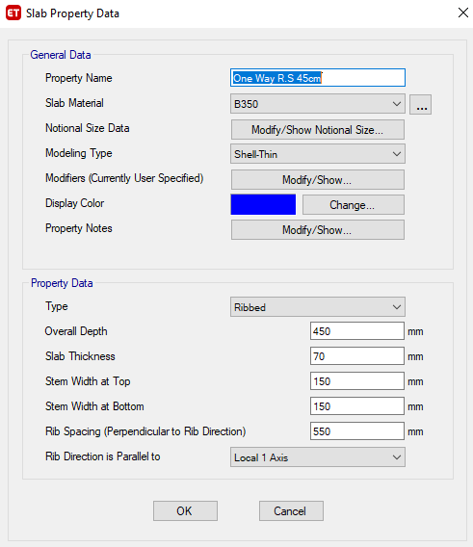
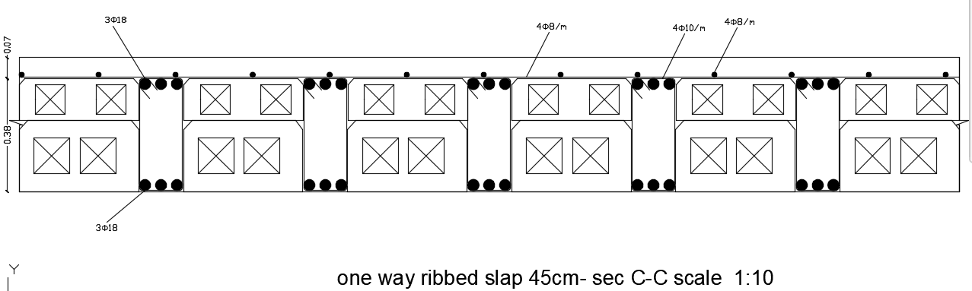
Structural analysis
Slap design
One way ribbed slap 45cm

Slide 36
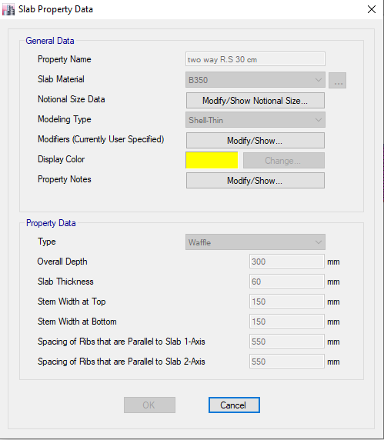

Structural analysis
Slap design
Two way ribbed slap 30cm

Slide 37

Structural analysis
Beam design

Slide 38

Structural analysis
Beam design
Drop beam 90*120

Slide 39

Structural analysis
Beam design
beam 30*80

Slide 40

Structural analysis
Beam design
beam 30*80

Slide 41

Structural analysis
Column design

Slide 42

Structural analysis
Column design
C1

Slide 43


Structural analysis
Column design
C2
Column design
C3

Slide 44

Structural analysis

Slide 45

Structural analysis
Shear wall design

Slide 46


Structural analysis
Shear wall design

Slide 47


Structural analysis
Basement wall design

Slide 48


Structural analysis
Footing design

Slide 49

Structural analysis
Footing design

Slide 50

Structural analysis
Footing design

Slide 51
Electrical Design

Slide 52



Electrical design
Lighting design
Luminaires used
Required Illuminance
space | E (LUX) Required | E (LUX) Used
Cinema halls | 200-300 | 250
Waiting area | 300 | 377
Service room | 300-500 | 377
Corridors | 200-300 | 300
WC | 150-300 | 350
Ticketing room | 300 | 350
Cafeteria | 300-500 | 400
Kitchens | 200 | 220
Manager Room | 500 | 500
Staff room | 500 | 500

Slide 53


Electrical design
Luminaires distribution
Luminaires distribution on the ground floor
Luminaires distribution on the first floor

Slide 54


Electrical design
Luminaires distribution
Luminaires distribution in Cafeteria
Luminaires distribution in Cinema hall

Slide 55


Electrical design
Sockets distribution

Slide 56

Electrical design
Electrical calculations
Floor |  | Load Current (A) | C.B Current (A) | Cable Current (A)
Building A | Ground Floor | 32.54421053 | 40.68026316 | 50.85032895
 | First Floor | 50.31726316 | 62.89657895 | 78.62072368
Building B | Ground Floor | 22.09789474 | 27.62236842 | 34.52796053
 | First Floor | 29.19473684 | 36.49342105 | 45.61677632
Floor |  | Load Current (A) | C.B Current (A) | Cable Current (A) | ϼ(Ώm) | Max L(m) | A(mm2) | R(Ώ) | Drop voltage | %Drop voltage
Building A | Ground Floor | 11.2 | 14 | 17.5 | 1.68E-08 | 50 | 2.5 | 0.336 | 3.7632 | 1.710545
 | First Floor | 19 | 23.75 | 29.6875 | 1.68E-08 | 45 | 2.5 | 0.3024 | 5.7456 | 2.611636
Building B | Ground Floor | 9.5 | 11.875 | 14.84375 | 1.68E-08 | 20 | 2.5 | 0.1344 | 1.2768 | 0.580364
 | First Floor | 27 | 33.75 | 42.1875 | 1.68E-08 | 18 | 2.5 | 0.12096 | 3.26592 | 1.484509

Slide 57
  Mechanical aspects

Slide 58

Mechanical aspects
Water Supply
Diameter Of Pipes
type | Diameter (inch)
Vertical | 2
Horizontal | 1.25
Branch | 0.75

Slide 59

Mechanical aspects
Drainage system
distribution fixture units for Building A

Slide 60

Mechanical aspects
Drainage system
Drainage System Plan
Pipe Diameter
Type | Diameter
WC | 4 inches.
Lavatory | 2 inches.
Kitchen Sink | 2 inches.
Main Stack | 4 inches.
Between Manholes | 6 inches.

Slide 61
Mechanical aspects
HVAC System
From the Design Builder program
Building A :
Total Heating Load = 54.46 kW.
Total Cooling Load = 127.71 kW.
Total Flowrate = 5.7159 m^3/s.
Outdoor unit used : Samsung model number AM140FXVAGH / GR, 135.2 KW
Indoor unit : fan coil was selected by type FWD04-18A with flowrate 3000 m3/h.
Building B :
Total Heating Load = 22.896kW.
Total Cooling Load = 91.58kW.
Total Flowrate = 3.2945 m^3/s.
Outdoor unit used : Samsung model number AM120FXVAGH / GR 95.2 KW
Indoor unit : fan coil was selected by type FWD04-18A with flowrate 3000 m3/h.

Slide 62

Mechanical aspects
HVAC System
Distribution of Indoor Unit for first floor

Slide 63


Mechanical aspects
Fire Fighting System
Sprinkler System used : Wet pipe system

Slide 64



Mechanical aspects
Fire alarm System

Slide 65
Mechanical aspects
Fire alarm System

Slide 66
Project cost
The total cost of the project is 2866660 ₪
Work | Budget Cost (₪) | Percentage (%)
sub-structure | 951981.875 | 33.20874648
Finishing Works | 1228299.19 | 42.84774476
Mechanical Work | 168042 | 5.861943722
Electrical Work | 446400 | 15.57212886
Total | 2866660.07 | 100

Slide 67
Thank you for attention

