Slide 1

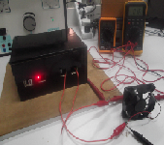
An-Najah National University
Electrical Engineering Department
Graduation Project
Power supply with regulated adjustable output
Supervisor : Prof.Dr.Marwa
Students:
Qamar Hazeem(10716189)
Fareeda odeh(10718807)

Slide 2
Introduction:
A regulated power supply is one that controls the output voltage or current to a specific value.
A power supply converting AC line voltage to DC power must perform
the following functions at high efficiency and at low cost:
1. Rectification: Convert the incoming AC line voltage to DC voltage.
2. Voltage transformation: Supply the correct DC voltage level(s).
3. Filtering: Smooth the ripple of the rectified voltage.
4. Regulation: Control the output voltage level to a constant value.
5. Isolation: Separate electrically the output from the input voltage source.
6. Protection: Prevent damaging voltage surges from reaching the output; provide back-up power or shut down during a brown-out.

Slide 3

In our project we built two type of power supply :
In our project we built two type of power supply :
Linear power supply
Switched-mode power supply
1-Linear power supply
2-Switched-mode power supply

Slide 4

Linear power supply
Linear power supply
linear power supply with the following block diagram:
linear power supply with the following block diagram:

Slide 5
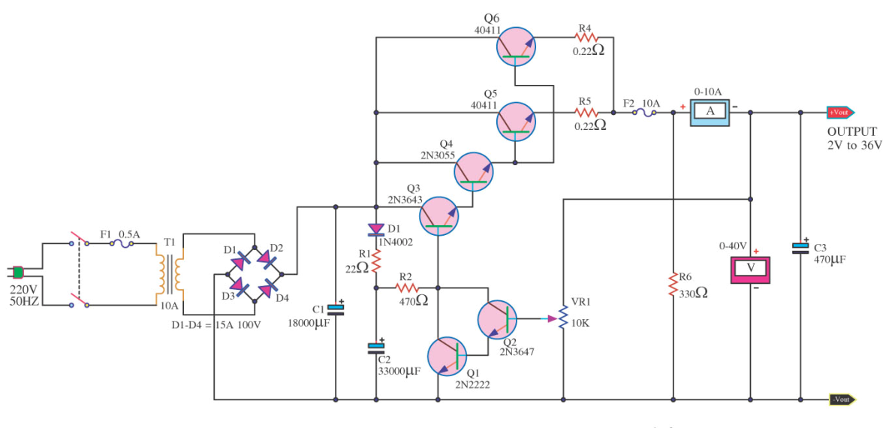
We choose the following circuit to build it , but we have a problem in availability the component (high power transistor Q5,Q6)
We choose the following circuit to build it , but we have a problem in availability the component (high power transistor Q5,Q6)

Slide 6
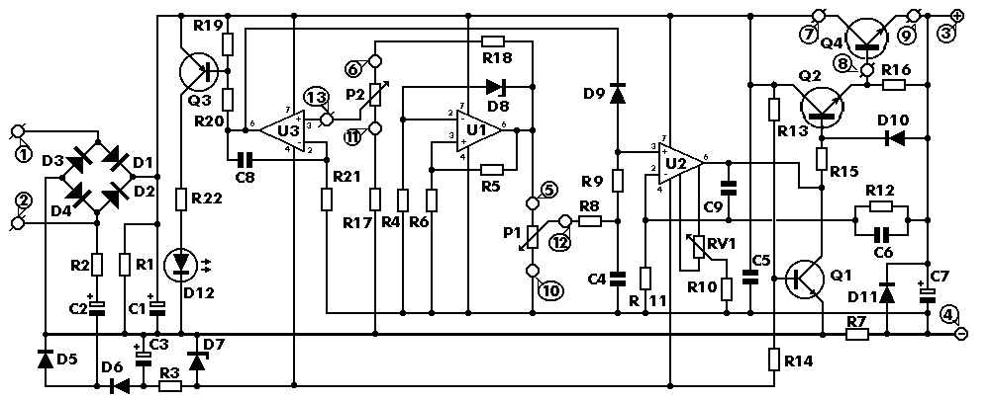
So we choose another circuit that make voltage ,current regulator with limit ( 0-30 Vdc,.002-3 A).
So we choose another circuit that make voltage ,current regulator with limit ( 0-30 Vdc,.002-3 A).

Slide 7
General Description about the linear power supply circuit :
This is a high quality power supply with a continuously variable tabilized output adjustable at any value between 0 and 30VDC. The circuit also incorporates an electronic output current limiter that effectively controls the output current from a few milliamperes (2 mA) to the maximum output of three amperes that the circuit can deliver.
General Description about the linear power supply circuit :
This is a high quality power supply with a continuously variable tabilized output adjustable at any value between 0 and 30VDC. The circuit also incorporates an electronic output current limiter that effectively controls the output current from a few milliamperes (2 mA) to the maximum output of three amperes that the circuit can deliver.

Slide 8
Technical Specifications:
Technical Specifications:
Input Voltage: .…............ 24 VAC
Input Voltage: .…............ 24 VAC
Input Current: .…............ 3 A (max)
Output Voltage: .…......... 0-30 V adjustable
Input Current: .…............ 3 A (max)
Output Voltage: .…......... 0-30 V adjustable
Output Current: .…......... 2 mA-3 A adjustable
Output Current: .…......... 2 mA-3 A adjustable
Output Voltage Ripple: .… 0.01 % maximum
Output Voltage Ripple: .… 0.01 % maximum
Features:
- Reduced dimensions, easy construction, simple operation.
- Output voltage easily adjustable.
- Output current limiting with visual indication.
- Complete protection of the supplied device against over loads and malfunction.
Features:
- Reduced dimensions, easy construction, simple operation.
- Output voltage easily adjustable.
- Output current limiting with visual indication.
- Complete protection of the supplied device against over loads and malfunction.

Slide 9
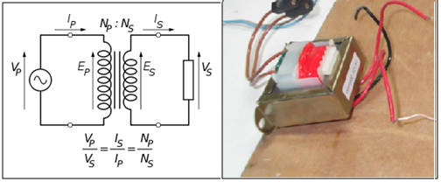
How the circuit Works
How the circuit Works:
Transformer:
Transformer:
A transformer is a device that transfers electrical energy from one circuit to another through inductively coupled conductors
A transformer is a device that transfers electrical energy from one circuit to another through inductively coupled conductors
In our project:
In our project:
There is a step-down mains transformer with a secondary winding rated at 24 V/3 A
There is a step-down mains transformer with a secondary winding rated at 24 V/3 A

Slide 10
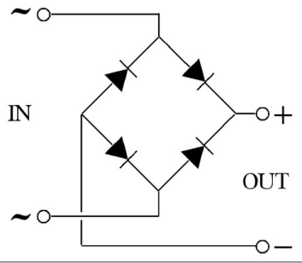
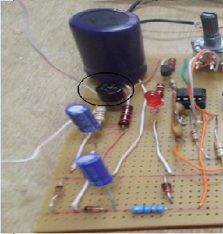
Rectifier:
Rectifier:
A rectifier is an electrical device that converts alternating current (AC), which periodically reverses direction, to direct current (DC), which flows in only one direction. The process is known as rectification.
A rectifier is an electrical device that converts alternating current (AC), which periodically reverses direction, to direct current (DC), which flows in only one direction. The process is known as rectification.
In our project:
In our project:
The AC voltage of the transformers secondary winding is rectified by the bridge formed by the four diodes D1-D4.
The AC voltage of the transformers secondary winding is rectified by the bridge formed by the four diodes D1-D4.

Slide 11

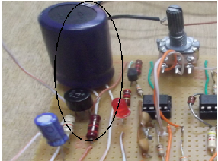
Rippel smoothing circuit :
Rippel smoothing circuit :
The DC voltage taken across the output of the bridge is smoothed by the filter formed by the reservoir capacitor C1 and the resistor R1.
The DC voltage taken across the output of the bridge is smoothed by the filter formed by the reservoir capacitor C1 and the resistor R1.

Slide 12
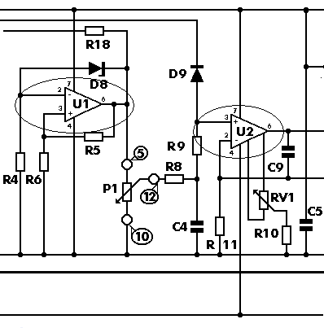
Voltage regulator:

Slide 13
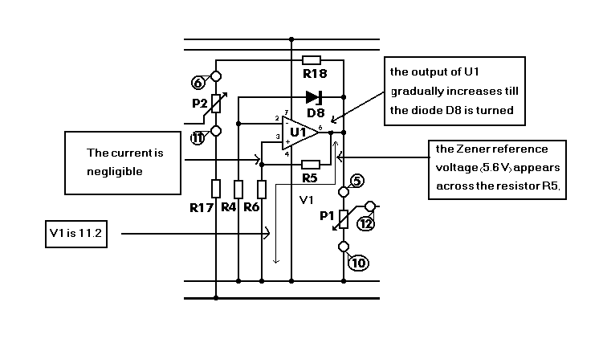

Slide 14
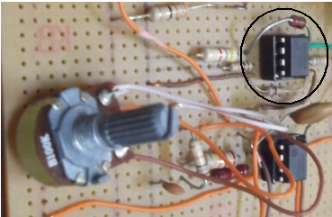
The integrated circuit U2 has a constant amplification factor of approximately 3 times, according to the formula A=(R11+R12)/R11, and raises the 11.2 V reference voltage to approximately 33 V
The integrated circuit U2 has a constant amplification factor of approximately 3 times, according to the formula A=(R11+R12)/R11, and raises the 11.2 V reference voltage to approximately 33 V

Slide 15
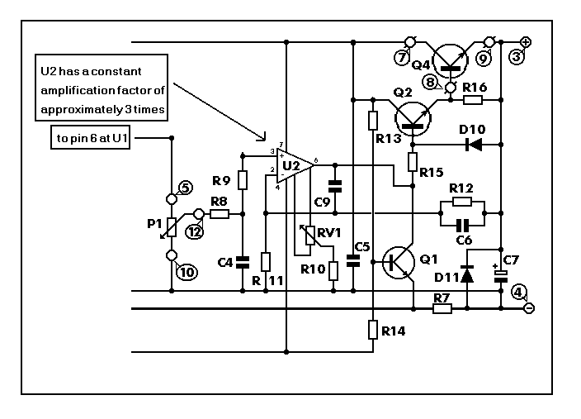
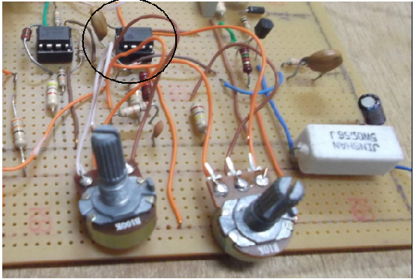

Slide 16
The following reading got from the circuit:
The following reading got from the circuit:
V_{IN} | V_{Load} | V_{drop} | I_{Load}
12v | 6.2 | 5.8 | 77.9 mA
15V | 8.4 | 6.6 | 97.6 mA
20.4V | 13.6 | 6.8 | 137.2 mA
12 | 6.6 | 5.4 | 72mA
15 | 8.9 | 6.1 | 77mA
20.4 | 14 | 5.6 | 88mA
V_{IN} | V_{Load} | V_{drop} | I_{Load}
12v | 6.2 | 5.8 | 77.9 mA
15V | 8.4 | 6.6 | 97.6 mA
20.4V | 13.6 | 6.8 | 137.2 mA
12 | 6.6 | 5.4 | 72mA
15 | 8.9 | 6.1 | 77mA
20.4 | 14 | 5.6 | 88mA

Slide 17
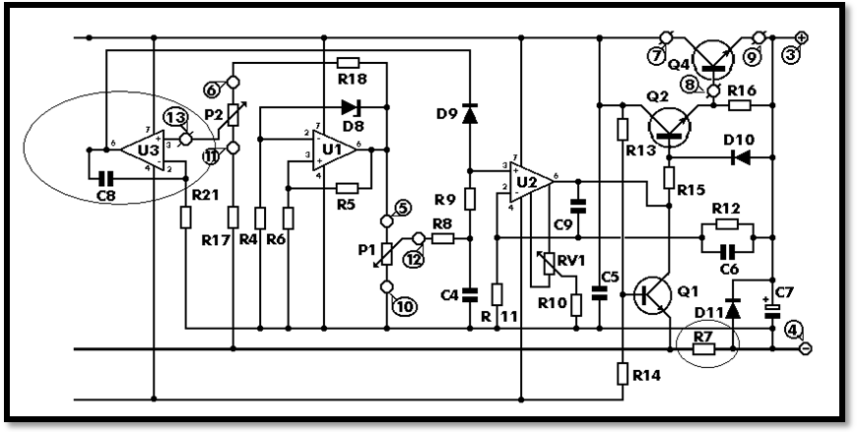
current regulator:
The output of U3 is low and coupled to the non inverting input of U2 by D9 , U2 is responsible for the voltage control and as U3 is coupled to its input the latter can effectively override its function, and the voltage decrease at the output of U2 ,so decreasing the voltage at the base of Q2 ,this is causing decrease the current sinking from emitter to the load, so the voltage drop across R7 decreasing because the current decreasing

Slide 18
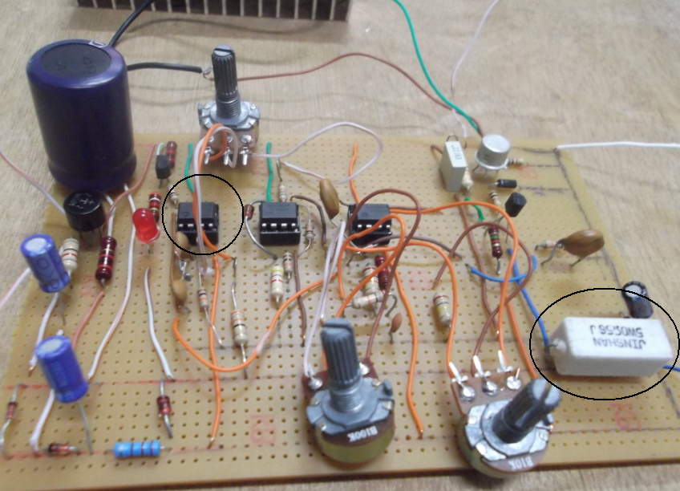
The following component make current regulator:

Slide 19
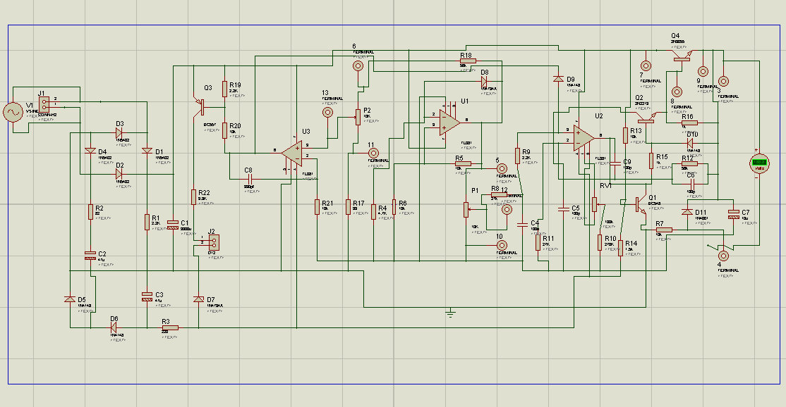
After we built this circuit as printed board (PCB),so we Implement it in PROTEUS PROGRAM .

Slide 20
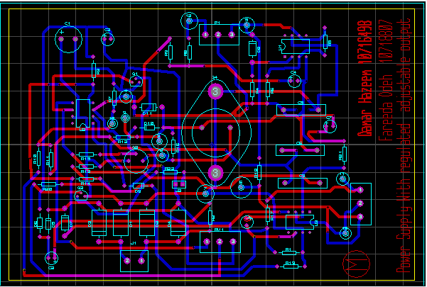
(PCB – Connections):

Slide 21
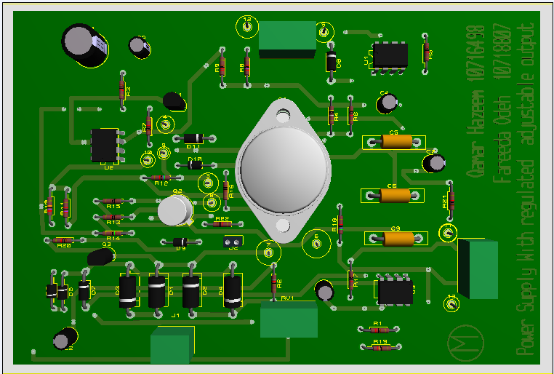

Slide 22
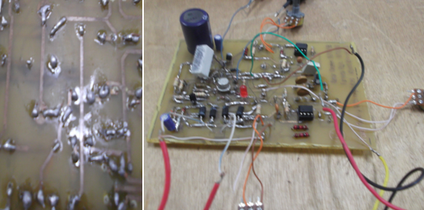
The following picture represent printed board circute:

Slide 23
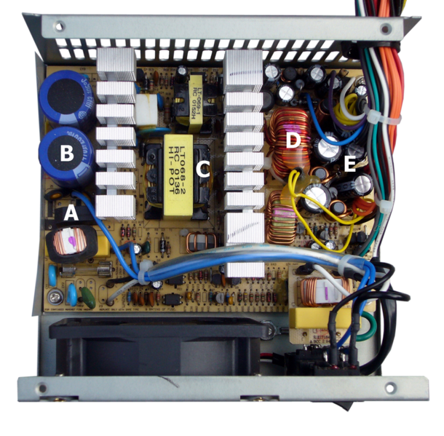
Switched mode power supply
Switched mode power supply
an SMPS transfers power from a source, like mains power, to a load, such as a personal computer, while converting voltage and current characteristics.
SMPS transfers power from a source, like mains power, to a load, such as a personal computer, while converting voltage and current characteristics. An SMPS is usually

Slide 24
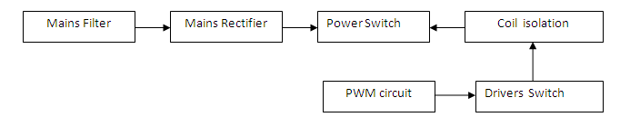
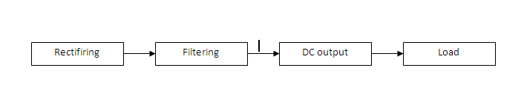
1-The primary side:
SMPS will divide in two part :
1-The primary side:
2- The secondary side:

Slide 25
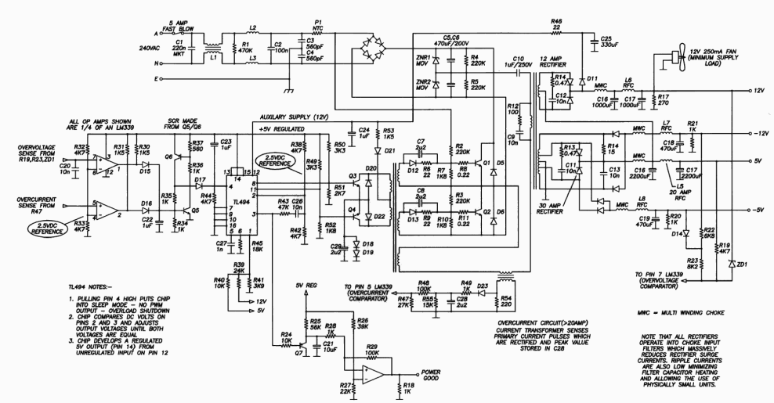
In my gradution project We built the following circuit for switch mode power supply :
Figure-24

Slide 26
These circuit can be divided into three staage:
Control circuit
High power circuit
Dc stage
First stage:
We built the control circuit to give us Pulse width modulation (PWM) by using IC component which is called (TL 494 IC).

Slide 27
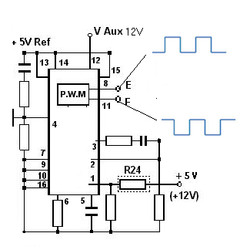
1-Pulse width modulation (PWM) control circuit(TL494 IC):
*The above diagram inside the regulator IC. In the top left hand corner there is an oscillator whose frequency is determined by the resistor and capacitor combination connected to pins 5 and 6.
*Pin 8 and Pin 11 will give pulses with shift reach to nanosecond which is make you in safe side that two driver transistor do not work at the same time.
*Pulling Pin 4 high put chip into sleep mode –No PWM output –over load shutdown, this happened when current over 20 amper.

Slide 28
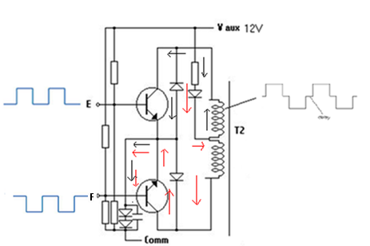
2- Drivers switch & coil isolation:
Now ,
*We use two diver transistor as shown in above circuit .
*The direction of current in coil will give alternating voltage .
*The transformer (T2) will make the isolation.
*E &F will take the pulses from PWM control circuit IC

Slide 29
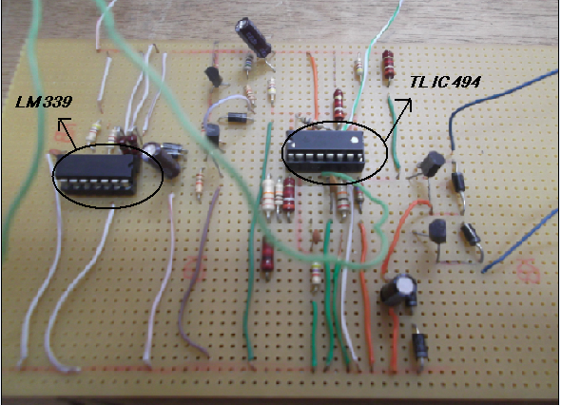
In our project:
Note:
We manipulate on our circuit to give us correct pulses by connecting (pin 3) with (pin 4)

Slide 30
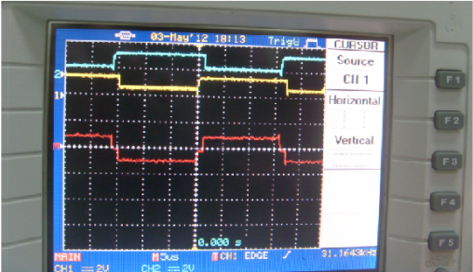
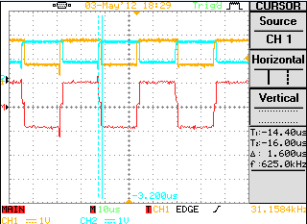
The result from these circuit as pulses on oscilloscope:

Slide 31
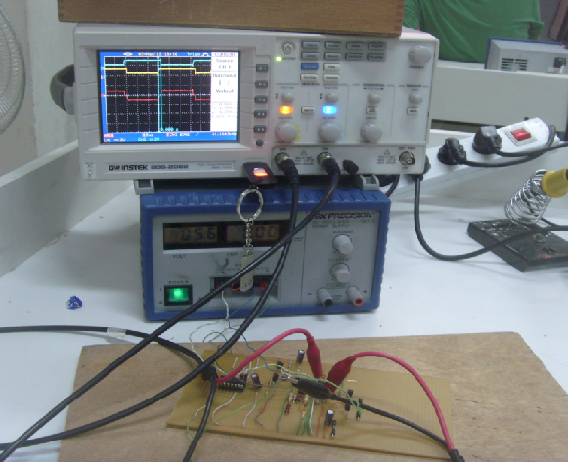
The complete control circuit in the following picture :
Figure-32

Slide 32
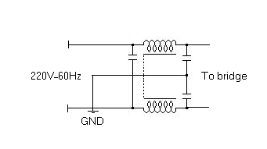
Second stage:
We built the high power circiut:
1-AC Harmonic Filter
*A harmonic filter is used to eliminate the harmonic distortion caused by appliances.
In our project:
*Input 220V,60 Hz to the AC filter as shown in the previous diagram consist L,C.
*The reason for using this filter that our project is a SMPS for personal computers,Which is a non linear load,so we need a harmonic filter.

Slide 33

2-Bridge rectifier :
in SMPS the bridge should have the the high limit of voltage and current than the linear which is reach to 300V ,15 A because the 220V AC from the gride will connect directly to the bridge without using step down transformer.

Slide 34
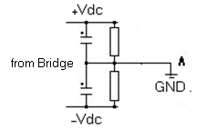
3-Rippel smoothing circuit:
In our project ,we will use the capacitor with value 470 micro F/200 V as shown in the Figure,and connected in way to give( +Vdc, -Vdc) and at the middle gives common.

Slide 35
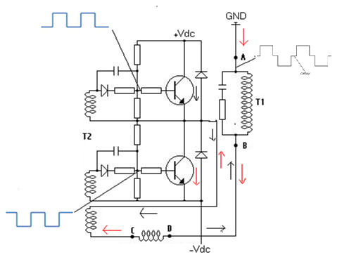
4-Power switch (BJT transistor):
*The important thing that you should take into account ,two transistor must not work at the same time, if this happened it will distortion system.

Slide 36
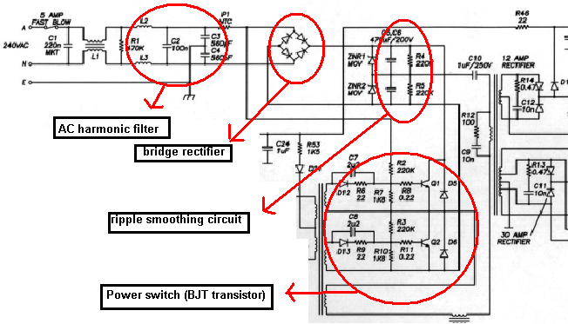
In our project:
We connect the following circuit:
Figure-37

Slide 37
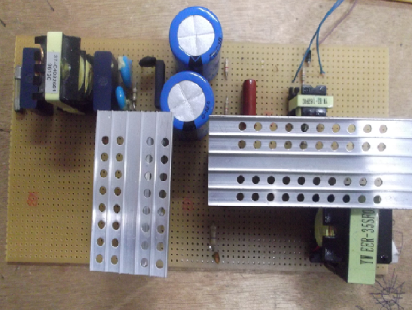

Slide 38
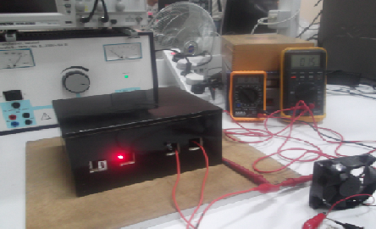

Slide 39

Thank ☺
you

