Slide 1

CCC Global – Luxury Car Rental Platform
AMJAD KAMAL KHREIM
11822577
CIS – An-Najah National University
Supervisor : D.Mutaseam Abuzant

Slide 2

INTRODUCTION
Luxury car rental services are usually managed manually or with limited systems
Customers face issues with availability, booking clarity, and communication
This project provides a complete digital solution

Slide 3
PROBLEM STATEMENT
No real-time availability tracking
Manual booking processes lead to errors and delays
Poor communication between customers and administrators
Limited control and reporting for admins

Slide 4
PROJECT OBJECTIVES
Develop a full-stack luxury car rental platform
Enable customers to browse, book, and rate cars
Provide administrators with full system control
Improve efficiency and user experience

Slide 5
PROPOSED SOLUTION
Web-based platform for customers and admins
Real-time car availability and booking system
Secure authentication and role-based access
Centralized admin dashboard

Slide 6
SYSTEM OVERVIEW
Backend: Node.js and Express.js
Frontend: React, TypeScript and Tailwind CSS
Database: PostgreSQL and Prisma ORM

Slide 7
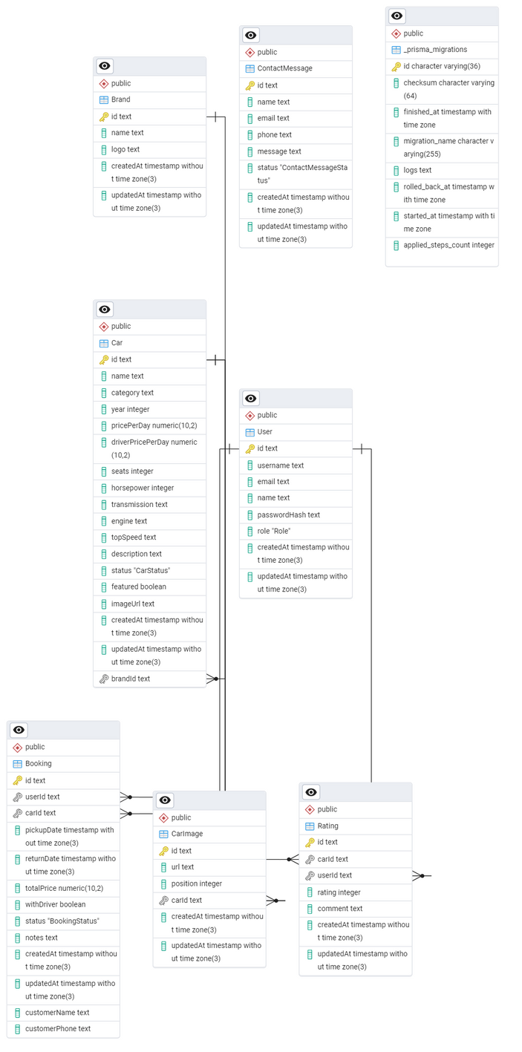
DATA BASE DIAGRAM

Slide 8
MAIN FEATURES
  Browse available luxury cars
  Check availability and make bookings
  View booking history
  Rate cars after completed bookings
Customer Features
  Manage cars, brands, and bookings
  View system statistics
  Handle contact messages and notifications
Admin Features

Slide 9
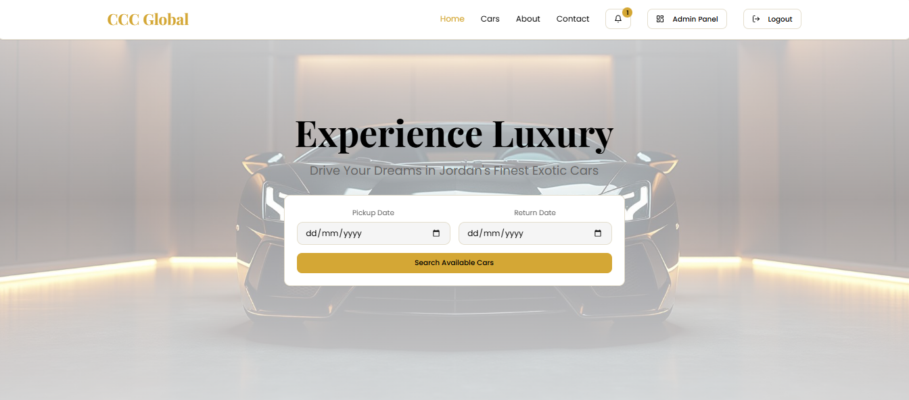
HOME PAGE

Slide 10
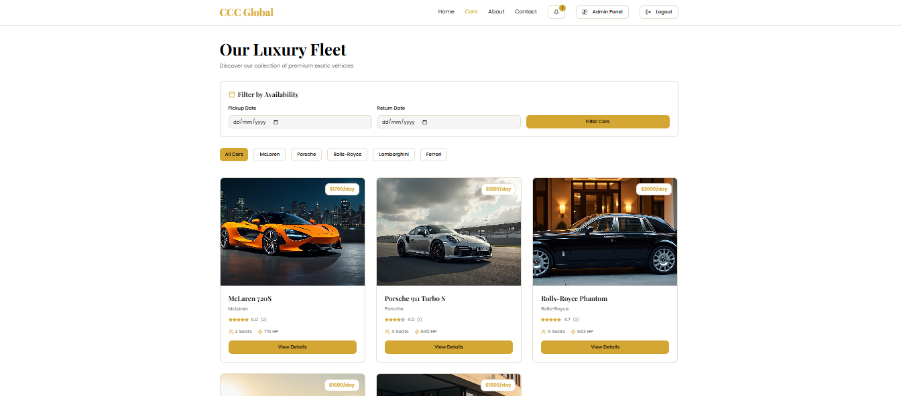
CARS LISTING PAGE

Slide 11
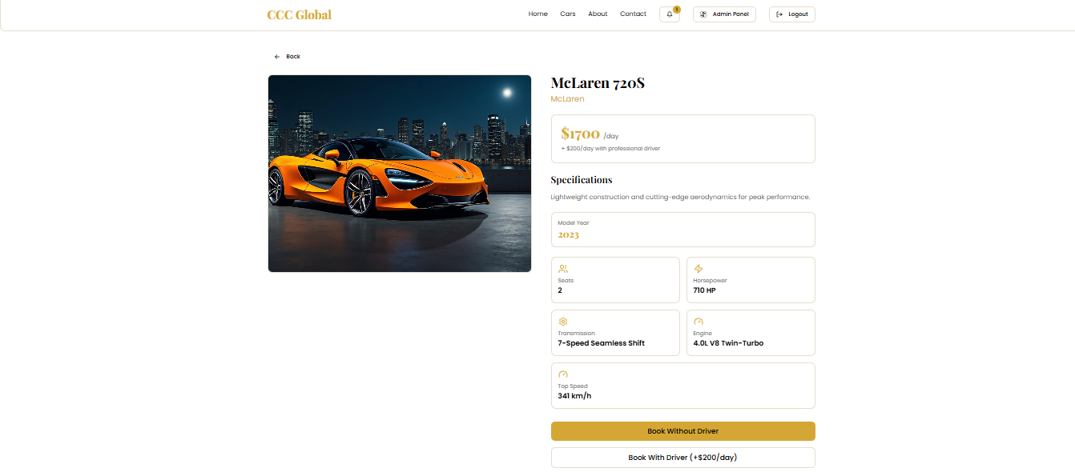
BOOKING PAGE

Slide 12
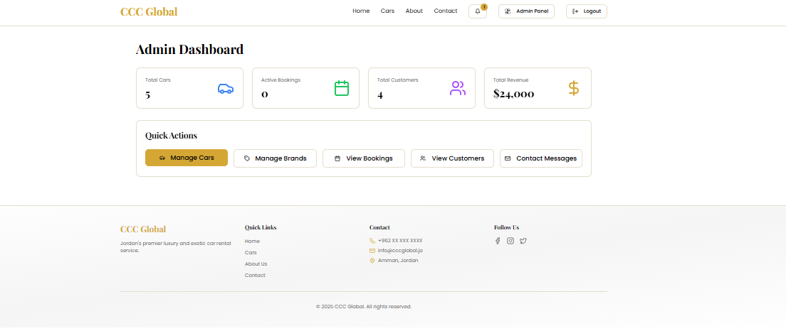
ADMIN DASHBOARD

Slide 13
CHALLENGES & LIMITATIONS
Implementing accurate booking availability logic
Handling notifications without real-time services
Time limitations during development

Slide 14
FUTURE WORK
System deployment to cloud
Real-time notifications
Payment gateway integration

Slide 15
THANK YOU
ANY QUASTION?

