Slide 1

Integrated Design Of Beauty Center
&
Wedding Hall
بسم الله الرحمن الرحيم
An-Najah National University
Faculty of Engineering & Information Technology
Department of Building Engineering
Prepared by :
Amal Fawaz Abu – Diak Lamees Nasasrah
Sama Suhail Abu- Dhair Tamara Balalem
Supervisor :
Dr.Monther Dweiakt

Slide 2
Outline
Architectural Design
Environmental Design
Structural Design
Mechanical And Safety Design
Quantity Survey And Cost Estimation
Electrical Design

Slide 3
Architectural Aspects
Slide 1

Slide 4
Site Analysis
.

Slide 5
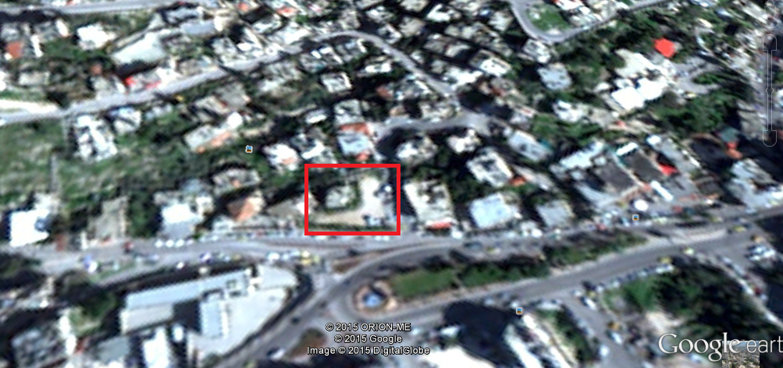
Site Analysis
Slide 1
Nablus City
المستشفى الوطني
الموقع
مدرسة الكندي

Slide 6
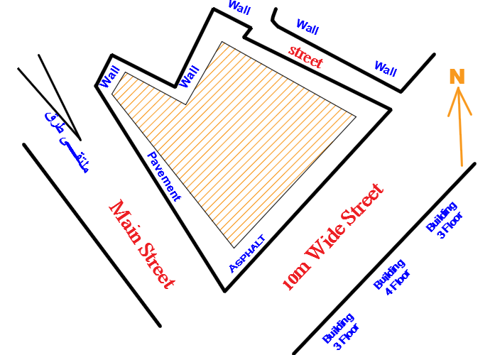
Site Analysis
Slide 1
Total Area = 2780 m2

Slide 7
Slide 1
Architectural
Requirements
.

Slide 8
Architectural Requirements
Slide 1
Beauty Center Part.
Wedding Hall Part.
A Link Between The Beauty Center & The Wedding Hall
Parking.
.

Slide 9
Architectural Requirements
Slide 1
1. Beauty Center
It Designed To Contain A Section For Beauty, And A
Section For Physical Therapy
&
A Link With The Wedding Hall

Slide 10
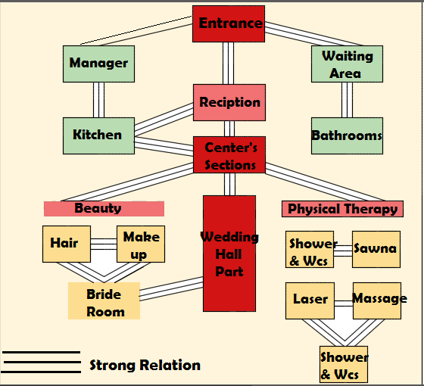
Architectural Requirements
Slide 1
Beauty Center

Slide 11
Architectural Requirements
Slide 1
2. Wedding Hall
It Designed To Contain :
The Main Hall
The Men Hall
Services.
Manager Area
Photography area

Slide 12
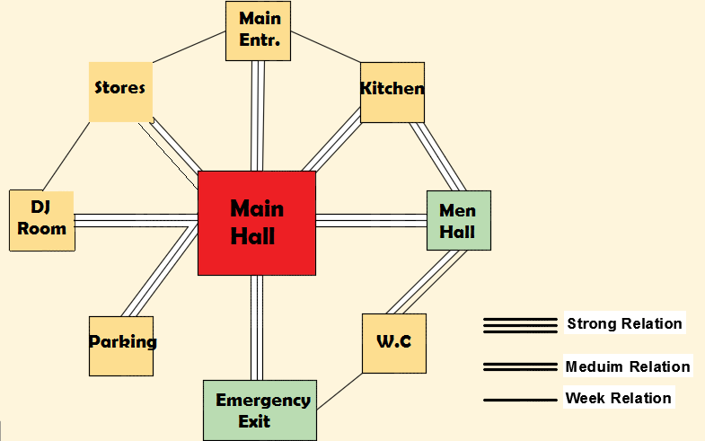
Architectural Requirements
Slide 1
Wedding Hall

Slide 13
Architectural Requirements
Slide 1
3. Parking
It Designed To Accommodate The Attendants
For Every 20 m2 ---- > 1 Parking
Achieved ---- > 76 Parking

Slide 14
Slide 1
The Design
Phase
.

Slide 15
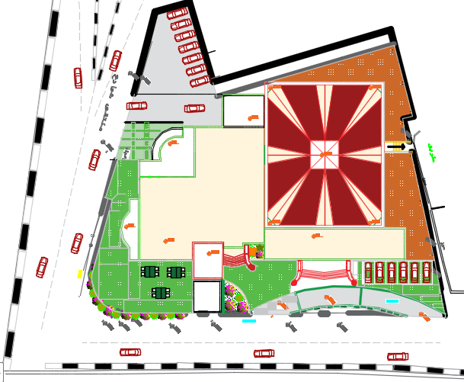
Architectural Design
Slide 1
Site Plan

Slide 16
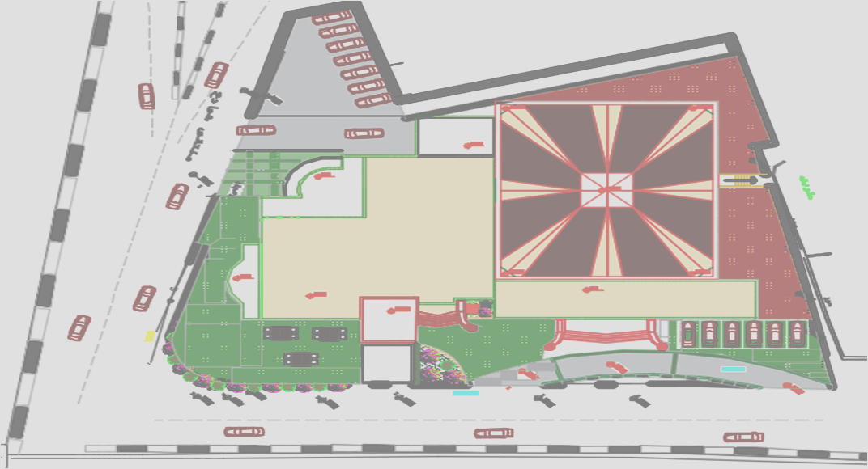
Entrances
Slide 1
Parking
Beauty Center
MEN Hall
Main Hall

Slide 17
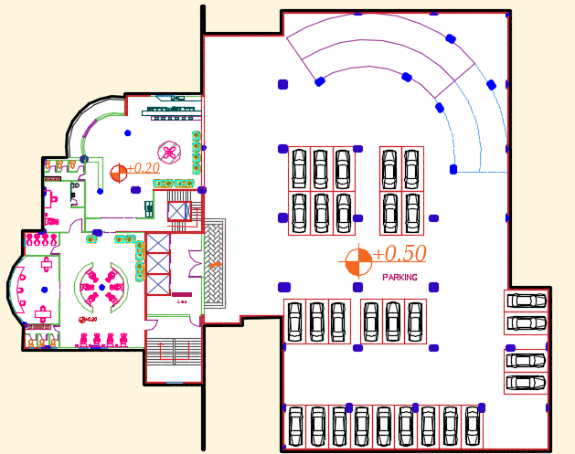
Architectural Design
Slide 1
Ground
Floor
Plan

Slide 18
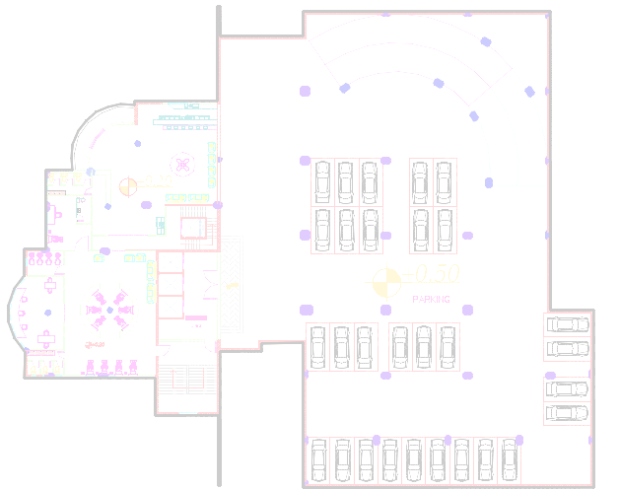
Architectural Design
Slide 1
Total Area
=
2680 m2

Slide 19
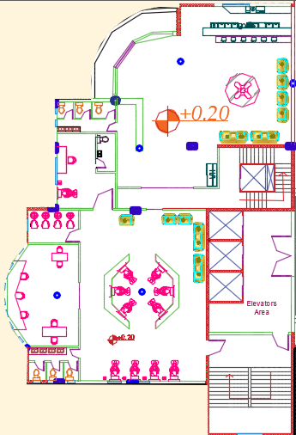

Slide 20
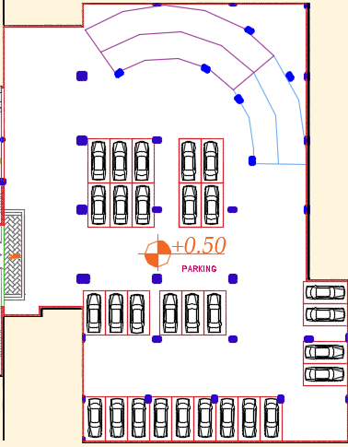

Slide 21
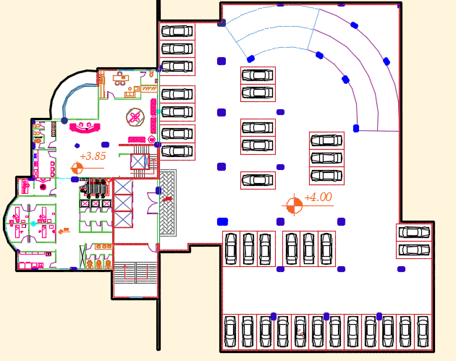
Architectural Design
Slide 1
First
Floor
Plan

Slide 22
Architectural Design
Slide 1
Total Area
=
2680 m²

Slide 23
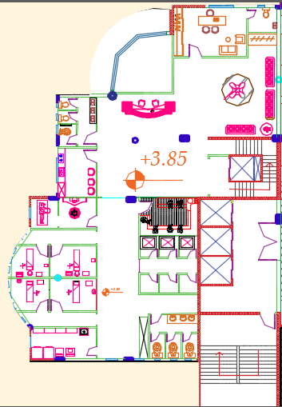

Slide 24
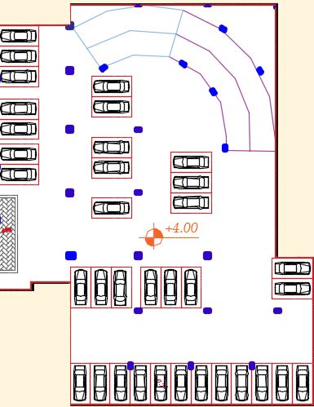

Slide 25
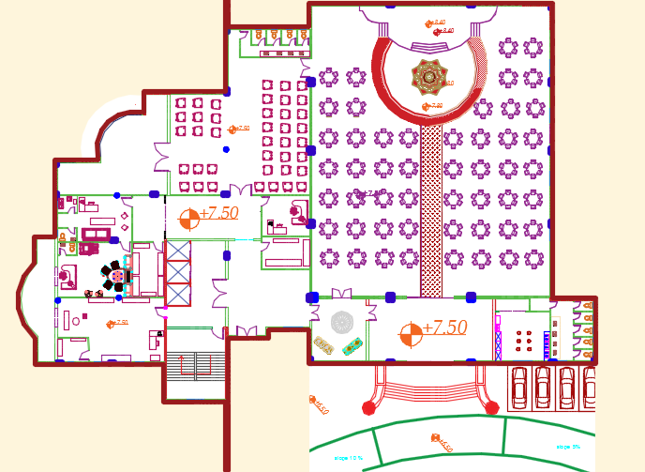
Architectural Design
Slide 1
Second
Floor
Plan

Slide 26
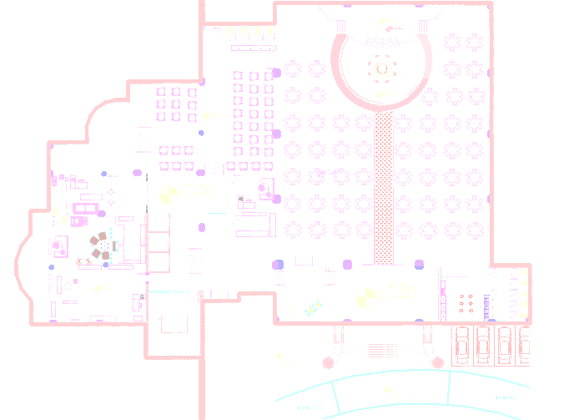
Architectural Design
Slide 1
Total Area
=
1858 m²

Slide 27
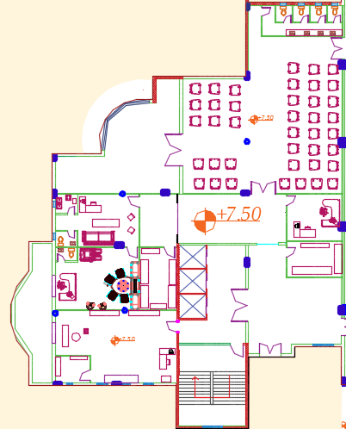

Slide 28
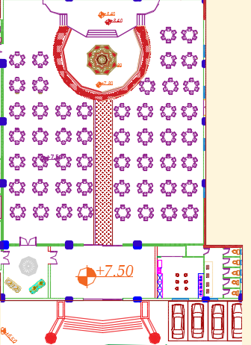

Slide 29
Slide 1
Elevations&
Sections
.

Slide 30
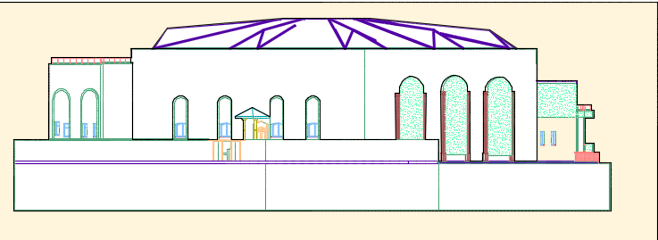
Architectural Design
Slide 1
North
Elevation

Slide 31
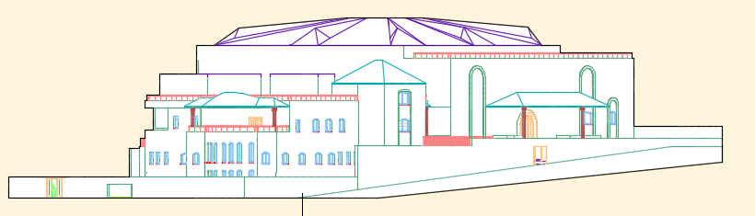
Architectural Design
Slide 1
South
Elevation

Slide 32
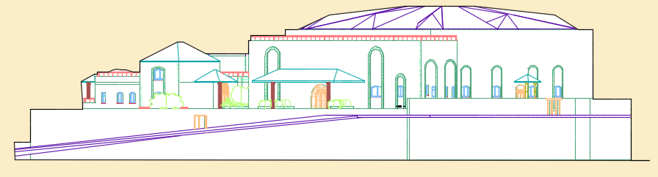
Architectural Design
Slide 1
EAST
Elevation

Slide 33
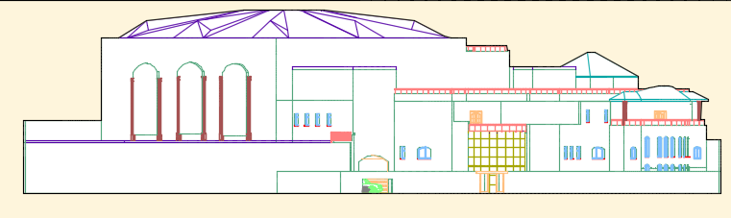
Architectural Design
Slide 1
WEST
Elevation

Slide 34
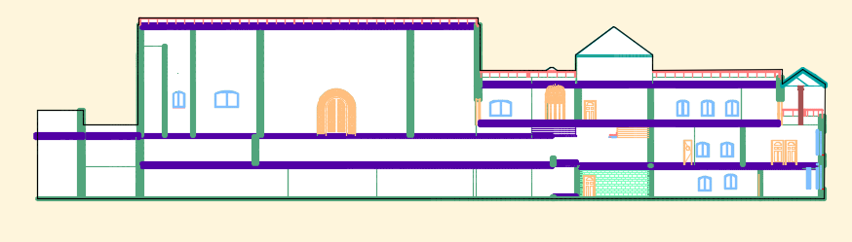
Architectural Design
Slide 1
Section
A-A

Slide 35
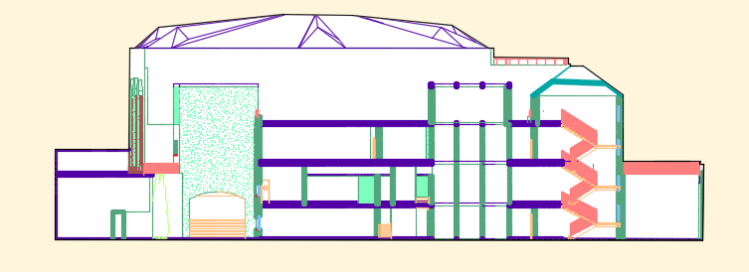
Architectural Design
Slide 1
Section
B-B

Slide 36
Architectural Design
Slide 1
Final 3D
View

Slide 37
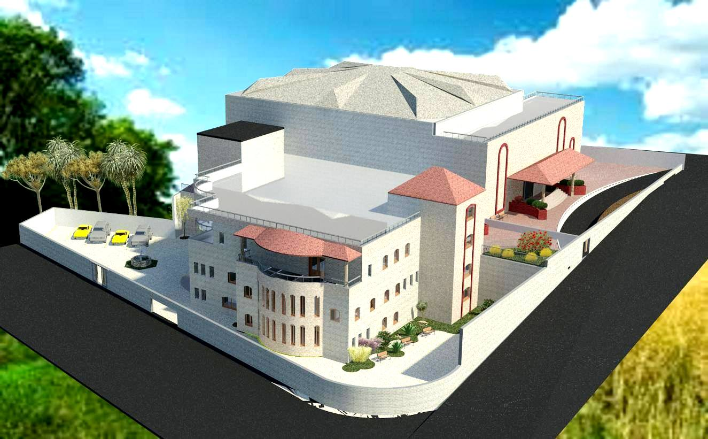
Slide 1

Slide 38
Slide 1
VEDIO

Slide 39
Environmental ASPECTS

Slide 40
ENVIROMENTAL Aspects
Thermal analysis.
Energy simulation.
Acoustical analysis .

Slide 41
Thermal analysis

Slide 42
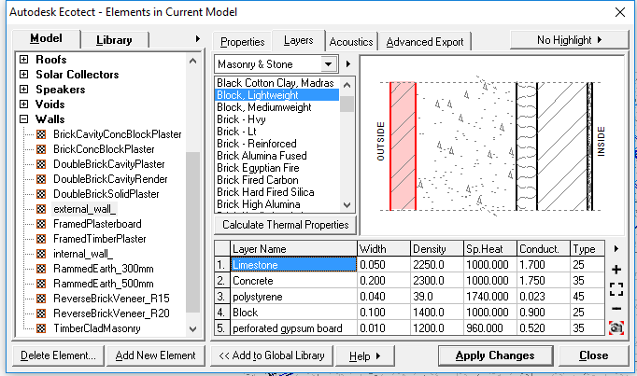
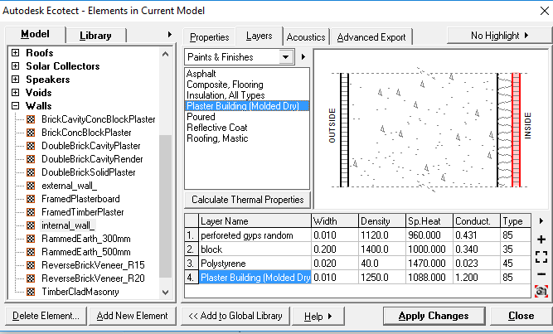
Thermal Analysis
External walls Internal walls
U value = 0.47 W/m²k U value = 0.6 W/m²k

Slide 43
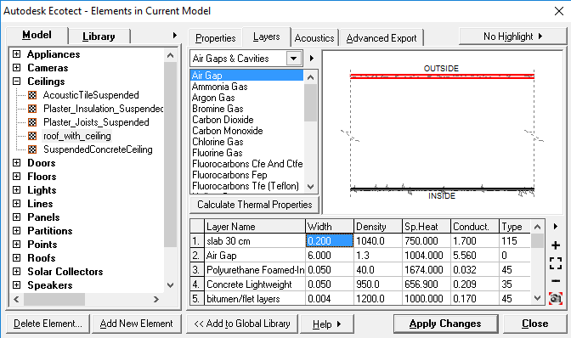
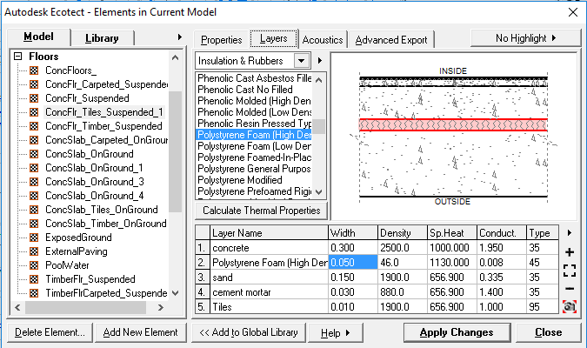
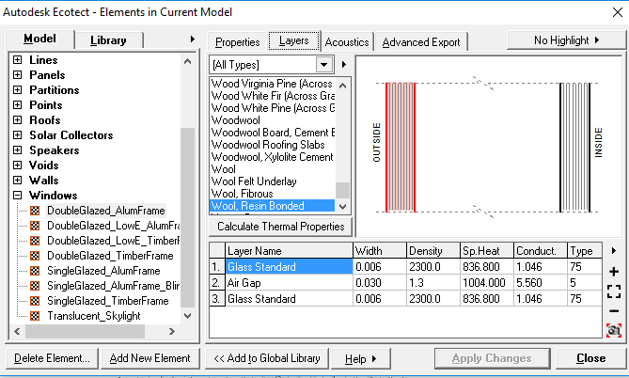
Thermal Analysis
Roof Floor
U value = 0.43 W/m²k U value = 0.70 W/m²k
U value = 0.70 W/m²k
Glass

Slide 44
Energy simulation

Slide 45
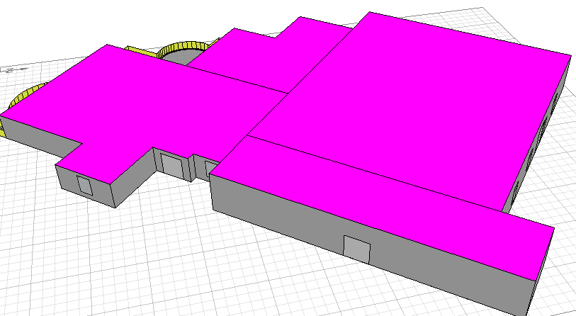
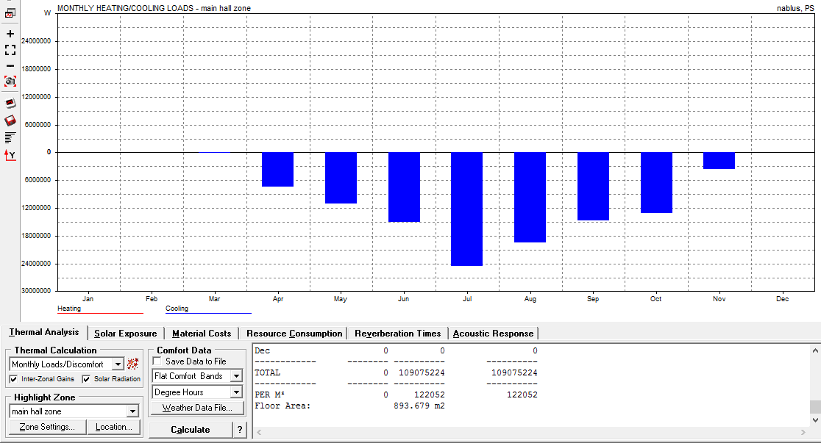
Environmental Design
Energy Simulation
When the hall is almost full with 300
Audience (cooling only )
Max Cooling: 117 KW/m²
at 13:00 on 5th August

Slide 46
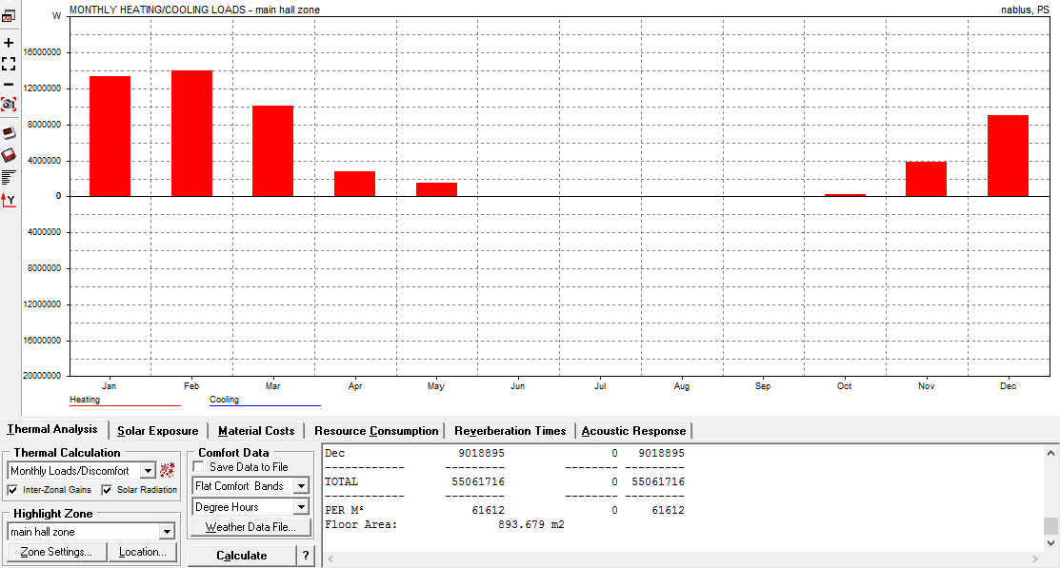
Environmental Design
When there is no audience in the hall ( heating only )
Max Heating: 82 kW/m² at 23:00 on 17th January

Slide 47
Acoustical analysis

Slide 48
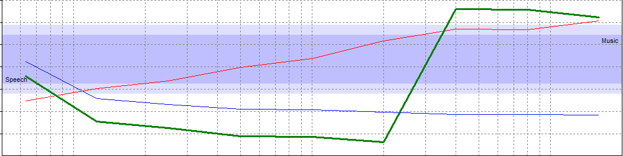
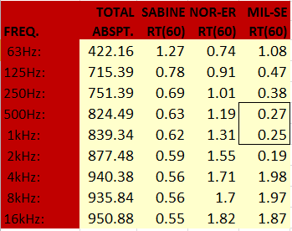
Acoustical Analysis
Reverberation time (RT60) in the main hall before modifications
RT60 range (1-1.60) s
From table and figure, the RT60 of the wedding hall is out the range.

Slide 49
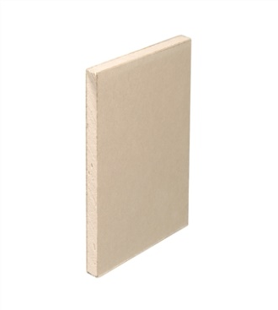
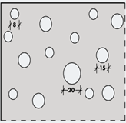


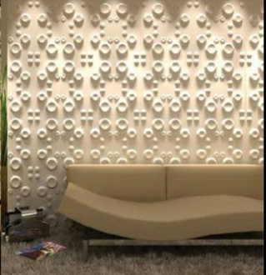



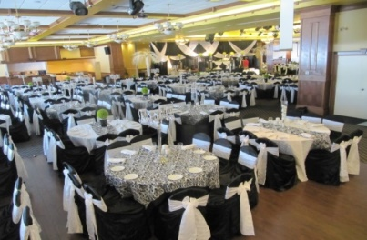

Acoustical Analysis
To meet the standards of the RT60
Plaster board with bitumen was used on ceiling Perforated aperture on walls
Wood panel on wall above the stage Fabric on tables and carpet floor

Slide 50
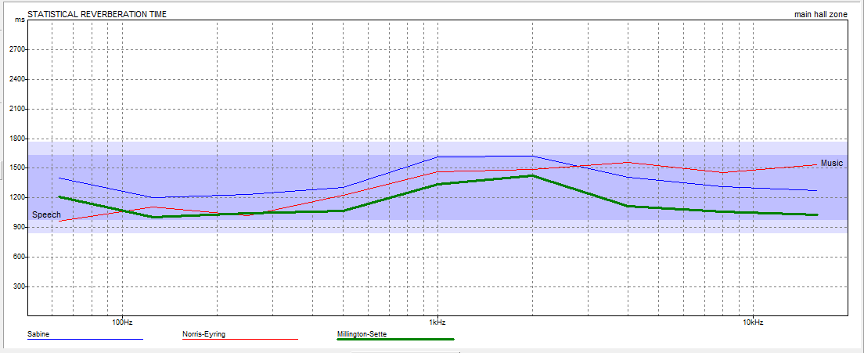
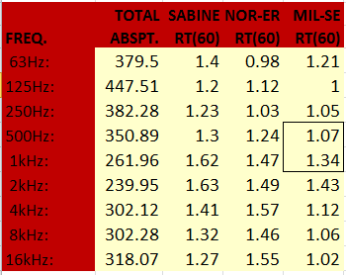
Acoustical Analysis
RT60 Values for main hall after modifications
From table and figure, the RT60 of the wedding
. hall is in the range

Slide 51
Sound Transmission Class (STC)
STC for wall =52 STC partition = 58
IIC for floor = 69

Slide 52
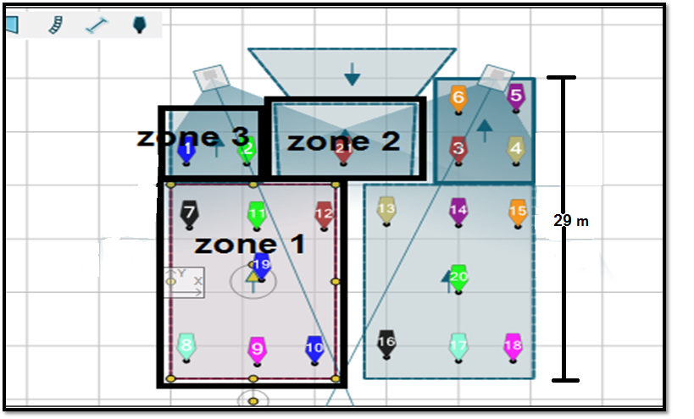
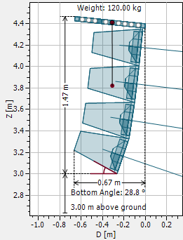
Speakers
For sound distribution EASE FOCUS was used
LA1214

Slide 53
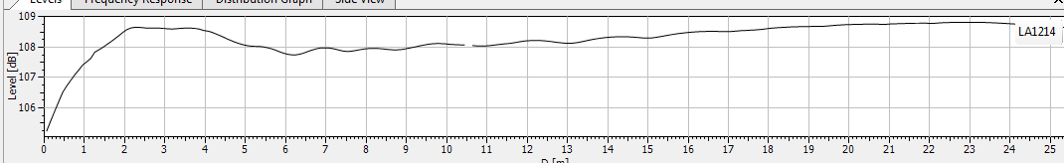
Speakers
Distribution of sound in the hall
The range between 106-109 dB

Slide 54
HVAC
system

Slide 55
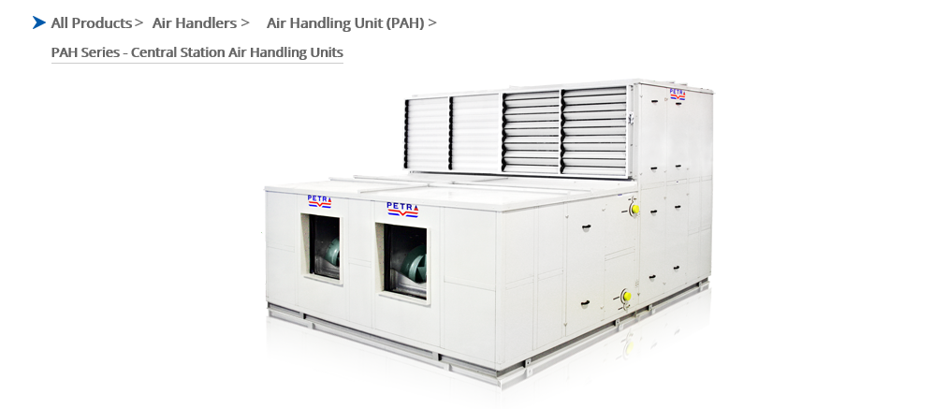

Mechanical Design
HVAC System Design
central air handling unit
diffuser

Slide 56
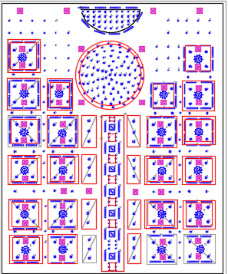
V V Mechanical Design
Number of diffuser in the hall = 54
Main duct size =0 .75 m
For all branches , duct size = 0.4 m
The diffusers size = 15x15 cm

Slide 57
Slide 1
Structural
Design

Slide 58
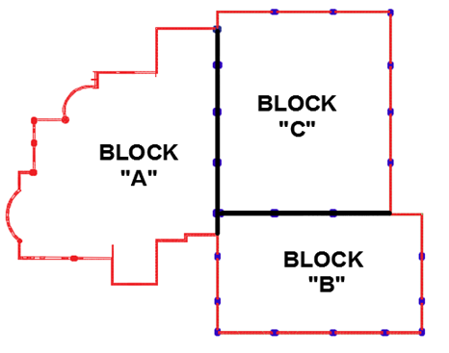
Blocks of Project
Blocks of Project
Slide 2

Slide 59
Design Data:
Slide 3
System design: One way ribbed with beam gerder and shell.
Concrete Fʹc = 24 MPa for slabs and concrete beams.
Concrete Fʹc = 28 MPa for footings, shear walls and concrete columns .
Allowable Bearing Capacity of Soil = 350 KN/m²
Loads:
Shell | Wedding Hells | Barking | Beauty Center | Loads
2 | 7 | 5 | 4 | Live Loads
2 | 4 | 4 | 4 | Super Imposed

Slide 60
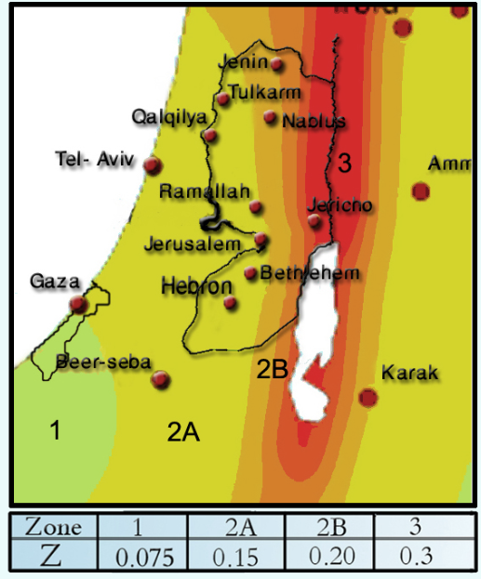
Seismic Design Data
Slide 4
Soil type: S_{D}
Location → Nablus
Zone =2B → Z=0.20
C_{V} = 0.40 , C_{a} = 0.28
I = 1.00
R = 5.50

Slide 61
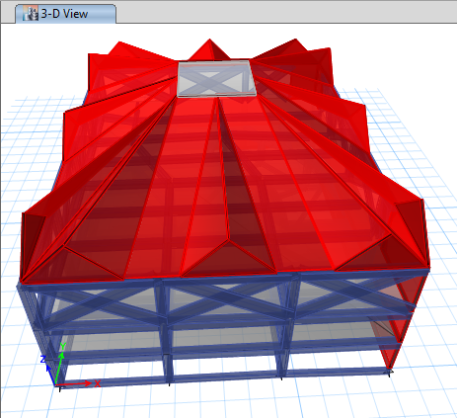
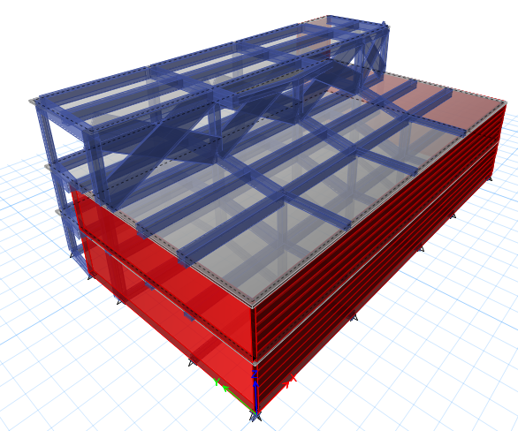
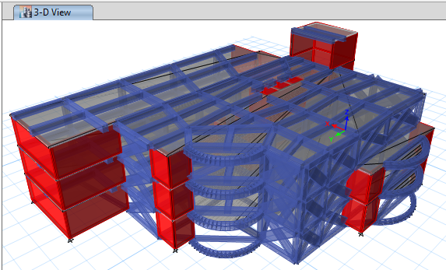
ETABs Models
Slide 5
Block (C)
Block (B)
Block (A)

Slide 62

Deformed shape of block (A)
Slide 6
The model is valid for
1. Compatibility,
2. Equilibrium,
3. and stress strain relationship
% of Error | ETABs Results (KN) | Manual Results (KN) | Equilibrium check
0.25 | 28895.41 | 28825.00 | Total Dead Load
2.10 | 9299.52 | 9100.00 | Total Live Load
3.0 | 19144.86 | 18500.00 | Total Super Imposed

Slide 63

Dynamic Checks
Slide 7
Period check:
T_{ETABs} = 0.131 sec
Drift check:
Maximum drift = 1.54 mm
Modal participation mass
ratio>90%
Base shear check

Slide 64

Results
Slide 8
Slab Design:

Slide 65


Results
Slide 9
Beam Design:

Slide 66


Results
Slide 10
Column Design:
Dimension:
60*60 cm, R 50 cm
Steel Reinforcement:
16Ø18 mm
3Ø10@125mm

Slide 67

Results
Slide 11
Shear wall

Slide 68



Results
Slide 12
Footings:

Slide 69

Results
Slide 13
Stair Design (By using SAP program)

Slide 70


Results
Slide 14
Shell Design:

Slide 71
Electrical Design

Slide 72
Lighting distribution
.

Slide 73



Slide 74


1- Chandeliers:

Slide 75


2- Spots:

Slide 76


3- led lamp:

Slide 77


4- projectors:

Slide 78

CALCULATION
& RESULT:
L.I= 721
>Target(700)
Uo=.67
L.I=770
>Target(750)
Uo=.7
L.I =545
>Target(500)
Uo=.62
L.I=706
>Target(700)
Uo=.75

Slide 79
Slide 1
Socket distribution
.

Slide 80

distribution of sockets:
first
floor

Slide 81
Mechanical
Design

Slide 82
Slide 1
Water supply
.

Slide 83

water consumption:
total building of water demand = 3640 g/ day

Slide 84

water supply system:
Small roof tank with basement storage and pump.
a water tank of 80 m3.

Slide 85



first floor
water supply design:
ground floor
Second floor

Slide 86
pipes diameters
(collector #3):
Vertical➔1.5 in
Horizontal➔1.25 in
Branch➔1.00 in
Total FU’S | Collectors
4 | 1
28 | 2
31 | 3
36 | 4
38 | 5
28 | 6
22 | 7
41 | 8
3 31
collector #3):

Slide 87
Drainage system

Slide 88



Mechanical Design
Piping Design for Drainage system ( ground floor )

Slide 89

Mechanical Design
Roof
and
storm
water
drainage

Slide 90
Slide 1
Safety design

Slide 91


Emergency exits
Slide 1
Second
Floor

Slide 92

Safety system:
1-Fire extinguishers.
2-Fire hose stations

Slide 93
QUANTITY SURVEY
&
Cost Estimates
Slide 1

Slide 94

Structural Quantities
Slide 1

Slide 95

TOTAL COST
Slide 1

Slide 96
Thank you

