Slide 1
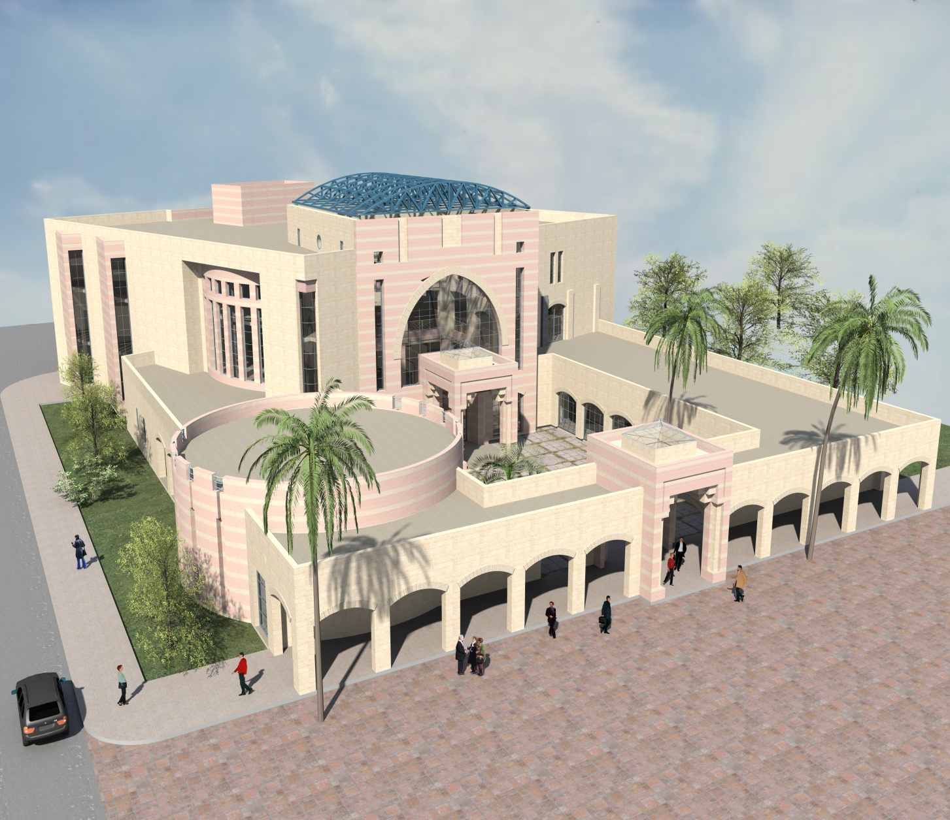

Design of Palestine Technical University New Library Building - Tulkarm
An-Najah National University
Faculty of Engineering
Civil Engineering Department
Prepared By:
Munther Haj Ali
Tariq Ghanayem

Slide 2
Chapters
Chapter One : Introduction
Chapter Two : Preliminary Design
Chapter Three : Three Dimensional Structural Analysis and Design

Slide 3
Chapter One : Introduction
  General
  This is a graduation project that introduces analysis and design of reinforced concrete structure. This structure is the new library building of Palestine Technical University (PTU) in Tulkarem city – Palestine.
  The building will be analyzed and designed using the primary principles of structural analysis and design by using one dimensional analysis and also using the most modern methods which is three dimensional analysis and design.

Slide 4
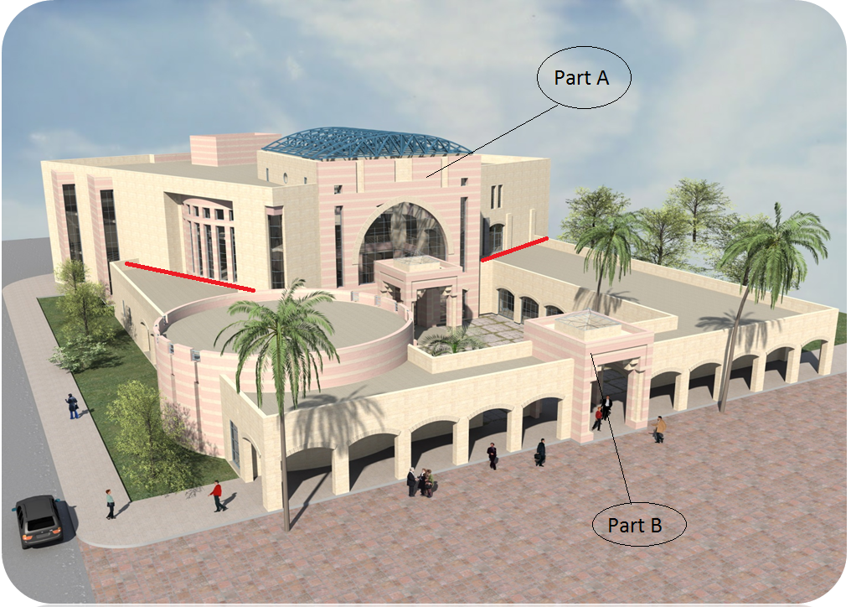
Figure 1.1: Architectural 3D model of the building
Note: The red lines in the previous figure are related to expansion joints

Slide 5
The building is divided into three parts which are separated by expansion joints. Figure 1.1 shows a three dimensional image of the building.
Part A in the building is composed of three stories . These are an over ground stories, the area of each one is about 1427 m² and its height is 4.5 m.
Part B is used as offices, video conference and arcade and auditorium . And it is composed of an over ground story whose area is about 1050 m² and its height is 4.5 m.

Slide 6
Codes and Standards
The structures are designed using practice code and specifications that control the design process and variables.
The following codes and standards are used in this study:
ACI 318-08 : American Concrete Institute provisions for reinforced concrete structural design.
UBC-97 : Uniform Building Code provisions for seismic load parameters determination.

Slide 7
Loads and Load combinations
Loads
1) Gravity loads:
Live load:
It comes from the people, machines and any movable objects in the buildings. The amount of live load depends on the type of the structure. In this project the live load is:
7.0 kN/m² (for Part A)
3.0 kN/m² (for Part B)
Dead load:
it is consisting of own weight of the structure and any permanent components. The super imposed dead load is 4.36 kN/m².

Slide 8
Materials
Structural materials
Concrete:
Concrete strength for slabs & beams is B350 (f’c = 28 MPa)
columns is B400 (f’c = 32 MPa)
Unit weight = 25 kN\m³
Steel:
For steel reinforcement( Fy=420 Mpa )
Non-structural materials
They are mainly, blocks, plasters, tiles, filling, mortar and masonry.

Slide 9
2) Lateral loads:
Seismic loads:
The structure is located in Tulkarm area which is classified as zone 2A according to Palestine seismic zones.
The UBC97 code seismic parameters are as follows:
  The seismic zone factor, Z= 0.15
  The soil is very dense soil and soft rock, so the soil type is Sc .
  The importance factor, I = 1. 25
  The ductility factor, R = 5.5
  The seismic coefficient, C_{a} = 0.18
  The seismic coefficient, C_{v} = 0.25

Slide 10
Load combinations
The ACI318-08 load combinations are used and they are summarized as follows:
U₁ = 1.4D
U₂ = 1.2D + 1.6L + 1.6H
U₃ = 1.2D + 1.0E + 1.0L
U₄ = 0.9D + 1.0E + 1.6H
Where:
D : is dead load
L : is live load
H : is weight and pressure load of soil
E : is earthquake load

Slide 11
Building Structural Systems
The structural system in the building parts ( A and B) shall be as follows:
part A, at first it was designed as two way ribbed slab with drop beams carried by columns.
But later it is designed as a solid slab with drop beams carried on columns and shear walls.
part B, the floor is designed as one way ribbed slab with hidden beams.

Slide 12
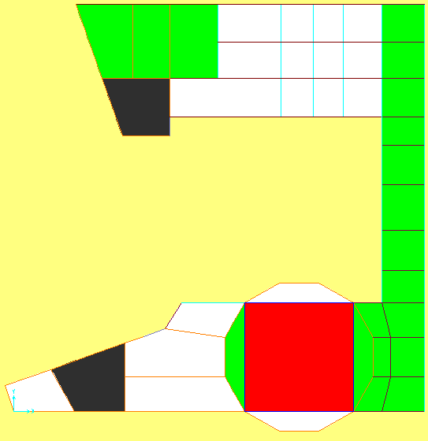

Slide 13
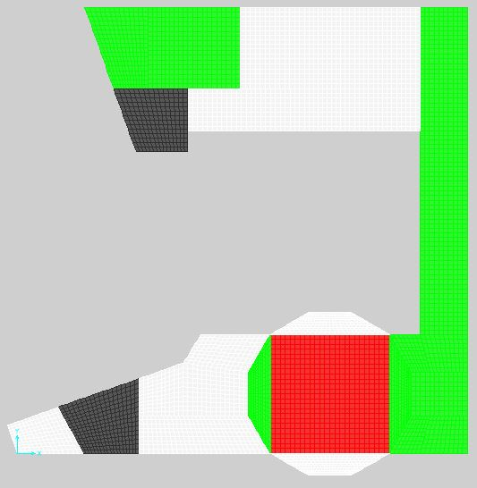

Slide 14
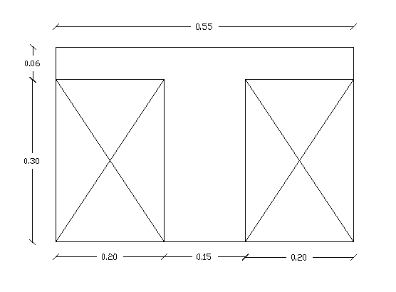
Chapter two : PRELIMINARY DESIGN
  Design of Slabs
  Ribbed slab analysis and design (Part A)
The thickness of the slab:
h_{min} = Ln/33 = 890/33 = 26.96 cm
→
h = 4/3 * 26.96 = 36 cm
Use h=36 cm

Slide 15
PRELIMINARY DESIGN
The direct design method will be used to check the preliminary dimensions of the slab and beams. So, one frame will be taken in calculations to represent the whole slabs as approximation.
The ribbed slab can be divided to frames in each direction . Here , calculations are made for
Frame A shown in figure ( 2-1)

Slide 16
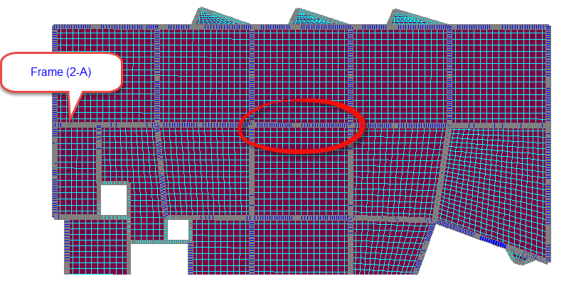
Plan of the slab in the basement floor and frame A
PRELIMINARY DESIGN

Slide 17
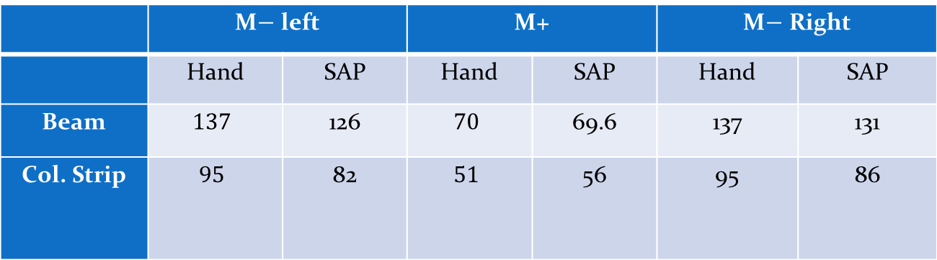
PRELIMINARY DESIGN
Difference from Negative moment =537.93−556.46537.93 * 100 % = 3.44 %
Difference from Positive moment
= 289.65−301289.65 * 100 % = 3.91 %
 | M$−$ left |  | M+ |  | M$−$ Right
 | Hand | SAP | Hand | SAP | Hand | SAP
Beam | $$137$$ | 126 | $$70$$ | 69.6 | 137 | 131
Col. Strip | $$95$$ | 82 | $$51$$ | 56 | 95 | 86

Slide 18
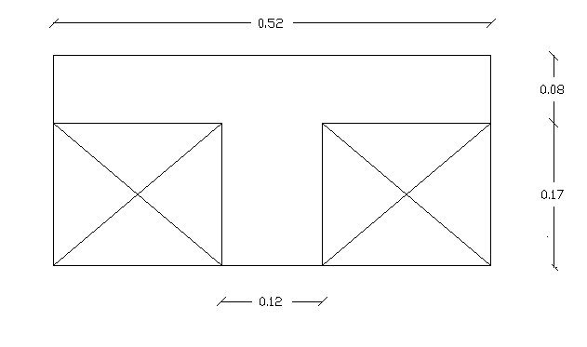
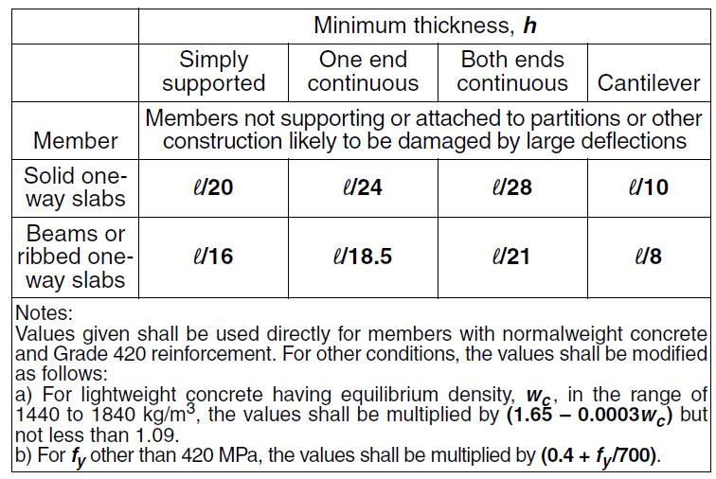
The thickness of the slab: h_{min} = l/21 = 500/21 = 23.8 cm → Use h=25 cm
  One Ribbed slab analysis and design (Part B)

Slide 19
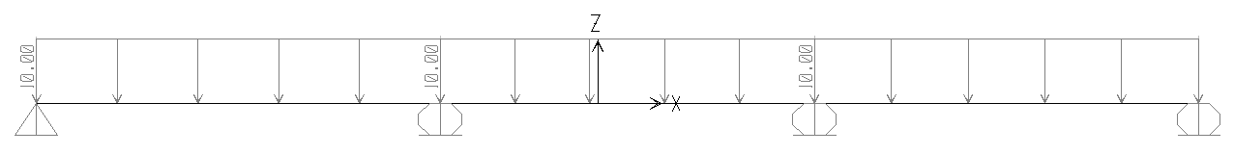
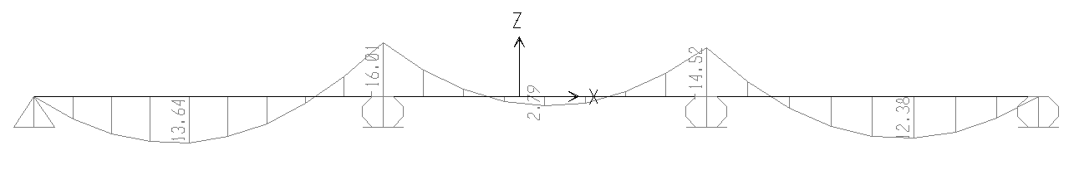
Design of Rib 5 in part B
Rib load Diagram (in kN/m)
Rib Bending Moment Diagram (in kN.m)

Slide 20
Max. neg. moment= 16.01 kN.m/rib
𝜌 = 0.00235
𝜌min = 0.00333
As = 2Ø12
Max. +ve moment= 13.64 kN.m/rib
𝜌 = 0.000537
𝜌min = 0.00333
As = 2Ø12

Slide 21
Design of column # 15
The ultimate load on the column is found using tributary area and number of stories, and the design load can be calculated using the following equation:
Tributary area=59.085 m²
Number of stories= 3
W_{u}=24.75 kN/m²
P_{u}=59.08x3x24.75 = 4387.06 kN
P_{n req} = 4387.06 / 0.65 = 6749.325 kN
Assume 𝜌 = 0.01
Pd= Ф P_{n} = Ф *λ {0.85* fc(Ag-As) + As* fy}
Pd=1.443Ag
6749.325/1.443
Square column → b=h =70. cm → use (80x80) the area of column to account for additional moments and lateral forces

Slide 22
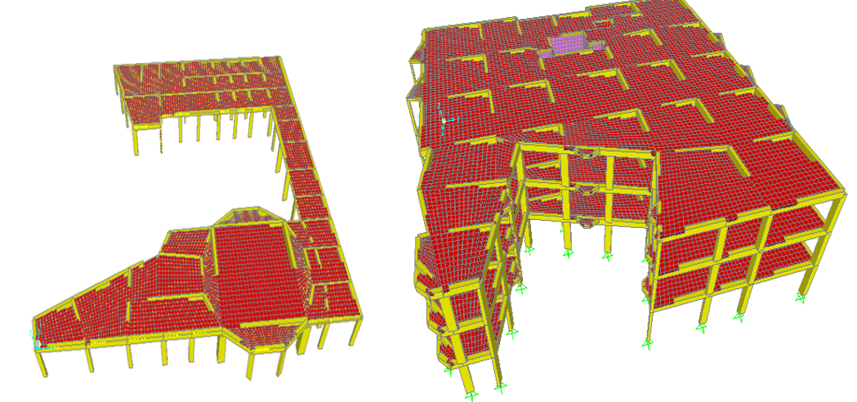
Chapter Three
Three Dimensional Structural Analysis and Design

Slide 23
* General
This chapter is a three dimensional analysis and design, which introduces the final and practical structural analysis and design of the structural elements with the practical structural drawings that are ready for construction.
Structural analysis consists of set of physical and mathematical laws required to study and predict the behaviour of structures under a given set of actions. The structural analysis of the model is aimed to determine the external reactions at the supports and the internal forces like bending moments, shear forces, and normal forces for the different members. Theses internal member forces are used to design the cross section of three elements.

Slide 24
Two way slab system:
Part A
Membrane f₁₁ modifier = (A₁ / A₃)= 0.1165/0.301 = 0.517
Membrane f₂₂ modifier = (A₁ / A₃)= 0.1165/0.301 = 0.517
Membrane f₁₂ modifier = (A₁ / A₃)= 0.1165/0.301 = 0.517
Bending m₁₁ modifier = 0.25*( I₁ / I₃) = 0.25
Bending m₂₂ modifier = 0.25*( I₁ / I₃) = 0.25
Bending m₁₂ modifier = 0.25
Shear v₁₃ modifier = (A₁ / A₃)= 0.517
Shear v₂₃ modifier = (A₁ / A₃)= 0.517
Mass m modifier = (M _{two way rib} / M _{solid}) = 1.012
Weight w modifier = (M _{two way rib} / M _{solid}) = 1.012

Slide 25
Part B
One way slab system (y-direction):
Membrane f₁₁modifier = (A₂/A₃) = 0.43
Membrane f₂₂ modifier = (A₁/A₃) = 0..64
Membrane f₁₂ modifier = (A₂/A₃) = = 043
Bending m₁₁ modifier = 0.25*( I₂/ I₃) = = 0.02
Bending m₂₂ modifier = 0.25*( I₁/ I₃) = = 0.25
Bending m₁₂ modifier = 0.25*( I₂/ I₃) =) = 0.02
Shear v₁₃ modifier = (A₂/A₃) = .43
Shear v₂₃ modifier = (A₁/A₃) = 0..64
Mass m modifier = (M _{1 way rib} / M _{solid}) 0.97
Weight w modifier = (M _{1 way rib}/ M _{solid}) = = 0.97

Slide 26
One way slab system (x-direction):
Membrane f₁₁ modifier = (A₁/A₃) = 0.64
Membrane f₂₂ modifier= (A₂/A₃) = 0.43
Membrane f₁₂ modifier = (A₂/A₃) = 0.43
Bending m₁₁ modifier = 0.25*( I₁/ I₃) = 0.25
Bending m₂₂ modifier = 0.25*( I₂/ I₃) = 0.02
Bending m₁₂ modifier = 0.25*( I₂/ I₃) = 0.02
Shear v₁₃ modifier = (A₁/A₃) = 0.64
Shear v₂₃ modifier = (A₂/A₃) = 0.43
Mass m modifier = (M _{1 way rib} / M _{solid}) = 0.97
Weight w modifier = (M _{1 way rib} / M _{solid}) = 0.97

Slide 27
Waffle slab :
Membrane f₁₁ modifier = (A₁/A₃) = 0.55
Membrane f₂₂ modifier= (A₂/A₃) = 0.55
Membrane f₁₂ modifier = (A₂/A₃) = 0.55
Bending m₁₁ modifier = 0.25*( I₁/ I₃) = 0.25
Bending m₂₂ modifier = 0.25*( I₂/ I₃) = 0.25
Bending m₁₂ modifier = 0.25*( I₂/ I₃) = 0.25
Shear v₁₃ modifier = (A₁/A₃) = 0.55
Shear v₂₃ modifier = (A₂/A₃) = 0.55
Mass m modifier = (M _{1 way rib} / M _{solid}) = 0.674
Weight w modifier = (M _{1 way rib} / M _{solid}) = 0.674

Slide 28
Structural Model Verification of Part A
Check Equilibrium
The building superimposed dead load = 18665 kN
The building live load =29967 kN
From SAP2000: superimposed dead load = 18009 kN
live load = 28913 kN
Error % in dead load= 3.52 %< 5% ok.
Error % in live load = 3.52%< 5% ok.

Slide 29
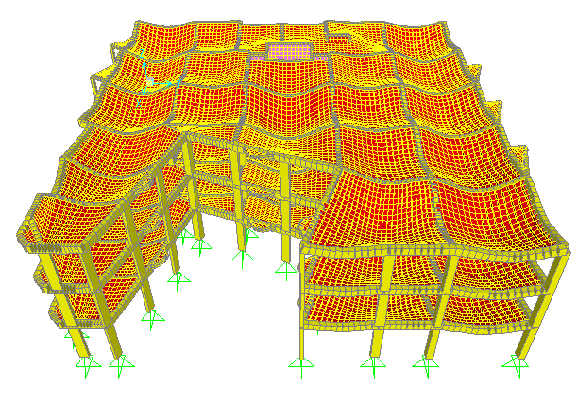
Check Compatibility

Slide 30
Structural Model Verification of Part B
Check Equilibrium
The building superimposed dead load = 4551.84kN
The building live load = 3132 kN
From SAP2000: superimposed dead load = 4552.23 kN
live load = 3132.269 kN
Error % in dead load = 0.0035%< 5% ok.
Error % in live load = 0.0 %< 5% ok.

Slide 31
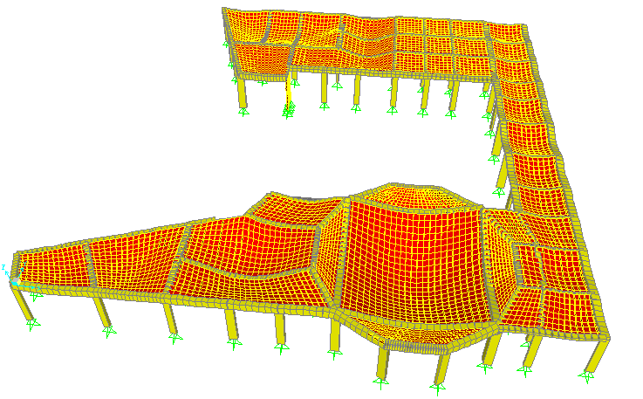
Check Compatibility

Slide 32
Thanks for listening

