Slide 1
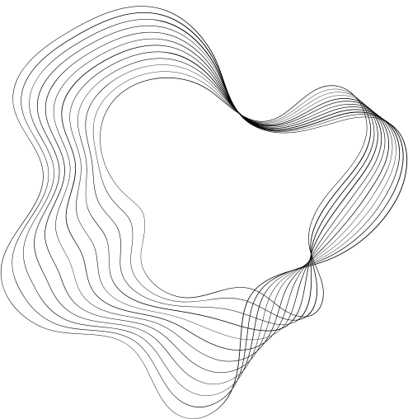


An-Najah National University
Telecommunications Engineering Department
Colorful Musical Dancing Fountain
Submitted by:
Isra Sarrawi 11820562
Tuqa Mosallam 11819474
Tabarak Salmiyah11820985
Raghad Bdear 11821417
Supervisor:
Dr. Saed Tarapiah.

Slide 2

Introduction
•The goal of this study is to build an autonomous musical fountain system that uses a microcontroller unit (MCU) to extract, amplify, and manipulate audio signals from a laptop.
•the MCU transforms analog signals into digital signals using an analog-to-digital converter (ADC).
•An Arduino Mega 2560 microprocessor, a breadboard, water pumps, an H-Bridge, nozzles, a control servo motor (MG996), and an RGB digital LED strip are just a few of the parts that make up the musical fountain system.

Slide 3


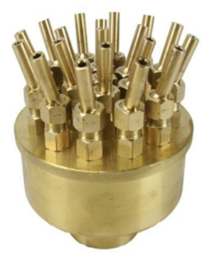
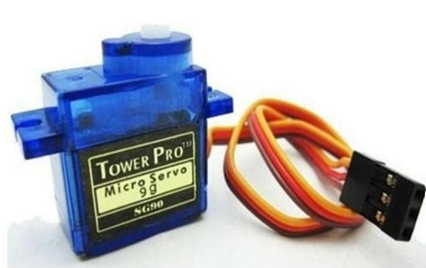
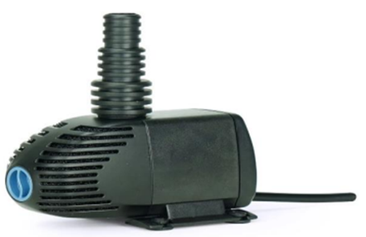
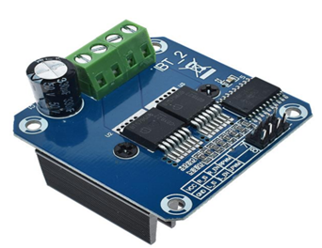
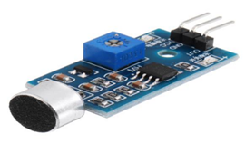
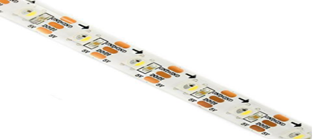

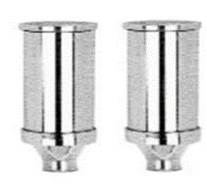
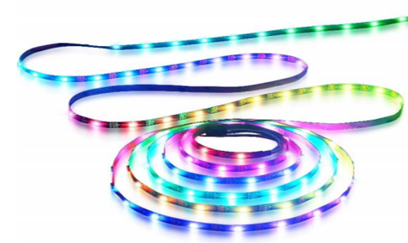
FOUNTAIN MAIN HARDWARE COMPONENT
•Nozzles
•water pumps
•H-Bridge
•Servomotor
•microphone sensor
•Serial RGB digital LEDs

Slide 4





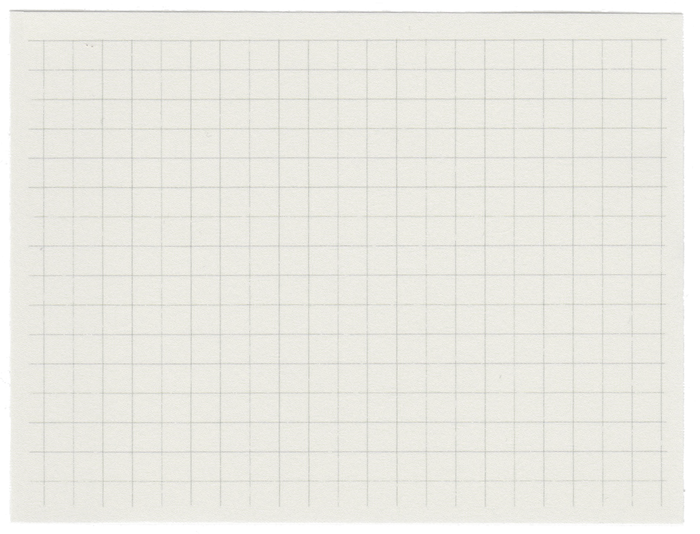

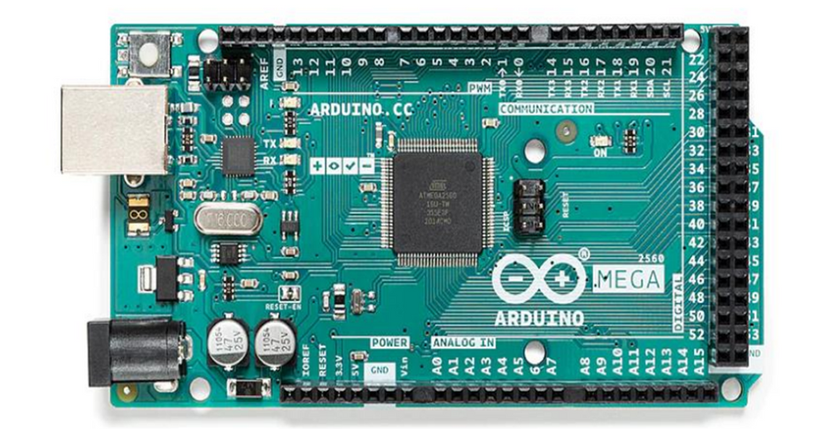
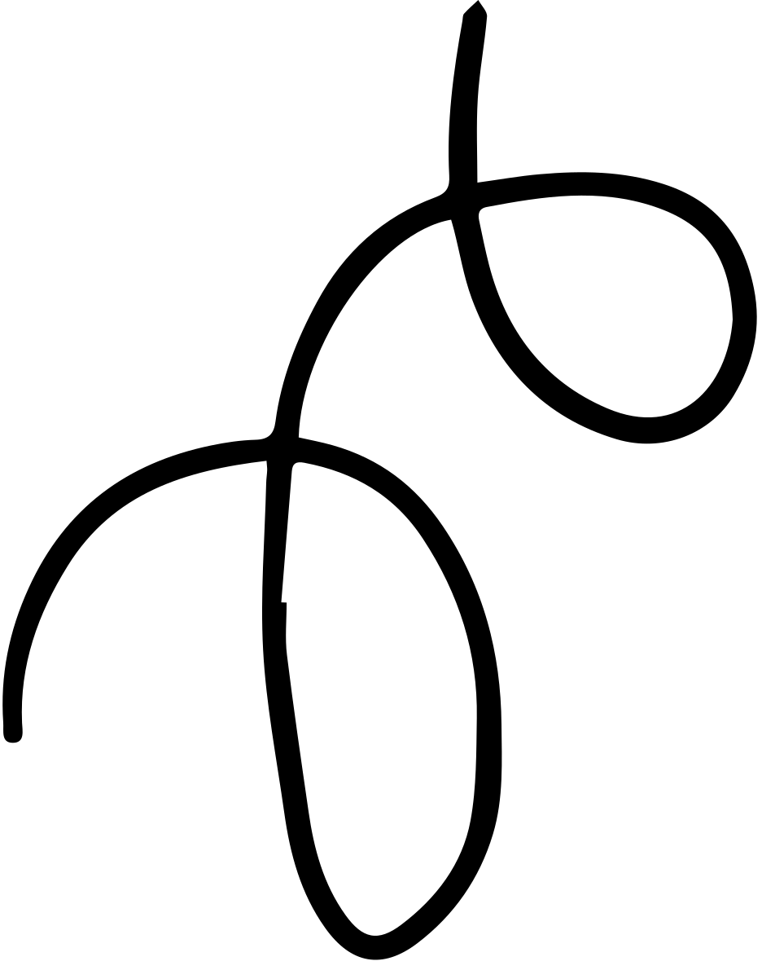
FOUNTAIN SOFTWARE COMPONENT
•Arduino
- Mega 2560

Slide 5
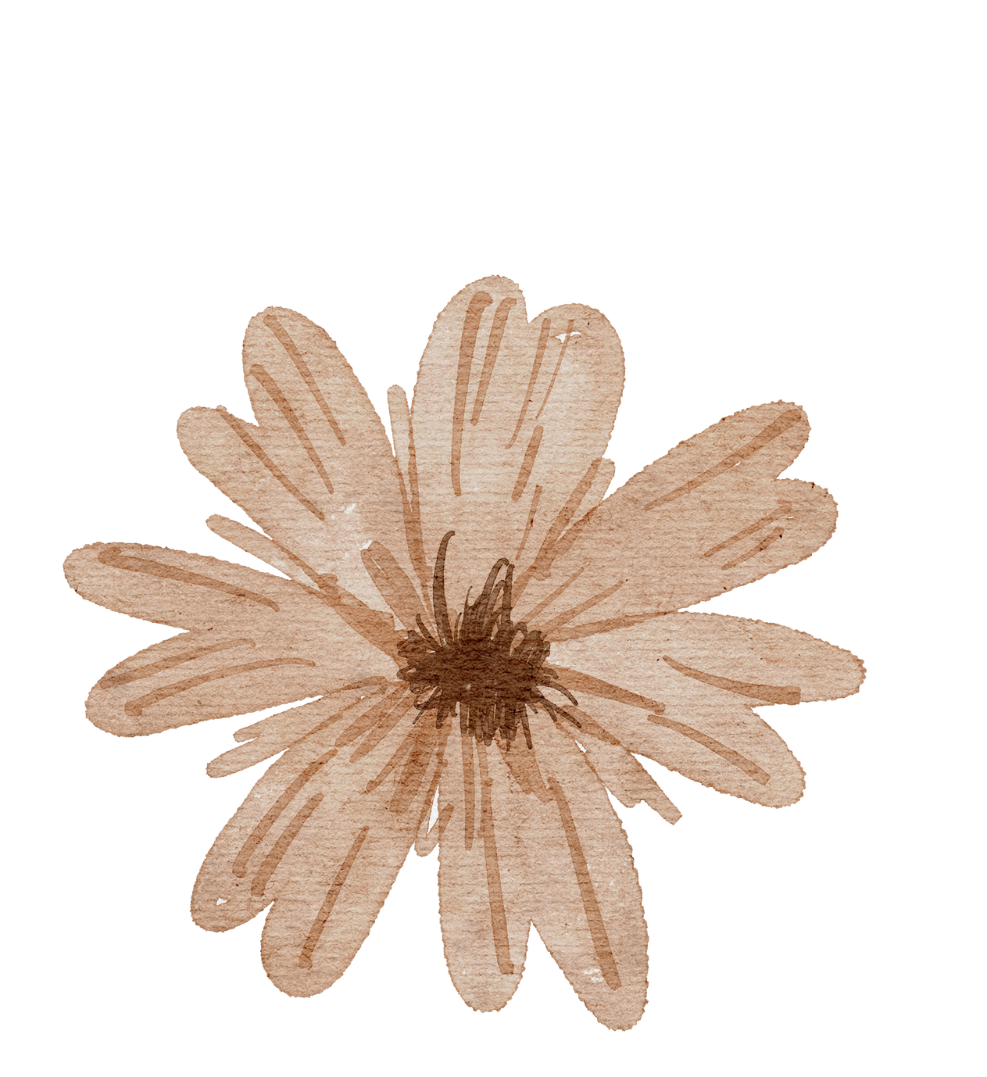
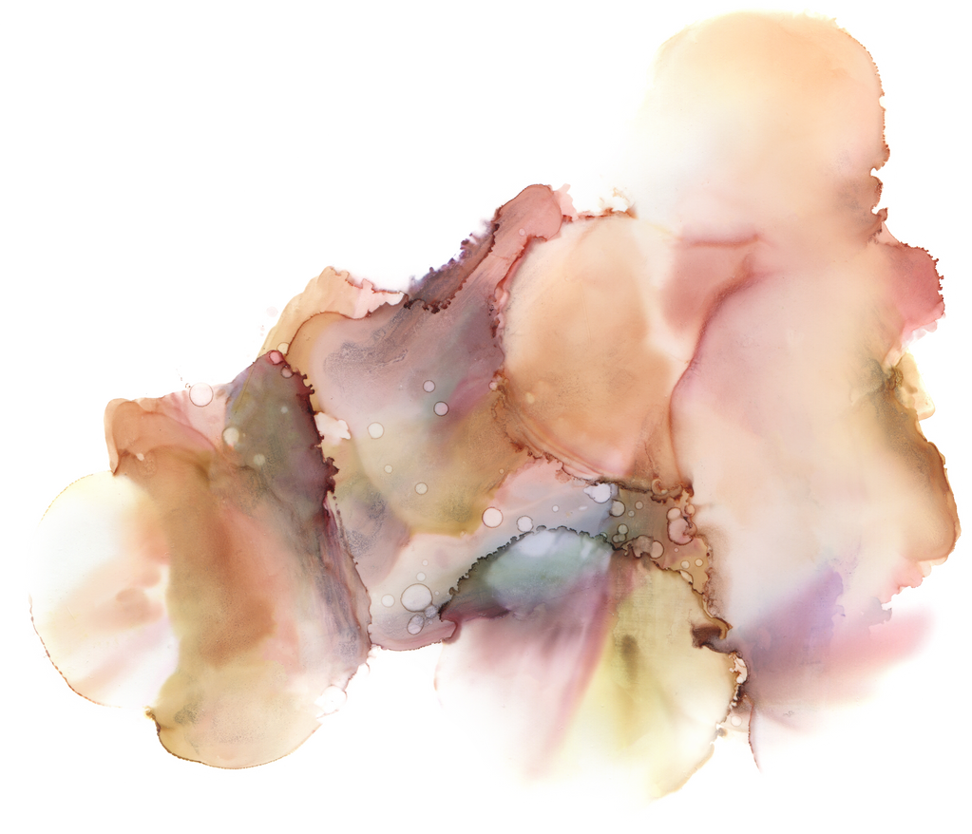

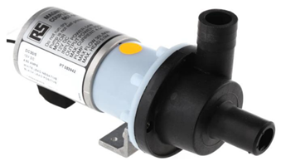

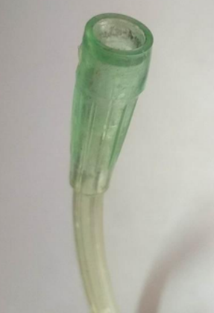
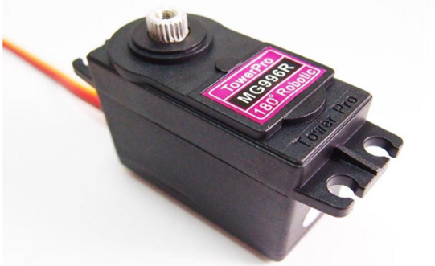

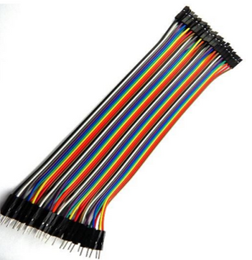
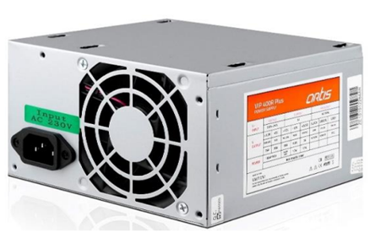
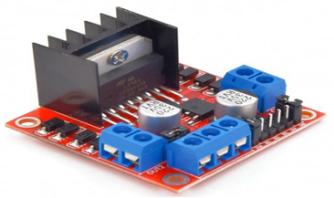
FOUNTAIN DESIGN
•shape and dimensions of the architectural fountain
•Number of Nozzles
•Number of Water Pumps
•Number of H-Bridge(driver)
•Number of Servomotor
•Number of Arduino
•Other assisted components

Slide 6

SOFTWARE PROGRAMMING
•C programming

Slide 7


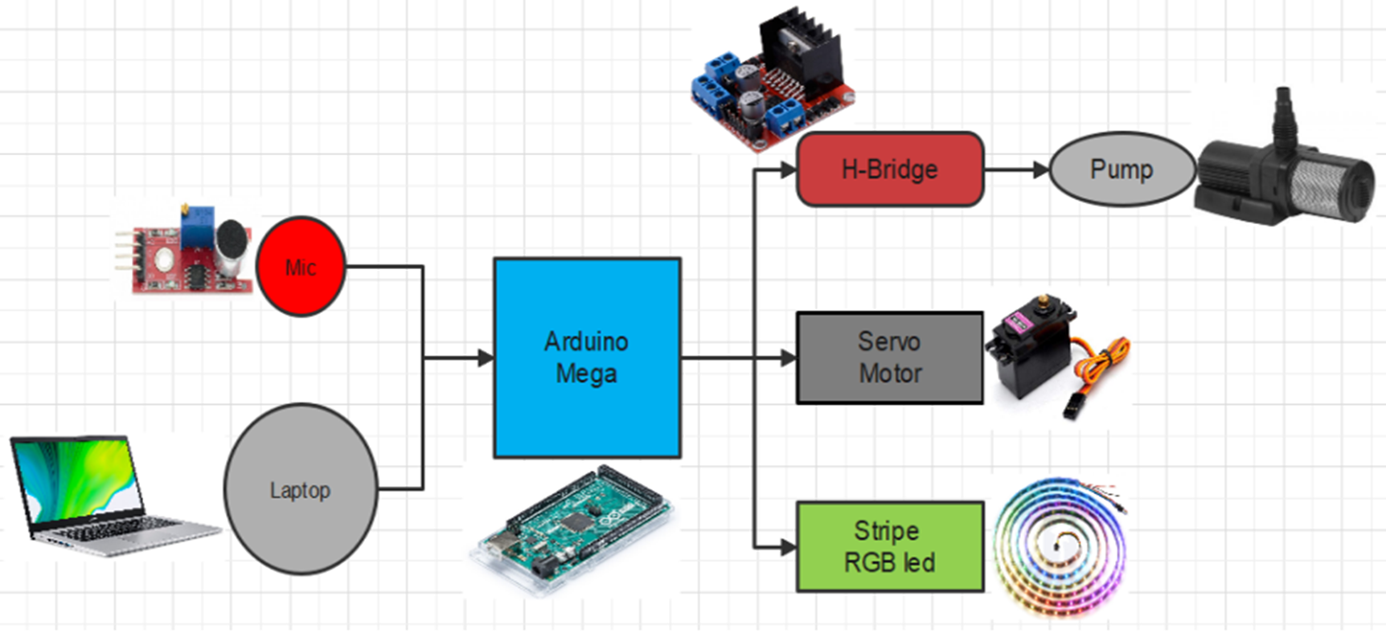

Block Diagram for Fountain System

Slide 8
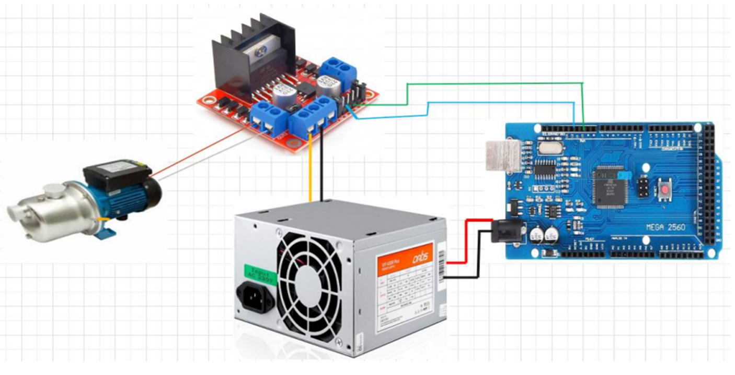
•Water pump control part

Slide 9


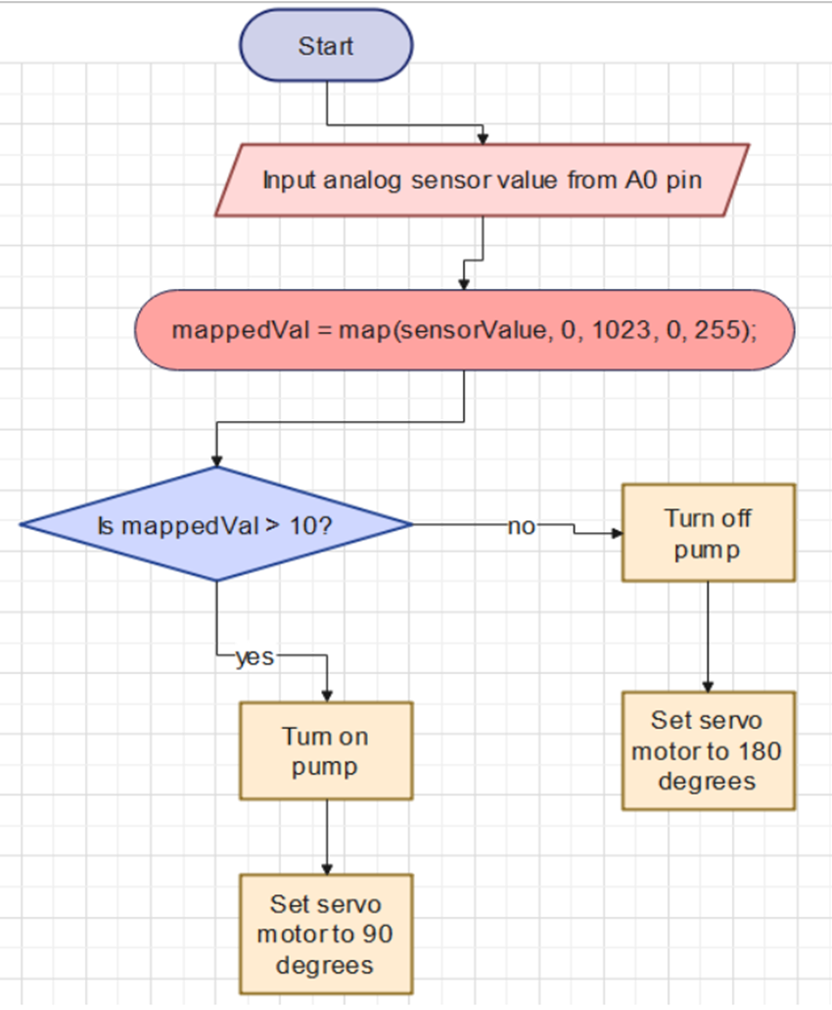
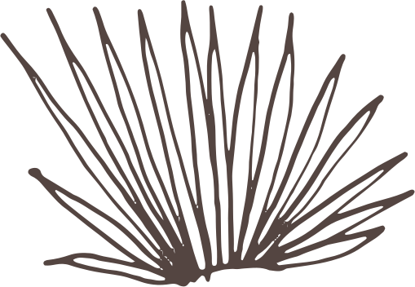
Flow Chart

Slide 10


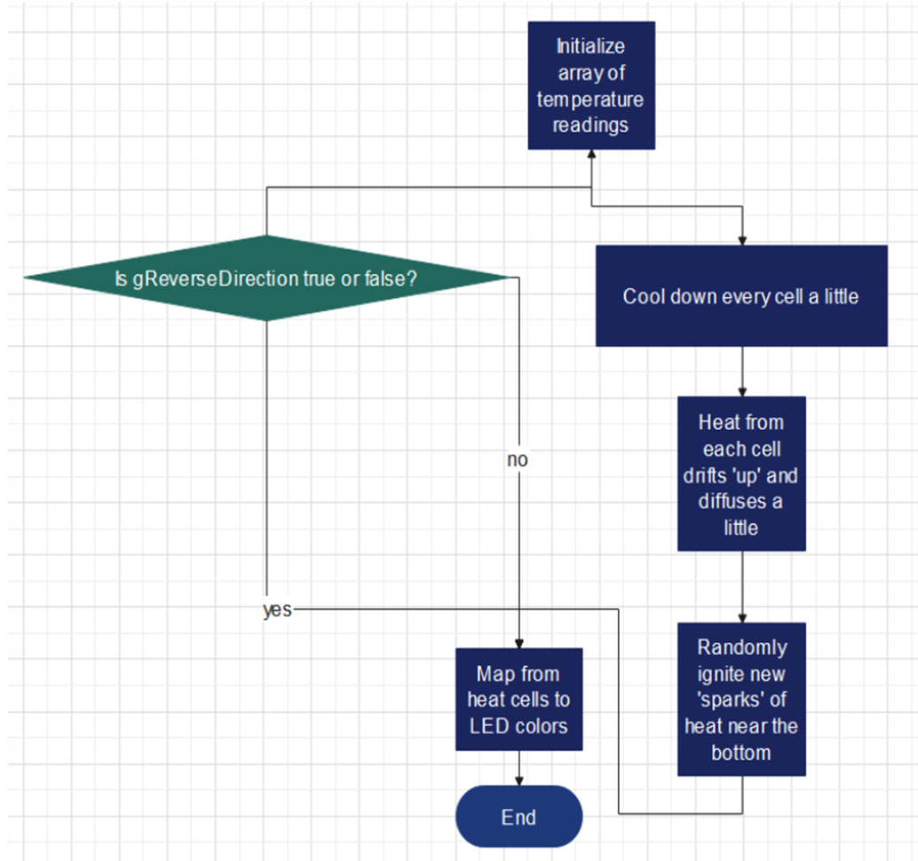


FLOW CHART– CONT.

Slide 11

Relationship between music and water
The relationship between music and the movement of water in a dancing fountain is achieved through a carefully orchestrated technological setup. I the process involved capturing the sound of the music through a microphone, amplifying it, and then transferring it to a microcontroller unit (MCU). The MCU in this case, an Arduino Mega 2560 plays a crucial role in processing the audio signals.

Slide 12


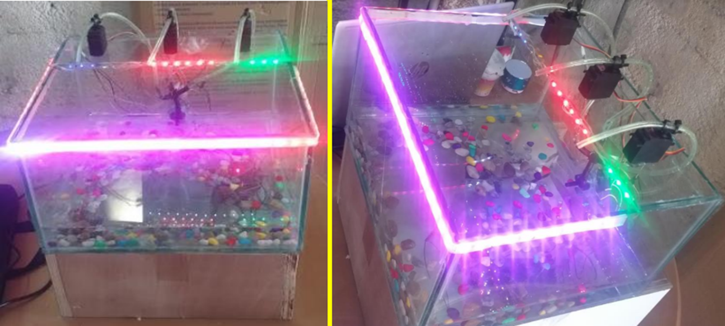
Practical part

Slide 13


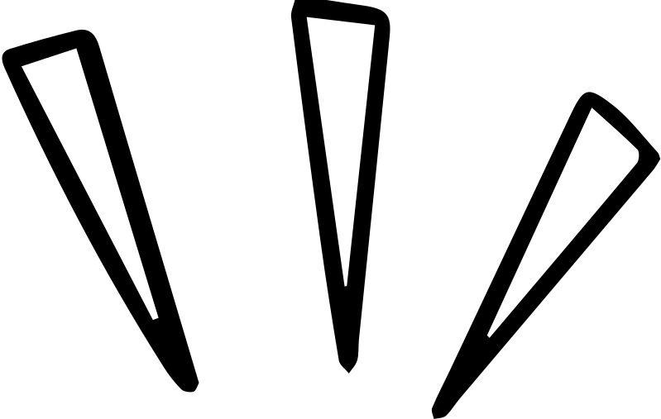
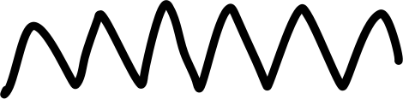
Thank you very much!

