Slide 1
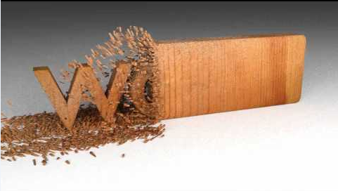
Operations Improvement at Orastel company
Supervisor :
Eng. Sulaiman Duaifi
Majd Abu Aisheh
Dina Asmah
Esraa Kousa
Thuraya Istaitieh

Slide 2
Introduction
Orastel is a new company for furniture manufacturing
It was established about 13 years ago in Nablus.
The factory started with a 100-meter square space and expanded incrementally until this day
The plant works 8 hours a day and 6 days weekly and contains 34 workers
The plant contains 3 workstations: Carpentry, Painting station, Upholstery station.

Slide 3
Video

Slide 4
Problem Statement
Machines arrangement is not optimized
Lack of detailed flowcharts of operations sequence
Poor organization structure
A lot of material waste
Lack of documented procedures for different department
No maintenance scheduling
Safety instructions are not implemented

Slide 5
Phase one Improvements
Current situation analysis
New plant layout
Organization structure

Slide 6
Phase two Improvements
Detailed management systems and working guides were created according to standards:
Production management system
Quality management system
Sales management system
Procurement management system
Stores management system
Safety procedure guide
Maintenance management system
Waste minimization guide

Slide 7
Followed Methodology
After making meetings with departmemnts’ managers and authorized people, needed information was gathered in order to clarify and document work procedures and steps, related forms were also created to ensure that all steps are documented

Slide 8
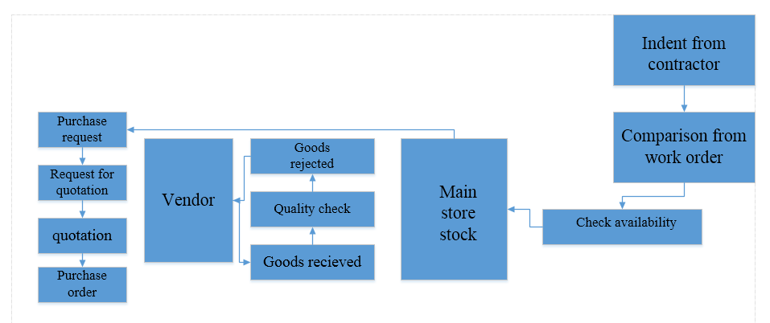
General Procedures for Purchasing, quality checking and storing

Slide 9
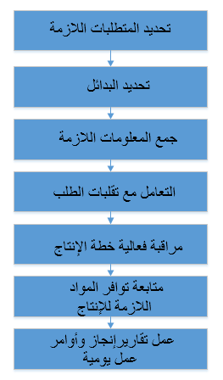
Production management system

Slide 10
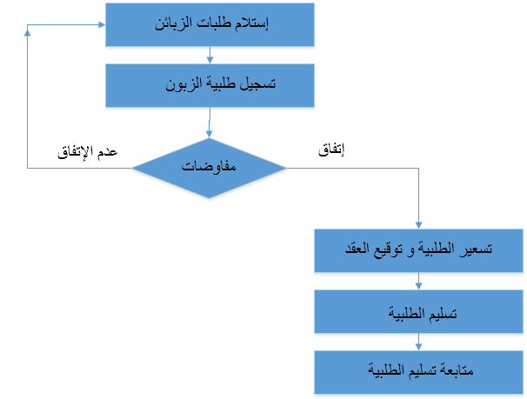
Sales management system

Slide 11
Project impact on the company
Organization structure identifies authorities and responsibilities which reduces conflicts
Higher production volume
Documents make work easier since it is a historical data
Documentation can be considered as a monitoring tool as it facilitates tracking working steps
Documentation facilitates communication between the company and clients and reduces response time

Slide 12
Recommendations
Procedures should be documented and followed in order to achieve the best performance
A maintenance schedule should be accredited to prevent breakdowns by preventive maintenance and repair machines by corrective maintenance
Its recommended to improve Safety instructions to prevent accidents or incidents
Quality assurance and quality control should be taken into consideration and be based on specific standards
Administrative affairs must increase employee awareness about the importance of following the procedures

Slide 13
Conclusion
Orastel Company has the ability to produce special and customized products. It has a good market share and high sales, but there is always an opportunity for improvement in order to achieve firm’s vision. Realizing the positive impact of improvement plans encourages the firm to implement them in order to have competitive advantages.

Slide 14
Thank you

