Slide 1
Smart Farm
Presented by: Fadi Jaber
Mohammad Dwekat
Supervisor: Dr. Aladdin Masri

Slide 2
Outline
Introduction.
Features.
Technologies.
Methods and Techniques.
Constrains.
Future work and Recommendation.

Slide 3
What is our Project?
an automation system that can maintain the operation of the farm without the intervention of human workers, minimizing the losses in case of any unexpected accidents and reduce the running cost of the farms.

Slide 4
Motivation
Smart farms are required in these days because it can reduce risks and costs of planting.
Provide a solutions for the problems by providing suitable conditions for plants using automation system and good monitoring system.

Slide 5


Used Technologies

Slide 6
Features
Managing the water consumption of the farm.
Provide a complete monitoring over the system.
Provide an easy to control and modify system to ensure the optimum conditions.
Equip the system with emergency procedures.
Using Solar Energy to power up our system.
The ability to control more than one green house at the same time.

Slide 7
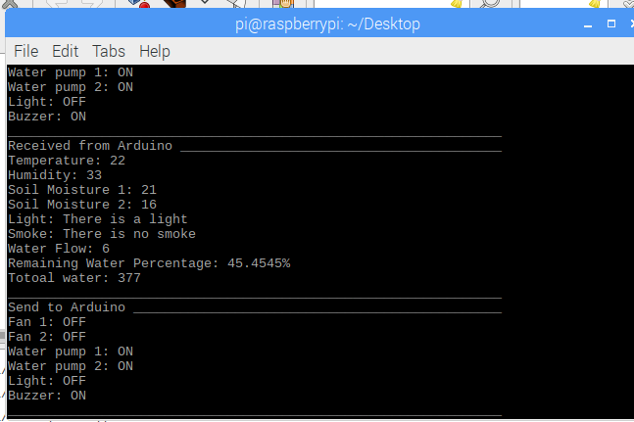
Demo

Slide 8
Constraints
Lack of time.
Learning a lot of new things.
Lack of money.
The greed of sellers.

Slide 9
Future Work
Expanding the mointoning system and adding more features to it.
Create mobile application for the farm.

