Slide 1
“Improve the Quality of Auto Service through PDCA & Lean Approaches”
At the UMT Company
Prepared by:
Ameer Aburabie
Ibrahim Abushehade
Supervisor:
Eng. Tamer Haddad

Slide 2
01
02
03
04
05
06
01
General Backgroud
02
Problem Statement
TABLE OF CONTENTS
Objectives
03
Methodology
04
Analysis and Results
05
Discussion and Recommendations

Slide 3

OUR COMPANY
United Motor Trade Company (UMT), previously named as Jamal Omar Al Masri’s Company
*Which was launched in Nablus City in the early 60s
*Recently has launched one of its biggest and most modern branches in North Palestine, which rests on a 5,000 km2 area in Nablus City.
*Has six maintenance centers

Slide 4
1,474
Problem Statement
80%
Vehicle Repair workshops and spare parts stores
In Palestine
Have no background
about Quality

Slide 5
This Project sheds lights on the Quality of Auto Service in Palestine taking UMT as a case study.
High quality gives:
an Added value to the Company
and customer satisfaction.

Slide 6
First
Second
Third
Added Value on Maintenance work?
Improving Maintenance?
Improving Service core Process?

Slide 7
This project aims to identify challenges in an automobile service center at (UMT) and to determine optimal solutions to improve the overall performance by integration between PDCA cycle and lean tools.
Identify the impact of the Deming Model implementation requirements PDCA in achieving added value for maintenance work.
WHAT WE ARE WORKING ON
Increase the productivity using Lean strategy; to reduce the wastage, non-value added activities.
Continuous improvement and adding value to the after sales department

Slide 8
STEP 2
STEP 4
System Understanding
Tools Used
Methodology
STEP 1
STEP 3
STEP 5
Kick-off meeting
Observation& Data Collection
Analysis &Results

Slide 9
Held with Eng. Moath Ibrahim the Service Manager at the Company to gain approval and making Interviews with employees and technicians.
We start visiting the company since September 2020 and based of these visiting we collect the data.
Methodology
STEP 1
Kick-off meeting

Slide 10
STEP 2
System Understanding
Methodology
Company Departments
Service Core Process
Standards KPI’s
STEP 1
Kick-off meeting

Slide 11
STEP 2
System Understanding
Methodology
Tracking the Process
Interviews
Questionnaire
Existing Data
STEP 1
STEP 3
Kick-off meeting
Observation& Data Collection

Slide 12
STEP 2
STEP 4
System Understanding
Tools Used
Methodology
Questionnaire Analyze
Apply PDCA Method
Adoption Lean Tools
STEP 1
STEP 3
Kick-off meeting
Observation& Data Collection

Slide 13
STEP 2
STEP 4
System Understanding
Tools Used
Methodology
STEP 1
STEP 3
STEP 5
Kick-off meeting
Observation& Data Collection
Analysis &Results

Slide 14
‘The Customer Comes First’
The Strategy of the Company

Slide 15
SERVICE CORE PROCESS
Appointment Agreement
Rework
1
7
1
1
2
Appointment Preparation
Vehicle Handover , Cost Settlement
6
3
4
5
Vehicle Reception
Repair/Service: workshop Findings
Quality Control Preparation for Vehicle return

Slide 16
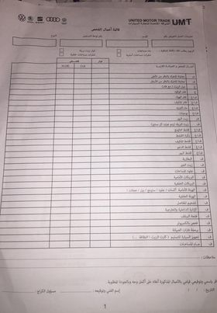
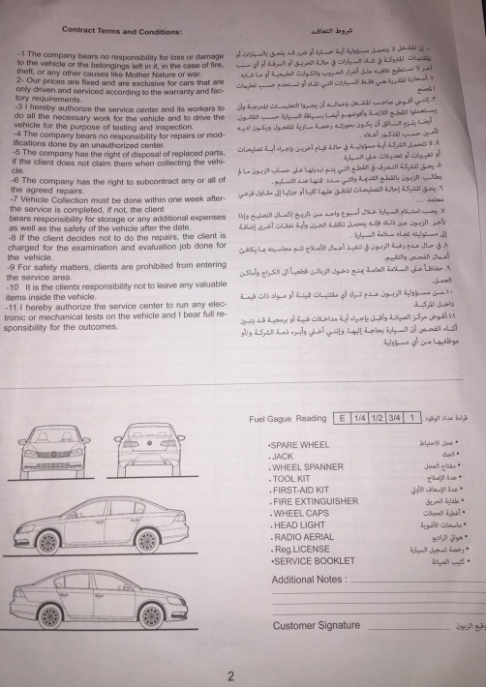
Hour :
Name of the customer
Car No.
Vin No.
Model
Mobile
T.U
The card
Vehicle problem
Appointment agreement, information from customers

Slide 17
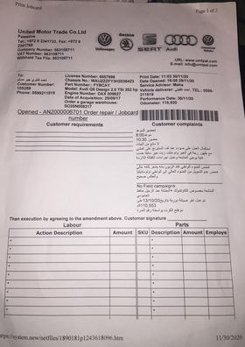
This job card contains all the information about the customer and his car and all the customer requirements and complains.

Slide 18
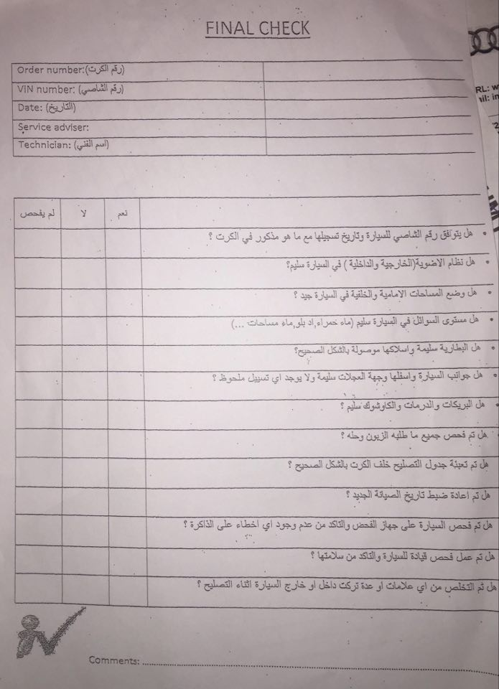
Repair / Service: workshop findings
1. Choose the job card
2. Check the customer requirements
3. Give the car to the right employee.
4. The employee sign on the job card.
5. Start fixing the car.
6. Filling the final check list
7. If there is any fail not solved, search on the reason
8. Checking the car
9. Back to the reception.

Slide 19
Our Work…
01
Analyze the Questionnaire using SPSS program to determine the need to apply PDCA.
02
Find out the problems.
03
Integration between PDCA and Lean tools to solve the problems.

Slide 20
number of given and recovered Questionnaires
 | No. of QQ Given | No. of QQ recovered | No. of QQ ready to analyze | %
Administrative | 19 | 18 | 18 | 54.50%
Technical | 19 | 19 | 15 | 45.50%
Total | 38 | 37 | 33 | 100%
Number of Questions based on variables.
Variable | Plan | Do | Check | Act
No. of Questions | 5 | 4 | 4 | 4
By applying cronbach alpha in order to check the validity of the study tool (questionnaire).
Based on the answers and their analysis, it was found 0.8

Slide 21
A Lean Audit Checklist has been done also to decide the importance of the application for Lean strategy.
YES! The company seeks continuous improvement, but based on ideas and opinions, not on quality tools.
So, there is need to apply PDCA cycle.

Slide 22
First, Key Areas where found which are:
Plan
Redundant motion of cars.
Root cause Analysis .
Excess inventory.
Why-Why Analysis .
Downtime due to spares shortfall.
Why-Why Analysis .

Slide 23
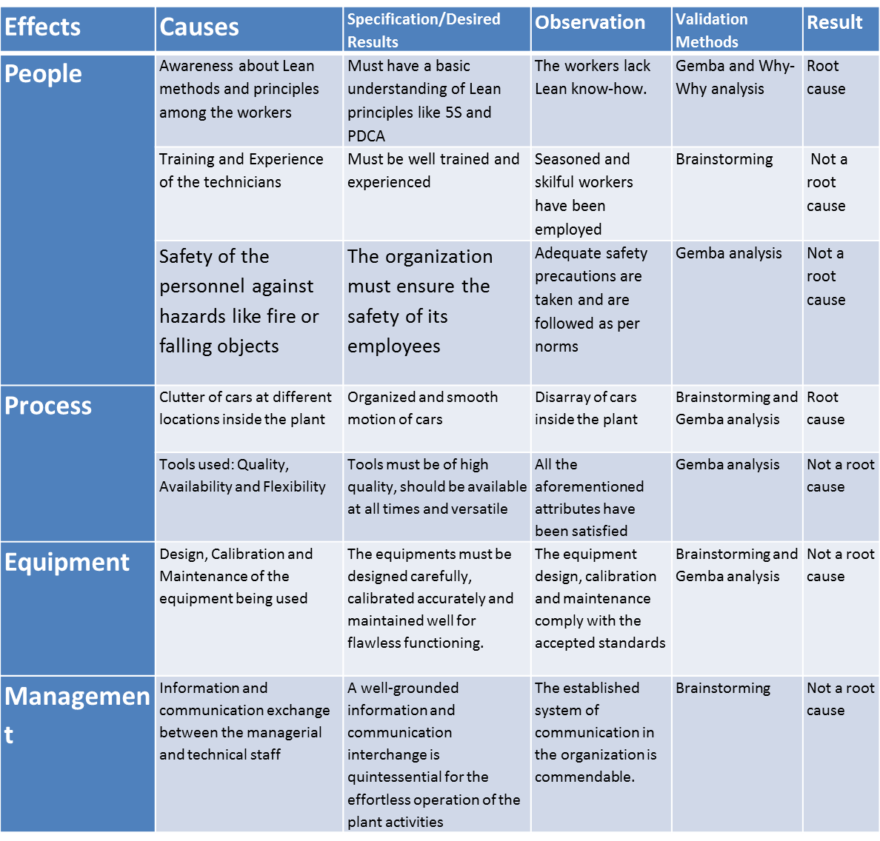
Based on it for Redundant Motion of Cars, Brainstorming and Gemba sessions were conducted which led to the discovery of two causes;
1.Lack of Lean Awareness among the Workers.
2.Clutter of Cars.
These steps needed the use of the fish bone diagram

Slide 24
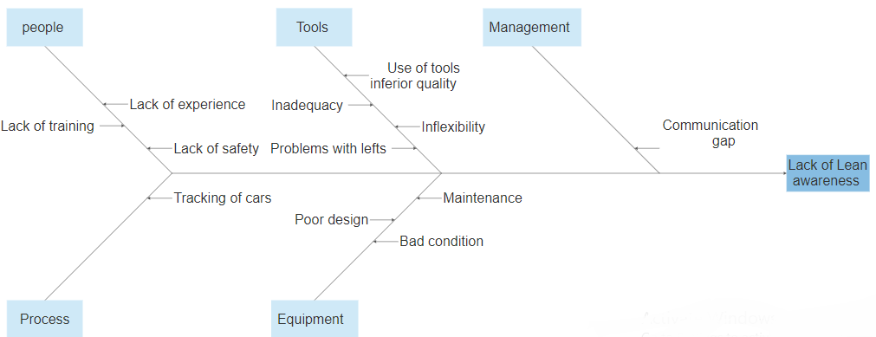
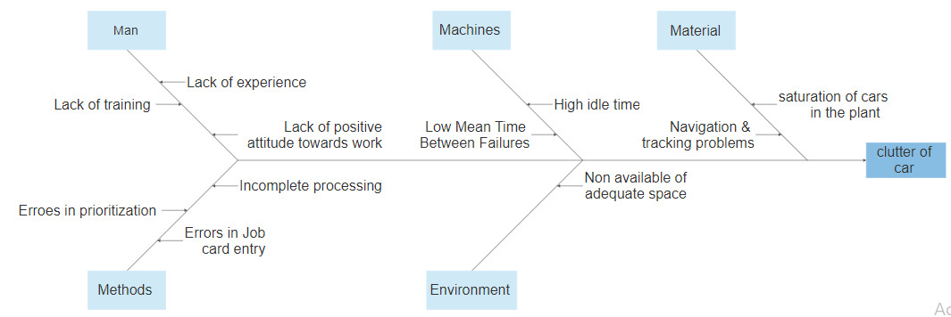
Fish Bone Diagram for Lack of Lean Awareness.
Fish Bone Diagram for Clutter of Cars.

Slide 25
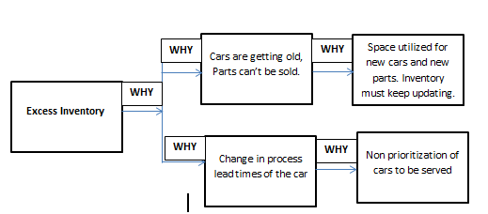
Why-Why Analysis used as a technique to solve the Excess Inventory Problem
  -Space constraint at parking area
  -Change in process lead time of the cars

Slide 26
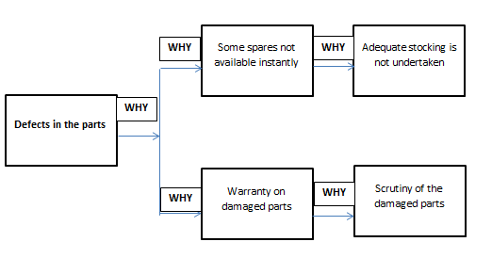
Why- Why Analysis was conducted to arrive at the solution for shortfall of spares
the spares are not stockpiled in appropriate amounts. Also the damaged parts need to be checked for warranties, if any and suitable measures are to be taken to address the issue. This process consumes time, thus adding to the process lead time.

Slide 27
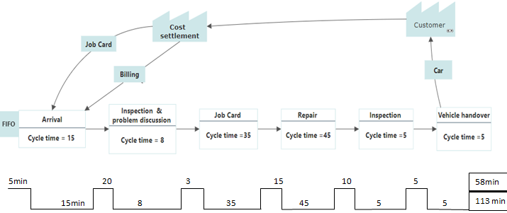
Prepare a Value Stream Mapping and current layout and to analyze the current state start with the application of 5S . It was applied on sample of the concerned equipment's and the cars.
DO
Value Stream Mapping - Current Scenario.

Slide 28
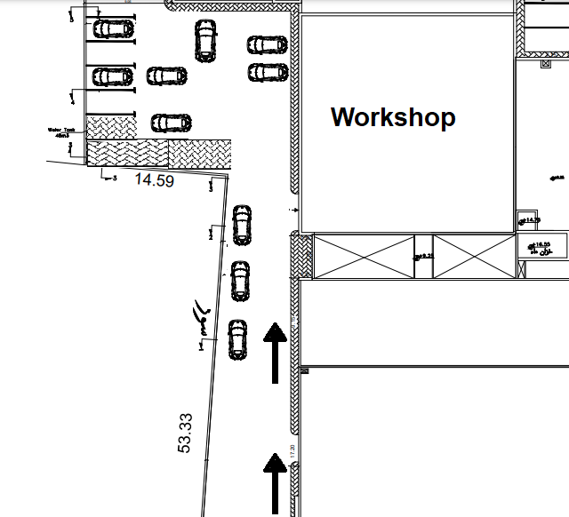
Current Layout.

Slide 29
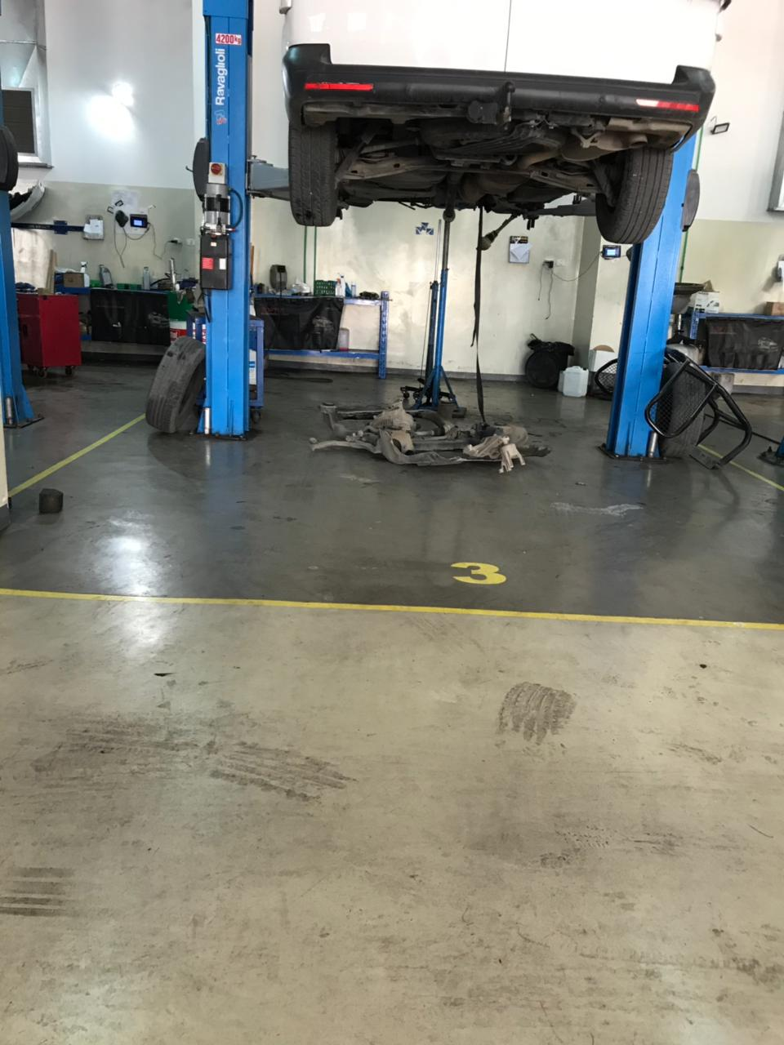
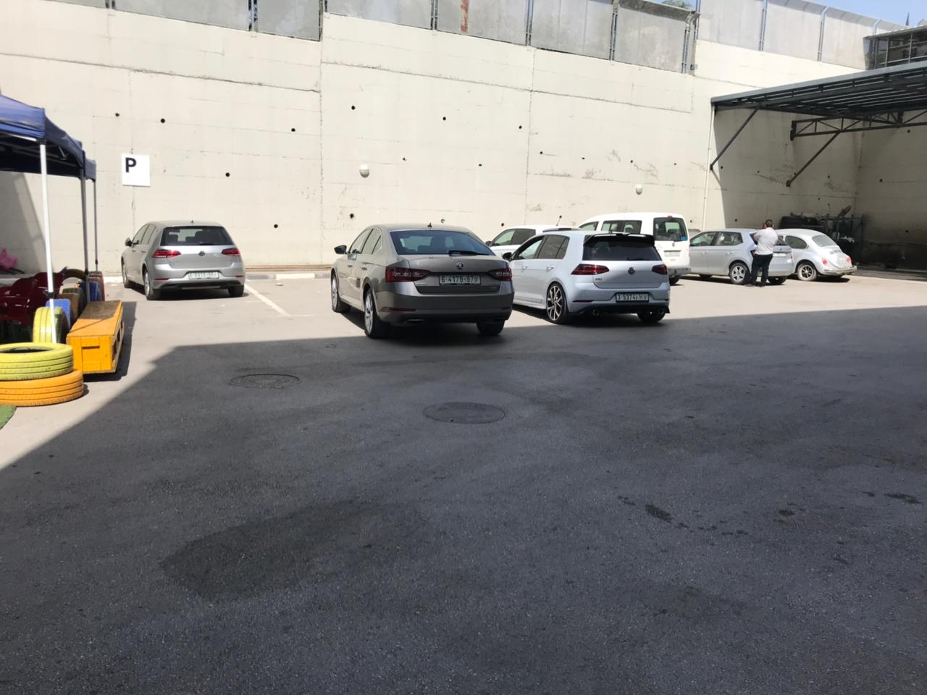
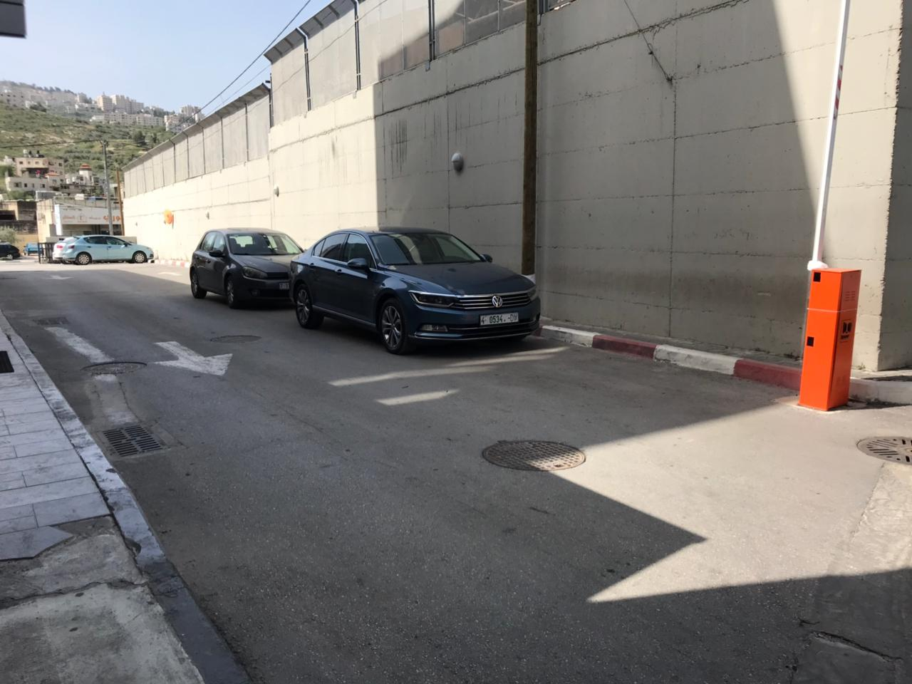

Slide 30
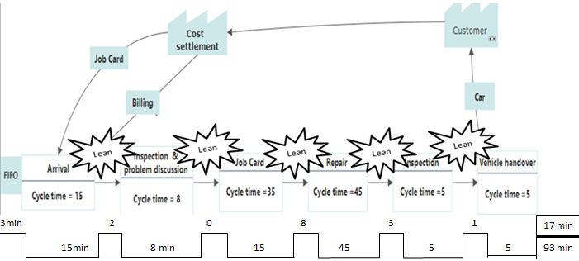
CHECK
Value Stream Mapping - Future Scenario.

Slide 31
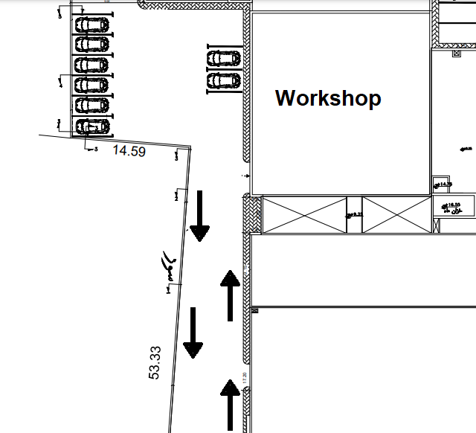
The new layout has all the vital changes that are required:
*segregation of cars depend on the priorities , or the cars with major complications from minor complications.
*Spares could be fetched in time for the ongoing process by intimating the supervisor, who fetches the spares instead of the technician so that downtime is reduced to minimum.

Slide 32
The changes that are anticipated with the incorporation of the revised layout are:
  Motion of the cars within the plant can be brought under check.
  Increase in productivity.
  Cars with shorter lead times can be clearly distinguished from those with longer lead times.
  Possible elimination of night shift with sustained implementation of the suggested measures.
The new layout was also developed in such a way that more floor area was available to do value added work. The new layout also brought down the unneeded cars on the floor area considerably. An estimated increase in productivity is provided in the next phase.

Slide 33
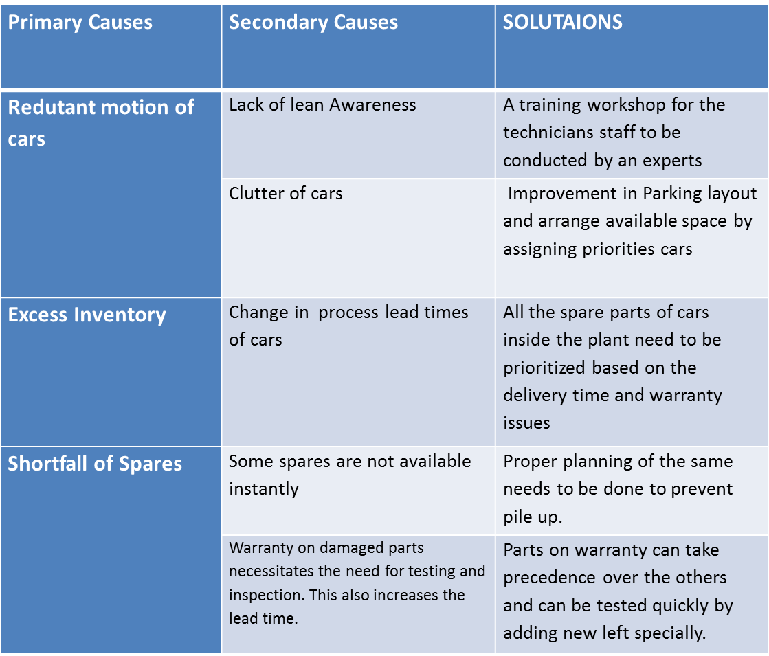
ACT

Slide 34
The Lean concepts can be applied to any type of industry. This research proves that Lean approach can be applied, and followed in any automobile service industry.
Conclusion
The research has resulted if the company encouraged to follow the recommendations given in reduced traffic of cars inside the plant.
A comprehensive implementation of the suggestions would result in an increase of up to 4-5 cars per day.

Slide 35
Improving the company's maintenance management due to its importance in reducing faults and time wastage and making them to minimum
Relying on Deming's quality model to ensure the quality of maintenance.
Recommendations
Apply Lean thinking tools to improve their service quality in parallel PDCA cycle
Motivating the employees of the UMT Company by increasing the material and moral incentives.

Slide 36

Build an online application serve the customers to book an appointment and add all the complains they faced in theirs automobiles needed to solve.
That’s helps to reduce the time of opening the job card at the office by 20 minutes average.

Slide 37

Recruit an employer for valet parking and inspections mission.
Keep in update with PDCA approach and lean manufacturing to stay in safe with high productivity.
Try change and replace the lefts with ones that suits the technical.

Slide 38
THANK YOU!
Does anyone have any questions?

